Slide 1
Max Flow Image Segmentation
Charles Mo, Darren Eldredge, Do Hun Ji

Slide 2
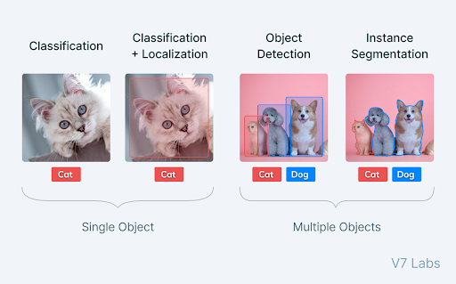
What is Image Segmentation?
Image segmentation aims to group similar regions or segments of an image under their respective class labels or masks, combining classification and localization.
https://www.v7labs.com/blog/image-segmentation-guide

Slide 3
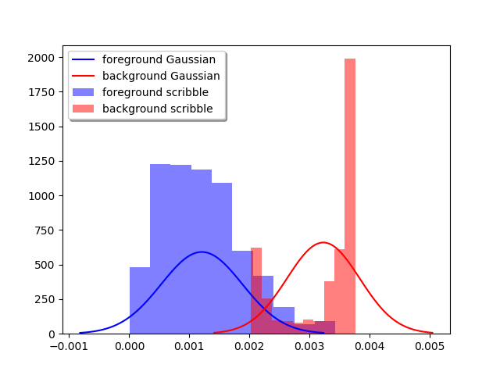
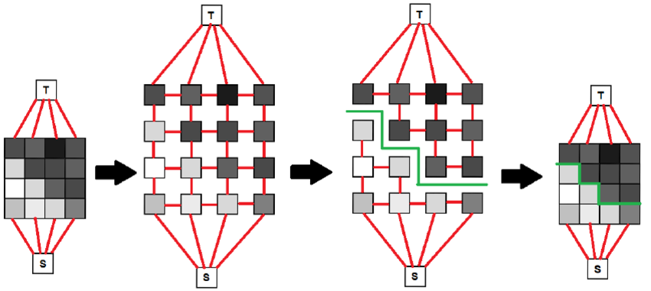
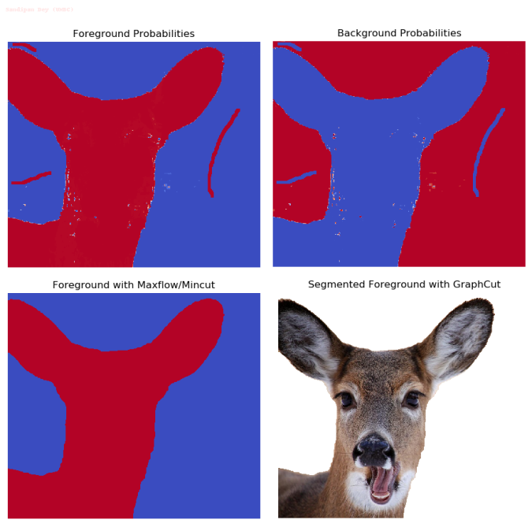
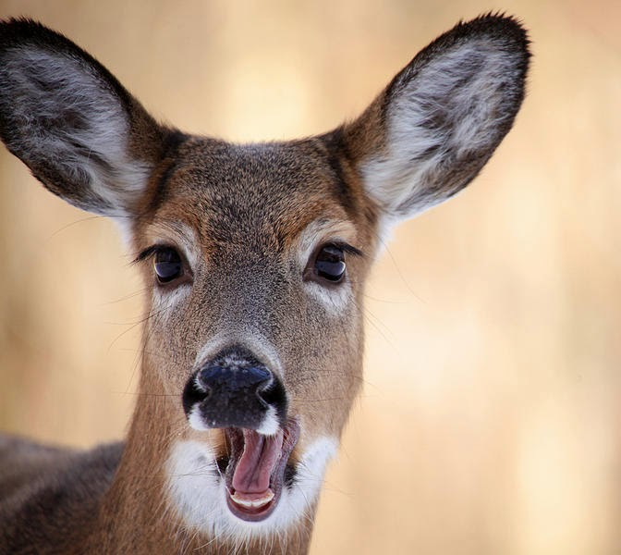

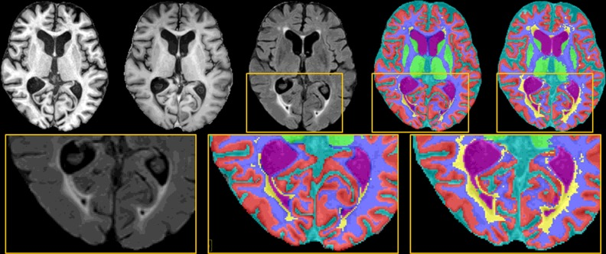
How is max flow currently used for image segmentation?
Examples:
Photoshop Magnetic Lasso
Automatic partitioning of an image into multiple clinically relevant regions
https://www.sciencedirect.com/science/article/pii/S1361841515000729
https://sandipanweb.wordpress.com/2018/02/11/interactive-image-segmentation-with-graph-cut/

Slide 4
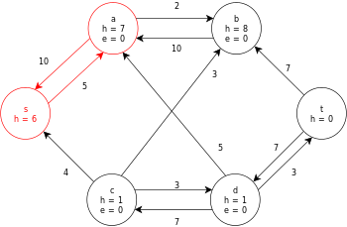
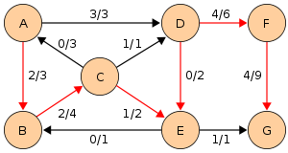
Proposal
https://en.wikipedia.org/wiki/File:Push-Relabel_Algorithm_Example_-_Step_9.svg.
Maximum flow segmentation
Edmonds-Karp
Push-Relabel
https://en.wikipedia.org/wiki/File:Edmonds-Karp_flow_example_4.svg

Slide 5
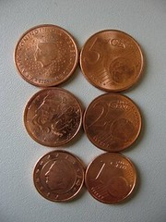
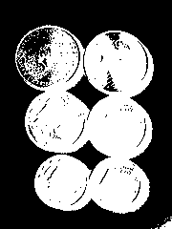
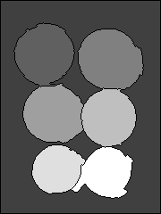
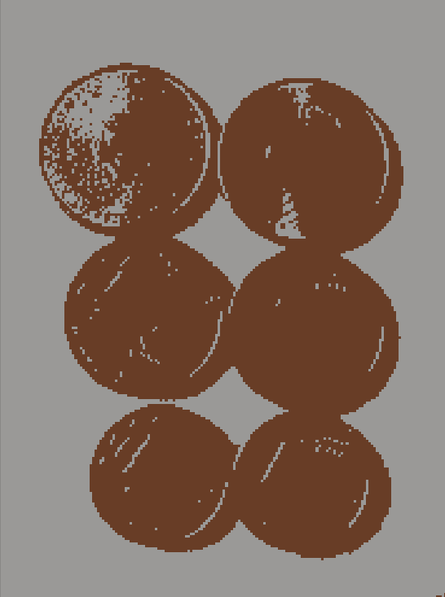
Implementation
Coins.jpg
Otsu’s method
Coins segmented with OpenCV’s watershed
OpenCV (Python, C++)
Comparison OpenCV’s watershed, Kmeans and GrabCut implementation
Comparison with Otsu’s method
Coins clustered with K-means (K=2)

Slide 6
References
https://julie-jiang.github.io/image-segmentation/ (useful explanation but same algorithms as those in prof. Brower’s example presentation)

