Slide 1
Contents
Title
Motivation
Dataset
Statistical Analysis
Feature Engineering
Model Comparison
The Melanoma Problem + Solution
Results
Error Analysis & Clinical Context
Conclusion & Future Work

Slide 2
6. Model Comparion
Model Comparison (Combined 50 Features + SMOTE)
Best Model: Tuned LightGBM
• Hyperparameter tuning: 15 configs × 5-fold CV
• Best params: lr=0.03, n_estimators=300, num_leaves=50
• CV Macro F1: 0.573 ± 0.025 (stable, no overfitting)
Model | Accuracy | Macro F1 | Weighted F1 | ROC - AUC
K-Nearest Neighbors | 69.6% | 0.389 | 0.731 | 0.744
Logistic Regression | 78.8% | 0.520 | 0.802 | 0.937
SVM (RBF) | 78.6% | 0.531 | 0.788 | 0.917
Random Forest | 78.8% | 0.542 | 0.802 | 0.939
LightGBM | 81.7% | 0.575 | 0.813 | 0.942
XGBoost | 81.5% | 0.578 | 0.815 | 0.948
Tuned LightGBM | 80.7% | 0.562 | 0.814 | 0.946
Notes:
Top Features: age, bstd (blue channel std), glcm_correlation, sstd, asymmetry_h, blue_white_ratio

Slide 3
Contents
Title
Motivation
Dataset
Statistical Analysis
Feature Engineering
Model Comparison
The Melanoma Problem + Solution
Results
Error Analysis & Clinical Context
Conclusion & Future Work

Slide 4
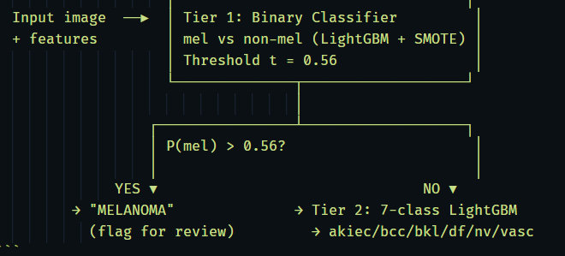
7. The Melanoma Problem + Solution
The Melanoma Challenge
Baseline (Tuned LightGBM, 7-class):
• Overall Accuracy: 80.7% | ROC-AUC: 0.946
• Melanoma Recall: 0.545 ← ⚠️ Too low for clinical use
• 56 out of 123 melanoma cases MISSED (45.5%)
→ 21 misclassified as nevus (most dangerous!)
Root Causes:
58× class imbalance → model optimizes for nv accuracy
7-class objective doesn't prioritize melanoma
mel vs nv visually very similar
Our Improvement Strategy: Two-Tier Pipeline
Notes:
Top Features: age, bstd (blue channel std), glcm_correlation, sstd, asymmetry_h, blue_white_ratio

Slide 5
Contents
Title
Motivation
Dataset
Statistical Analysis
Feature Engineering
Model Comparison
The Melanoma Problem + Solution
Results
Error Analysis & Clinical Context
Conclusion & Future Work

Slide 6
8. Results
Melanoma Improvement Results
Two-Tier Pipeline:
+38.8% relative improvement in Mel Recall
→ Missed melanomas: 56 → ~30 cases (-26 cases saved)
→ Macro F1 drop: only -0.012
Threshold Trade-off (Binary Classifier):
t = 0.36 → Recall 0.878, Precision 0.333, F1 0.483 (high sensitivity mode)
t = 0.56 → Recall 0.756, Precision 0.427, F1 0.545 (balanced mode)
Melanoma ROC-AUC:
7-class model: 0.924 | Binary model: 0.932
Method | Mel Recall | Mel Prec. | Macro F1 | Accuracy
Baseline (7-class, argmax) | 0.545 | 0.465 | 0. 562 | 80.7%
Binary classifier (thr=0.50) | 0.789 | 0.388 | --- | ---
Two-tier pipeline (t=0.56) | 0.756 | 0.396 | 0.550 | 79.7%
7-class threshold (t=0.05) | 0.927 | 0.265 | 0.529 | 72.3%
Notes:
Top Features: age, bstd (blue channel std), glcm_correlation, sstd, asymmetry_h, blue_white_ratio

Slide 7
Contents
Title
Motivation
Dataset
Statistical Analysis
Feature Engineering
Model Comparison
The Melanoma Problem + Solution
Results
Error Analysis & Clinical Context
Conclusion & Future Work

Slide 8
9. Error Analysis & Clinical Context
Error Analysis: Understanding Failures
Notable missed cases:
ISIC0029146 — Male, 65y, face 7-class P(mel)=0.020, Binary P(mel)=0.877
→ High ambiguity: visually confusing but clinically suspicious
ISIC0029397 — Male, 5y, back P(mel)=0.19, predicted as nv
→ Rare pediatric case — training data limited for young patients
False Negative Breakdown (missed melanoma):
Nv → 21 cases (benign misclassification)
bkl → 18 cases
akiec → 12 cases
bcc → 4 cases
df → 1 case
Clinical Positioning:
Two-tier pipeline is a SCREENING SUPPORT tool
Not a replacement for dermatologist diagnosis
Reduces workload: flag high-risk cases for priority review
Comparable sensitivity to entry-level dermoscopy reading
Notes:
> "Nhóm thực hiện error analysis để hiểu rõ mô hình thất bại ở đâu. Phần lớn ca bỏ sót bị nhầm thành **nevus** – đây là rủi ro lâm sàng cao nhất vì nevus là lành tính.
> Một ca tiêu biểu: ISIC0029146 – nam 65 tuổi, tổn thương ở mặt – mô hình 7 lớp chỉ cho xác suất mel là 0.02, nhưng binary model lại cho 0.877. Đây là trường hợp mà **pipeline 2 tầng đã cứu được** ca này.
> Nhóm nhấn mạnh: pipeline này được thiết kế như một **công cụ hỗ trợ sàng lọc**, không thay thế bác sĩ. Nó giúp ưu tiên các ca nghi ngờ cao để bác sĩ xem xét trước, giảm tải workload và giảm nguy cơ bỏ sót."

Slide 9
Contents
Title
Motivation
Dataset
Statistical Analysis
Feature Engineering
Model Comparison
The Melanoma Problem + Solution
Results
Error Analysis & Clinical Context
Conclusion & Future Work

Slide 10
10. Conclusion & Future Work
Conclusion
Achieved:
Multi-modal pipeline: metadata + handcrafted features (50 dims)
Statistically validated features (χ², Kruskal-Wallis, Dunn's)
Best model: Tuned LightGBM — Accuracy 80.7%, ROC-AUC 0.946
Two-tier pipeline: Mel Recall 0.545 → 0.756 (+38.8%)
Threshold analysis: full trade-off curve for clinical deployment
Limitations:
Handcrafted features cannot capture complex visual patterns
No lesion segmentation → background noise in features
External validation not performed
Future Work:
CNN/EfficientNet as feature extractor → fuse with metadata
Lesion segmentation (U-Net) → cleaner feature computation
External validation on ISIC 2019/2020 datasets
Explainability: SHAP + Grad-CAM for clinical trust

Slide 11
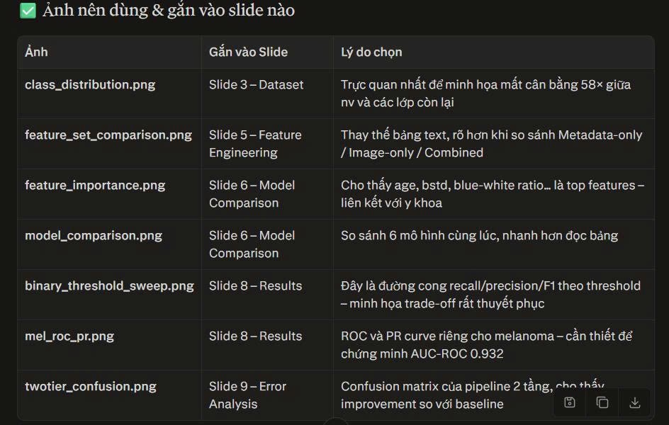
Notes:
Tóm lại, nhóm đang đi đúng hướng: pipeline đã hoàn chỉnh, đã có kết quả sơ bộ rõ ràng, và bước tiếp theo sẽ tập trung vào tăng độ tin cậy, khả năng giải thích và giá trị ứng dụng thực tế của mô hình.

Slide 12
Thank You
Q&A
Questions & Discussion
Project Resources:
• Dataset: ISIC HAM10000 (Tschandl et al., 2018)
• Notebook: inds-ham10000.ipynb
• Key metrics saved: results_summary.json
Team 07:
Bui Tran Tan Phat - 23110052
Nguyen Nhat Phat - 23110053
Course: Introduction to Data Science — HCMUTE 2026

