Slide 1
Reinforcement Learning-Based Bit-Flipping Decoding Strategy for Channel Coding
Error Control Coding for Communication and Computers (EECE 571E) Project
Idan Roth | Flynn Dowey | Cee Rikhh

Slide 2
Table of contents
What is Bit Flip decoding?
Overview of Reinforcement Learning (RL)
Modeling BFD as a RL problem
Simulations and Results
Summary and future work

Slide 3


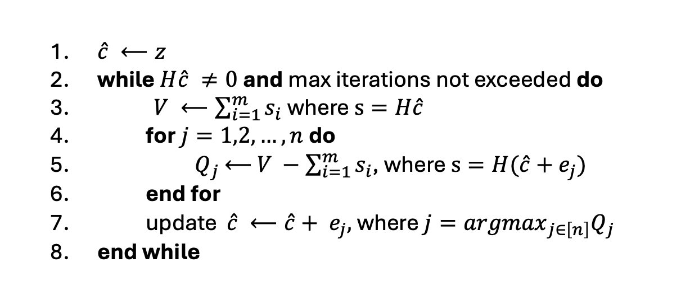

What is bit flipping decoding?
$$m∈{\left\{0, 1\right\}}^{k}$$
ENC
$$c∈{\left\{0, 1\right\}}^{n}$$
Channel
BFD
$$z∈{\left\{0, 1\right\}}^{n}$$
$\hat{c} ⟵z$
while $H\hat{c} ≠0$and max iterations not exceeded do
$V ⟵\sum_{i=1}^{m}{s_{i}}$where $s=H\hat{c}$
for $j=1,2,…, n$do
${ Q}_{j}$ $⟵$ $V −\sum_{i=1}^{m}{s_{i}}$, where $s=H(\hat{c}+e_{j})$
end for
update $\hat{c} ⟵\hat{c}+ e_{j},$ where $j={argmax}_{j∈\left[n\right]}Q_{j}$
end while

Slide 4
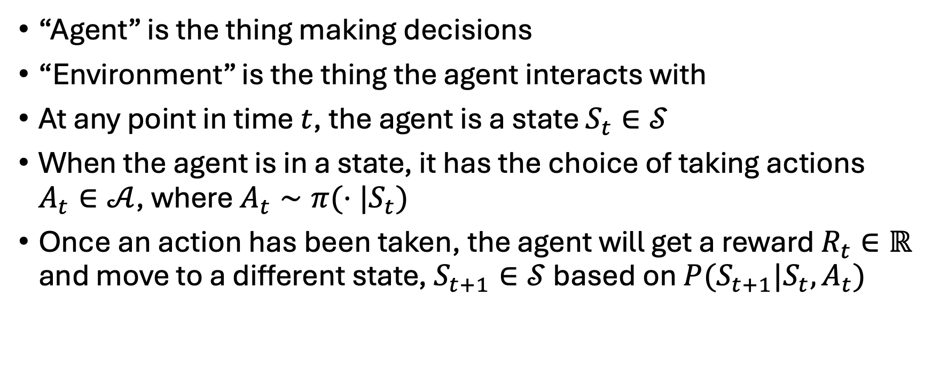
Overview of Reinforcement learning
“Agent” is the thing making decisions
“Environment” is the thing the agent interacts with
At any point in time $t$, the agent is a state $S_{t}∈𝒮$
When the agent is in a state, it has the choice of taking actions $A_{t}∈𝒜$, where $A_{t}∼π(⋅|S_{t})$
Once an action has been taken, the agent will get a reward $R_{t}∈ℝ$ and move to a different state, $S_{t+1}∈𝒮$ based on $P(S_{t+1}|S_{t}, A_{t})$

Slide 5
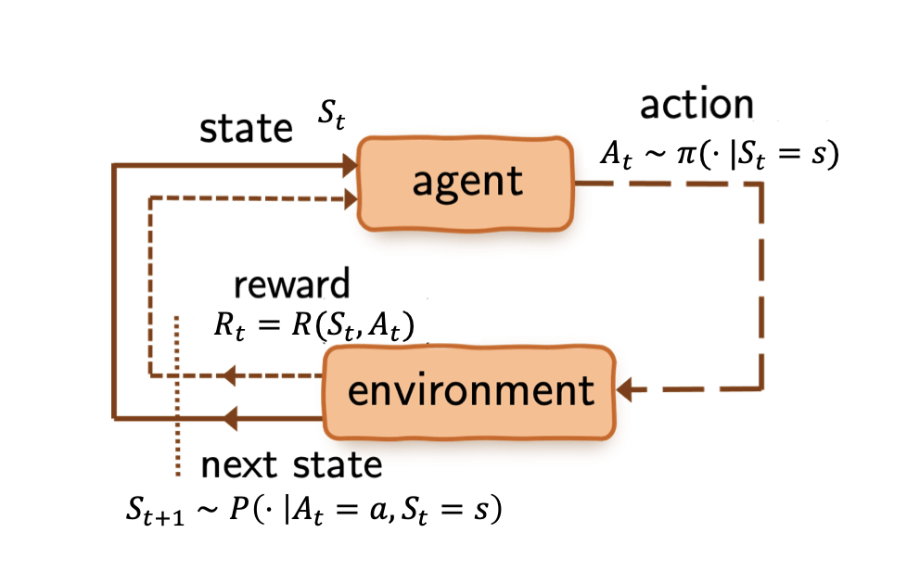
Overview of Reinforcement learning
“Policy”
Goal: obtain the maximum sum of discounted rewards by learning the optimal actions

Slide 6
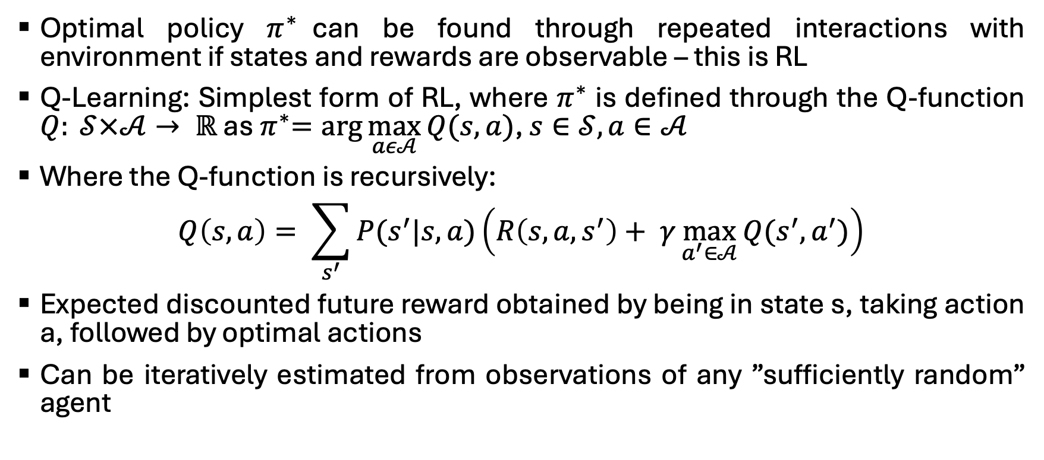
Sarsa (need to modify)
Optimal policy $π^{∗}$can be found through repeated interactions with environment if states and rewards are observable – this is RL
Q-Learning: Simplest form of RL, where $π^{∗}$ is defined through the Q-function $Q: 𝒮×𝒜→ ℝ$ as${ π}^{∗}=arg\max_{aε𝒜}{Q(s,a)}$, $s∈𝒮, a∈𝒜$
Where the Q-function is recursively:
$$Q\left(s,a\right)= \sum_{s^{′}}{P(s^{′}|s,a)\left(R\left(s,a,s^{′}\right)+ γ\max_{a^{′}∈𝒜}{Q(s^{′},a^{′})}\right)}$$
Expected discounted future reward obtained by being in state s, taking action a, followed by optimal actions
Can be iteratively estimated from observations of any ”sufficiently random” agent

Slide 7
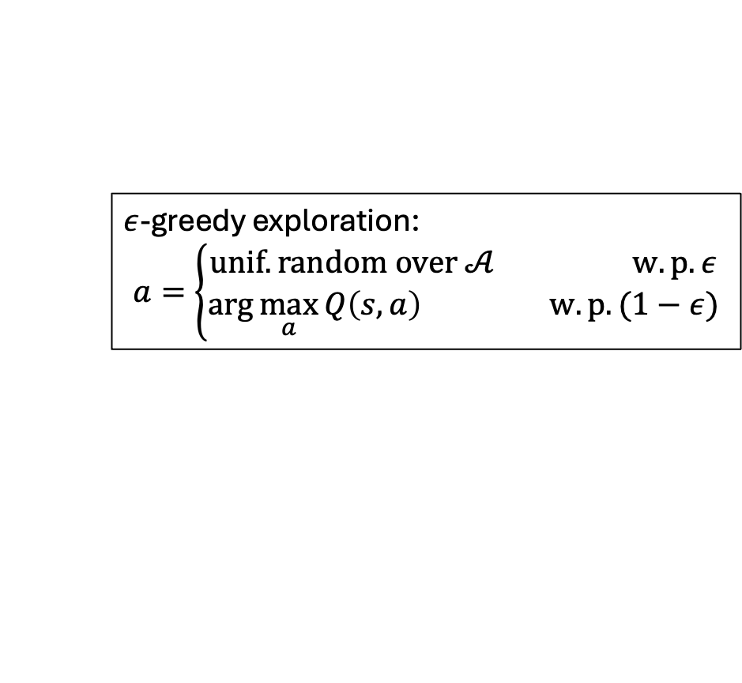
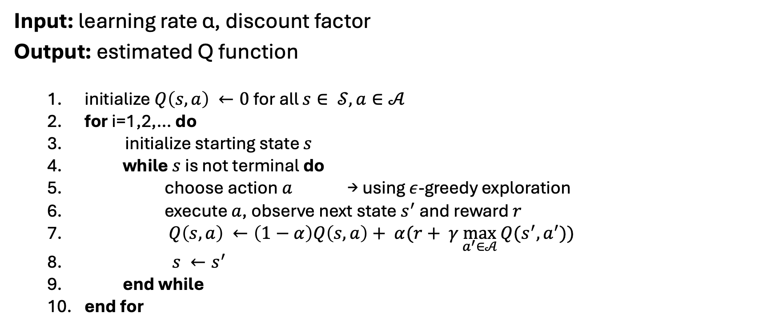
Need to change
Input: learning rate α, discount factor
Output: estimated Q function
initialize $Q\left(s,a\right) ←0$for all $s∈ 𝒮, a∈𝒜$
for i=1,2,… do
initialize starting state $s$
while $s$ is not terminal do
choose action $a$ → using $ε$-greedy exploration
execute $a$, observe next state $s^{′}$ and reward $r$
$Q\left(s,a\right) ←\left(1−α\right)Q\left(s,a\right)+ α(r+ γ\max_{a^{′}∈𝒜}{Q(s^{′},a^{′}))}$
$s ←s^{′}$
end while
end for
$ε$-greedy exploration:
$$a=\left\{\begin{aligned}unif. random over 𝒜 w.p. ε \\ arg\max_{a}{Q\left(s,a\right) } w.p. (1−ε)\end{aligned}\right.$$

Slide 8



Channel (not done)
Env
$$m∈{\left\{0, 1\right\}}^{k}$$
ENC
$$c∈{\left\{0, 1\right\}}^{n}$$
Channel
$$z∈{\left\{0, 1\right\}}^{n}$$
Agent

Slide 9
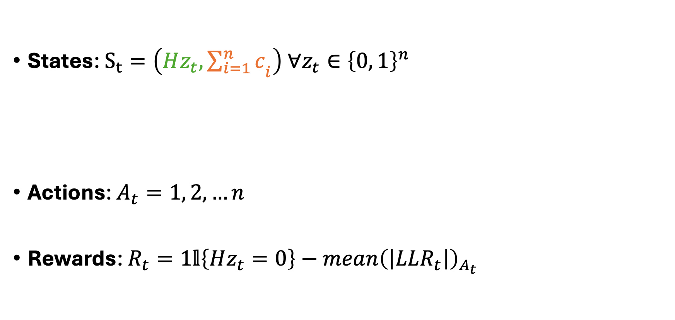
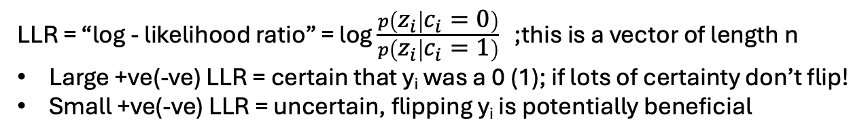
Modeling bit flipping as a RL problem
States: $S_{t}=\left(Hz_{t}, {\sum_{i=1}^{n}{c}}_{i}\right) ∀z_{t}∈{\left\{0, 1\right\}}^{n}$
Actions: $A_{t}=1, 2, …n$
Rewards: $R_{t}=1𝕝\left\{Hz_{t}=0\right\}−mean{\left(\left|LLR_{t}\right|\right)}_{A_{t}}$
Syndrome; z_{t} is the noisy codeword the agent changes at time t
How many 1s were in the original codeword
Which bit of z_{t} does the agent flip?
LLR = [LLR₁, LLR₂, …, LLR_{n}]
Indexed at bit that was flipped
LLR = “log - likelihood ratio” = log $\frac{p\left(z_{i} | c_{i}=0\right)}{p\left(z_{i} | c_{i}=1\right)} ⁡$;this is a vector of length n
Large +ve(-ve) LLR = certain that y_{i} was a 0 (1); if lots of certainty don’t flip!
Small +ve(-ve) LLR = uncertain, flipping y_{i} is potentially beneficial

Slide 10
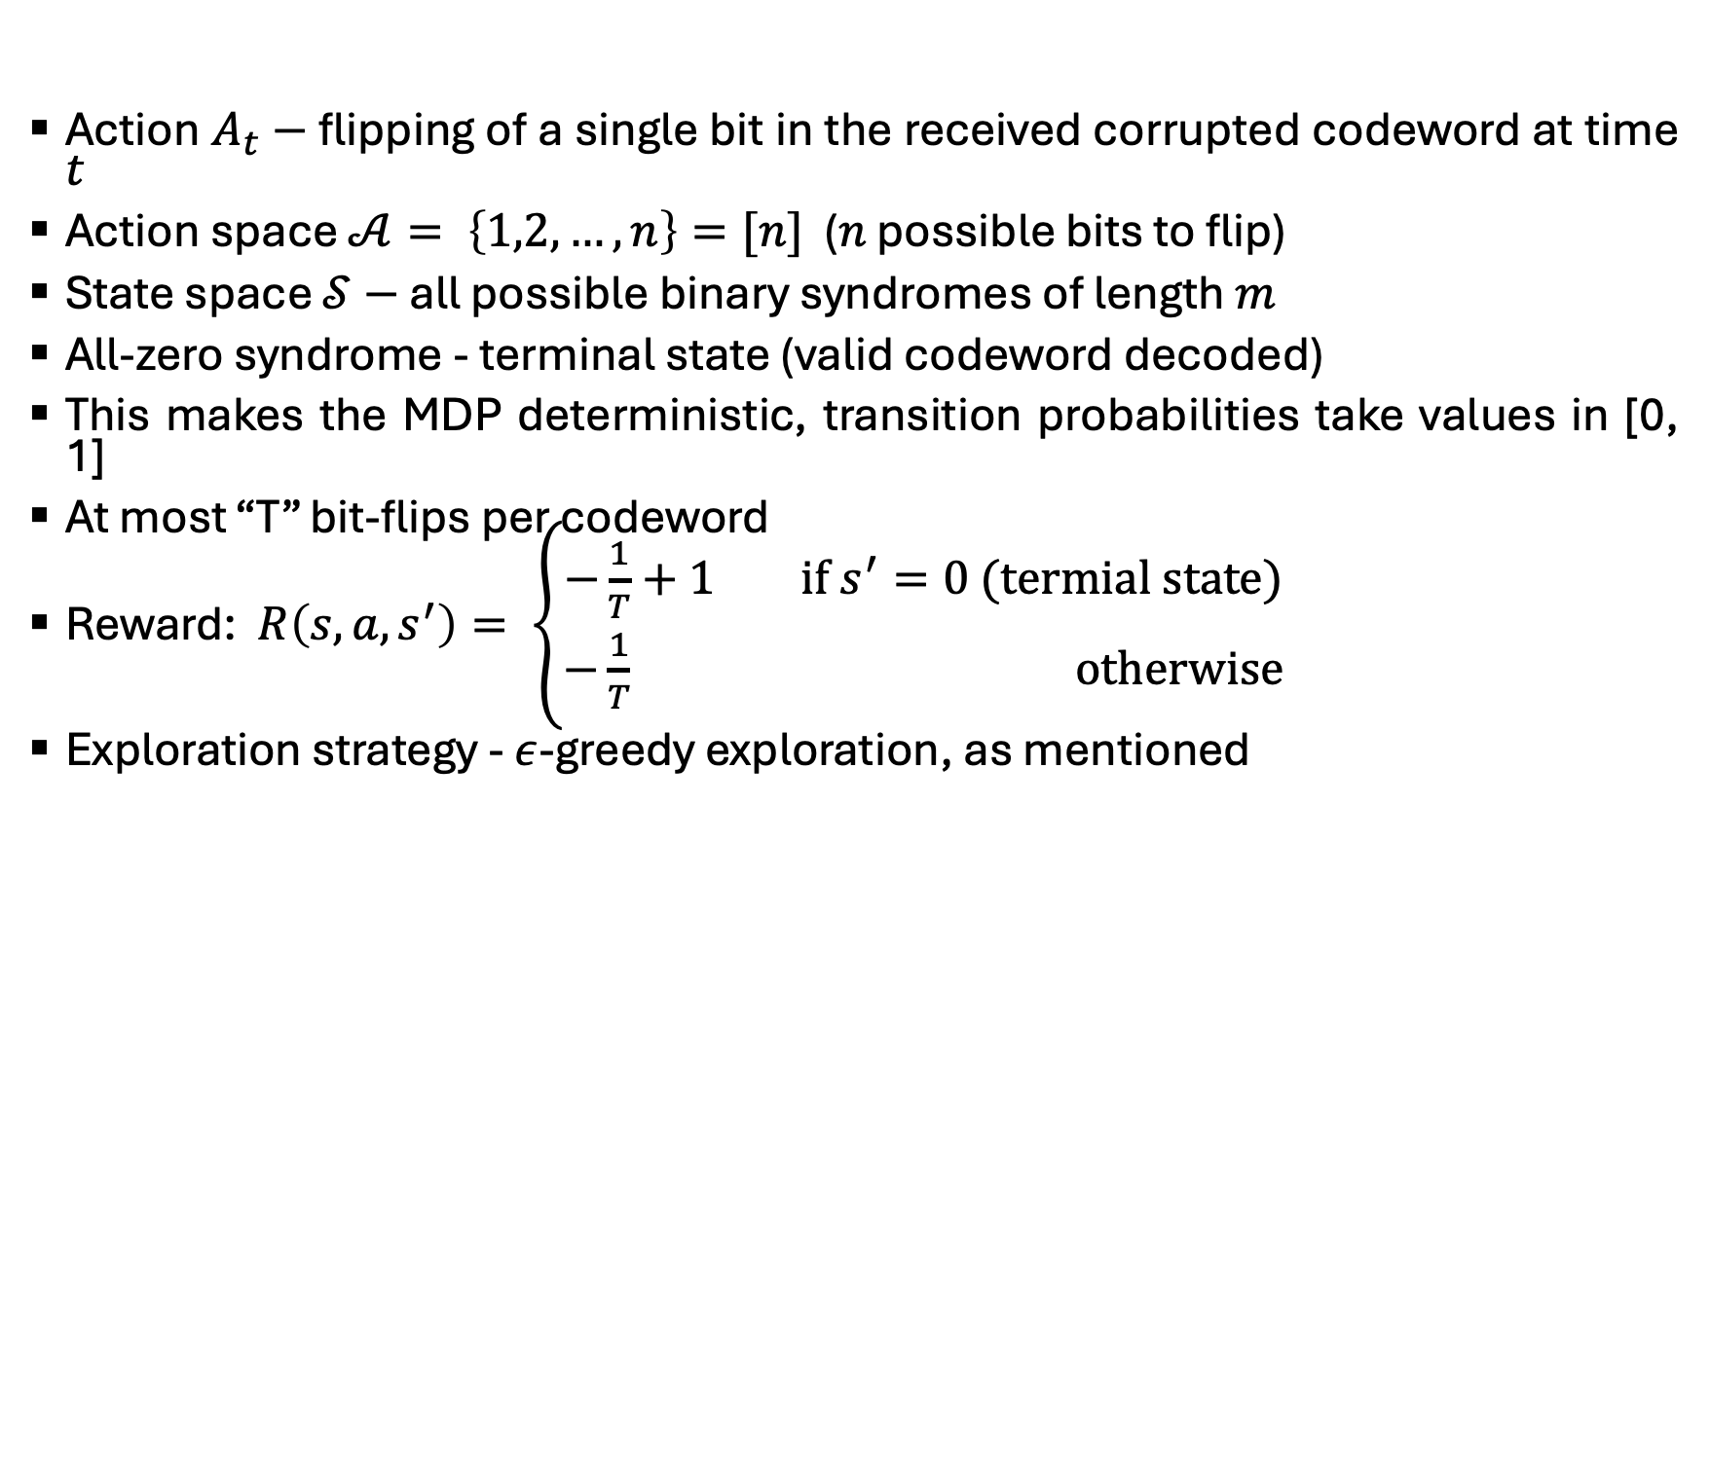
Action $A_{t}−$ flipping of a single bit in the received corrupted codeword at time $t$
Action space $𝒜= \left\{1,2,…,n\right\}=[n]$ ($n$ possible bits to flip)
State space $𝒮−$ all possible binary syndromes of length $m$
All-zero syndrome - terminal state (valid codeword decoded)
This makes the MDP deterministic, transition probabilities take values in [0, 1]
At most “T” bit-flips per codeword
Reward: $R\left(s,a,s^{′}\right)= \left\{\begin{aligned}−\frac{1}{T}+1 if s^{′}=0 (termial state) \\ −\frac{1}{T} otherwise\end{aligned}\right.$
Exploration strategy - $ε$-greedy exploration, as mentioned

Slide 11
References
[1] A. Bennatan, Y. Choukroun, and P. Kisilev, “Deep learning for decoding of linear codes-a syndrome-based approach,” in 2018 IEEE International Symposium on Information Theory (ISIT), pp. 1595–1599, IEEE, 2018.
[2] T. Gruber, S. Cammerer, J. Hoydis, and S. Ten Brink, “On deep learningbased channel decoding,” in 2017 51st annual conference on information sciences and systems (CISS), pp. 1–6, IEEE, 2017.
[3] H. Kim, Y. Jiang, R. Rana, S. Kannan, S. Oh, and P. Viswanath, “Communication algorithms via deep learning,” arXiv preprint arXiv:1805.09317, 2018.
[4] E. Nachmani, Y. Be’ery, and D. Burshtein, “Learning to decode linear codes using deep learning,” in 2016 54th Annual Allerton Conference on Communication, Control, and Computing (Allerton), pp. 341–346, IEEE, 2016.
[5] T. O’shea and J. Hoydis, “An introduction to deep learning for the physical layer,” IEEE Transactions on Cognitive Communications and Networking, vol. 3, no. 4, pp. 563–575, 2017.
[6] R. Raheli, H. D. Pfister, C. Hager, M. Martal ¨ o, and F. Carpi, “Exploring ` machine learning algorithms for decoding linear block codes,” 2018.
[7] L. Tallini and P. Cull, “Neural nets for decoding error-correcting codes,” in IEEE Technical applications conference and workshops. Northcon/95. Conference record, p. 89, IEEE, 1995.
[8] F. Carpi, C. Hager, M. Martal ¨ o, R. Raheli, and H. D. Pfister, “Rein- ` forcement learning for channel coding: Learned bit-flipping decoding,” in 2019 57th Annual Allerton Conference on Communication, Control, and Computing (Allerton), pp. 922–929, IEEE, 2019.
[9] V. Guruswami, A. Rudra, and M. Sudan, “Essential coding theory,” Draft available at http://www. cse. buffalo. edu/atri/courses/codingtheory/book, vol. 2, no. 1, 2012.
[10] C. J. C. H. Watkins, “Learning from delayed rewards,” 1989.

