Slide 2
Linear resonant waveguide slot array with narrow-wall slots
Antenna 2 : Results

Slide 3
Linear resonant waveguide slot array with narrow-wall slots
Antenna 2 : sketches, objectives and parameters

Slide 4
Antenna Structure: Antenna Parameters
Name | Description
f₀ | Centre frequency
Wg | Waveguide width
Hg | Waveguide height
Sf | Distance from feed to first slot
St | Distance from last slot to termination
N | Number of slots
Ss | Slot spacing
Ws | Slot width
θ1 | Slot 1 angle
θ2 | Slot 2 angle

Slide 5
Antenna Structure: Antenna Parameters (2)
Name | Description
θ3 | Slot 3 angle
θ4 | Slot 4 angle
θ5 | Slot 5 angle
θ6 | Slot 6 angle
θ7 | Slot 7 angle
θ8 | Slot 8 angle
θ9 | Slot 9 angle
θ10 | Slot 10 angle
θ11 | Slot 11 angle
θ12 | Slot 12 angle

Slide 6
Antenna Structure: Antenna Parameters (3)
Name | Description
θ13 | Slot 13 angle
θ14 | Slot 14 angle
θ15 | Slot 15 angle
θ16 | Slot 16 angle
θ17 | Slot 17 angle
θ18 | Slot 18 angle
θ19 | Slot 19 angle
θ20 | Slot 20 angle
θ21 | Slot 21 angle
θ22 | Slot 22 angle

Slide 7
Antenna Structure: Antenna Parameters (4)
Name | Description
θ23 | Slot 23 angle
θ24 | Slot 24 angle
θ25 | Slot 25 angle
θ26 | Slot 26 angle
θ27 | Slot 27 angle
θ28 | Slot 28 angle
θ29 | Slot 29 angle
θ30 | Slot 30 angle
θ31 | Slot 31 angle
θ32 | Slot 32 angle

Slide 8
Antenna Structure: Antenna Parameters (5)
Name | Description
θ33 | Slot 33 angle
θ34 | Slot 34 angle
θ35 | Slot 35 angle
θ36 | Slot 36 angle
θ37 | Slot 37 angle
θ38 | Slot 38 angle
θ39 | Slot 39 angle
θ40 | Slot 40 angle
θ41 | Slot 41 angle
θ42 | Slot 42 angle

Slide 9
Antenna Structure: Antenna Parameters (6)
Name | Description
θ43 | Slot 43 angle
θ44 | Slot 44 angle
θ45 | Slot 45 angle
θ46 | Slot 46 angle
θ47 | Slot 47 angle
θ48 | Slot 48 angle
θ49 | Slot 49 angle
θ50 | Slot 50 angle
δ1 | Slot 1 depth
δ2 | Slot 2 depth

Slide 10
Antenna Structure: Antenna Parameters (7)
Name | Description
δ3 | Slot 3 depth
δ4 | Slot 4 depth
δ5 | Slot 5 depth
δ6 | Slot 6 depth
δ7 | Slot 7 depth
δ8 | Slot 8 depth
δ9 | Slot 9 depth
δ10 | Slot 10 depth
δ11 | Slot 11 depth
δ12 | Slot 12 depth

Slide 11
Antenna Structure: Antenna Parameters (8)
Name | Description
δ13 | Slot 13 depth
δ14 | Slot 14 depth
δ15 | Slot 15 depth
δ16 | Slot 16 depth
δ17 | Slot 17 depth
δ18 | Slot 18 depth
δ19 | Slot 19 depth
δ20 | Slot 20 depth
δ21 | Slot 21 depth
δ22 | Slot 22 depth

Slide 12
Antenna Structure: Antenna Parameters (9)
Name | Description
δ23 | Slot 23 depth
δ24 | Slot 24 depth
δ25 | Slot 25 depth
δ26 | Slot 26 depth
δ27 | Slot 27 depth
δ28 | Slot 28 depth
δ29 | Slot 29 depth
δ30 | Slot 30 depth
δ31 | Slot 31 depth
δ32 | Slot 32 depth

Slide 13
Antenna Structure: Antenna Parameters (10)
Name | Description
δ33 | Slot 33 depth
δ34 | Slot 34 depth
δ35 | Slot 35 depth
δ36 | Slot 36 depth
δ37 | Slot 37 depth
δ38 | Slot 38 depth
δ39 | Slot 39 depth
δ40 | Slot 40 depth
δ41 | Slot 41 depth
δ42 | Slot 42 depth

Slide 14
Antenna Structure: Antenna Parameters (11)
Name | Description
δ43 | Slot 43 depth
δ44 | Slot 44 depth
δ45 | Slot 45 depth
δ46 | Slot 46 depth
δ47 | Slot 47 depth
δ48 | Slot 48 depth
δ49 | Slot 49 depth
δ50 | Slot 50 depth
X | Device X-dimension
Y | Device Y-dimension

Slide 15
Antenna Structure: Antenna Parameters (12)
Name | Description
Z | Device Z-dimension

Slide 16
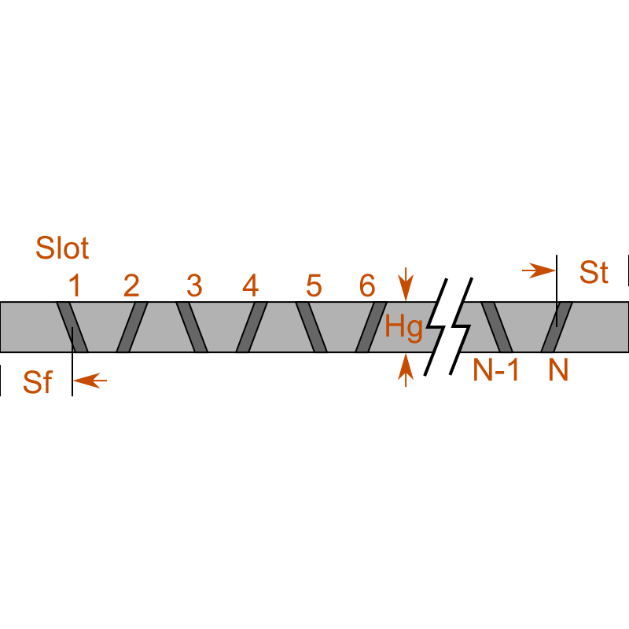
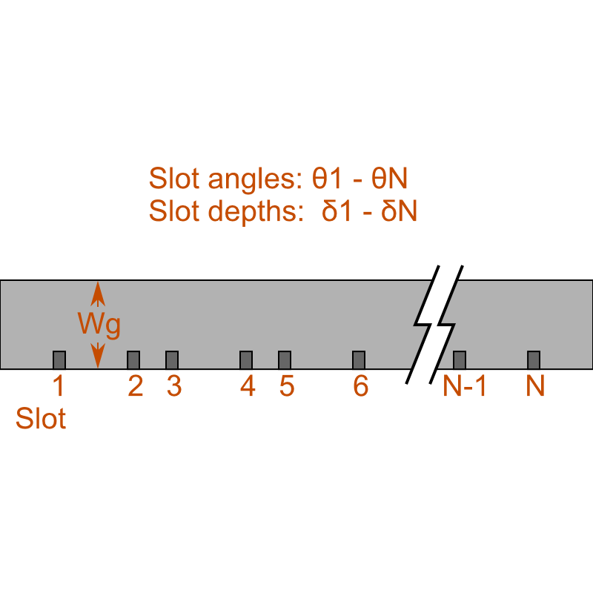
Sketches
Side view
Top view

Slide 17
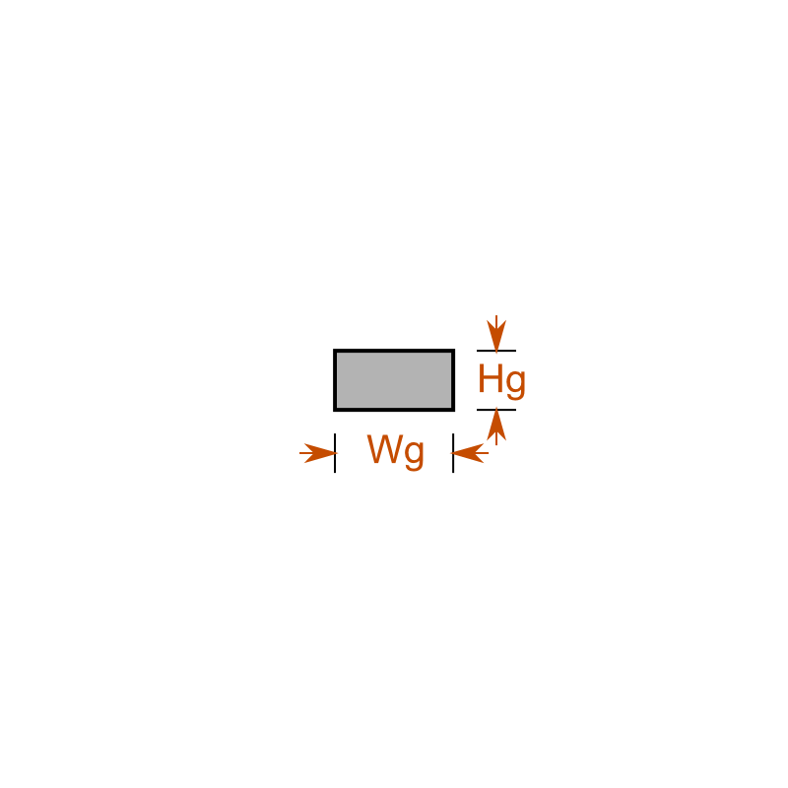
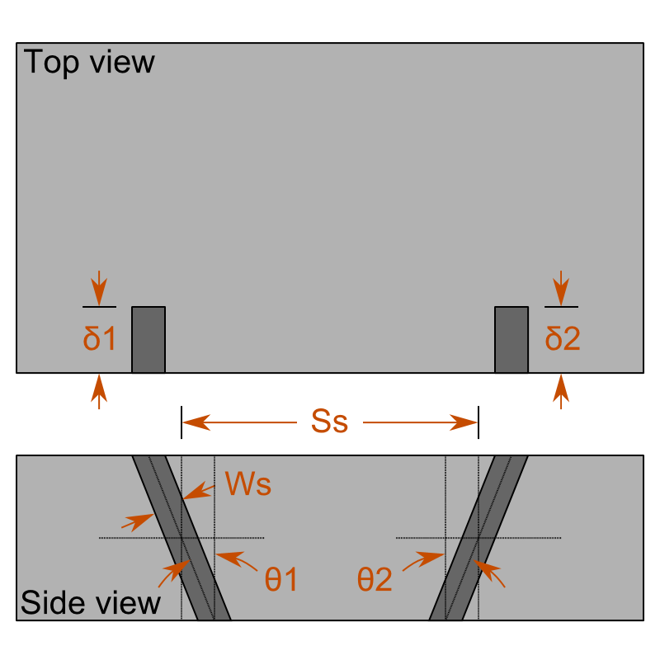
Sketches (2)
End view
Zoom view

Slide 18
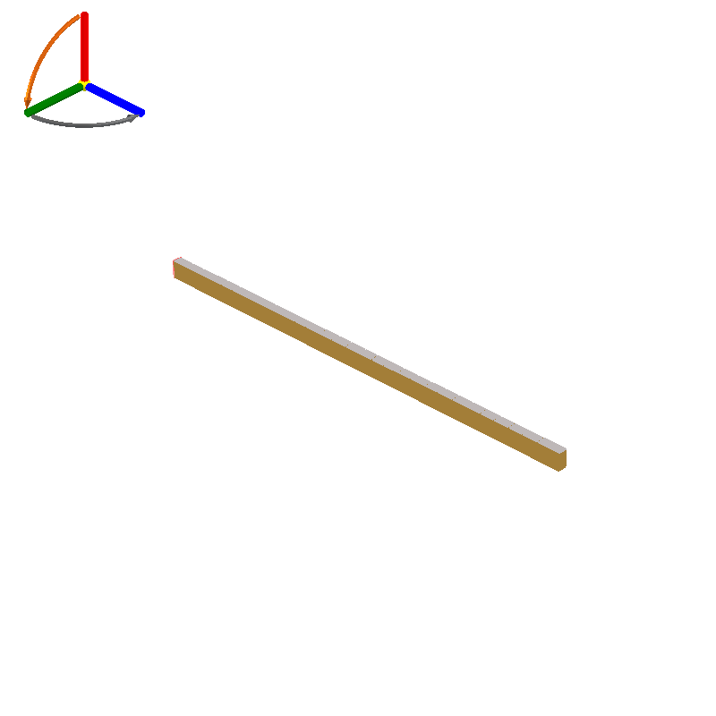
Design 7: Preview

Slide 19
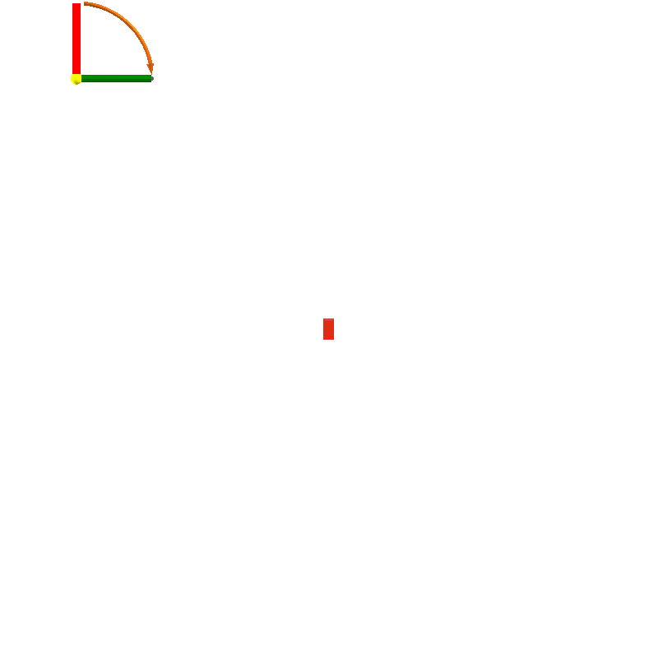
Design 7: Front Side Preview

Slide 20
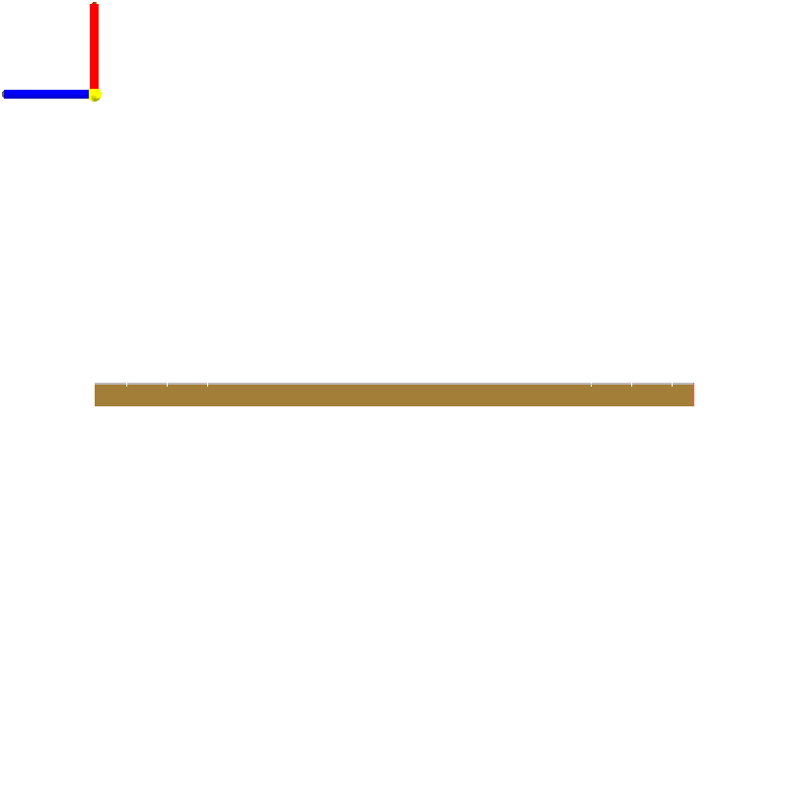
Design 7: Left Side Preview

Slide 21
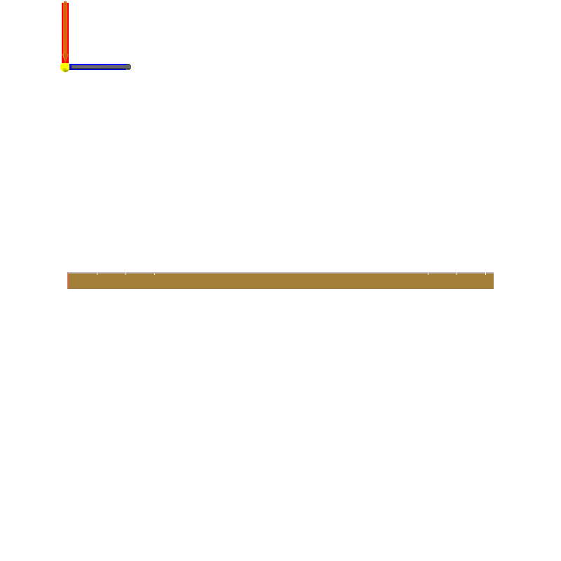
Design 7: Right Side Preview

Slide 22
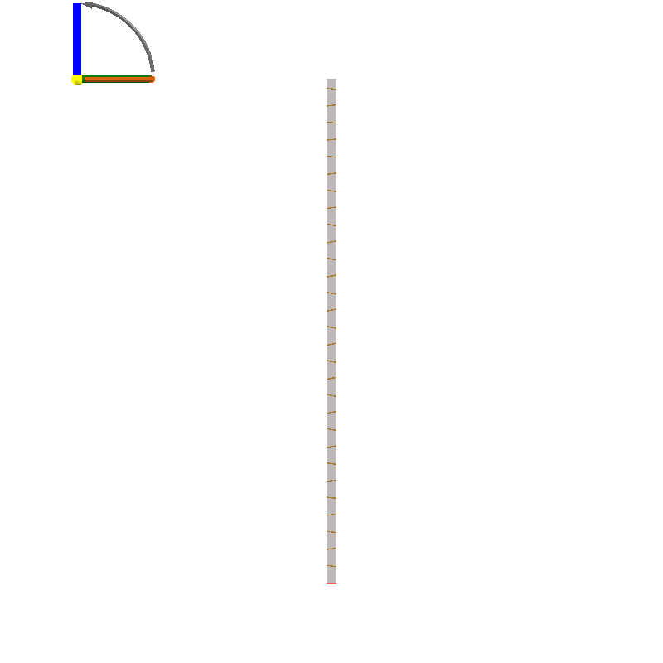
Design 7: Top Side Preview

Slide 23
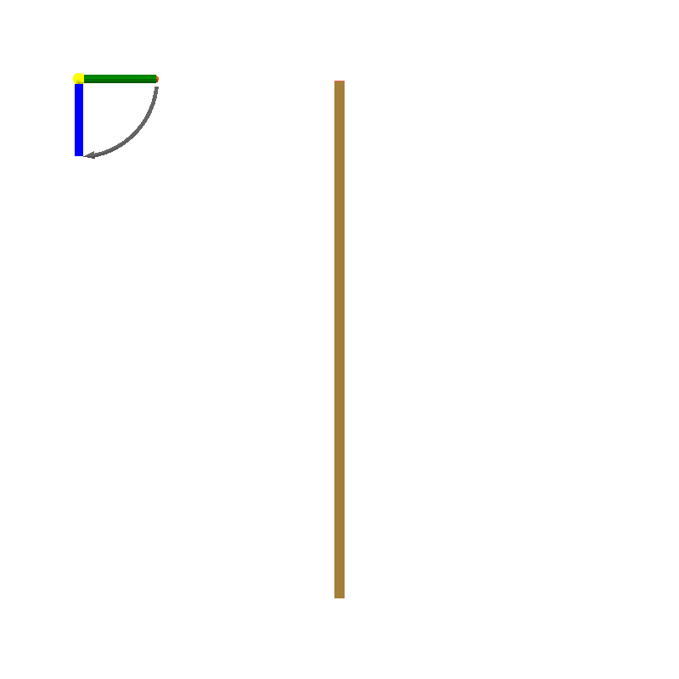
Design 7: Bottom Side Preview

Slide 24
Design 7: Design Objectives
Objective Group: beamwidth
Name | Description | Value
f₀ | Centre frequency | 24 GHz
bw | 3dB beamwidth | 2.8 °
Tt | Select the taper to be used | Villeneuve

Slide 25
Design 7: Physical Parameters
Name | Description | Value
Wg | Waveguide width | 8.930 mm
Hg | Waveguide height | 3.969 mm
Sf | Distance from feed to first slot | 8.739 mm
St | Distance from last slot to termination | 4.369 mm
N | Number of slots | 29
Ss | Slot spacing | 8.739 mm
Ws | Slot width | 624.6 μm
θ1 | Slot 1 angle | 7.737 °
θ2 | Slot 2 angle | 7.461 °
θ3 | Slot 3 angle | 7.099 °

Slide 26
Design 7: Physical Parameters (2)
Name | Description | Value
θ4 | Slot 4 angle | 6.895 °
θ5 | Slot 5 angle | 7.020 °
θ6 | Slot 6 angle | 7.509 °
θ7 | Slot 7 angle | 8.266 °
θ8 | Slot 8 angle | 9.097 °
θ9 | Slot 9 angle | 9.821 °
θ10 | Slot 10 angle | 10.37 °
θ11 | Slot 11 angle | 10.78 °
θ12 | Slot 12 angle | 11.13 °
θ13 | Slot 13 angle | 11.46 °

Slide 27
Design 7: Physical Parameters (3)
Name | Description | Value
θ14 | Slot 14 angle | 11.71 °
θ15 | Slot 15 angle | 11.80 °
θ16 | Slot 16 angle | 11.71 °
θ17 | Slot 17 angle | 11.46 °
θ18 | Slot 18 angle | 11.13 °
θ19 | Slot 19 angle | 10.78 °
θ20 | Slot 20 angle | 10.37 °
θ21 | Slot 21 angle | 9.821 °
θ22 | Slot 22 angle | 9.097 °
θ23 | Slot 23 angle | 8.266 °

Slide 28
Design 7: Physical Parameters (4)
Name | Description | Value
θ24 | Slot 24 angle | 7.509 °
θ25 | Slot 25 angle | 7.020 °
θ26 | Slot 26 angle | 6.895 °
θ27 | Slot 27 angle | 7.099 °
θ28 | Slot 28 angle | 7.461 °
θ29 | Slot 29 angle | 7.737 °
θ30 | Slot 30 angle | 30 °
θ31 | Slot 31 angle | 30 °
θ32 | Slot 32 angle | 30 °
θ33 | Slot 33 angle | 30 °

Slide 29
Design 7: Physical Parameters (5)
Name | Description | Value
θ34 | Slot 34 angle | 30 °
θ35 | Slot 35 angle | 30 °
θ36 | Slot 36 angle | 30 °
θ37 | Slot 37 angle | 30 °
θ38 | Slot 38 angle | 30 °
θ39 | Slot 39 angle | 30 °
θ40 | Slot 40 angle | 30 °
θ41 | Slot 41 angle | 30 °
θ42 | Slot 42 angle | 30 °
θ43 | Slot 43 angle | 30 °

Slide 30
Design 7: Physical Parameters (6)
Name | Description | Value
θ44 | Slot 44 angle | 30 °
θ45 | Slot 45 angle | 30 °
θ46 | Slot 46 angle | 30 °
θ47 | Slot 47 angle | 30 °
θ48 | Slot 48 angle | 30 °
θ49 | Slot 49 angle | 30 °
θ50 | Slot 50 angle | 30 °
δ1 | Slot 1 depth | 883.5 μm
δ2 | Slot 2 depth | 884.9 μm
δ3 | Slot 3 depth | 886.7 μm

Slide 31
Design 7: Physical Parameters (7)
Name | Description | Value
δ4 | Slot 4 depth | 887.7 μm
δ5 | Slot 5 depth | 887.1 μm
δ6 | Slot 6 depth | 884.7 μm
δ7 | Slot 7 depth | 880.8 μm
δ8 | Slot 8 depth | 876.3 μm
δ9 | Slot 9 depth | 872.1 μm
δ10 | Slot 10 depth | 868.9 μm
δ11 | Slot 11 depth | 866.3 μm
δ12 | Slot 12 depth | 864.0 μm
δ13 | Slot 13 depth | 861.8 μm

Slide 32
Design 7: Physical Parameters (8)
Name | Description | Value
δ14 | Slot 14 depth | 860.1 μm
δ15 | Slot 15 depth | 859.5 μm
δ16 | Slot 16 depth | 860.1 μm
δ17 | Slot 17 depth | 861.8 μm
δ18 | Slot 18 depth | 864.0 μm
δ19 | Slot 19 depth | 866.3 μm
δ20 | Slot 20 depth | 868.9 μm
δ21 | Slot 21 depth | 872.1 μm
δ22 | Slot 22 depth | 876.3 μm
δ23 | Slot 23 depth | 880.8 μm

Slide 33
Design 7: Physical Parameters (9)
Name | Description | Value
δ24 | Slot 24 depth | 884.7 μm
δ25 | Slot 25 depth | 887.1 μm
δ26 | Slot 26 depth | 887.7 μm
δ27 | Slot 27 depth | 886.7 μm
δ28 | Slot 28 depth | 884.9 μm
δ29 | Slot 29 depth | 883.5 μm
δ30 | Slot 30 depth | 893.0 μm
δ31 | Slot 31 depth | 893.0 μm
δ32 | Slot 32 depth | 893.0 μm
δ33 | Slot 33 depth | 893.0 μm

Slide 34
Design 7: Physical Parameters (10)
Name | Description | Value
δ34 | Slot 34 depth | 893.0 μm
δ35 | Slot 35 depth | 893.0 μm
δ36 | Slot 36 depth | 893.0 μm
δ37 | Slot 37 depth | 893.0 μm
δ38 | Slot 38 depth | 893.0 μm
δ39 | Slot 39 depth | 893.0 μm
δ40 | Slot 40 depth | 893.0 μm
δ41 | Slot 41 depth | 893.0 μm
δ42 | Slot 42 depth | 893.0 μm
δ43 | Slot 43 depth | 893.0 μm

Slide 35
Design 7: Physical Parameters (11)
Name | Description | Value
δ44 | Slot 44 depth | 893.0 μm
δ45 | Slot 45 depth | 893.0 μm
δ46 | Slot 46 depth | 893.0 μm
δ47 | Slot 47 depth | 893.0 μm
δ48 | Slot 48 depth | 893.0 μm
δ49 | Slot 49 depth | 893.0 μm
δ50 | Slot 50 depth | 893.0 μm

Slide 36
Design 7: Derived Quantities
Name | Description | Value
X | Device X-dimension | 3.969 mm
Y | Device Y-dimension | 257.8 mm
Z | Device Z-dimension | 8.930 mm

Slide 37
Linear resonant waveguide slot array with narrow-wall slots
Antenna 2 : estimated performance charts

Slide 38
S-Reflection vs Frequency

Slide 39
Far Field vs Angle @ f0

Slide 40
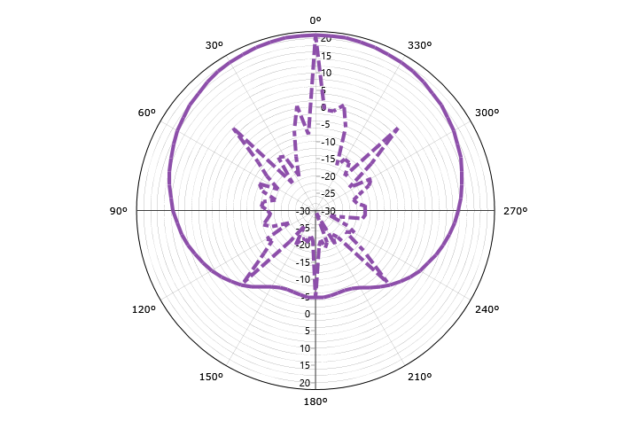
Far Field vs Angle @ f0
Gain (Total)

Slide 41
Far Field vs Angle @ f0

Slide 42
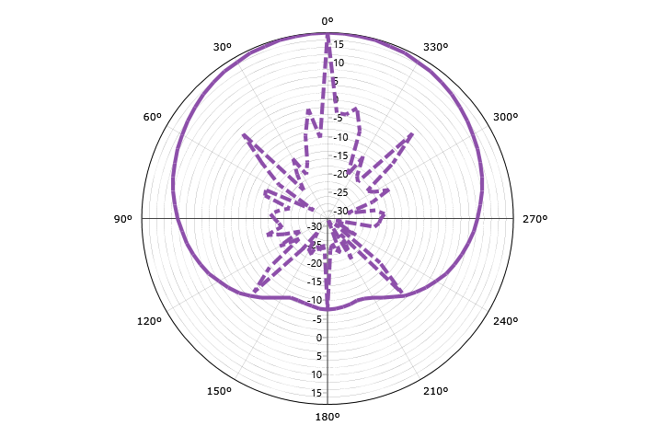
Far Field vs Angle @ f0
Gain (LHC)

Slide 43
Far Field vs Angle @ f0

Slide 44
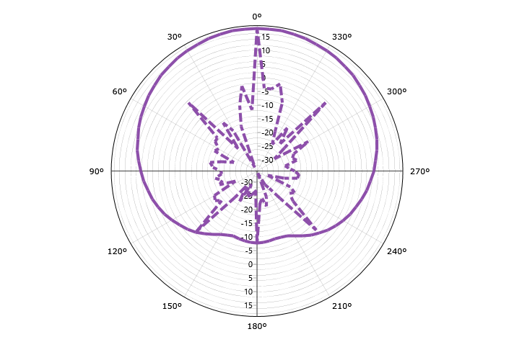
Far Field vs Angle @ f0
Gain (RHC)

Slide 45
Far Field vs Angle @ f0

Slide 46
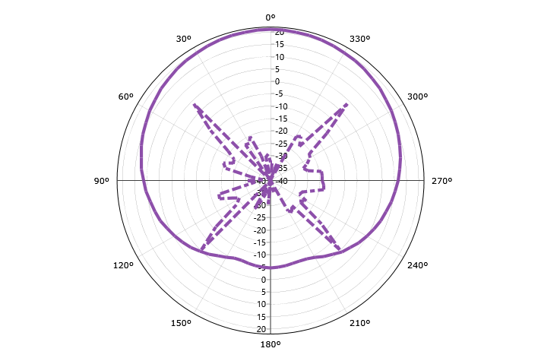
Far Field vs Angle @ f0
Gain (Horizontal)

Slide 47
Far Field vs Angle @ f0

Slide 48
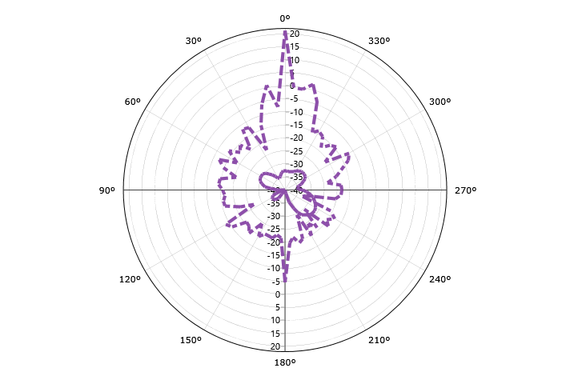
Far Field vs Angle @ f0
Gain (Vertical)

Slide 49
Far Field vs Angle @ f0

Slide 50
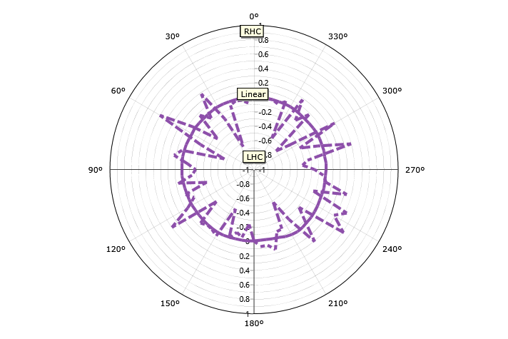
Far Field vs Angle @ f0
Axial Ratio (Handed)

Slide 51
Far Field vs Angle @ f0

Slide 52
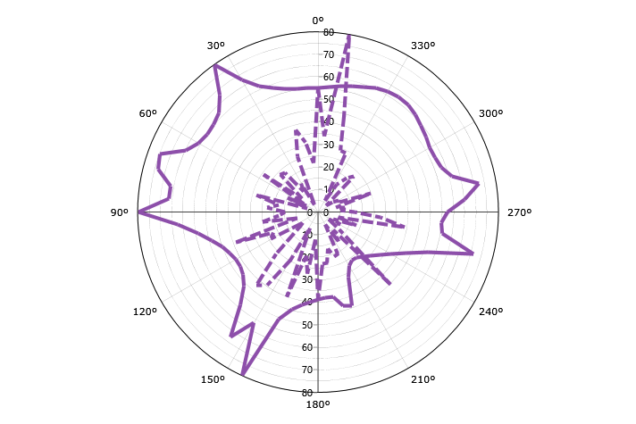
Far Field vs Angle @ f0
Axial Ratio (IEEE)

Slide 53
Far Field vs Angle @ f0

Slide 54
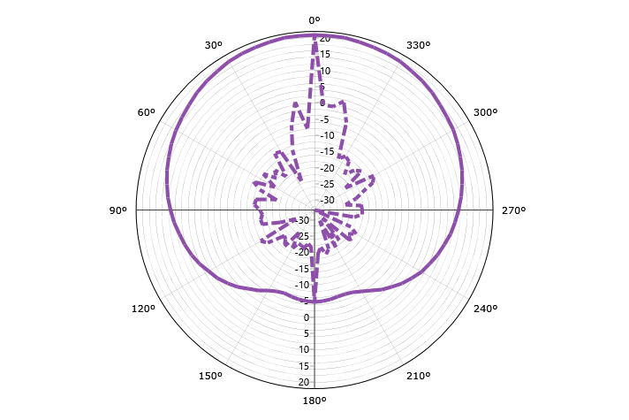
Far Field vs Angle @ f0
Ludwig III (Co)

Slide 55
Far Field vs Angle @ f0

Slide 56
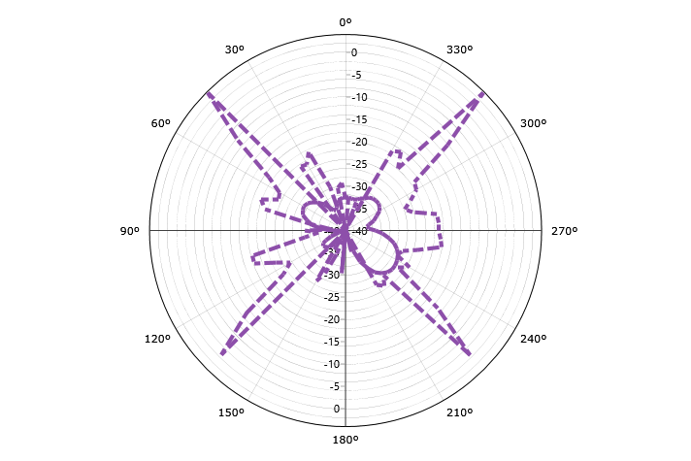
Far Field vs Angle @ f0
Ludwig III (Cross)

