Slide 1
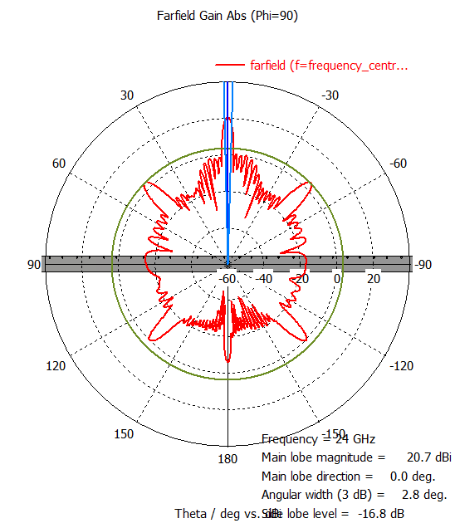
Farfields\farfield (f=frequency_centre) [1]

Slide 2
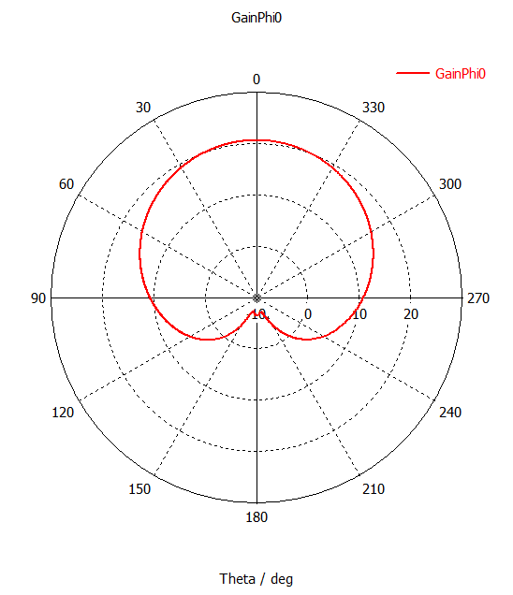
Tables\1D Results\GainPhi0

Slide 3
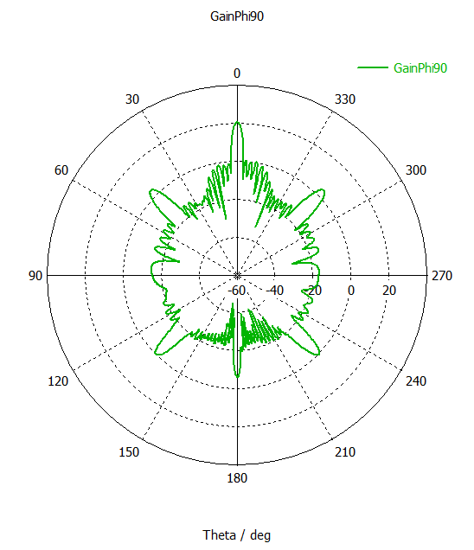
Tables\1D Results\GainPhi90

Slide 4
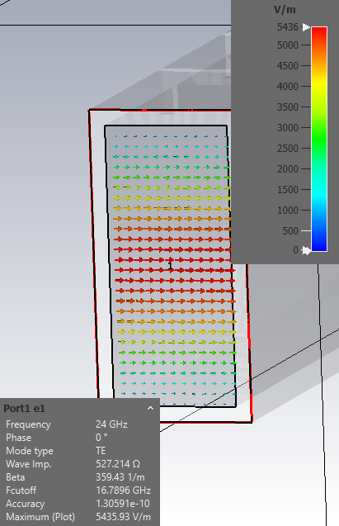
2D/3D Results\Port Modes\Port1\e1

Slide 5
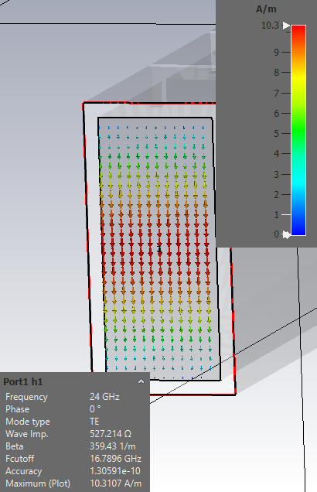
2D/3D Results\Port Modes\Port1\h1

Slide 6
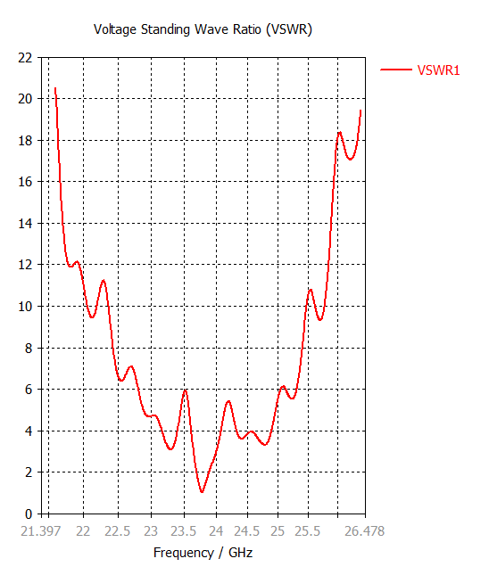
1D Results\VSWR

Slide 7
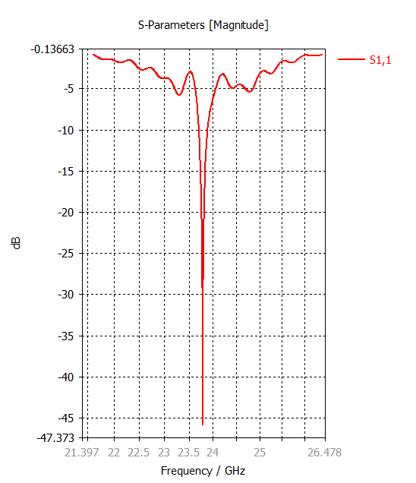
1D Results\S-Parameters\S1,1

Slide 8
1D Results\S-Parameters

Slide 9
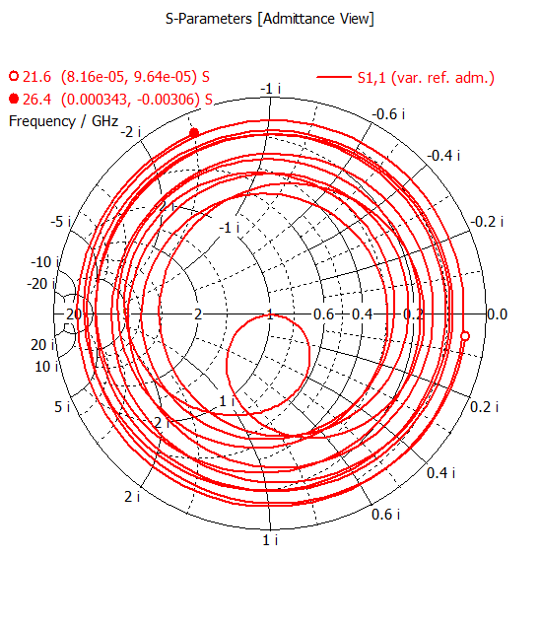
1D Results\S-Parameters

