Slide 1
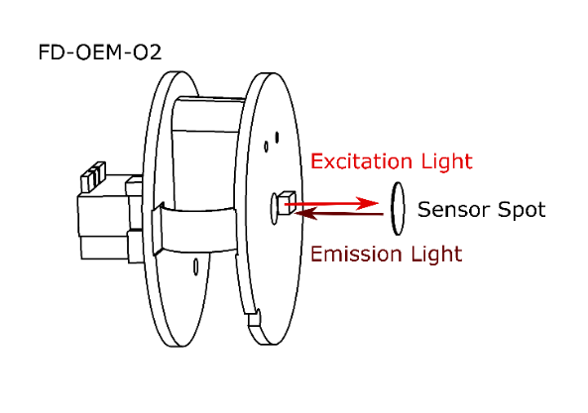
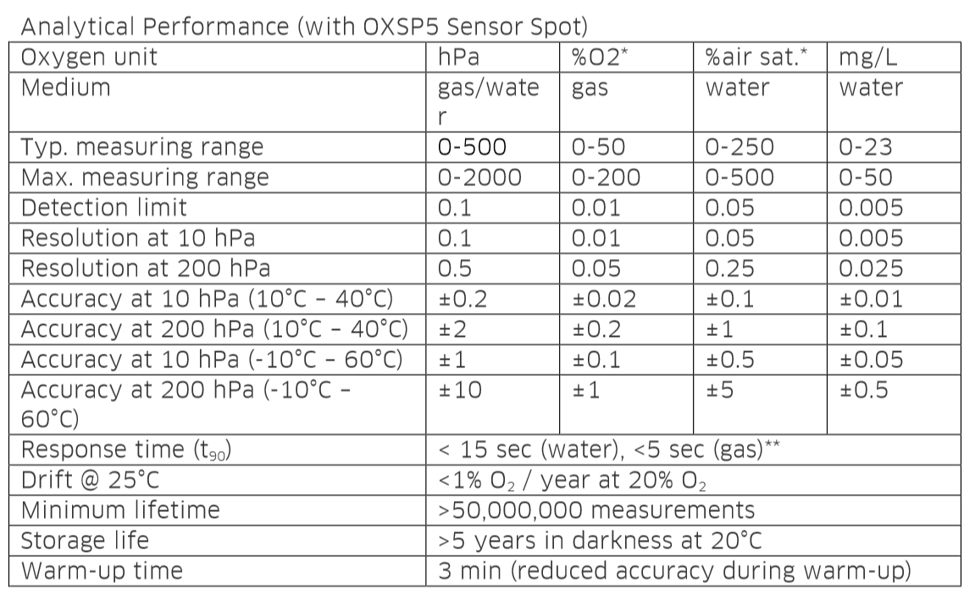
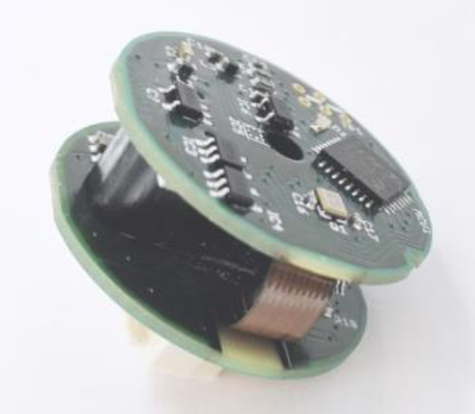
PyroSience
Dissolved O2
If not sponsored 450€ a Sensor + 300€ for 6 spots + Extra Hardware required BUT they did sponsor 75% + gave some for free
Not on the Website!
Small Footprint
Also measures ambient UV light, ambient pressure, ambient temperature & ambient humidity
UART based. Software (in C) exisiting
Maybe for free from SpiCy in February?
Non intrusive
Also available for PH & Temperature

Slide 2
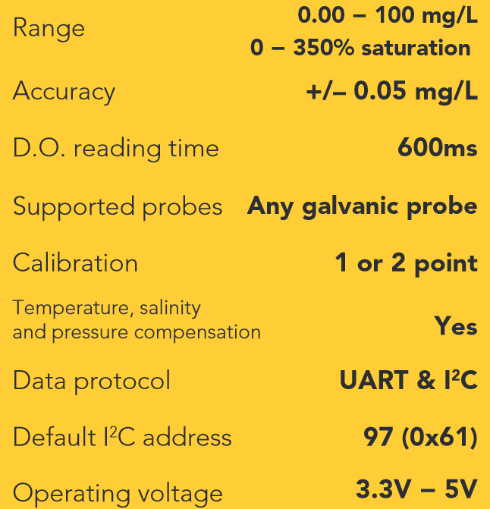
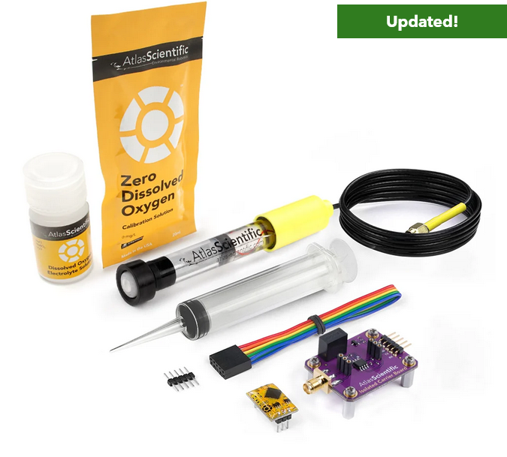
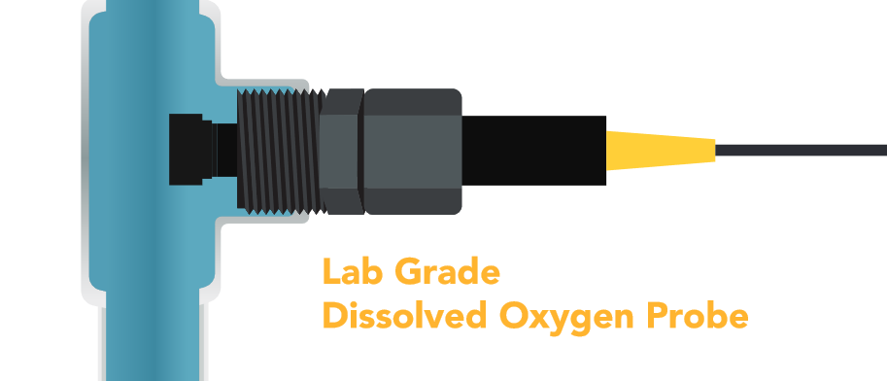
AtlasScientific
Dissolved O2
354€ for full kit, probe 160€ I got one we can use
Quite huge (12cm), made for pipes
UART & I2C based. Very pleasant in terms of software
Intrusive, uses up a bit of oxygen (60ml/min , https://files.atlas-scientific.com/DO_EZO_Datasheet.pdf page 70)
Also available for PH(175€ kit 40€ sensor) & Temperature

Slide 3
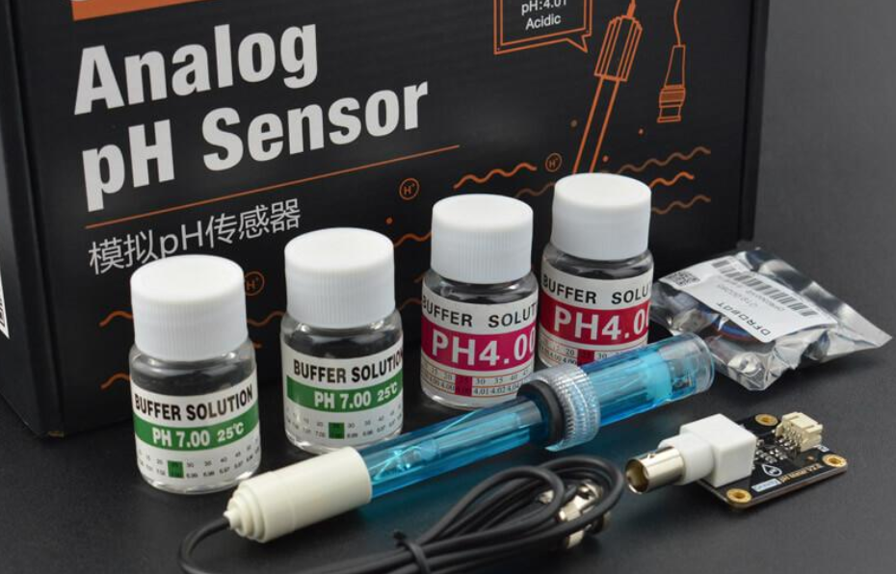
Gravity
PH
47,80€
Analog Signal
https://wiki.dfrobot.com/Gravity__Analog_pH_Sensor_Meter_Kit_V2_SKU_SEN0161-V2
There are better versions available
https://www.dfrobot.com/blog-1138.htm
https://www.mouser.de/ProductDetail/DFRobot/SEN0169?qs=lqAf%2FiVYw9h7p9WXQvmXEQ%3D%3D&mgh=1&vip=1&srsltid=AfmBOopwmsmAfMMLqLApefzCYbJ93YjBi-50N7S2uCjpQjift9l-HvWDkNI
l
0-14PH
0.1 PH accuracy, I think?

Slide 4
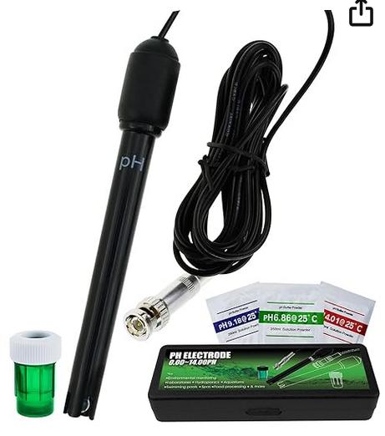
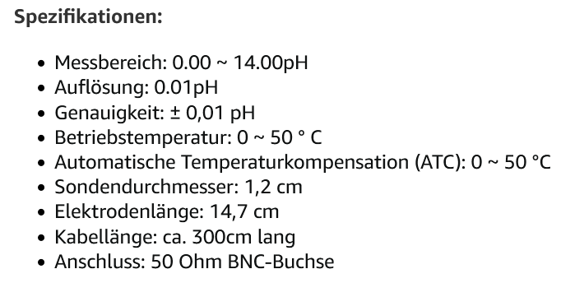
Average Amazon Trash
PH
26,99€
Analog Signal
https://wiki.dfrobot.com/Gravity__Analog_pH_Sensor_Meter_Kit_V2_SKU_SEN0161-V2

Slide 5
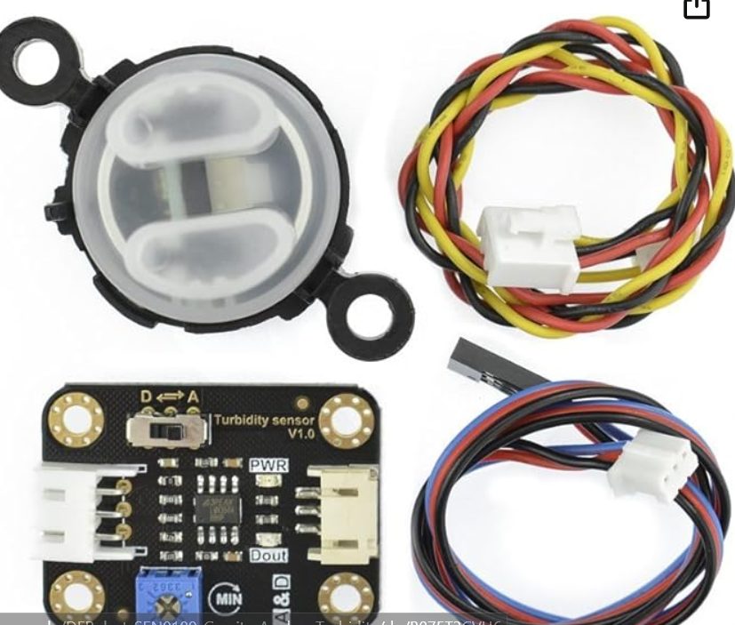
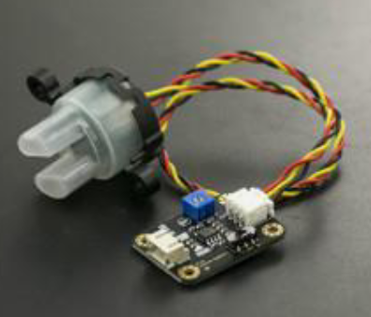
Gravity
Turbidity / optical density Sensor
23€ amazon 8,3€ Farnell
Analog Signal
http://www.farnell.com/datasheets/2700162.pdf

Slide 6
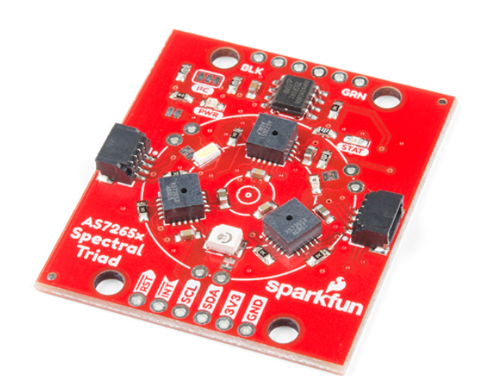
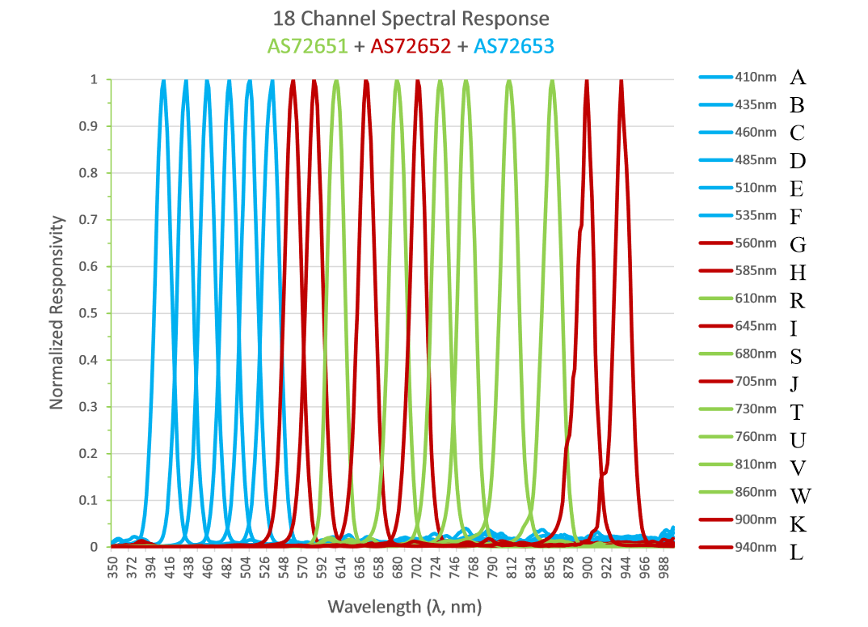
AS7265x
Light spektrometer
69.95€ (~15€ per Sensor)
Sparkfun light spektrometers
can detect the light from 410nm (UV) to 940nm (IR)
18 individual light frequencies can be measured with precision down to 28.6 nW/cm2 and accuracy of +/-12%.

