Slide 1



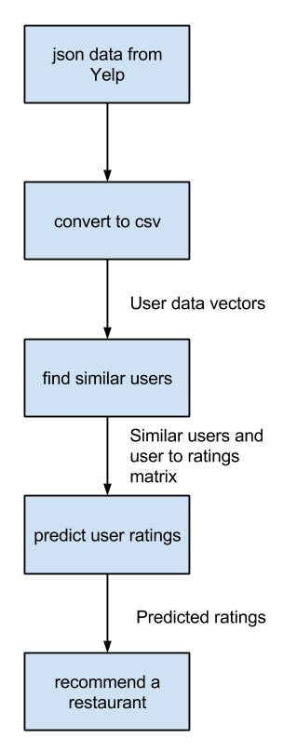
Yelp Recommendations
Gavriel Adler, Spencer Barton and Fridtjof Melle
Carnegie Mellon University
Background
Results
-- Inserted abstract --
(Illustrations)
This is the standard font-size
(Results goes here)
Method
Method goes here
(this is the smallest font- size)
(Illustrations)
(More stuff)
Future Work
Use generative models for classification
Our current model uses deterministic association to predict. An option is develop user characterizing models with generative learning algorithms.
Implement geographical restrictions
As the Yelp dataset contains reviews and restaurants all around the globe, it would be helpful to restrict recommendations to user-specific areas.
Notes:
Advice:
- If you are using a block of text rather than bullets go to the ruler bar and move the little pointer to the left so the top and bottom pointers line up
- You can reduce the font size if need be but try to keep it at least 40 point
- You can also increase the font size
- Feel free to change the layout so that there are more sections or change whether sections are single column or double column. Change the section titles as you see fit.
- A picture is worth 1000 words! Use figures, graphs, etc. where possible

