Slide 1
Prototype
emotion Change detector and enhancement application

Slide 2
Overview
 Every human being has emotional swings, and in some emotional periods they don’t even realize they need some cheering up.
 When these emotions are left ignored, they can develop into chronic emotions and even lead to related mental health disorders such as depression, bipolar disorder, and even euphoria.
 Therefore, it is important to address these emotions before they develop into serious medical conditions.

Slide 3
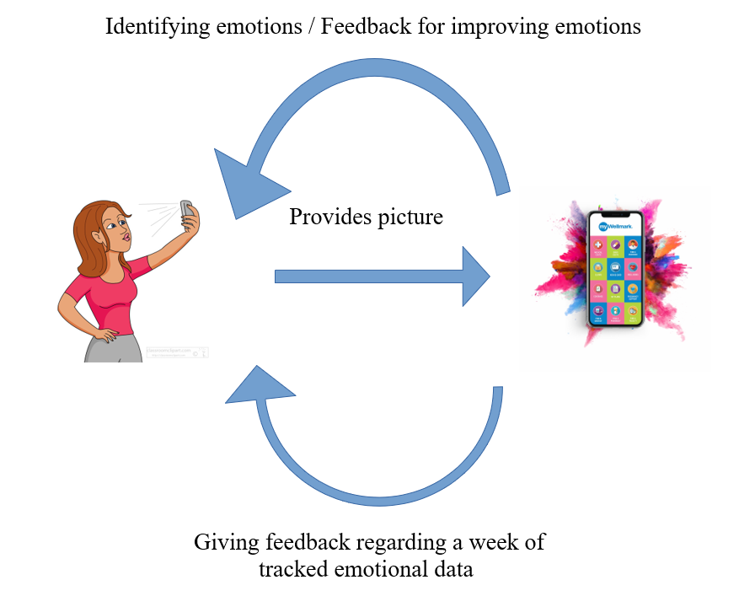
Rich picture

Slide 4
Features
Identifying human emotions using facial images. (Using machine learning)
Feedback and suggestions regarding the improvement of emotions.
Tracking emotion for better feedback.

Slide 5
Applications
 When attending therapy, the weekly reports from the application can be shared with the therapist.
 Children’s emotion swings can be monitored which is difficult to do manually due to frequent emotion swings.
 Can be used for self-awareness, and personal growth

Slide 6
Benefits
Improving daily life while helping to prevent disorders such as depression, OCD etc. in the long run.
Ability to identify emotions in each time period such as a week and make changes in daily routines.
Parents can check on their children’s emotions.

Slide 7
How are we different from other competitors?
 When considering the prevailing emotion tracking applications, they all consist of manual input of data related to the emotion. But as we have a conscious and a subconscious. When manually inputting data automatically our mind goes to the conscious mode.
 Conscious actions are based on our awareness and when we are aware we might automatically input the emotional data that we wish to express or record instead of what we are actually feeling.

Slide 8
How are we different from other competitors?
 When ML is used to determine the emotion by inputting an image through analyzing the facial expressions, this human interference can be avoided.
 Therefore, this is comparatively more reliable to use.

Slide 9
How are we different from other competitors?
 Another common feature missing in the prevailing emotion trackers is that they track the emotions daily but don’t maintain the records for a period of time to analyze the chronic emotions.
 In the designed application, emotions are tracked for a week and the frequency of different emotions during the week are analyzed.

Slide 10
How are we different from other competitors?
 This analytical data can be used to determine if the person is prone to depression or euphoria or even chronic stress under the supervision of a doctor.
 Therefore, this information can be used to diagnose medical conditions and can even be used as an emotion diary to share with the therapist when needed.

