Slide 1



CGB1201 – JAVA PROGRAMMING
Department of Artificial Intelligence and Data Science
Academic Year: 2024 – 2025 (Odd Semester)
Register Number Name | :2303811724321068 :MOHAMED IBRAHIM F
Year | :II
Semester | :III
Section | :B
Date | :03/12/24
1
CGB1201 – JAVA PROGRAMMING

Slide 2
TITLE OF THE PROJECT
WEATHER FORECASTING SYSTEM
2
CGB1201 – JAVA PROGRAMMING

Slide 3
Problem Identification
Unpredictable Weather: The need for accurate weather predictions to avoid disruptions.
Delayed Alerts: Lack of timely warnings for extreme weather conditions.
Decision-Making Challenges: Industries dependent on weather data face inefficiencies without accurate forecasts.

Slide 4
Objective
Accurate Predictions: Provide precise, real-time weather forecasts.
Timely Alerts: Deliver early warnings for severe weather conditions.
User Accessibility: Develop an intuitive platform for general users and specialized industries.

Slide 5
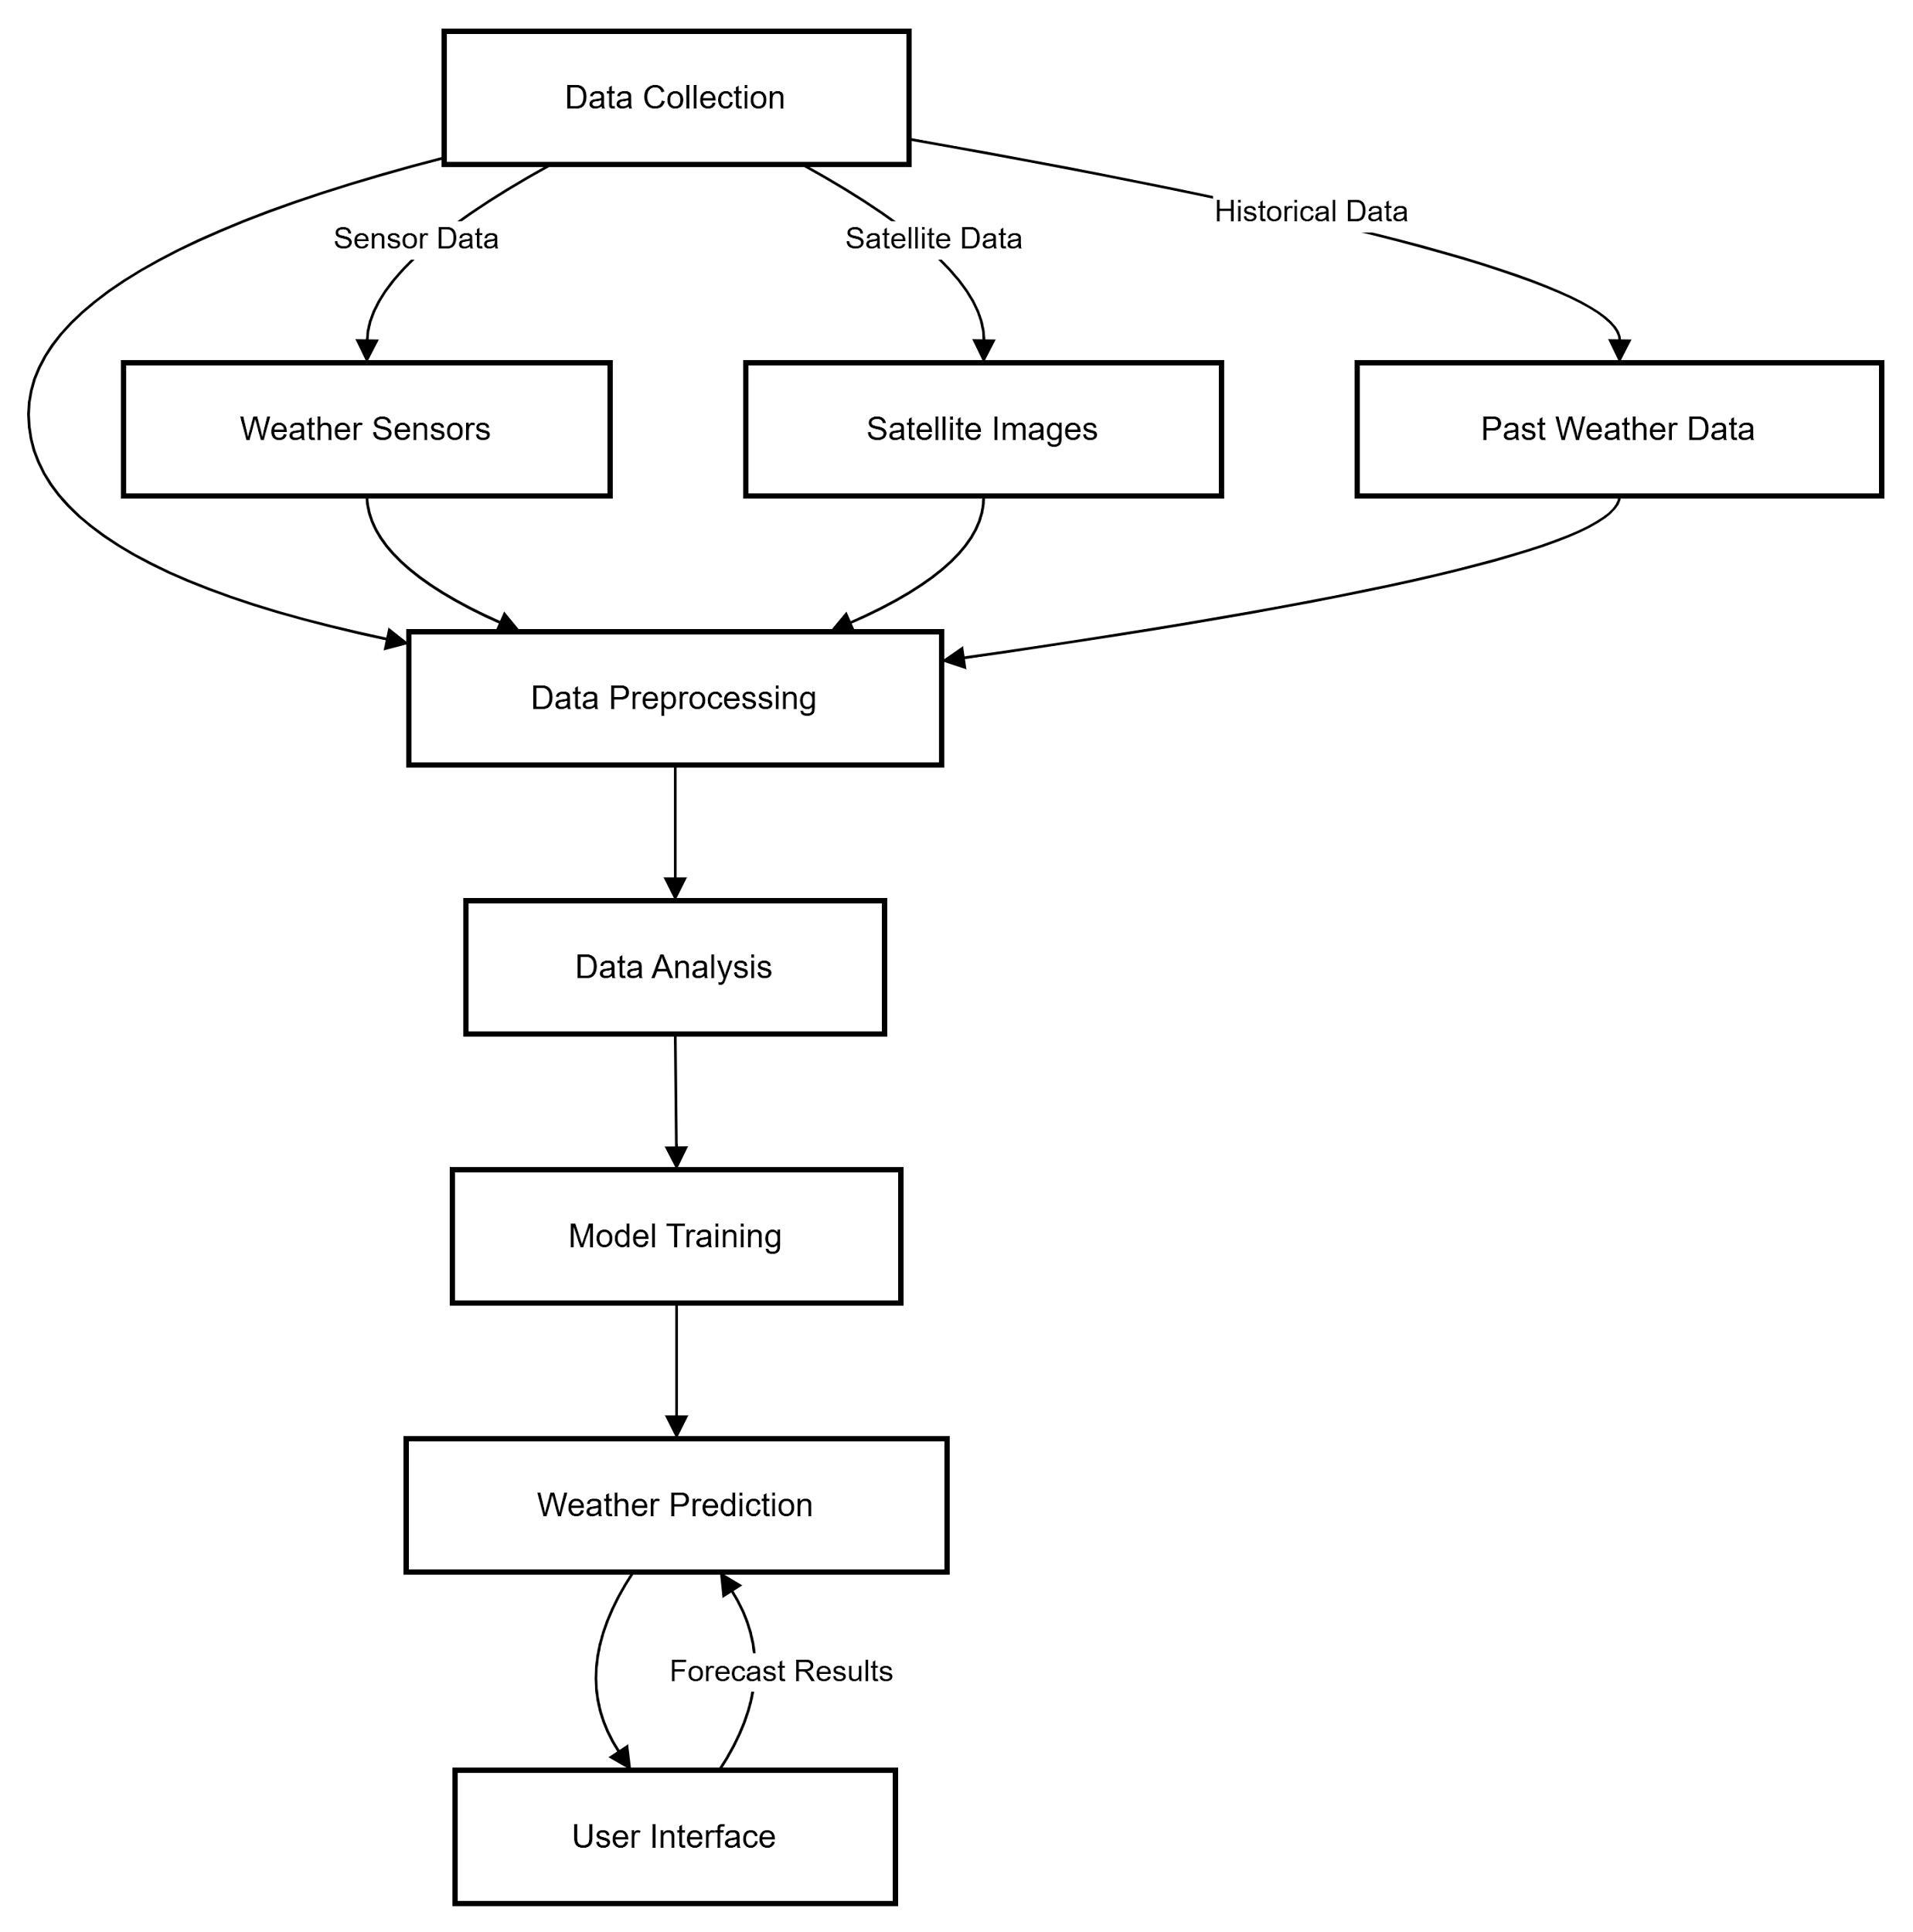
PROPOSED ARCHITECTURE

Slide 6
Java Programming - Concepts Used
Object-Oriented Programming: Modular design for components like data collection and processing.
APIs and Networking: Fetching weather data from APIs.
Event Handling: For interactive user inputs.
Collections Framework: Manage weather data efficiently.

Slide 7
List of Modules
Weather Data Collection
Data Processing and Analysis
Forecast Generation
Weather Alert
User Interaction

Slide 8
MODULE DESCRIPTION
Weather Data Collection : Fetches real-time data from APIs and sensors.
Data Processing : Analyzes and processes raw data.
Forecast Generation : Uses algorithms to generate predictions.
Weather Alert : Triggers timely notifications for severe weather.
User Interaction : Displays current weather and forecasts on a user-friendly interface.

Slide 9
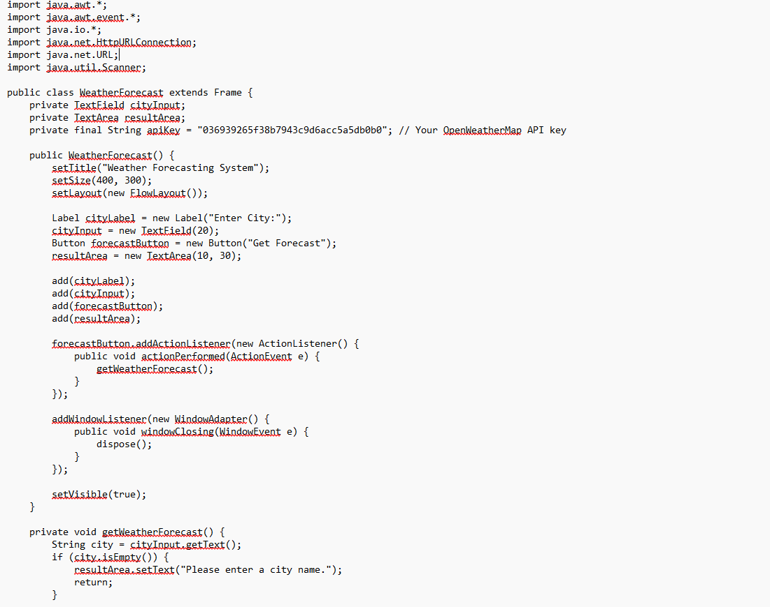
Source Code

Slide 10
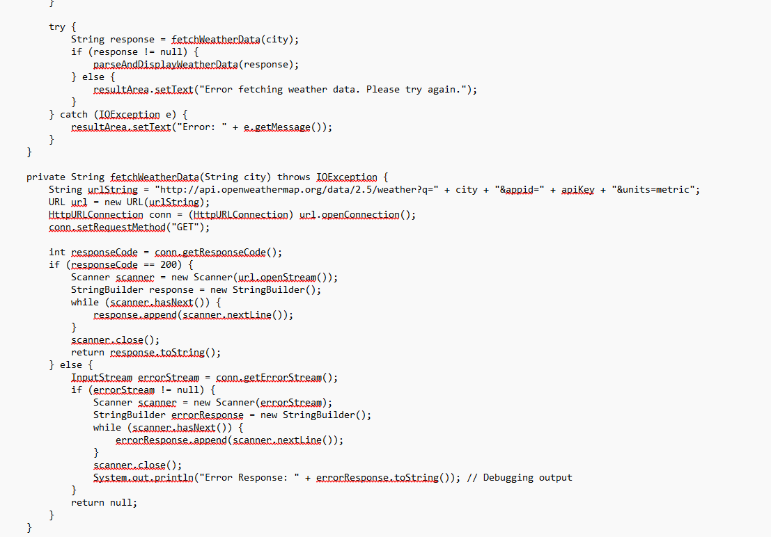
Source Code

Slide 11
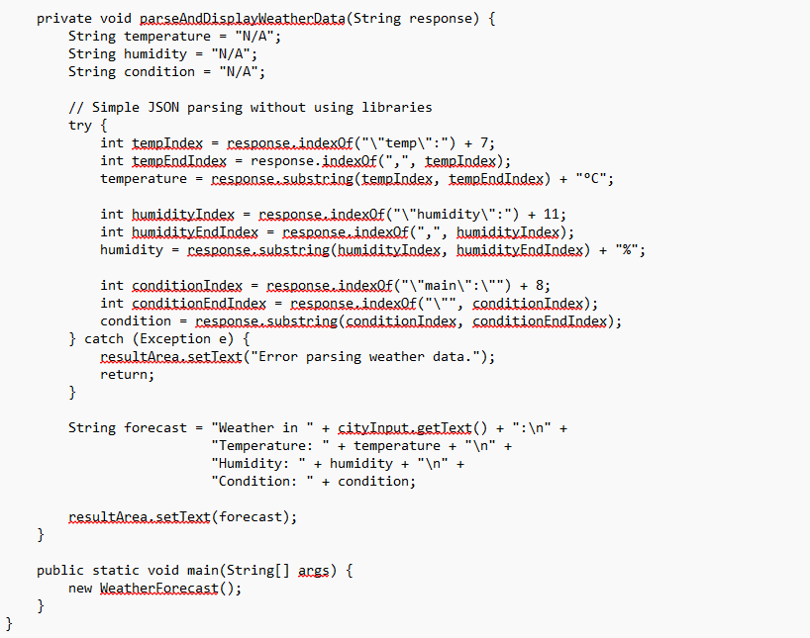
Source Code

Slide 12
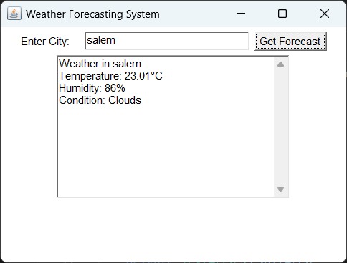
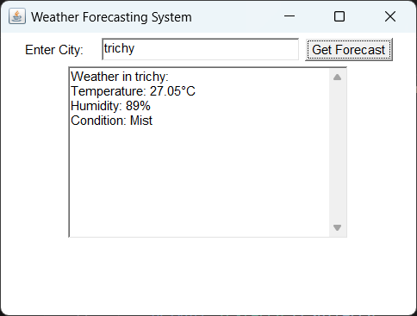
Results

Slide 13
CONCLUSION
The Weather Forecasting System built using Java provides an efficient and accurate solution for obtaining real-time weather updates and forecasts. By leveraging Object-Oriented Programming (OOP) principles, the system ensures modularity, scalability, and ease of maintenance. The Data Collection module integrates with APIs to fetch real-time weather data, while the Data Processing and Pattern Analysis modules efficiently handle the parsing and analysis of weather patterns, enabling reliable forecasting.

Slide 14
THANK YOU

