Slide 1
Project Title: TO-Do List for EDGE
Submitted by
Gazi Md. Noor Hossain
EDGE ID: 26 (Batch-01)
4th Year, 2nd Semester
Department of ICT, MBSTU
Submitted to
Dr Ziaur Rahman
Instructor
Python (Django), EDGE Project
Associate Professor, ICT dept., MBSTU

Slide 2
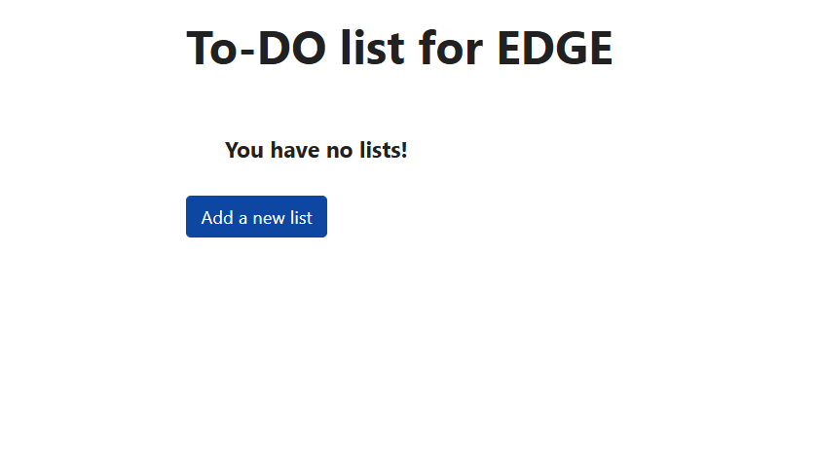
Front Page

Slide 3
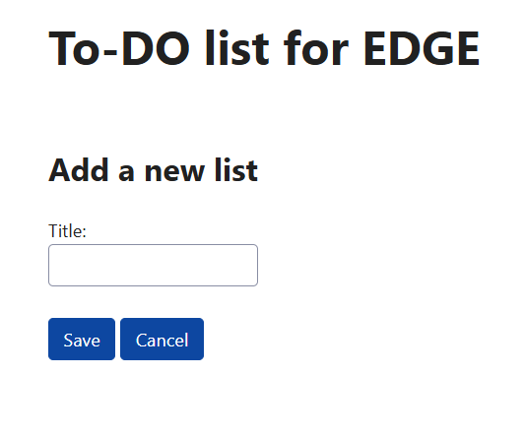
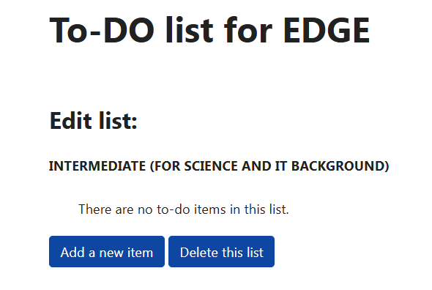
Insert new item

Slide 4
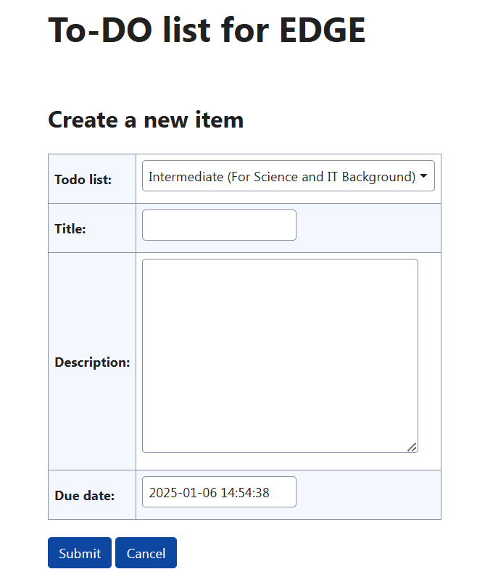
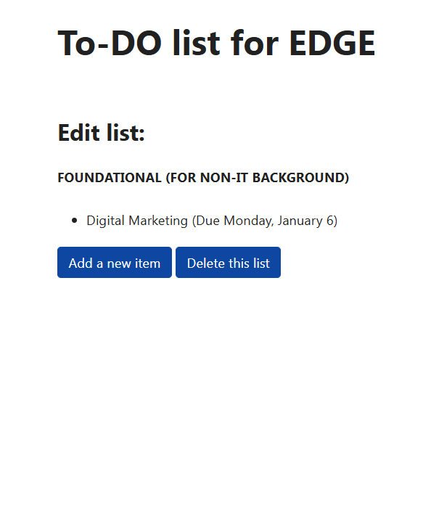
Insert description on the Item

Slide 5
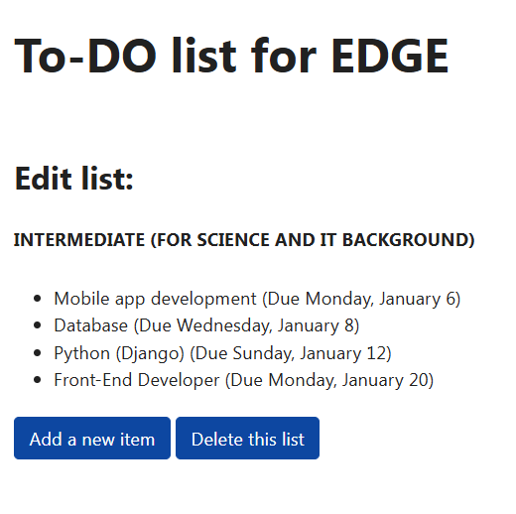
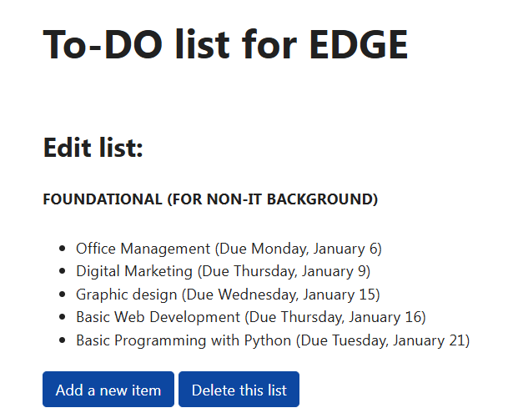
2 items are listed

Slide 6
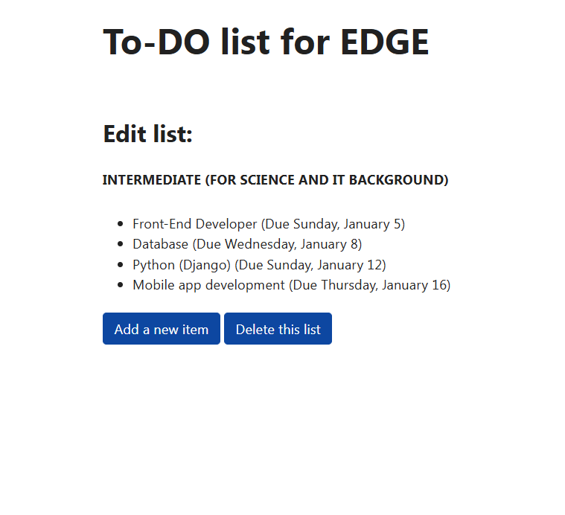
Update item list

Slide 7
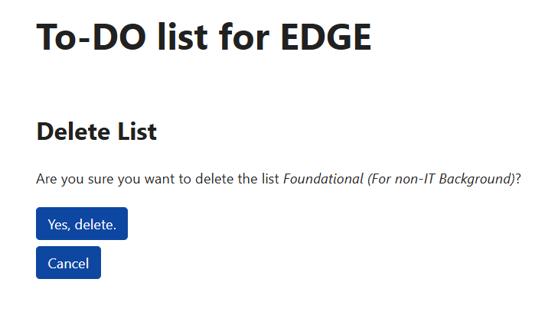
Delete an item

