Slide 1
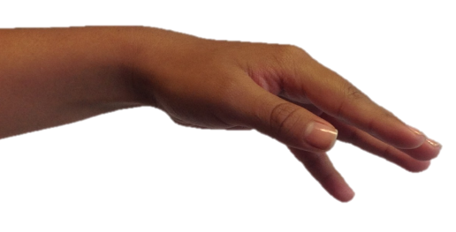
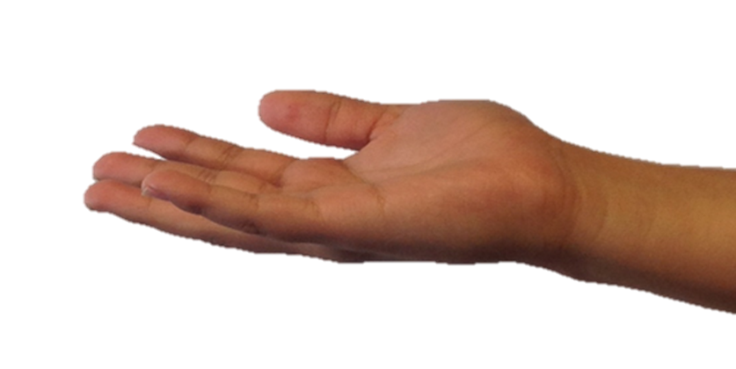

identiQuake
Detect & Protect

Slide 2
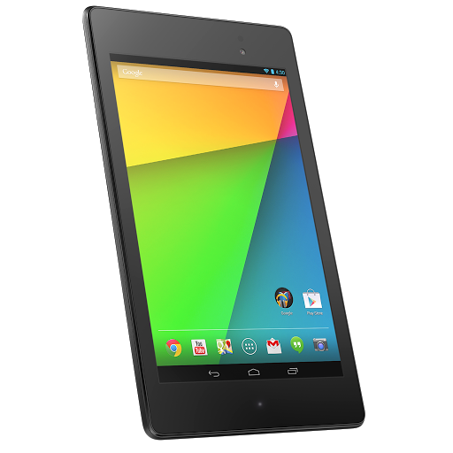
identiQuake is your phone’s accelerometer and GPS working in harmony to help save your life.

Slide 3
Behind the Scenes
Android Device
Parse Database
Web Interface

Slide 4
“In Depth Defence” – Automatic Reporting
Earthquake occurs
Android device detects vibration
Android decides whether it is real earthquake
If it is then it sends GPS data to Parse database
Parse stores latitude, longitude & magnitude
Web interface plots Parse data using Google™ Maps API

Slide 5
“In Depth Defence” – Manual Reporting
“Help” button on Android app is triggered
Android device sends out SOS GPS information
GPS data is sent to Parse database
Parse stores latitude, longitude and severity level
Web interface plots Parse data using Google™ Maps API

Slide 6
Upgrades that didn’t quite make it
The ability to use Bluetooth to channel emergency data to Parse database if most mobile towers were destroyed by the quake.
Excluding location that may trigger false alarms for automatic reporting only, e.g. a theme park
Apps for iOS & Firefox OS

Slide 7






Technology that made this all possible - thank you!

