Slide 1

Bitcoin Throughput Analysis
Final presentation
By : Tal Tzafrir & Itzik Solomon
Supervisor : Alexander Manuskin

Slide 2
Outline

Slide 3

Project goals
Learn about Bitcoin
Create framework for Bitcoin network analysis
Research how propagation time in network is affected by different aspects

Slide 4
Tools

Slide 5
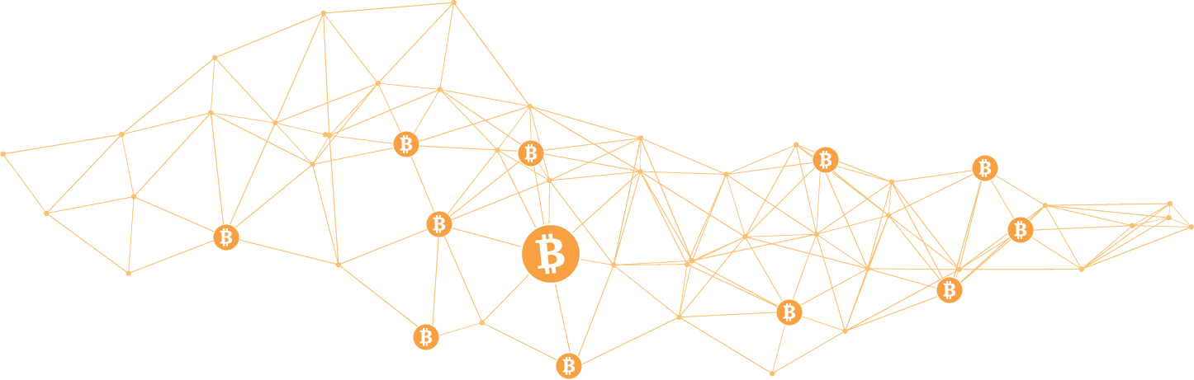
What is Bitcoin?
Most common cryptocurrency
Based on blockchain technology
Solves key cryptocurrency problems

Slide 6

Bitcoin Blockchain
Blocks
Transactions
UTXO set

Slide 7
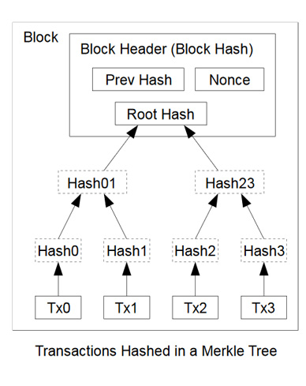
Blocks
Block Version Number
Previous Block Hash
Mining Difficulty Target
Nonce
Transactions

Slide 8
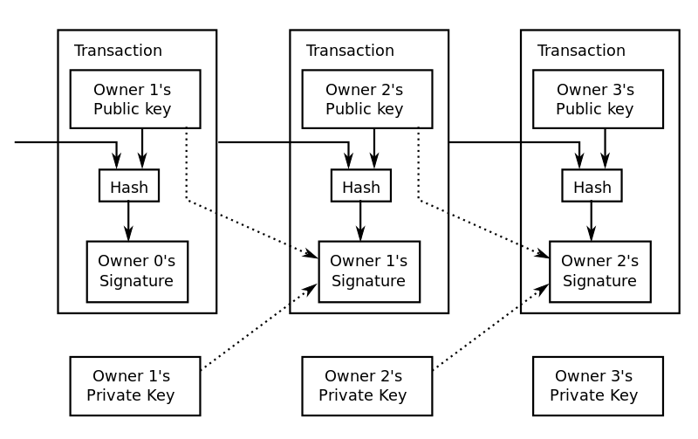
Transaction
Inputs
Prev tx
Index
Private key
Outputs
Value
Public key

Slide 9
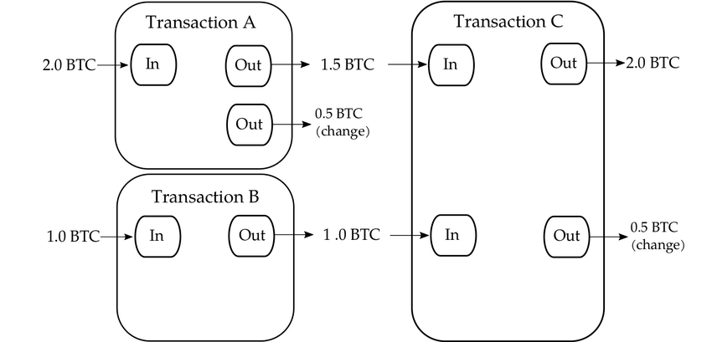
UTXO set example

Slide 10
UTXO set example

Slide 11
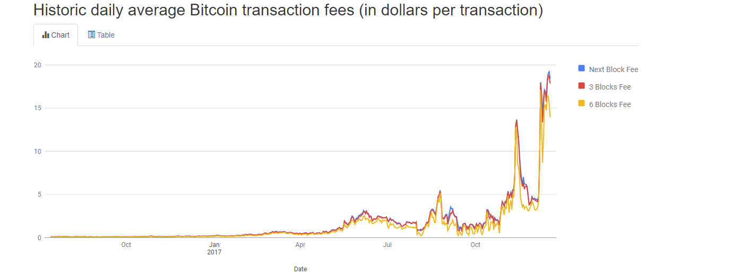
Bitcoin scalability problem
Average block creation time
Block size limit
Efficiency

Slide 12

Parameters of interest
Block size
UTXO set size out of cache size
Topology of nodes
Notes:
UTXO size
Block size
Dependencies
Bandwidth/Latency
Topology
RAM/CPU

Slide 13
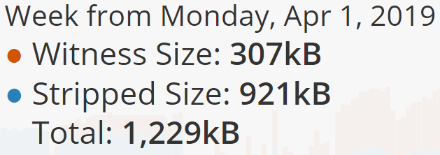
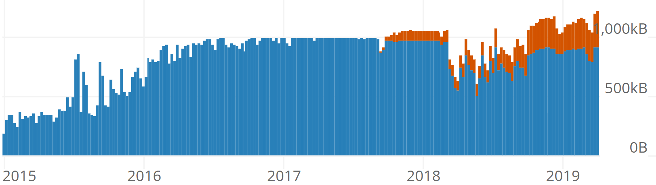
Block Size
Legacy size limitation – 1MB
SegWit and block weight
New theoretical limitation is 4MB
Witness and striped size

Slide 14
UTXO set Size

Slide 15
Our Setup
Local server
Scripts
Library of data directories
results
AWS instances
Bitcoin core client
Server script (only miner)
Block notify script

Slide 16
Topology
Mesh (clique)
Static (deterministic random)
Dynamic (non deterministic random)

Slide 17

Scripts
make_setup_test.py – main script
Create_starting_blockchain.py
Run measurements
Collect and display results

Slide 18

Current status
Research
Experimenting with Bitcoin core
Characterization of framework

Slide 19

Next steps
Build framework
Build network on AWS
Measurements
Analysis and conclusions

