Slide 1
REQUIREMENT 1
Single-Campaign Stochastic Bidding
Algorithms, Environment, and Empirical Results — Detailed Report
Online Learning Applications
Foad Zahedi

Slide 2
The Problem We're Solving
Requirement 1 looks at a single advertising campaign that has to bid in a long sequence of first-price auctions, one after another, against a budget that does not refill. Each round it chooses a bid, a competitor's highest bid is drawn at random, and if the campaign's bid clears that competitor's bid, the campaign wins: it pays exactly what it bid (that's what "first-price" means) and earns value minus bid. If it loses, it pays nothing and earns nothing.
The twist that makes this interesting is the budget. Winning costs real money, and once the budget runs out the campaign simply cannot bid anymore for the rest of the horizon — it goes bankrupt. So a good bidding strategy has to do two things at once: learn which bid tends to work well, and not spend so aggressively that it dies before the campaign is supposed to end.
We measure performance with regret: the gap between what an algorithm actually earned and what the best possible fixed strategy would have earned over the same horizon. Specifically we use pseudo-regret — at every round we compare against the true expected reward of the bid that was played, computed from the closed-form auction formula, rather than the noisy win/lose outcome of that one round. This removes sampling luck from the comparison and shows convergence much more clearly, which matters a lot over a horizon of only 1,000 rounds.
Requirement 1 — Single-Campaign Stochastic Bidding

Slide 3
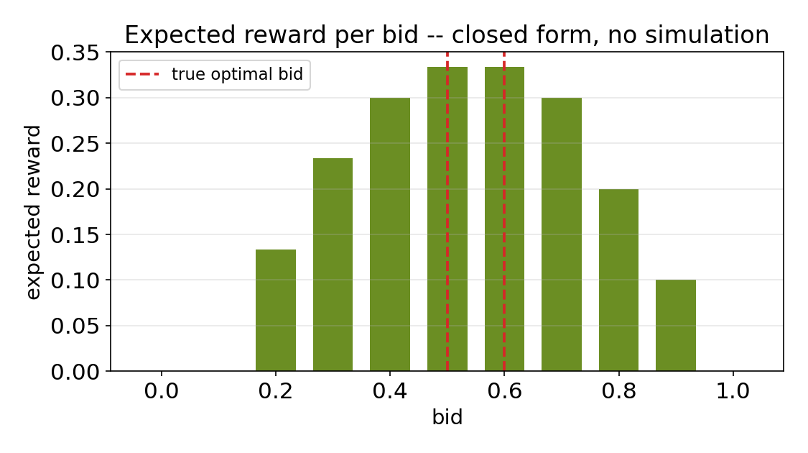
The Environment, Precisely
PARAMETERS
Campaign value
1.0
Horizon
1,000 rounds
Budget
300
Competing bid
Uniform(0.1, 0.7)
Competitors per round
2 (highest one counts)
Candidate bids
11 values, 0.0 to 1.0, step 0.1
Config file
configs/req1.yaml
The win rule is simple: the campaign wins a round if its bid is at least as high as the highest competing bid for that round, which is drawn uniformly between 0.1 and 0.7. That gives a closed-form expected reward for every candidate bid, so we can compute the true best bid exactly instead of estimating it — no simulation needed.
Requirement 1 — Single-Campaign Stochastic Bidding

Slide 4
Six Algorithms, Three Ideas
We implemented three different ways of choosing how much to explore, and ran each one both without and with budget pacing — six algorithms in total, but really only three ideas.
Exploration idea | Budget-free version | Budget-aware version
Fixed confidence bound | UCB1 | Budgeted UCB
Variance-adaptive confidence bound (UCB1-Tuned, Auer et al. 2002) | UCB1-Tuned | Budgeted UCB1-Tuned
Constant rescaled to this environment's best achievable reward | Rescaled-Constant UCB | Budgeted Rescaled-Constant UCB
The budget-aware column isn't a different exploration rule — it's the same confidence bound, with a linear-programming pacing layer added on top (see the next slide) so the campaign spends at a sustainable rate instead of front-loading its budget.
Requirement 1 — Single-Campaign Stochastic Bidding

Slide 5
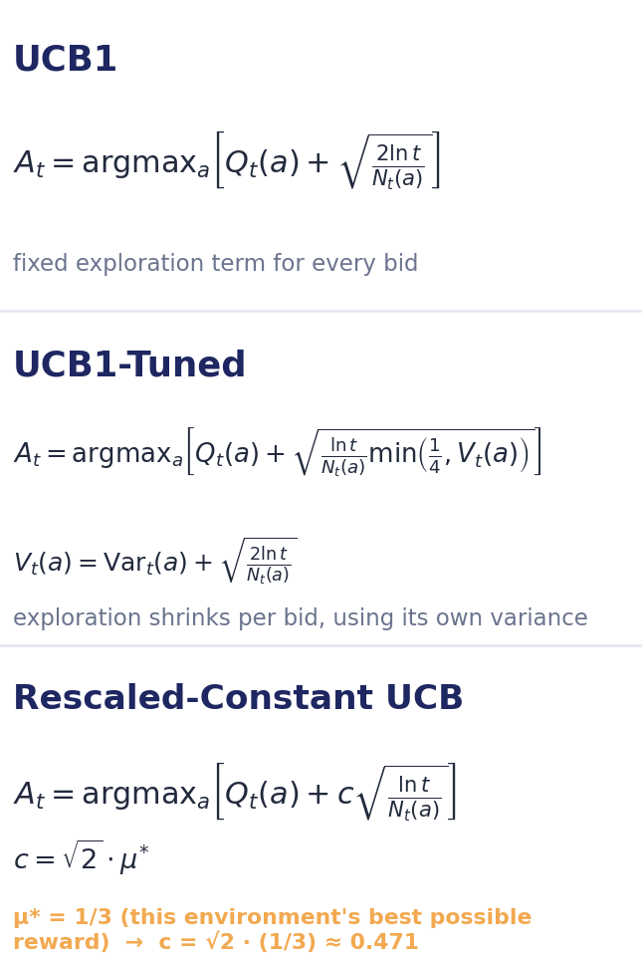
The Three Exploration Rules, in Full
Each rule picks the bid maximizing Q_t(a) + an exploration bonus that shrinks as a bid gets played more
Requirement 1 — Single-Campaign Stochastic Bidding

Slide 6
How Budget Pacing Actually Works
Every budget-aware algorithm uses the exact same trick on top of its exploration rule: instead of just playing the bid with the highest confidence-bound score, it solves a small linear program each round over the reachable bid mixtures, and samples its next bid from that distribution.
THE LP, EVERY ROUND
maximize Σ γ_b · reward_ucb(b)
subject to Σ γ_b · cost_estimate(b) ≤ budget_left / rounds_remaining
Σ γ_b = 1, γ_b ≥ 0
With only one budget constraint, the optimal solution never needs more than two bids mixed together, so the implementation just enumerates every affordable single bid and every two-bid mixture and keeps the best one — no external solver needed.
The right-hand side of the constraint, budget left divided by rounds remaining, is what actually does the pacing: it re-solves every round for a smaller allowance as the campaign progresses, which is exactly why the budget-aware algorithms glide their spending down to zero right around the final round instead of running out early.
Requirement 1 — Single-Campaign Stochastic Bidding

Slide 7
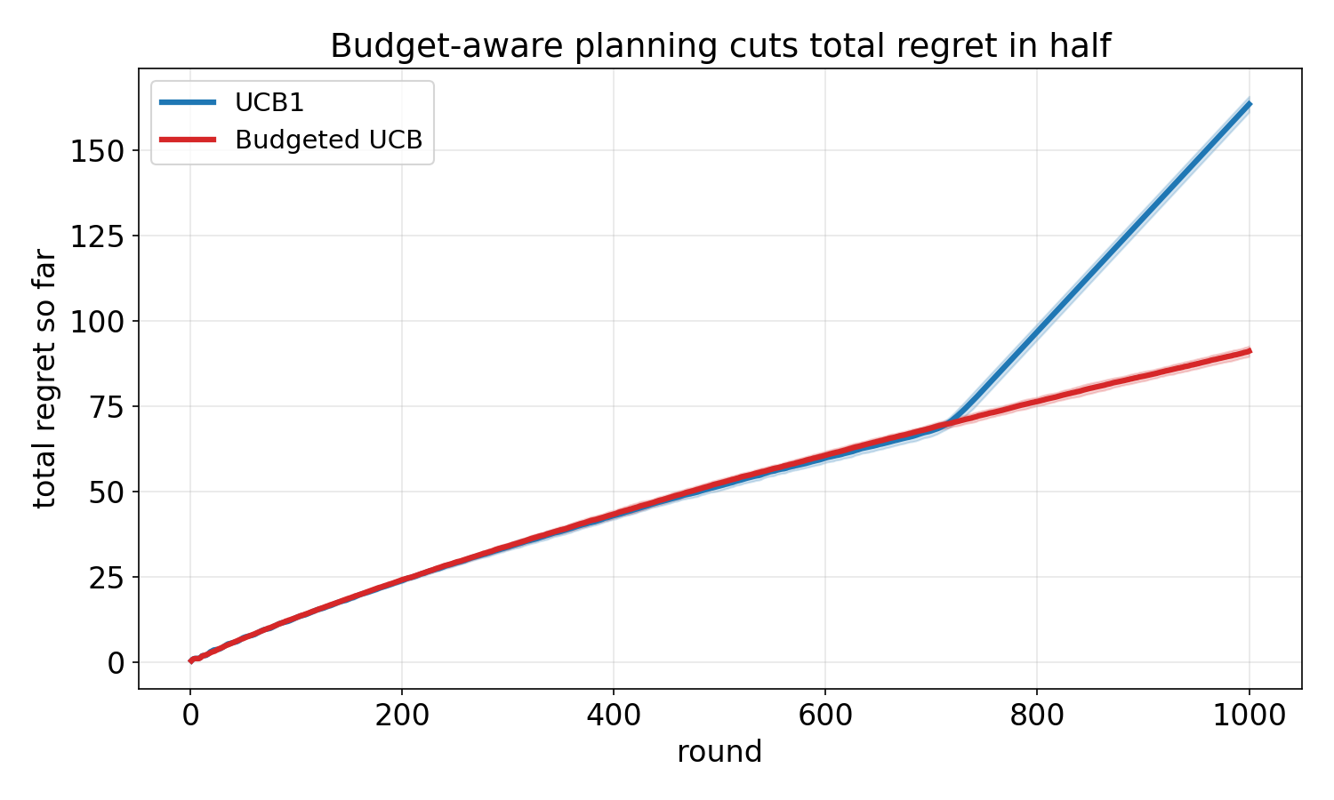
Experiment 1 — Does Budget Pacing Matter?
T = 1,000, B = 300, UCB1 vs. Budgeted UCB, averaged over 30 seeds
163.4 → 91.1
mean full-horizon regret
UCB1 vs. Budgeted UCB
UCB1 goes bankrupt at round 716 on average, having already committed 99.90% of its budget by then — it just isn't thinking about the budget at all. Budgeted UCB uses 99.95% of its budget too, but spreads it across the full 1,000 rounds instead of front-loading it, so it never stops playing.
Once every missed round is fairly charged at the full benchmark rate, that difference alone roughly halves total regret — and it isn't because Budgeted UCB is smarter about which bid is best. It's the same exploration rule; it just doesn't die halfway through the campaign.
Requirement 1 — Single-Campaign Stochastic Bidding

Slide 8
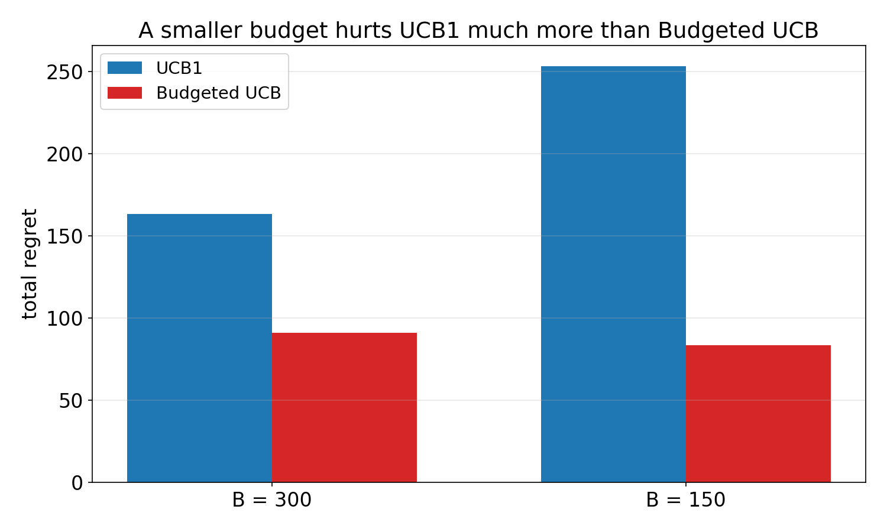
Experiment 2 — What Happens When Money Is Tighter?
Same setup, budget cut from 300 to 150
+55%
more regret for UCB1
when the budget is cut in half
Cutting the budget in half roughly halves how long UCB1 survives — bankruptcy now hits around round 357 on average instead of 716, and its full-horizon regret climbs to 253.3.
Budgeted UCB still finishes all 1,000 rounds, and its regret actually comes out a touch lower here (83.6 vs. 91.1) — not because it performs better in absolute terms, but because the achievable benchmark itself is lower under a tighter budget (0.267 vs. 0.325 reward per round), so there's simply less regret left on the table to accumulate against a weaker target.
The bottom line: UCB1's blindness to the budget gets punished harder exactly when the budget is tight, while Budgeted UCB's LP pacing just re-solves for a smaller rate and keeps going.
Requirement 1 — Single-Campaign Stochastic Bidding

Slide 9
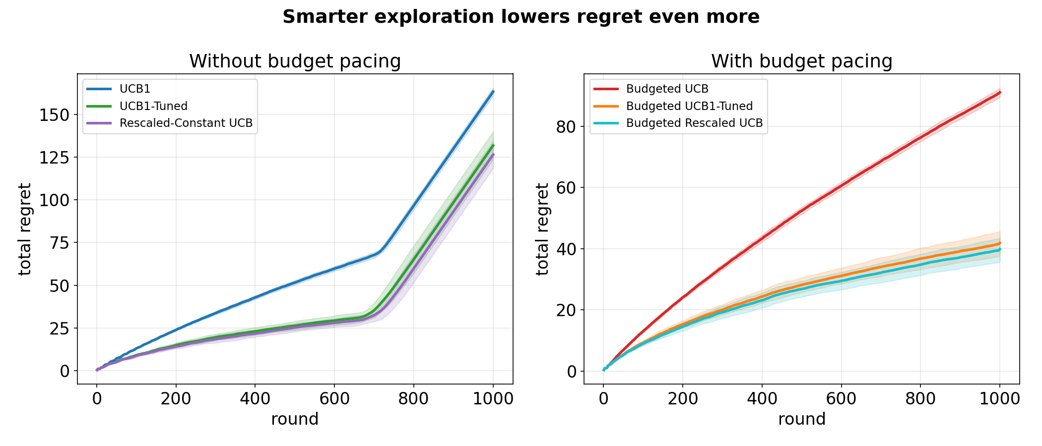
Experiment 3 — Does Smarter Exploration Help Too?
T = 1,000, B = 300, UCB1-Tuned and Rescaled-Constant UCB vs. their plain counterparts
Algorithm | Budget-aware? | Mean full-horizon regret
UCB1 | No | 163.4
UCB1-Tuned | No | 131.9
Rescaled-Constant UCB | No | 126.6
Budgeted UCB | Yes | 91.1
Budgeted UCB1-Tuned | Yes | 41.9
Budgeted Rescaled-Constant UCB | Yes | 39.8
Requirement 1 — Single-Campaign Stochastic Bidding

Slide 10
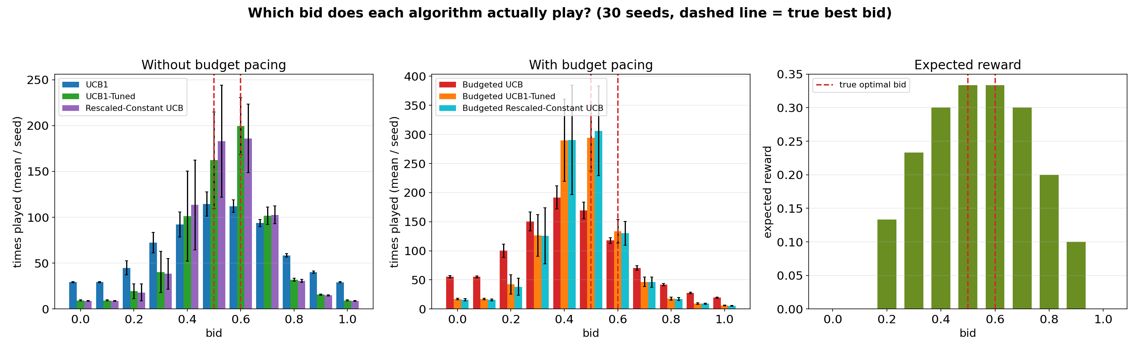
What Bid Does Each Algorithm Actually Learn?
1,000 rounds, budget = 300, all six algorithms, averaged over 30 runs
The true best bid is 0.5, tied exactly with 0.6 (both give expected reward 1/3 on this discrete grid). Without budget pacing, UCB1-Tuned and Rescaled-Constant UCB land on that tied-optimal set about 51.7% of the time, versus 31.6% for plain UCB1; the same gap shows up with budget pacing too (42.8% and 43.6% vs. 28.7%). A uniform-random bidder would land on it only 9.1% of the time, so all six algorithms are clearly learning — the tuned and rescaled variants are just converging on the same answer with a tighter, more confident distribution, which is the direct mechanism behind their lower regret.
Requirement 1 — Single-Campaign Stochastic Bidding

Slide 11
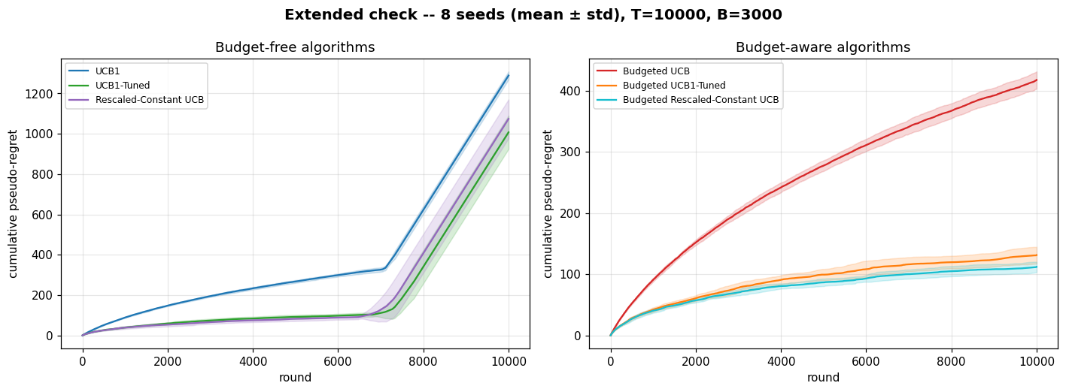
Extended Check — Is Regret Actually Sublinear?
Same ratio (B/T = 0.3), scaled 10x: T = 10,000, B = 3,000, 8 seeds
At T = 1,000 it's genuinely hard to tell by eye whether regret is growing sublinearly. Scaled up 10x, the budget-free algorithms trace a clearly concave, flattening curve for about the first 7,100 rounds before kinking into a straight-line ramp once they run out of budget — the same fair full-horizon accounting used everywhere else, not a sign they stopped learning. The budget-aware algorithms never hit that wall: their curves stay concave the entire way to round 10,000, ending around 417 (Budgeted UCB), 131 (Budgeted UCB1-Tuned), and 112 (Budgeted Rescaled-Constant UCB) — a much smaller regret per round than at T = 1,000, which is exactly the sublinear signature we were looking for.
Requirement 1 — Single-Campaign Stochastic Bidding

Slide 12
All Six Algorithms, Side by Side
Algorithm | Budget | Stopped early | Mean rounds played | Mean full-horizon regret (± std)
UCB1 | 300 | 30 / 30 | 716.1 | 163.4 (± 2.32)
Budgeted UCB | 300 | 0 / 30 | 1000.0 | 91.1 (± 1.54)
UCB1-Tuned | 300 | 30 / 30 | 700.4 | 131.9 (± 8.06)
Rescaled-Constant UCB | 300 | 30 / 30 | 713.5 | 126.6 (± 8.01)
Budgeted UCB1-Tuned | 300 | 0 / 30 | 1000.0 | 41.9 (± 4.05)
Budgeted Rescaled-Constant UCB | 300 | 0 / 30 | 1000.0 | 39.8 (± 3.98)
UCB1 | 150 | 30 / 30 | 356.8 | 253.3 (± 1.22)
Budgeted UCB | 150 | 0 / 30 | 1000.0 | 83.6 (± 1.60)
All budget-free algorithms go bankrupt before round 1,000 despite sharing the same budget and horizon, because each exploration rule bids differently and so spends down its budget at a different rate; every budget-aware algorithm paces itself via the LP each round and reliably reaches round 1,000 with budget to spare. All numbers are averaged over 30 seeds (1,000-round rows) except the extended check on the previous slide, which used 8 seeds at T = 10,000.
Requirement 1 — Single-Campaign Stochastic Bidding

Slide 13
Conclusions
1
Budget awareness matters more than almost anything else
Plain UCB1 loses the vast majority of its full-horizon regret simply to going bankrupt and stopping mid-campaign, not to picking worse bids. Budgeted UCB's LP-based pacing fixes that on its own, before any change to the exploration rule — roughly halving regret at B=300 and keeping it essentially flat as the budget tightens.
2
Smarter exploration adds a real, separate improvement
UCB1-Tuned and Rescaled-Constant UCB both converge to the tied-optimal bid {0.5, 0.6} faster than canonical UCB1, cutting regret by roughly 20% without budget pacing and by more once pacing is added — the two improvements stack because they solve different problems.
3
The sublinear-regret story holds up at scale
Scaling the test 10x (T=10,000, B=3,000, same B/T ratio) shows the budget-aware algorithms' regret curves stay concave the entire way, confirming genuine convergence rather than a short-horizon artifact.
Requirement 1 — Single-Campaign Stochastic Bidding

