Slide 1
REQUIREMENT 2
COMBINATORIAL UCB
for multi-campaign bidding

Slide 2

Goal & Setting
First the aim and the objects; then the rules, the benchmark, the algorithm, the results
01 · THE SETTING
5 campaigns, 1000 rounds, 1 budget
We run N = 5 advertising campaigns for T = 1000 rounds, sharing one budget B = 850. Each round, every campaign we enter is a first-price auction against a rival bid drawn from a Gaussian: per-campaign means (0.44 to 0.60), std 0.1, clipped to [0,1] so it stays a valid bid (formula below).
02 · THE MOVES
Arms and super-arms
An arm is one (campaign, bid) pair, bids on the grid {0, 0.1, ..., 1}: 55 arms in total. A super-arm is the set of campaigns played in one round, one bid each. A conflict graph forbids some pairs: next slide.
03 · THE GOAL
Max reward, budget safe
A win earns v = 1 and costs the bid. The aim: maximize total reward over the 1000 rounds, never exceed the budget (0.85 per round on average; results over 20 seeds), always play allowed super-arms.
OBJECTIVE
In one line: earn as much as possible, never exceed the budget, never play a forbidden pair.
REQ 2 · COMBINATORIAL UCB
2/18

Slide 3
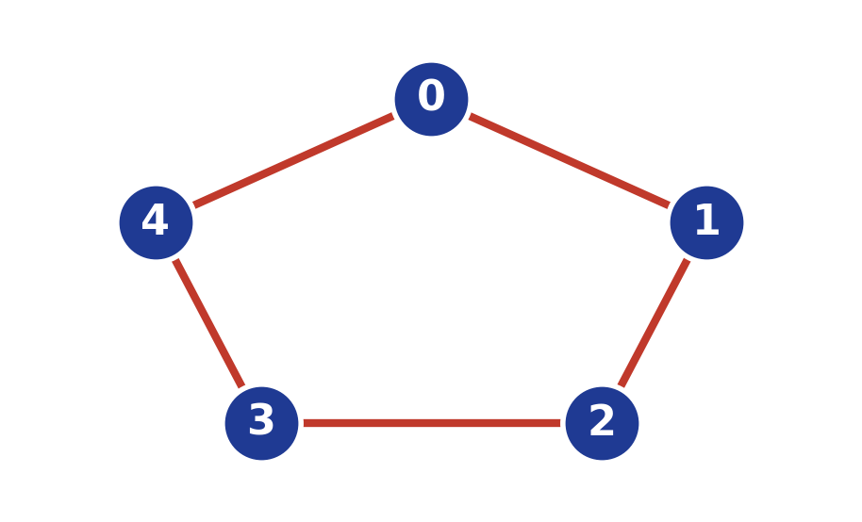
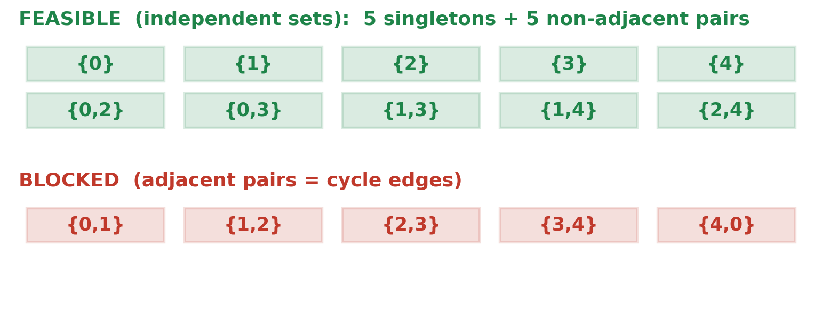
Conflict Graph
Rule one, the graph: only conflict-free sets of campaigns can be played
01 • GRAPH
V = {0,1,2,3,4}, E = 5-cycle
Vertices are the campaigns; an edge joins two that cannot be served together. The five edges form a cycle 0-1-2-3-4-0, so each campaign conflicts with its two neighbours.
02 • FEASIBILITY
{i,j} ⊄ S for every edge
A super-arm S is playable only if it is an independent set of the graph: it must contain no conflicting pair, for every edge (i,j) ∈ E.
03 • EFFECT
10 feasible super-arms
On a 5-cycle the independent sets are the 5 singletons plus the 5 non-adjacent pairs, so 10 non-empty super-arms remain feasible.
FEASIBLE (GREEN) VS BLOCKED (RED) SUPER-ARMS
Forbidden: adjacent pairs (the 5 cycle edges)
Allowed: ∅, 5 singletons, 5 non-adjacent pairs
REQ 2 · COMBINATORIAL UCB
3/18

Slide 4
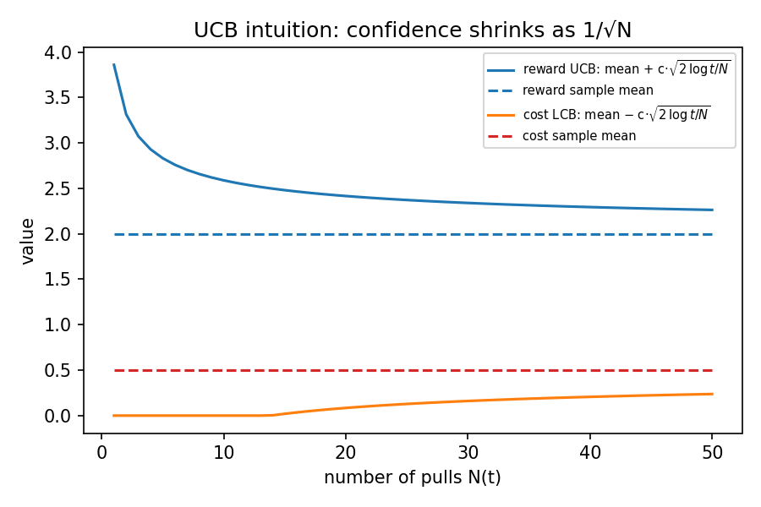
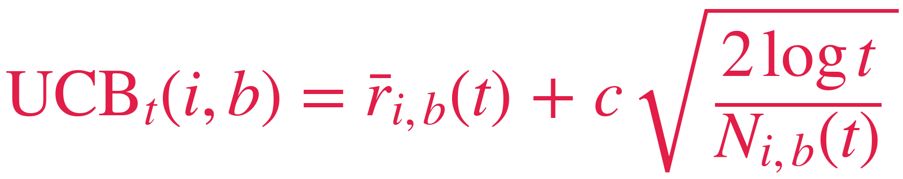
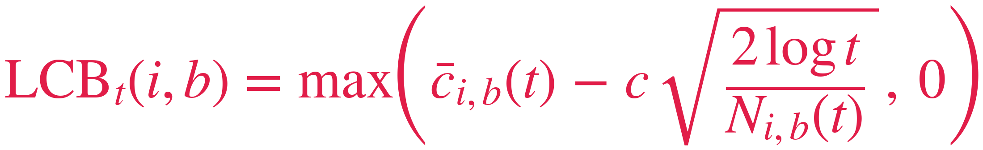
The Algorithm
Our answer: learn at ARM level, decide at SUPER-ARM level
01 · WARM-UP (ROUNDS 1-55)
Arms play alone
Each of the 55 arms is played once, as a singleton, so every arm gets one real observation. No sets yet: this phase is pure arm level.
02 · EACH ROUND · ARM LEVEL
Score every arm
Every arm gets two scores from its own history: UCB = average reward + w (optimistic) and LCB = average cost − w (careful). The bonus w shrinks as the arm is tried. Formulas below.
03 · EACH ROUND · SUPER-ARM LEVEL
Combine and play
Here the sets enter the game: every feasible set is scored by SUMMING the UCBs of its arms; sets failing the three budget checks are dropped; we play the argmax, usually a non-adjacent pair.
04 · AFTER THE ROUND
Update the arms
We observe win/lose for each campaign played, never the rival bid (semi-bandit): untried bids teach us nothing, which is why we must explore. We update ONLY the played arms
CONFIDENCE WIDTH SHRINKS AS 1/√N(T)
REWARD INDEX (UPPER CONFIDENCE)
Optimism makes the learner explore under-sampled but potentially profitable arms.
COST INDEX (LOWER CONFIDENCE)
Pessimism on cost stops a few lucky cheap rounds from fooling the budget filters.
REQ 2 · COMBINATORIAL UCB
5/18

Slide 5
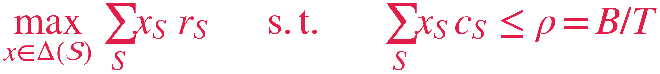
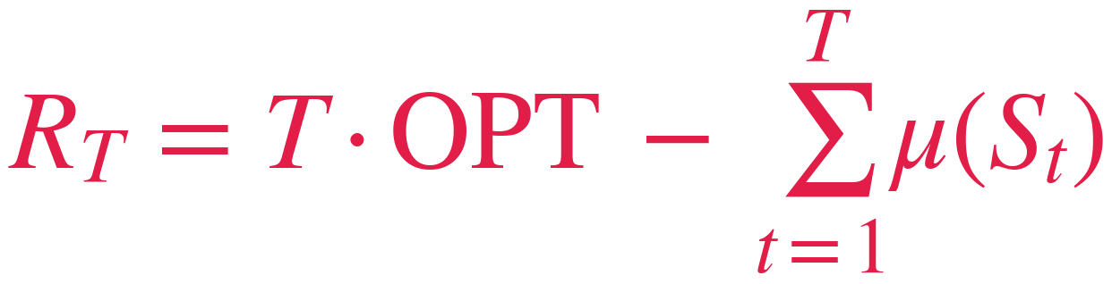
Clairvoyant & Regret
The yardstick: the best mixed policy that fits the budget rate
1 · FULL KNOWLEDGE
2 · LINEAR PROGRAM
3 · VALUE
The clairvoyant knows the true market distribution, so for every (campaign, bid) it computes the exact expected reward (v − b) · p(b) and cost b · p(b): it is handed the table the learner must estimate from wins and losses.
The variables x(S) form a distribution over feasible super-arms: the LP finds the best mix whose expected per-round cost stays within ρ = B/T = 0.85, so expensive rounds can be balanced by cheap ones.
OPT = 0.705 per round
The best fixed super-arm within the cap reaches 0.65 (the cheapest pair {0,2}). The 0.053 difference is the value of mixing: a structural gap that no policy playing one super-arm per round can close.
PSEUDO-REGRET
The comparator r★ = OPTˢ is the per-round optimum of the budgeted problem (Bandits with Knapsacks). The pseudo-regret is measured on expected rewards, so it is non-negative and monotone non-decreasing: sub-linear growth means the learner is converging.
REQ 2 · COMBINATORIAL UCB
4/18

Slide 6
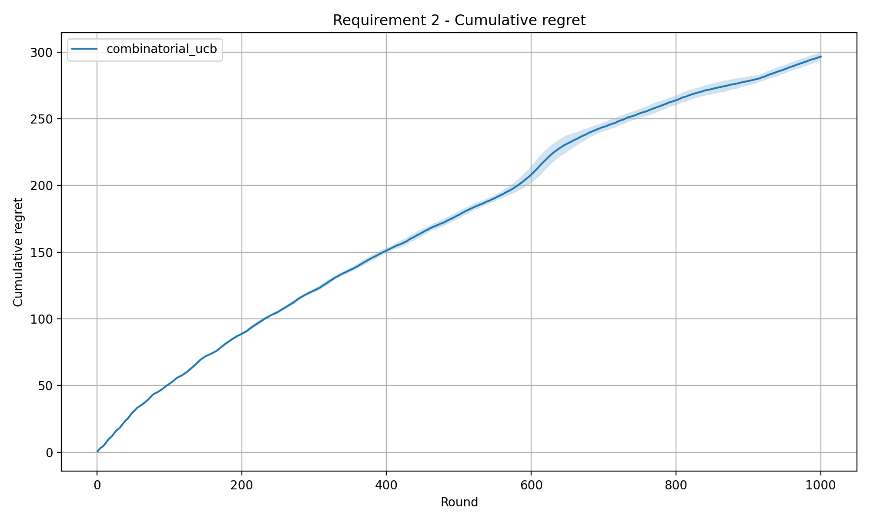
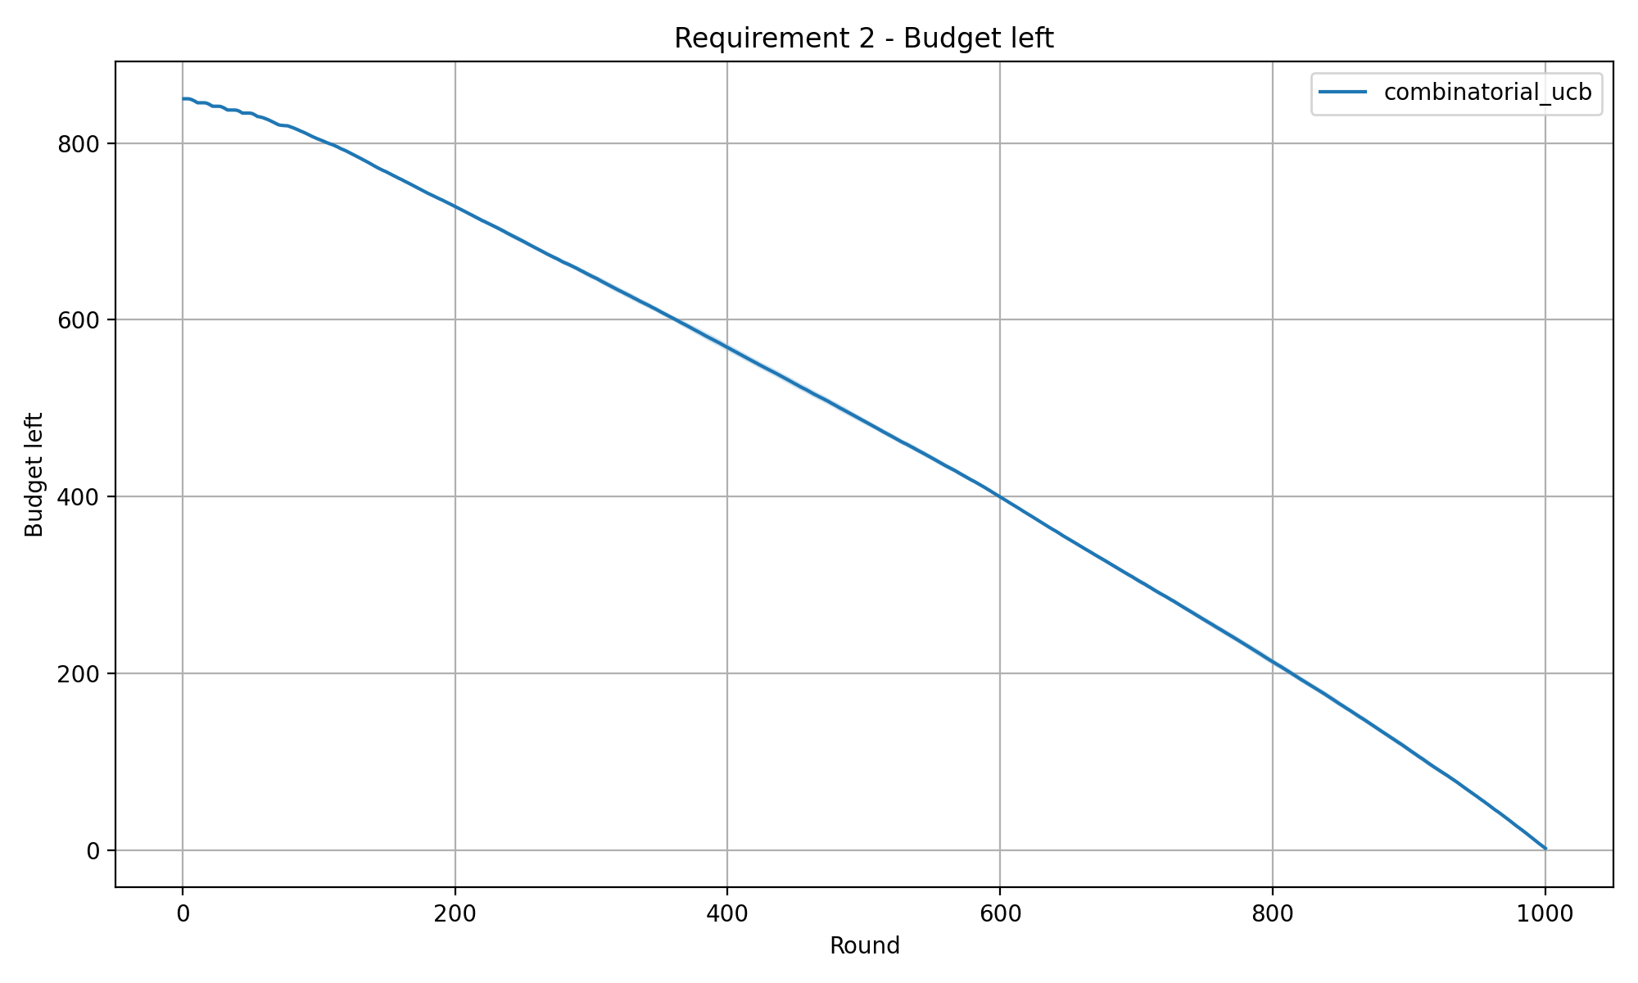
Results
The verdict: sub-linear regret, and a hard cap never crossed
CUMULATIVE PSEUDO-REGRET VS CLAIRVOYANT (LP)
BUDGET REMAINING OVER TIME
READING
Left: the regret ends at 296.7 ± 3.0 and grows sub-linearly: steep while exploring, then it flattens as the arms are learned. Right: the budget falls smoothly to 1.9 unused out of 850, and the hard cap is never crossed on any of the 20 seeds. Final reward 405.3 ± 6.9. Req2 is the stochastic baseline that Requirements 3 and 4 build on.
REQ 2 · COMBINATORIAL UCB
6/18

Slide 7
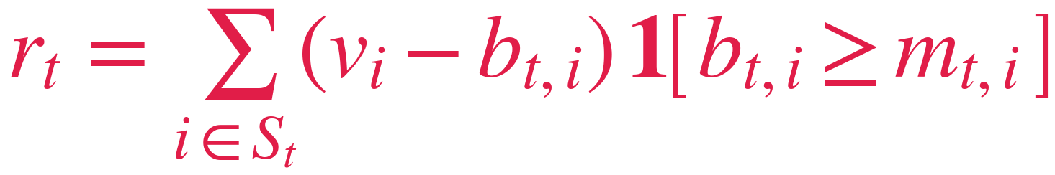
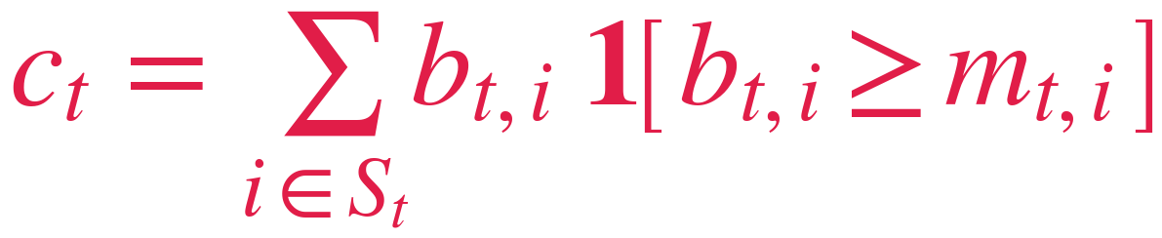
Backup · Auction mechanics
Rule two, the auction: first-price, and we only observe win or lose (semi-bandit)
1 · CHOOSE
sum UCBs, pick best set
2 · MARKET
rivals sample bids
3 · OUTCOME
win if bid ≥ rival
4 · UPDATE
refresh played arms
THE ROUND, STEP BY STEP
REWARD (SURPLUS ON WINS)
COST (FIRST-PRICE)
1. CHOOSE: score every arm (UCB for reward, LCB for cost), sum the scores over each feasible set, drop the sets that break the budget, and play the best one.
2. MARKET: draws the rival bids.
3. OUTCOME: you win a campaign where your bid ≥ the rival’s, and you pay your own bid.
4. UPDATE: you see only win/lose per played campaign and refresh those arms; the rival bid stays hidden, so this is semi-bandit.
The indicator 𝟙[·] is 1 only when you win. The surplus v_{i} − b_{t,i} is positive only when you bid below the campaign value, so it rewards winning cheaply rather than just winning.
Auctions are first-price: on every win you pay exactly your own bid b_{t,i}. A higher bid raises the win probability but also the price, which is the core tension the learner must balance.
REQ 2 · COMBINATORIAL UCB
7/18

Slide 8
Backup · Takeaways
What to remember: it learns, it obeys the graph, it never overspends
01 • LEARNING
Fast convergence
CUCB estimates each arm from semi-bandit feedback and quickly shifts from exploration to exploitation, so the reward curve climbs early and then steadily improves over the horizon.
02 • FEASIBILITY
Graph enforced
The conflict graph is checked at selection time, so an infeasible super-arm is never played, not even once across all 20 seeds and 1000 rounds.
03 • BUDGET
No overspend
The rate cap, pacing guard and affordability filter act together so the budget is almost fully used yet the hard cap is never exceeded on any run.
FINAL TAKEAWAY
Req2 is the stochastic baseline for everything that follows: CUCB maximizes reward while respecting campaign incompatibilities and pacing a finite budget safely over T rounds. Its pseudo-regret against the clairvoyant LP optimum stays non-negative and grows sub-linearly, flattening as the learner converges to the best feasible super-arm.
REQ 2 · COMBINATORIAL UCB
8/18

Slide 9
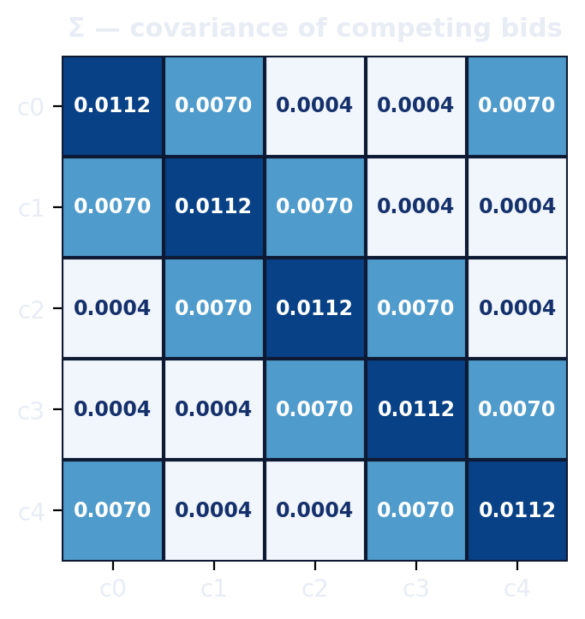
Backup · Experiment setup in detail
The test bench: 1000 rounds, budget 850, 20 seeds, 11 bids
HORIZON
T = 1000
rounds
CAMPAIGNS
N = 5
5-cycle (5 edges)
BUDGET
B = 850
ρ = 0.85
SEEDS
20
mean ± std
BIDS
11
0.0 to 1.0
ENVIRONMENT
AGGREGATION
Every campaign has a common value v_{i} = 1.
Rival bids have per-campaign means from 0.44 to 0.60 with std σ = 0.1: the cheapest markets, campaigns 0 and 2, form the best pair. Each conflicting pair on the 5-cycle carries a strong edge correlation α = 0.8.
All curves are the mean ± std over 20 independent random seeds.
Each series is carried to the full horizon T even when the budget is depleted early, so the runs stay directly comparable, and the shaded bands in every plot show the spread across the 20 seeds.
REQ 2 · COMBINATORIAL UCB
9/18

Slide 10

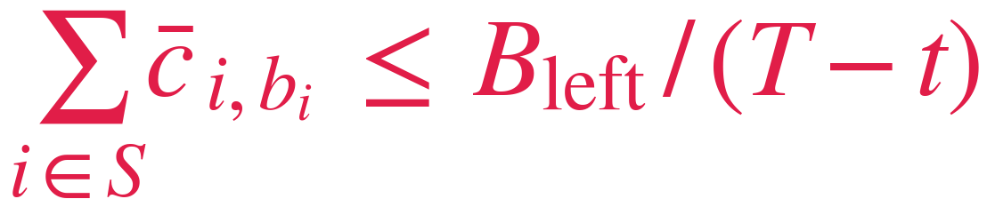

Backup · The three budget filters
Three budget checks before any bid is placed
1 · RATE CAP
2 · PACING GUARD
3 · AFFORDABILITY
Using a pessimistic (lower-confidence) cost keeps the expected per-round spend within the average rate ρ. This is the long-run pacing target that must hold on a typical round.
A dynamic check that re-budgets on the fly: it adapts to how much money is still available and how many rounds are still left, tightening near the end of the run.
The final hard constraint on the actual bids placed this round: they can never exceed the remaining budget, so the cap is guaranteed and not merely expected.
WHY THREE FILTERS TOGETHER
Rate cap on estimates · pacing on money left · affordability on real bids
All three checks act on the whole set, summing over its members: the rate cap on pessimistic cost estimates, the pacing guard on the money actually left, affordability on the real bids. Estimates can be wrong, money cannot: the hard cap was never violated on any of the 20 seeds.
REQ 2 · COMBINATORIAL UCB
10/18

Slide 11

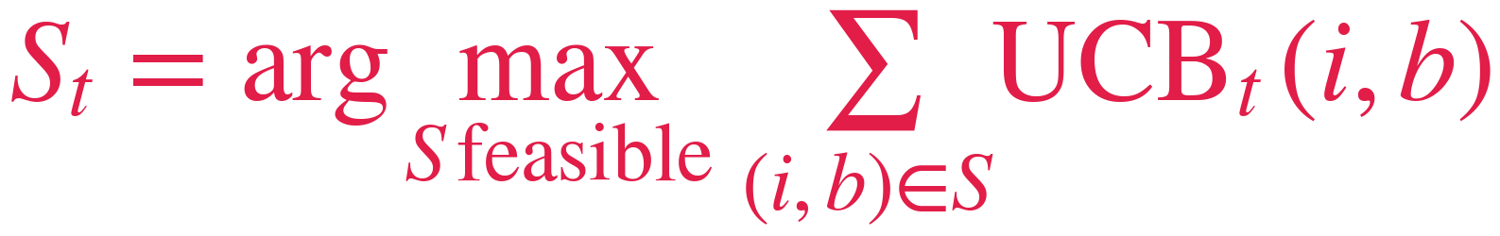

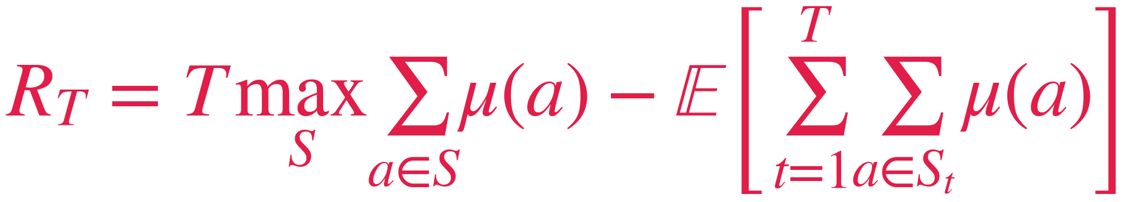
Backup · Why optimism works
The theory behind UCB and regret, as in the course
1 · CONFIDENCE
2 · OPTIMISM
3 · GUARANTEE
After N pulls, Hoeffding bounds the error of the empirical mean. With width w = c sqrt(2 log t / N) every arm stays inside its confidence interval for the whole run, with high probability, and the interval shrinks as 1 / sqrt(N).
Play the feasible super-arm with the highest sum of upper bounds. Either the optimistic guess is right and we exploit, or it is wrong and the pulled arm shrinks its interval: both outcomes improve the next decision. Exploration without randomness.
Course theorem: Combinatorial-UCB has instance-dependent logarithmic pseudo-regret against the best fixed super-arm, so R over T goes to zero. The constant C explodes when the reward gaps are small (here down to 0.04), which motivates tuning c.
PSEUDO-REGRET, COURSE DEFINITION
Measured on expected values, not realized rewards, so noise cannot hide the trend. In our budgeted problem the comparator is strengthened from the best fixed super-arm to the LP clairvoyant of the previous slide, which can also mix.
REQ 2 · COMBINATORIAL UCB
11/18

Slide 12
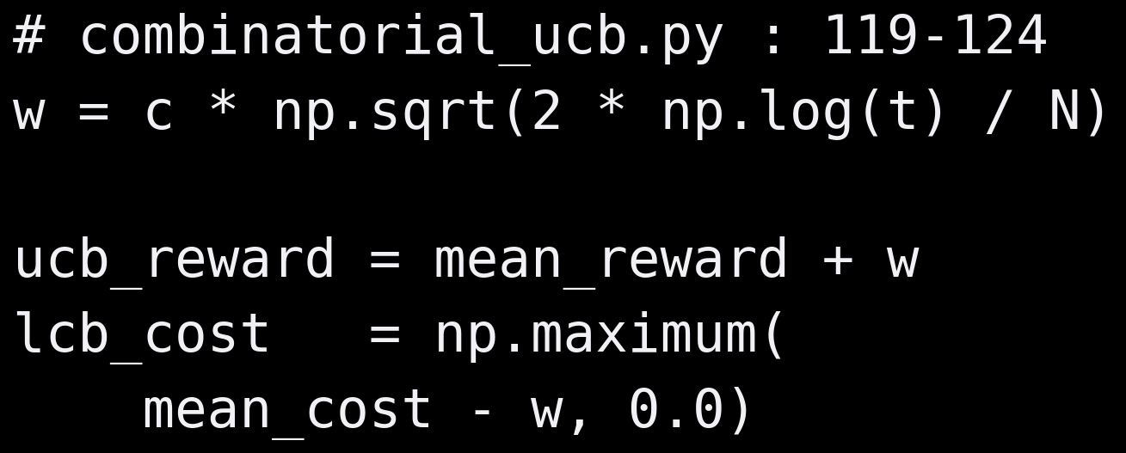
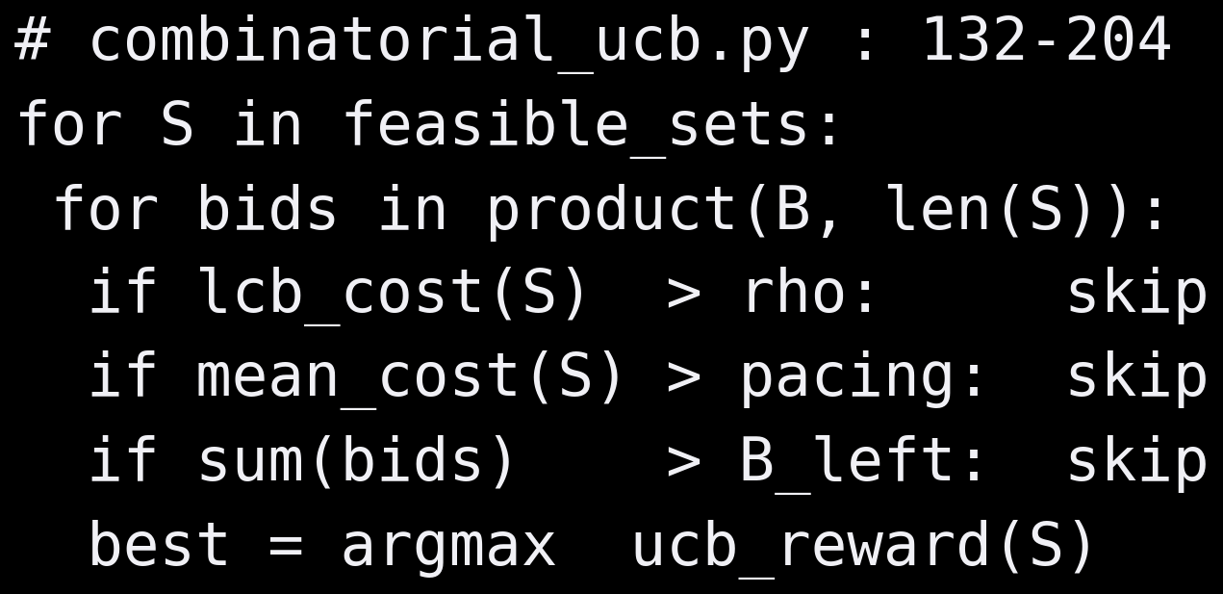
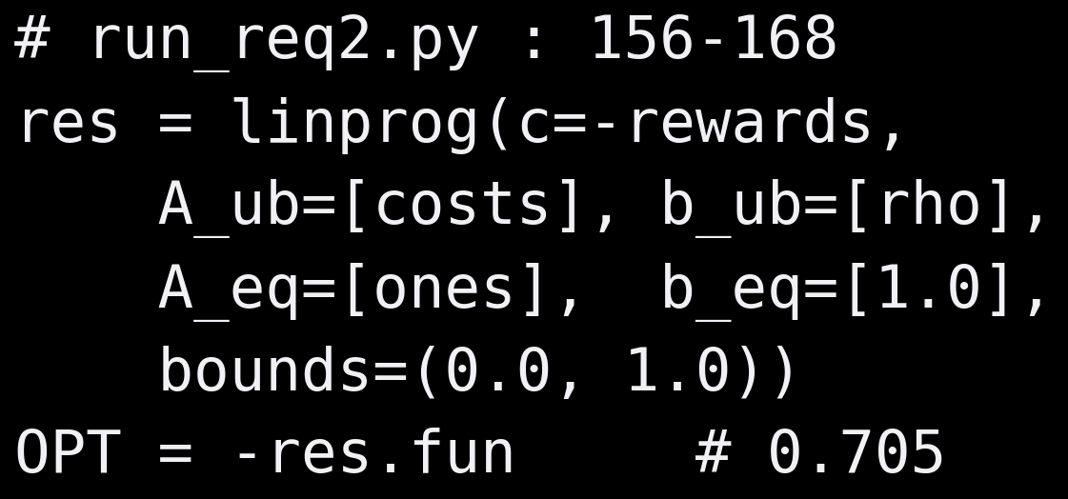
Backup · Inside the code
The three blocks that implement everything shown so far
INDICES · UCB / LCB
ORACLE + BUDGET FILTERS
CLAIRVOYANT LP
READING
55 arms learned in one vectorized step, 660 candidates scored each round, one LP
The indices update in a single NumPy step; the oracle enumerates every feasible (set, bids) pair and applies the three budget filters before the argmax; the LP is solved once at start-up. All of it is covered by tests (feasibility, budget safety, warm-up, benchmark dominance): full suite 33/33 passing.
REQ 2 · COMBINATORIAL UCB
12/18

Slide 13
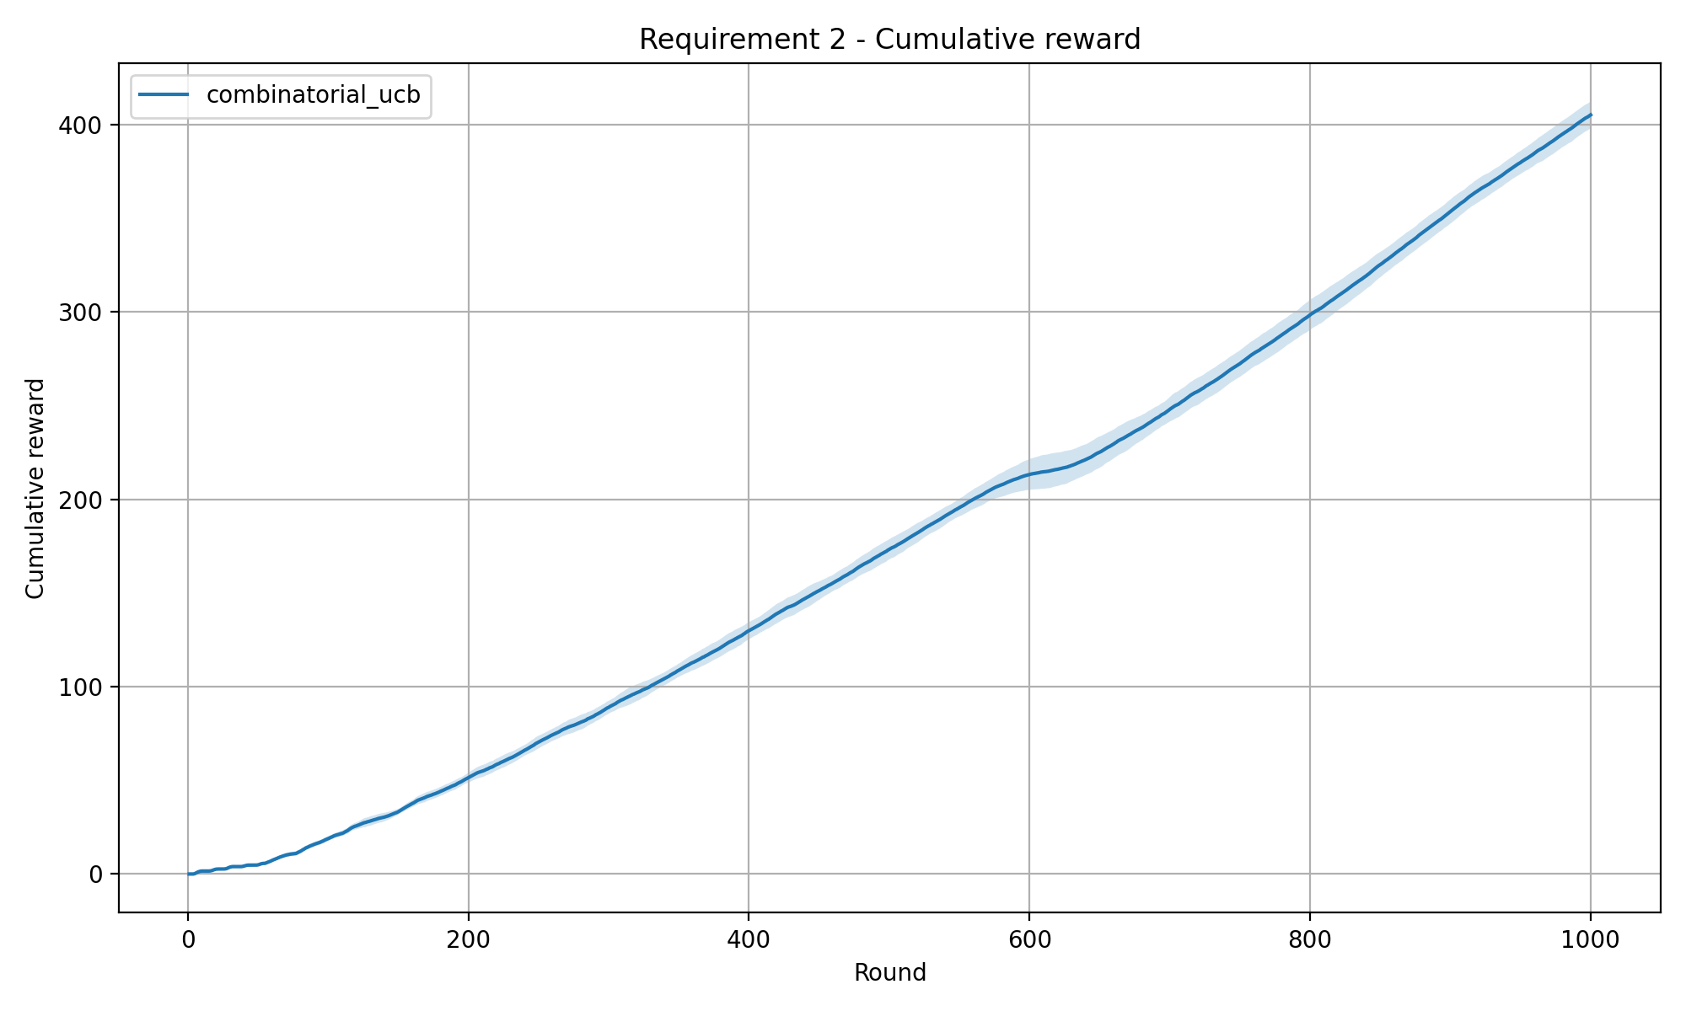
Backup · Reward & regret in detail
An exploration phase, then exploitation once the arms are learned
CUMULATIVE REWARD (MEAN ± STD)
CUMULATIVE PSEUDO-REGRET VS. CLAIRVOYANT (LP)
READING
Final reward 405.3 ± 6.9. Against the clairvoyant LP optimum the cumulative pseudo-regret stays non-negative and grows sub-linearly to +296.7 ± 3.0: the curve is steep early and flattens once the arms are learned, with a final slope about a quarter of the initial one. The residual slope reflects the mixing clairvoyant benchmark, which a single super-arm per round cannot fully match.
REQ 2 · COMBINATORIAL UCB
13/18

Slide 14
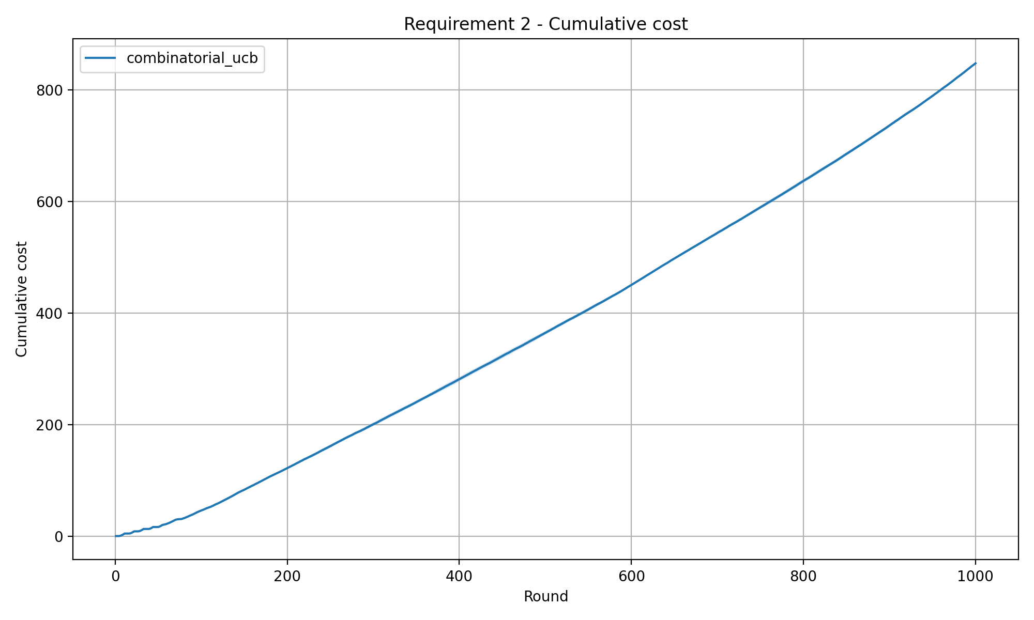
Backup · Budget usage in detail
The key Req2 safety check: spend it all, but stay under the cap
CUMULATIVE COST (MEAN ± STD)
BUDGET REMAINING OVER TIME
READING
Mean cost 848.0 ± 1.9 against a budget of 850, ending with only 1.9 ± 1.9 units unused. The budget is paced smoothly and almost fully across the horizon, and the hard cap is never violated on any of the 20 seeds, exactly the behaviour the three filters are designed to guarantee.
REQ 2 · COMBINATORIAL UCB
14/18

Slide 15
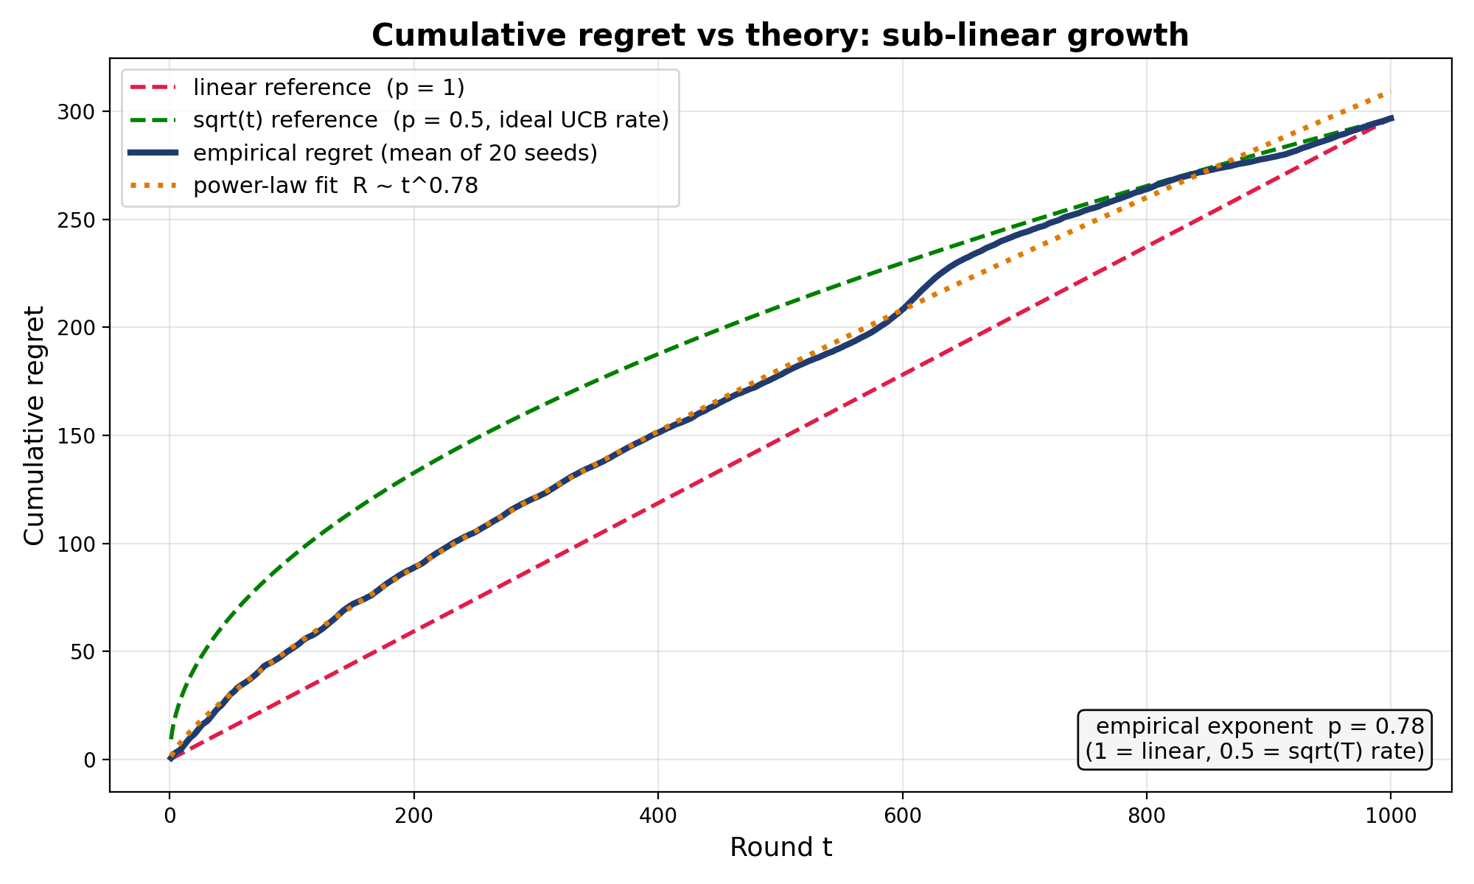
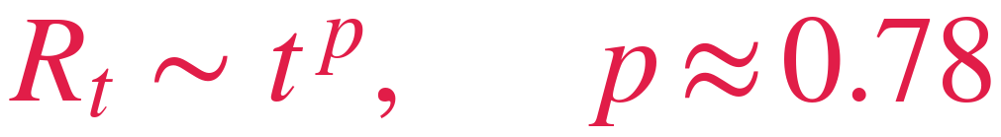
Backup · Is the regret sub-linear?
Comparing the measured curve with the theoretical growth rates
MEASURED REGRET VS REFERENCE GROWTH RATES
COURSE THEOREM
Combinatorial-UCB has logarithmic instance-dependent pseudo-regret against the best fixed super-arm; the constant C depends on the instance and can be arbitrarily large (here: 55 arms, small reward gaps).
MEASURED
Clearly sub-linear (p = 1 would be linear). Why not 0.5? The LP clairvoyant may alternate expensive and cheap sets so that costs only average 0.85; we play one set per round under a hard cap, so our ceiling is the best fixed set: 0.65 vs 0.705. That fixed 0.053 per round, about 53 of the 297, is a design choice, not a learning failure.
REQ 2 · COMBINATORIAL UCB
15/18

Slide 16
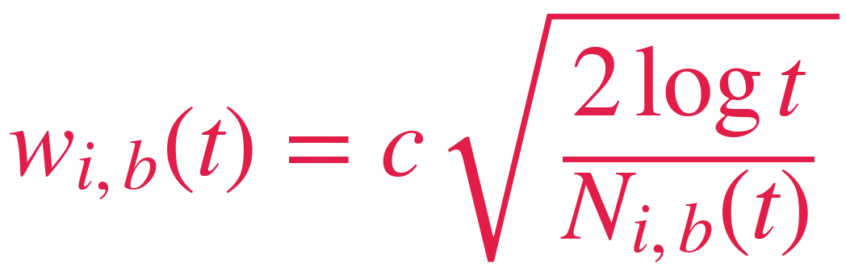
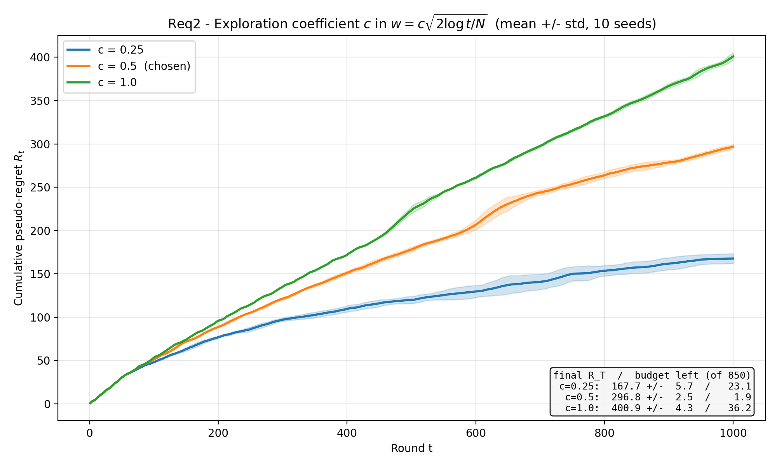
Backup · Choosing the exploration coefficient c
A deliberately conservative exploration, and why the textbook c = 1 fails here
CUMULATIVE PSEUDO-REGRET FOR c IN {0.25, 0.5, 1.0}
ROLE IN THE ALGORITHM
Every round the oracle plays the feasible super-arm maximizing Σ (mean + w), so the bonus enters every single selection: c scales how strongly under-sampled arms are favoured. It rescales the confidence width to the true reward scale (max 0.38, not 1).
SWEEP & CHOICE
c: 0.25 / 0.5 / 1.0 ⇒ R_T: 168 / 297 / 401
The textbook bonus is calibrated for rewards spanning [0,1]; here the best arm pays 0.38, so with c = 1 optimism dominates every index and exploration never ends within T = 1000 (regret 401, near-linear). We pick the conservative middle c = 0.5: enough to converge in time, without over-tuning to this instance like c = 0.25, which risks locking on a wrong arm when gaps are smaller.
REQ 2 · COMBINATORIAL UCB
16/18

Slide 17
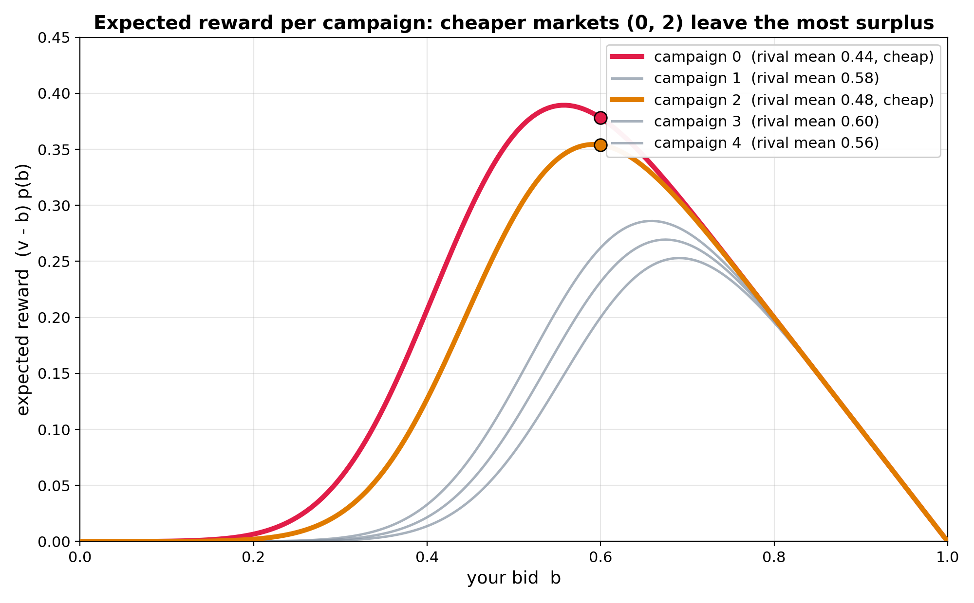
Backup · The bidding trade-off
Each campaign faces a different market: the cheapest, 0 and 2, leave the most surplus
STOCHASTIC MARKET MODEL
EXPECTED REWARD (v - b) p(b) FOR ALL 5 CAMPAIGNS
m̃_{t} ∼ 𝒩(μ, Σ), m_{t} = clip_{[0,1]^N}(m̃_{t})
Rival bids are drawn from a Gaussian and then clipped to [0,1]. Here μ = (0.44, 0.58, 0.48, 0.60, 0.56) and σ = 0.1, and conflicting pairs on the 5-cycle are correlated, α = 0.8, so their markets move together.
EXPECTED REWARD & COST
𝔼[r | b] = (v_{i} − b) · p_{i}(b), 𝔼[c | b] = b · p_{i}(b)
with win probability p_i(b) = P(b >= m_i). Each curve is hump-shaped (win more but keep less surplus), and the cheapest campaigns 0 and 2 peak highest (0.38 and 0.35 at bid 0.6), which is exactly why the best pair is {0,2}.
REQ 2 · COMBINATORIAL UCB
17/18

Slide 18
Backup · Summary statistics
The 20-seed run summarised in numbers
20-SEED SUMMARY
REWARD STABILITY
The reward std is ≈ 1.7% of the mean, a tight variance for a stochastic bandit run all the way to T = 1000.
It tells us the good performance is systematic, not a lucky seed.
Metric
Mean
Std
Min
Max
Cumul. reward
405.26
6.94
391.10
416.00
Cumul. cost
848.05
1.85
843.90
850.00
COST STABILITY
Cumul. regret
296.66
3.02
291.71
302.05
A cost std of ≈ 1.9 against an 850 budget shows the pacing logic behaves consistently across every seed.
Spending is reproducible and never overshoots the cap.
Budget left
1.95
1.85
0.00
6.10
REQ 2 · COMBINATORIAL UCB
18/18

