Slide 1
Notation
Symbols are formatted exactly as they appear in the model and update rules.
T
horizon; T = 3000 rounds
N
number of campaigns; N = 5
G
finite bid grid: {0.0, 0.1, ..., 1.0}
|G|
number of bid levels; |G| = 11
b_{t}
bid vector selected at round t
m_{t}
highest-competing-bid vector at round t
v_{i}
campaign i value; normalized to 1
λ_{t}
dual price controlling expenditure at round t
1

Slide 2
Shared non-stationary market environment
sKL controls how different regimes are; frequency controls how often the regime changes.
1. Three Gaussian modes
2. Separation between modes
z_{t} ∈ {0, 1, 2}, m_{t} ~ N(μ_{zₜ}, Σ_{zₜ})
sKL(P_{a}, P_{b}) ∈ {20, 200, 500}
Each mode is a 5-dimensional distribution of competing bids.
Larger sKL means a more visible distribution shift.
3. Stochastic mode switching
4. Freeze the realized market
Pr(z_{t} ≠ z_{t−1}) = p
M = [m₁, ..., m_{T}]⊤ ∈ [0, 1]^{3000×5}
p = 1/1500, 1/200, or 1/25; larger p gives more change points.
Once sampled, this exact matrix is reused by every algorithm.
EXAMPLE PATH
Mode 0
Mode 2
Mode 1
Mode 0
round
5

Slide 3
Experiment setting
Fixed parameters and the 3 x 3 grid used for the Req3 empirical evaluation.
SHARED BASE
SEPARATION SKL
CHANGE PROB. P
REPLICATIONS
T=3000, N=5
20 / 200 / 500
1/1500 / 1/200 / 1/25
R=10 per cell
B=2500; 11 bid levels
low, medium, high
low, medium, high frequency
90 runs in total
3 x 3 experimental grid
One cell = one setting with 10 shared realizations
Symmetric KL separation
sKL 20
sKL 200
sKL 500
p = 1/1500
10 realizations
10 realizations
10 realizations
low frequency
The learner receives the precomputed $m_{t}$ sequence; learner randomness does not regenerate $q_{t}$ or the market stream.
p = 1/200
10 realizations
10 realizations
10 realizations
medium frequency
p = 1/25
10 realizations
10 realizations
10 realizations
high frequency
The grid is designed to separate the effect of regime separation from the effect of change frequency.
3

Slide 4
One round of the auction model
A compact view of the action, feedback, utility, and cost at round t.
1. Choose bids
2. Observe market
3. Determine wins
b_{t} = (b_{t,1}, ..., b_{t,N})
m_{t} = (m_{t,1}, ..., m_{t,N})
b_{t,i} ≥ m_{t,i}
One bid for every campaign.
Highest competing bids.
Campaign i is won iff this holds.
Utility
Cost
u_{t}(b_{t}) = Σ_{i=1}^{N} (v_{i} − b_{t,i}) 1{b_{t,i} ≥ m_{t,i}}
c_{t}(b_{t}) = Σ_{i=1}^{N} b_{t,i} 1{b_{t,i} ≥ m_{t,i}}
Value minus payment, summed over won auctions.
Only won auctions consume budget.
c_{t}(b_{t}) ≤ Σ_{i=1}^{N} b_{t,i}
This worst-case upper bound enables a deterministic budget guarantee.
3

Slide 5
Conflict graph and feasible super-arms
Edges are incompatible campaign pairs; a super-arm is feasible only if it contains no edge.
0
Blocked
{0,1}, {1,2}, {2,3}, {3,4}, {4,0}
Adjacent campaigns cannot run in the same round.
4
1
Feasible
Singletons: {0}, {1}, {2}, {3}, {4}
Non-adjacent pairs: {0,2}, {0,3}, {1,3}, {1,4}, {2,4}
3
2
These 10 sets are the super-arms learned by the Req3 policy.
Forbidden pairs are the five cycle edges.
The learner and the oracle use the same feasible super-arm set, so regret is measured on the same action space.
4

Slide 6
Factorized primal-dual bid policy
One Hedge distribution over feasible super-arms plus one bid distribution per campaign.
1. Learn super-arms
2. Sample active bids
3. Build feasible action
S_{t} ~ q_{t}
b_{t,i} ~ p_{t,i}, i in S_{t}
b_{t,i} = 0 for i not in S_{t}
Choose one feasible singleton or non-adjacent pair.
Draw affordable bids only for active campaigns.
Inactive or conflicting campaigns are not served.
Super-arm weights
Bid weights
Budget safety
Hedge increases weight on campaign sets with higher penalized payoff.
Each campaign keeps its own distribution over the 11 bid levels.
Sampling is filtered by the remaining budget.
6

Slide 7
Primal-dual update
Primal weights learn useful bids; the dual price reacts to spending pressure.
1. Arm score
2. Hedge update
ℓ_{t,i}(g) = u_{t,i}(g) − λ_{t} c_{t,i}(g)
w_{t+1,i}(g) = w_{t,i}(g) exp(η ℓ̃_{t,i}(g))
Higher dual prices penalize expensive bids.
ℓ_{t,i}^{min} = min over h in G ℓ_{t,i}(h), ℓ_{t,i}^{max} = max over h in G ℓ_{t,i}(h)
ℓ̃_{t,i}(g) = (ℓ_{t,i}(g) - ℓ_{t,i}^{min}) / (ℓ_{t,i}^{max} - ℓ_{t,i}^{min})
Normalized high-score bids gain multiplicative weight.
3. Dual update
4. Interpretation
λ_{t+1} = Π_{[0,1/ρ]}(λ_{t} + η_{λ}(c_{t} − ρ))
If spending exceeds ρ, λ rises and costly bids become less attractive. Below ρ, the pressure can relax.
ρ = B / T
Projection keeps the multiplier bounded.
Full-information feedback: after observing m_{t}, every campaign-bid arm can be evaluated.
8

Slide 8
Hard budget filter
The dual update encourages control; the feasibility filter provides the guarantee.
Before sampling
Why it is safe
Fallback action
Σ_{i=1}^{N} b_{t,i} ≤ B_{t}
c_{t}(b_{t}) ≤ Σ_{i=1}^{N} b_{t,i}
b_{t} = 0
Affordable under remaining budget B_{t}.
Only winning bids are actually paid.
Choose the zero vector if no positive bid is affordable.
Deterministic guarantee
Σ_{t=1}^{T} c_{t}(b_{t}) ≤ B
The filter is conservative, but cumulative realized spending can never exceed the total budget.
9

Slide 9
Algorithm: factorized primal-dual Hedge
Hedge-style primal update with a projected dual price for the budget constraint.
ALGORITHM
Input: feasible super-arms set 𝒜, bid grid 𝒢, budget B, rates η and ηλ
Primal update
1
Initialize q₁(S)=1/|𝒜|, p₁,ᵢ(g)=1/|𝒢|, and λ₁=0.
Same idea as Hedge in the lectures: normalize weights, then multiply by an exponential score factor.
2
For each round t = 1 to T:
3
Draw Sₜ ~ qₜ and bids gₜ,ᵢ ~ pₜ,ᵢ for active campaigns i ∈ Sₜ.
Dual update
4
Observe the full market vector mₜ and evaluate every campaign-bid arm.
Projected gradient step on the budget multiplier. If spending exceeds the target pace ρ, λ increases.
5
Compute Lagrangian scores: zₜ,ᵢ(g) = uₜ,ᵢ(g) − λₜ cₜ,ᵢ(g).
6
Aggregate super-arm score: Zₜ(S) = ∑ᵢ∈S z̄ₜ,ᵢ.
Full feedback
7
Hedge update: qₜ₊₁(S) ∝ qₜ(S) exp(η Zₜ(S)).
Because mₜ is observed, all campaign-bid scores are available. No EXP3 importance-weighted estimator is needed.
8
Bid update: pₜ₊₁,ᵢ(g) ∝ pₜ,ᵢ(g) exp(η zₜ,ᵢ(g)).
9
Dual update: λₜ₊₁ = Π[0,1/ρ](λₜ + ηλ(Cₜ − ρ)), with ρ=B/T.
z̄ₜ,ᵢ is the bid-level score summarized for campaign i when updating the super-arm distribution.
10
Apply the remaining-budget filter before the next draw.
The hard filter is a safety layer; the learning rule is the Hedge primal update plus projected dual update.
7

Slide 10
Current experiment setup
All numerical results from this point use the 3 x 3 grid with 10 realizations per cell.
HORIZON
CAMPAIGNS
BUDGET
BID GRID
3000 rounds
5
2500
0.0 to 1.0
Step 0.1; 11 bids
Learner
Reported metrics
Factorized primal-dual Hedge: one distribution over feasible super-arms and one bid distribution per campaign, with a dual price for spending.
Learner and oracle cumulative utility and cost, cumulative regret, dual multiplier, and mean +/- SD across 10 shared realizations.
Conflict graph: edges (0,1), (1,2), (2,3), (3,4), (4,0) cannot run together; feasible super-arms are 5 singletons plus 5 non-adjacent pairs.
Oracle: exact piecewise-static hindsight optimum. It knows the true change points, selects one feasible super-arm action within each regime, and obeys the same global budget B=2500.
10

Slide 11
Shared-realization protocol
Every algorithm is evaluated on the same saved market path for each setting and realization.
1. Generate a market setting
2. Freeze one realization
For each sKL-frequency pair, generate the Gaussian constellation, regime-change schedule, and 10 market realizations.
M^{(s,r)} ∈ [0, 1]^{3000×5}
Rows: rounds t Columns: campaigns i
3. Reuse the exact matrix
4. Align and save outputs
Primal-dual, sliding-window CUCB, and change-detector CUCB load the same matrix for setting s and realization r. Only their bid decisions differ.
Store per-round bids, utility, cost, and remaining budget; then save one final summary row for each algorithm-realization pair.
WHY THIS IS FAIR
Performance differences come from the learning rules, not from different sampled auctions.
config.json records sKL, frequency, seeds, change points, and active modes; learner seeds remain algorithm-specific.
11

Slide 12
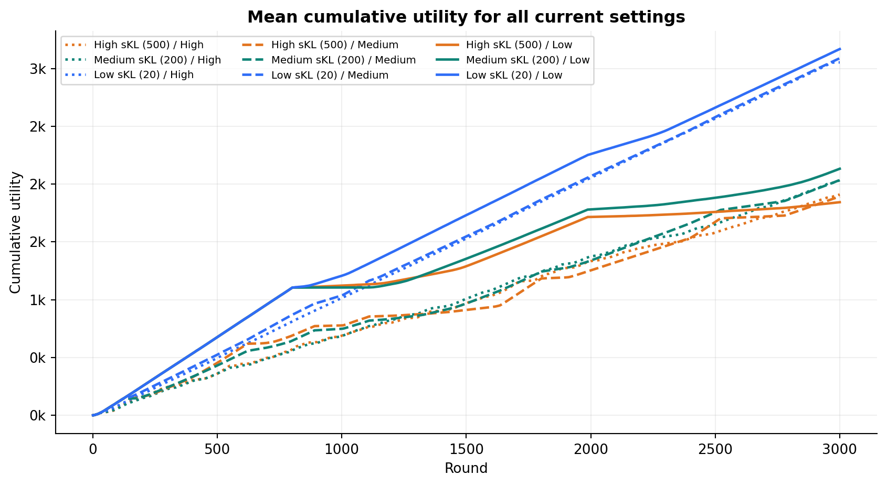
Overall primal-dual results
Pooled view over all 90 current shared realizations.
RUNS
MEAN UTILITY
MEAN ORACLE UTILITY
MEAN FINAL REGRET
90
2,350.3
3,394.0
1,043.7
9 settings x 10 matrices
SD 542.3
SD 109.0
SD 547.5
12

Slide 13
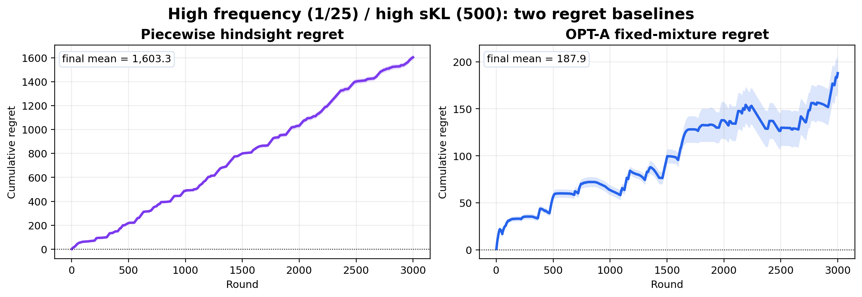
High frequency / high sKL: OPT-A regret
Same setting as diagnostic plot; piecewise is the main benchmark and OPT-A is a small theory check.
CHANGES
PIECEWISE
131
1,603.3
short regimes
final regret
OPT-A
COST
187.9
1,865.0
final regret
below B=2500
Benchmark meaning
Piecewise can switch to the best feasible super-arm in each regime. OPT-A chooses one fixed randomized action after the full sequence, so it cannot switch across regimes.
Large piecewise regret comes from chasing many short-regime optima, not from budget violation; OPT-A is smaller because its comparator is fixed.
28

Slide 14
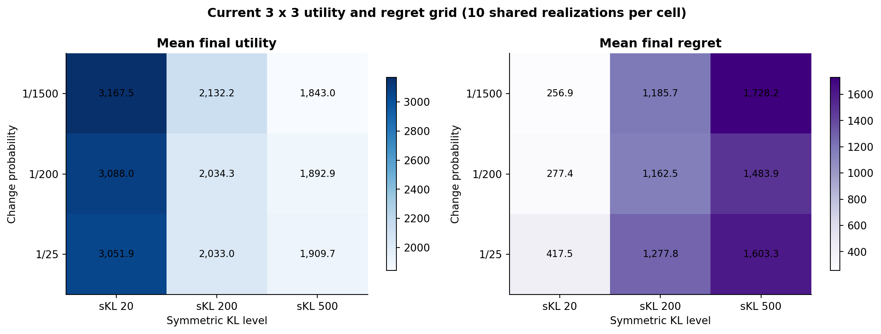
Utility and regret across the full grid
Each cell is a mean over 10 shared realizations; uncertainty is shown in the detailed diagnostics.
13

Slide 15
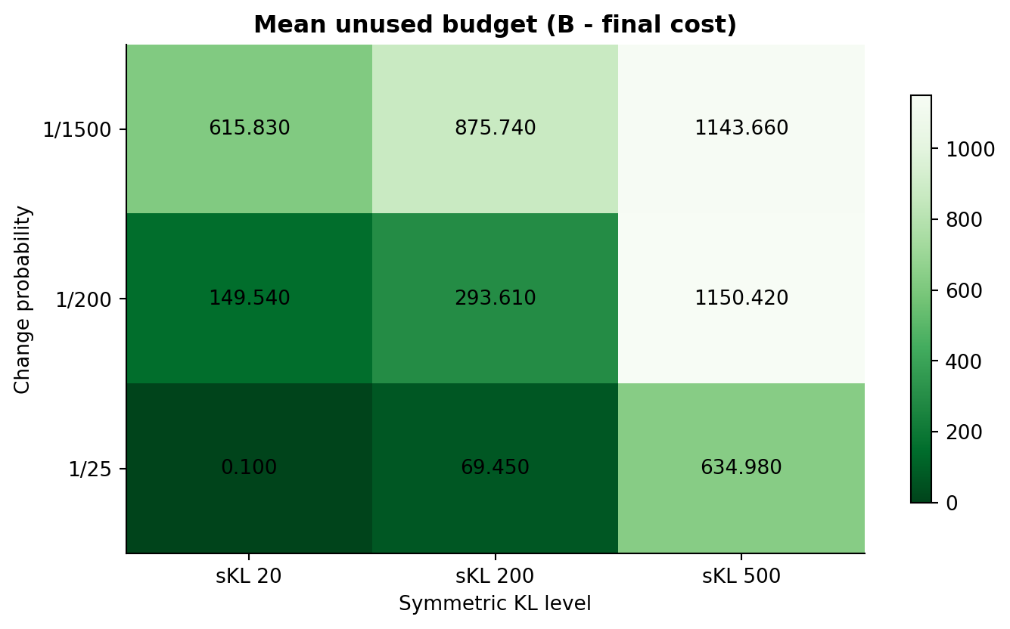
Budget feasibility in every setting
The hard filter keeps realized cumulative cost at or below B=2500 in all 90 runs.
MAXIMUM COST
2,499.90
MINIMUM COST
1,283.10
VIOLATIONS
0 / 90
14

Slide 16
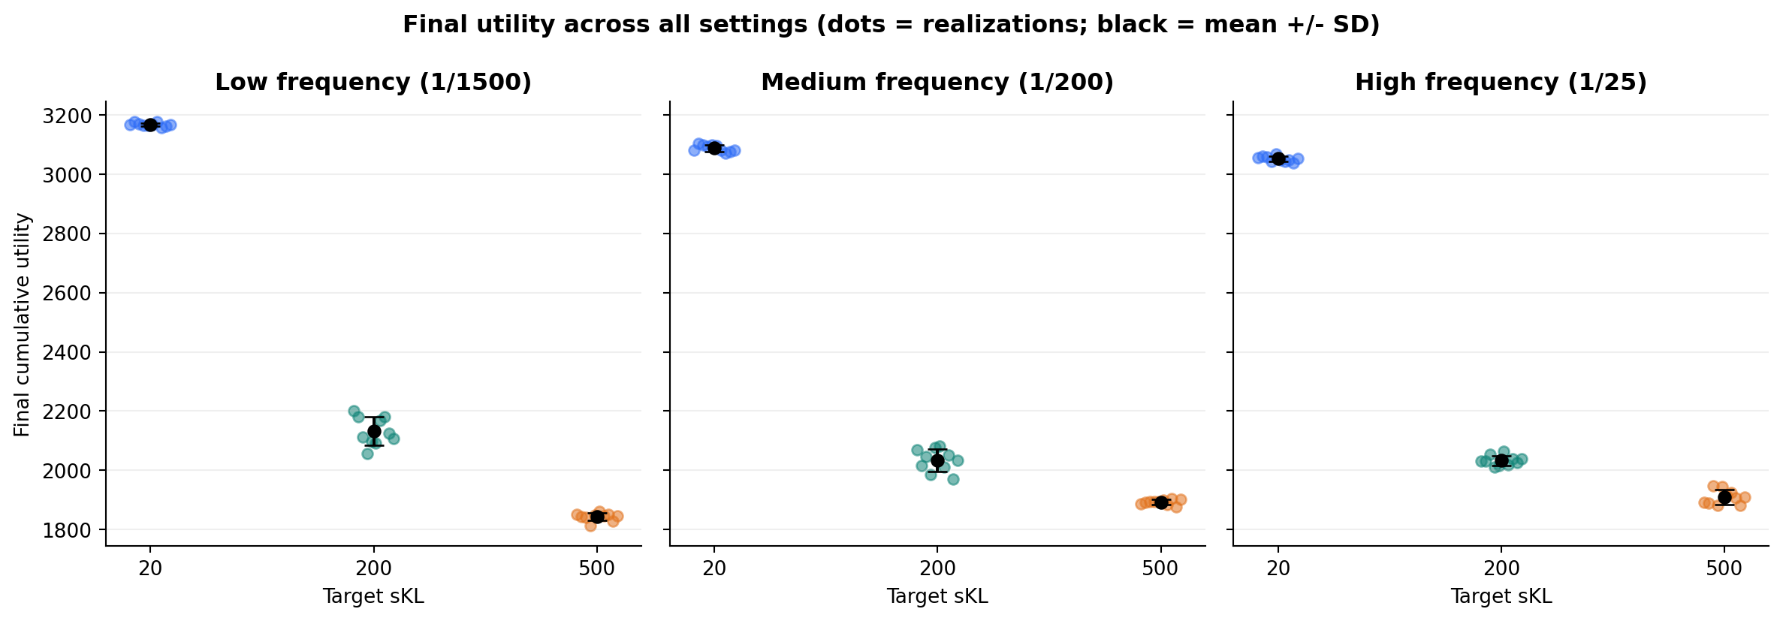
Final utility distribution across all settings
Each dot is one realization; black markers show mean +/- 1 SD.
15

Slide 17
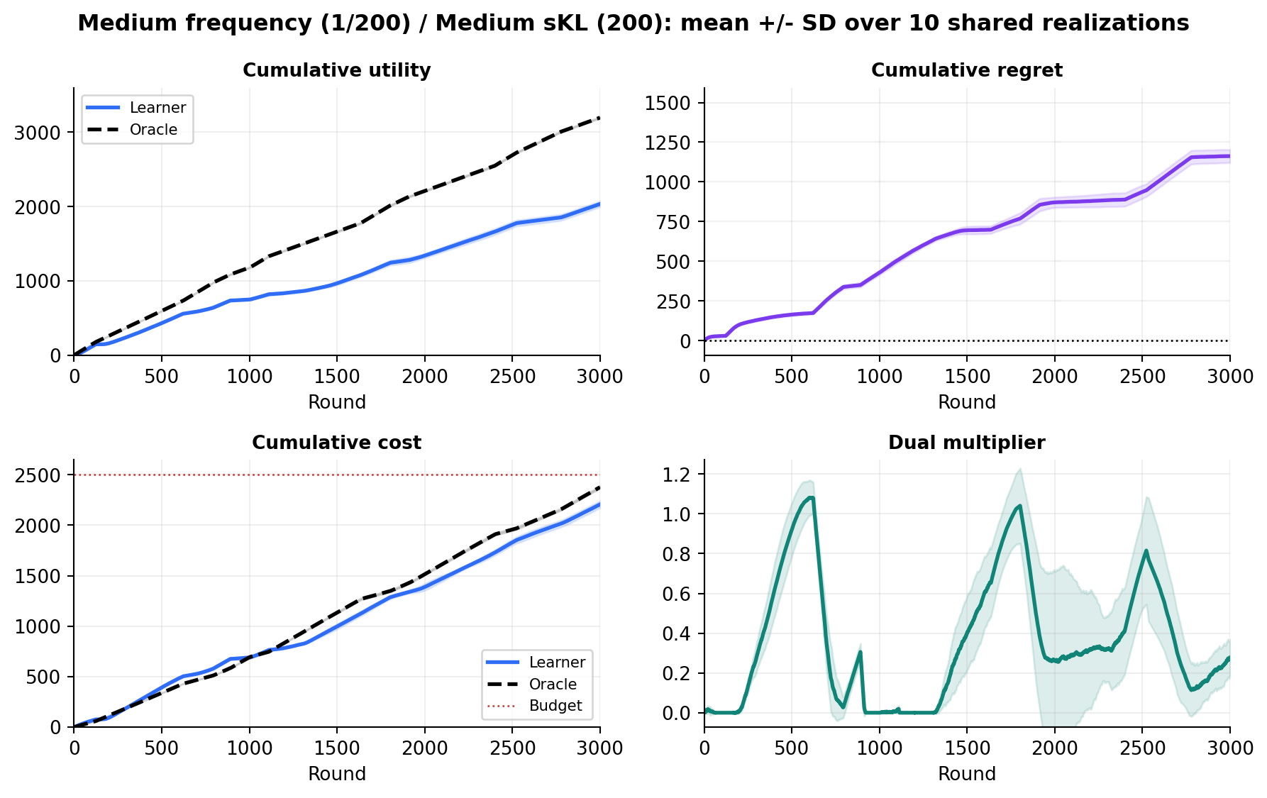
Representative current run dynamics
Medium sKL (200), medium frequency (1/200), mean +/- SD over 10 shared realizations.
LEARNER UTILITY
2,034.3
SD 38.5
ORACLE UTILITY
3,196.8
SD 9.3
FINAL REGRET
1,162.5
SD 41.2
FINAL COST
2,206.39
SD 34.570
16

Slide 18
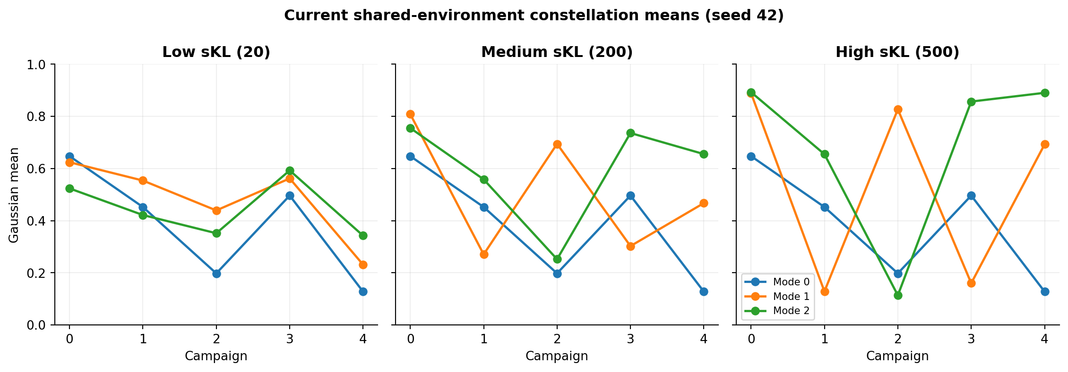
Constellation profiles by sKL
Gaussian mode means generated by the shared environment at the three requested sKL levels.
17

Slide 19
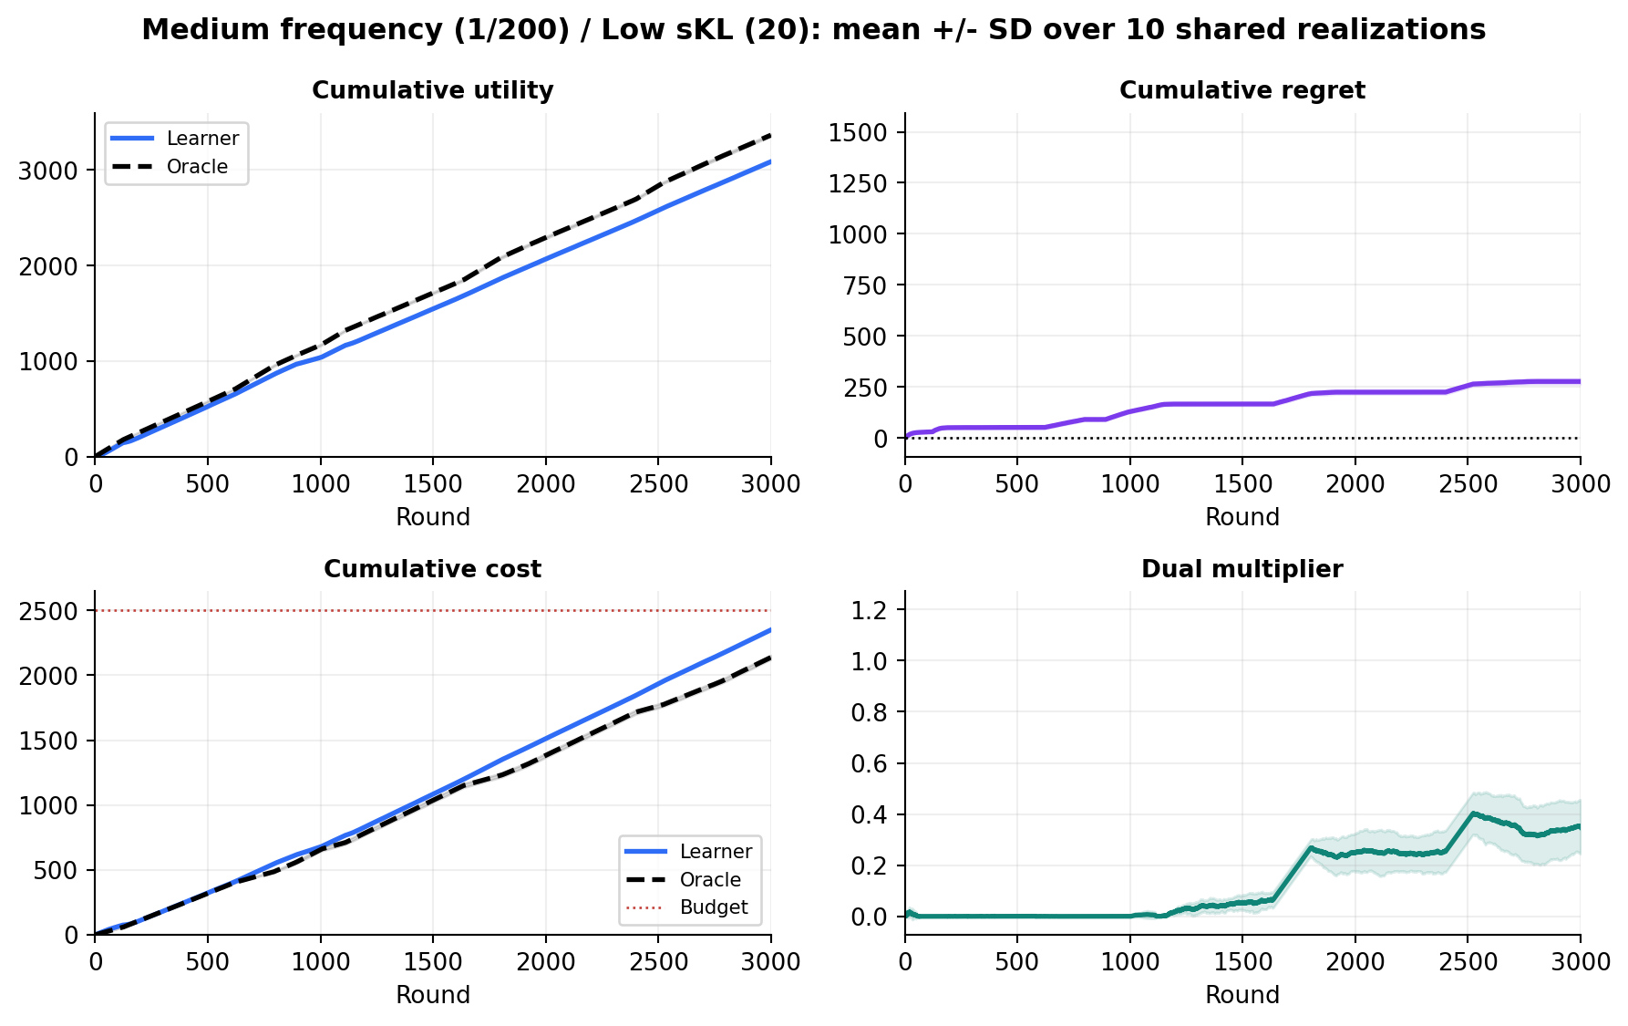
Low sKL (20) diagnostics
Medium change frequency (1/200); mean +/- SD over the 10 shared realizations.
LEARNER UTILITY
3,088.0
SD 11.3
ORACLE UTILITY
3,365.4
SD 11.0
FINAL REGRET
277.4
SD 11.8
FINAL COST
2,350.46
SD 6.675
19

Slide 20
Medium sKL (200) diagnostics
Medium change frequency (1/200); mean +/- SD over the 10 shared realizations.
LEARNER UTILITY
2,034.3
SD 38.5
ORACLE UTILITY
3,196.8
SD 9.3
FINAL REGRET
1,162.5
SD 41.2
FINAL COST
2,206.39
SD 34.570
20

Slide 21
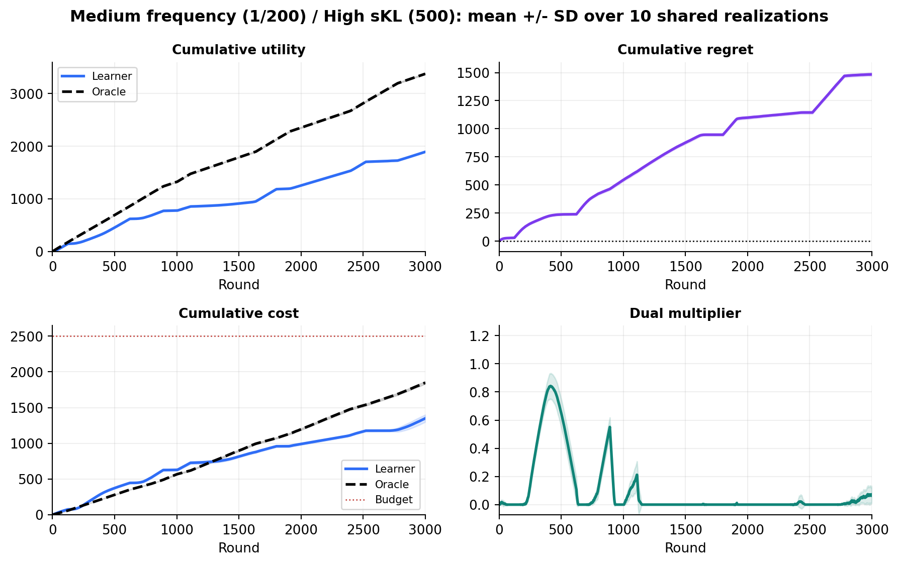
High sKL (500) diagnostics
Medium change frequency (1/200); mean +/- SD over the 10 shared realizations.
LEARNER UTILITY
1,892.9
SD 8.2
ORACLE UTILITY
3,376.8
SD 10.5
FINAL REGRET
1,483.9
SD 13.9
FINAL COST
1,349.58
SD 50.299
21

Slide 22
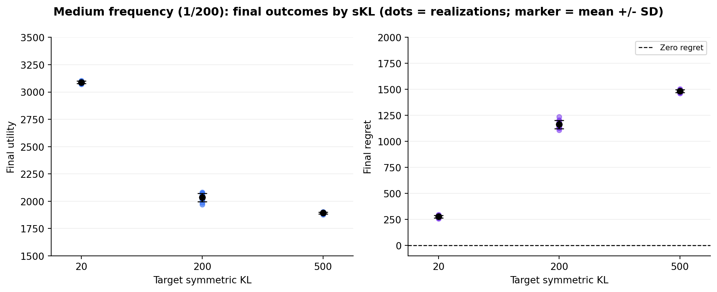
sKL summary at medium frequency
Dots are individual shared realizations; black markers show mean +/- SD.
22

Slide 23
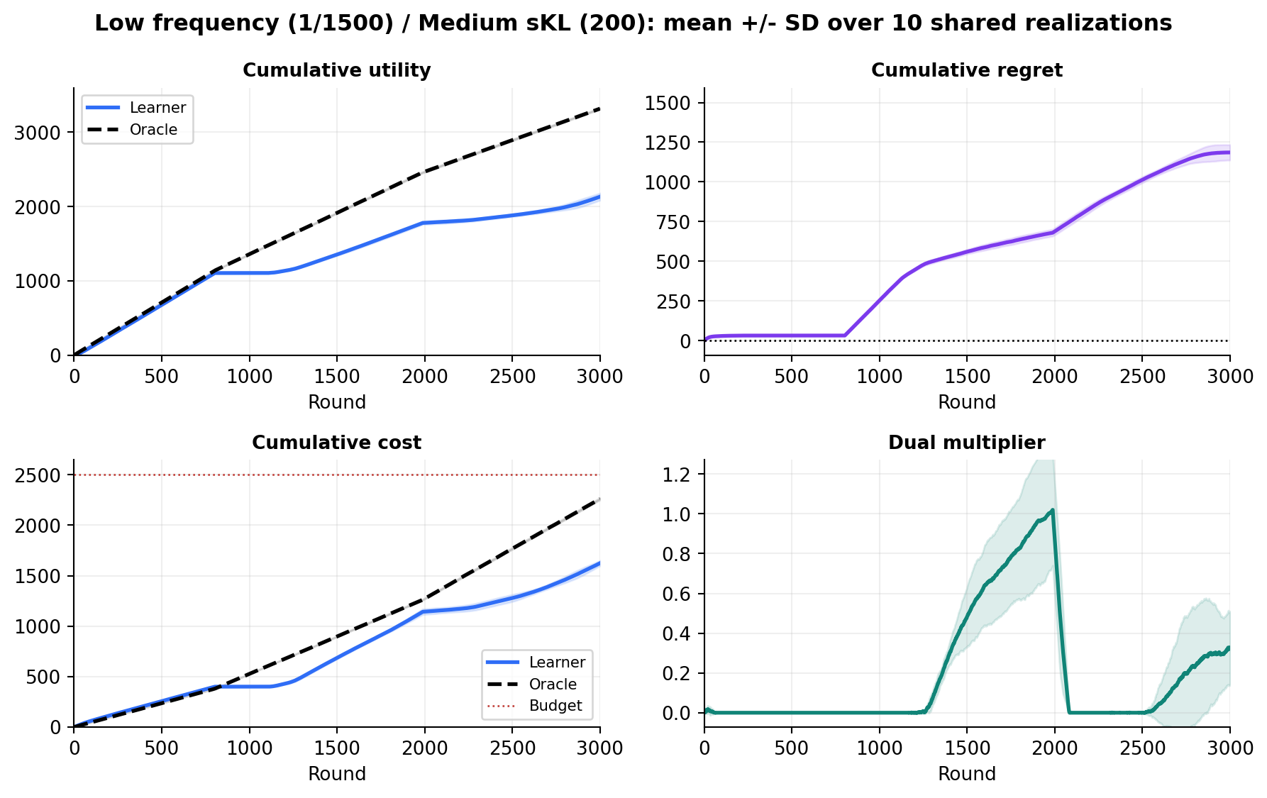
Low frequency (1/1500) diagnostics
Medium sKL (200); mean +/- SD over the 10 shared realizations.
LEARNER UTILITY
2,132.2
SD 47.9
ORACLE UTILITY
3,318.0
SD 8.5
FINAL REGRET
1,185.7
SD 47.8
FINAL COST
1,624.26
SD 25.974
23

Slide 24
Medium frequency (1/200) diagnostics
Medium sKL (200); mean +/- SD over the 10 shared realizations.
LEARNER UTILITY
2,034.3
SD 38.5
ORACLE UTILITY
3,196.8
SD 9.3
FINAL REGRET
1,162.5
SD 41.2
FINAL COST
2,206.39
SD 34.570
24

Slide 25
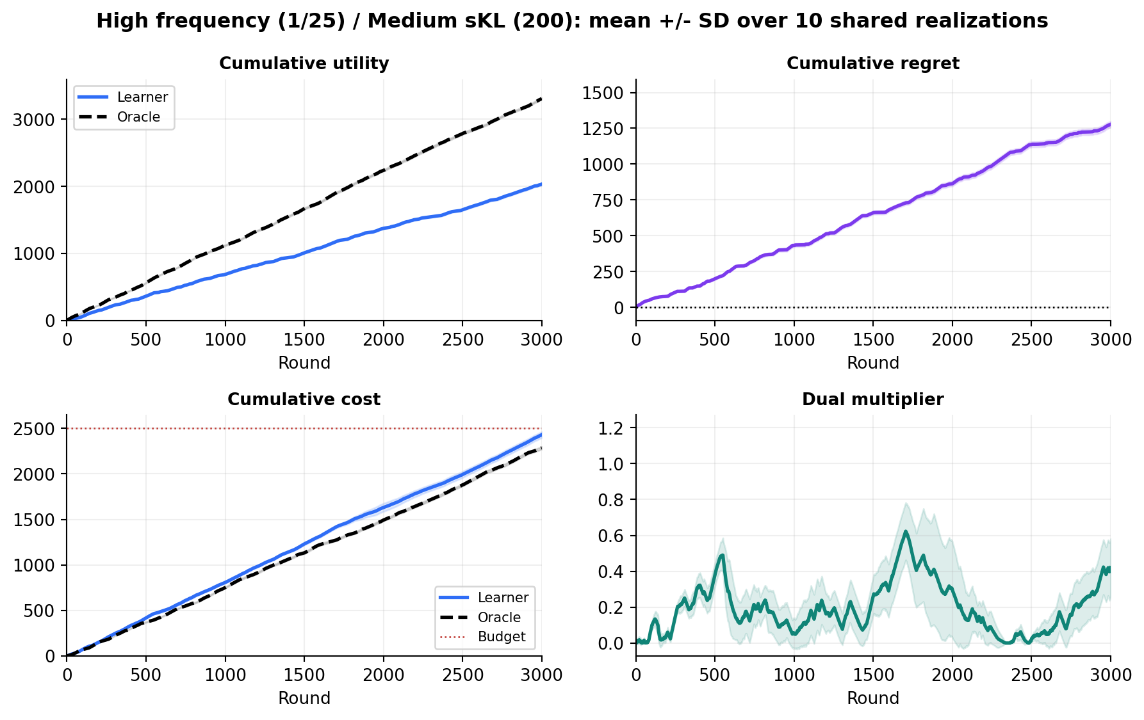
High frequency (1/25) diagnostics
Medium sKL (200); mean +/- SD over the 10 shared realizations.
LEARNER UTILITY
2,033.0
SD 16.6
ORACLE UTILITY
3,310.9
SD 13.0
FINAL REGRET
1,277.8
SD 21.4
FINAL COST
2,430.55
SD 33.378
25

Slide 26
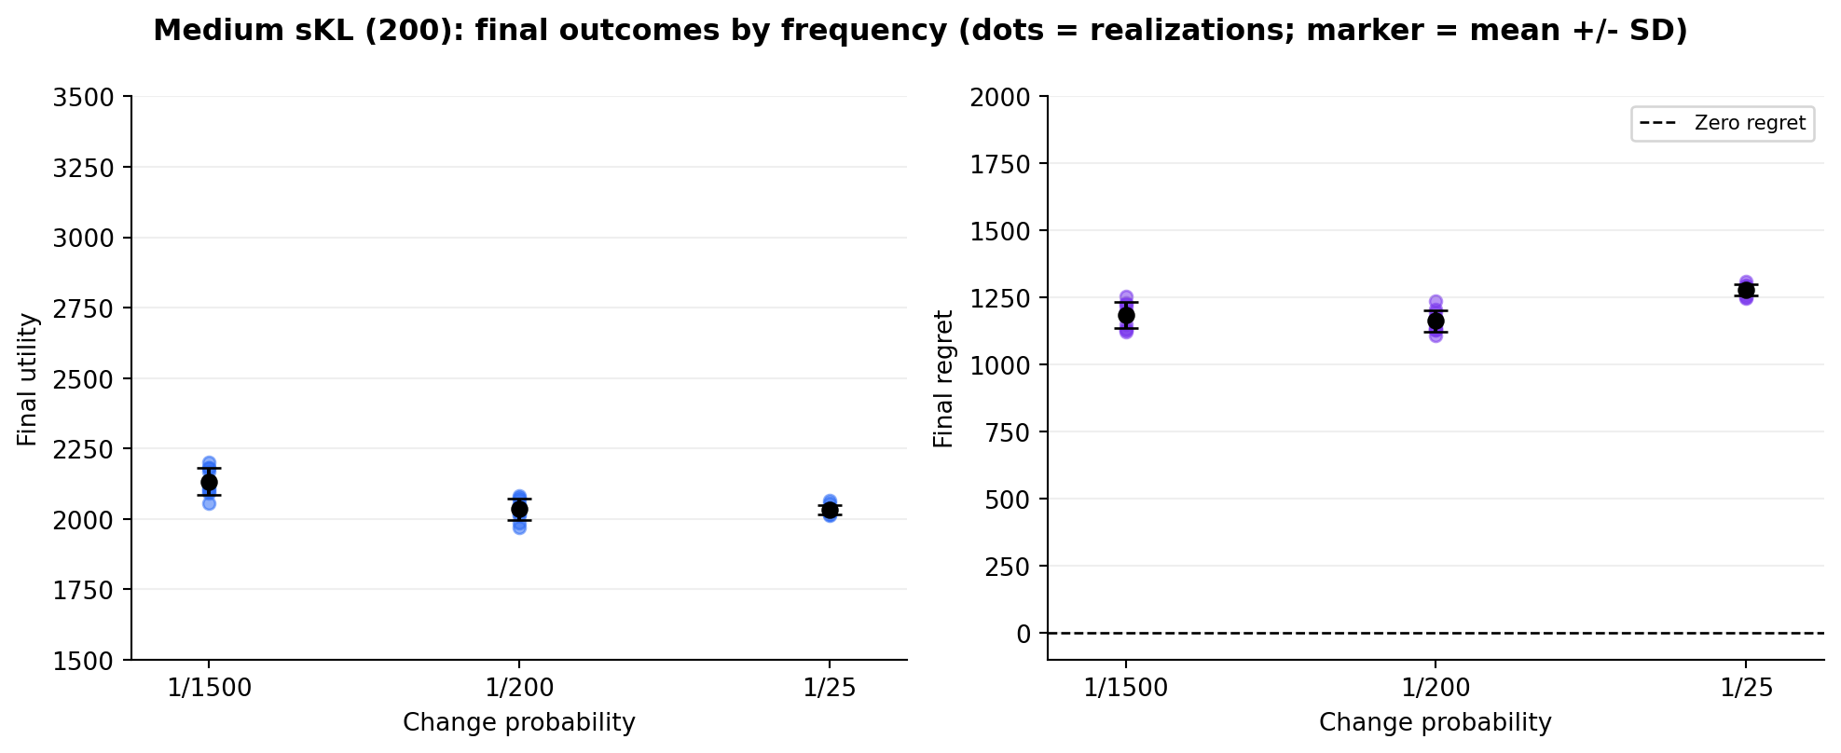
Frequency summary at medium sKL
The schedules change 2, 12, and 131 times at p=1/1500, 1/200, and 1/25.
Why utility is not monotone: schedule seeds do not equalize time spent in each mode. Mode 0/1/2 shares are 27/40/34%, 23/32/45%, and 28/33/38% for p=1/1500, 1/200, and 1/25.
26

Slide 27
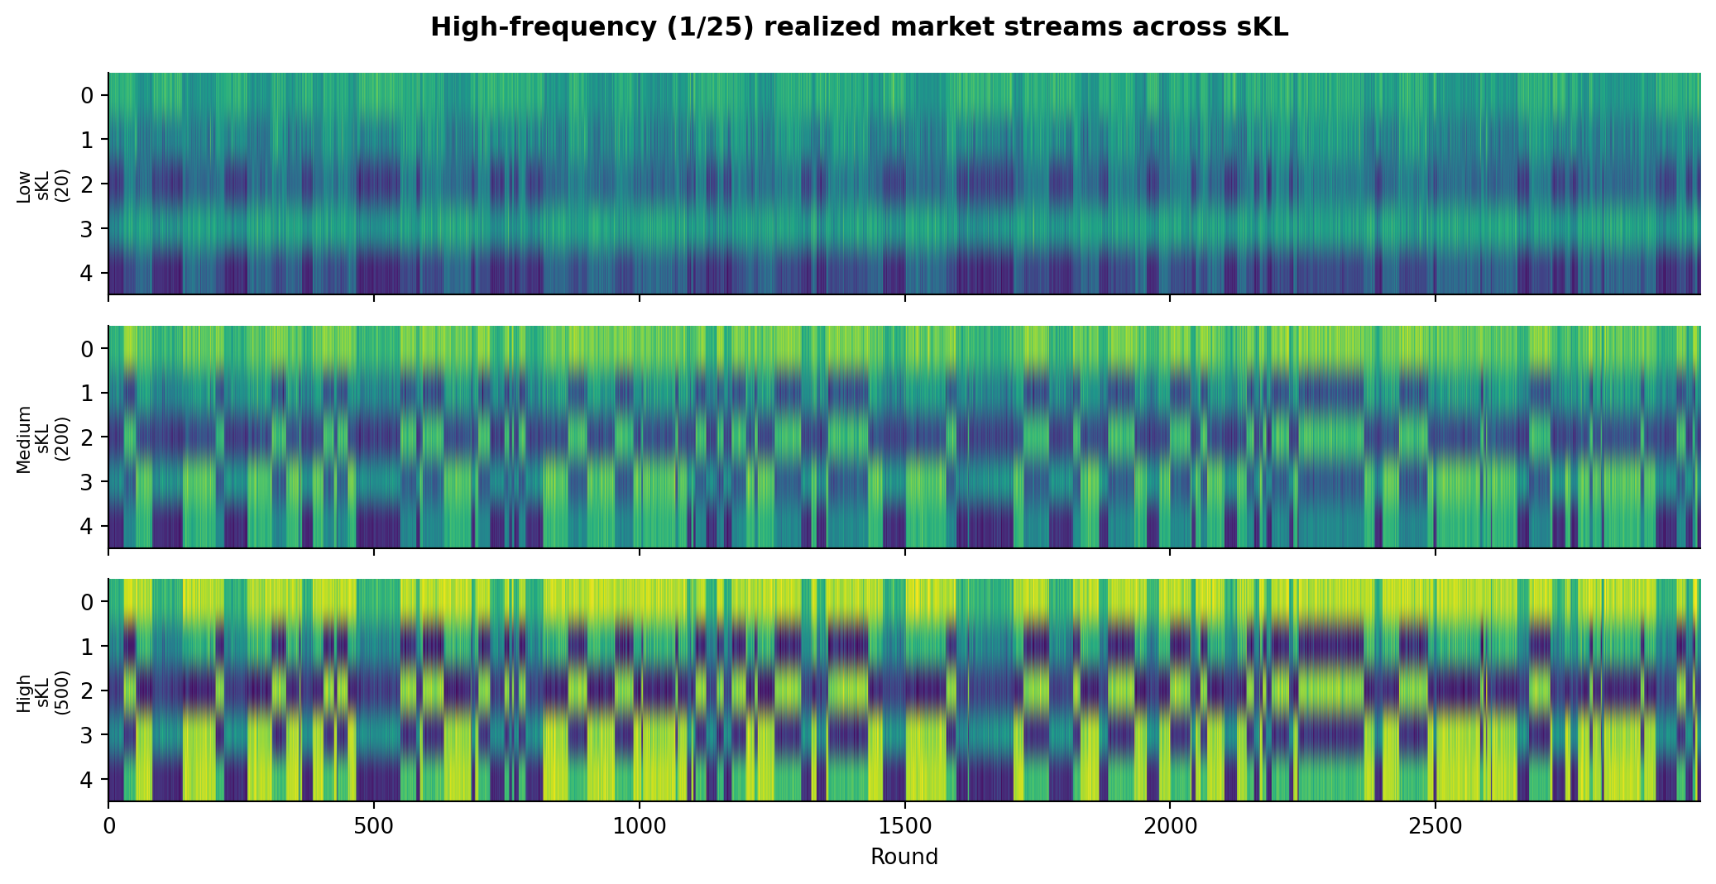
Hidden: high-frequency realized market spectrum
Kept for reference, hidden from the presentation.
27

Slide 28
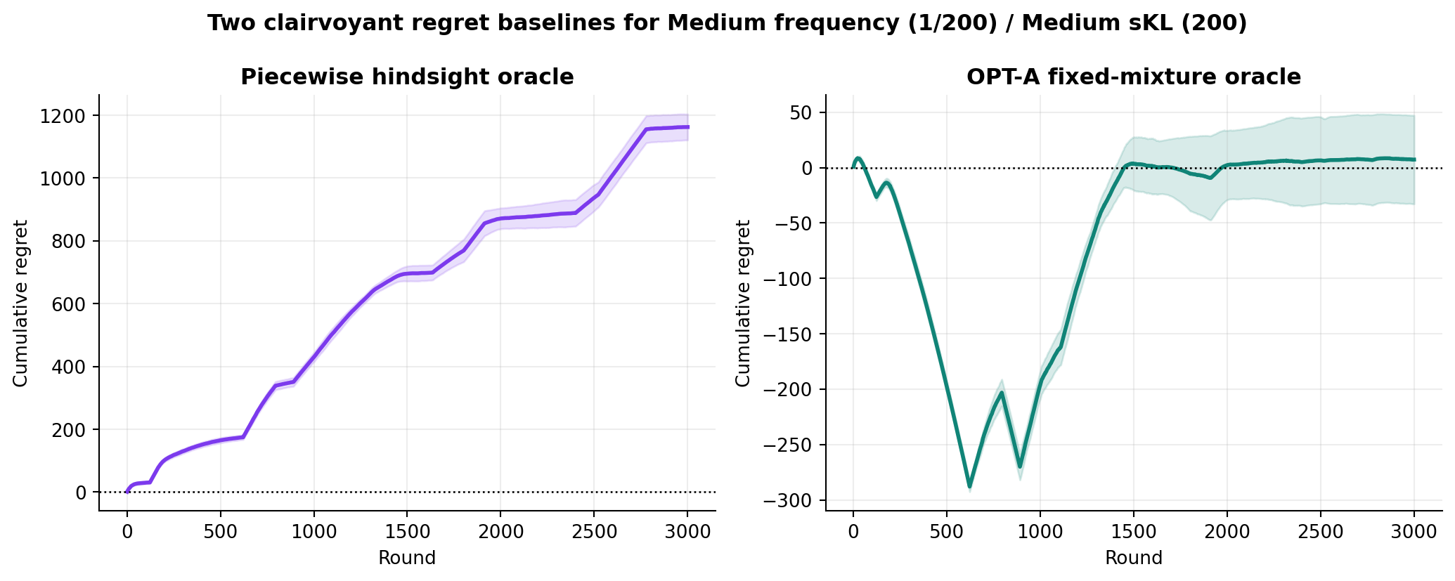
Two clairvoyant regret baselines
Piecewise hindsight remains the main comparison; OPT-A is the fixed-mixture adversarial benchmark.
OPT-A solves one LP after observing the full sequence: maximize average reward under average cost <= B/T, then evaluates that fixed randomized action over time.
18

