Slide 1
REQUIREMENT 4 · SLIDING-WINDOW CUCB
Low Frequency Low SKL — Fixed window — window=55

Slide 2
REQUIREMENT 4 · SLIDING-WINDOW CUCB
Low Frequency Medium SKL — Fixed window — window=55

Slide 3
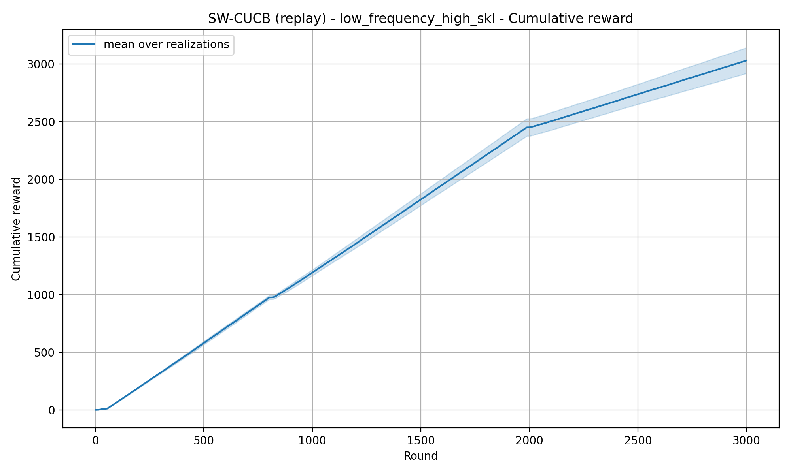
REQUIREMENT 4 · SLIDING-WINDOW CUCB
Low Frequency High SKL — Fixed window — window=55

Slide 4
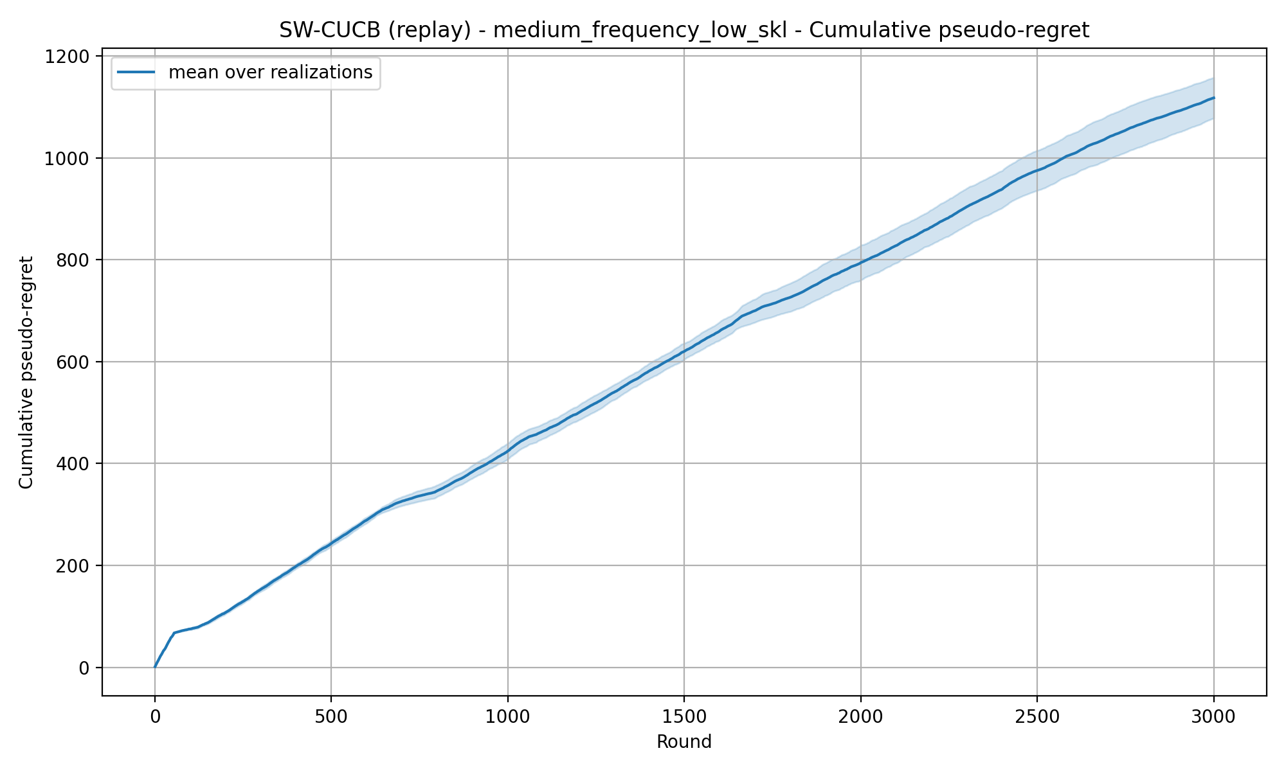
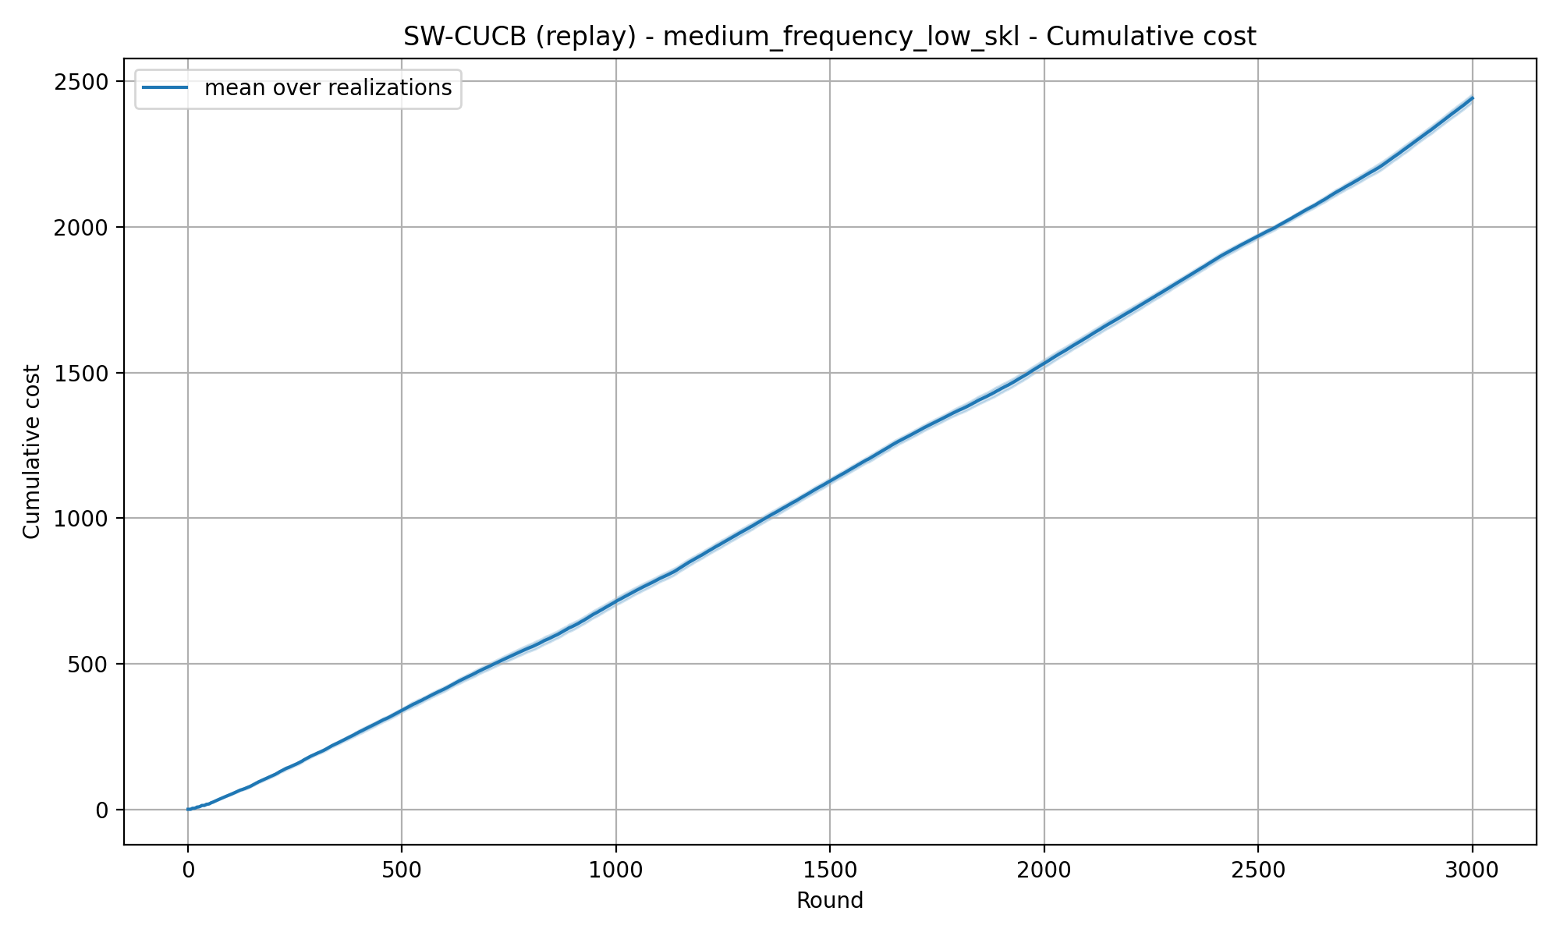
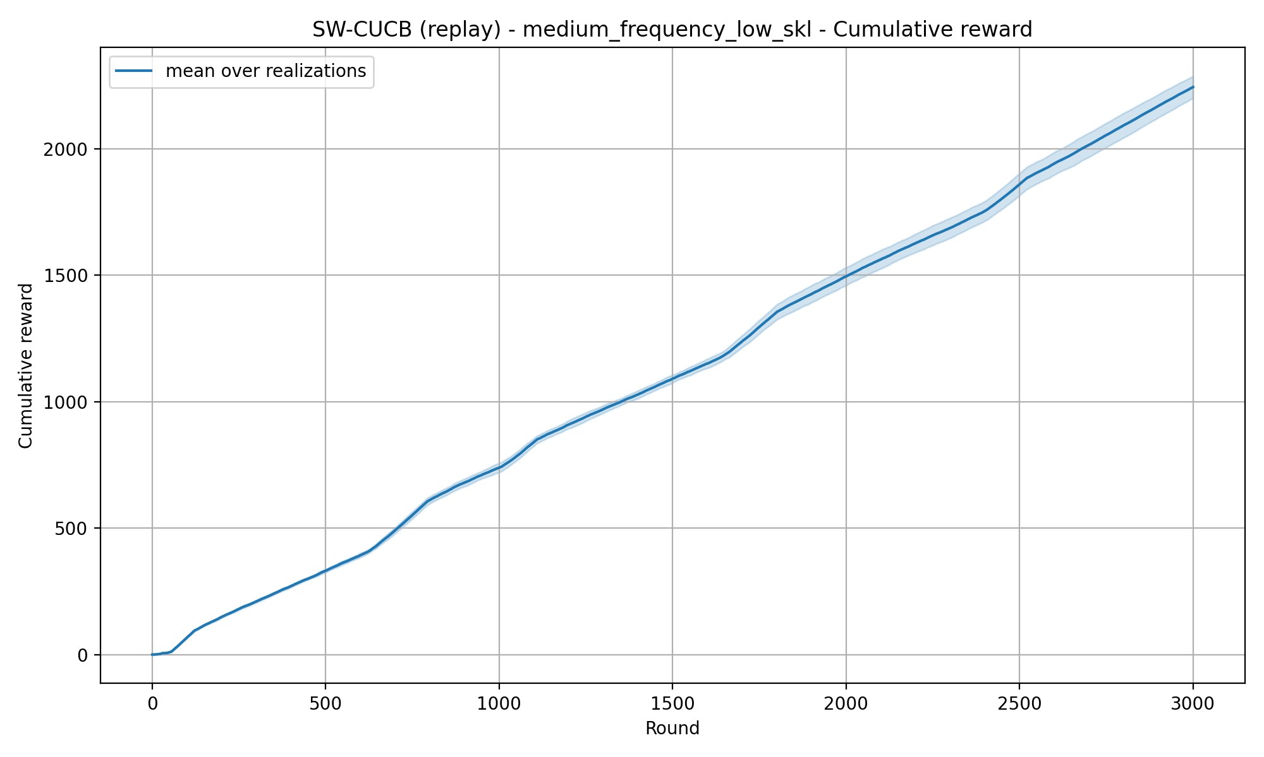
REQUIREMENT 4 · SLIDING-WINDOW CUCB
Medium Frequency Low SKL — Fixed window — window=55

Slide 5
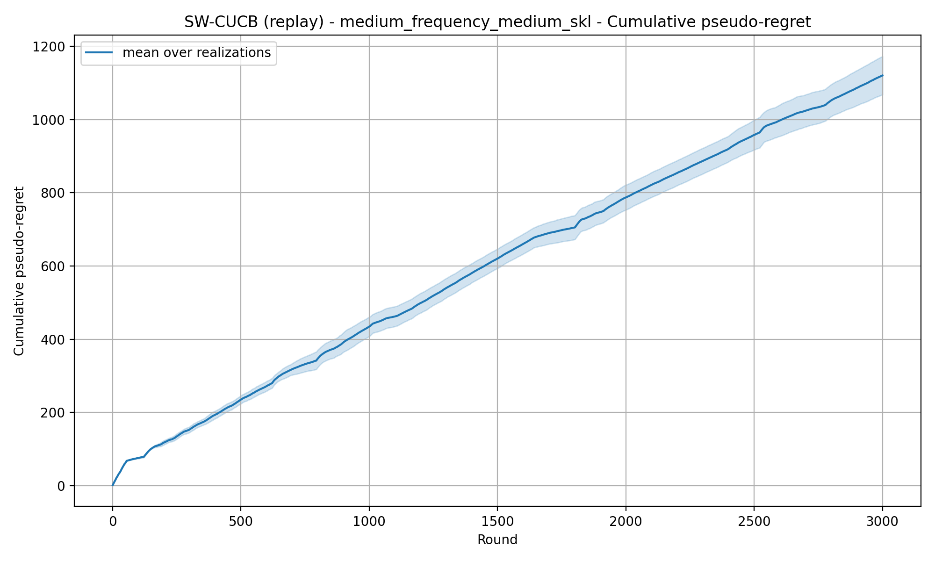
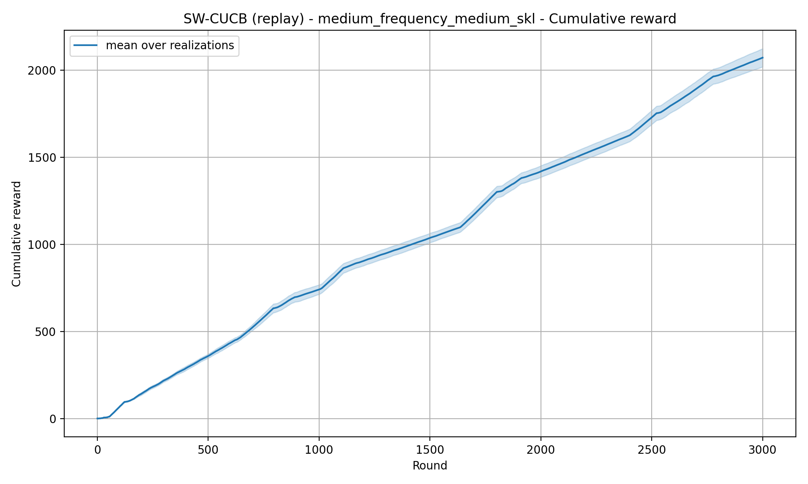
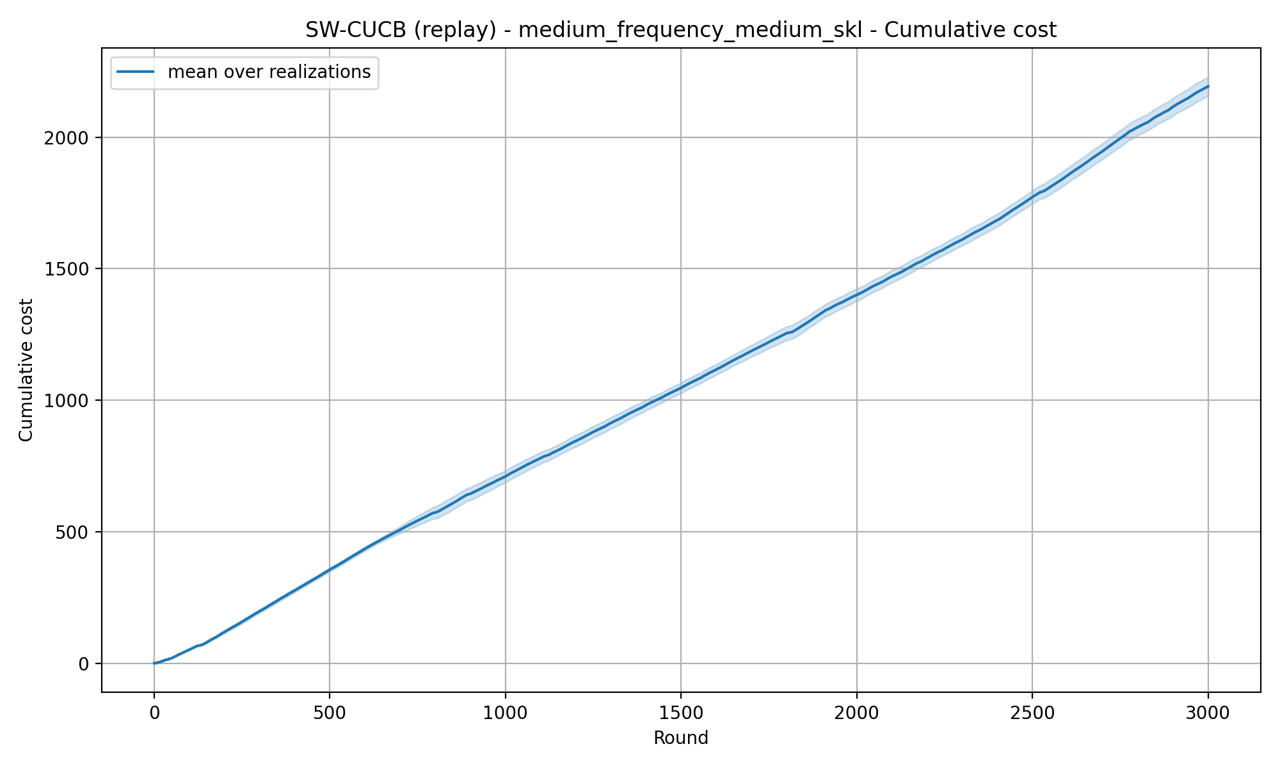
REQUIREMENT 4 · SLIDING-WINDOW CUCB
Medium Frequency Medium SKL — Fixed window — window=55

Slide 6
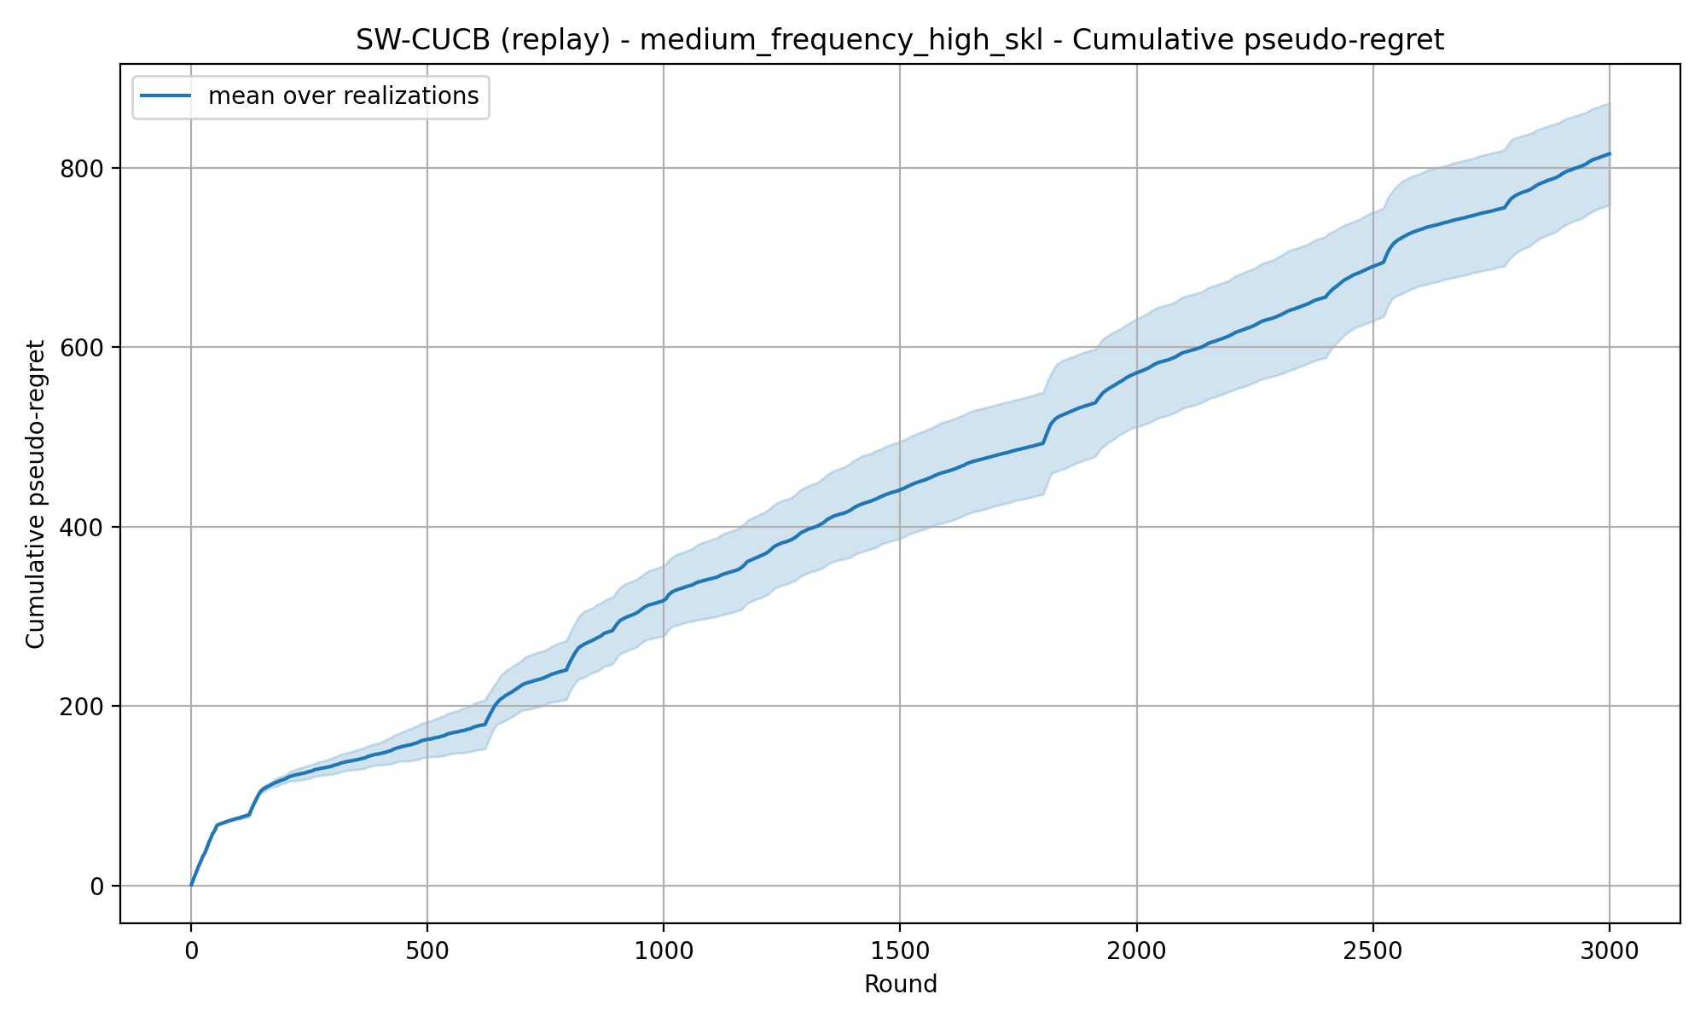
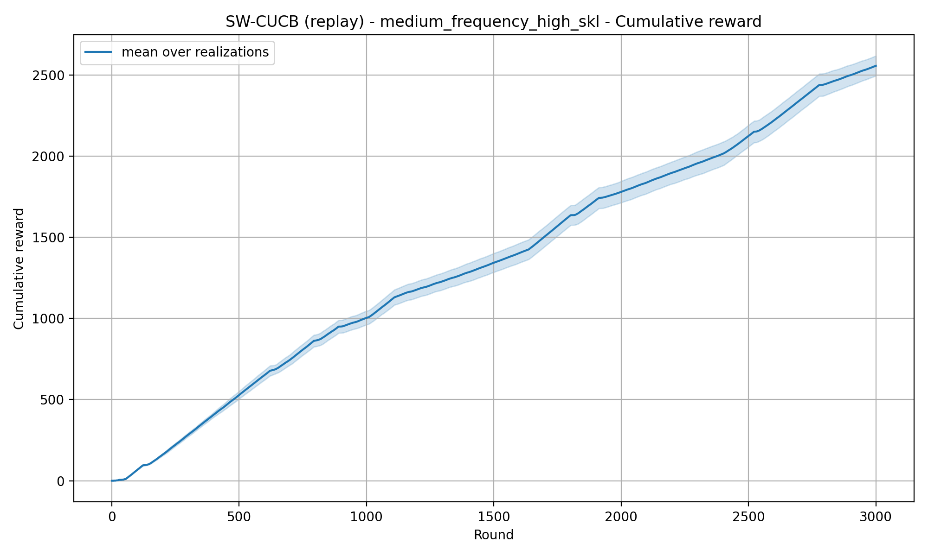
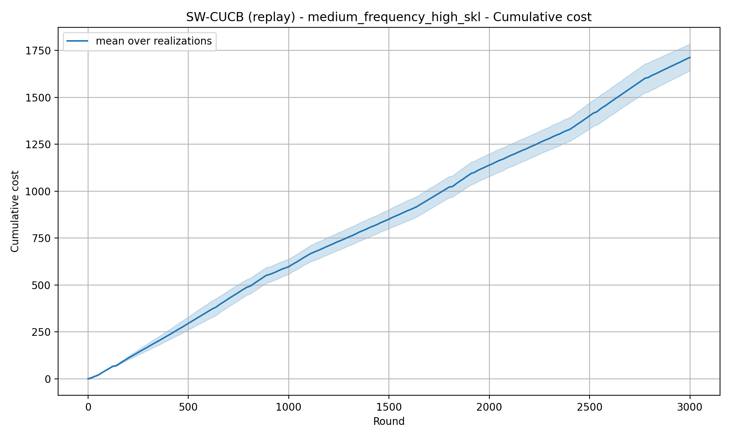
REQUIREMENT 4 · SLIDING-WINDOW CUCB
Medium Frequency High SKL — Fixed window — window=55

Slide 7
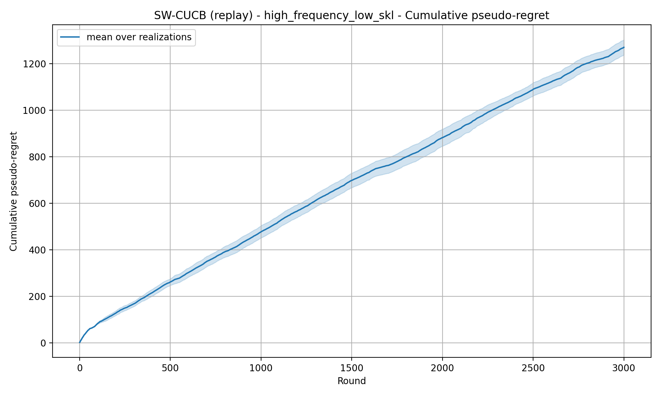
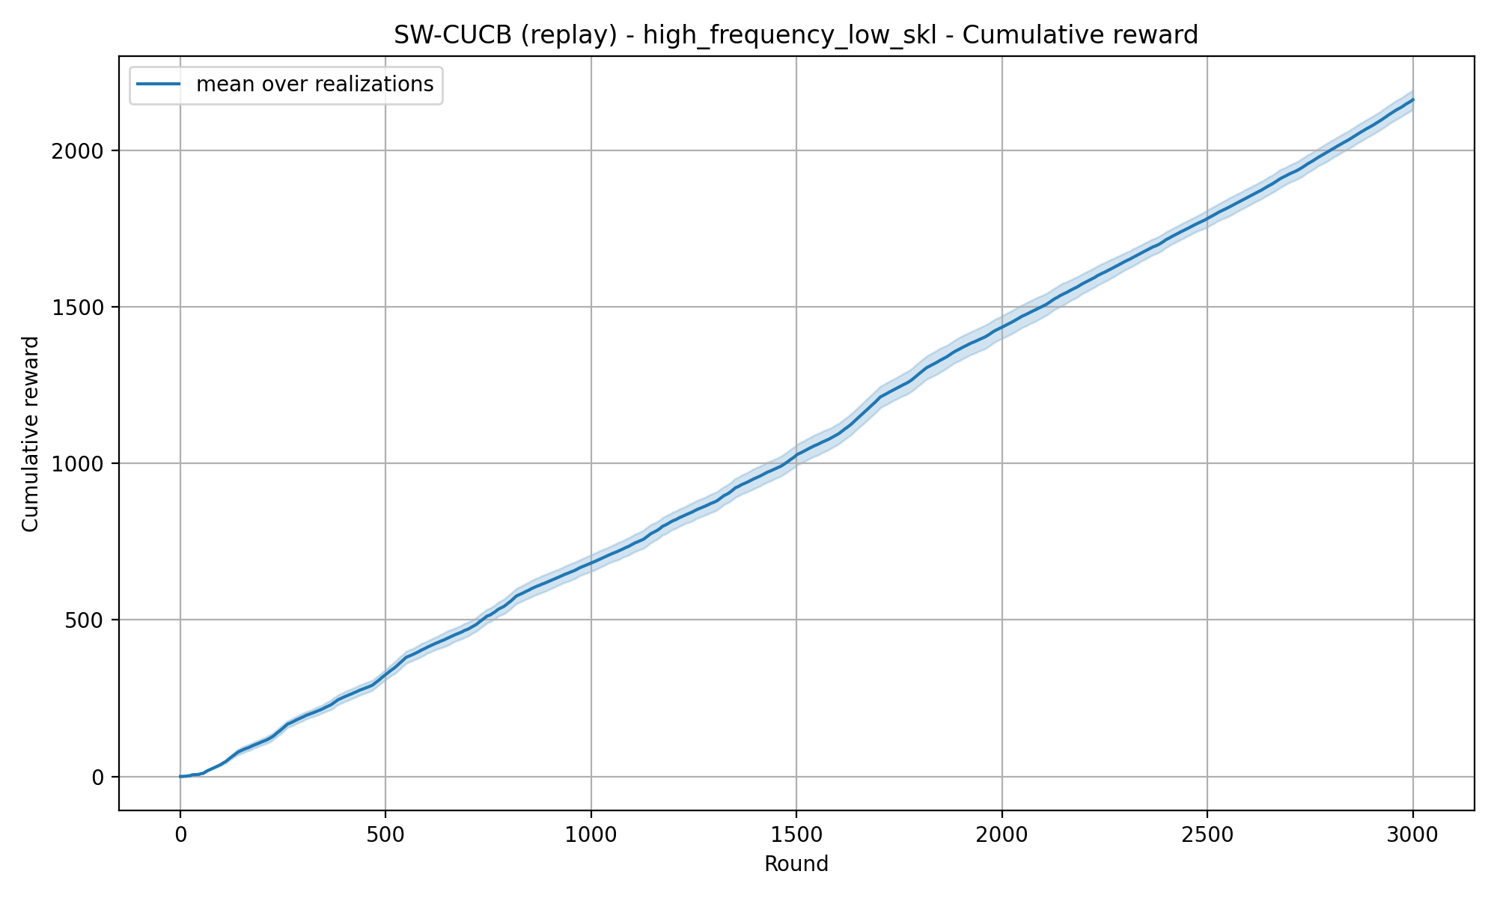
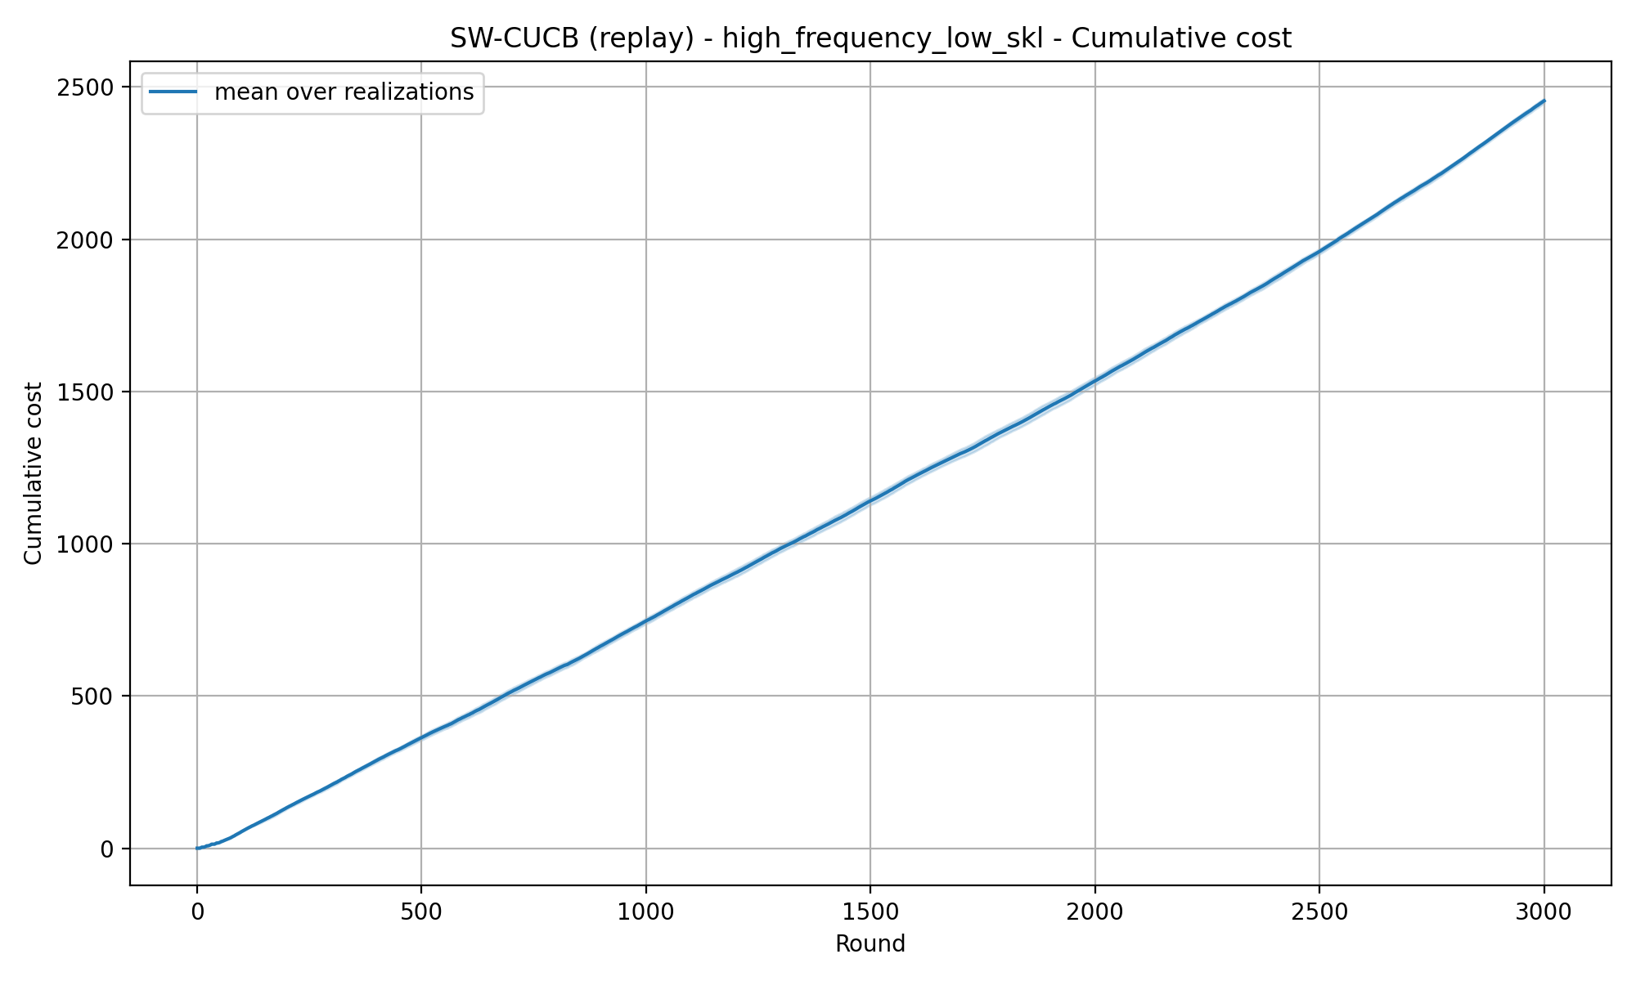
REQUIREMENT 4 · SLIDING-WINDOW CUCB
High Frequency Low SKL — Fixed window — window=55

Slide 8
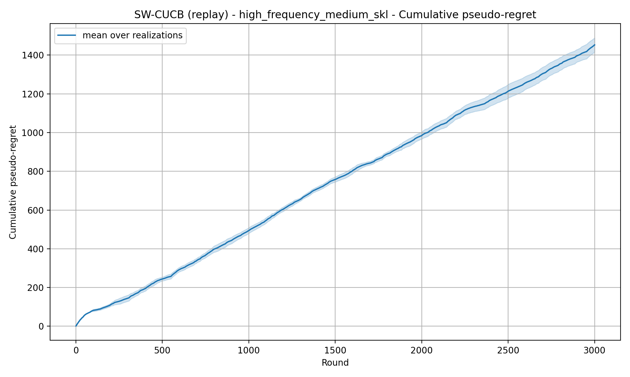
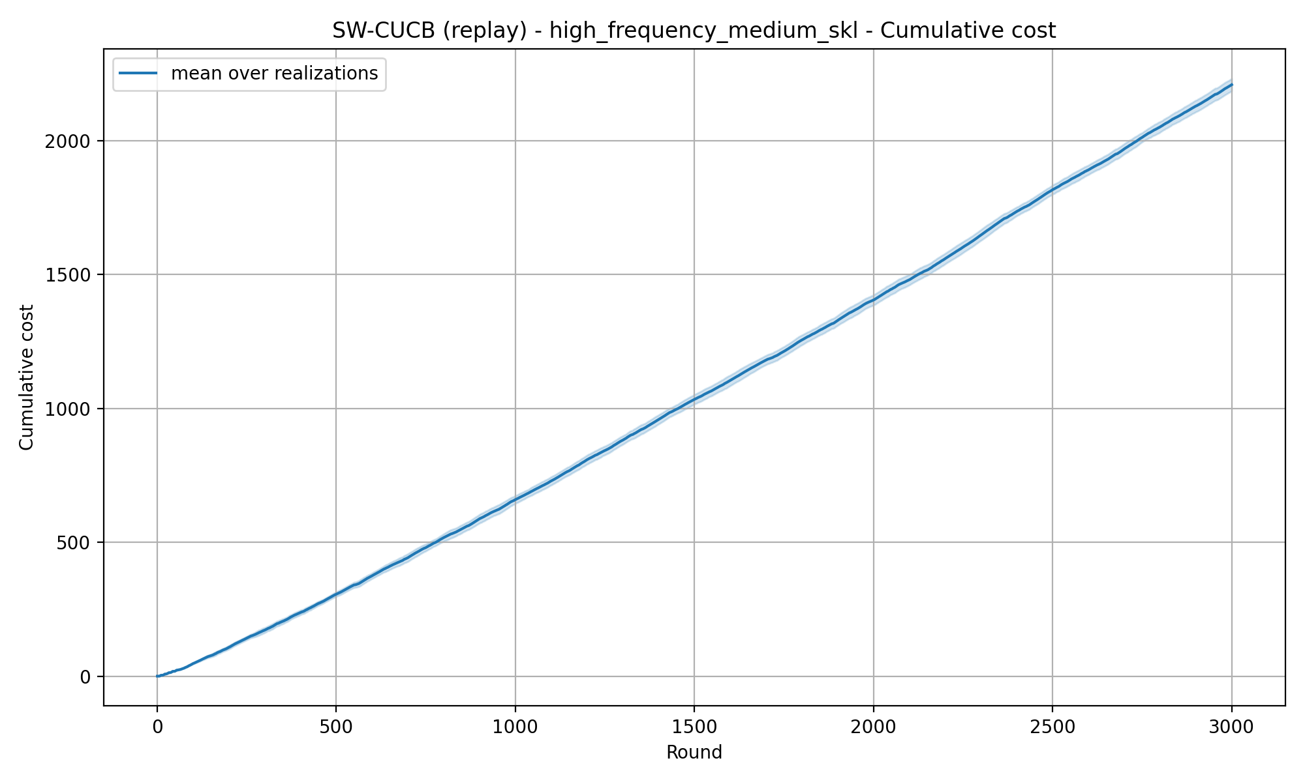
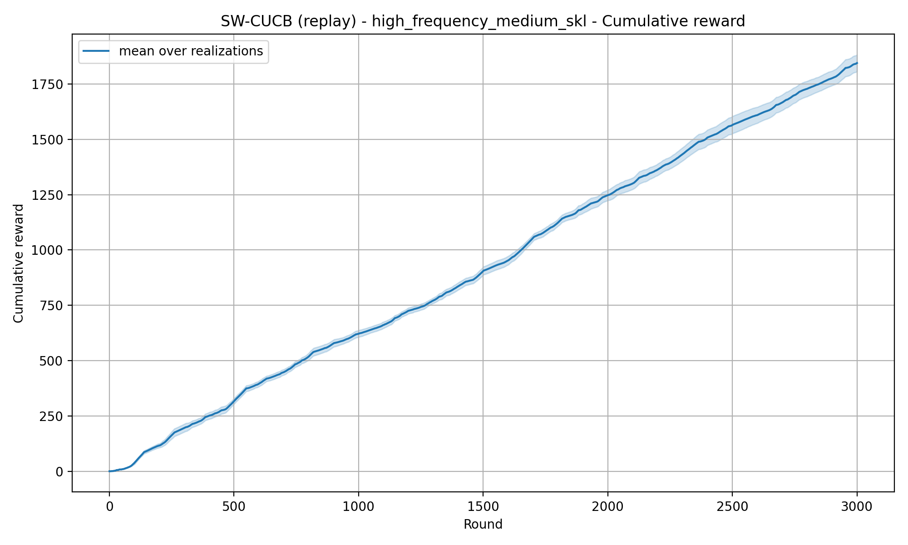
REQUIREMENT 4 · SLIDING-WINDOW CUCB
High Frequency Medium SKL — Fixed window — window=55

Slide 9
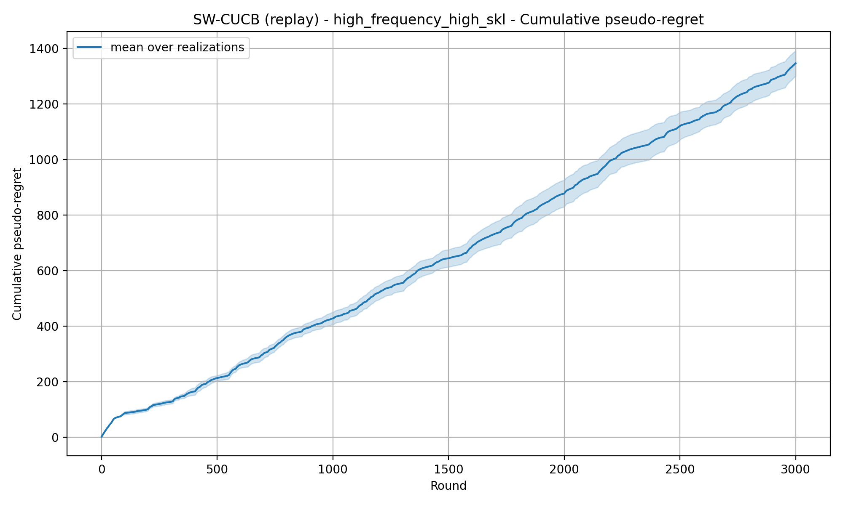
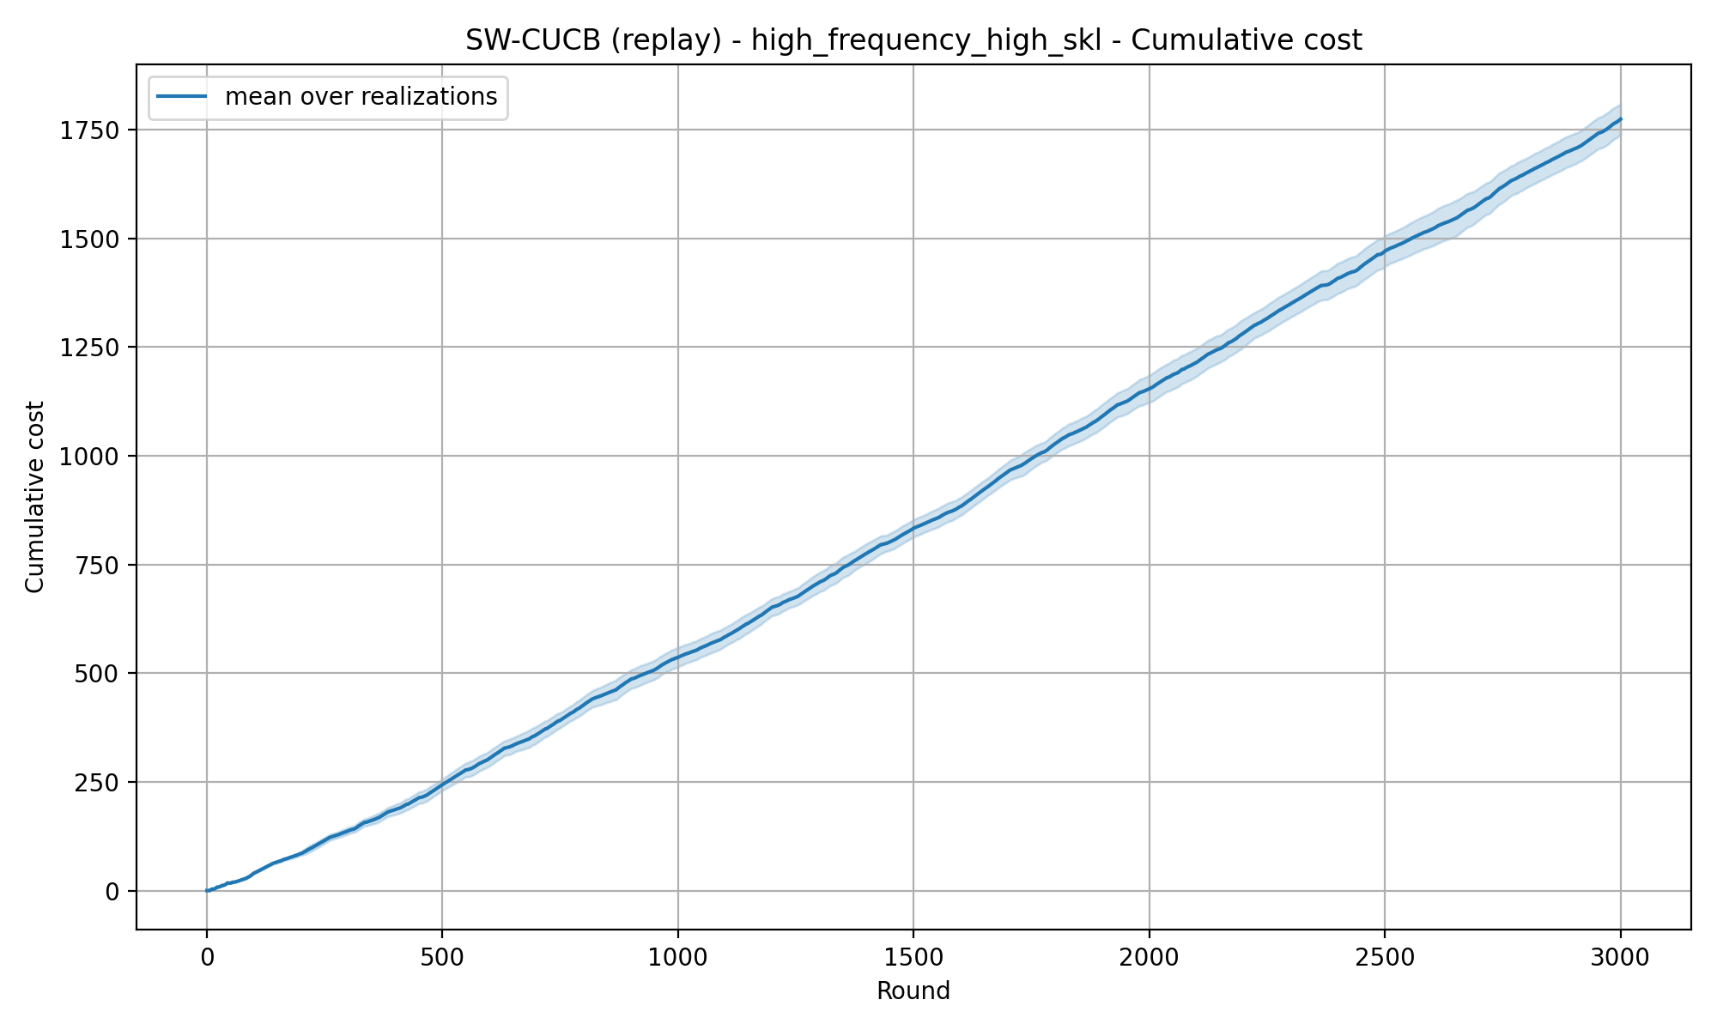
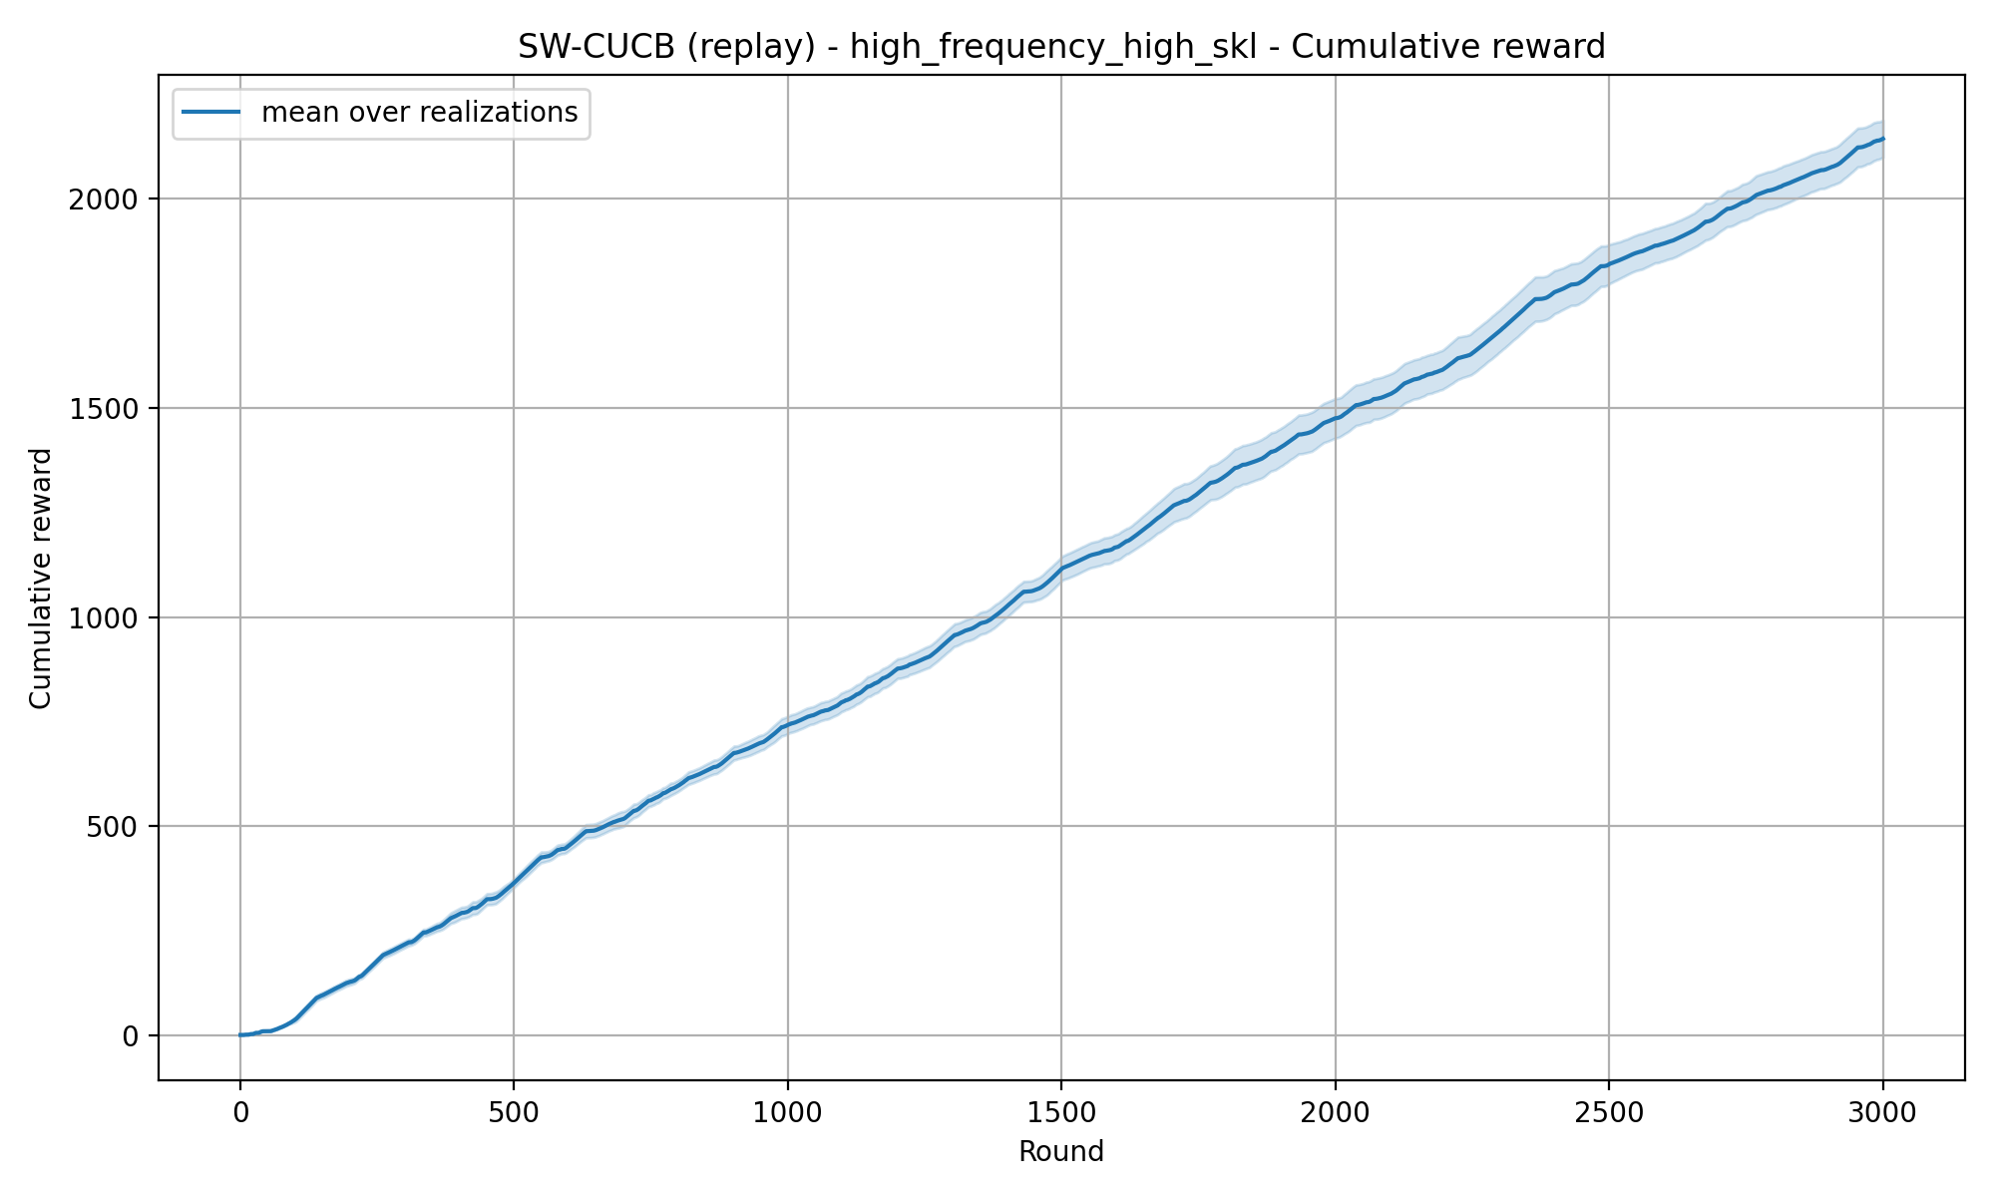
REQUIREMENT 4 · SLIDING-WINDOW CUCB
High Frequency High SKL — Fixed window — window=55

Slide 10
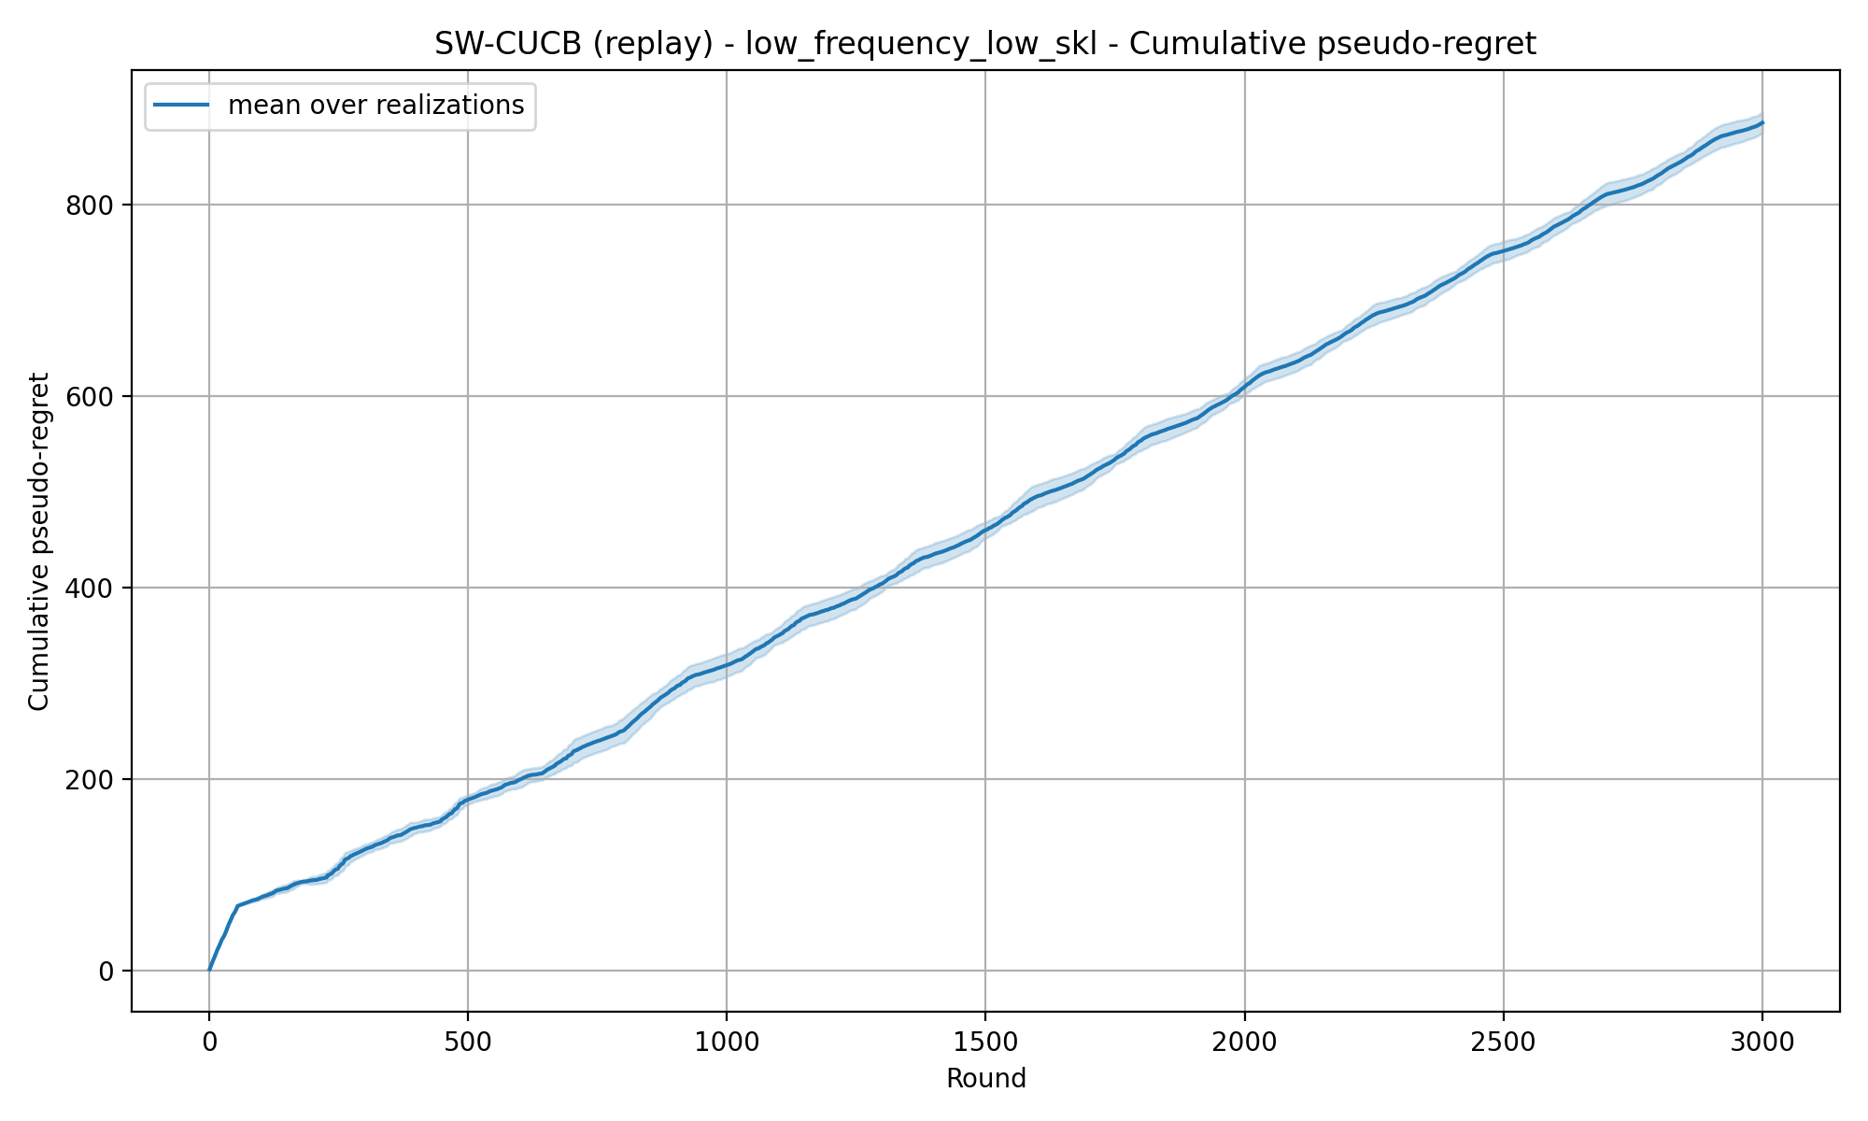

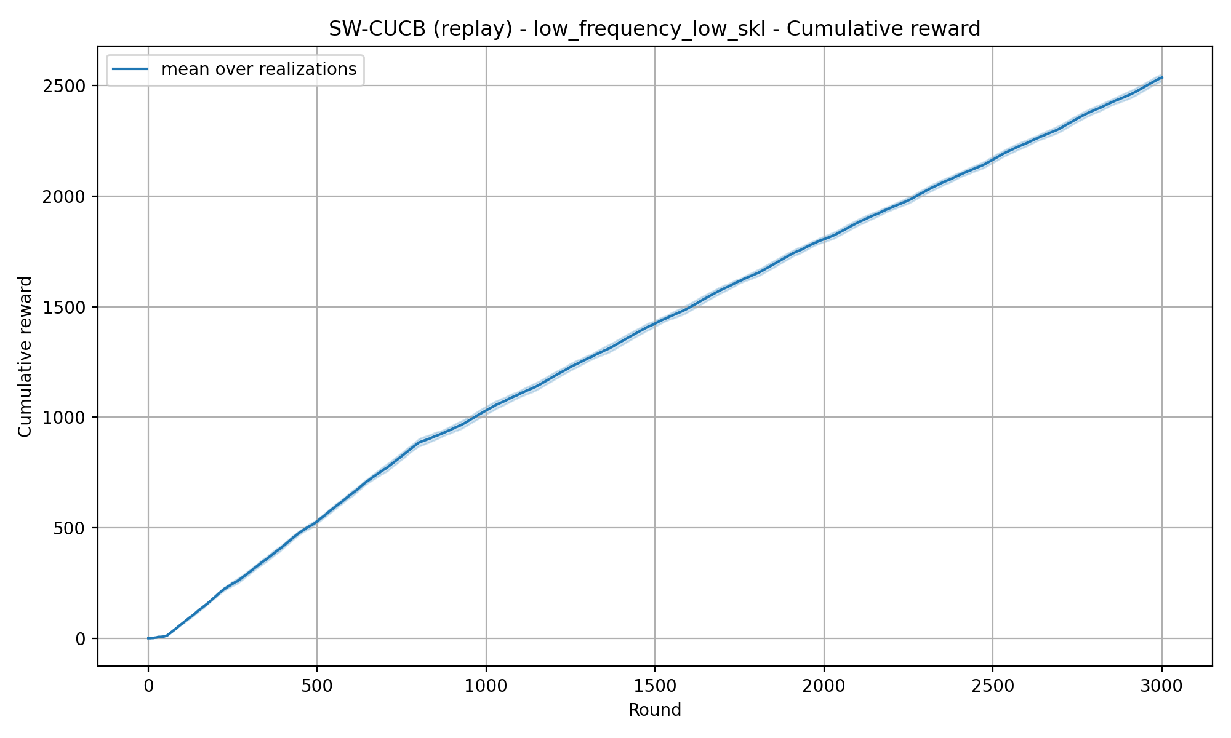
REQUIREMENT 4 · SLIDING-WINDOW CUCB
Low Frequency Low SKL — Theory window — window=219

Slide 11
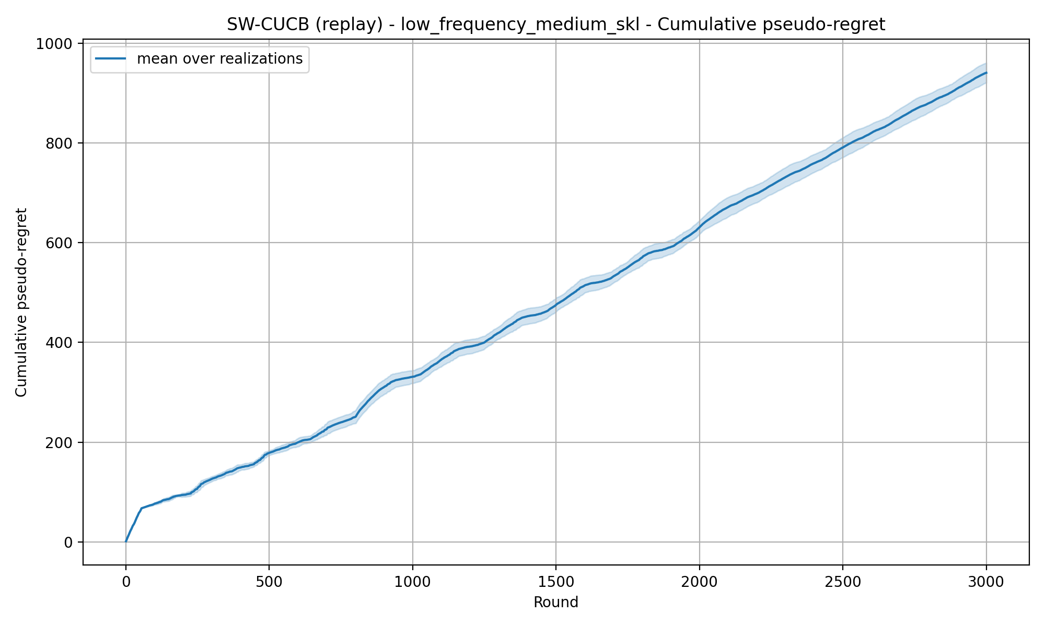

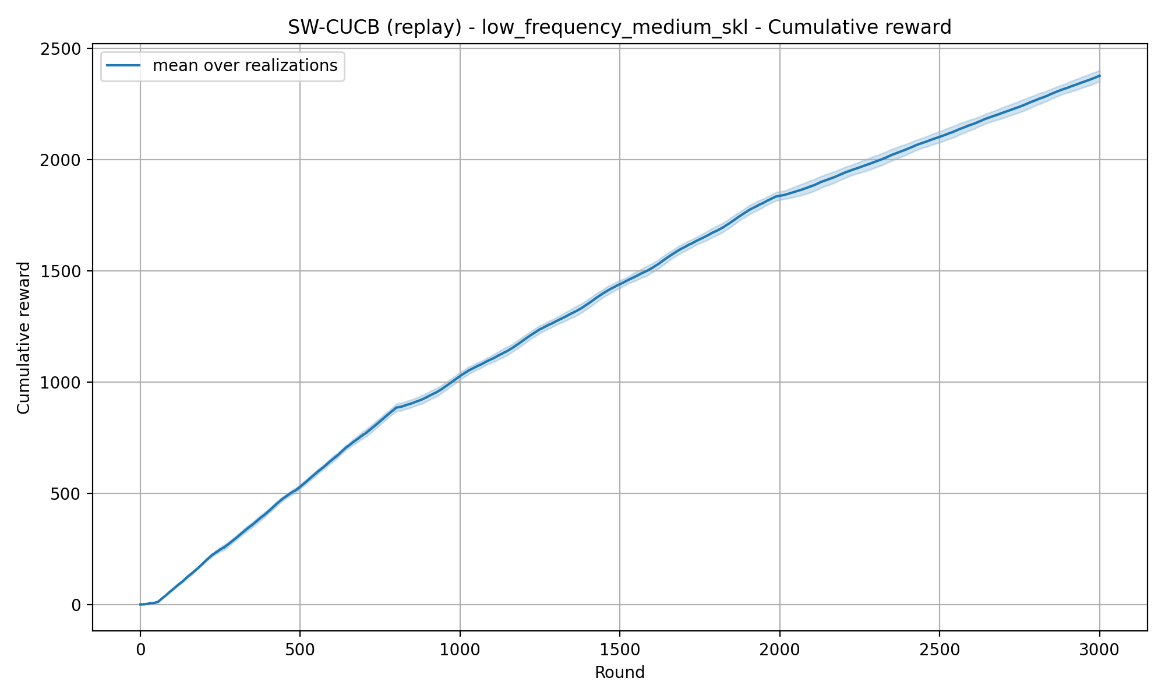
REQUIREMENT 4 · SLIDING-WINDOW CUCB
Low Frequency Medium SKL — Theory window — window=219

Slide 12
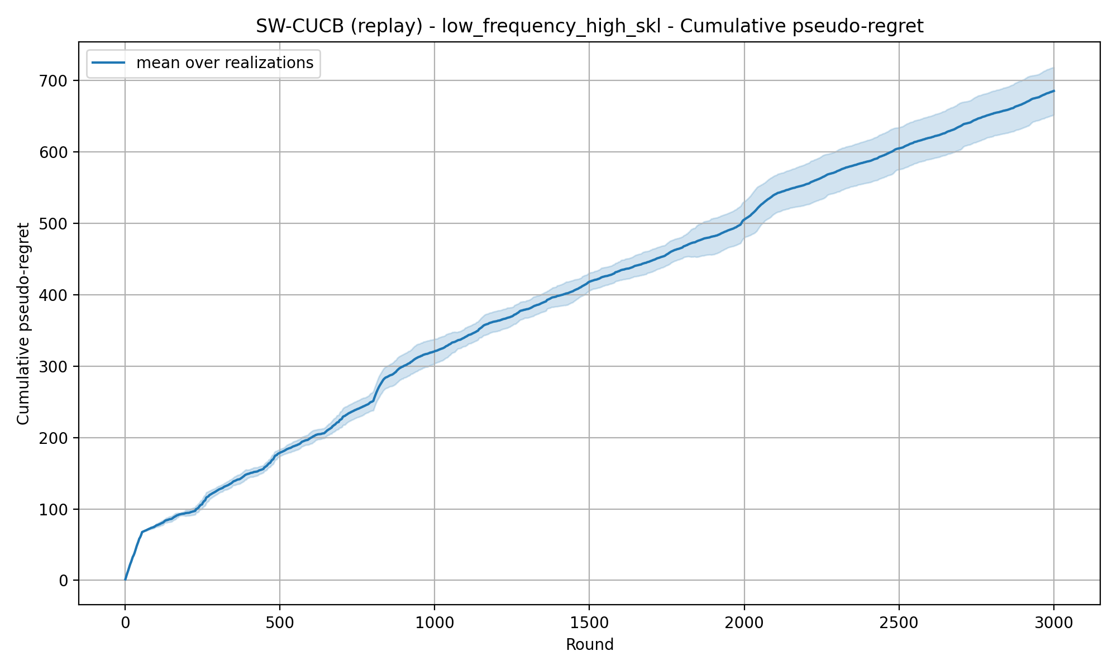
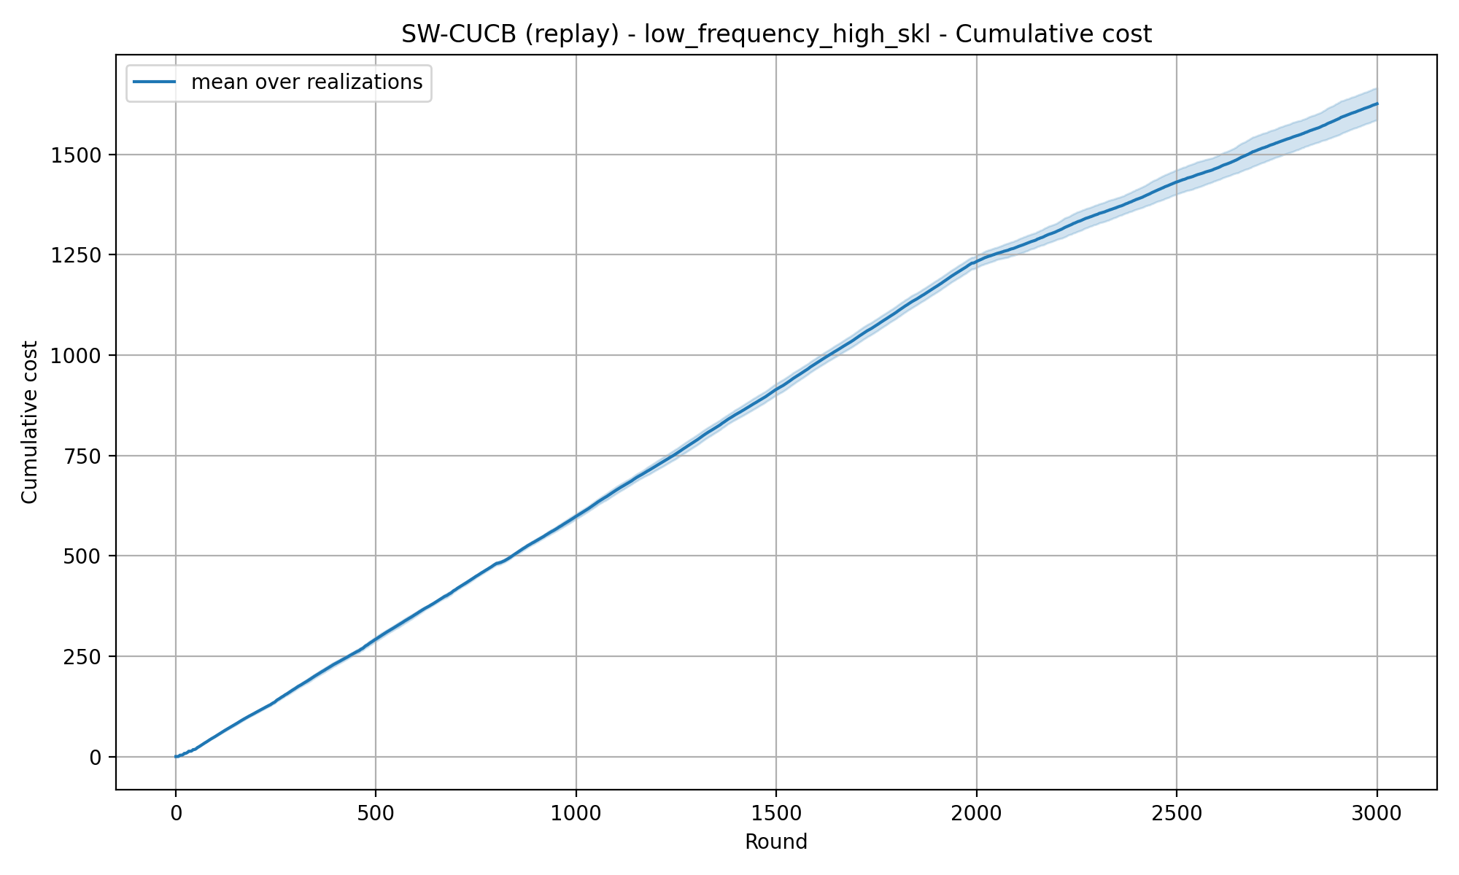
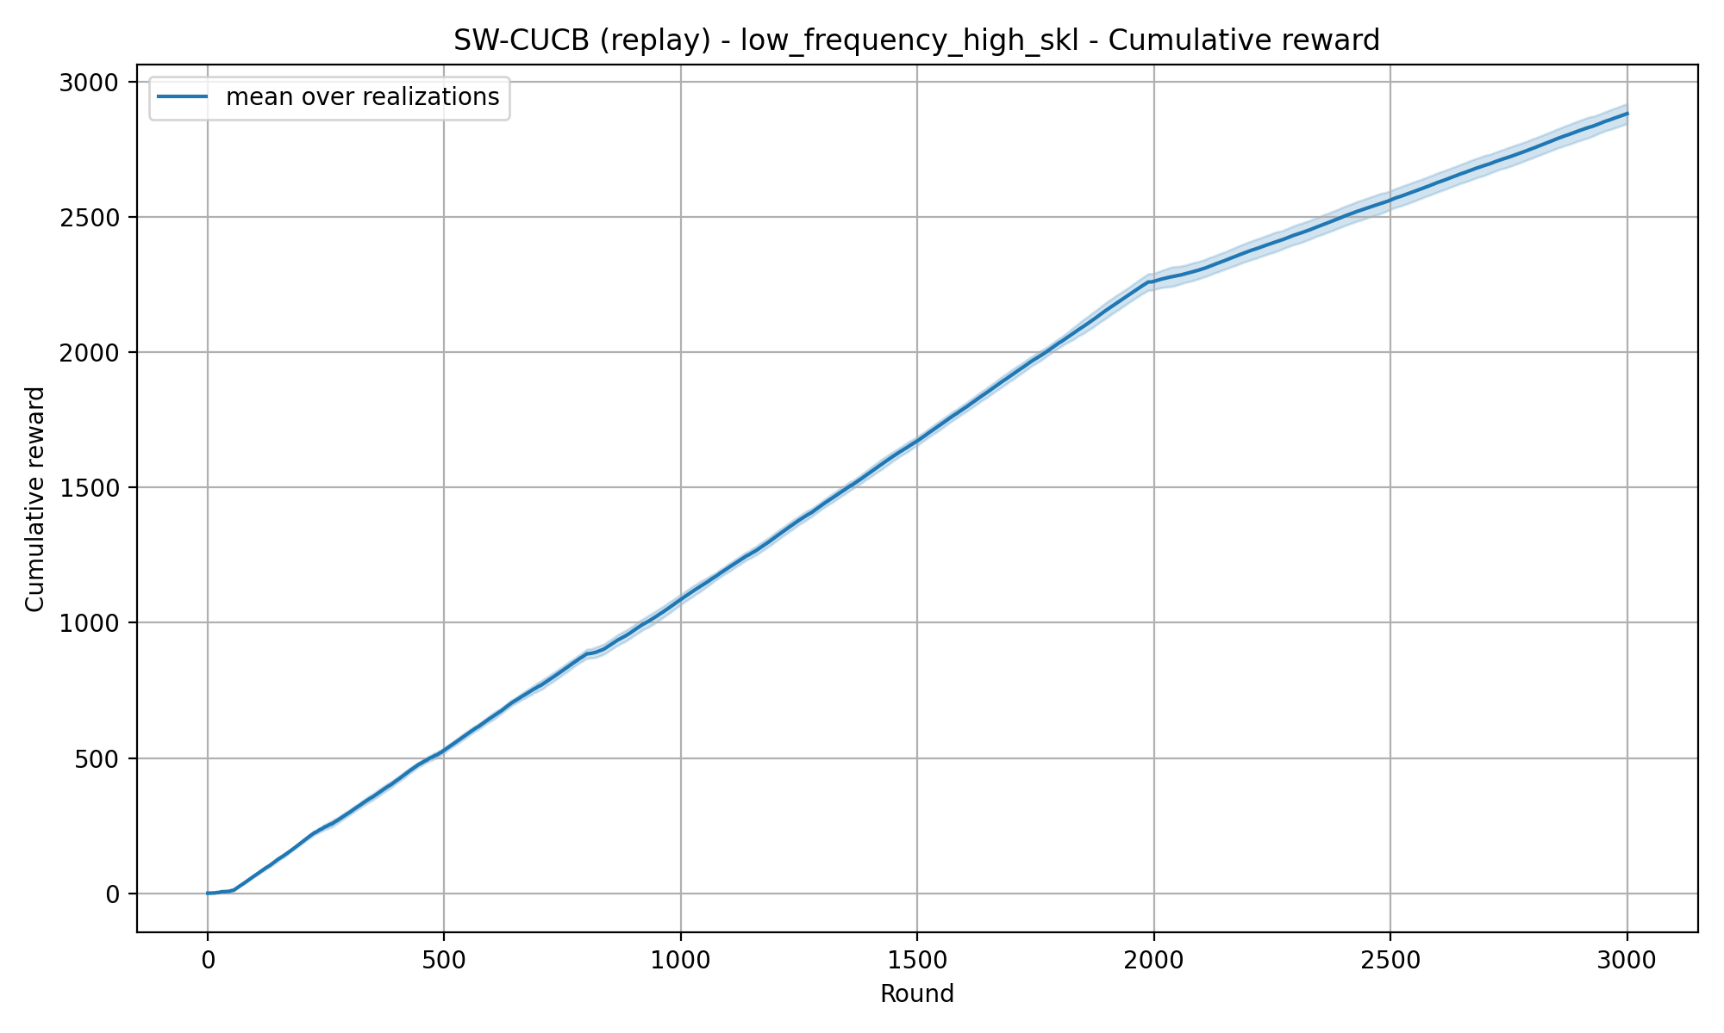
REQUIREMENT 4 · SLIDING-WINDOW CUCB
Low Frequency High SKL — Theory window — window=219

Slide 13
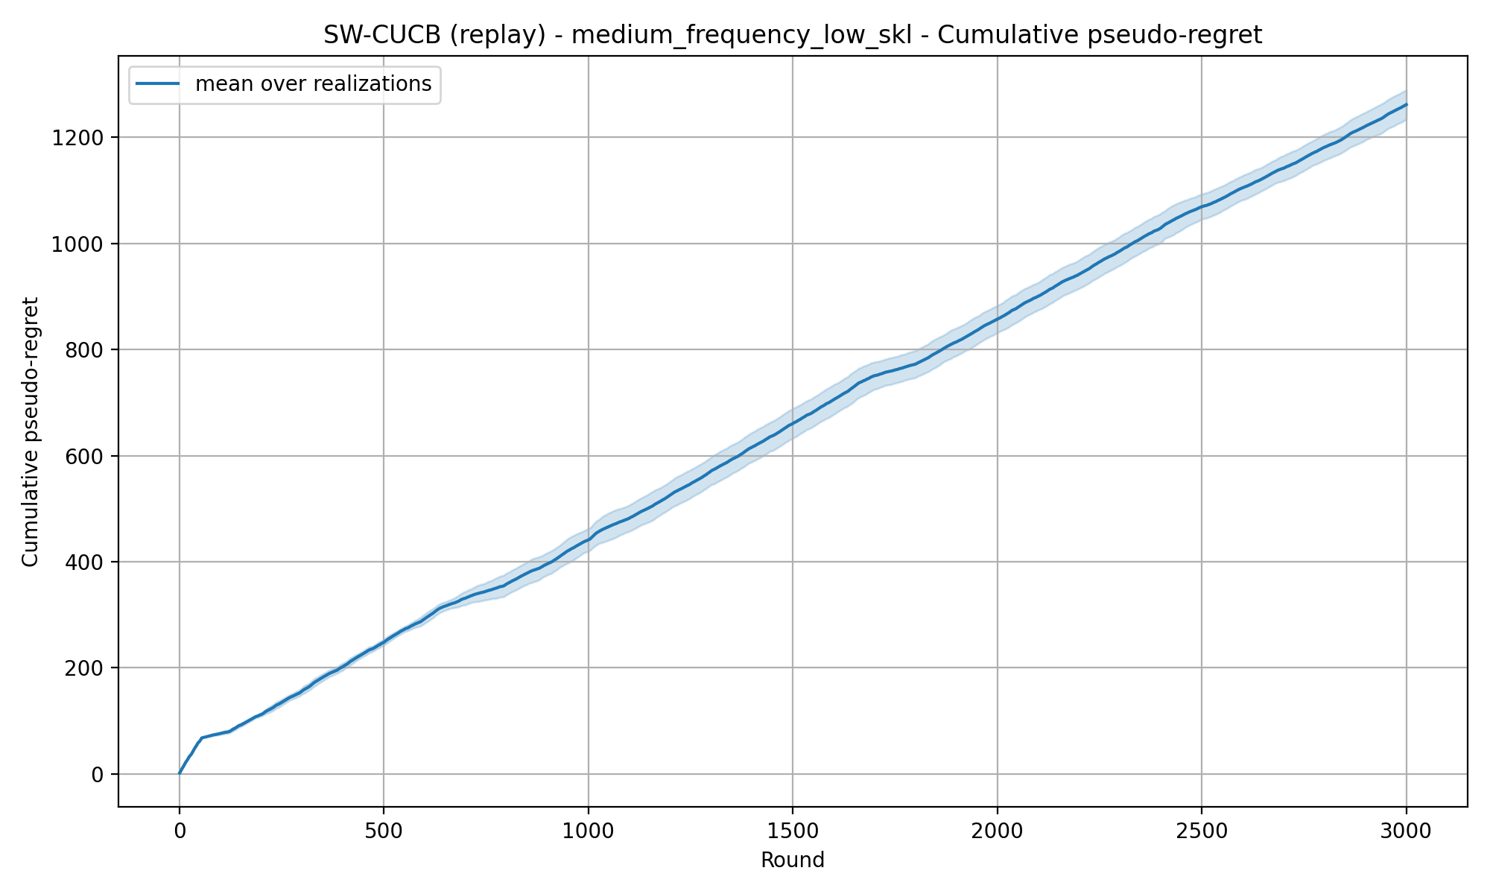
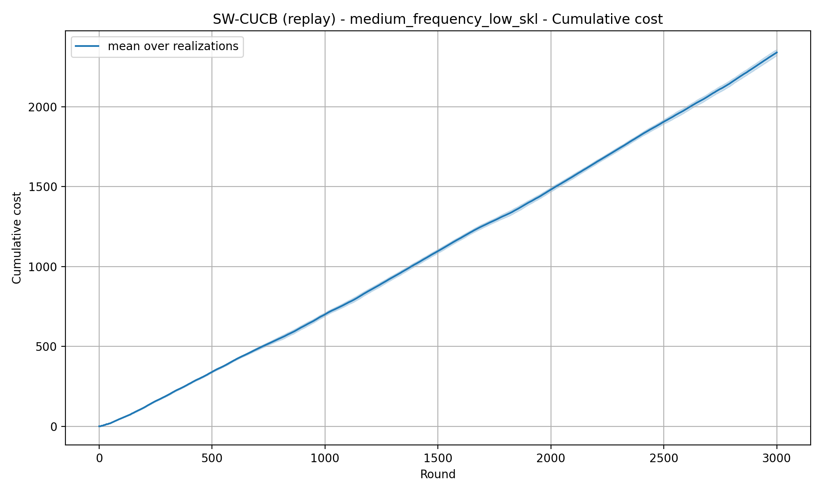
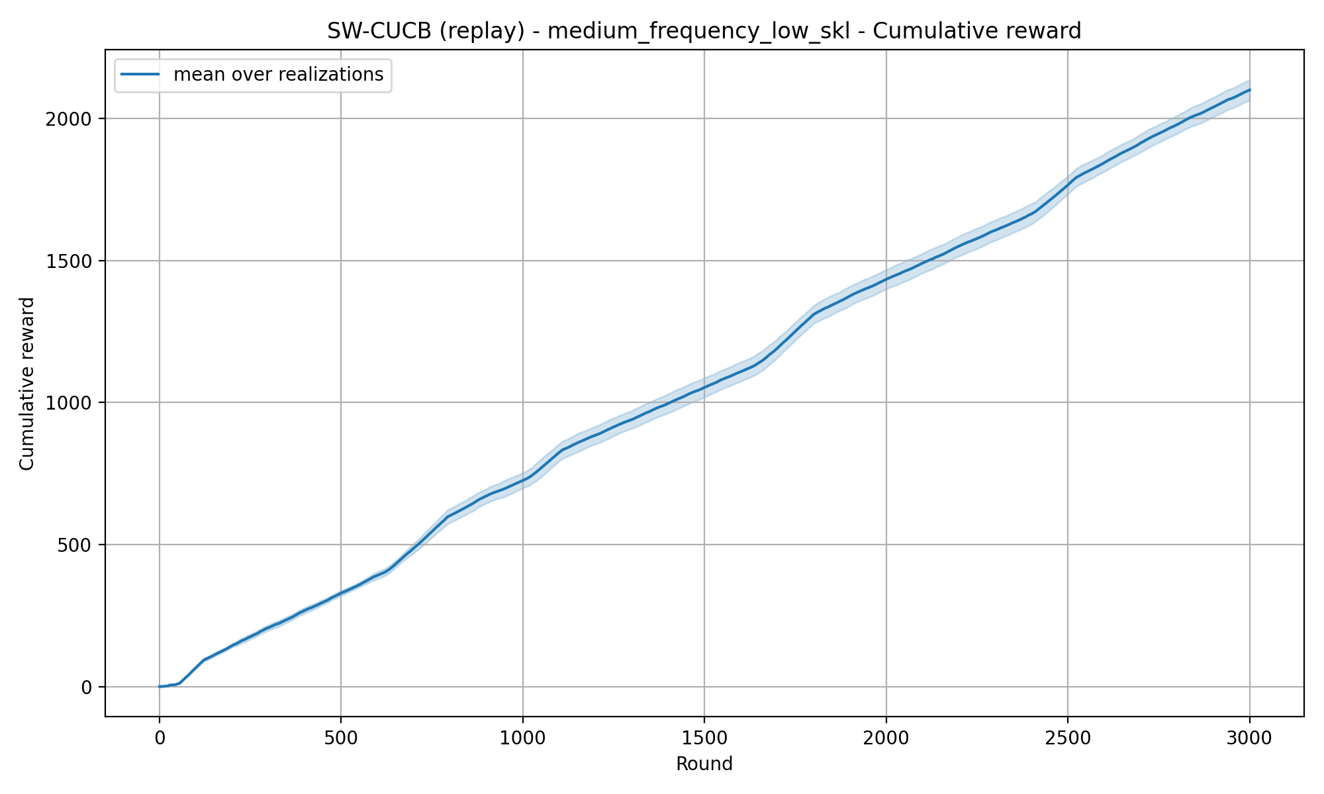
REQUIREMENT 4 · SLIDING-WINDOW CUCB
Medium Frequency Low SKL — Theory window — window=89

Slide 14
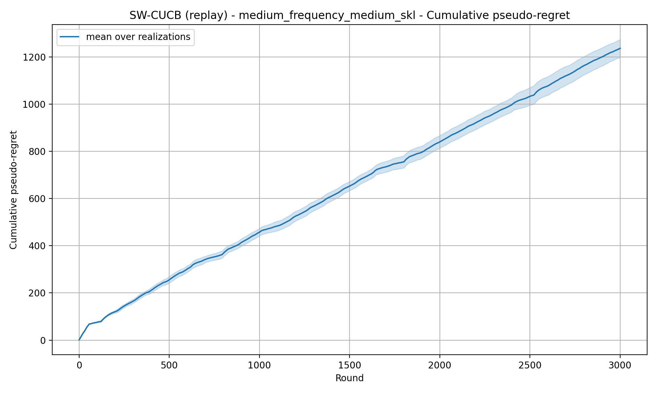

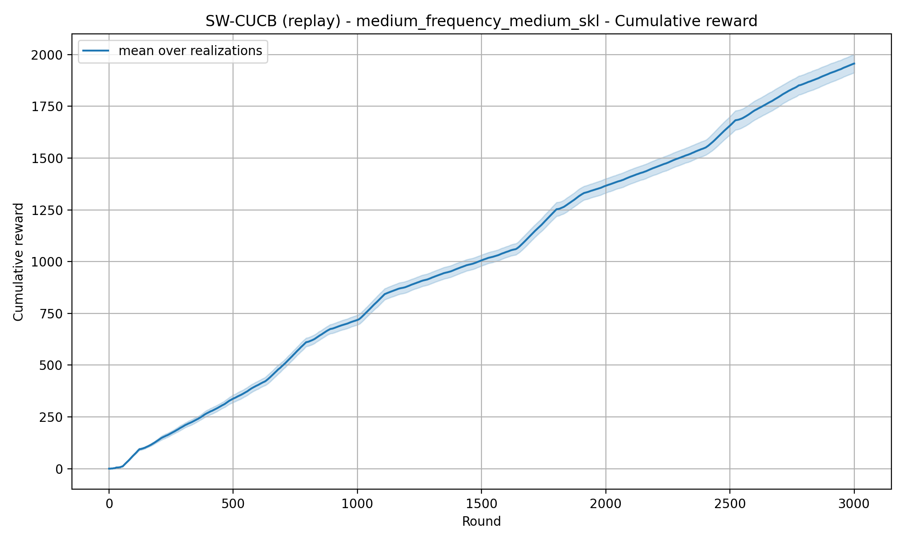
REQUIREMENT 4 · SLIDING-WINDOW CUCB
Medium Frequency Medium SKL — Theory window — window=89

Slide 15
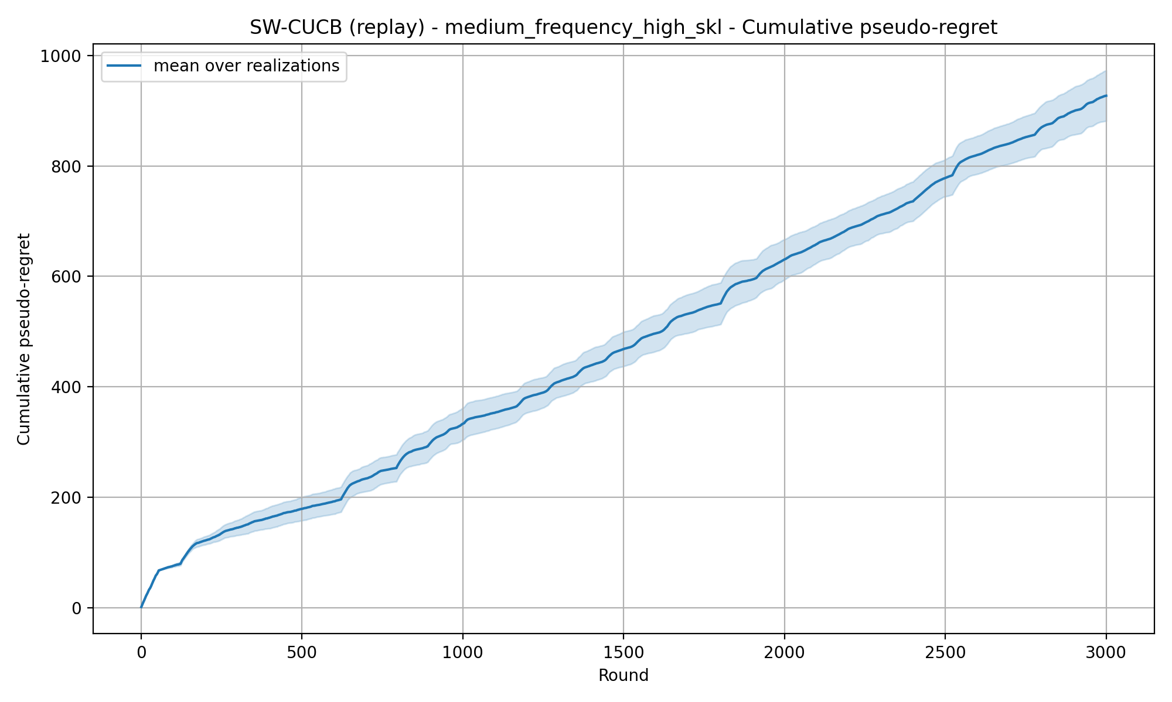
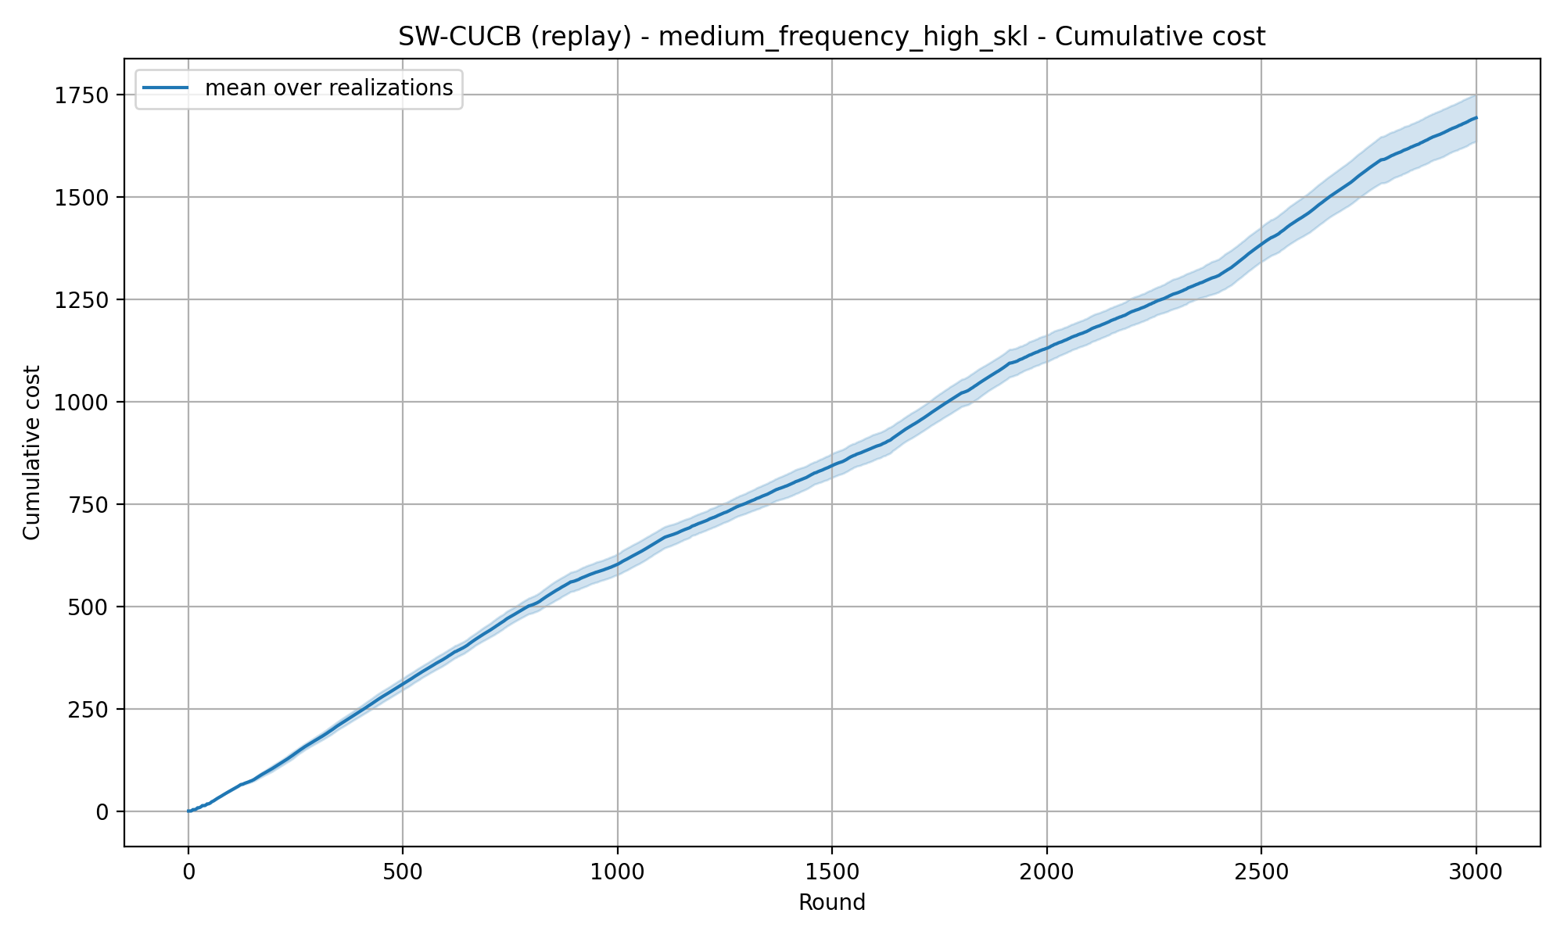
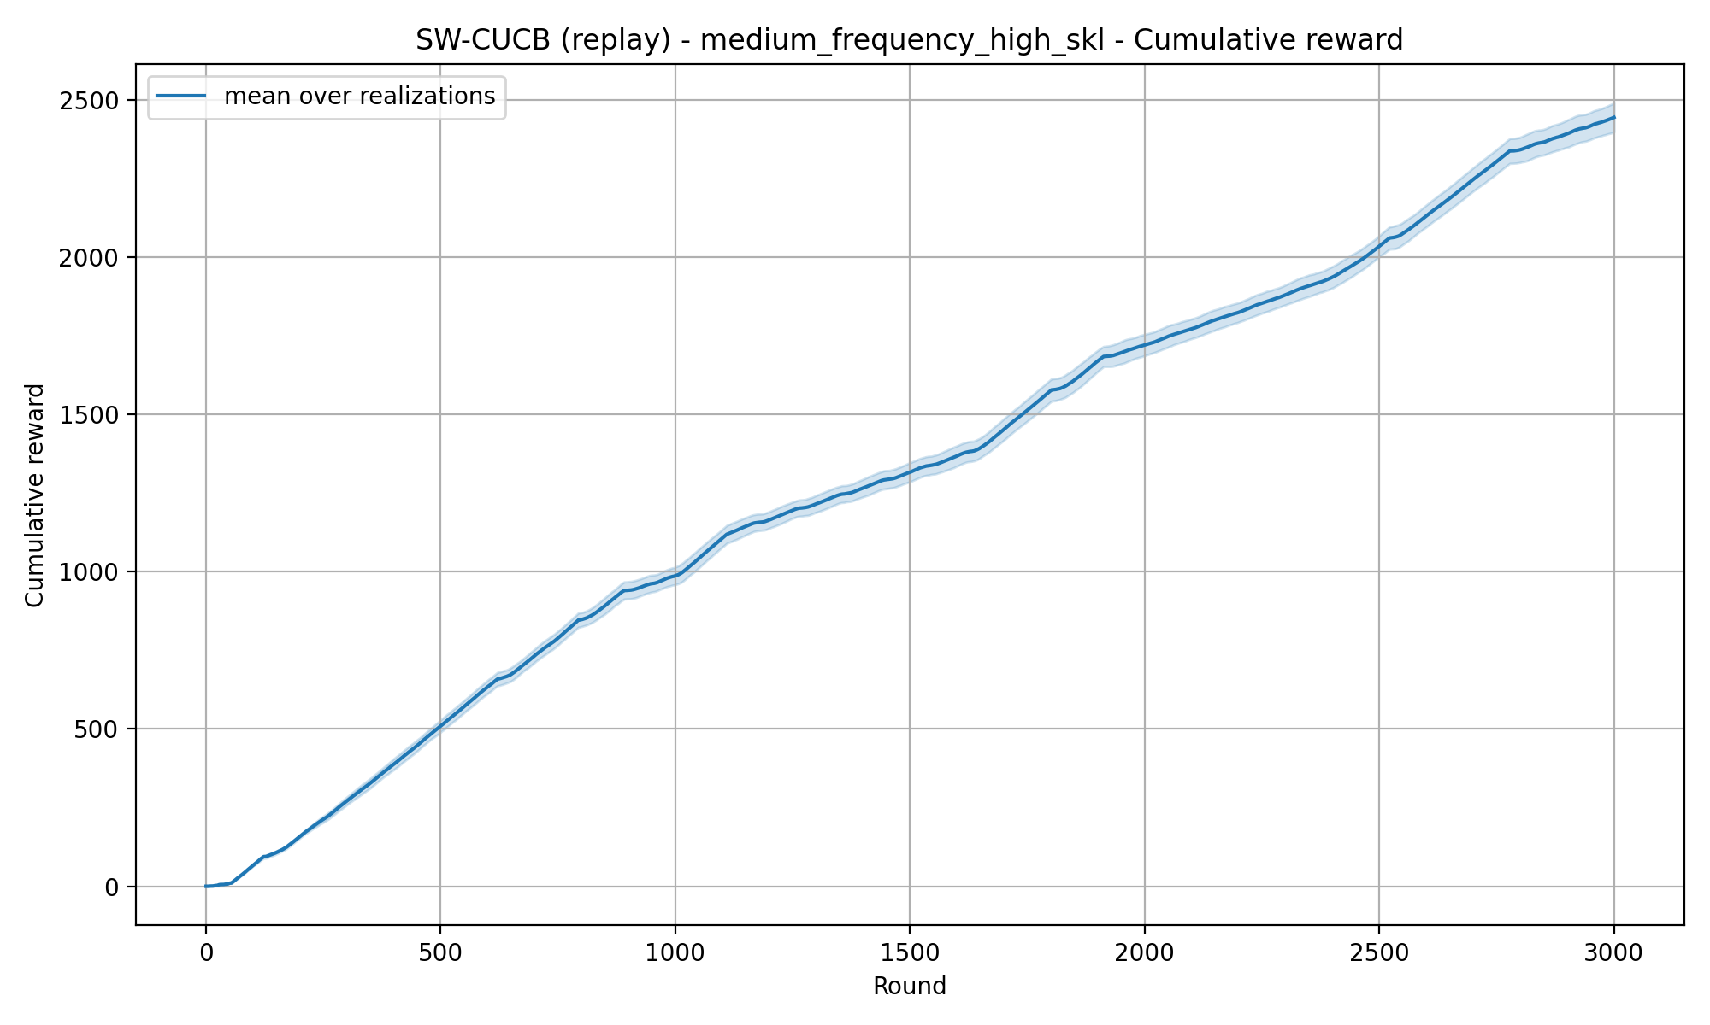
REQUIREMENT 4 · SLIDING-WINDOW CUCB
Medium Frequency High SKL — Theory window — window=89

Slide 16
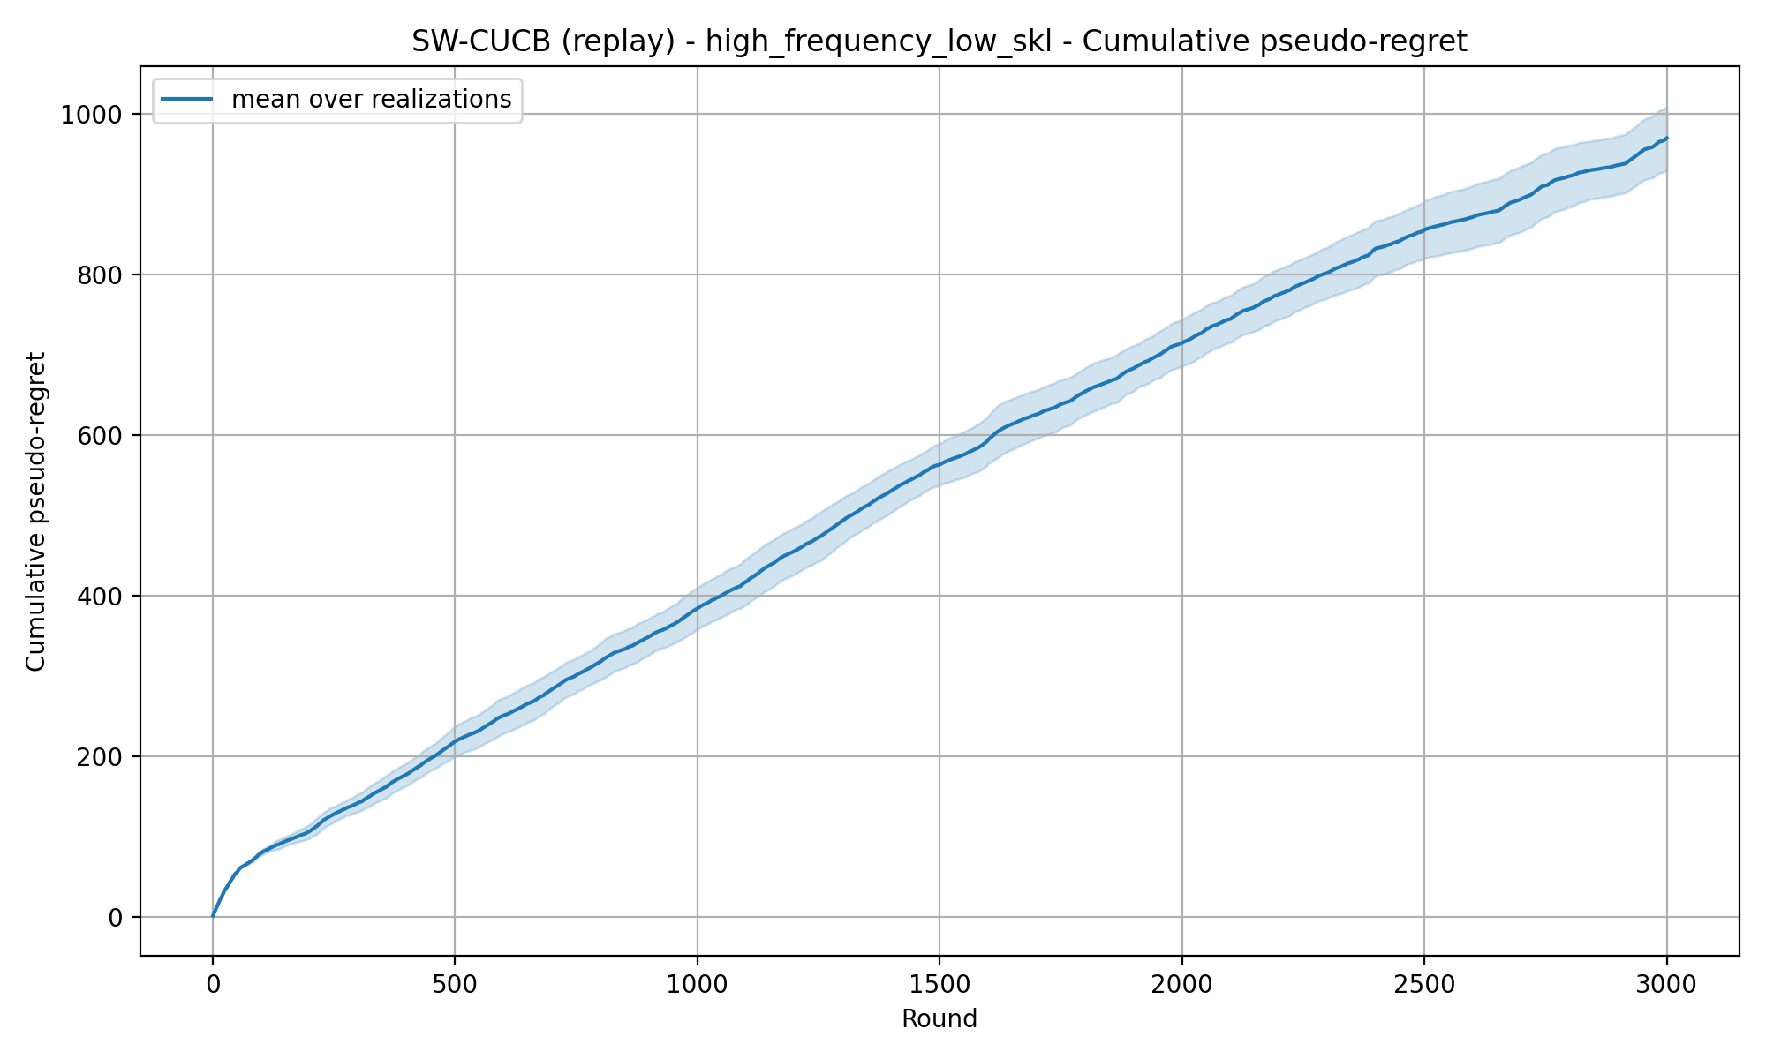
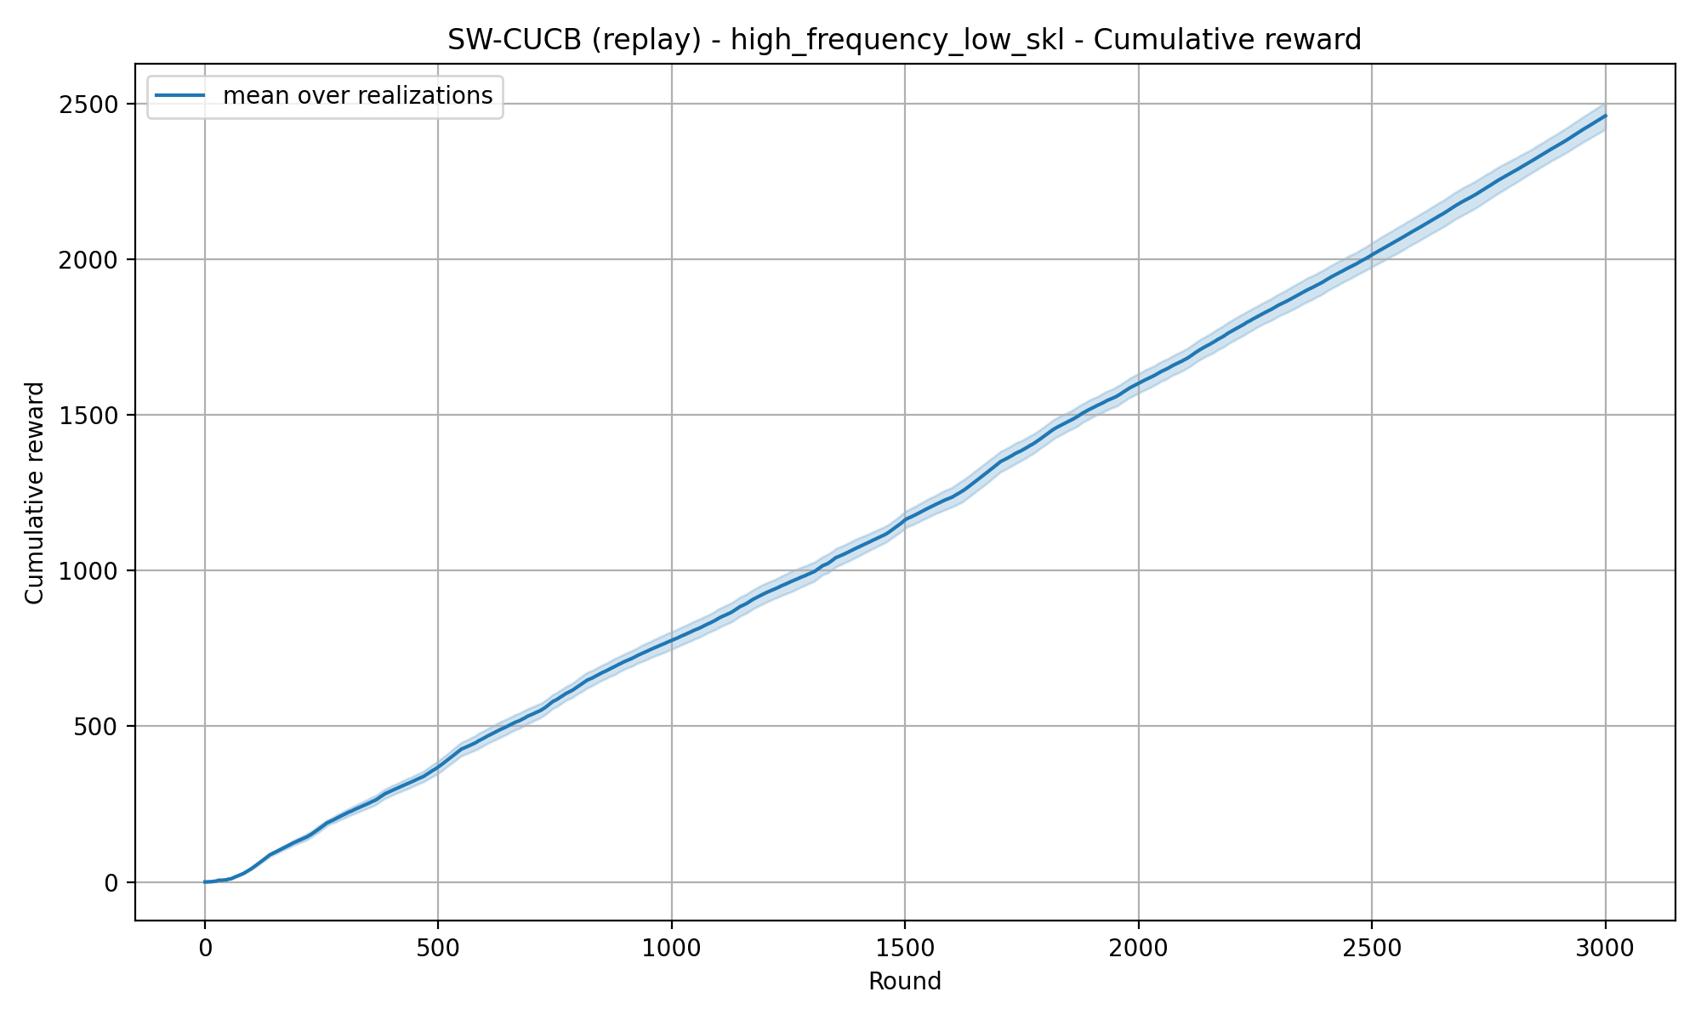

REQUIREMENT 4 · SLIDING-WINDOW CUCB
High Frequency Low SKL — Theory window — window=27

Slide 17


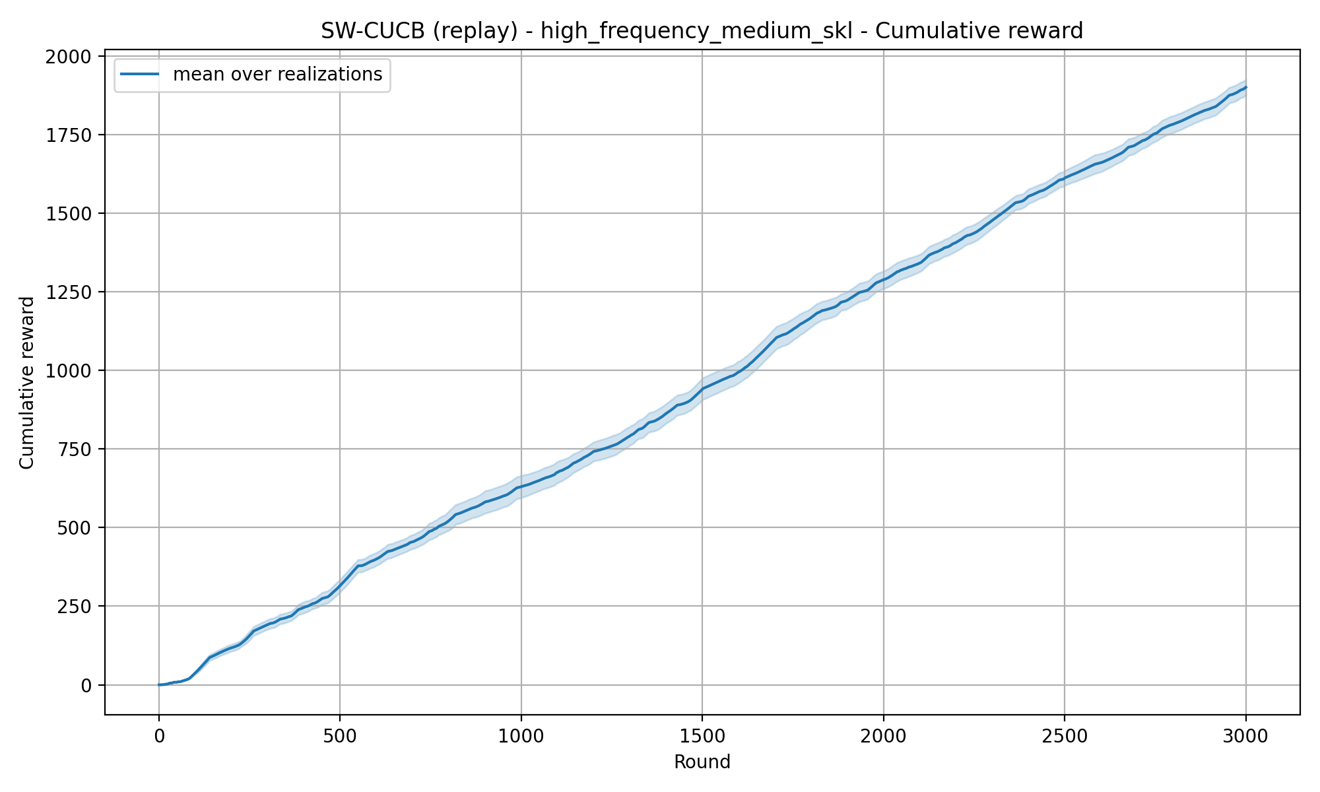
REQUIREMENT 4 · SLIDING-WINDOW CUCB
High Frequency Medium SKL — Theory window — window=27

Slide 18
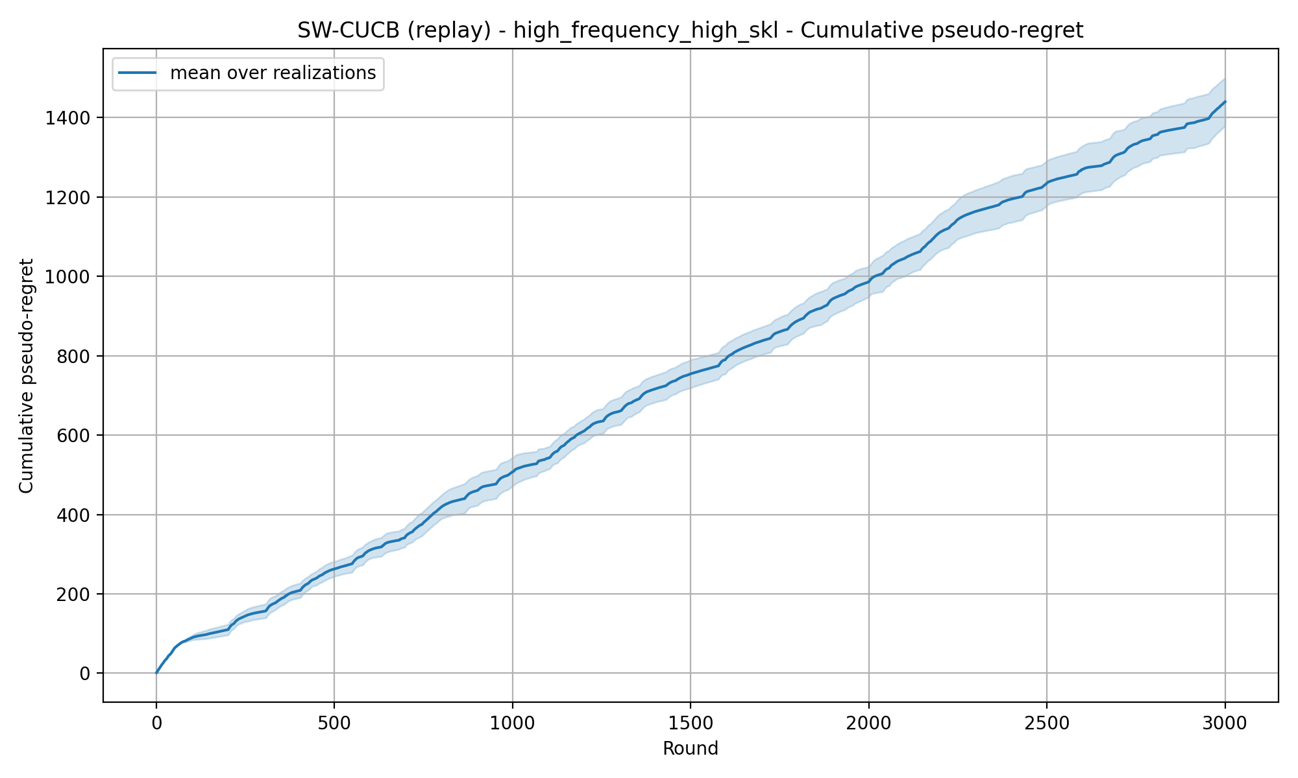

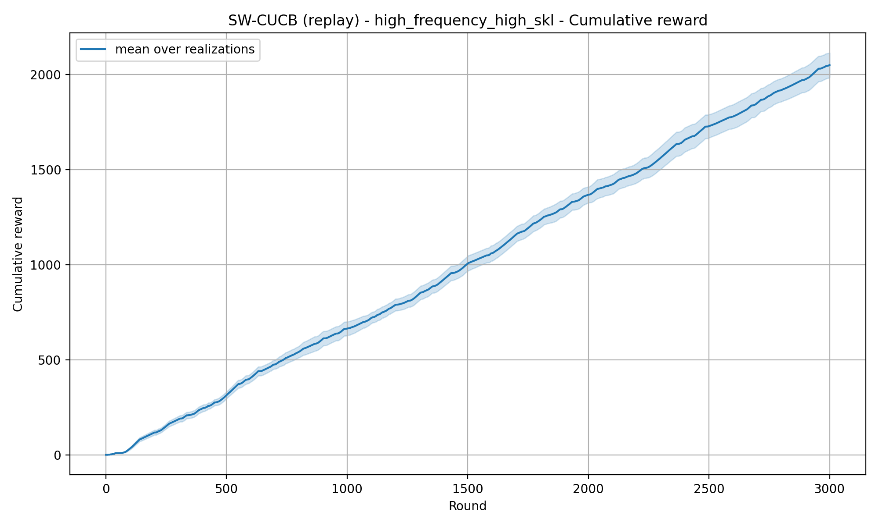
REQUIREMENT 4 · SLIDING-WINDOW CUCB
High Frequency High SKL — Theory window — window=27

Slide 19
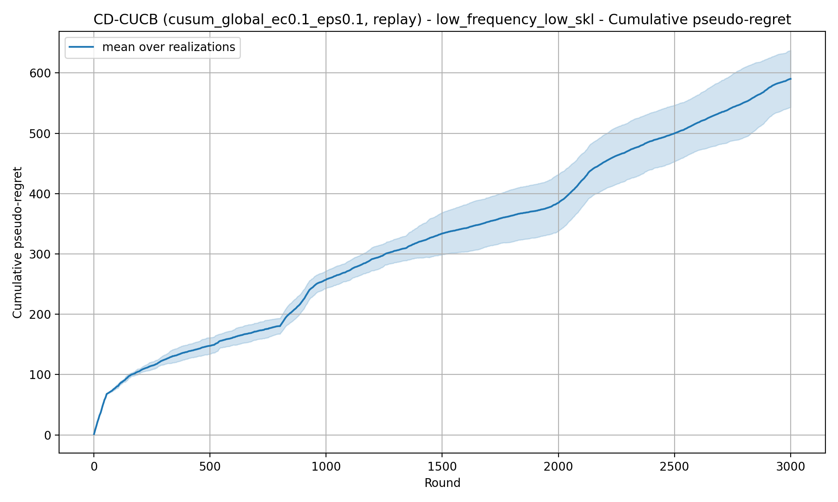
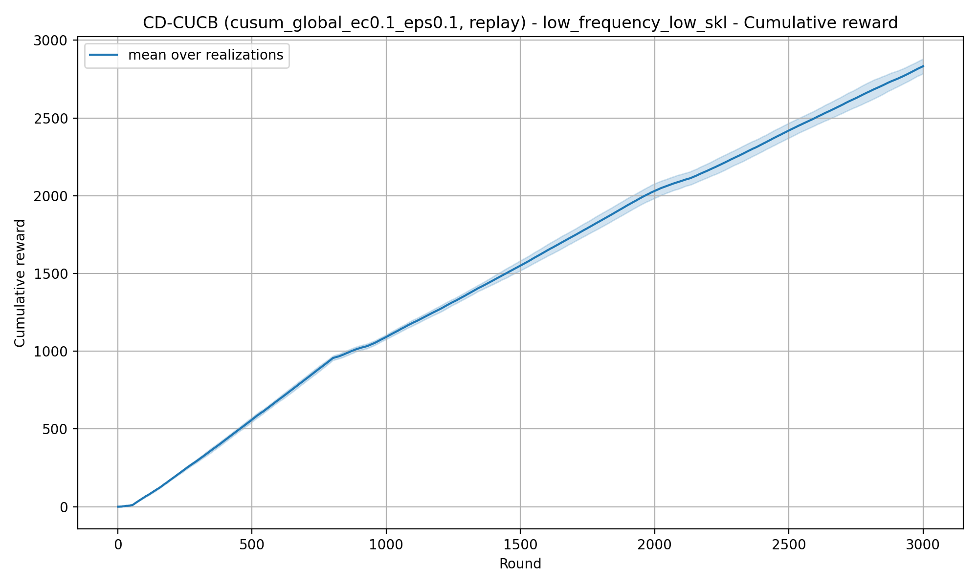
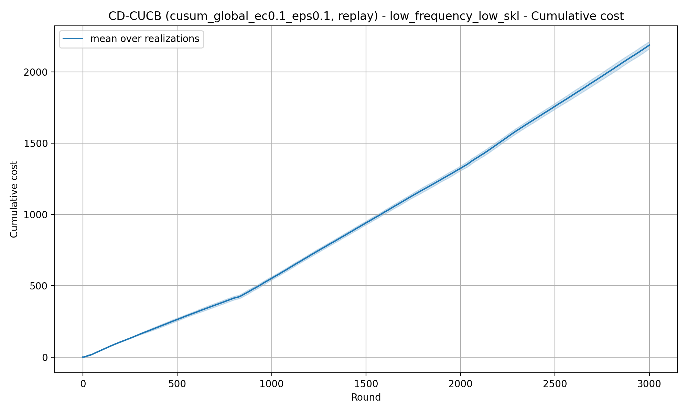
REQUIREMENT 4 · Change Detection CUSUM CUCB
Low Frequency Low SKL — Global Reset — eps=0.1 — ec=0.1

Slide 20
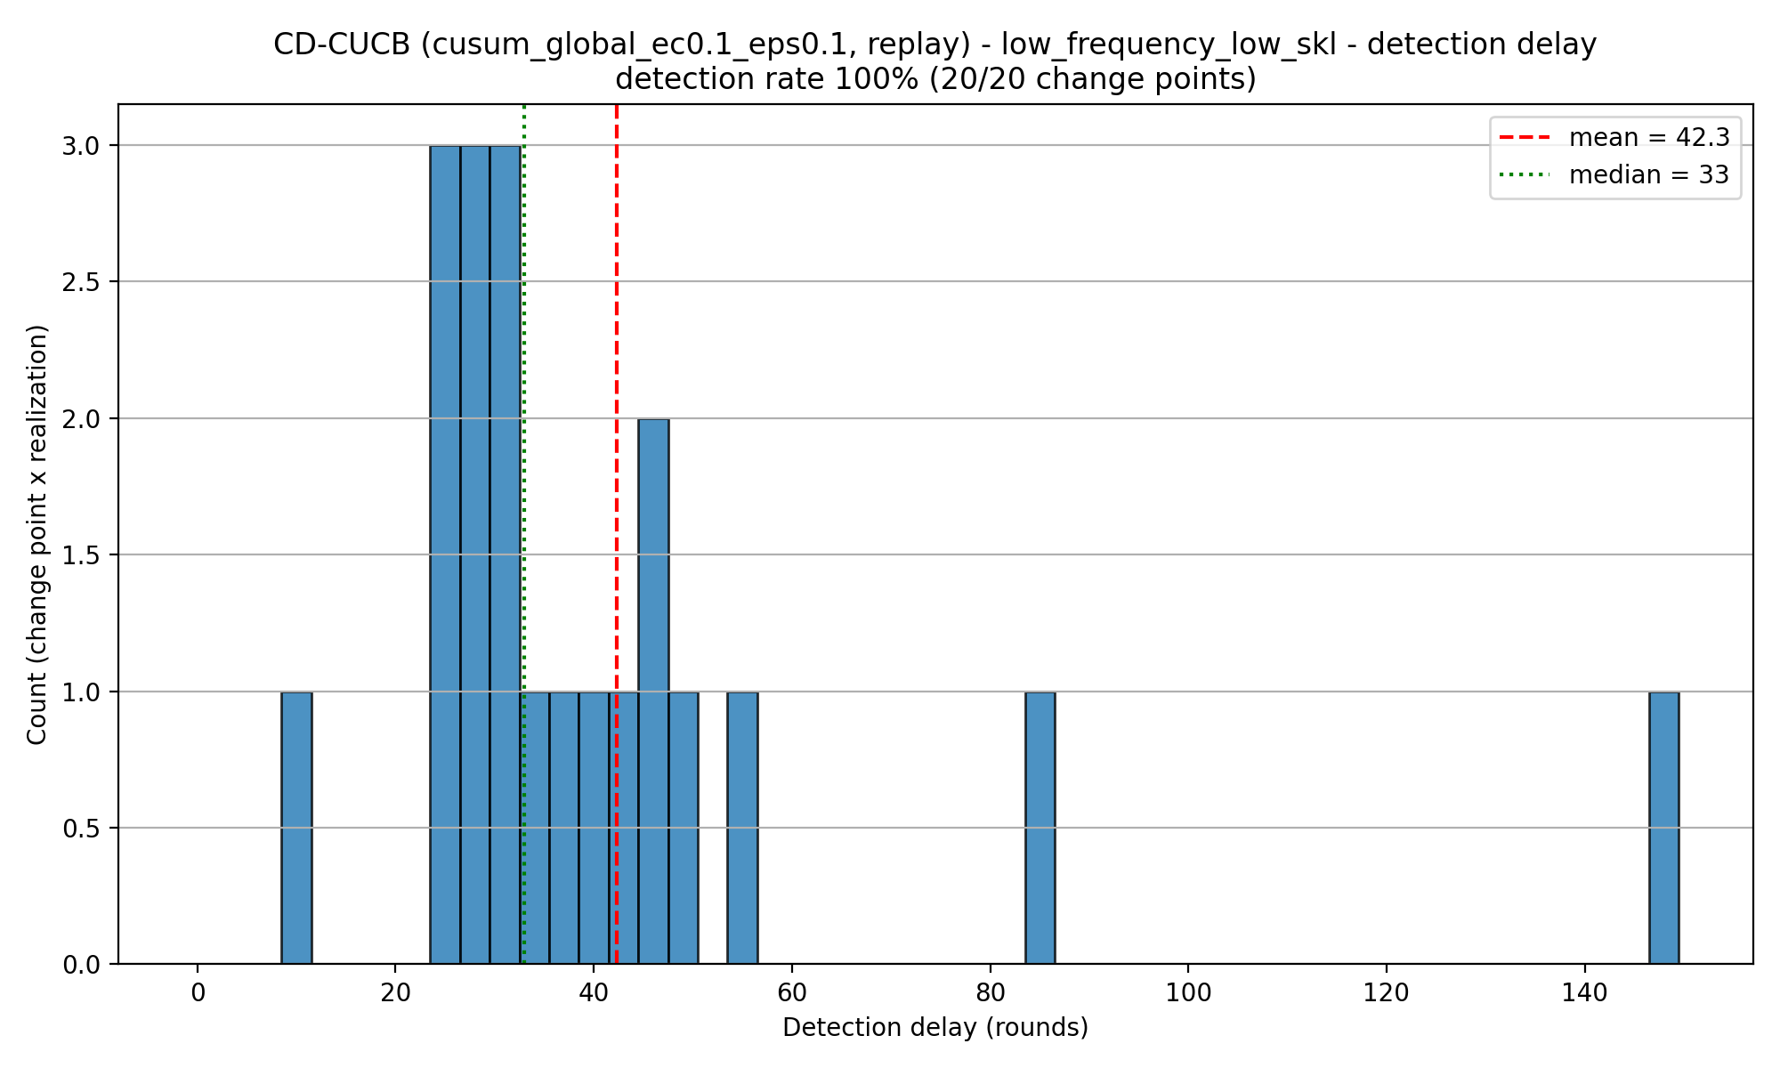
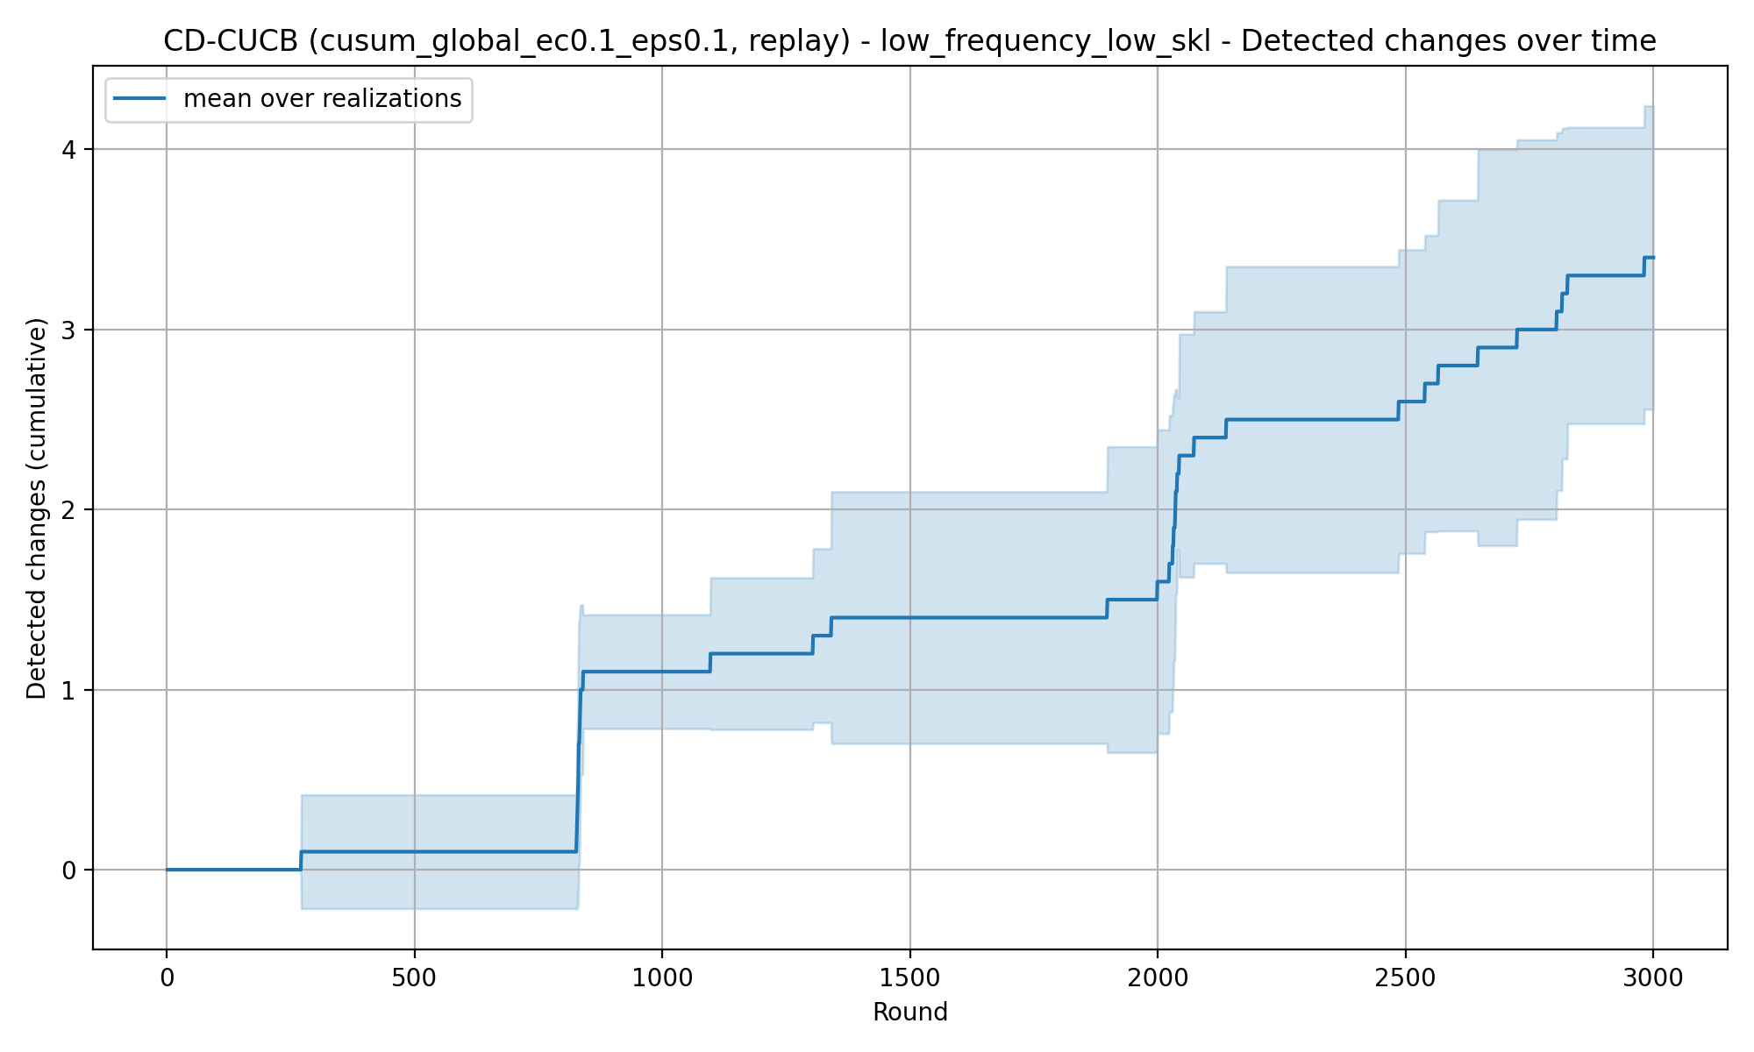
REQUIREMENT 4 · Change Detection CUSUM CUCB
Low Frequency Low SKL — Global Reset — eps=0.1 — ec=0.1

Slide 21
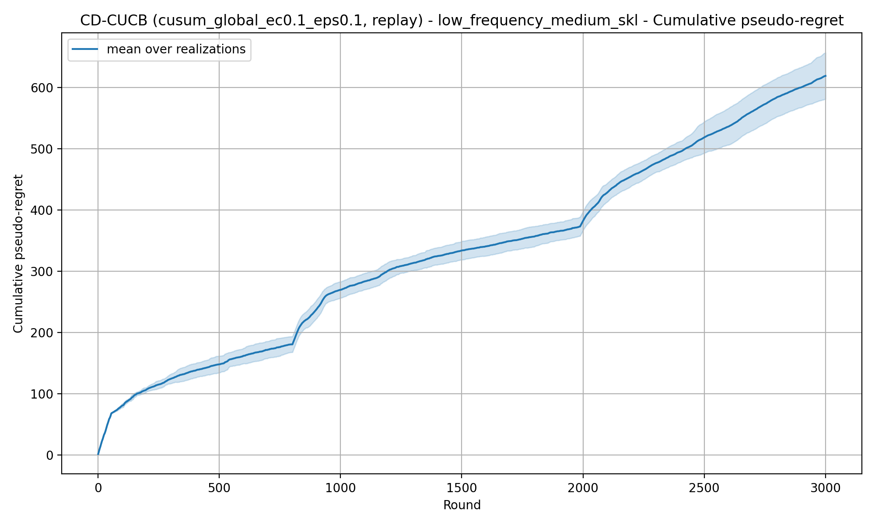

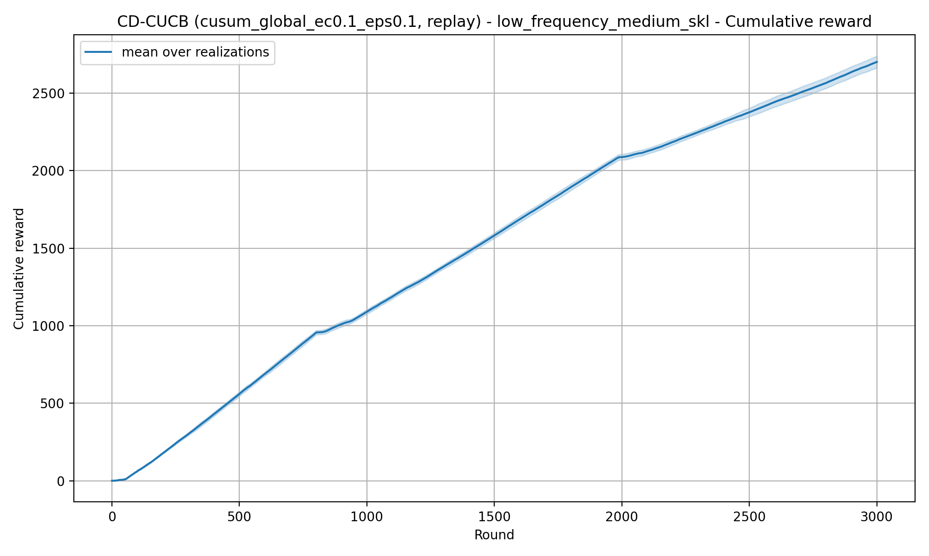
REQUIREMENT 4 · Change Detection CUSUM CUCB
Low Frequency Medium SKL — Global Reset — eps=0.1 — ec=0.1

Slide 22
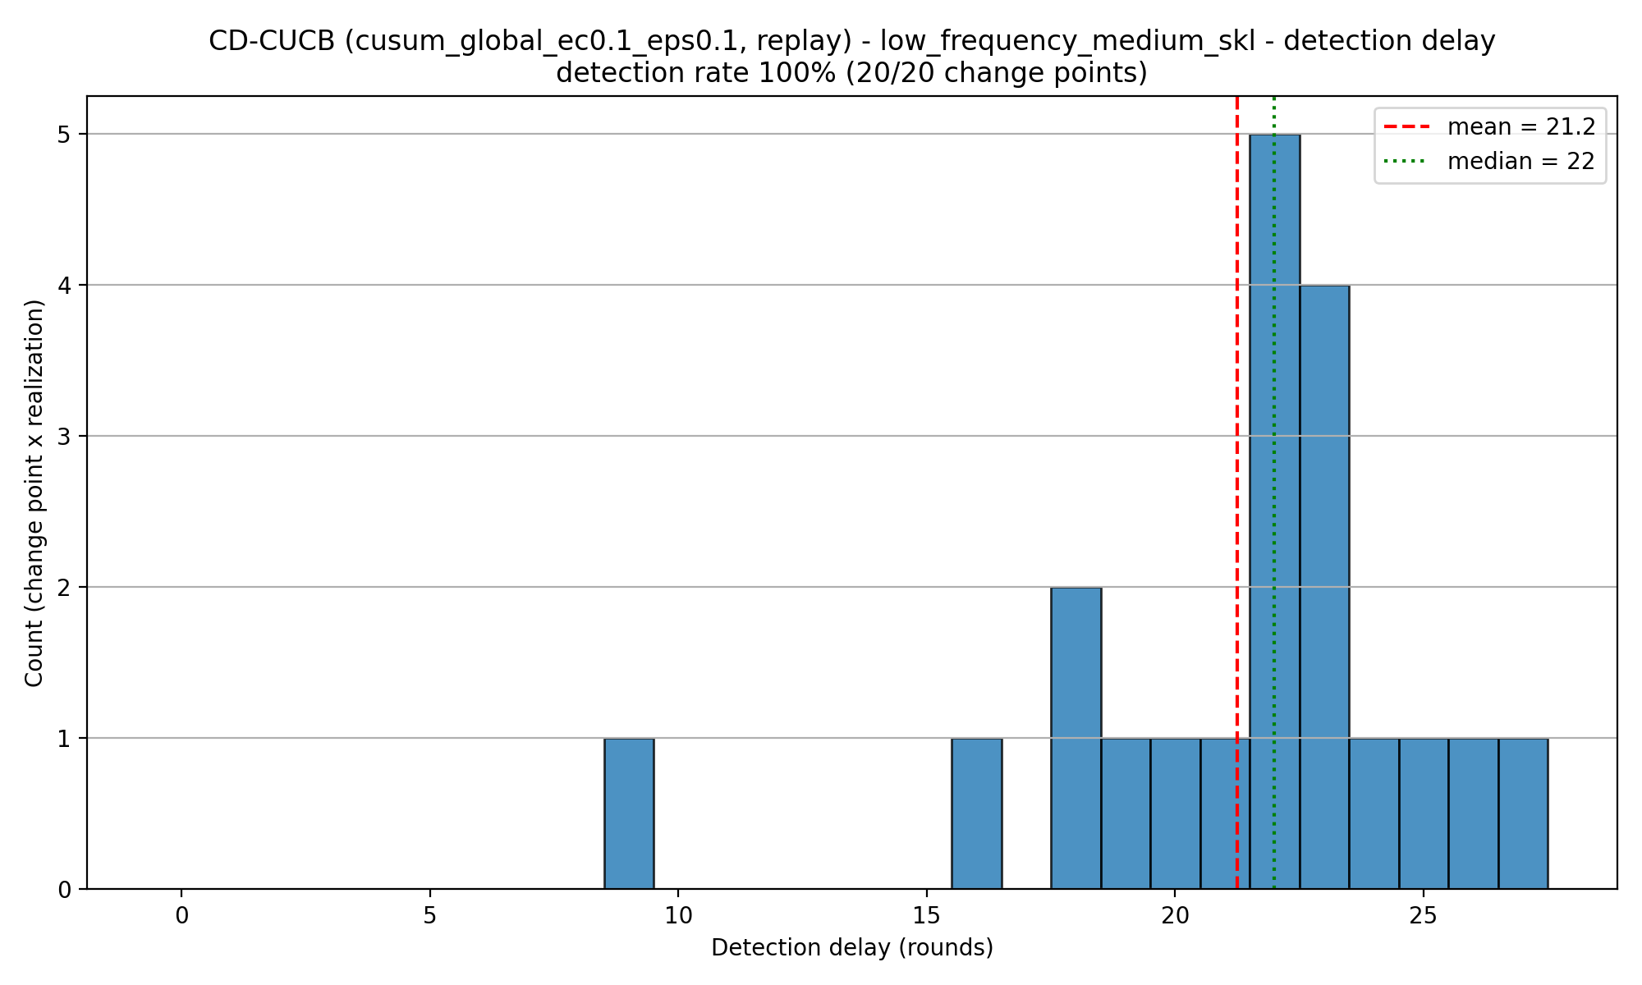
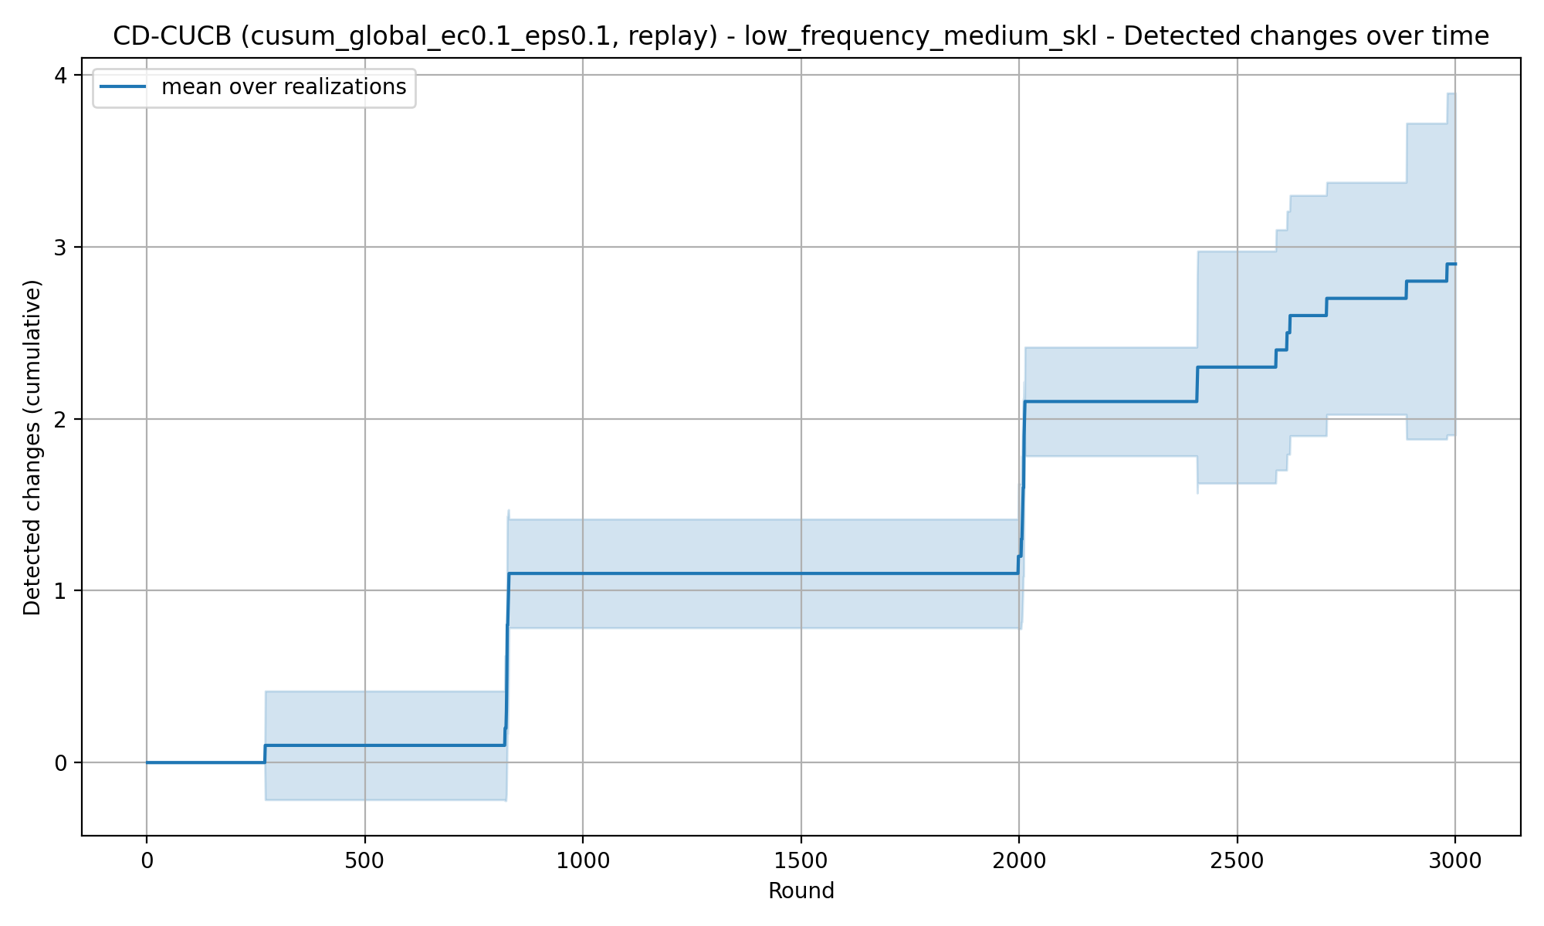
REQUIREMENT 4 · Change Detection CUSUM CUCB
Low Frequency Medium SKL — Global Reset — eps=0.1 — ec=0.1

Slide 23
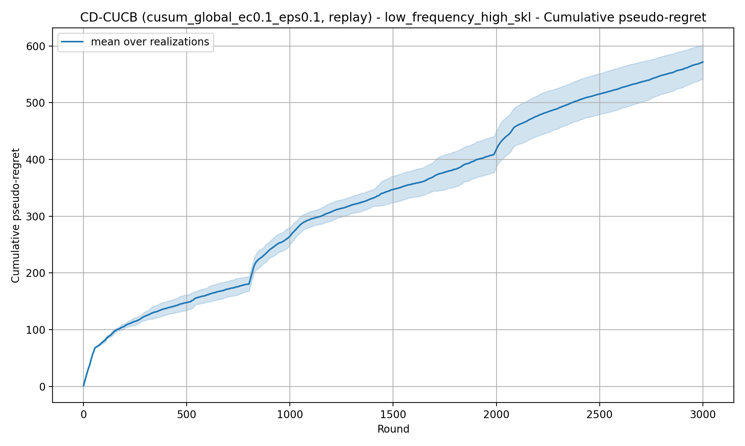
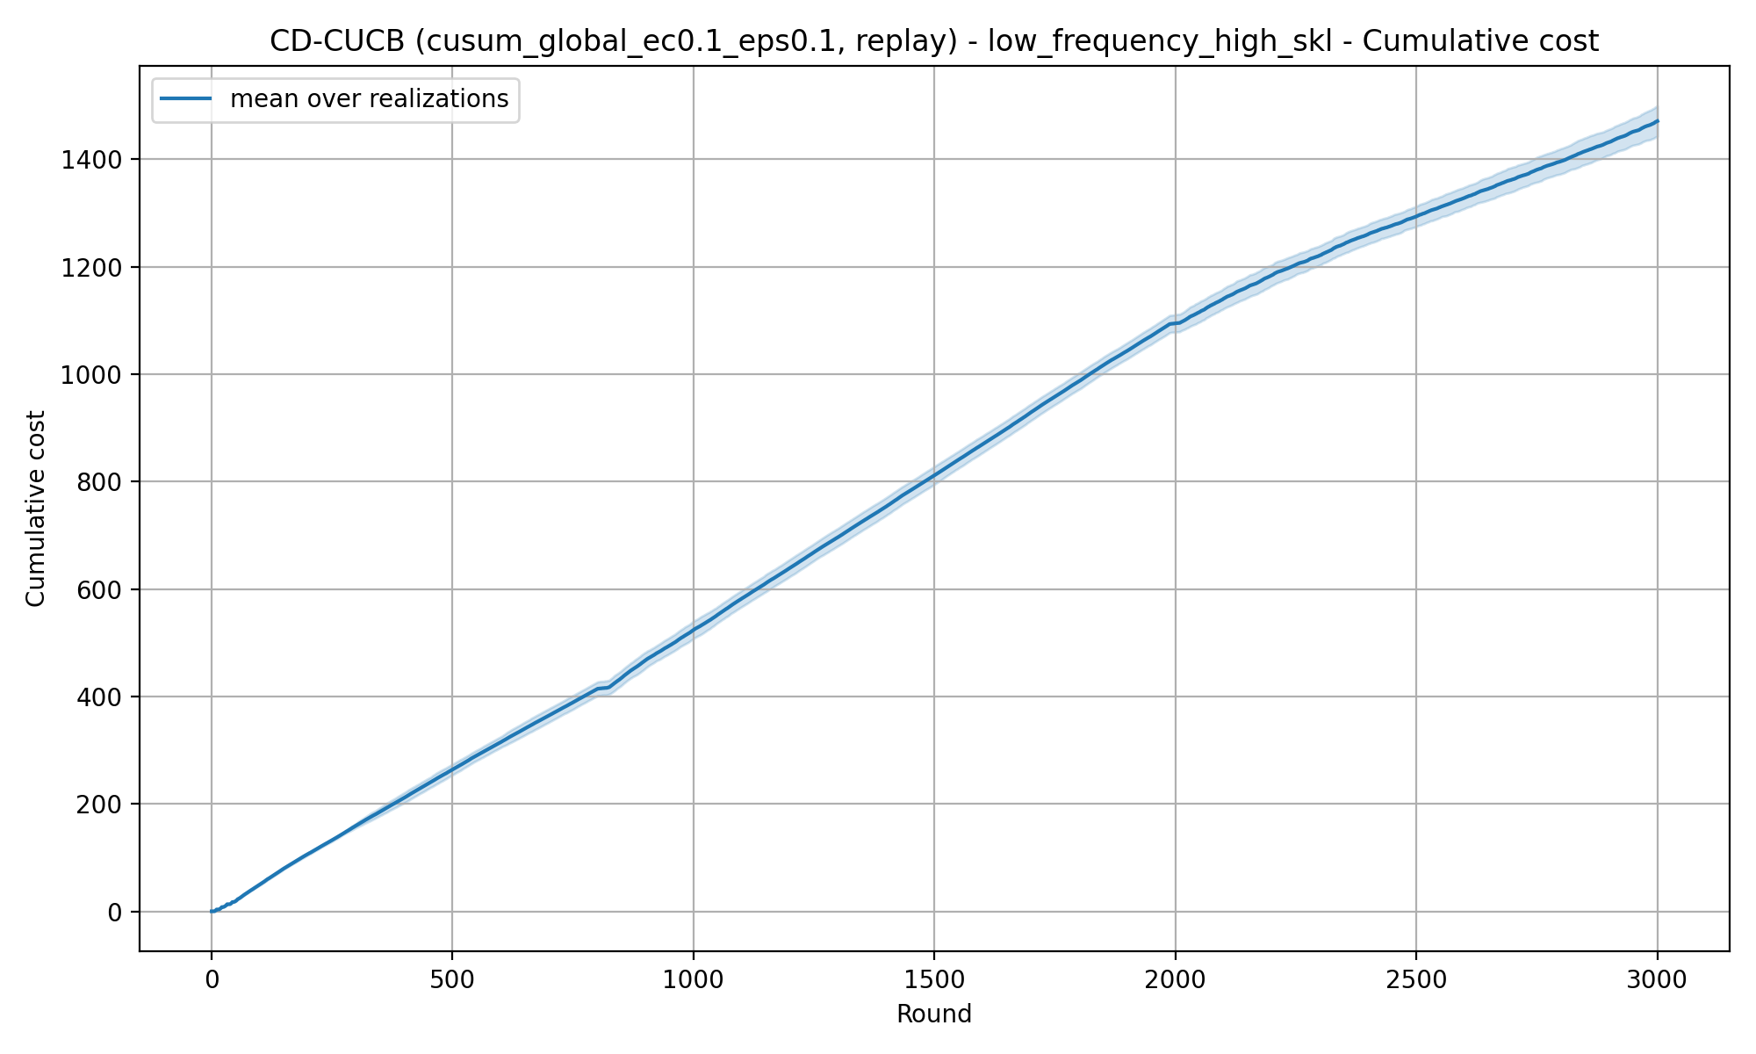

REQUIREMENT 4 · Change Detection CUSUM CUCB
Low Frequency High SKL — Global Reset — eps=0.1 — ec=0.1

Slide 24


REQUIREMENT 4 · Change Detection CUSUM CUCB
Low Frequency High SKL — Global Reset — eps=0.1 — ec=0.1

Slide 25


REQUIREMENT 4 · Change Detection CUSUM CUCB
Medium Frequency Low SKL — Global Reset — eps=0.1 — ec=0.1

Slide 26
REQUIREMENT 4 · Change Detection CUSUM CUCB
Medium Frequency Low SKL — Global Reset — eps=0.1 — ec=0.1

Slide 27
REQUIREMENT 4 · Change Detection CUSUM CUCB
Medium Frequency Medium SKL — Global Reset — eps=0.1 — ec=0.1

Slide 28
REQUIREMENT 4 · Change Detection CUSUM CUCB
Medium Frequency Medium SKL — Global Reset — eps=0.1 — ec=0.1

Slide 29
REQUIREMENT 4 · Change Detection CUSUM CUCB
Medium Frequency High SKL — Global Reset — eps=0.1 — ec=0.1

Slide 30
REQUIREMENT 4 · Change Detection CUSUM CUCB
Medium Frequency High SKL — Global Reset — eps=0.1 — ec=0.1

Slide 31
REQUIREMENT 4 · Change Detection CUSUM CUCB
High Frequency Low SKL — Global Reset — eps=0.1 — ec=0.1

Slide 32
REQUIREMENT 4 · Change Detection CUSUM CUCB
High Frequency Low SKL — Global Reset — eps=0.1 — ec=0.1

Slide 33
REQUIREMENT 4 · Change Detection CUSUM CUCB
High Frequency Medium SKL — Global Reset — eps=0.1 — ec=0.1

Slide 34
REQUIREMENT 4 · Change Detection CUSUM CUCB
High Frequency Medium SKL — Global Reset — eps=0.1 — ec=0.1

Slide 35
REQUIREMENT 4 · Change Detection CUSUM CUCB
High Frequency High SKL — Global Reset — eps=0.1 — ec=0.1

Slide 36
REQUIREMENT 4 · Change Detection CUSUM CUCB
High Frequency High SKL — Global Reset — eps=0.1 — ec=0.1

Slide 37
REQUIREMENT 4 · Change Detection Normal Discrepancy CUCB
Low Frequency Low SKL — window=50 — eps=0.1

Slide 38
REQUIREMENT 4 · Change Detection Normal Discrepancy CUCB
Low Frequency Low SKL — window=50 — eps=0.1

Slide 39
REQUIREMENT 4 · Change Detection Normal Discrepancy CUCB
Low Frequency Medium SKL — window=50 — eps=0.1

Slide 40
REQUIREMENT 4 · Change Detection Normal Discrepancy CUCB
Low Frequency Medium SKL — window=50 — eps=0.1

Slide 41
REQUIREMENT 4 · Change Detection Normal Discrepancy CUCB
Low Frequency High SKL — window=50 — eps=0.1

Slide 42
REQUIREMENT 4 · Change Detection Normal Discrepancy CUCB
Low Frequency High SKL — window=50 — eps=0.1

Slide 43
REQUIREMENT 4 · Change Detection Normal Discrepancy CUCB
Medium Frequency Low SKL — window=50 — eps=0.1

Slide 44
REQUIREMENT 4 · Change Detection Normal Discrepancy CUCB
Medium Frequency Low SKL — window=50 — eps=0.1

Slide 45
REQUIREMENT 4 · Change Detection Normal Discrepancy CUCB
Medium Frequency Medium SKL — window=50 — eps=0.1

Slide 46
REQUIREMENT 4 · Change Detection Normal Discrepancy CUCB
Medium Frequency Medium SKL — window=50 — eps=0.1

Slide 47
REQUIREMENT 4 · Change Detection Normal Discrepancy CUCB
Medium Frequency High SKL — window=50 — eps=0.1

Slide 48
REQUIREMENT 4 · Change Detection Normal Discrepancy CUCB
Medium Frequency High SKL — window=50 — eps=0.1

Slide 49
REQUIREMENT 4 · Change Detection Normal Discrepancy CUCB
High Frequency Low SKL — window=50 — eps=0.1

Slide 50


REQUIREMENT 4 · Change Detection Normal Discrepancy CUCB
High Frequency Low SKL — window=50 — eps=0.1

Slide 51



REQUIREMENT 4 · Change Detection Normal Discrepancy CUCB
High Frequency Medium SKL — window=50 — eps=0.1

Slide 52

REQUIREMENT 4 · Change Detection Normal Discrepancy CUCB
High Frequency Medium SKL — window=50 — eps=0.1

Slide 53
REQUIREMENT 4 · Change Detection Normal Discrepancy CUCB
High Frequency High SKL — window=50 — eps=0.1

Slide 54
REQUIREMENT 4 · Change Detection Normal Discrepancy CUCB
High Frequency High SKL — window=50 — eps=0.1

Slide 55
ONLINE LEARNING APPLICATIONS · REQUIREMENT 4
Gaussian Constellations
Realizations of the per-interval competing-bid distributions
ola/environments/non_stationary.py · ola/utils/constellation

Slide 56
Case 1: Low Frequency Low SKL
ONLINE LEARNING APPLICATIONS · REQUIREMENT 4
ola/environments/non_stationary.py · ola/utils/constellation

Slide 57
Case 2: Medium Frequency Medium SKL
ONLINE LEARNING APPLICATIONS · REQUIREMENT 4
ola/environments/non_stationary.py · ola/utils/constellation

Slide 58
Case 3: High Frequency High SKL
ONLINE LEARNING APPLICATIONS · REQUIREMENT 4
ola/environments/non_stationary.py · ola/utils/constellation

