Slide 1
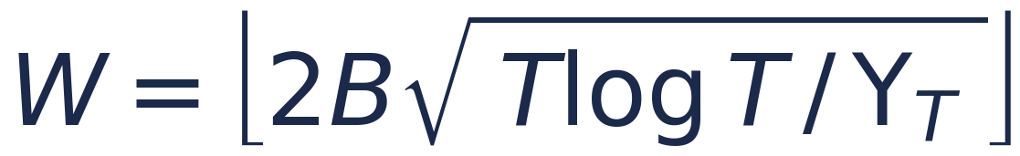
REQUIREMENT 4 · SLIGHTLY NON-STATIONARY ENVIRONMENT
Combinatorial-UCB with Sliding Window
The idea. When the distribution of competing bids changes over time, old observations describe a regime that no longer holds. Standard Combinatorial-UCB averages over the whole history and adapts too slowly. SW-CUCB keeps the CUCB machinery but trusts only the most recent W rounds.
How it works
Windowed exploration
The exploration term of each arm's UCB estimate now uses only its last W samples, not its full history:
UCB = μ̂ + √( c·log(min(t,W)) / n )
μ̂, n : mean & pull count over the last W rounds c : exploration coeff.
▪ Windowed estimates: reward mean, cost mean and pull counts are computed from the last W rounds only; older observations are evicted as the window slides.
▪ Windowed bonus: the confidence width uses log(min(t, W)) instead of log(T) — exploration is calibrated to the data the window can hold.
▪ Low exploration coefficient c: set well below the classical 2.0. Campaign values lie in [0, 1], so the standard bonus would dwarf the estimated means; a smaller c keeps the exploration term from always dominating the UCB, so the learner genuinely exploits — not only explores.
▪ Passive adaptation to changes: after a change, arms whose window empties get a wide optimistic bonus and are re-explored automatically — no explicit reset needed.
window size
W ≈ √T default, number of changes unknown
from B, T, Υ_T
too large → slow adaptation · too small → noisy estimates
ola/algorithms/sw_cucb.py

Slide 2
REQUIREMENT 4 · SLIGHTLY NON-STATIONARY ENVIRONMENT
Experiments Environments
Disclaimer for the Considered Cases for the Experiments
Since the specification required a slightly non-stationary environment for the requirement 4 assignment, we decided to test, firstly, the sliding window and change detection algorithms in ideal scenarios, in order to show the desired, sub-linear, behaviour of the many approaches.
Then, the same algorithms have been tested also in more highly non-stationary environments, used at the same time for the comparison between requirement 4 and requirement 3 different algorithms. In the final cases shown, the environment exhibits a much higher frequency for the highest competing bids Gaussian distributions.
Slightly non-Stationary Environment
Time horizon T
Intervals
Budget B
Per-round budget ρ = B / T
4000
3
8000
2.0
In particular, the time horizon is divided into 3 equal intervals; and the related change points occur at round 1333 and 2666.
ola/algorithms/sw_cucb.py

Slide 3
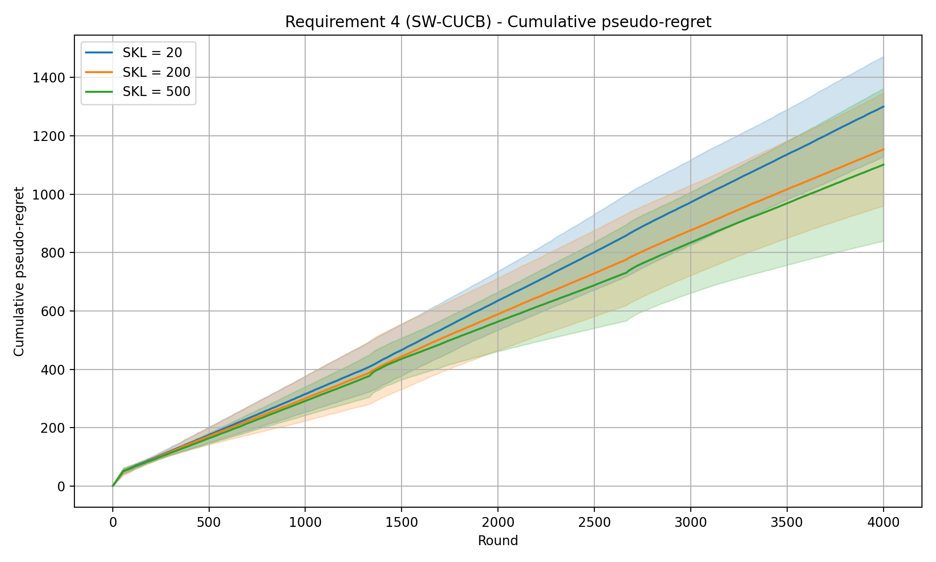
REQUIREMENT 4 · SLIDING-WINDOW CUCB · EXPERIMENTS
SW-CUCB — cumulative pseudo-regret
Experiment setup
Time horizon T
Intervals
Budget B
Per-round budget ρ = B / T
Exploration coeff. c
Window size W = √T
4000
3
8000
2.0
0.1
63
SKL levels (curves) 20 / 200 / 500
Shaded bands: mean ± std across 20 repeated runs.
SW-CUCB · cumReg_3int_DefWin_0.1ec

Slide 4
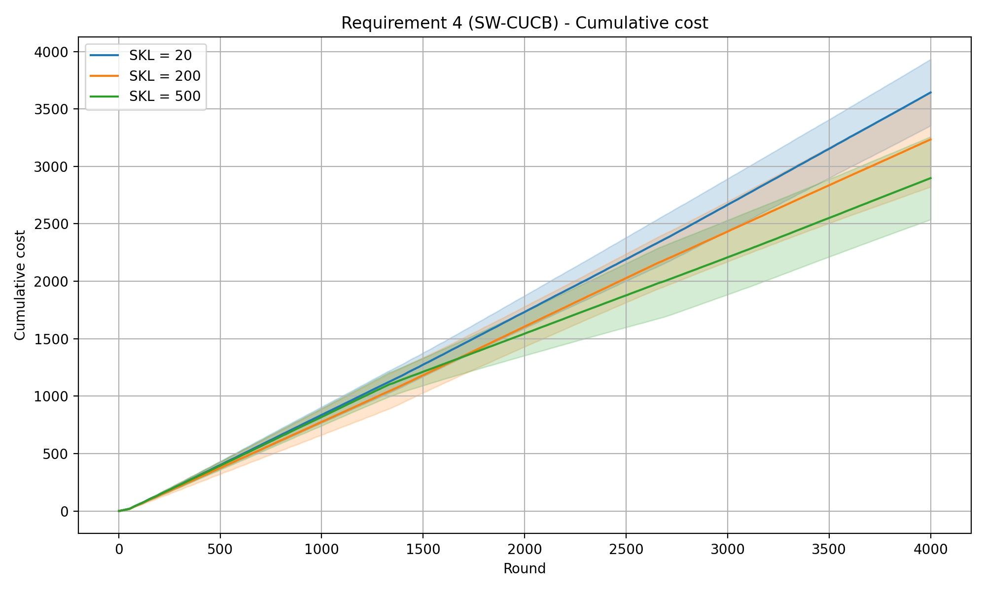
REQUIREMENT 4 · SLIDING-WINDOW CUCB · EXPERIMENTS
SW-CUCB — cumulative pseudo-regret
SW-CUCB · cumReg_3int_DefWin_0.1ec

Slide 5
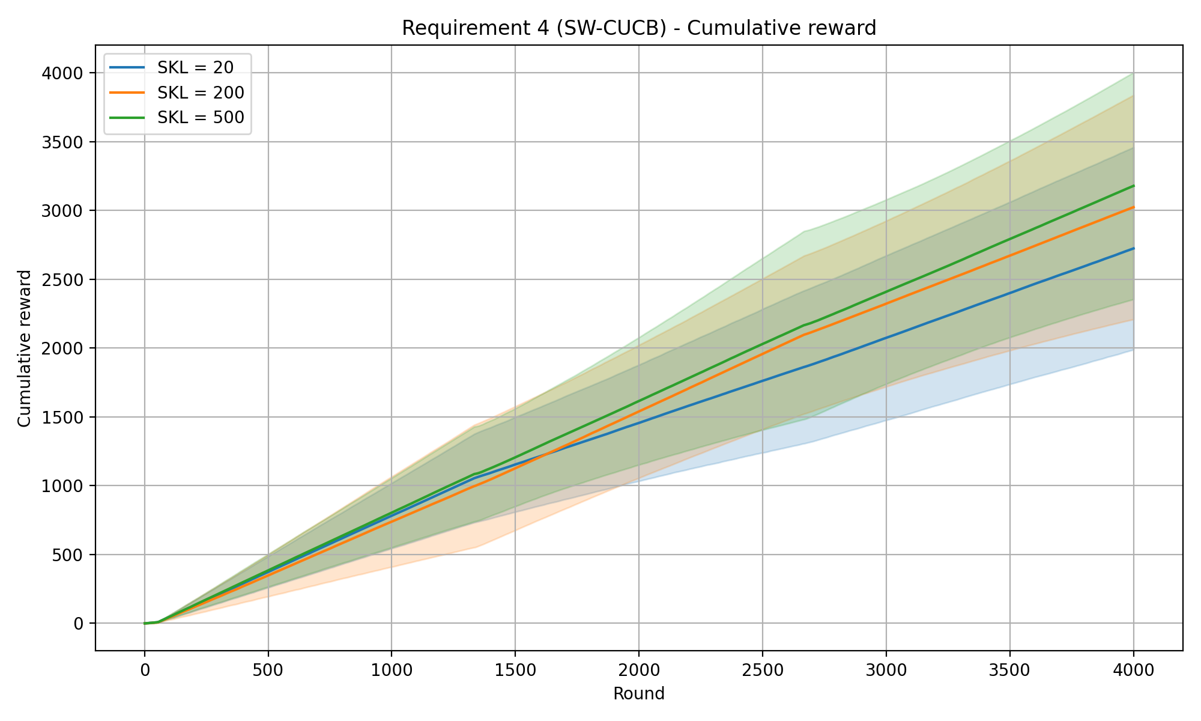
REQUIREMENT 4 · SLIDING-WINDOW CUCB · EXPERIMENTS
SW-CUCB — cumulative pseudo-regret
SW-CUCB · cumReg_3int_DefWin_0.1ec

Slide 6
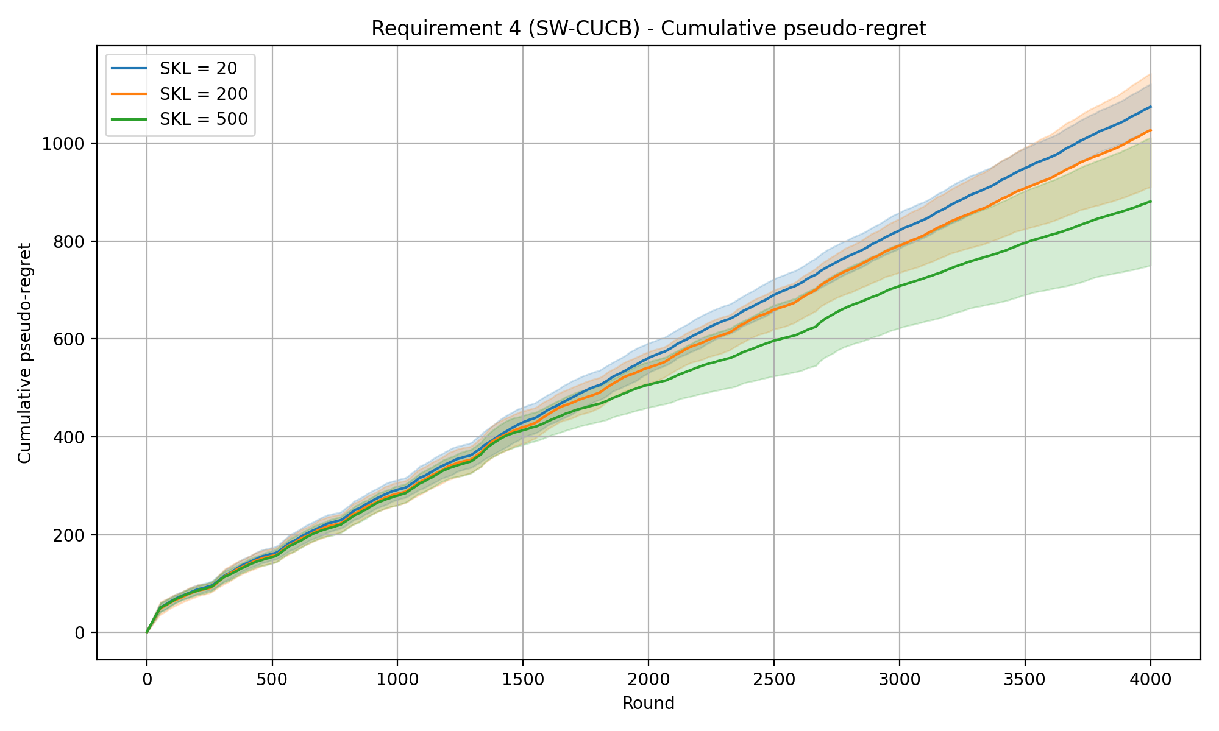
REQUIREMENT 4 · SLIDING-WINDOW CUCB · EXPERIMENTS
SW-CUCB — cumulative pseudo-regret
Experiment setup
Time horizon T
Intervals
Budget B
Per-round budget ρ = B / T
Exploration coeff. c
4000
3
8000
2.0
0.1
257
SKL levels (curves) 20 / 200 / 500
Shaded bands: mean ± std across 20 repeated runs.
SW-CUCB · cumReg_3int_257win_0.1ec

Slide 7
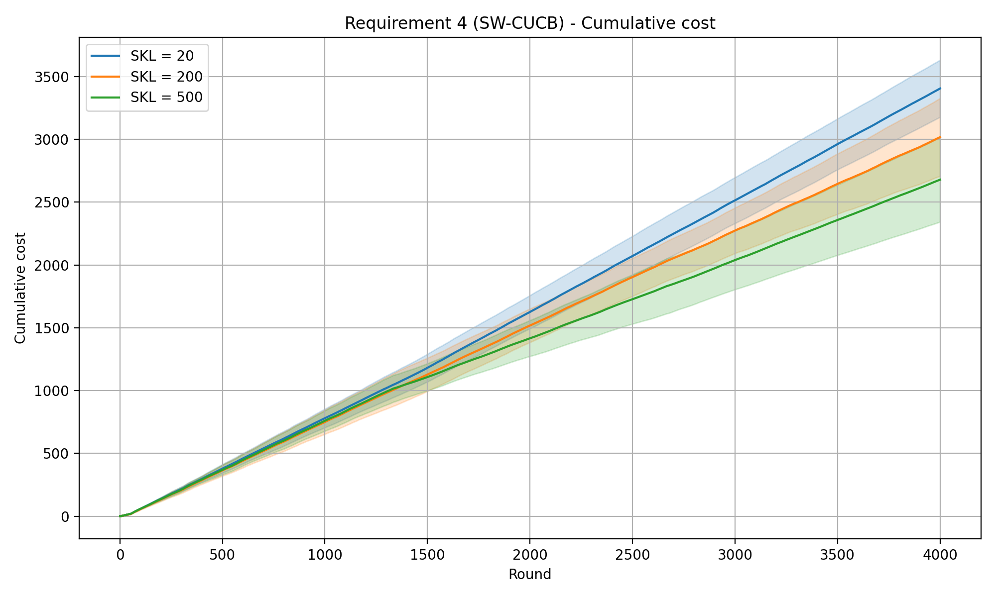
REQUIREMENT 4 · SLIDING-WINDOW CUCB · EXPERIMENTS
SW-CUCB — cumulative pseudo-regret
SW-CUCB · cumReg_3int_DefWin_0.1ec

Slide 8
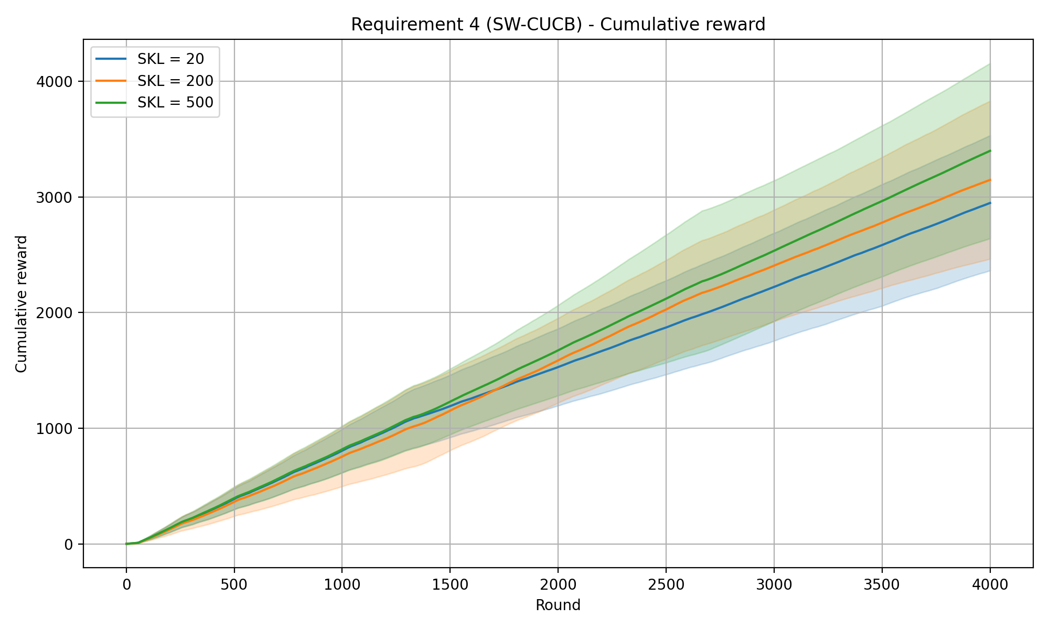
REQUIREMENT 4 · SLIDING-WINDOW CUCB · EXPERIMENTS
SW-CUCB — cumulative pseudo-regret
SW-CUCB · cumReg_3int_DefWin_0.1ec

Slide 9
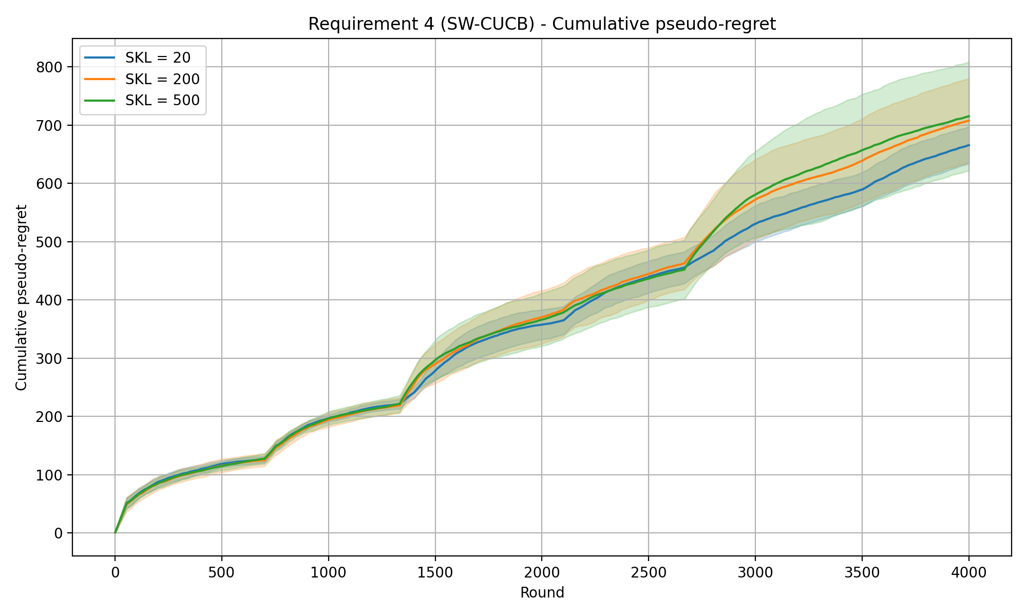
REQUIREMENT 4 · SLIDING-WINDOW CUCB · EXPERIMENTS
SW-CUCB — cumulative pseudo-regret
Experiment setup
Time horizon T
Intervals
Budget B
Per-round budget ρ = B / T
Exploration coeff. c
Window size W
4000
3
8000
2.0
0.1
700
SKL levels (curves) 20 / 200 / 500
Shaded bands: mean ± std across 20 repeated runs.
SW-CUCB · cumReg_3int_700win_0.1exp

Slide 10
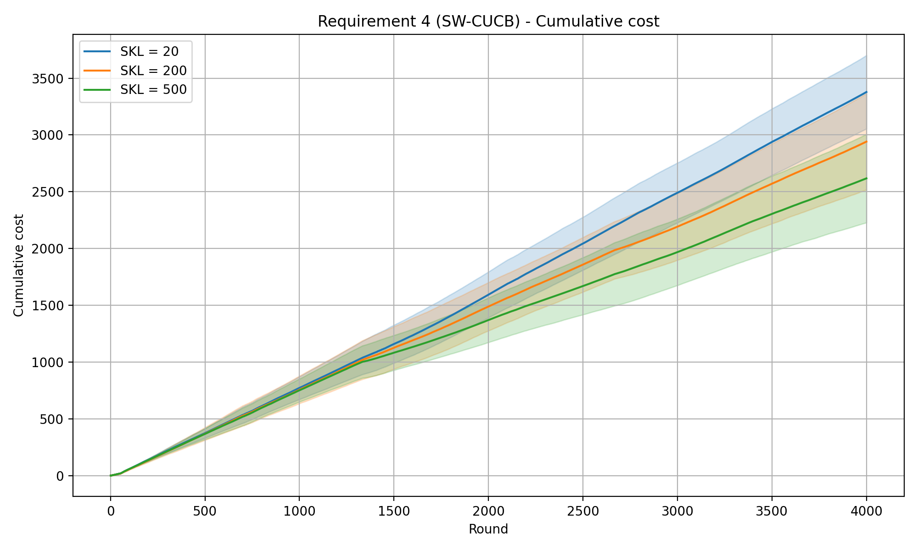
REQUIREMENT 4 · SLIDING-WINDOW CUCB · EXPERIMENTS
SW-CUCB — cumulative pseudo-regret
SW-CUCB · cumReg_3int_DefWin_0.1ec

Slide 11
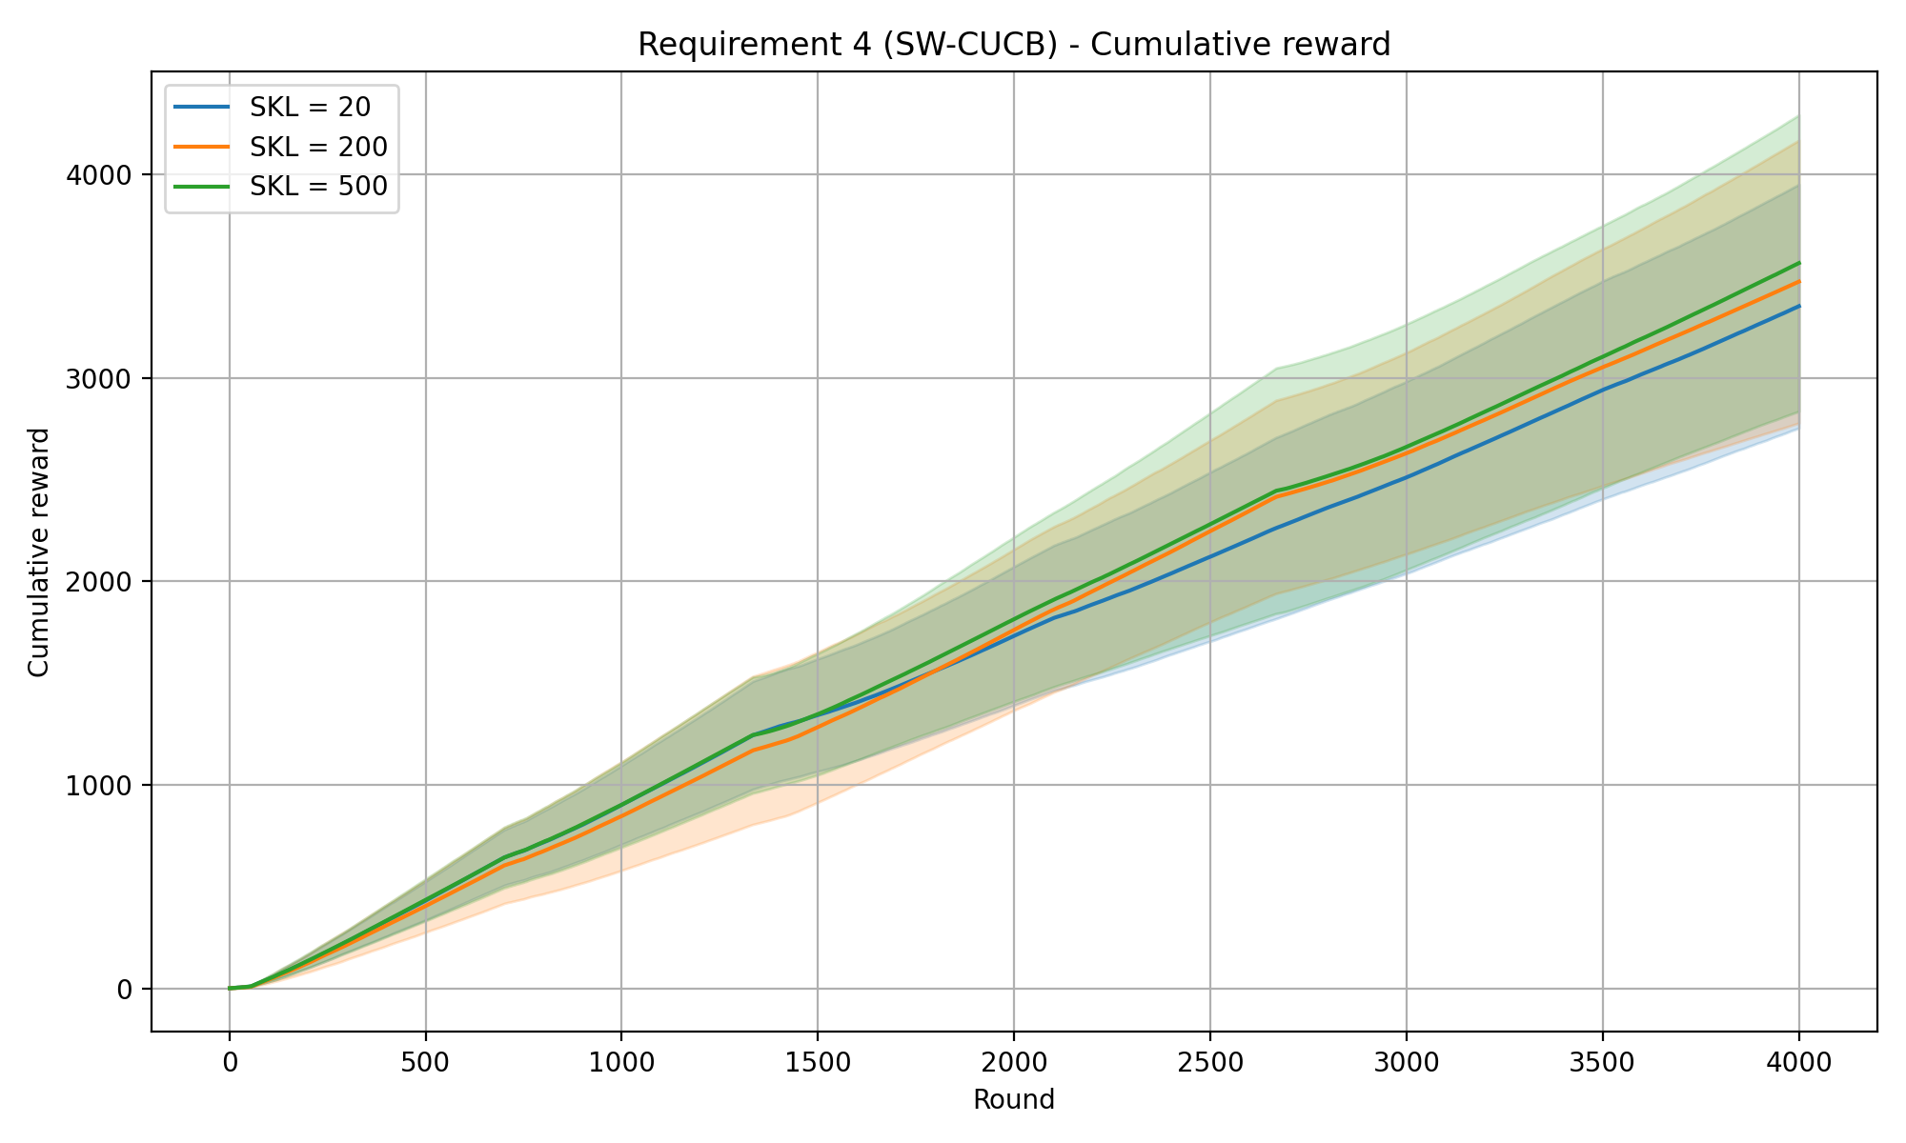
REQUIREMENT 4 · SLIDING-WINDOW CUCB · EXPERIMENTS
SW-CUCB — cumulative pseudo-regret
SW-CUCB · cumReg_3int_DefWin_0.1ec

Slide 12
REQUIREMENT 4 · SLIGHTLY NON-STATIONARY ENVIRONMENT
Combinatorial-UCB with Change Detector
The idea. Keep the Combinatorial-UCB machinery, but attach a CUSUM change detector to every (campaign, bid) arm. While a regime is stable it behaves like standard CUCB; when a detector fires, statistics are reset — either only that arm or every arm (see reset scope) — so the learner re-learns under the new distribution.
How it works
CUSUM parameters
M — warm-up samples → reference win-rate
ε — slack: ignore small deviations
h — detection threshold
ever_pulled — mask for the forced initial exploration
α — forced exploration parameter
▪ Win-indicator signal: each arm monitors the Bernoulli win indicator, not the raw reward: reward = win·(value − bid) shrinks as the bid grows, so a single threshold would be unfair across arms. The win indicator stays in [0, 1] for every arm.
▪ CUSUM detector: after M warm-up samples fix a reference win-rate; the statistics g⁺ / g⁻ accumulate deviations beyond a slack ε, and an alarm fires when either exceeds the threshold h.
▪ Forced exploration (α): with probability α the agent plays a random budget-feasible super-arm, so arms outside the current optimum keep feeding their detectors.
▪ Low exploration coefficient c: the same reasoning as in the sliding-window approach applies here as well.
▪ UCB estimates: both the exploitation term (the mean estimate) and the exploration term use only the samples gathered since the last reset; the exploration numerator is the total valid samples across arms, and each arm's count restarts on a detection.
Reset scope — two modes
per-arm — wipe only the firing arm.
global — restart every arm; fits synchronized regime shifts.
ola/algorithms/cd_cucb.py

Slide 13
REQUIREMENT 4 · SLIGHTLY NON-STATIONARY ENVIRONMENT
Combinatorial-UCB with Change Detector
Parameters estimation
α –forced exploration parameter
alpha = sqrt(U_T * log(T / U_T) / T)
M – Warm-up samples
M = int(log(T / U_T))
h — Detection threshold
h = 2 * log(T / U_T)
ola/algorithms/cd_cucb.py

Slide 14
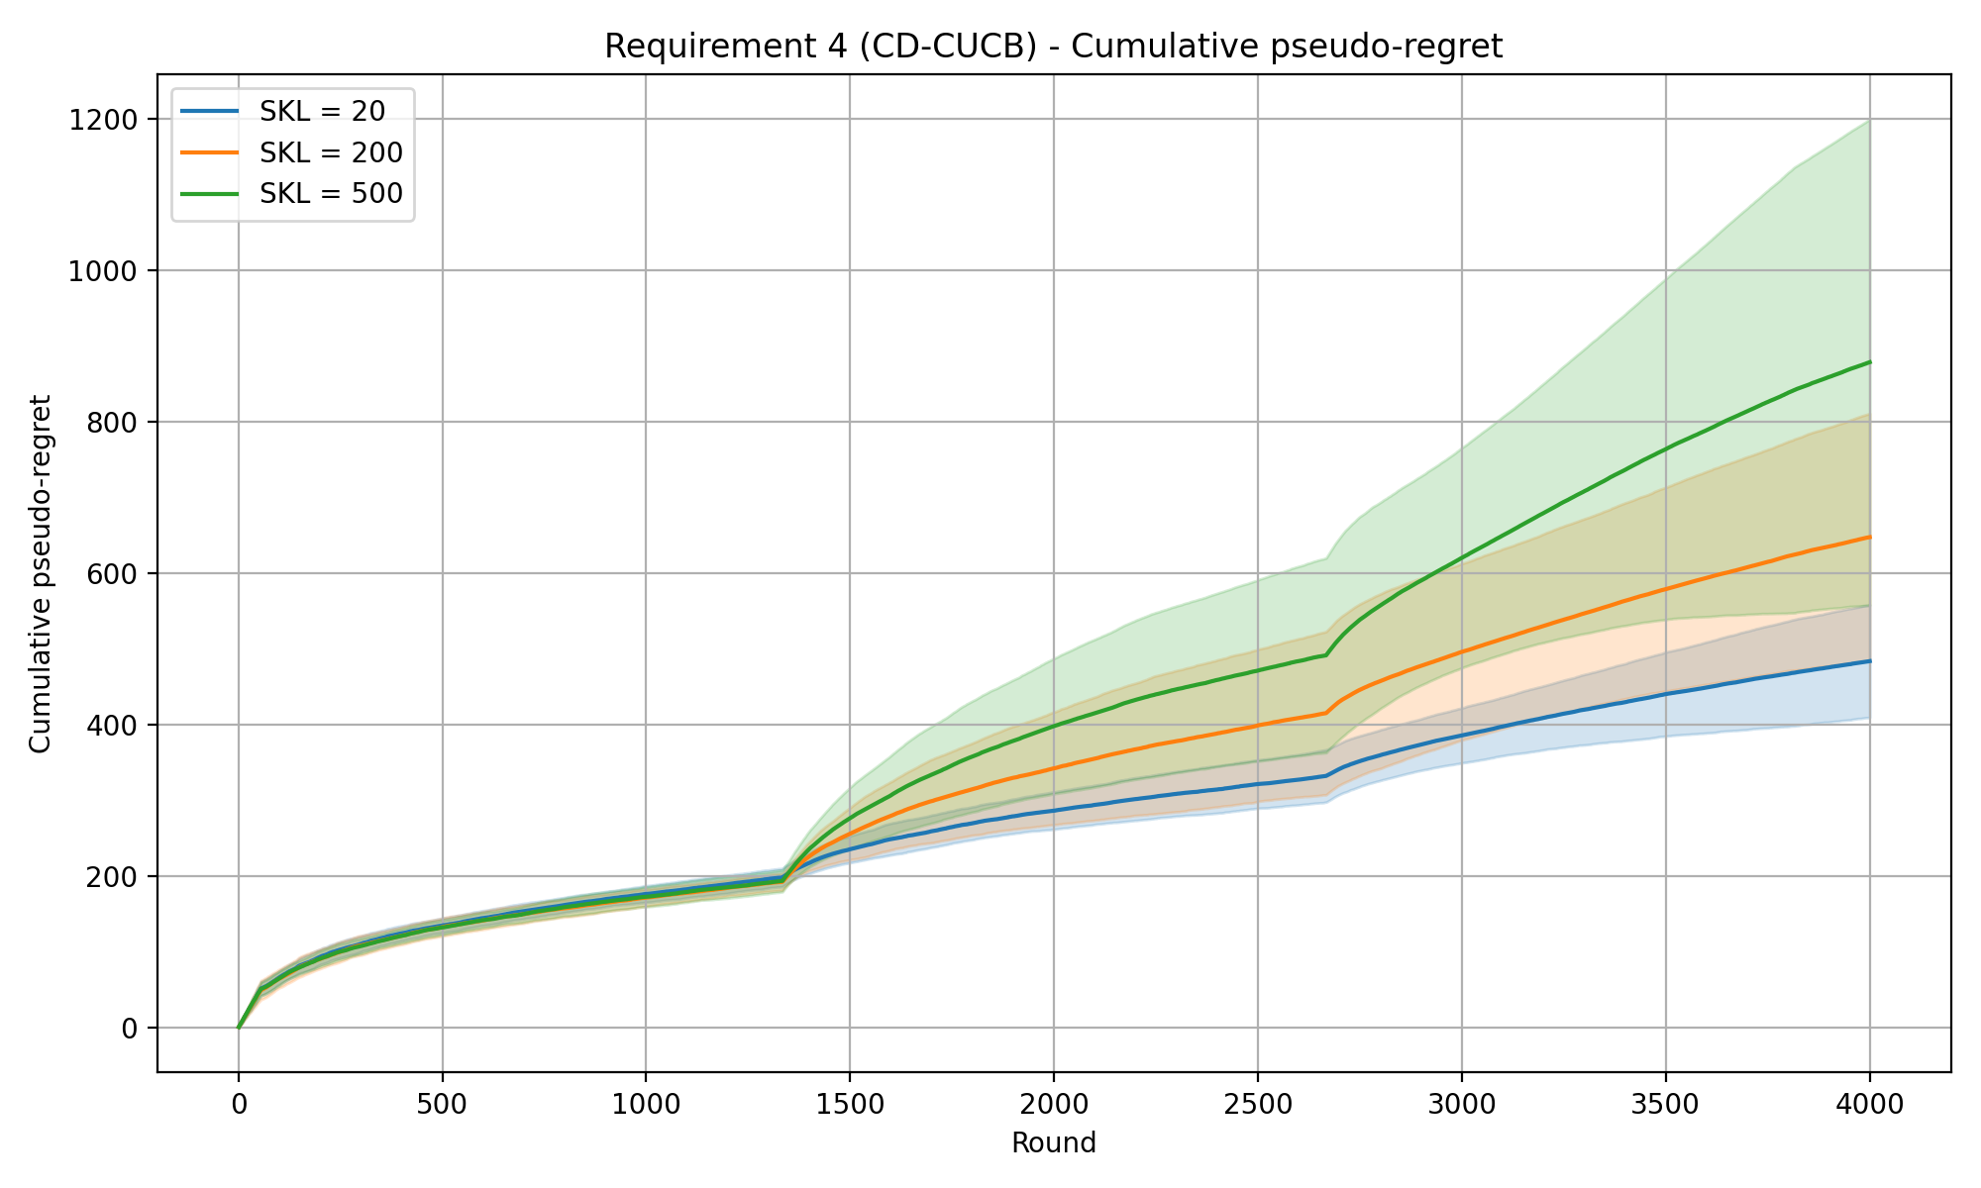
REQUIREMENT 4 · CHANGE-DETECTOR CUCB · EXPERIMENTS · PER-ARM RESET
CD-CUCB (CUSUM) — cumulative pseudo-regret
Experiment setup
Time horizon T
Intervals
Budget B
Per-round budget ρ = B / T
Exploration coeff. c
CUSUM slack ε
Warm-up samples M
Detection threshold h
Forced-explore prob. α
4000
3
8000
2.0
0.1
0.1
7
15.2
0.0616
SKL levels (curves) 20 / 200 / 500
Mean detection delay (rounds)
SKL 20
SKL 200
SKL 500
94.2 ±144
55.9 ±90
41.5 ±66
Shaded bands: mean ± std across 20 repeated runs.
CD-CUCB (CUSUM) · cumReg_3int_0.1eps_0.1exp

Slide 15
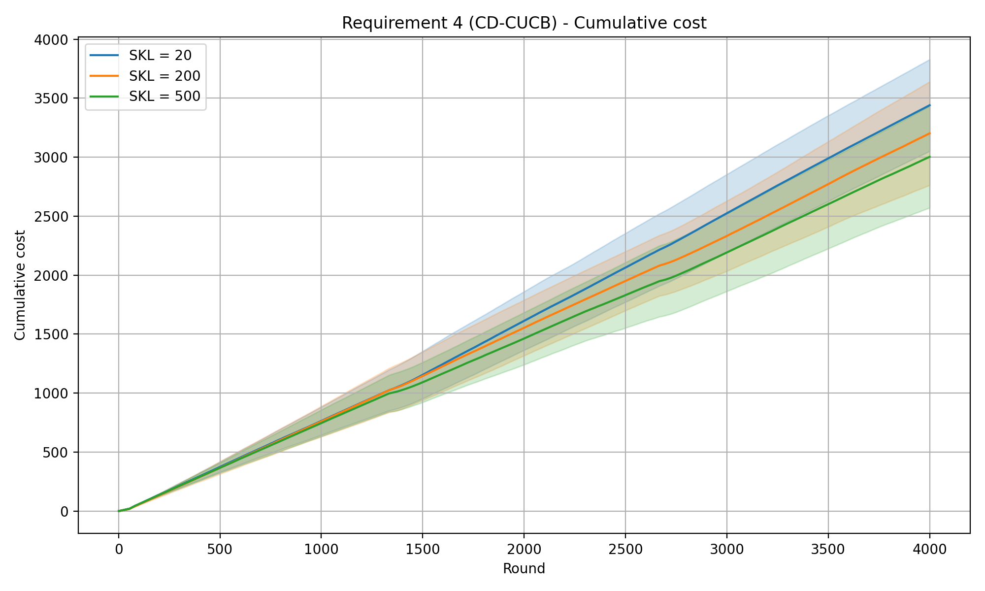
REQUIREMENT 4 · CHANGE-DETECTOR CUCB · BACKUP · PER-ARM RESET
CD-CUCB — cumulative cost
CD-CUCB (CUSUM) · req4_cd_cumulative_cost.png

Slide 16
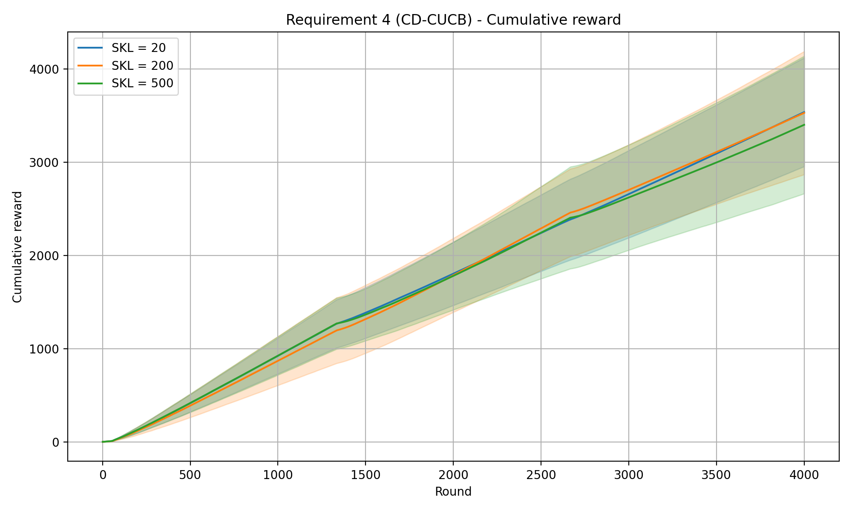
REQUIREMENT 4 · CHANGE-DETECTOR CUCB · BACKUP · PER-ARM RESET
CD-CUCB — cumulative reward
CD-CUCB (CUSUM) · req4_cd_cumulative_reward.png

Slide 17
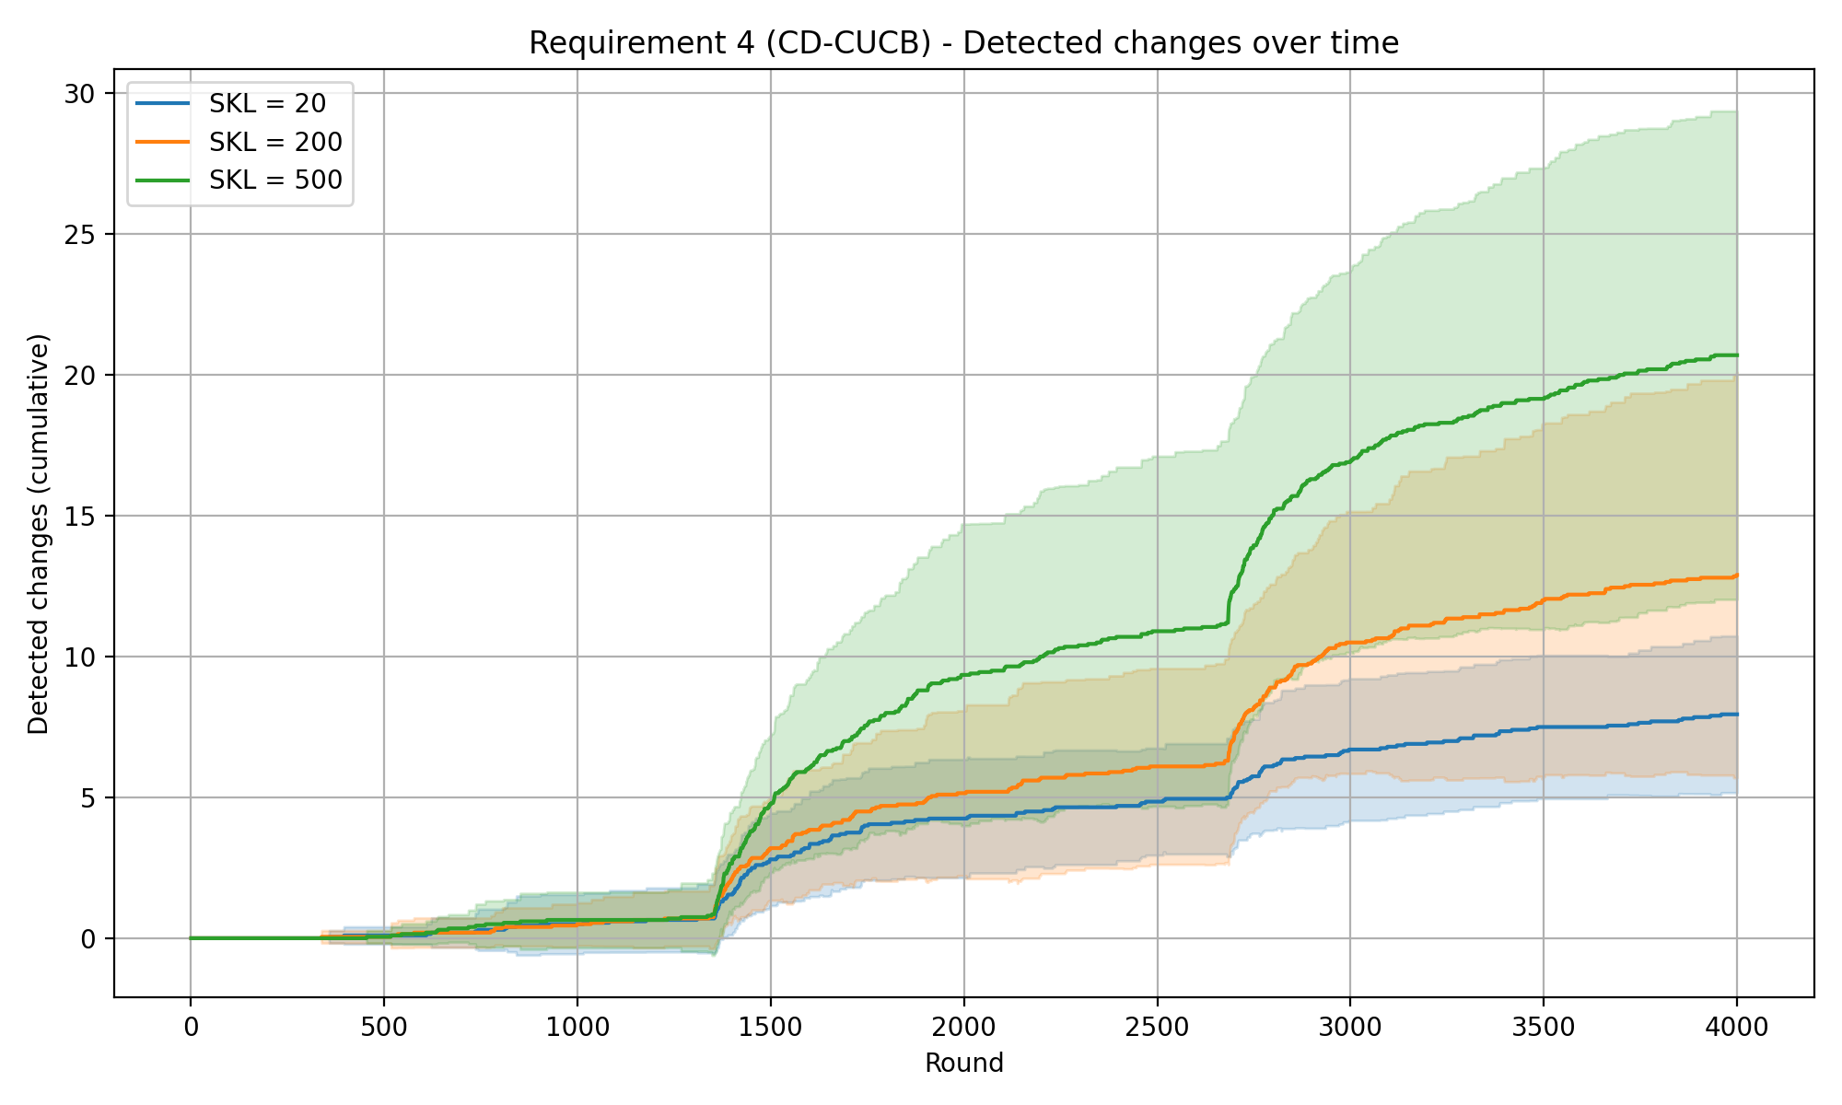
REQUIREMENT 4 · CHANGE-DETECTOR CUCB · BACKUP · PER-ARM RESET
CD-CUCB — detected changes over time
CD-CUCB (CUSUM) · req4_cd_detected_changes.png

Slide 18
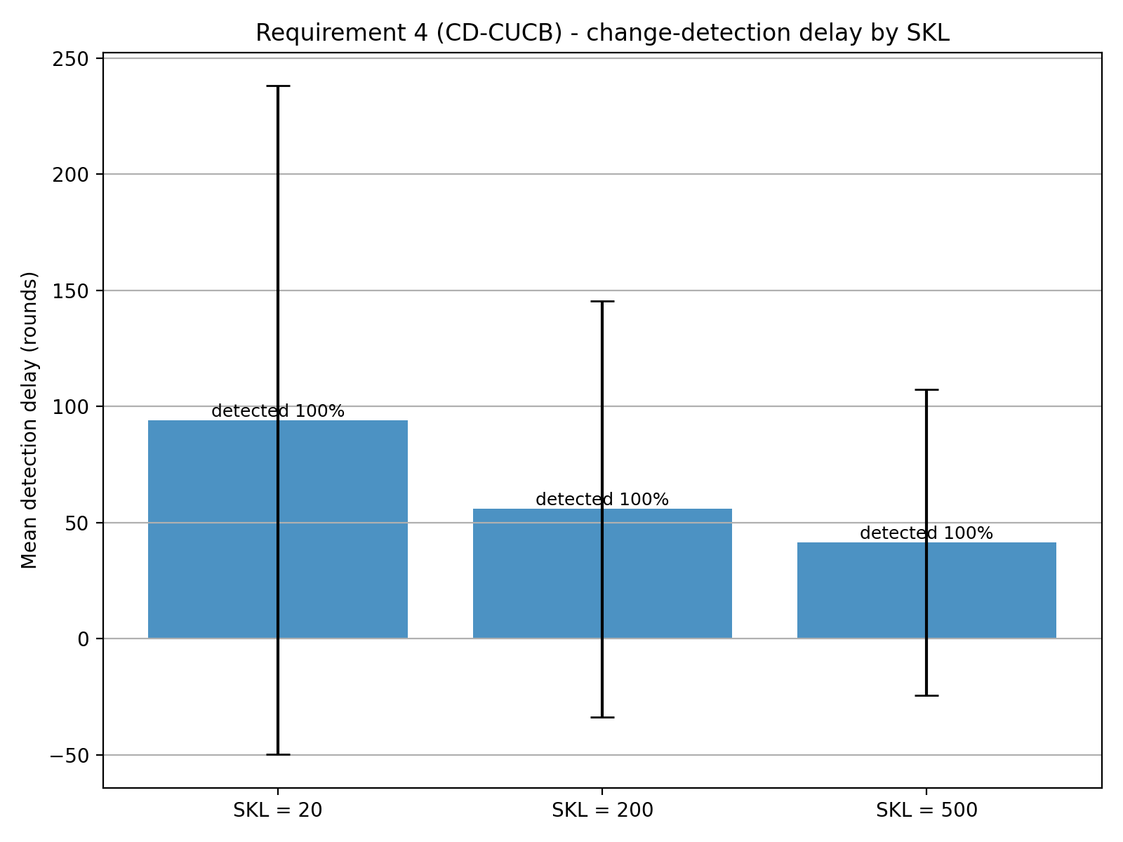
REQUIREMENT 4 · CHANGE-DETECTOR CUCB · BACKUP · PER-ARM RESET
CD-CUCB — detection delay
Mean detection delay
SKL = 20
94.2 ±144
median 42
SKL = 200
55.9 ±90
median 24
SKL = 500
41.5 ±66
median 24.5
All change points detected — 100%.
CD-CUCB (CUSUM) · req4_cd_detection_delay.png

Slide 19
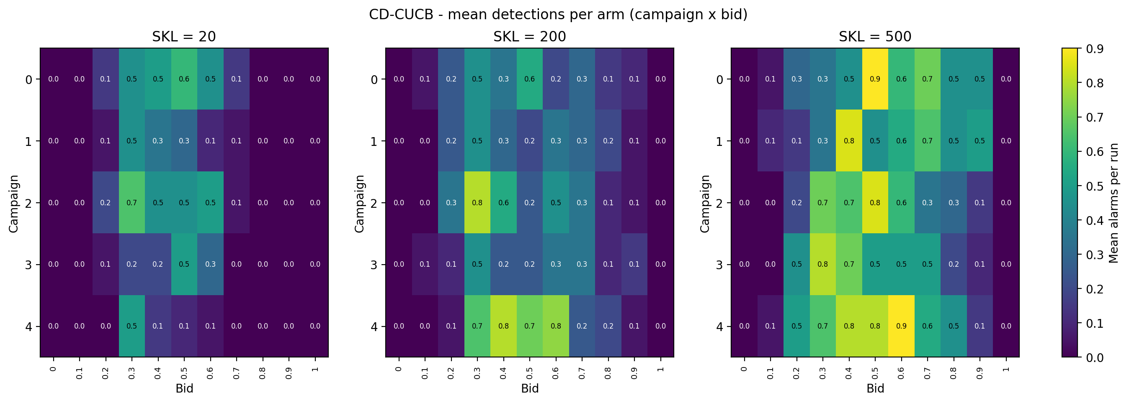
REQUIREMENT 4 · CHANGE-DETECTOR CUCB · BACKUP · PER-ARM RESET
CD-CUCB — detections per arm
CD-CUCB (CUSUM) · req4_cd_detections_per_arm.png

Slide 20
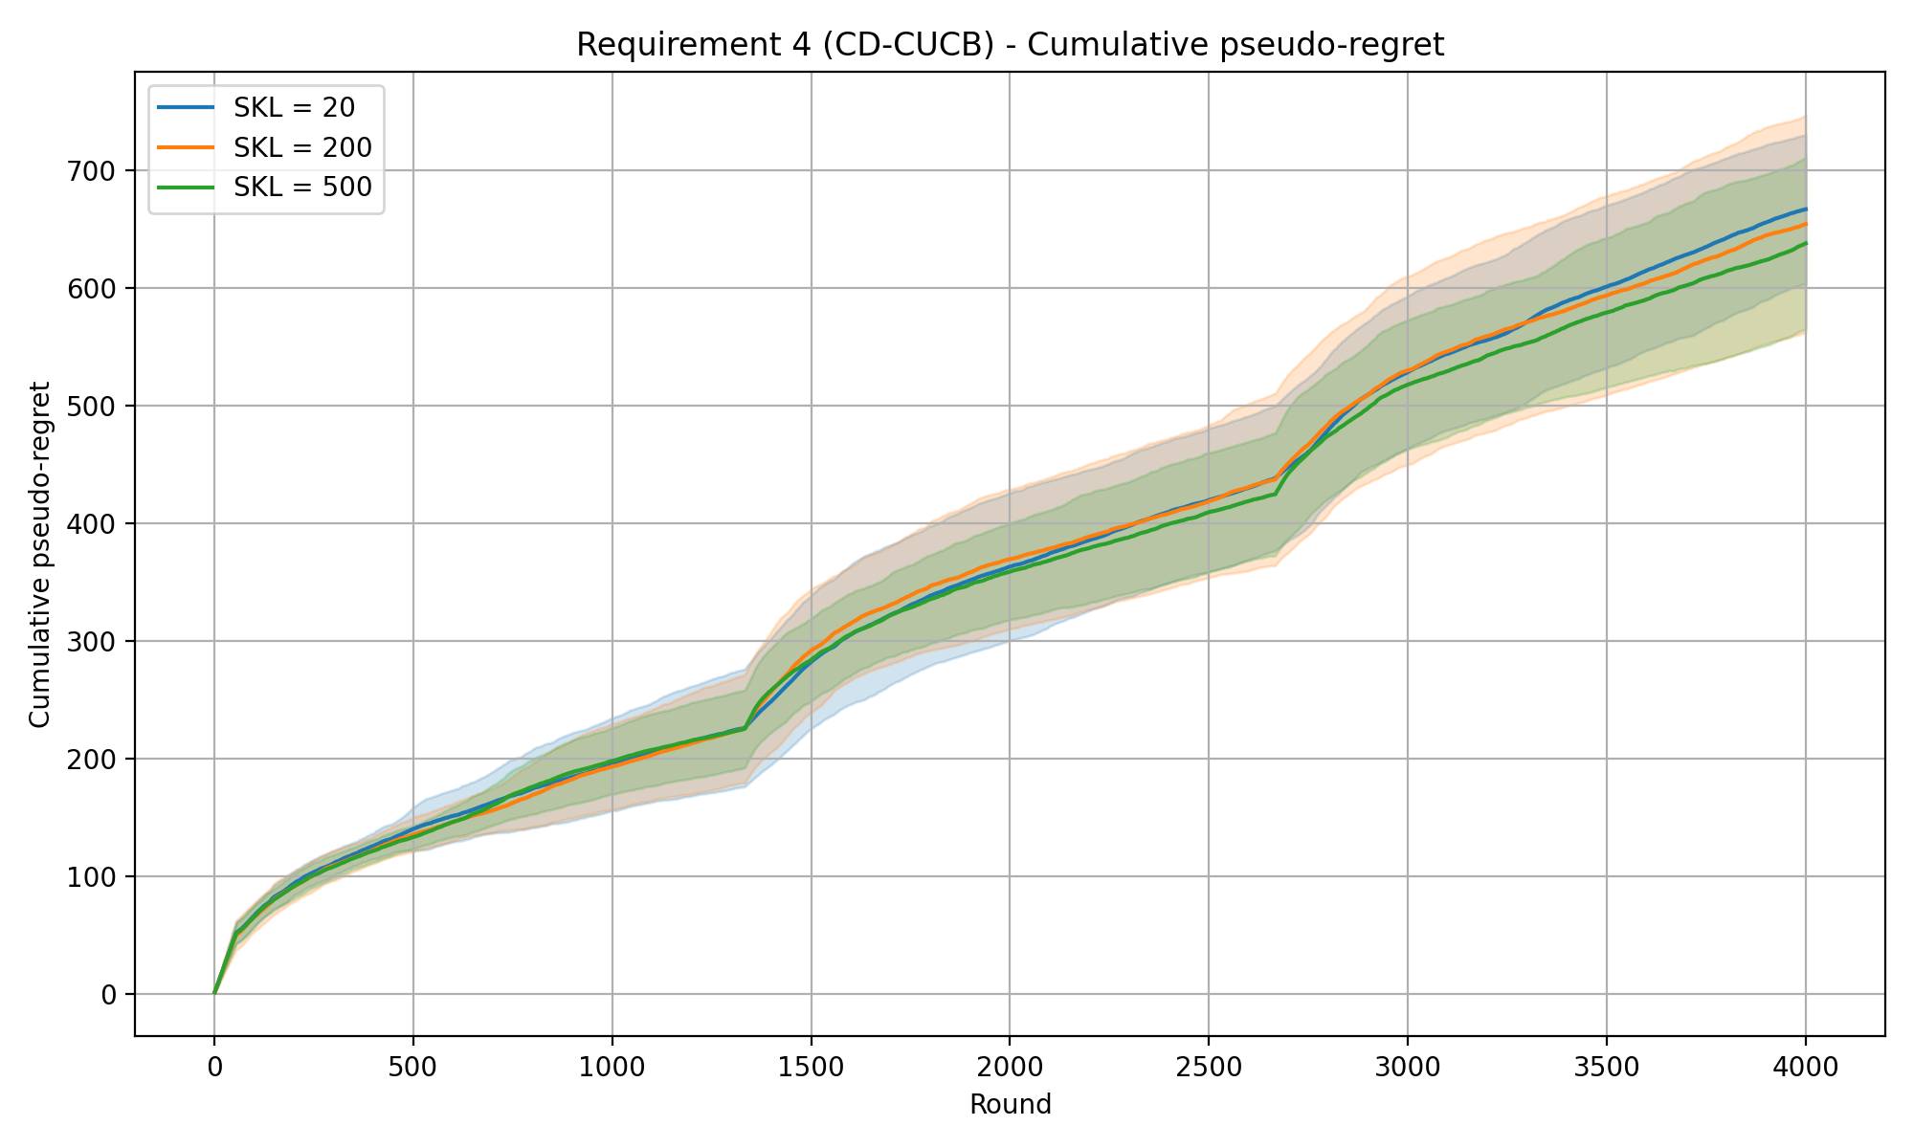
REQUIREMENT 4 · CHANGE-DETECTOR CUCB · EXPERIMENTS · GLOBAL RESET
CD-CUCB (CUSUM) — cumulative pseudo-regret
Experiment setup
Time horizon T
Intervals
Budget B
Per-round budget ρ = B / T
Exploration coeff. c
CUSUM slack ε
Warm-up samples M
Detection threshold h
Forced-explore prob. α
4000
3
8000
2.0
0.1
0.1
7
15.2
0.0616
SKL levels (curves) 20 / 200 / 500
Mean detection delay (rounds)
SKL 20
SKL 200
SKL 500
115.1 ±158.0
73.8 ±86.2
58.5 ±116.3
Shaded bands: mean ± std across 20 repeated runs.
CD-CUCB (CUSUM) · cumReg_3int_0.1eps_0.1exp_GlobReset

Slide 21
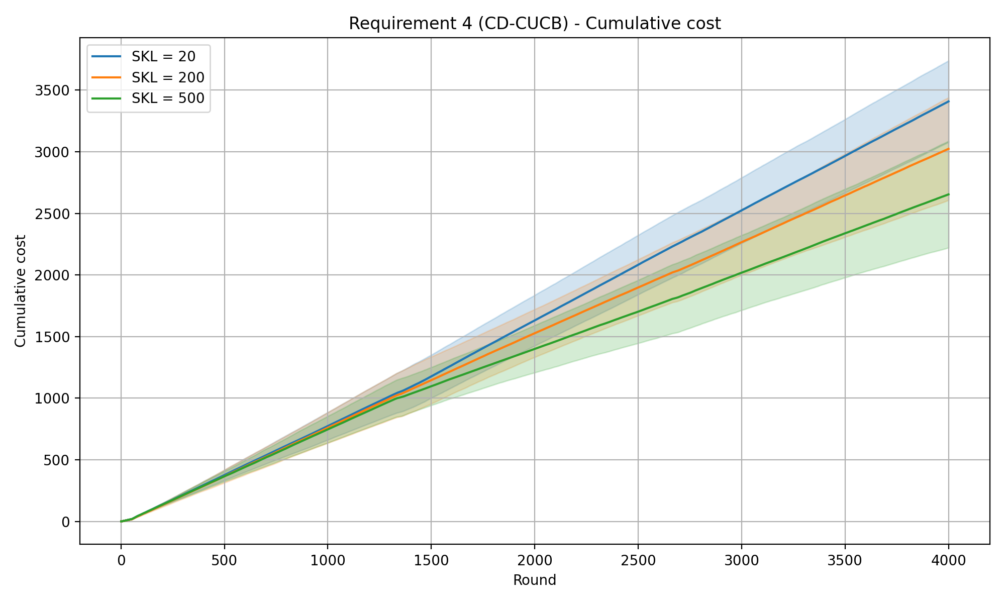
REQUIREMENT 4 · CHANGE-DETECTOR CUCB · BACKUP · GLOBAL RESET
CD-CUCB — cumulative cost
CD-CUCB (CUSUM) · req4_cd_cumulative_cost.png

Slide 22

REQUIREMENT 4 · CHANGE-DETECTOR CUCB · BACKUP · GLOBAL RESET
CD-CUCB — cumulative reward
CD-CUCB (CUSUM) · req4_cd_cumulative_reward.png

Slide 23
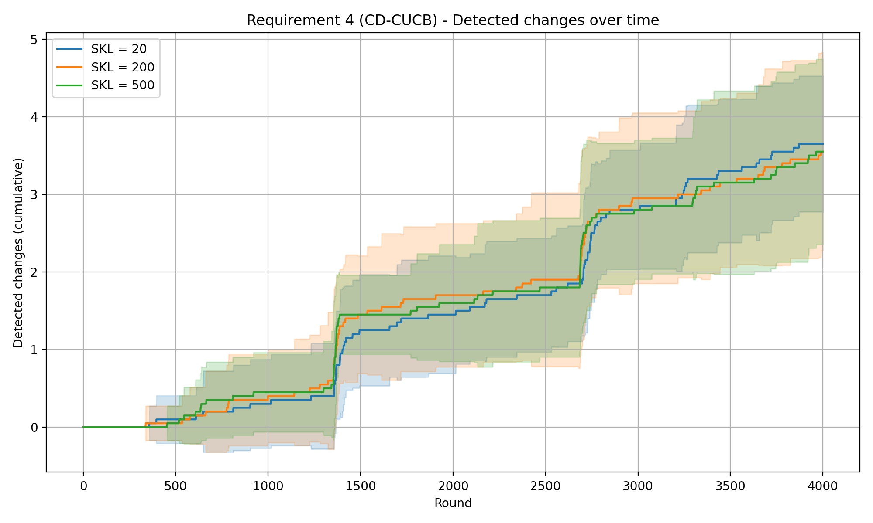
REQUIREMENT 4 · CHANGE-DETECTOR CUCB · BACKUP · GLOBAL RESET
CD-CUCB — detected changes over time
CD-CUCB (CUSUM) · req4_cd_detected_changes.png

Slide 24
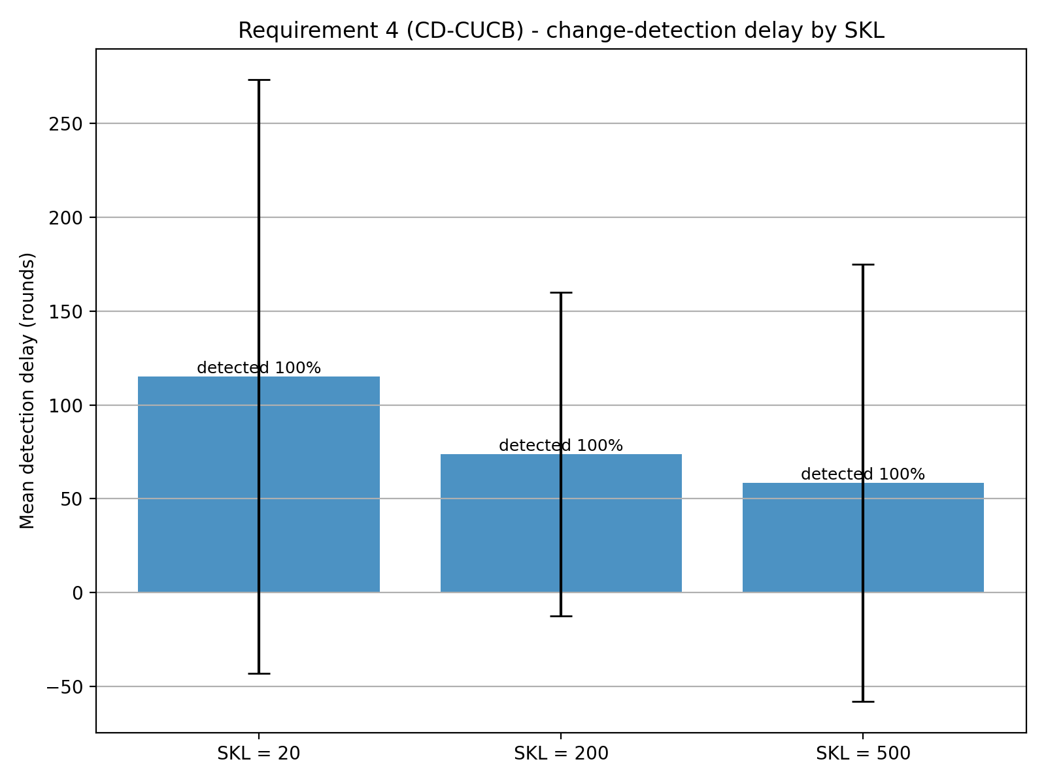
REQUIREMENT 4 · CHANGE-DETECTOR CUCB · BACKUP · GLOBAL RESET
CD-CUCB — detection delay
Mean detection delay
SKL = 20
115.1 ±158.0
median 69
SKL = 200
73.8 ±86.2
median 40
SKL = 500
58.45 ±116.3
median 30
All change points detected — 100%.
CD-CUCB (CUSUM) · req4_cd_detection_delay.png

Slide 25
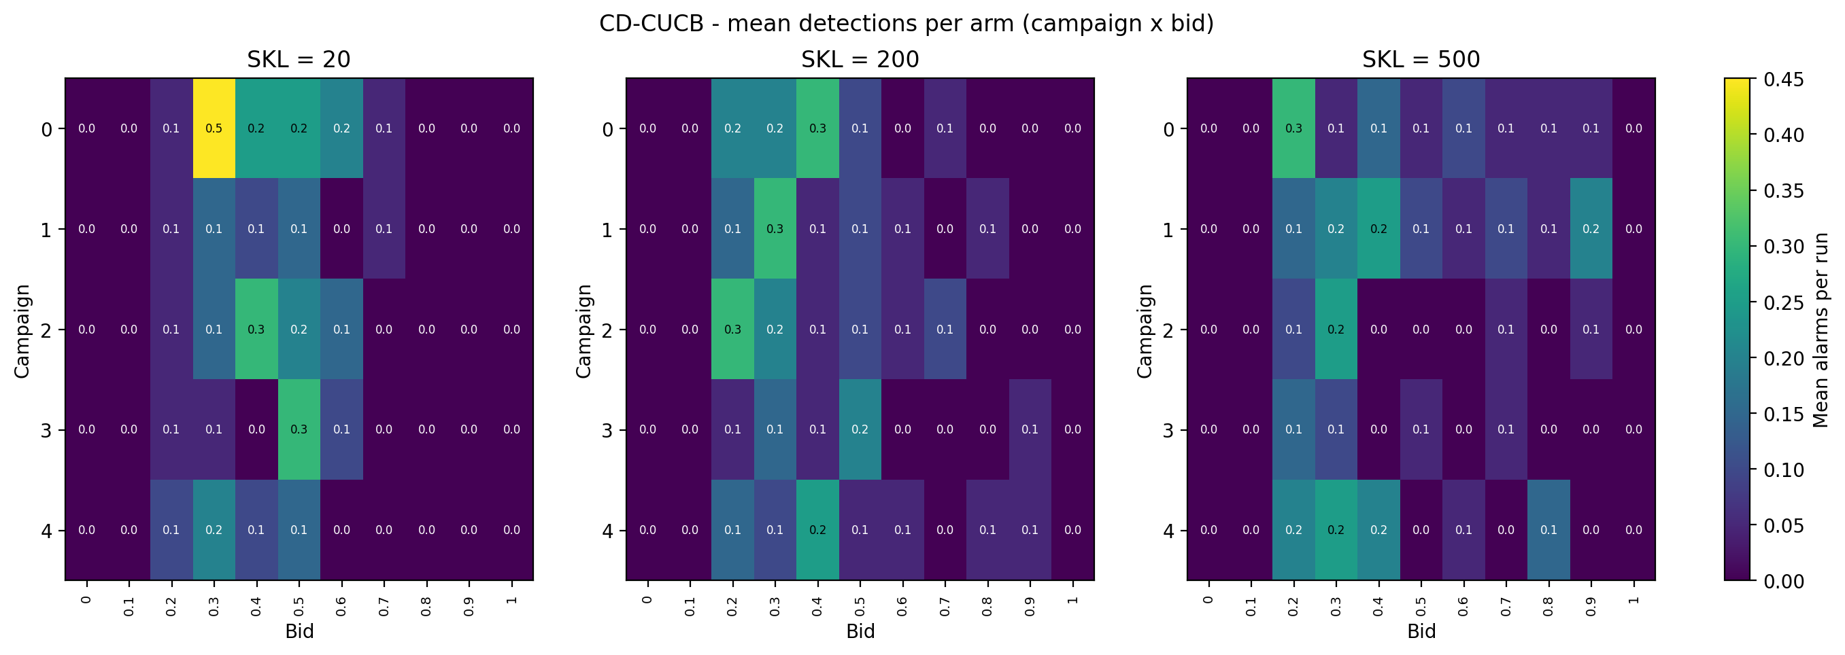
REQUIREMENT 4 · CHANGE-DETECTOR CUCB · BACKUP · GLOBAL RESET
CD-CUCB — detections per arm
CD-CUCB (CUSUM) · req4_cd_detections_per_arm.png

Slide 26
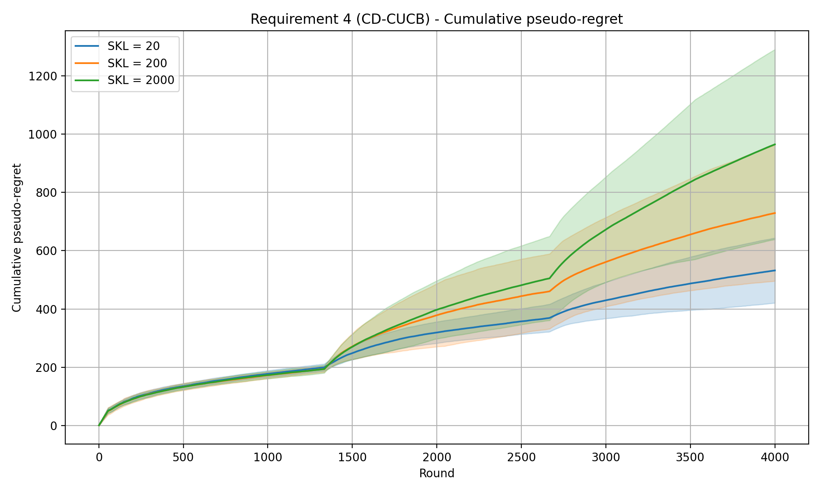
REQUIREMENT 4 · CHANGE-DETECTOR CUCB · EXPERIMENTS · PER-ARM RESET
CD-CUCB (CUSUM) — cumulative pseudo-regret
Experiment setup
Time horizon T
Intervals
Budget B
Per-round budget ρ = B / T
Exploration coeff. c
CUSUM slack ε
Warm-up samples M
Detection threshold h
Forced-explore prob. α
4000
3
8000
2.0
0.1
0.1
7
50
0.0616
SKL levels (curves) 20 / 200 / 2000
Mean detection delay (rounds)
SKL 20
SKL 200
SKL 2000
257.3 ±212.5
112.2 ±71.9
140.7 ±189.7
Shaded bands: mean ± std across 20 repeated runs.
CD-CUCB (CUSUM) · cumReg_3int_0.1eps_0.1exp_50h

Slide 27
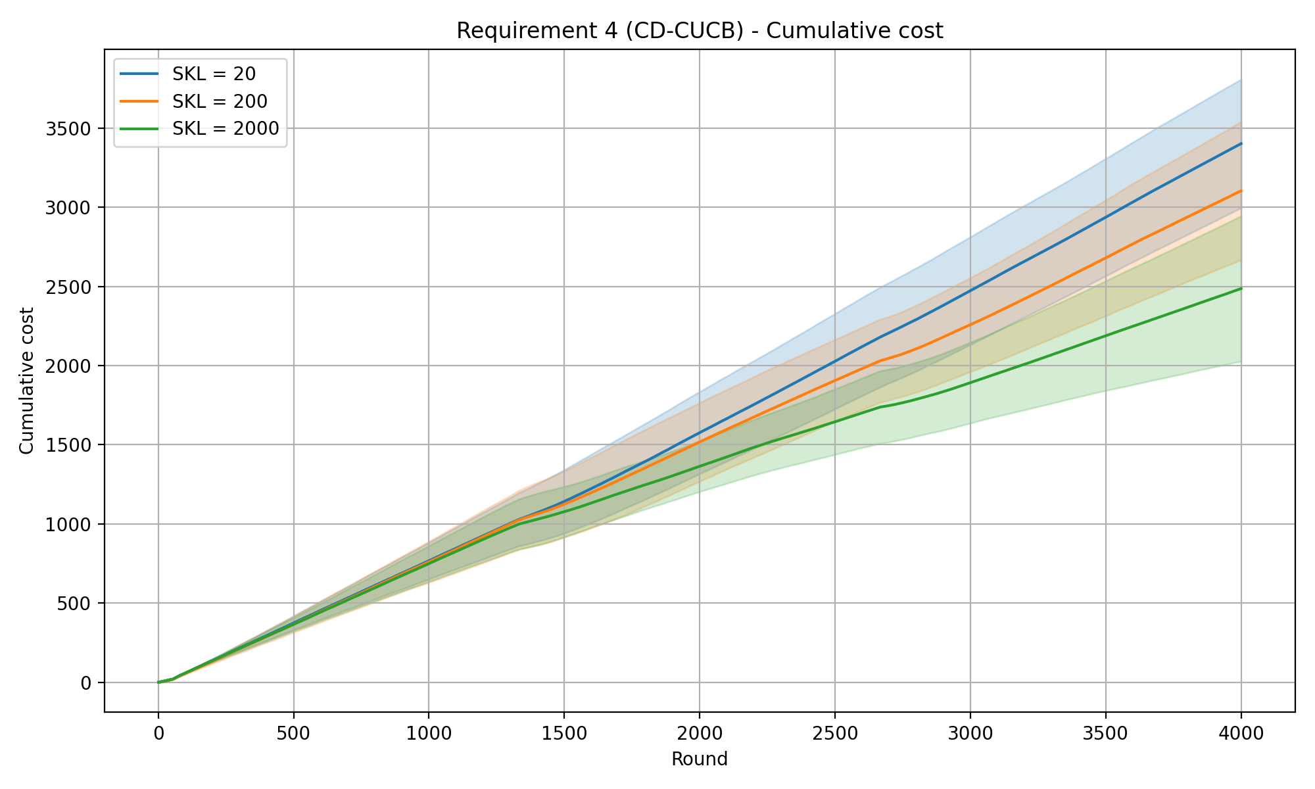
REQUIREMENT 4 · CHANGE-DETECTOR CUCB · BACKUP · PER-ARM RESET (H = 50)
CD-CUCB — cumulative cost
CD-CUCB (CUSUM) · req4_cd_cumulative_cost.png

Slide 28

REQUIREMENT 4 · CHANGE-DETECTOR CUCB · BACKUP · PER-ARM RESET (H = 50)
CD-CUCB — cumulative reward
CD-CUCB (CUSUM) · req4_cd_cumulative_reward.png

Slide 29
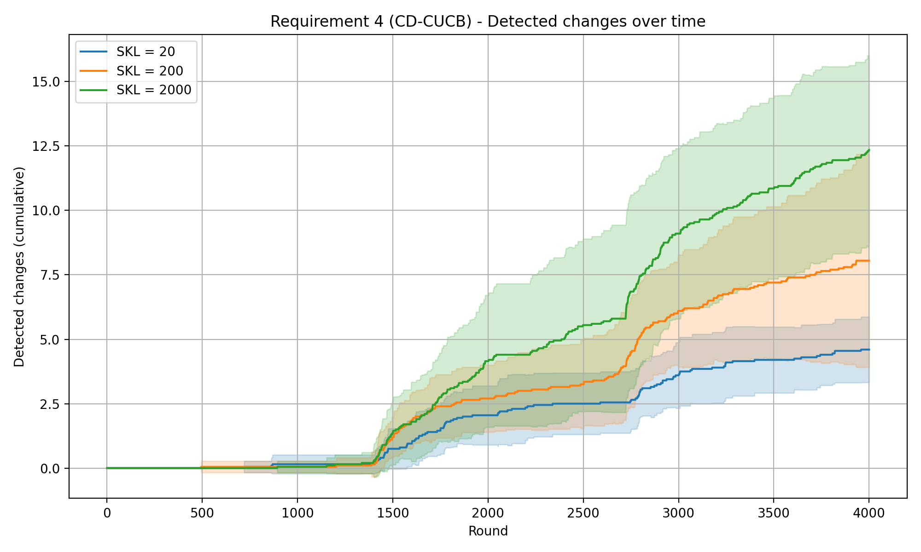
REQUIREMENT 4 · CHANGE-DETECTOR CUCB · BACKUP · PER-ARM RESET (H = 50)
CD-CUCB — detected changes over time
CD-CUCB (CUSUM) · req4_cd_detected_changes.png

Slide 30
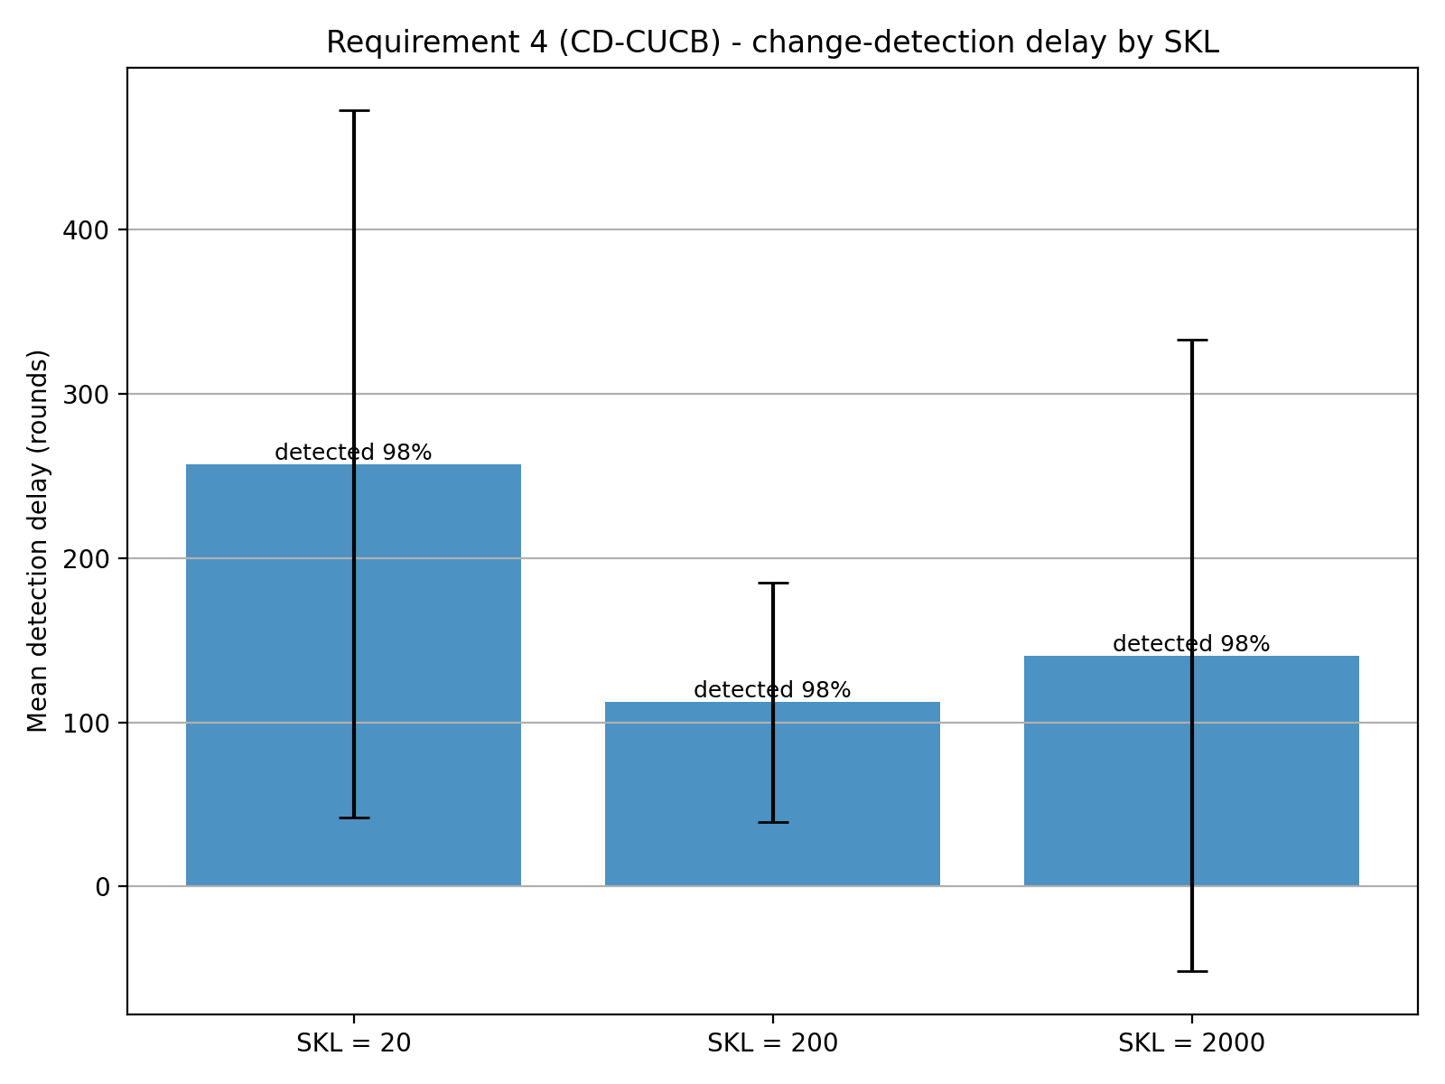
REQUIREMENT 4 · CHANGE-DETECTOR CUCB · BACKUP · PER-ARM RESET (H = 50)
CD-CUCB — detection delay
Mean detection delay
SKL = 20
257.3 ±212.5
median 202
SKL = 200
112.2 ±71.9
median 91
SKL = 2000
140.7 ±189.7
median 90
All change points detected — 98%.
CD-CUCB (CUSUM) · req4_cd_detection_delay.png

Slide 31
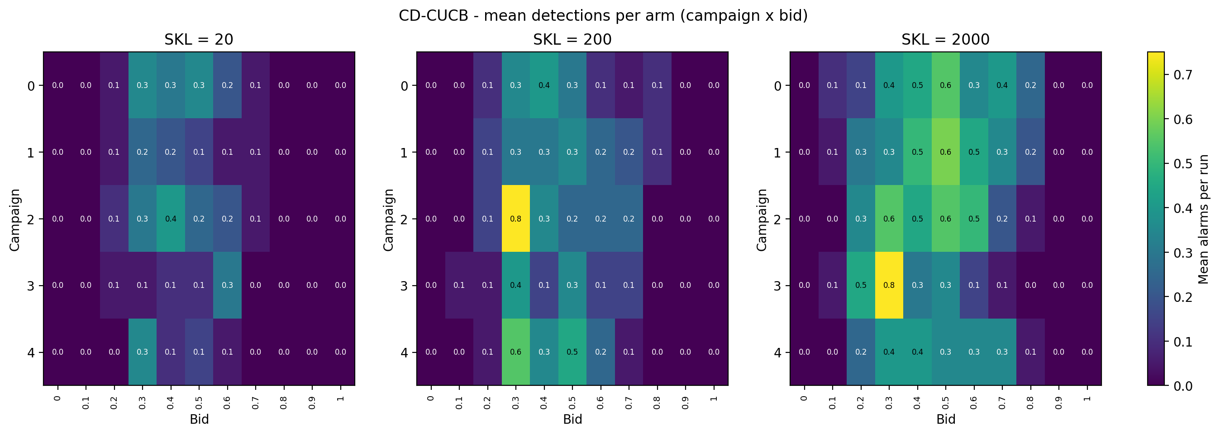
REQUIREMENT 4 · CHANGE-DETECTOR CUCB · BACKUP · PER-ARM RESET (H = 50)
CD-CUCB — detections per arm
CD-CUCB (CUSUM) · req4_cd_detections_per_arm.png

Slide 32
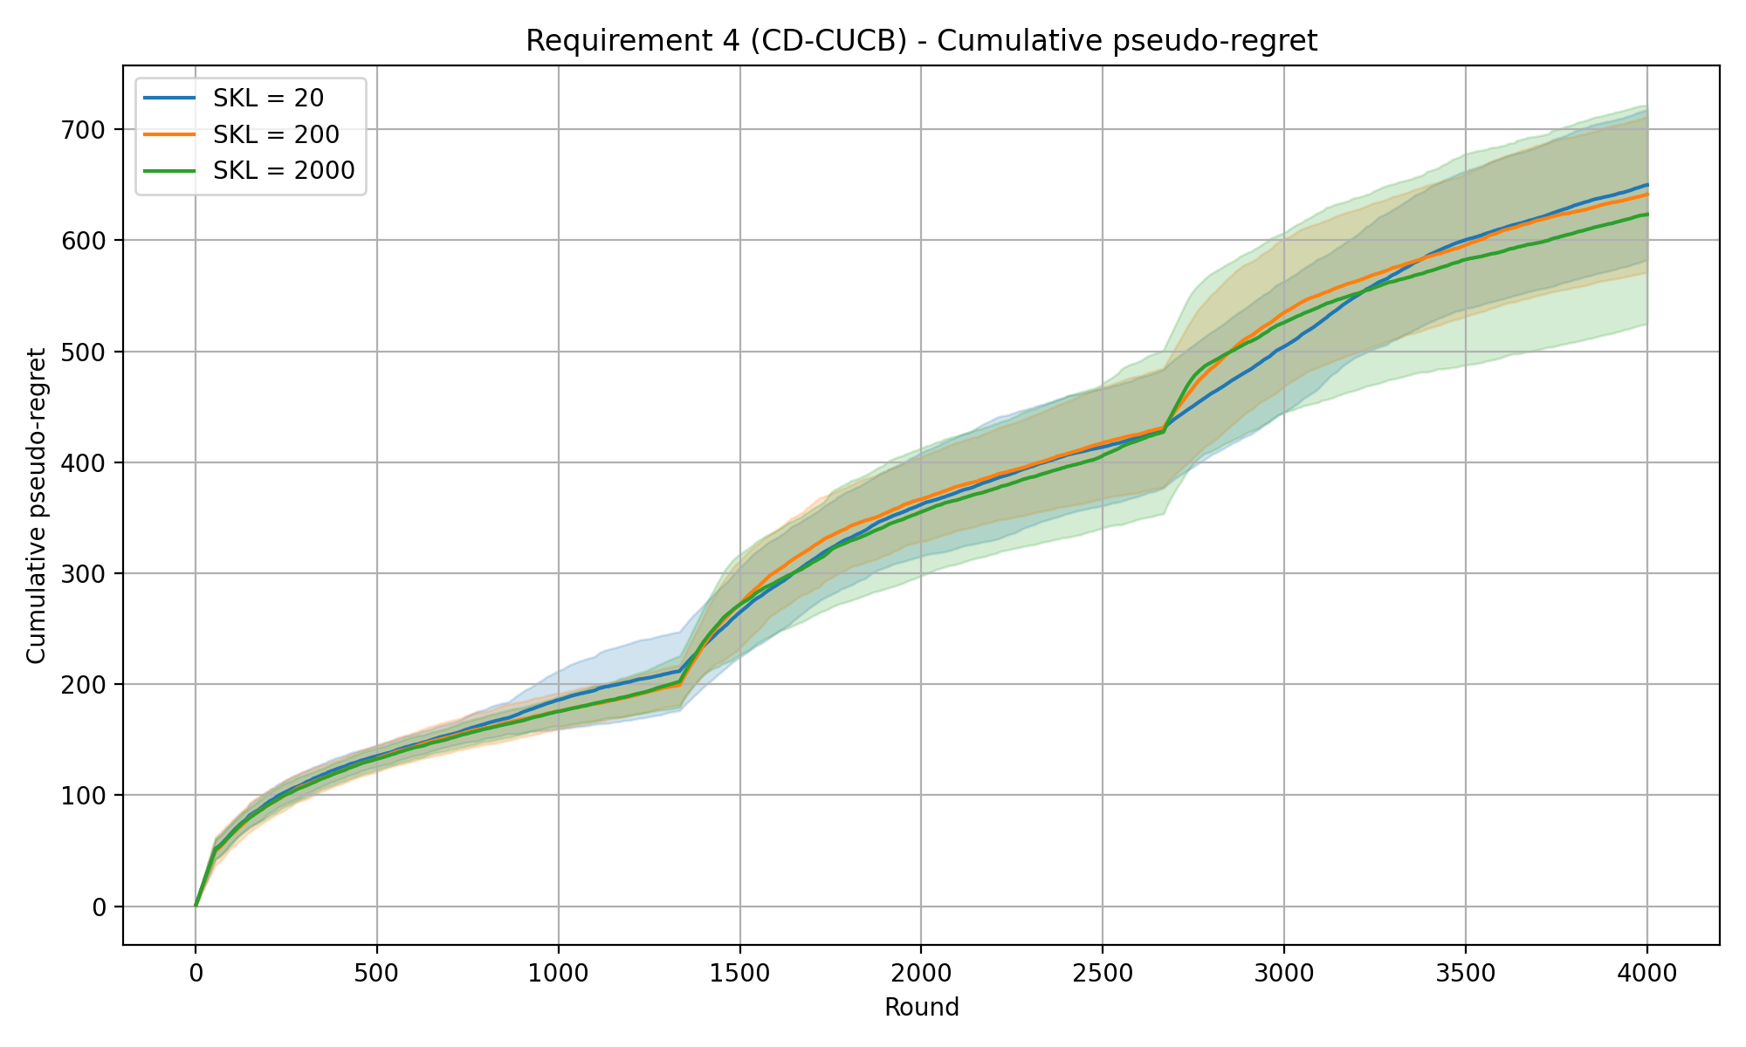
REQUIREMENT 4 · CHANGE-DETECTOR CUCB · EXPERIMENTS · GLOBAL RESET
CD-CUCB (CUSUM) — cumulative pseudo-regret
Experiment setup
Time horizon T
Intervals
Budget B
Per-round budget ρ = B / T
Exploration coeff. c
CUSUM slack ε
Warm-up samples M
Detection threshold h
Forced-explore prob. α
4000
3
8000
2.0
0.1
0.1
7
50
0.0616
SKL levels (curves) 20 / 200 / 2000
Mean detection delay (rounds)
SKL 20
SKL 200
SKL 2000
352.4 ±219.2
158.5 ±131.8
153.6 ±185.3
Shaded bands: mean ± std across 20 repeated runs.
CD-CUCB (CUSUM) · cumReg_3int_0.1eps_0.1exp_50h_GlobReset

Slide 33
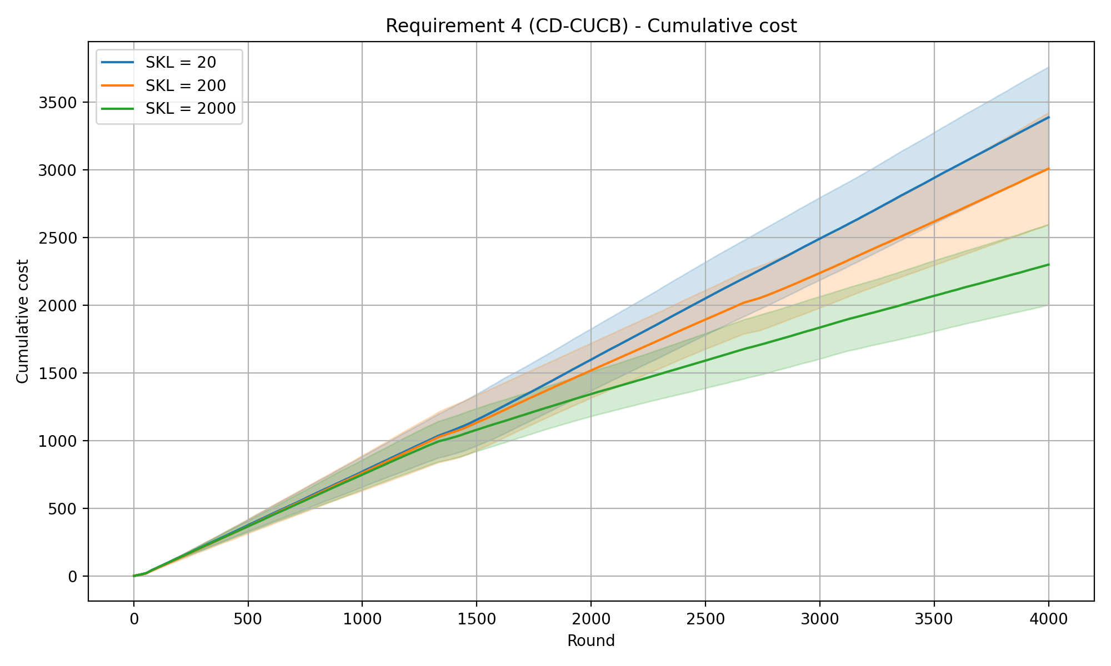
REQUIREMENT 4 · CHANGE-DETECTOR CUCB · BACKUP · GLOBAL RESET (H = 50)
CD-CUCB — cumulative cost
CD-CUCB (CUSUM) · req4_cd_cumulative_cost.png

Slide 34

REQUIREMENT 4 · CHANGE-DETECTOR CUCB · BACKUP · GLOBAL RESET (H = 50)
CD-CUCB — cumulative reward
CD-CUCB (CUSUM) · req4_cd_cumulative_reward.png

Slide 35
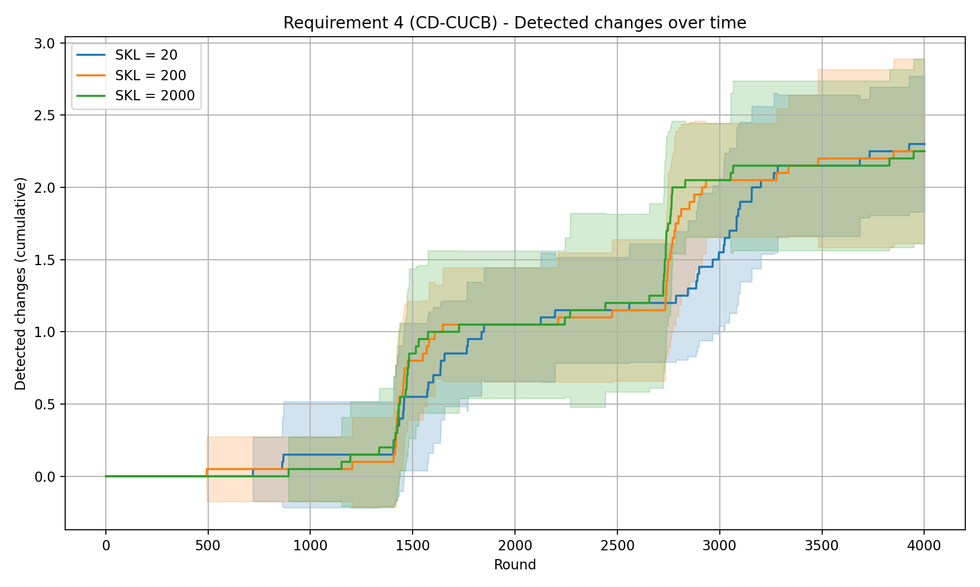
REQUIREMENT 4 · CHANGE-DETECTOR CUCB · BACKUP · GLOBAL RESET (H = 50)
CD-CUCB — detected changes over time
CD-CUCB (CUSUM) · req4_cd_detected_changes.png

Slide 36
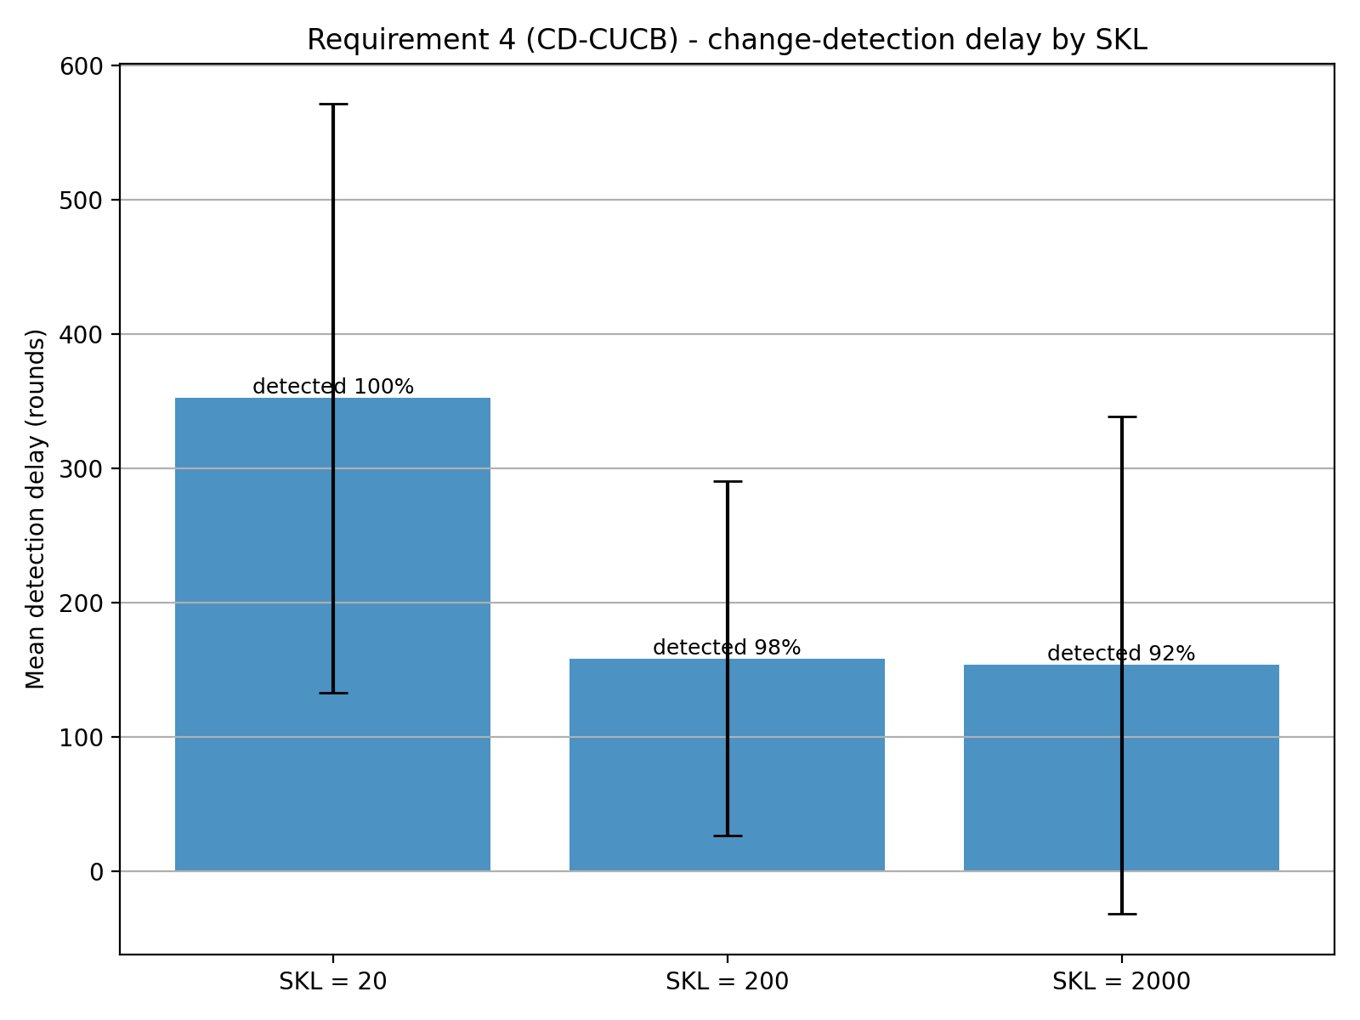
REQUIREMENT 4 · CHANGE-DETECTOR CUCB · BACKUP · GLOBAL RESET (H = 50)
CD-CUCB — detection delay
Mean detection delay
SKL = 20
352.4 ±219.2
median 324
SKL = 200
158.5 ±131.8
median 111
SKL = 2000
153.6 ±185.3
median 97
detected: 100% / 98% / 92% (SKL 20 / 200 / 2000).
CD-CUCB (CUSUM) · req4_cd_detection_delay.png
Notes:
The detection rate for high SKL values can be explained through the fact that to cross the threshold of 50, the algorithm needs to pull the arm a sufficient number of times; but at the same time, the UCB algorithm can start to abandon the arms that show the change because of the sudden drop of its UCB value, driven by the collapse of its reward estimate (from clearly the best arm before, now it becomes clearly the worst arm). The change of the UCB arm selection can happen before the detection algorithm fires a change in the distribution, so the change remains undetected.
This can't happen using the ND approach since the algorithm uses full feedback: every arm is observed at each round, independently of the chosen arm.

Slide 37
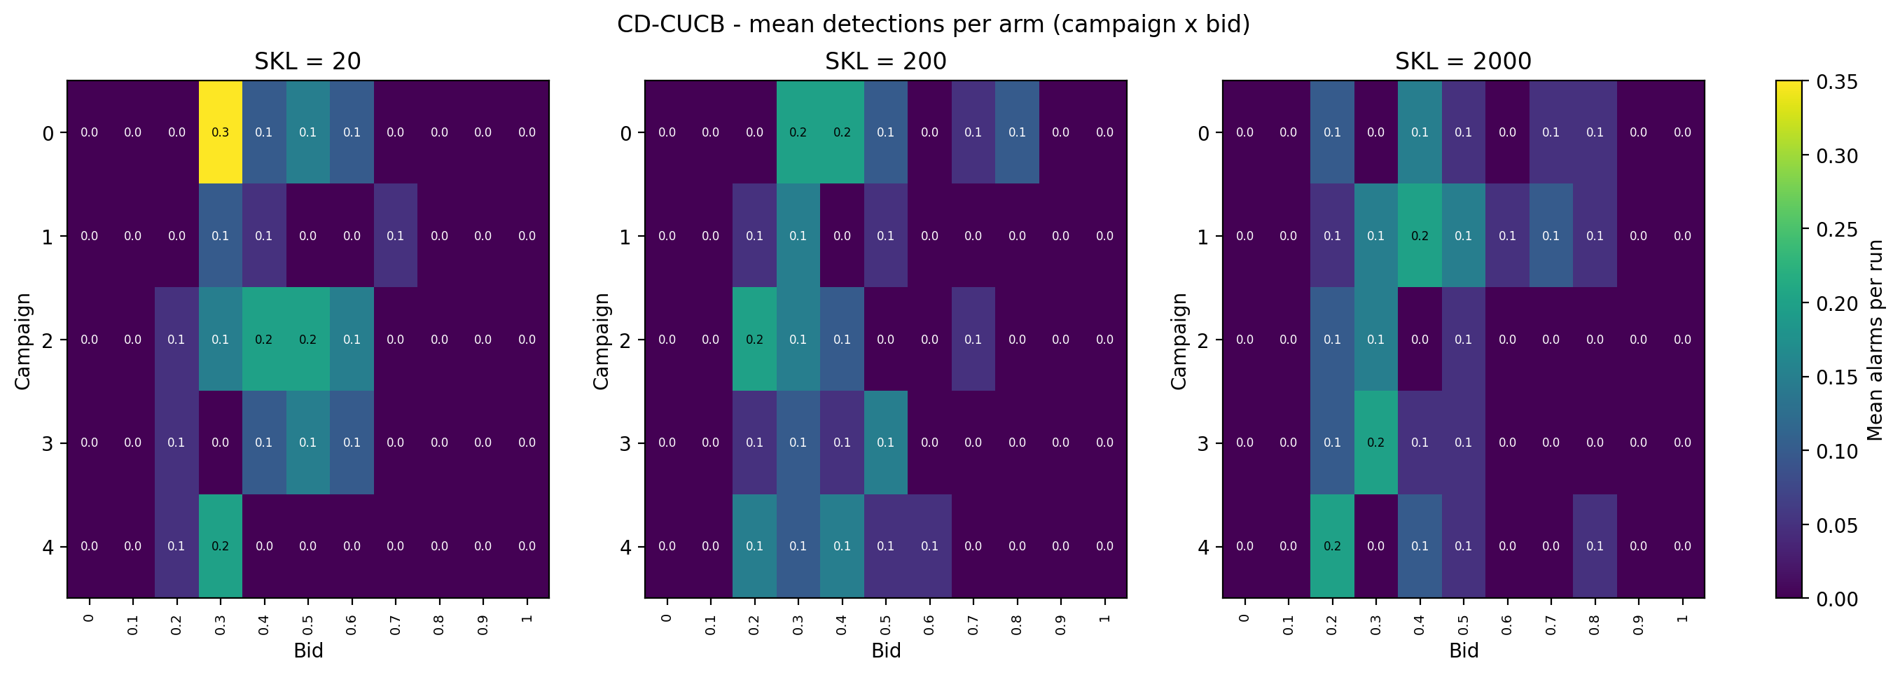
REQUIREMENT 4 · CHANGE-DETECTOR CUCB · BACKUP · GLOBAL RESET (H = 50)
CD-CUCB — detections per arm
CD-CUCB (CUSUM) · req4_cd_detections_per_arm.png

Slide 38
REQUIREMENT 4 · CHANGE-DETECTOR CUCB
Change Detection with Normal Discrepancy
The idea. A single joint detector watches the whole vector of competing bids over a sliding window: when the window's first and second halves look like different distributions, declare a change and restart the learner. Normal Discrepancy also exploits the multivariate structure of the Gaussians used in the experiments to detect change points more effectively.
How it works
Normal Discrepancy
▪ Joint detector on m(t): a single detector watches the full N-dimensional competing-bid vector over a sliding window of the last nd_window_size rounds — not one detector per arm.
▪ Normal Discrepancy: split the window at its midpoint and compare the full-window covariance with its two halves. ND ≈ 0 when both halves share a distribution and grows when a change sits inside the window.
▪ Full feedback: the detector, as well as the UCB algorithm, exploit the information of the full-feedback approach.
▪ Global reset: being a single joint detector, one alarm restarts every arm and clears the window — the reset is always global.
▪ No need for forced exploration: since the UCB estimator uses the full-feedback information, the forced exploration parameter is set to 0. Also, the exploration term of the UCB formula is ignored. The mean estimates are the only considered term.
Σ: full-window covariance; Σ_L, Σ_R: its two half-windows. ND ≈ 0 with no change, spikes on a shift.
ND parameters
nd_window_size — window length
nd_threshold — alarm level
ola/algorithms/cd_cucb.py · detector_type = nd_full_feedback

Slide 39
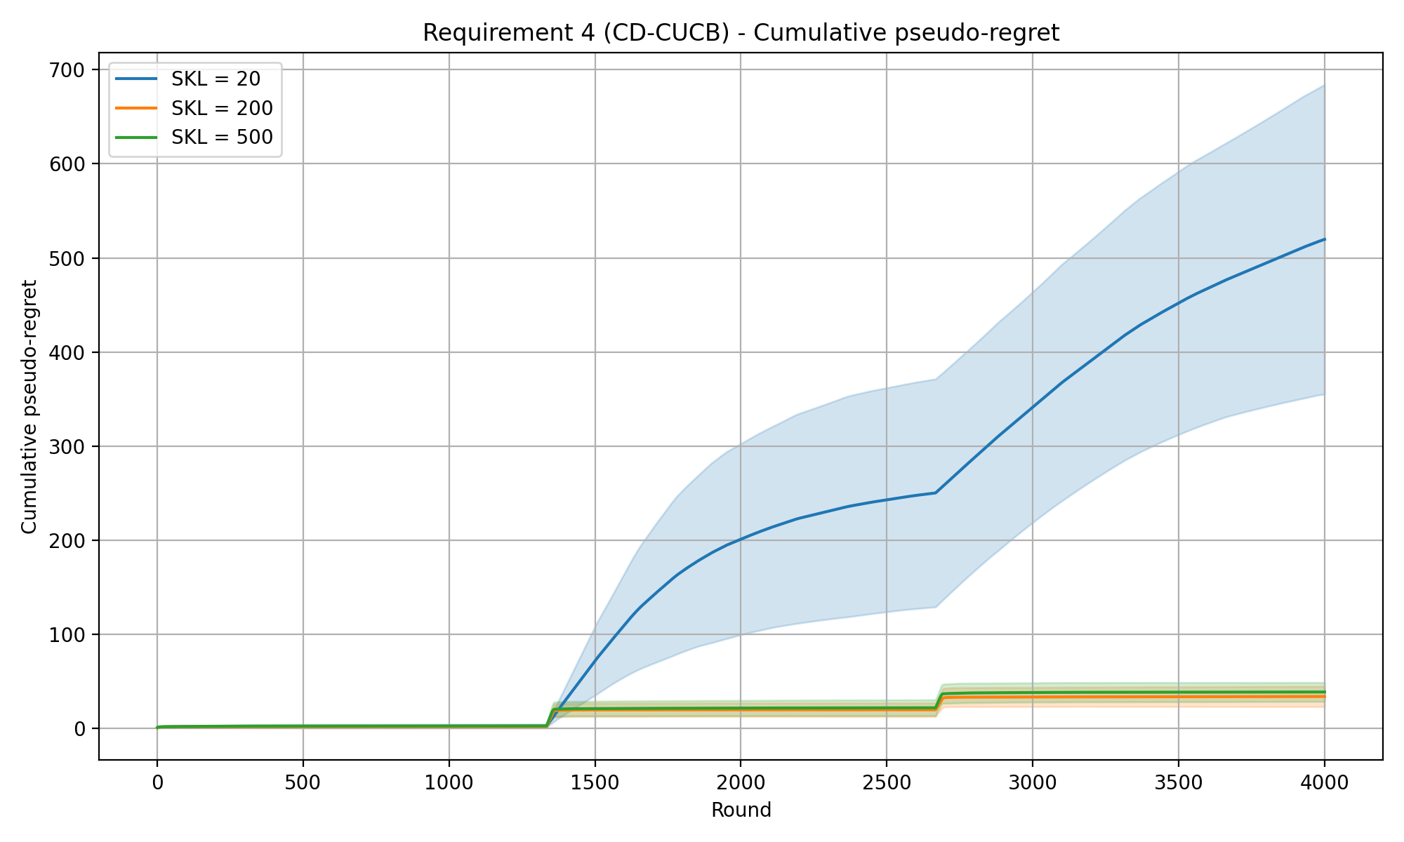
REQUIREMENT 4 · CHANGE-DETECTOR CUCB · EXPERIMENTS
CD-CUCB (ND) — cumulative pseudo-regret
Experiment setup
Time horizon T
Intervals
Budget B
Per-round budget ρ = B / T
Exploration coeff. c
ND threshold
ND window size
4000
3
8000
2.0
0.1
3
50
SKL levels (curves) 20 / 200 / 500
Mean detection delay (rounds)
SKL 20
SKL 200
SKL 500
n/a
22.2 ±2.0
18.9 ±3.2
Shaded bands: mean ± std across 20 repeated runs.
SKL 20: no change detected.
CD-CUCB (ND) · ND_ec=0.1 (threshold = 3)

Slide 40
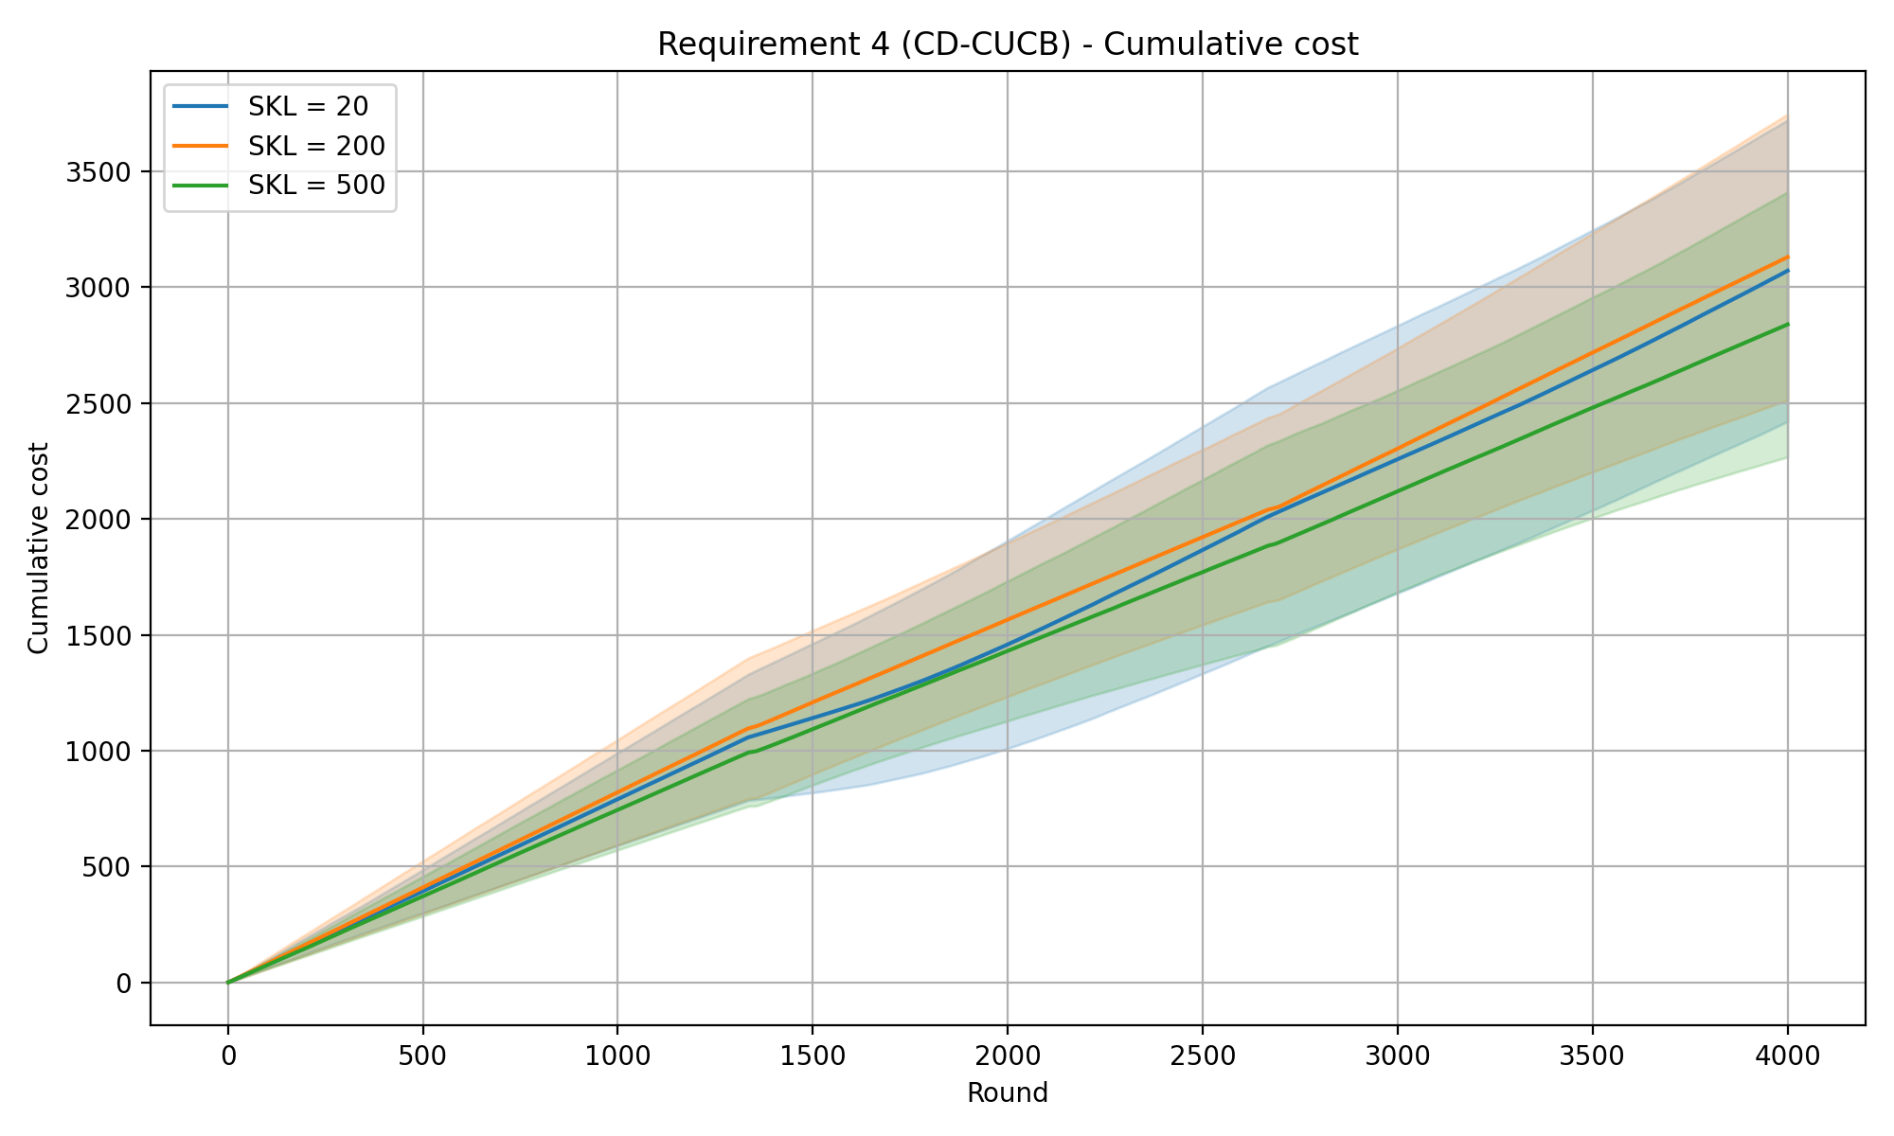
REQUIREMENT 4 · CHANGE-DETECTOR CUCB · BACKUP · NORMAL DISCREPANCY (THRESHOLD = 3)
CD-CUCB (ND) — cumulative cost
CD-CUCB (CUSUM) · req4_cd_cumulative_cost.png

Slide 41
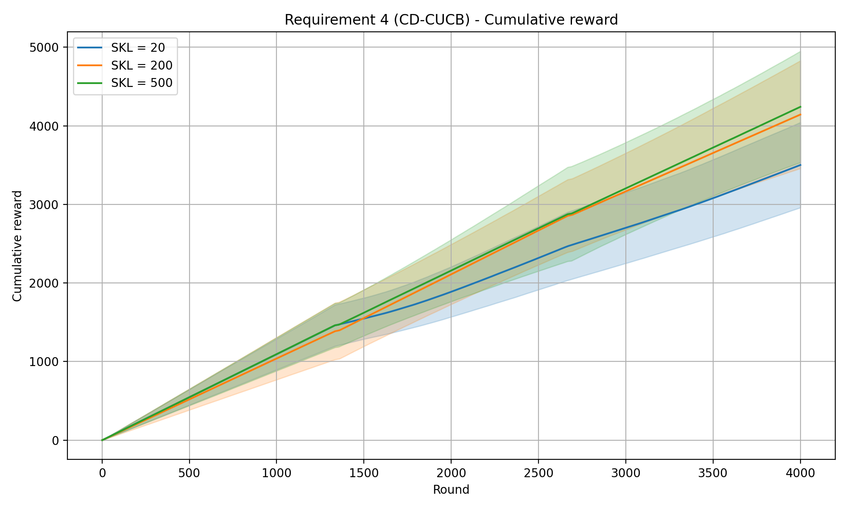
REQUIREMENT 4 · CHANGE-DETECTOR CUCB · BACKUP · NORMAL DISCREPANCY (THRESHOLD = 3)
CD-CUCB (ND) — cumulative reward
CD-CUCB (CUSUM) · req4_cd_cumulative_reward.png

Slide 42
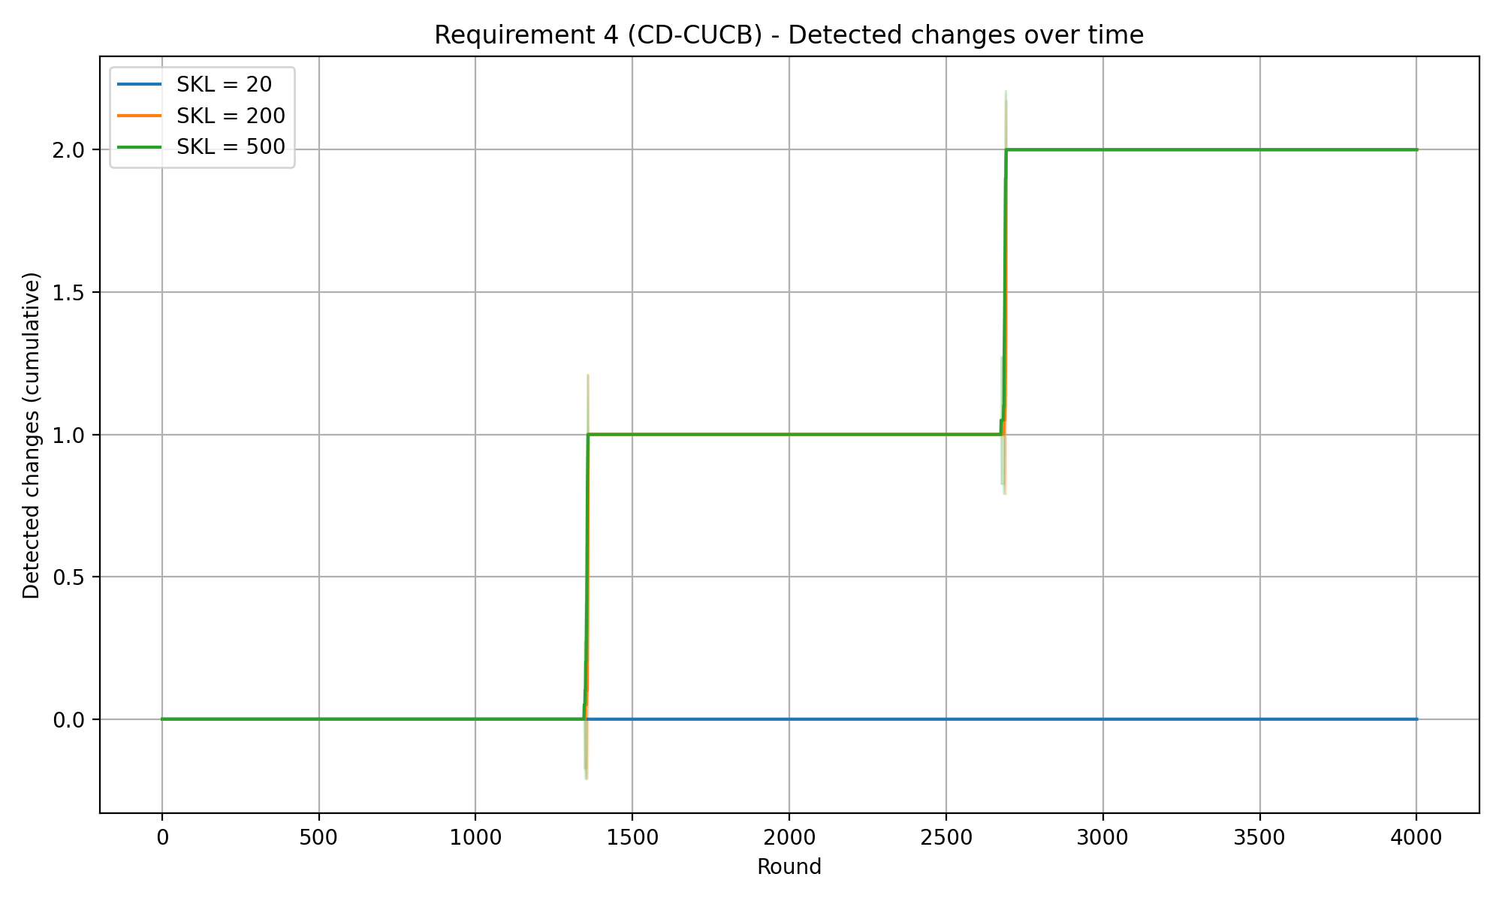
REQUIREMENT 4 · CHANGE-DETECTOR CUCB · BACKUP · NORMAL DISCREPANCY (THRESHOLD = 3)
CD-CUCB (ND) — detected changes over time
CD-CUCB (CUSUM) · req4_cd_detected_changes.png

Slide 43
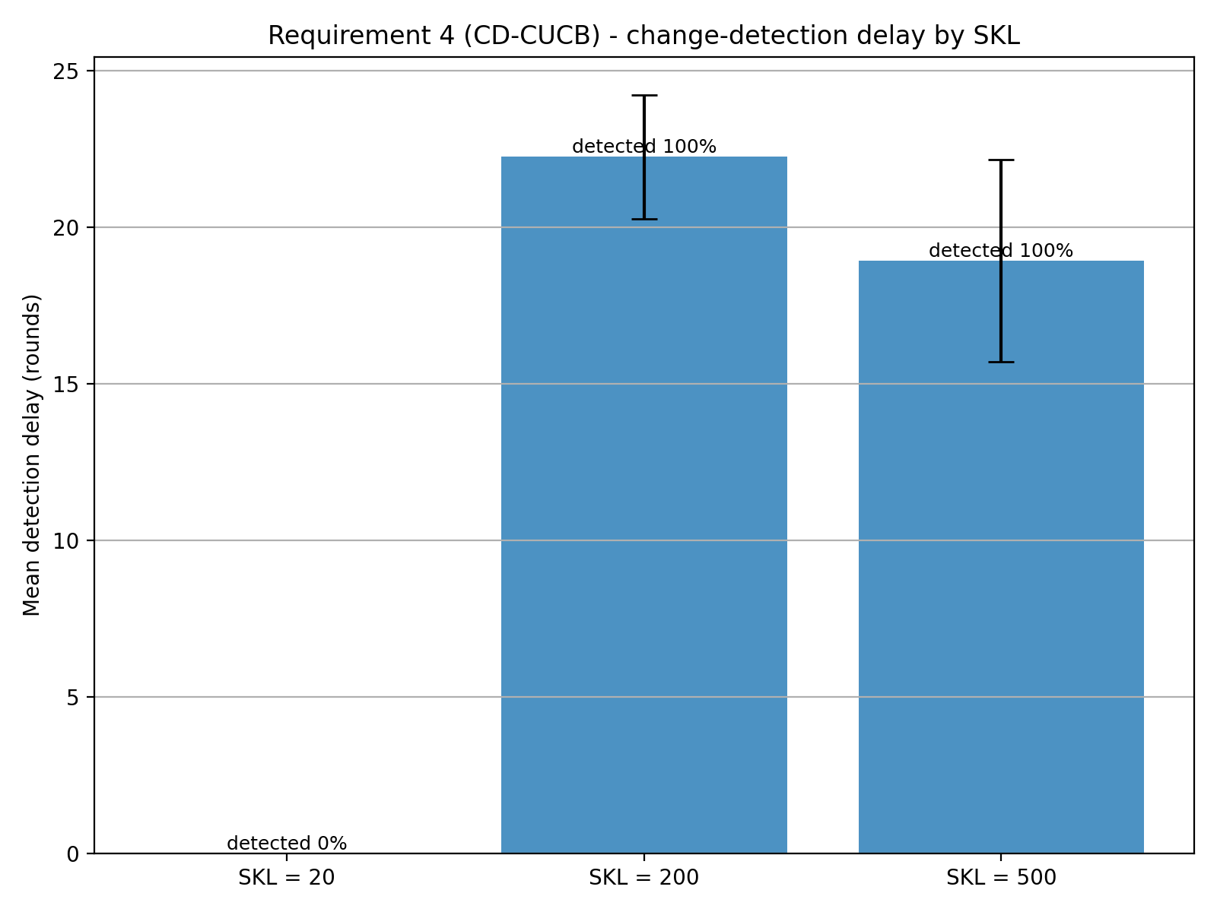
REQUIREMENT 4 · CHANGE-DETECTOR CUCB · BACKUP · NORMAL DISCREPANCY (THRESHOLD = 3)
CD-CUCB (ND) — detection delay
Mean detection delay
SKL = 20
n/a
median n/a
SKL = 200
22.2 ±2.0
median 23
SKL = 500
18.9 ±3.2
median 19.5
SKL 20 not detected (0%); 200 / 500: 100%.
CD-CUCB (CUSUM) · req4_cd_detection_delay.png

Slide 44
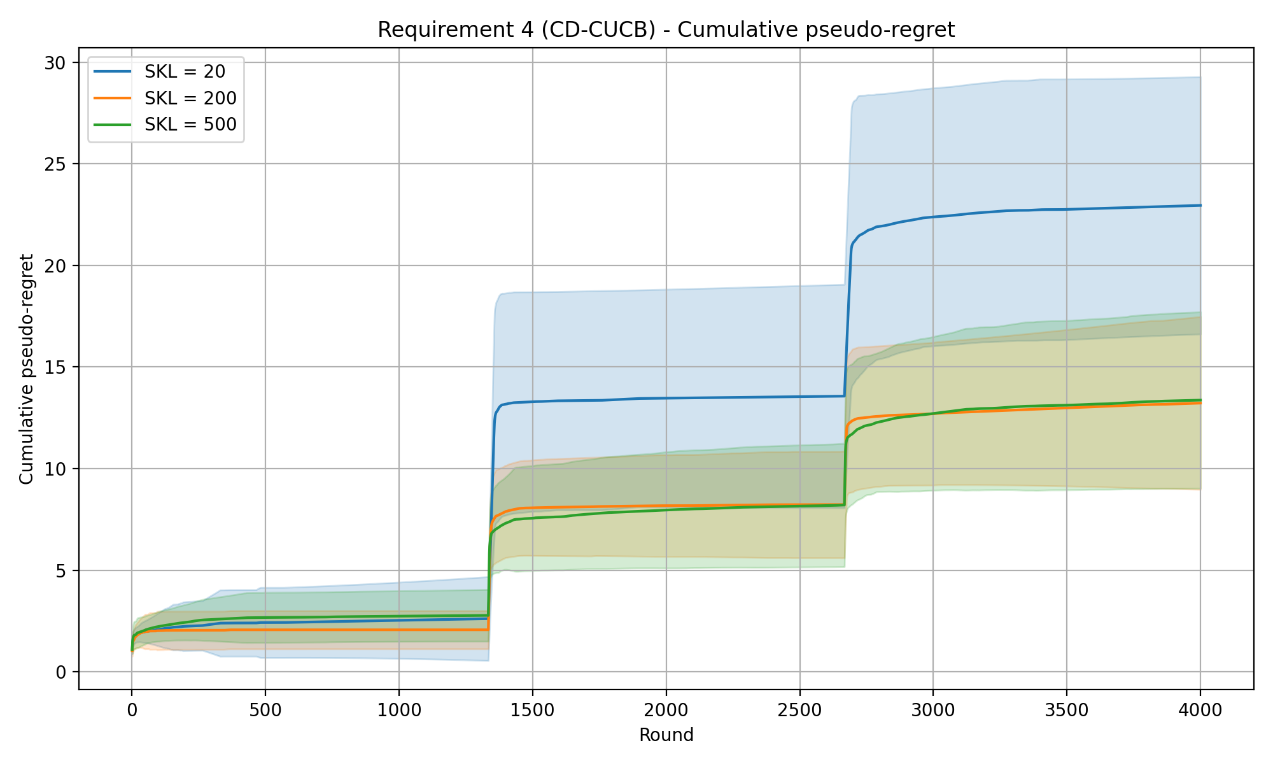
REQUIREMENT 4 · CHANGE-DETECTOR CUCB · EXPERIMENTS
CD-CUCB (ND) — cumulative pseudo-regret
Experiment setup
Time horizon T
Intervals
Budget B
Per-round budget ρ = B / T
Exploration coeff. c
ND threshold
ND window size
4000
3
8000
2.0
0.1
1.5
50
SKL levels (curves) 20 / 200 / 500
Mean detection delay (rounds)
SKL 20
SKL 200
SKL 500
19.9 ±2.8
4.6 ±2.0
1.9 ±1.3
Shaded bands: mean ± std across 20 repeated runs.
CD-CUCB (ND) · ND_ec=0.1_threshold=1.5

Slide 45
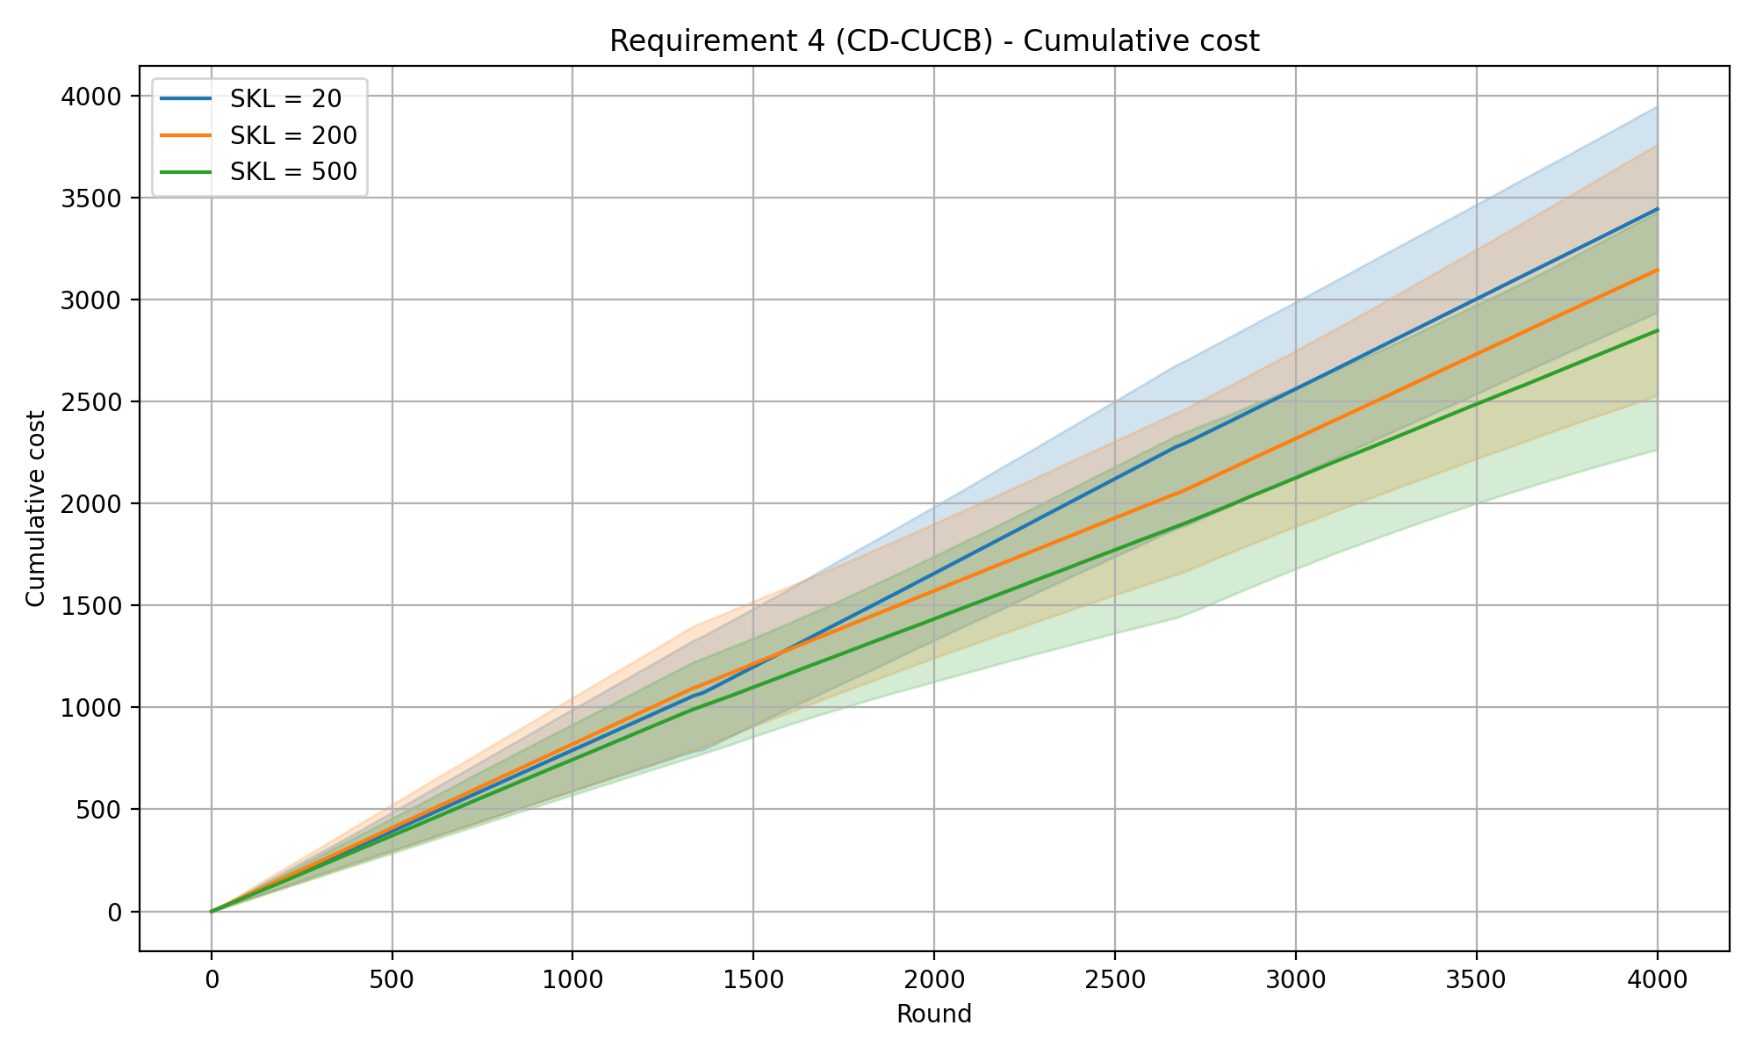
REQUIREMENT 4 · CHANGE-DETECTOR CUCB · BACKUP · NORMAL DISCREPANCY (THRESHOLD = 1.5)
CD-CUCB (ND) — cumulative cost
CD-CUCB (CUSUM) · req4_cd_cumulative_cost.png

Slide 46
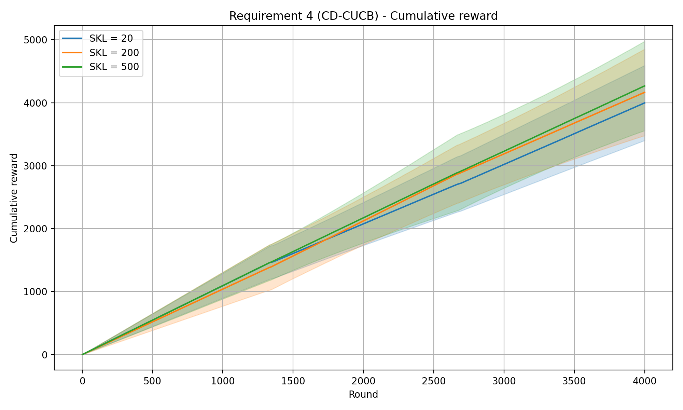
REQUIREMENT 4 · CHANGE-DETECTOR CUCB · BACKUP · NORMAL DISCREPANCY (THRESHOLD = 1.5)
CD-CUCB (ND) — cumulative reward
CD-CUCB (CUSUM) · req4_cd_cumulative_reward.png

Slide 47
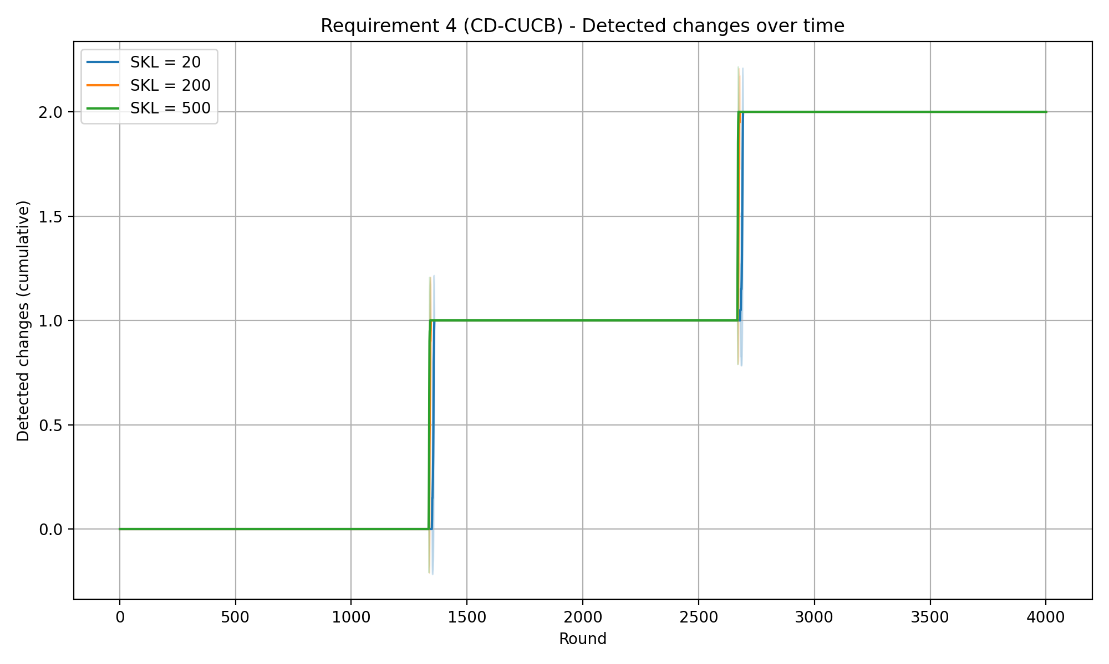
REQUIREMENT 4 · CHANGE-DETECTOR CUCB · BACKUP · NORMAL DISCREPANCY (THRESHOLD = 1.5)
CD-CUCB (ND) — detected changes over time
CD-CUCB (CUSUM) · req4_cd_detected_changes.png

Slide 48
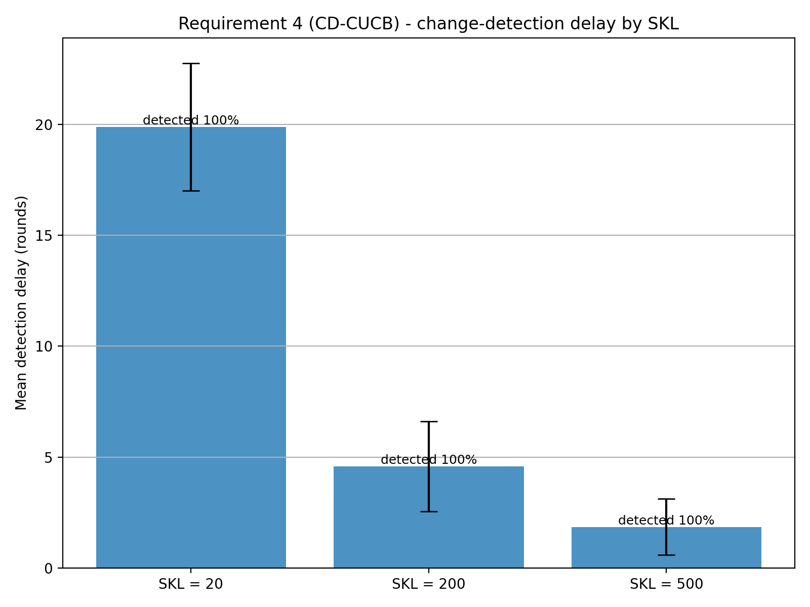
REQUIREMENT 4 · CHANGE-DETECTOR CUCB · BACKUP · NORMAL DISCREPANCY (THRESHOLD = 1.5)
CD-CUCB (ND) — detection delay
Mean detection delay
SKL = 20
19.9 ±2.9
median 21
SKL = 200
4.6 ±2.0
median 5
SKL = 500
1.8 ±1.3
median 2
All change points detected — 100%.
CD-CUCB (CUSUM) · req4_cd_detection_delay.png

Slide 49
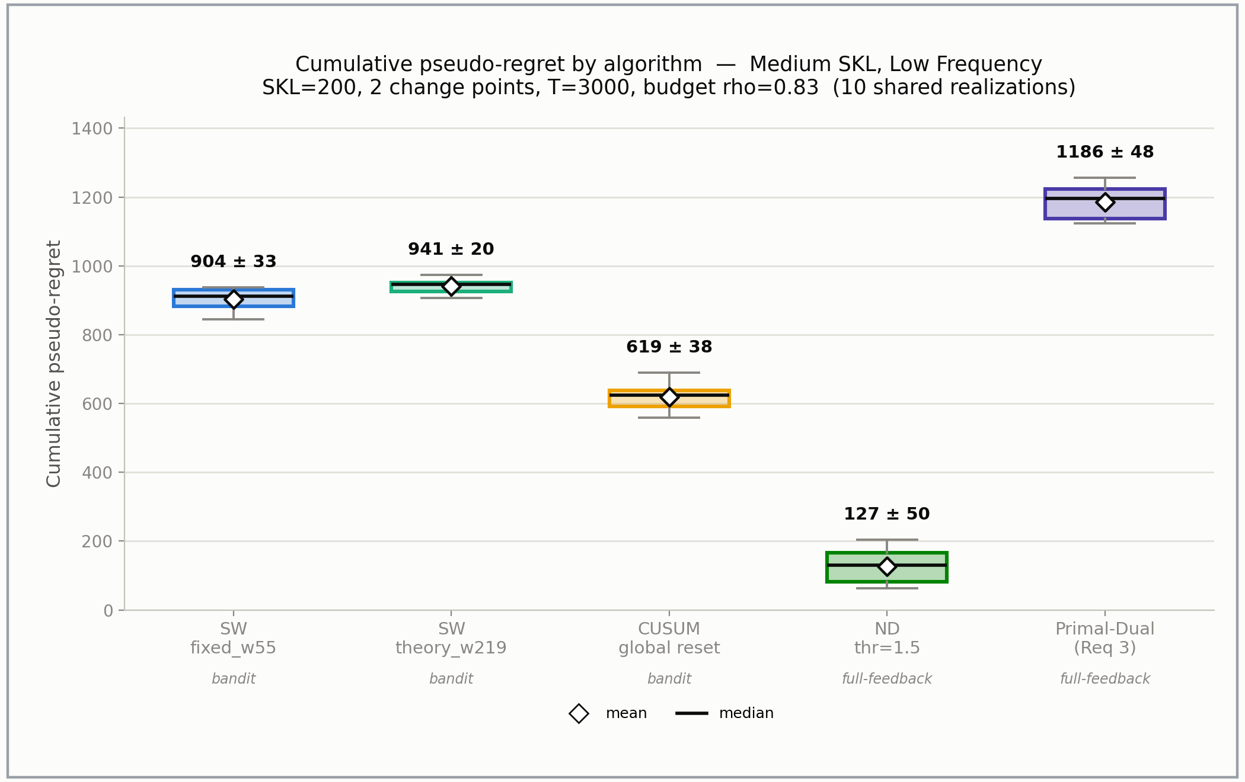
REQUIREMENT 4 ·COMPARISON
LOW FREQUENCY MEDIUM SKL — CUMULATIVE REGRET
Comparison

Slide 50
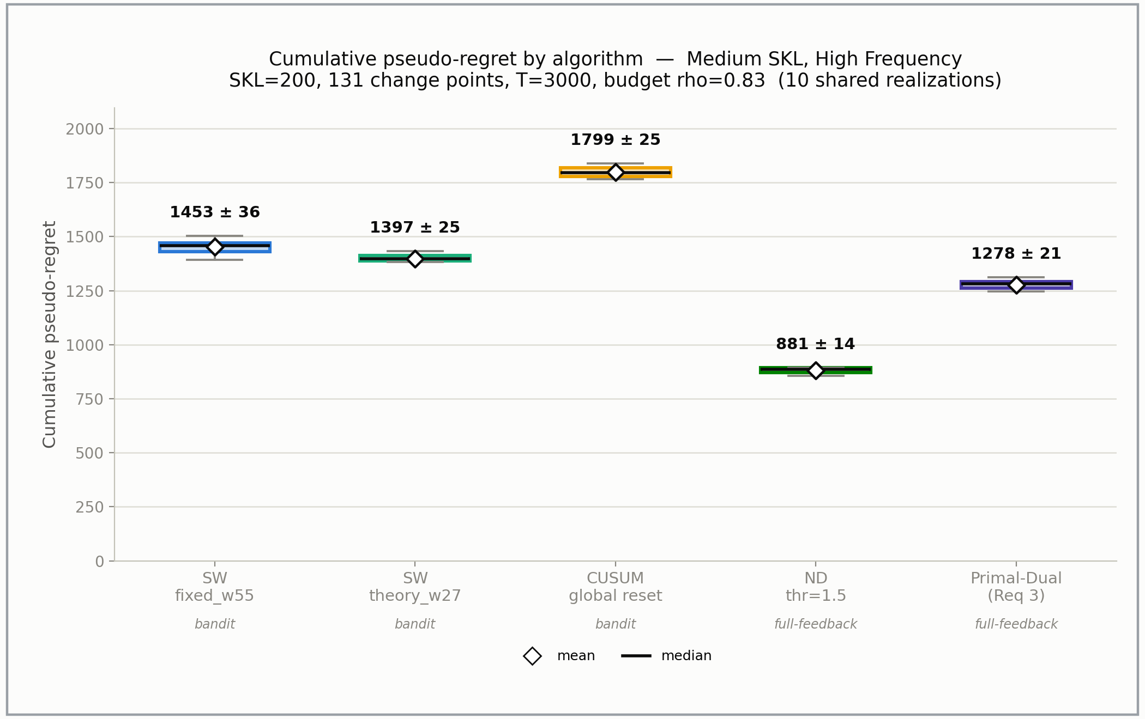
REQUIREMENT 4 ·COMPARISON
HIGH FREQUENCY MEDIUM SKL — CUMULATIVE REGRET
Comparison

