Slide 1
Notation
Symbols are formatted exactly as they appear in the model and update rules.
T
horizon; T = 3000 rounds
N
number of campaigns; N = 10
G
finite bid grid: {0.0, 0.1, ..., 1.0}
|G|
number of bid levels; |G| = 11
b_{t}
bid vector selected at round t
m_{t}
highest-competing-bid vector at round t
v_{i}
campaign i value; normalized to 1
λ_{t}
dual price controlling expenditure at round t
1

Slide 2
Final Req3 environment alignment
Req3 and Req4 now differ in algorithm, not in the realized market input.
SHARED BASE
SKL GRID
FREQUENCY GRID
REPLICATIONS
T=3000, N=10
20 / 200 / 2000
1/100 / 1/50 / 1/25
10 per cell
B=10000; 11 bid levels
Shared symmetric-KL definition
Stochastic regime changes
90 exact market matrices
Comparison rule
For realization r in setting s, every algorithm loads the same realization_r.npy file. The file fixes the complete highest-competing-bid matrix. config.json records the constellation seed, sample seed, change points, and active modes.
This deck reports the Req3 primal-dual results only; the common inputs make the later three-way comparison valid.
2

Slide 3
One round of the auction model
A compact view of the action, feedback, utility, and cost at round t.
1. Choose bids
2. Observe market
3. Determine wins
b_{t} = (b_{t,1}, ..., b_{t,N})
m_{t} = (m_{t,1}, ..., m_{t,N})
b_{t,i} ≥ m_{t,i}
One bid for every campaign.
Highest competing bids.
Campaign i is won iff this holds.
Utility
Cost
u_{t}(b_{t}) = Σ_{i=1}^{N} (v_{i} − b_{t,i}) 1{b_{t,i} ≥ m_{t,i}}
c_{t}(b_{t}) = Σ_{i=1}^{N} b_{t,i} 1{b_{t,i} ≥ m_{t,i}}
Value minus payment, summed over won auctions.
Only won auctions consume budget.
c_{t}(b_{t}) ≤ Σ_{i=1}^{N} b_{t,i}
This worst-case upper bound enables a deterministic budget guarantee.
3

Slide 4
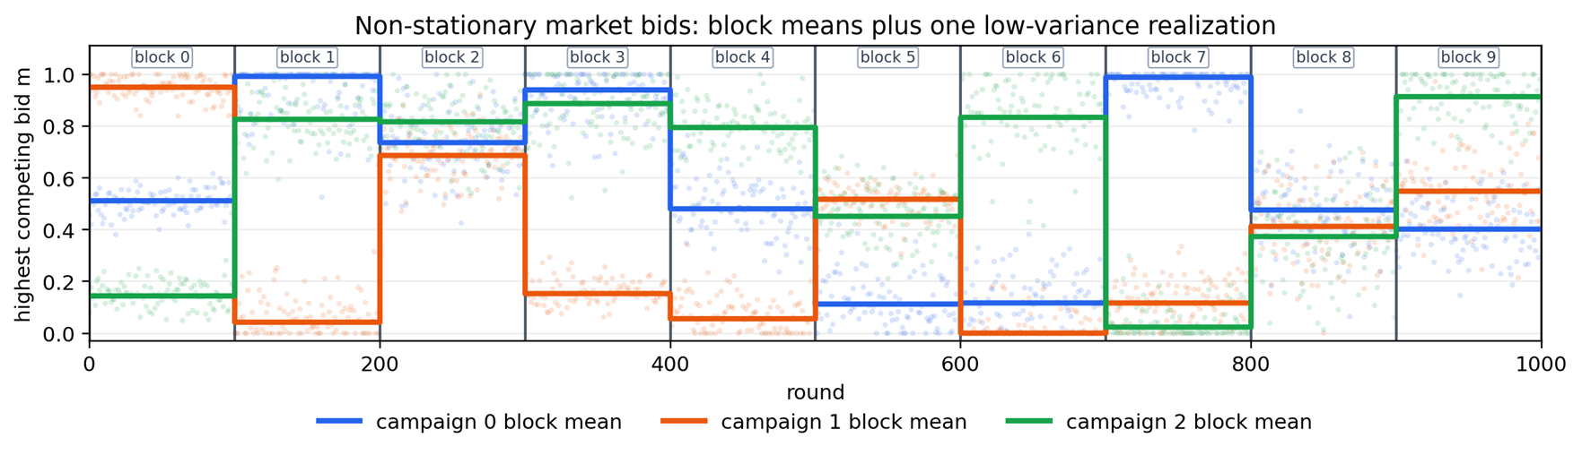
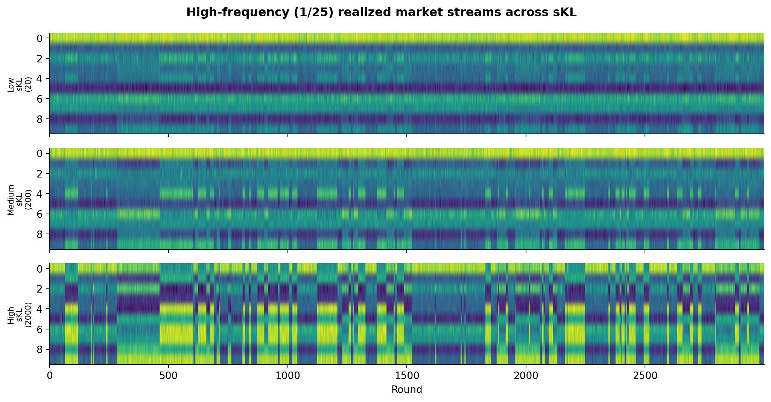
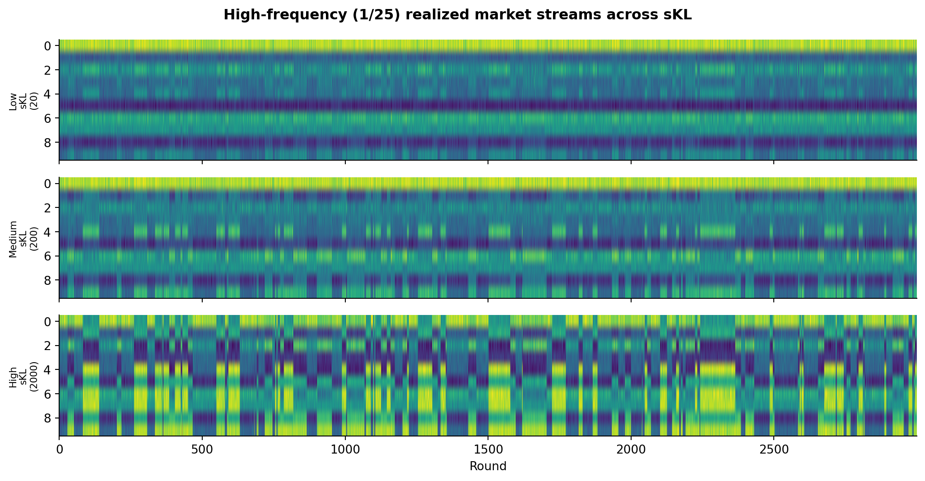
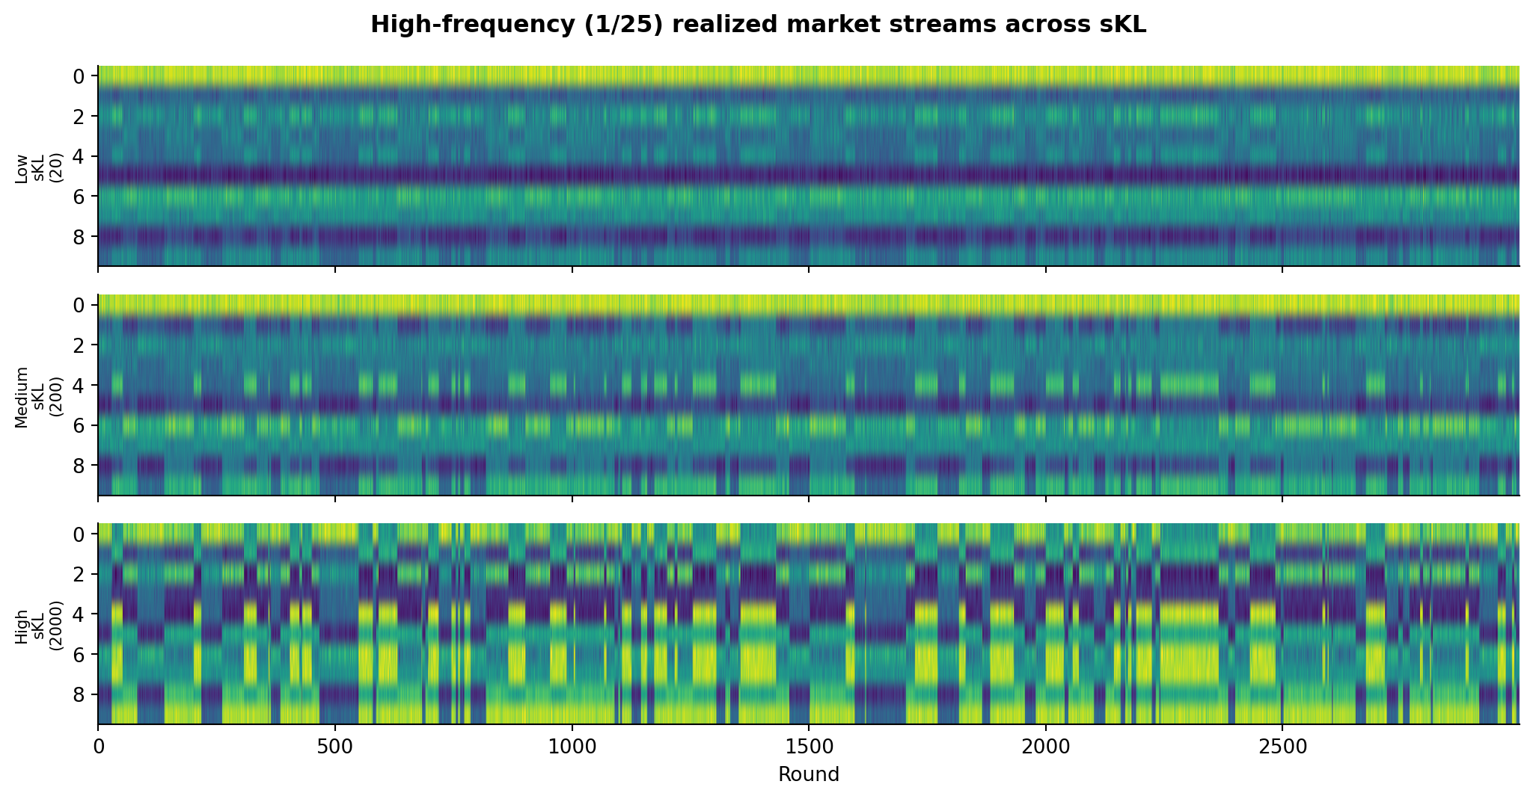
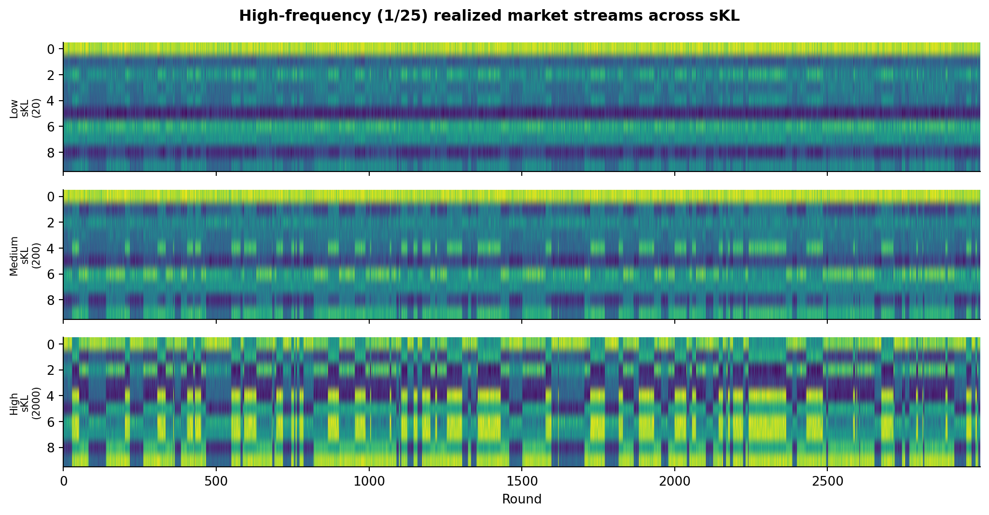
Shared non-stationary market environment
sKL controls how different regimes are; frequency controls how often the regime changes.
1. Three Gaussian modes
2. Separation between modes
z_{t} ∈ {0, 1, 2}, m_{t} ~ N(μ_{zₜ}, Σ_{zₜ})
sKL(P_{a}, P_{b}) ∈ {20, 200, 2000}
Each mode is a 10-dimensional distribution of competing bids.
Larger sKL means a more visible distribution shift.
3. Stochastic mode switching
4. Freeze the realized market
Pr(z_{t} ≠ z_{t−1}) = p
M = [m₁, ..., m_{T}]⊤ ∈ [0, 1]^{3000×10}
p = 1/100, 1/50, or 1/25; larger p gives more change points.
Once sampled, this exact matrix is reused by every algorithm.
EXAMPLE PATH
Mode 0
Mode 2
Mode 1
Mode 0
round
4

Slide 5
Factorized primal-dual bid policy
One Hedge distribution per campaign; no enumeration of the full joint action space.
1. Maintain weights
2. Sample per campaign
3. Assemble the vector
w_{t,i}(g), g ∈ G
b_{t,i} ~ p_{t,i}
b_{t} = (b_{t,1}, ..., b_{t,N})
Scores every bid g for campaign i.
Draw one affordable bid per campaign.
The complete 10-dimensional action.
Current setup
Computational benefit
Budget safety
No conflict edges: all 10 campaigns remain available.
10 × 11 arm weights instead of 11^10 joint actions.
Sampling is filtered by the remaining budget.
5

Slide 6
Primal-dual update
Primal weights learn useful bids; the dual price reacts to spending pressure.
1. Arm score
2. Hedge update
ℓ_{t,i}(g) = u_{t,i}(g) − λ_{t} c_{t,i}(g)
w_{t+1,i}(g) = w_{t,i}(g) exp(η ℓ̃_{t,i}(g))
Higher dual prices penalize expensive bids.
Normalized high-score bids gain multiplicative weight.
3. Dual update
4. Interpretation
λ_{t+1} = Π_{[0,1/ρ]}(λ_{t} + η_{λ}(c_{t} − ρ))
If spending exceeds ρ, λ rises and costly bids become less attractive. Below ρ, the pressure can relax.
ρ = B / T
Projection keeps the multiplier bounded.
Full-information feedback: after observing m_{t}, every campaign-bid arm can be evaluated.
6

Slide 7
Hard budget filter
The dual update encourages control; the feasibility filter provides the guarantee.
Before sampling
Why it is safe
Fallback action
Σ_{i=1}^{N} b_{t,i} ≤ B_{t}
c_{t}(b_{t}) ≤ Σ_{i=1}^{N} b_{t,i}
b_{t} = 0
Affordable under remaining budget B_{t}.
Only winning bids are actually paid.
Choose the zero vector if no positive bid is affordable.
Deterministic guarantee
Σ_{t=1}^{T} c_{t}(b_{t}) ≤ B
The filter is conservative, but cumulative realized spending can never exceed the total budget.
7

Slide 8
Current experiment setup
All numerical results from this point use the aligned 9 x 10 experiment grid.
HORIZON
CAMPAIGNS
BUDGET
BID GRID
3000 rounds
10
10000
0.0 to 1.0
Step 0.1; 11 bids
Learner
Reported metrics
Factorized primal-dual Hedge: one distribution over 11 bids per campaign, with a dual price for spending and a hard feasibility filter.
Learner and oracle cumulative utility and cost, cumulative regret, dual multiplier, and mean +/- SD across 10 shared realizations.
Oracle: exact piecewise-static hindsight optimum. It knows the true change points, selects one bid per campaign within each regime, and obeys the same global budget B=10000.
8

Slide 9
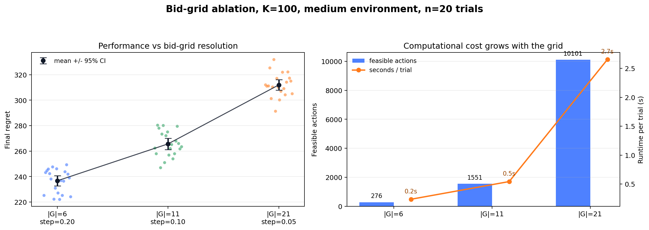
Shared-realization protocol
Every algorithm is evaluated on the same saved market path for each setting and realization.
1. Generate a market setting
2. Freeze one realization
For each sKL-frequency pair, generate the Gaussian constellation, regime-change schedule, and 10 market realizations.
M^{(s,r)} ∈ [0, 1]^{3000×10}
row t = one round; column i = one campaign
3. Reuse the exact matrix
4. Align and save outputs
Primal-dual, sliding-window CUCB, and change-detector CUCB load the same matrix for setting s and realization r. Only their bid decisions differ.
Store per-round bids, utility, cost, and remaining budget; then save one final summary row for each algorithm-realization pair.
WHY THIS IS FAIR
Performance differences come from the learning rules, not from different sampled auctions.
config.json records sKL, frequency, seeds, change points, and active modes; learner seeds remain algorithm-specific.
9

Slide 10
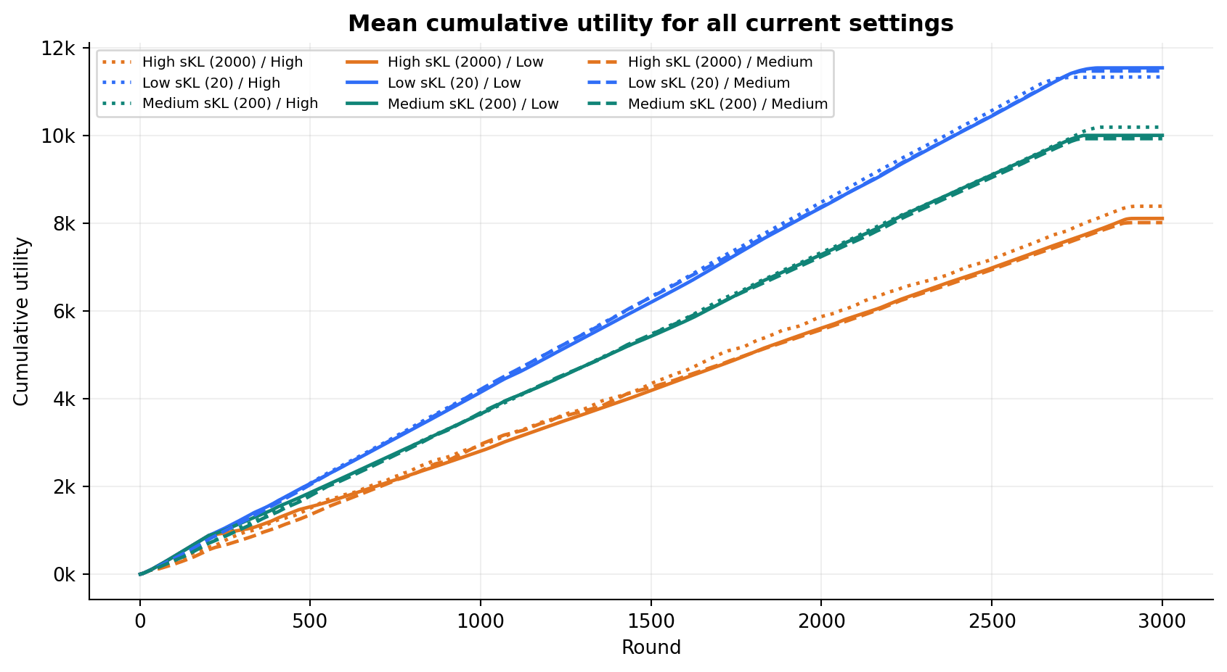
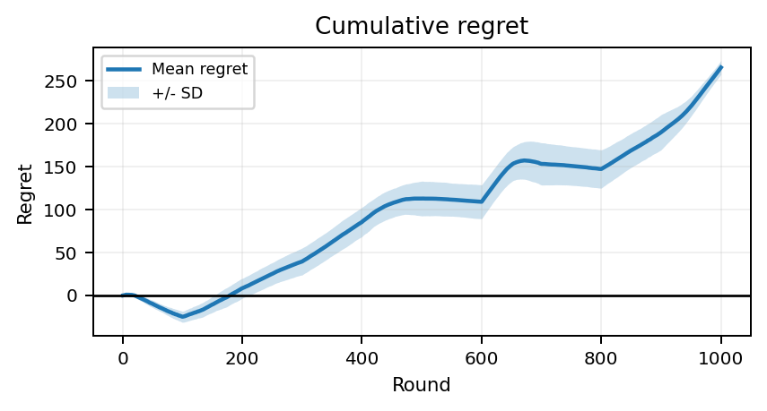
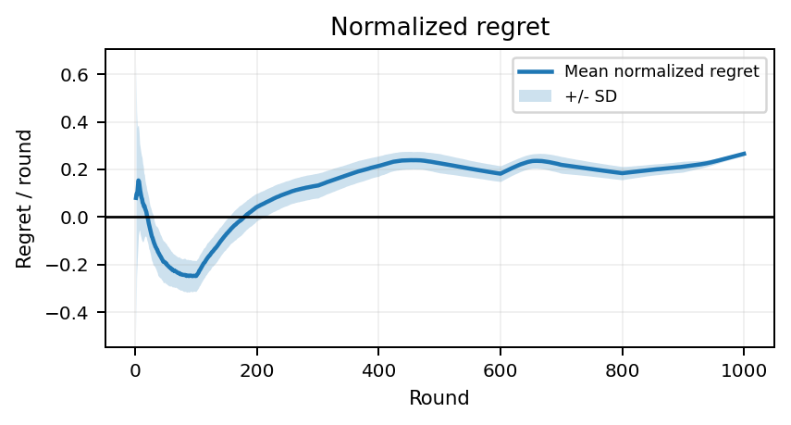
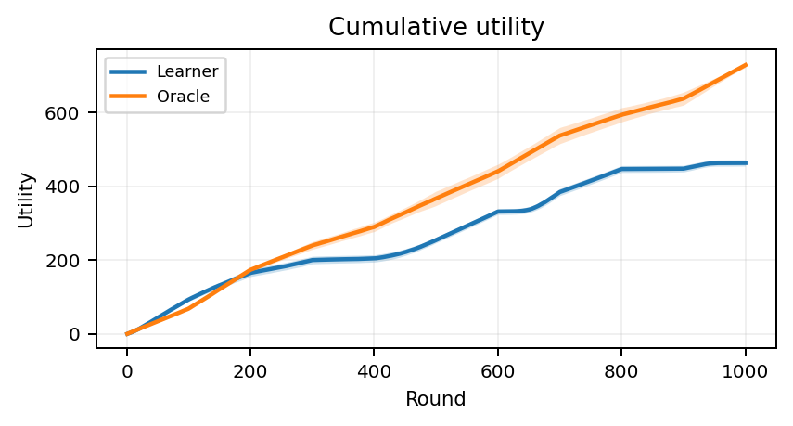
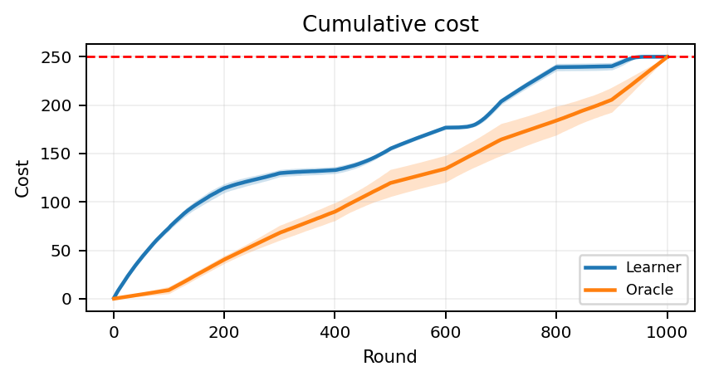
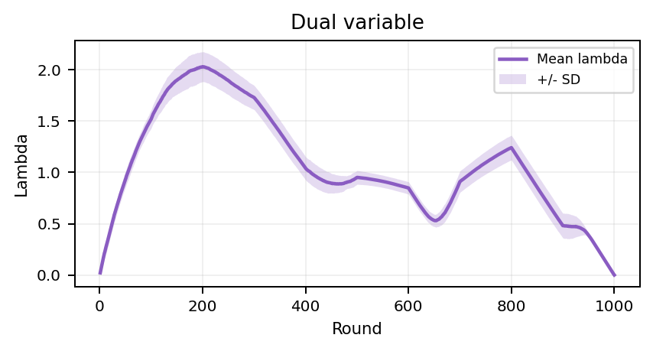
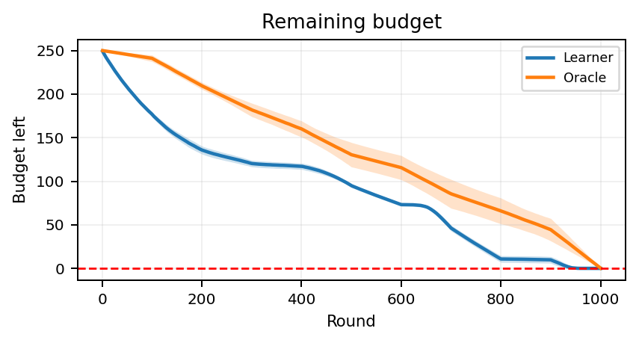
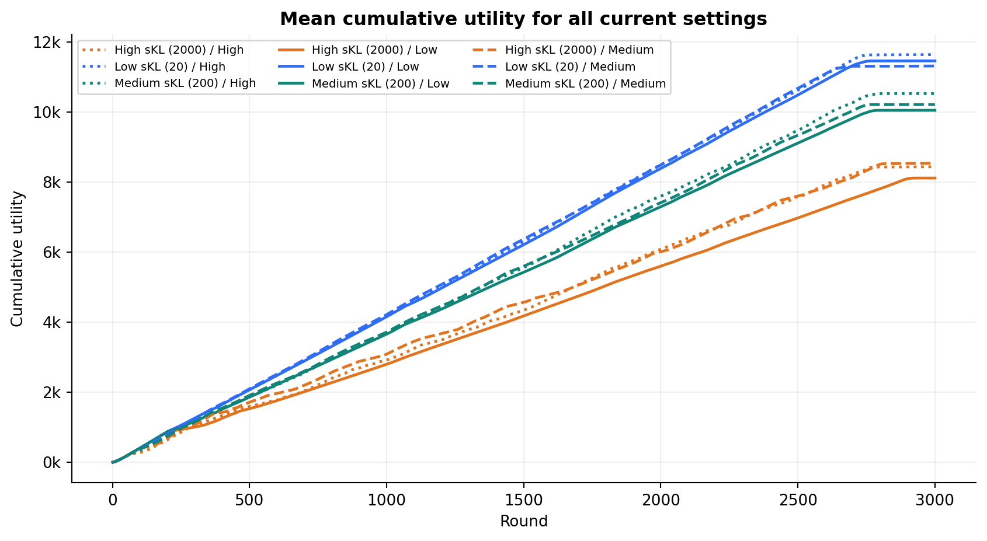
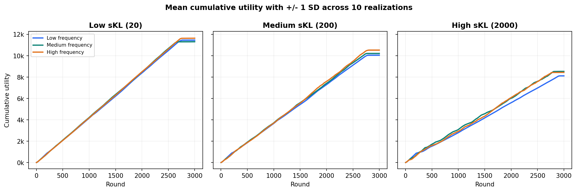
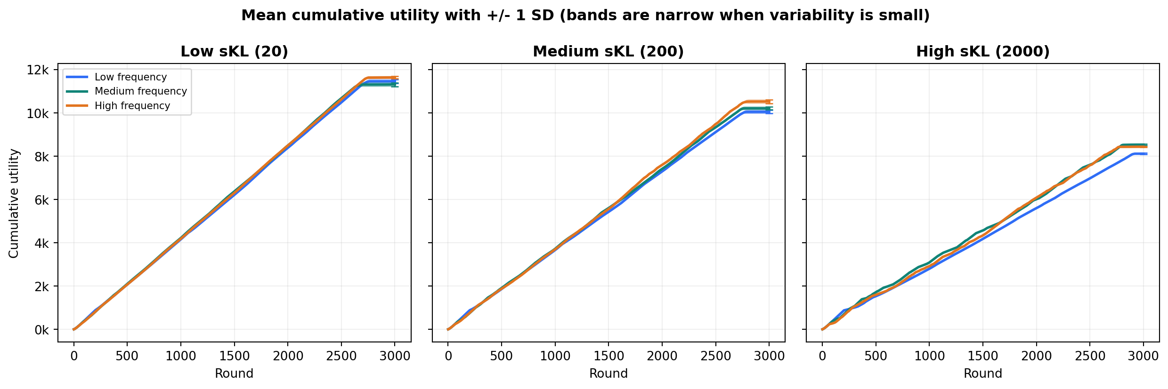
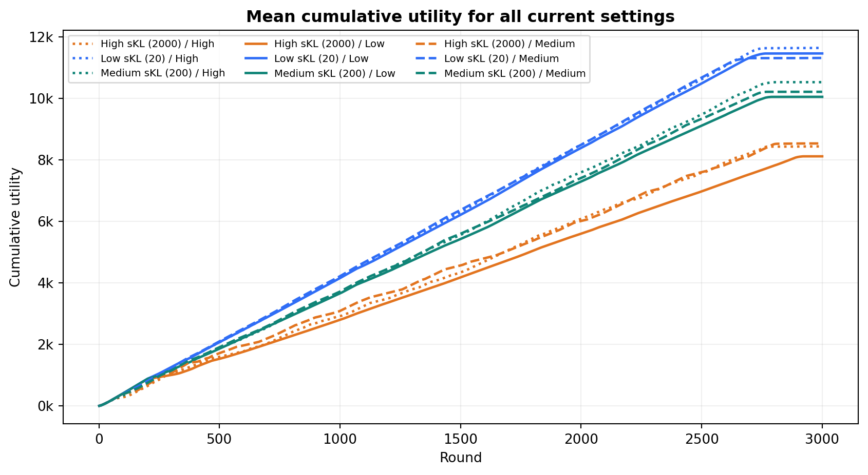
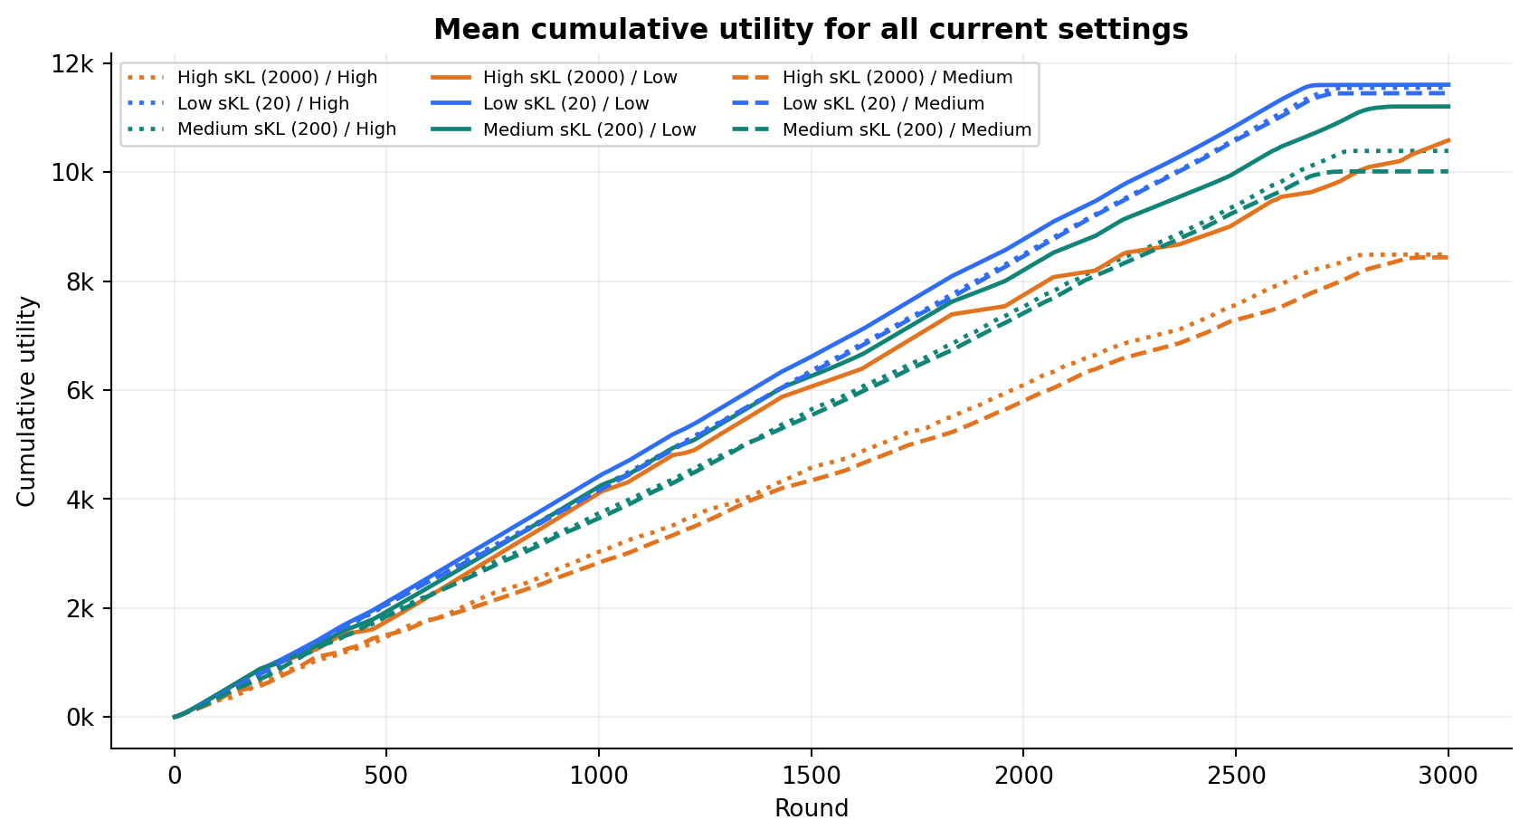
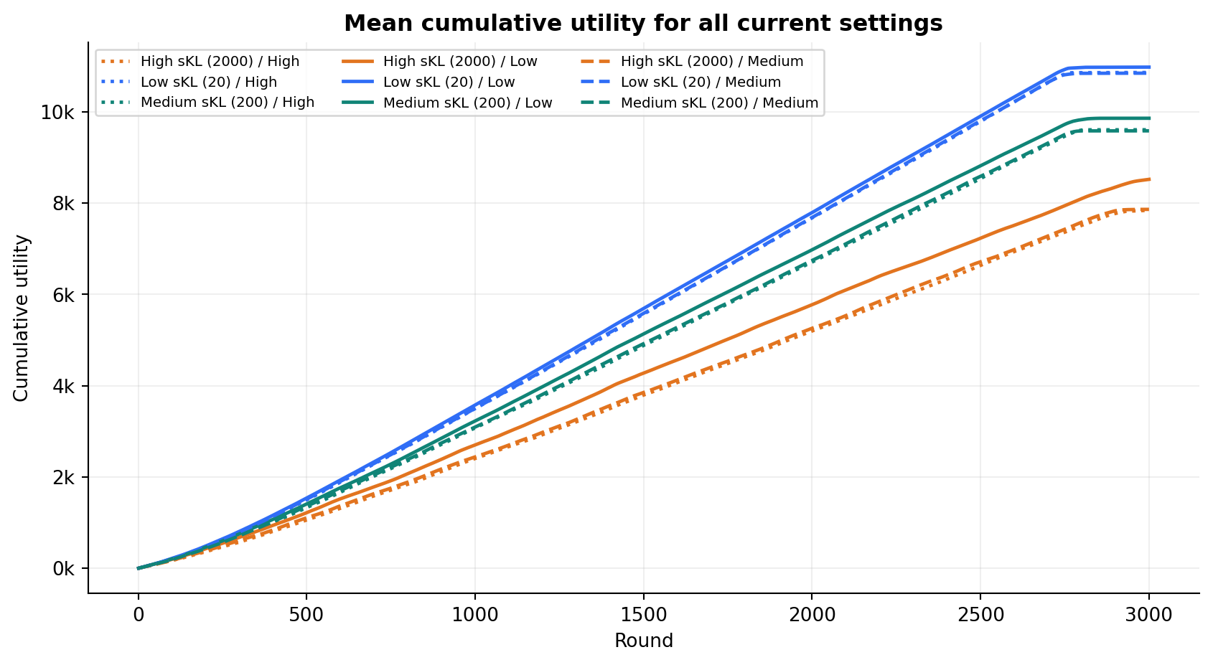

Overall primal-dual results
Pooled view over all 90 current shared realizations.
RUNS
MEAN UTILITY
MEAN ORACLE UTILITY
MEAN FINAL REGRET
90
9,890.2
11,933.2
2,043.0
9 settings x 10 matrices
SD 1,357.8
SD 984.4
SD 394.2
10

Slide 11
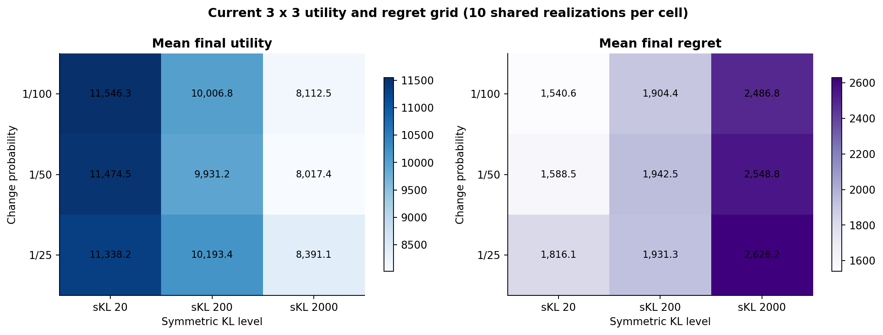
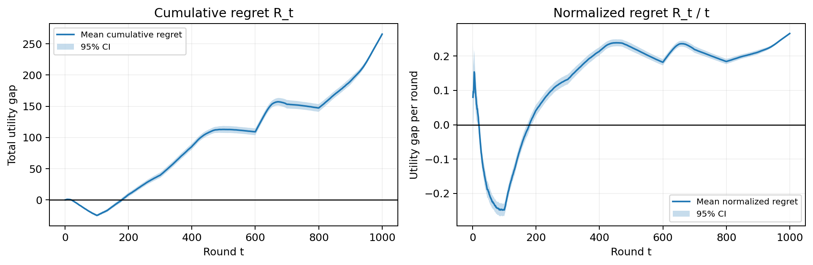
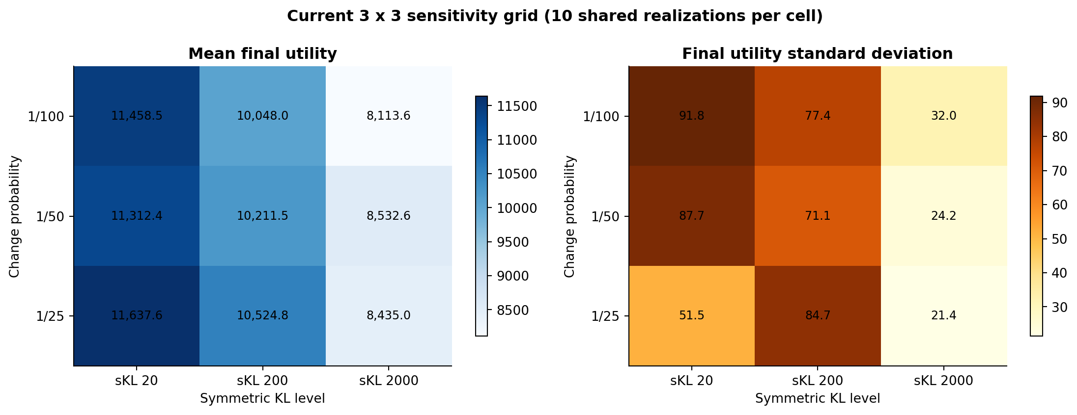
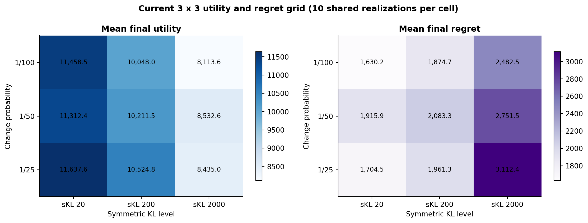
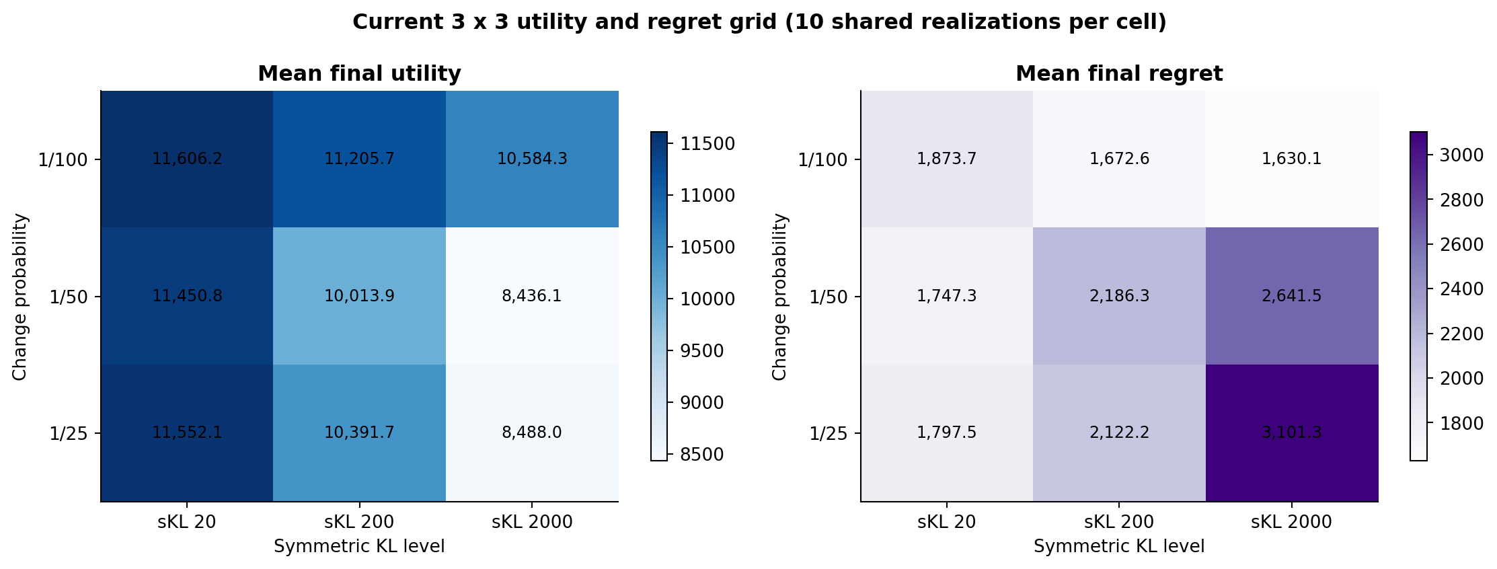

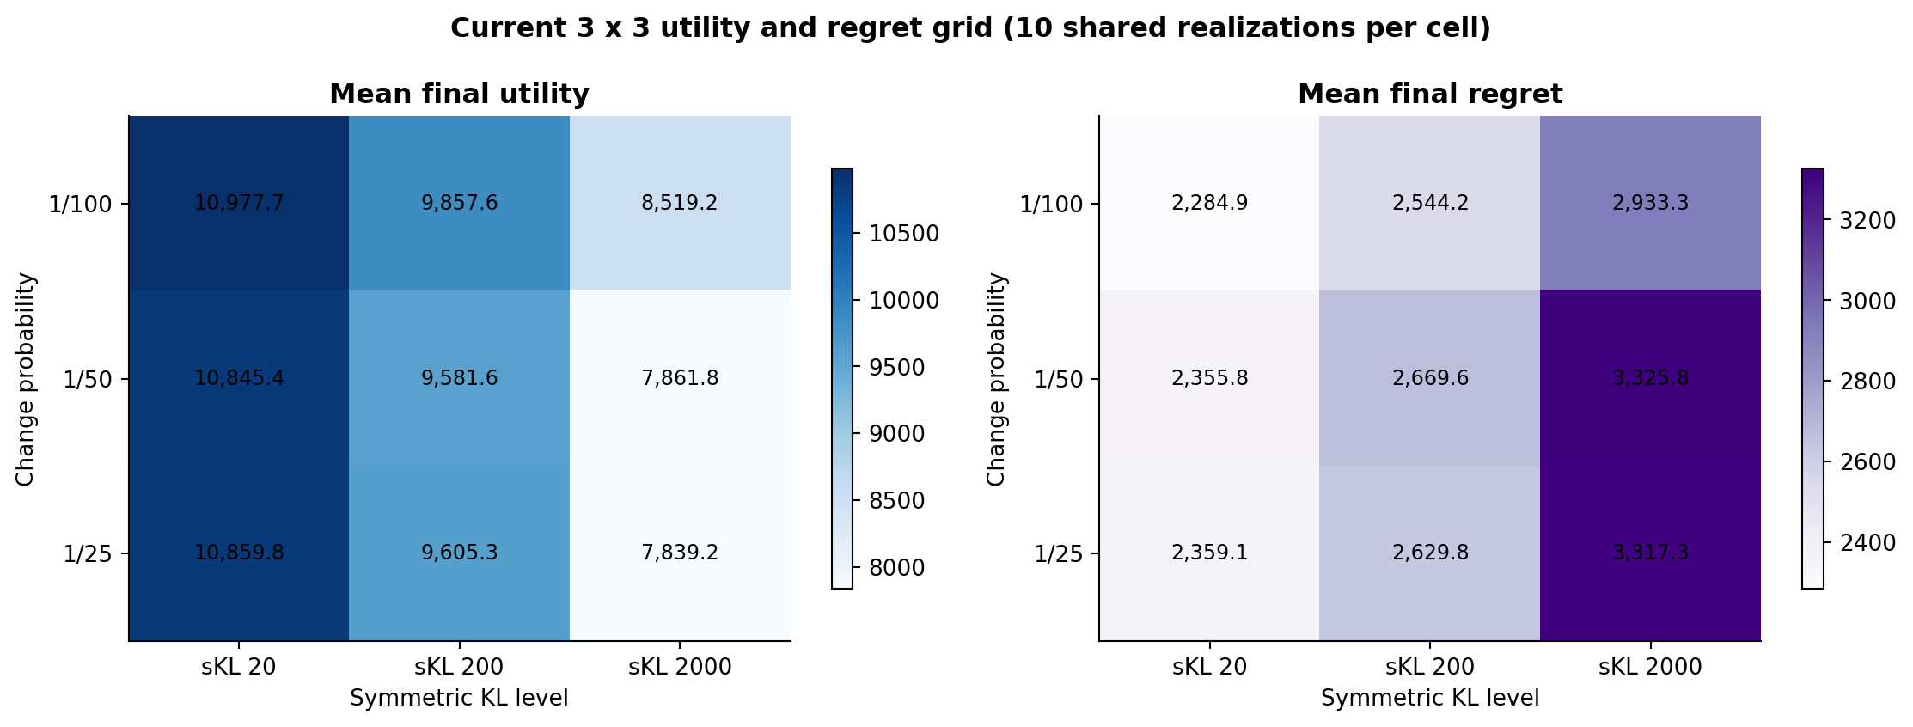
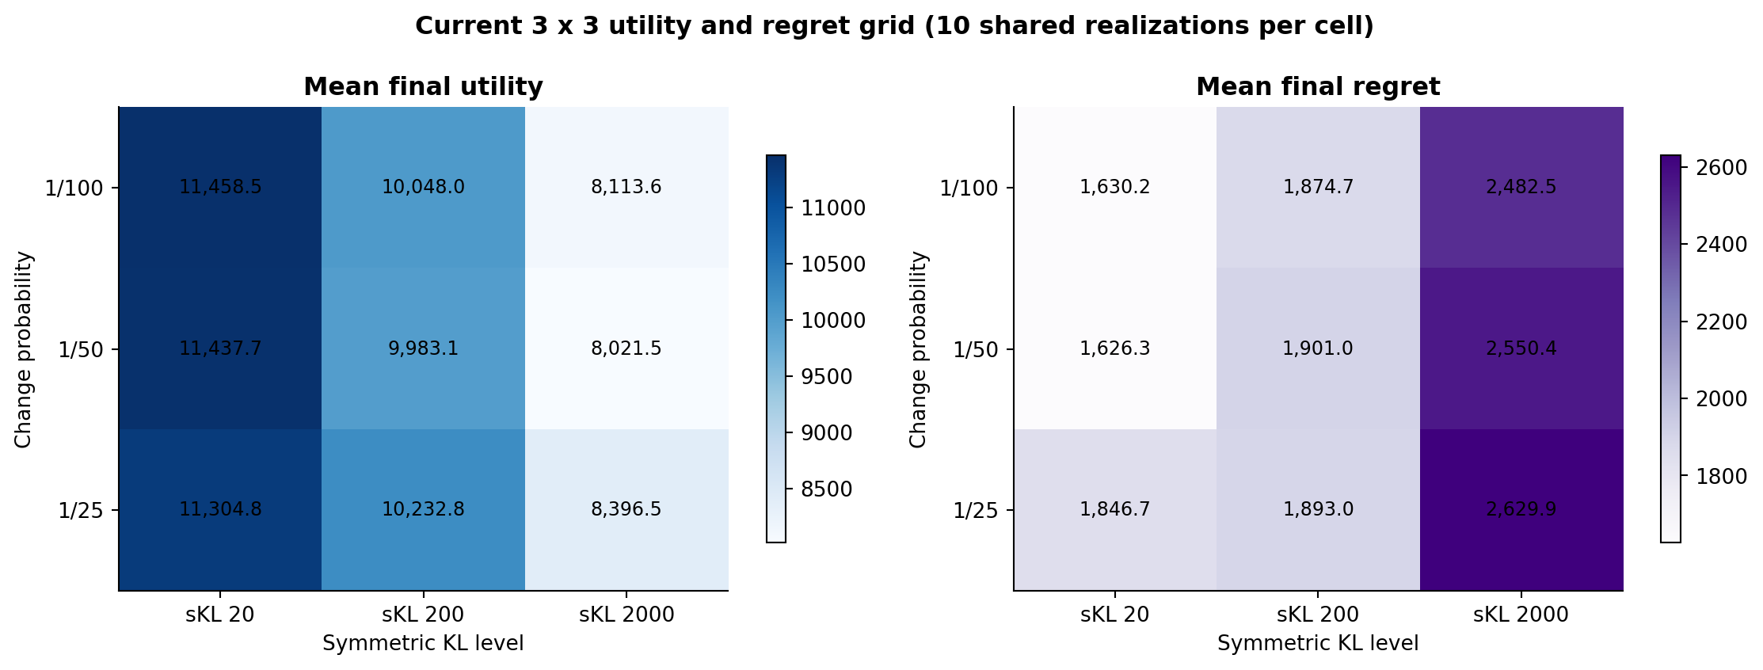
Utility and regret across the full grid
Each cell is a mean over 10 shared realizations; uncertainty is shown in the detailed diagnostics.
11

Slide 12
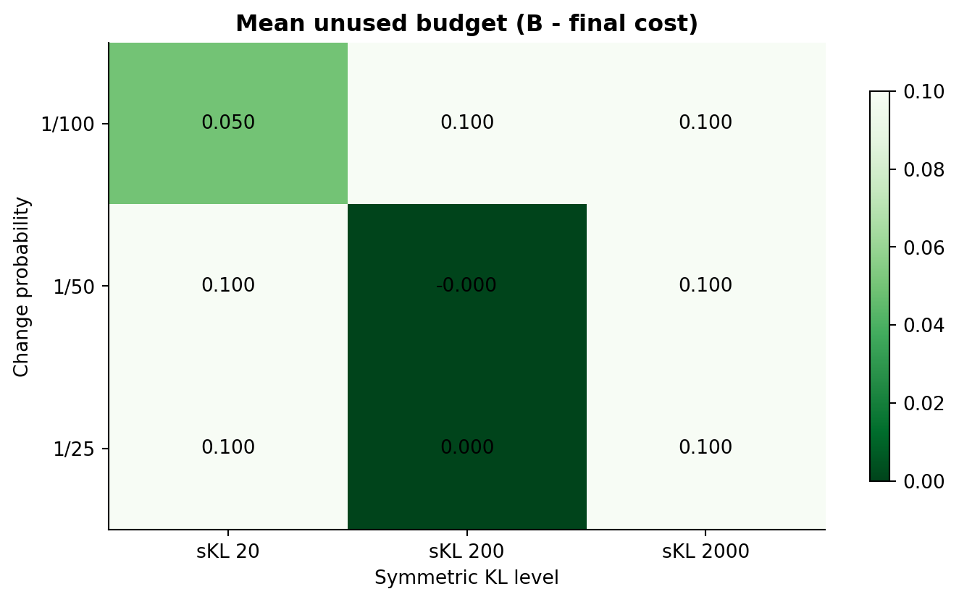
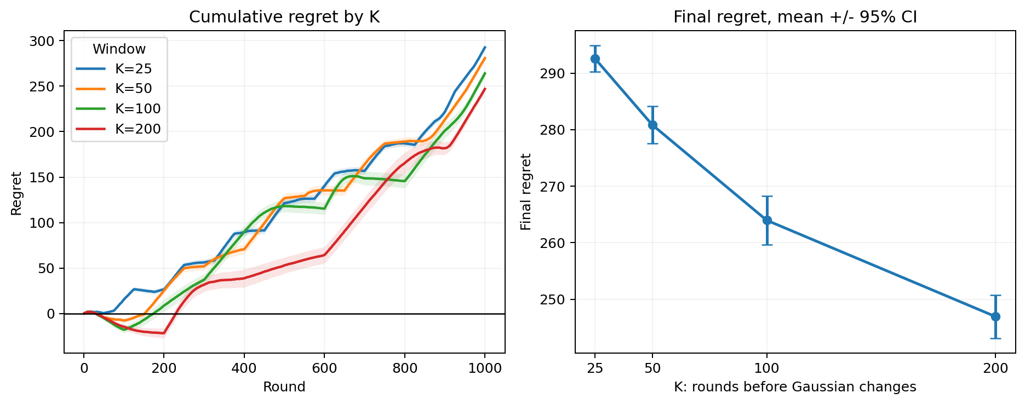
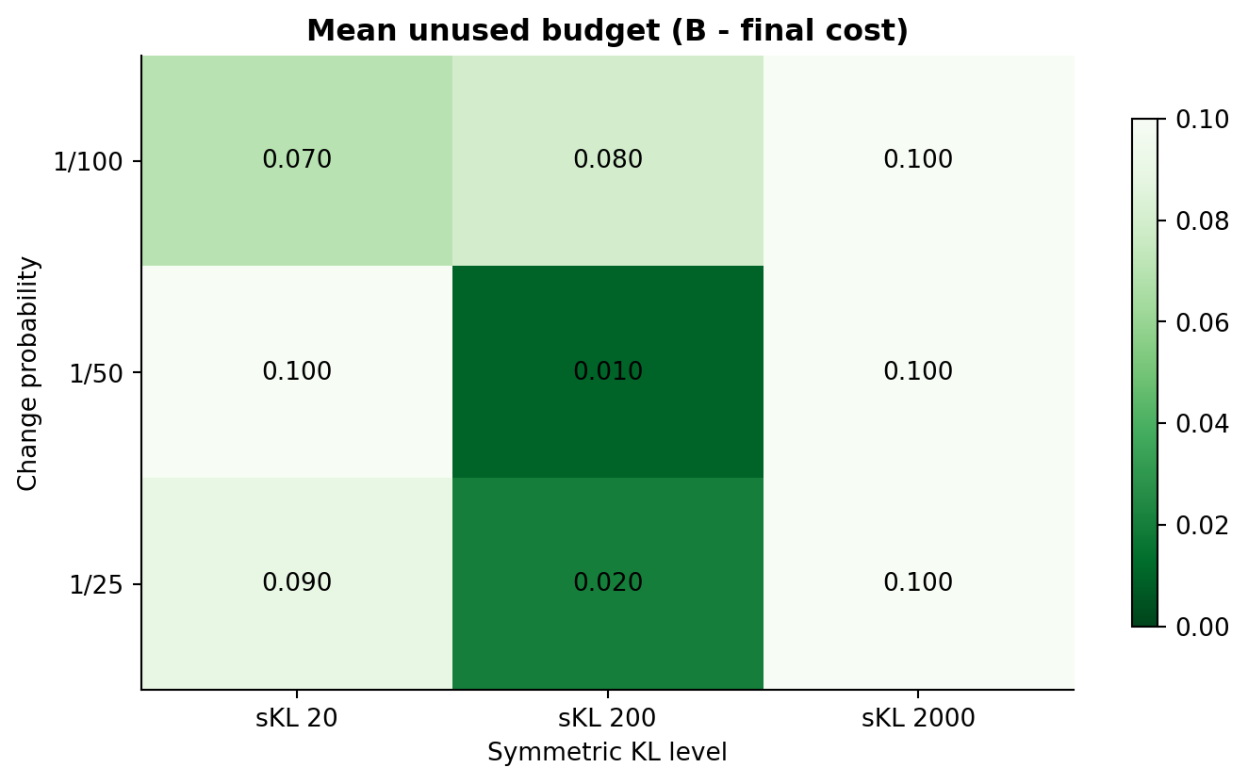
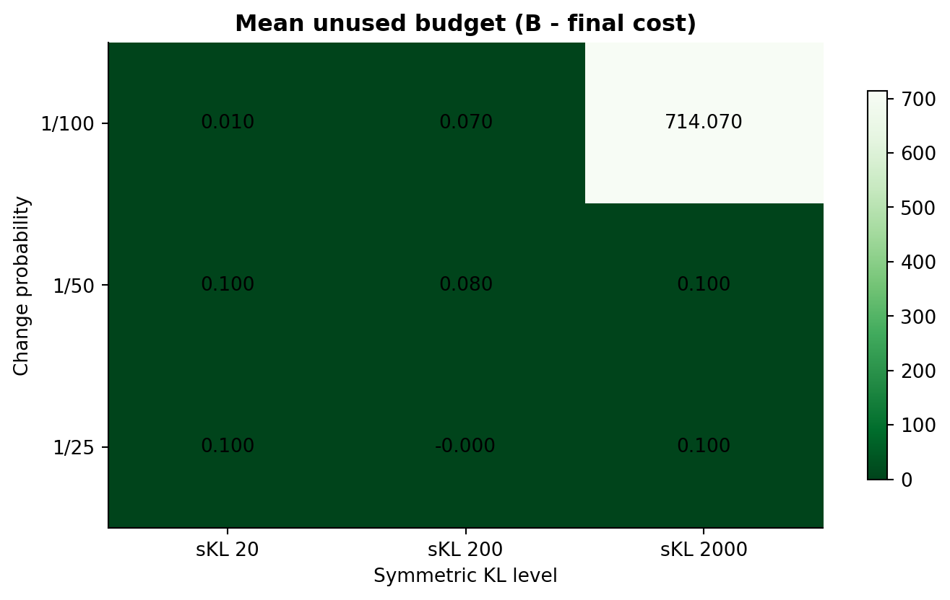


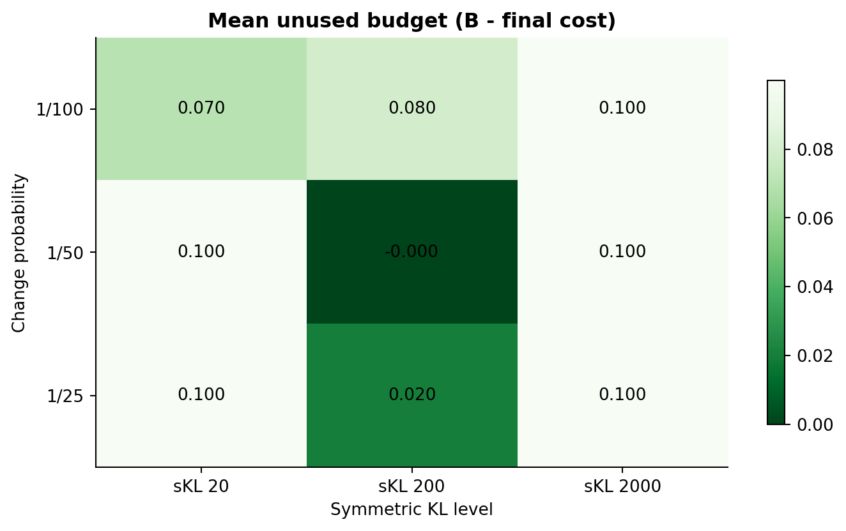
Budget feasibility in every setting
The hard filter keeps realized cumulative cost at or below B=10000 in all 90 runs.
MAXIMUM COST
10,000.00
MINIMUM COST
9,999.90
VIOLATIONS
0 / 90
12

Slide 13
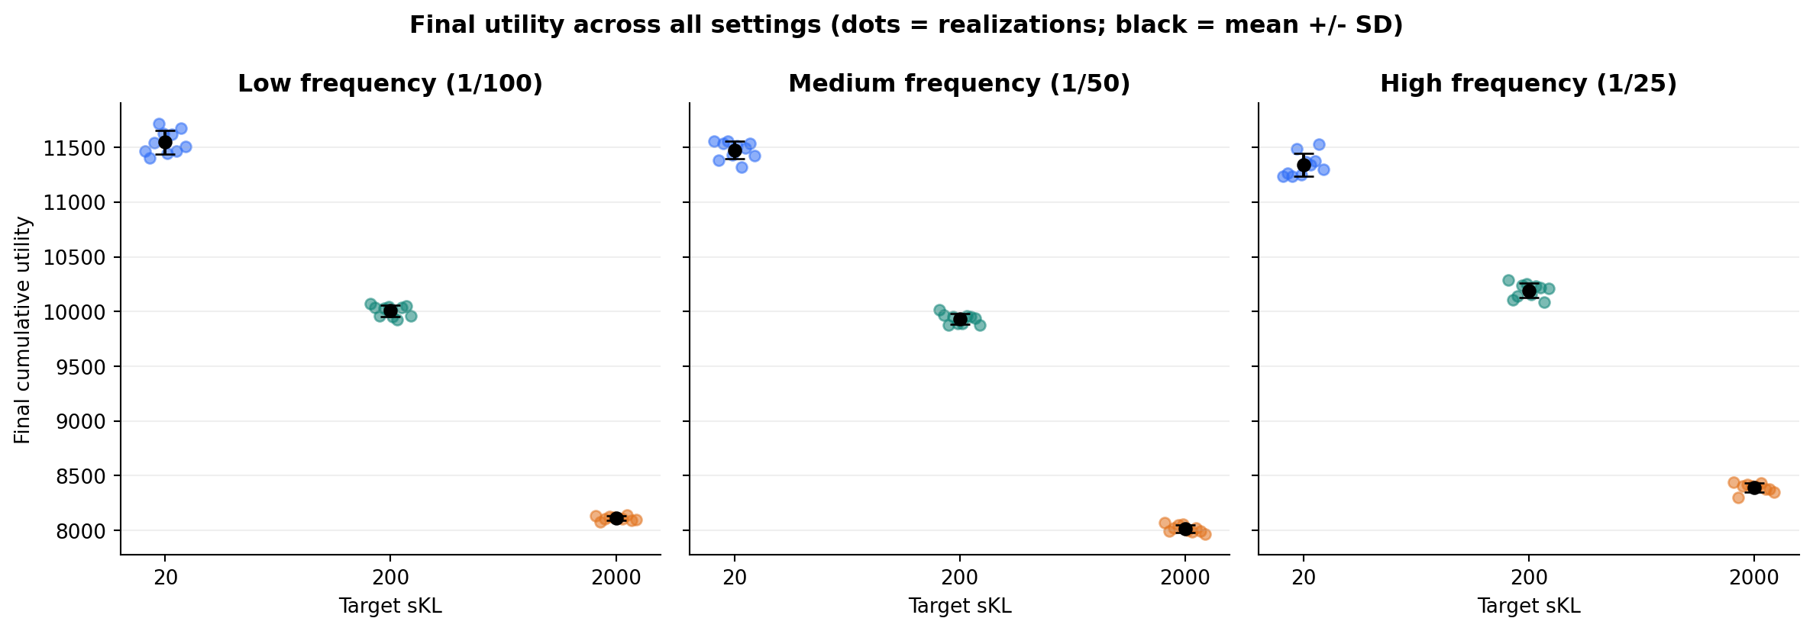
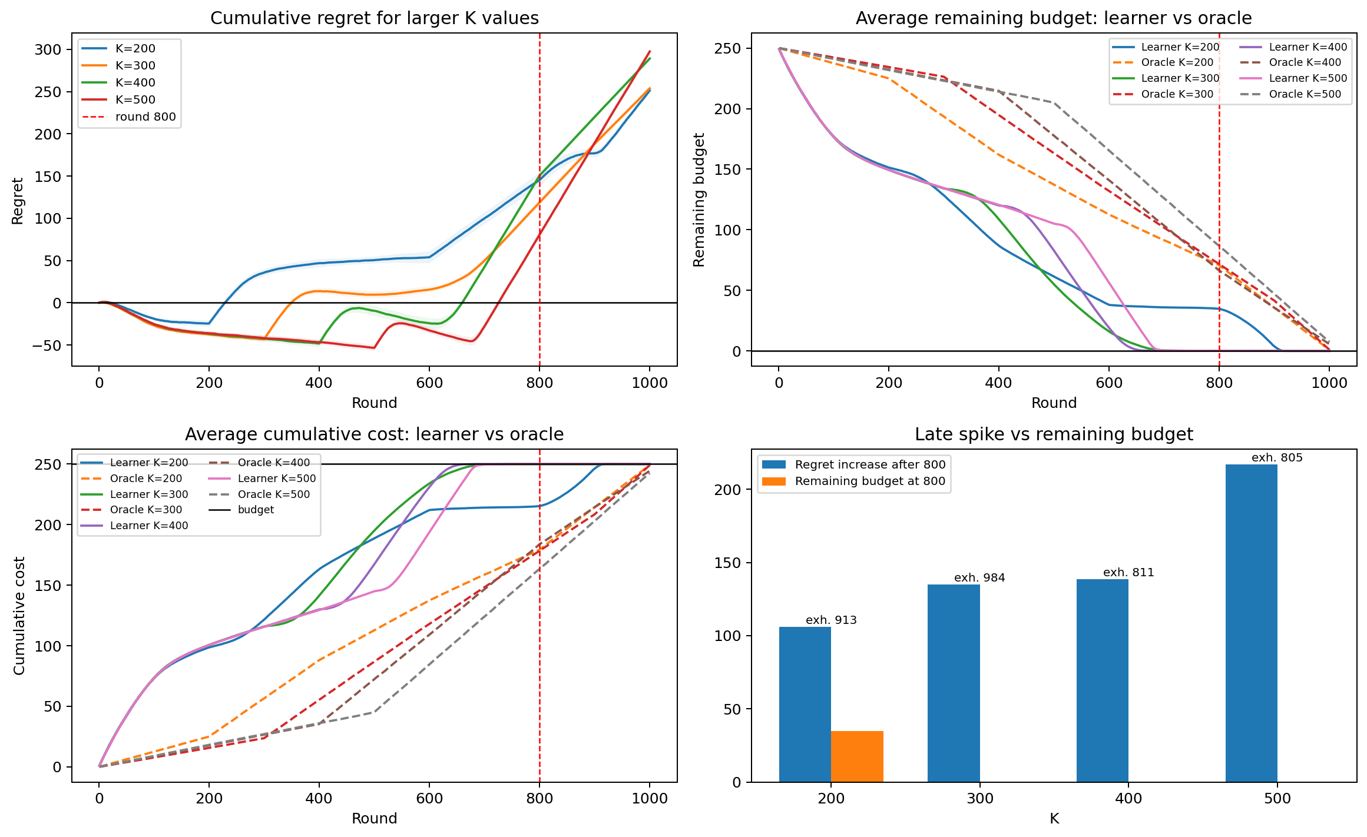
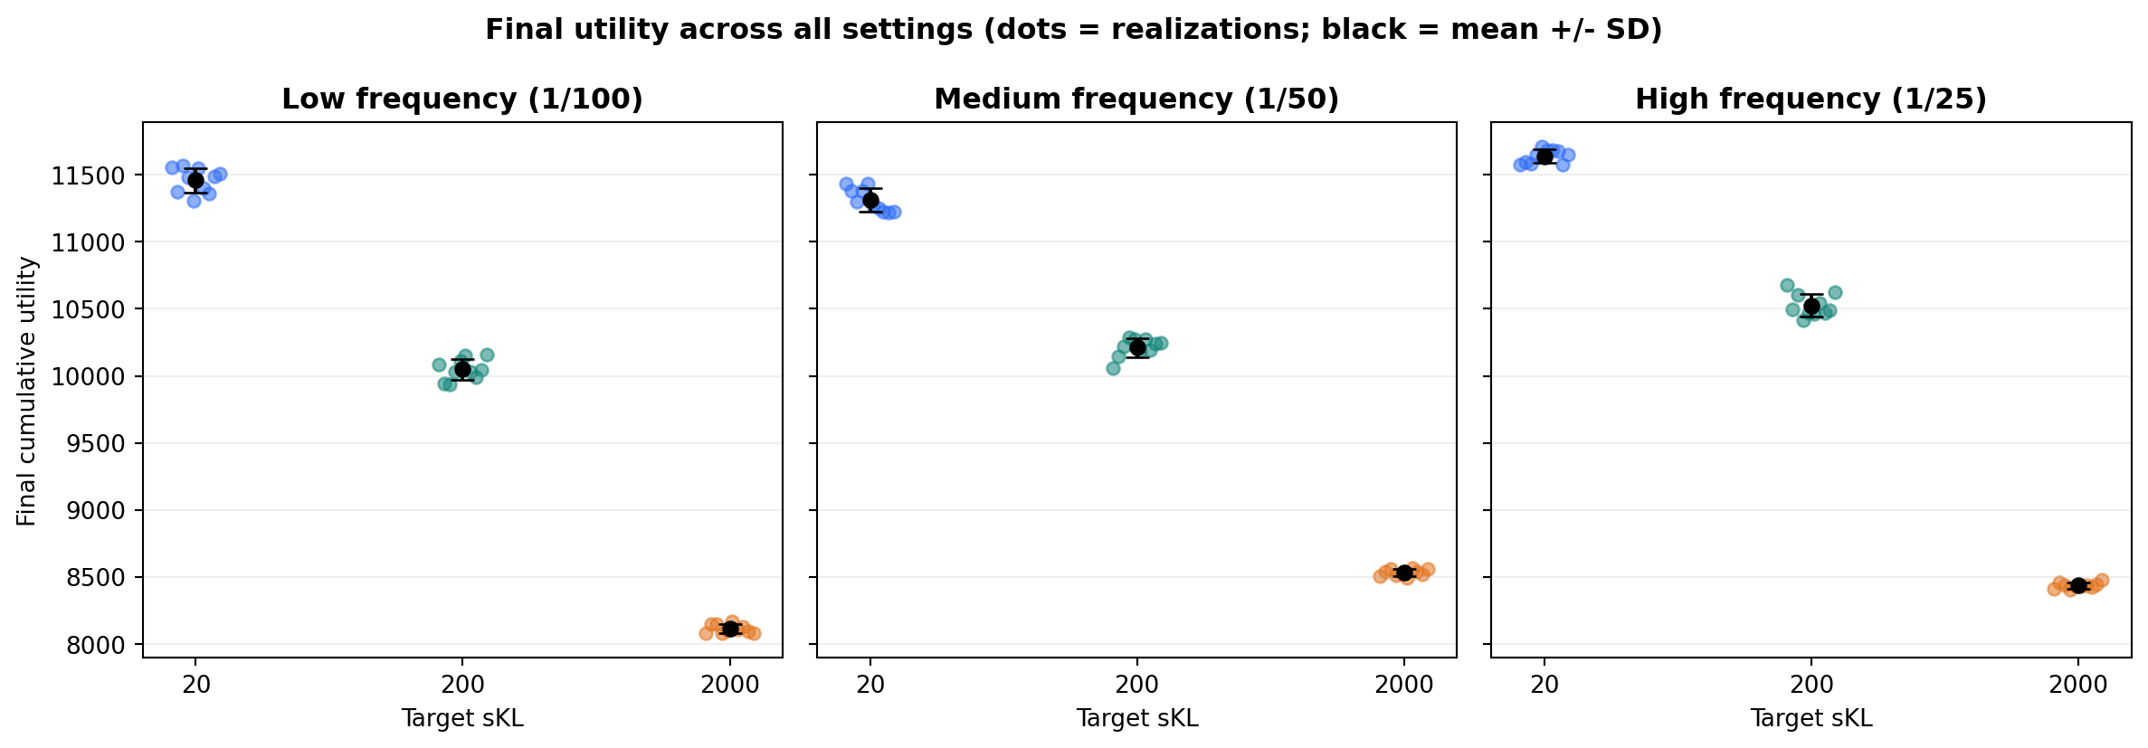
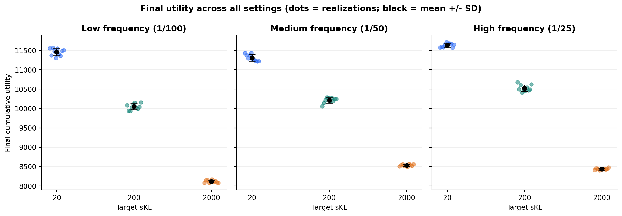
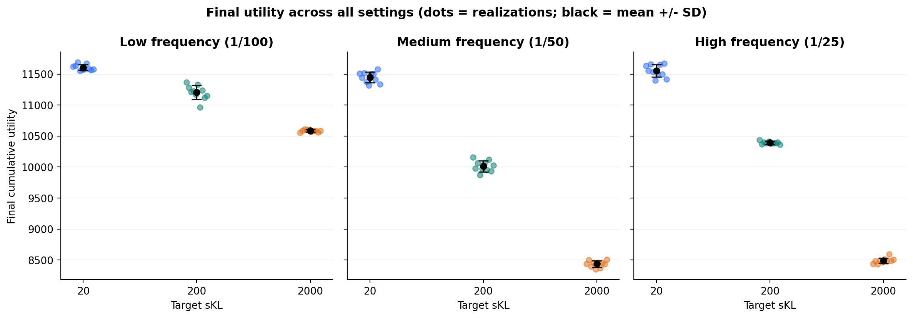
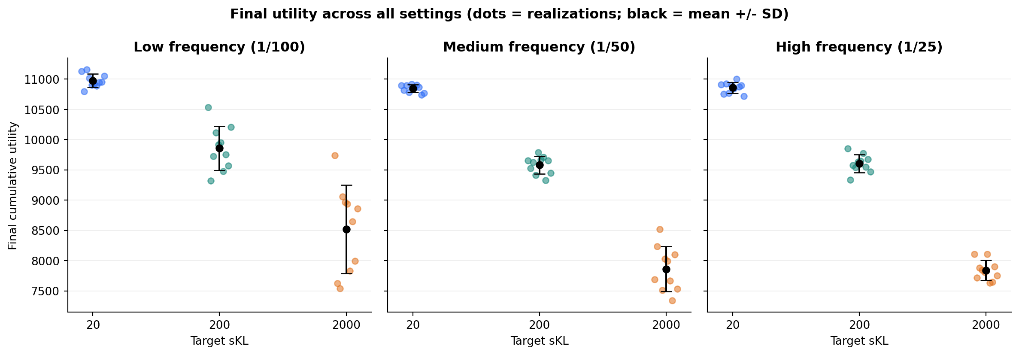
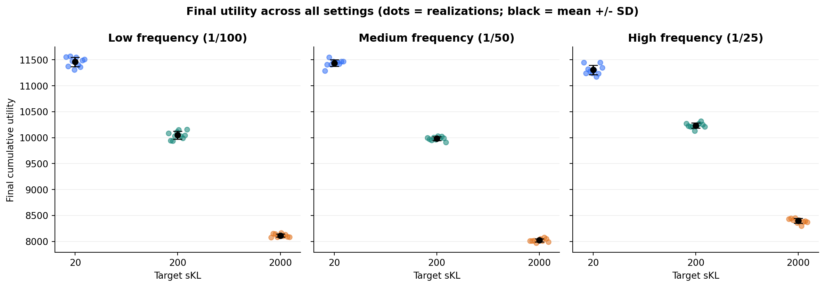
Final utility distribution across all settings
Each dot is one realization; black markers show mean +/- 1 SD.
13

Slide 14
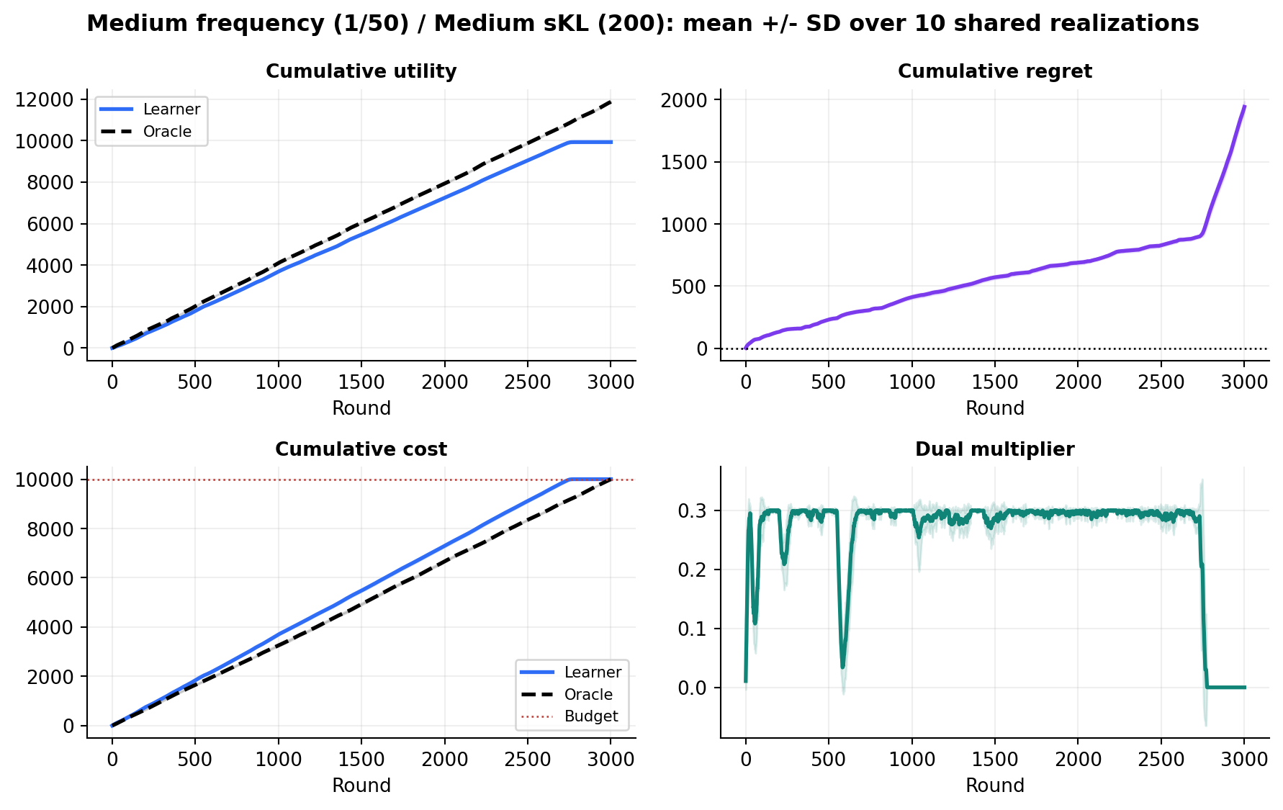
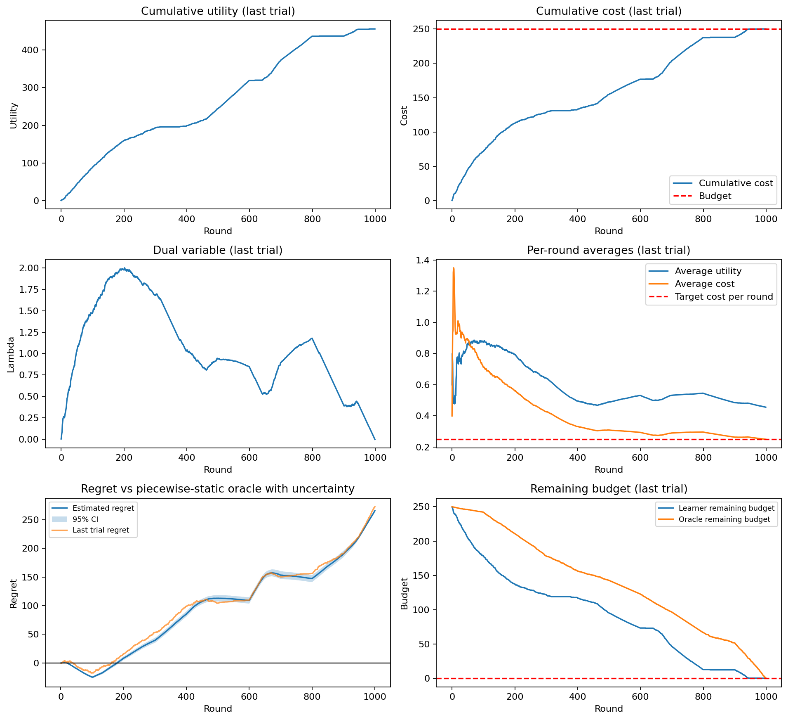
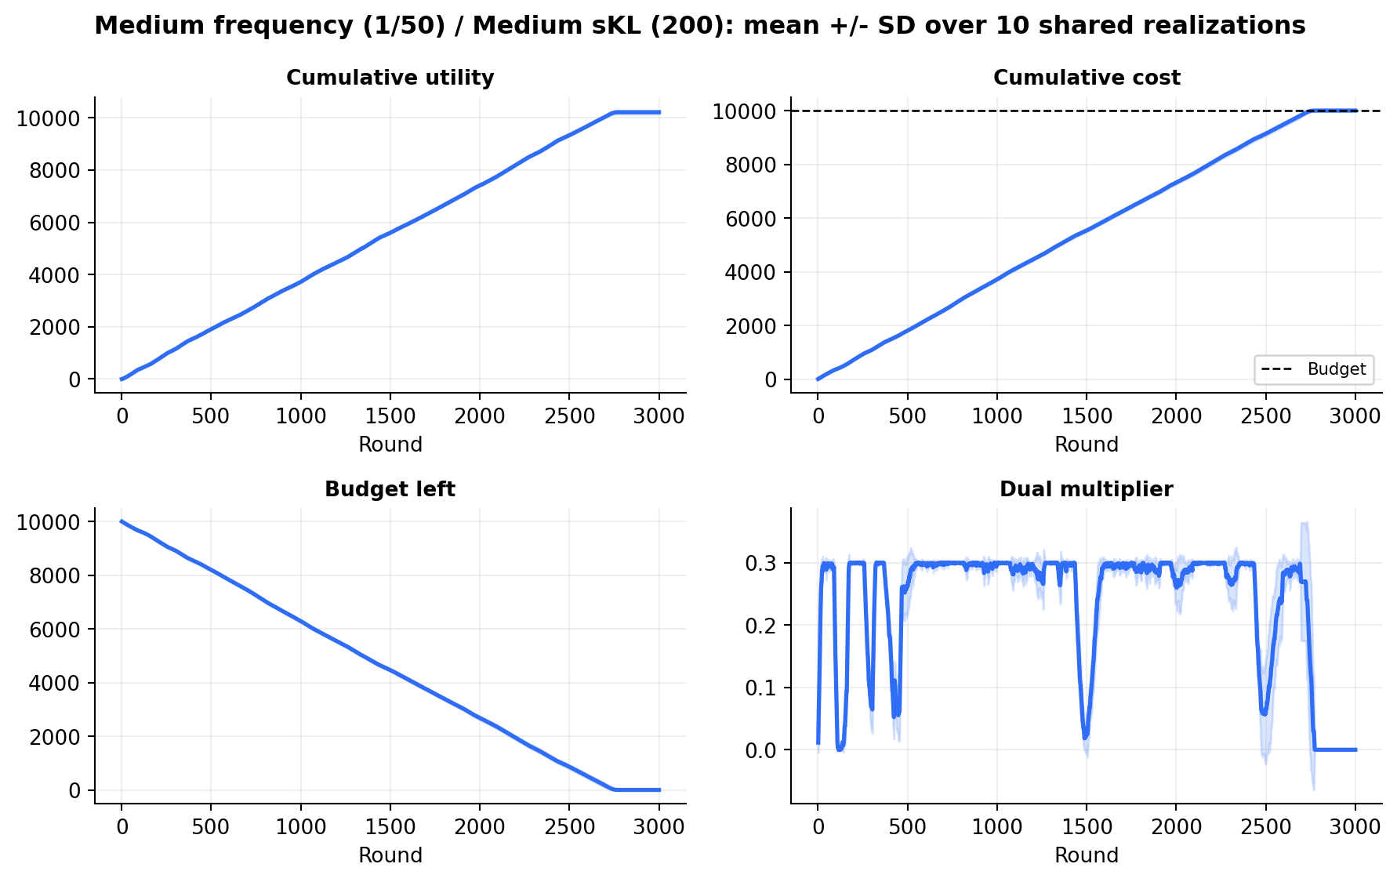
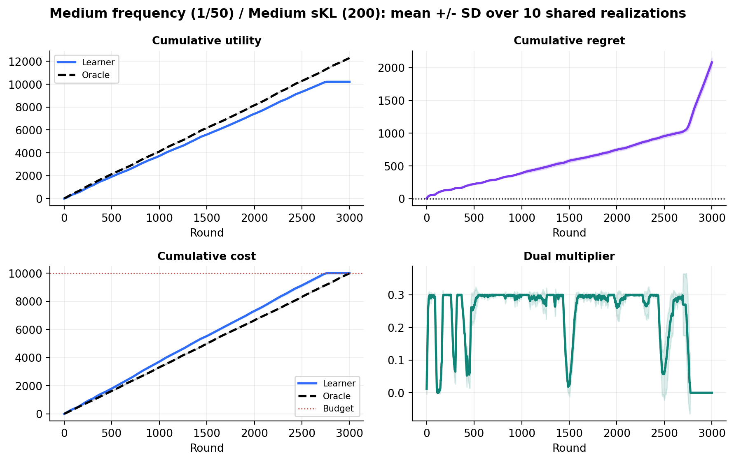

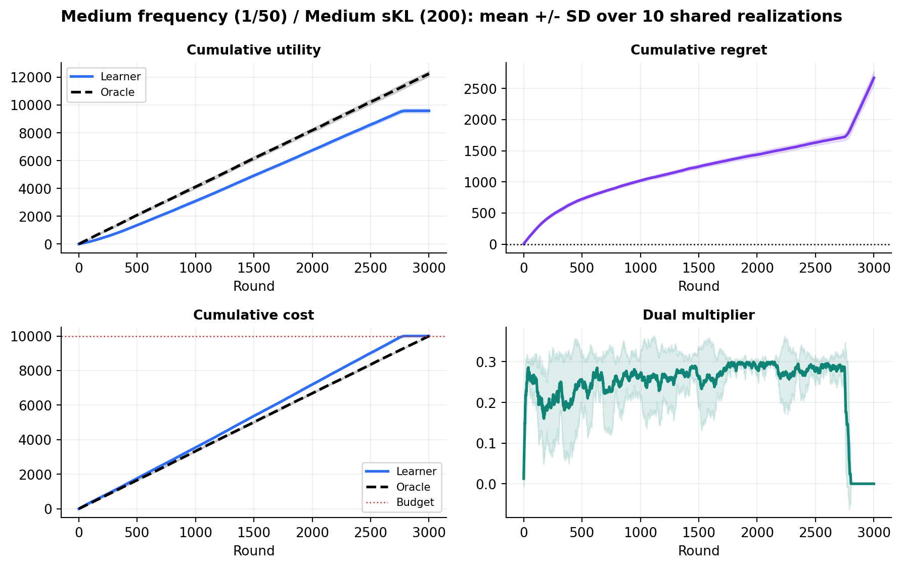
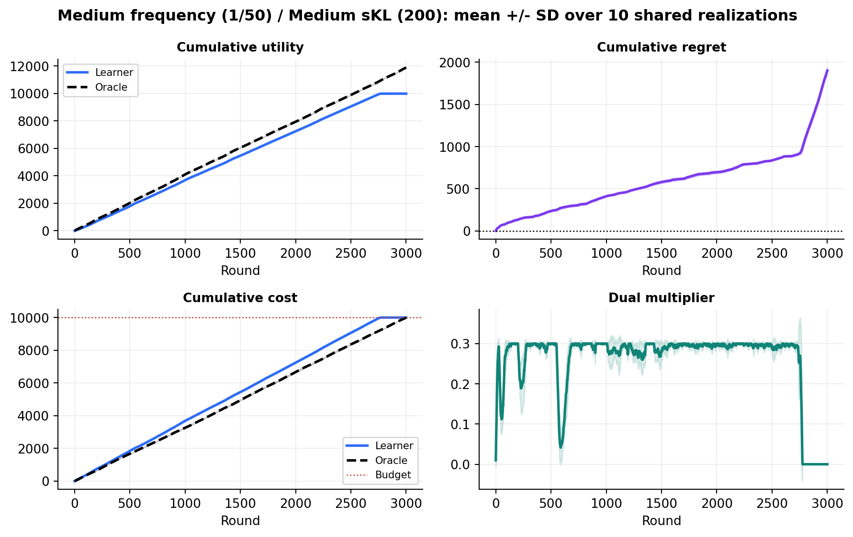
Representative current run dynamics
Medium sKL (200), medium frequency (1/50), mean +/- SD over 10 shared realizations.
LEARNER UTILITY
9,931.2
SD 47.6
ORACLE UTILITY
11,873.7
SD 20.0
FINAL REGRET
1,942.5
SD 44.1
FINAL COST
10,000.00
SD 0.000
14

Slide 15
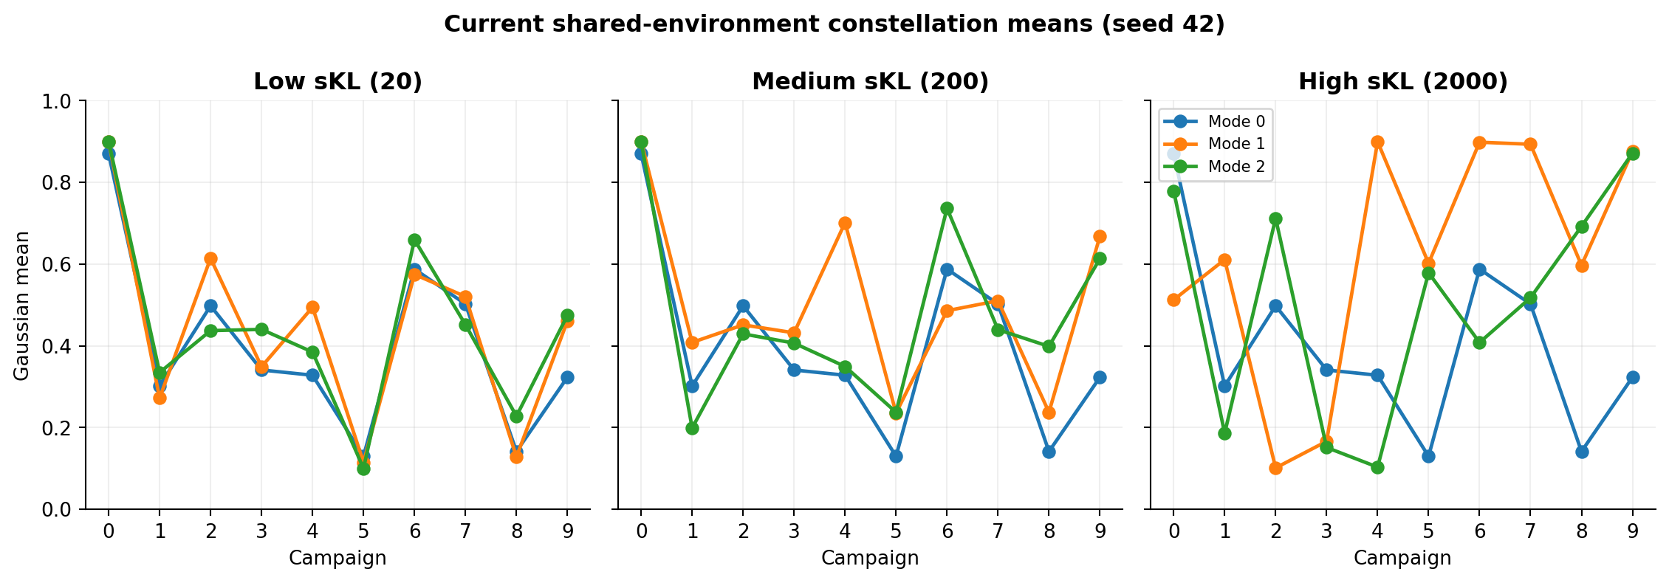

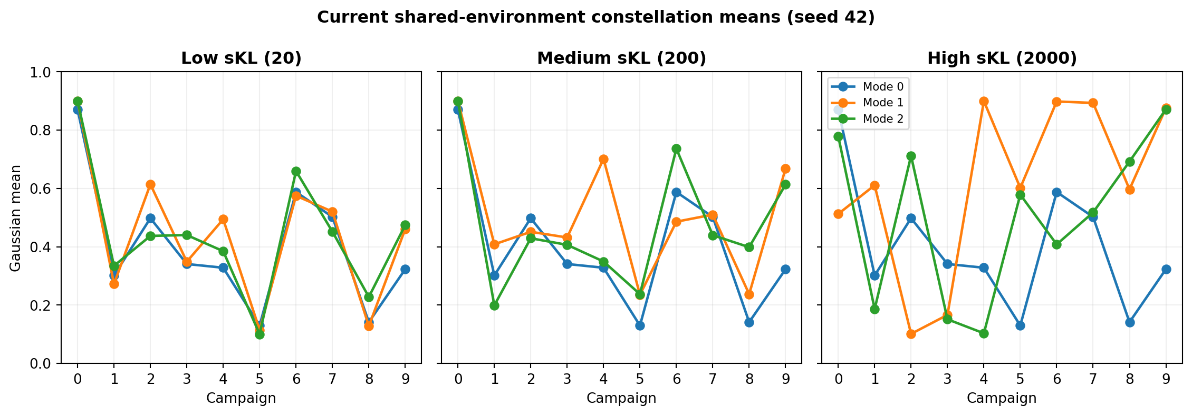
Gaussian Constellation setting
Current aligned input family used by every numerical slide that follows.
MODES
SKL
FREQUENCY
MATRICES
3 per setting
20 / 200 / 2000
1/100 / 1/50 / 1/25
90 total
15

Slide 16
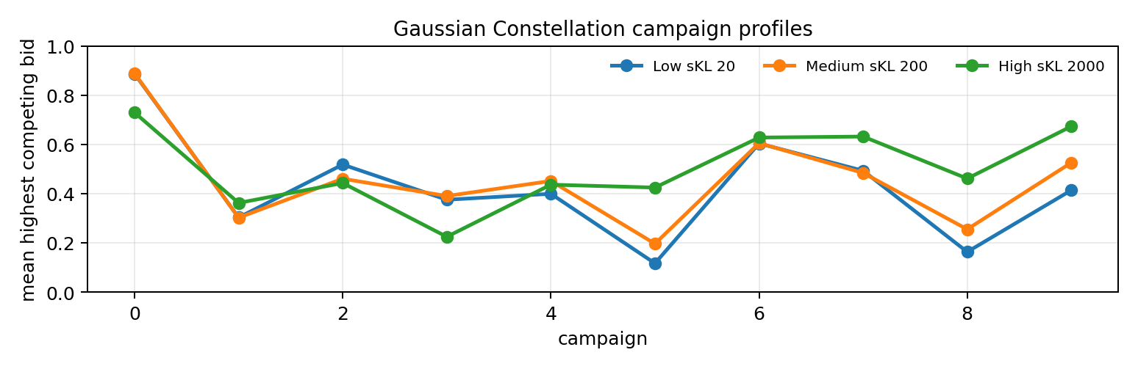
Current constellation profiles
Gaussian mode means generated by the shared environment at the three requested sKL levels.
16

Slide 17
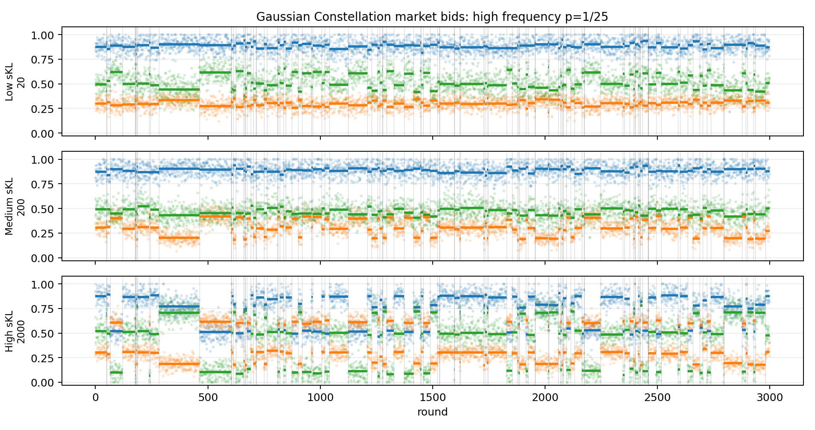
High-frequency realized market spectrum
The same realization index is shown for sKL 20, 200, and 2000 at p=1/25.
17

Slide 18
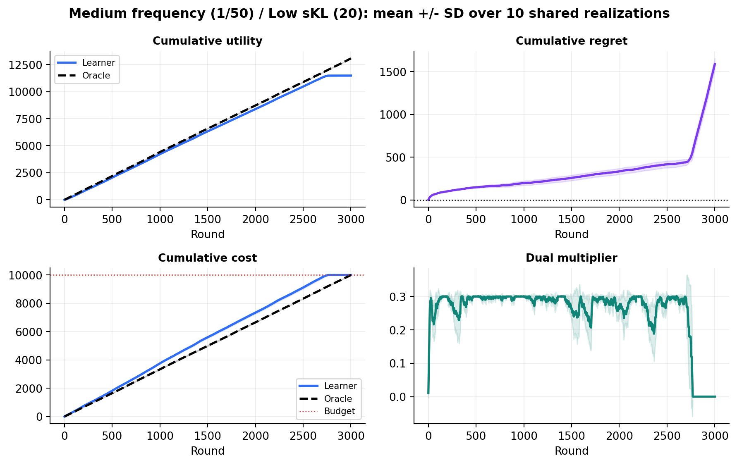
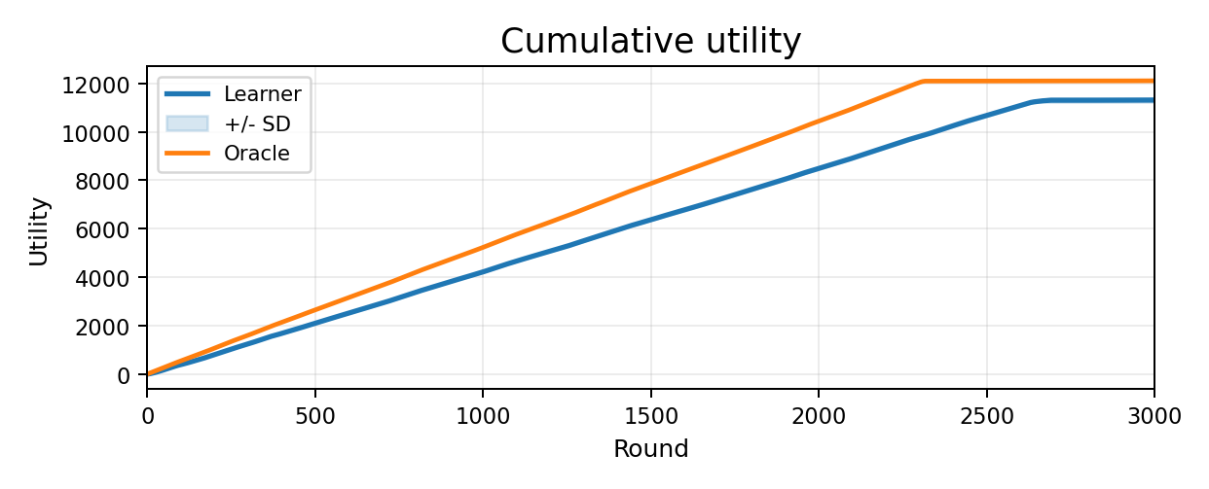








Low sKL (20) diagnostics
Medium change frequency (1/50); mean +/- SD over the 10 shared realizations.
LEARNER UTILITY
11,474.5
SD 81.8
ORACLE UTILITY
13,062.9
SD 20.0
FINAL REGRET
1,588.5
SD 68.9
FINAL COST
9,999.90
SD 0.000
18

Slide 19




Medium sKL (200) diagnostics
Medium change frequency (1/50); mean +/- SD over the 10 shared realizations.
LEARNER UTILITY
9,931.2
SD 47.6
ORACLE UTILITY
11,873.7
SD 20.0
FINAL REGRET
1,942.5
SD 44.1
FINAL COST
10,000.00
SD 0.000
19

Slide 20










High sKL (2000) diagnostics
Medium change frequency (1/50); mean +/- SD over the 10 shared realizations.
LEARNER UTILITY
8,017.4
SD 34.9
ORACLE UTILITY
10,566.2
SD 15.4
FINAL REGRET
2,548.8
SD 29.7
FINAL COST
9,999.90
SD 0.000
20

Slide 21








sKL summary at medium frequency
Dots are individual shared realizations; black markers show mean +/- SD.
21

Slide 22









Low frequency (1/100) diagnostics
Medium sKL (200); mean +/- SD over the 10 shared realizations.
LEARNER UTILITY
10,006.8
SD 51.4
ORACLE UTILITY
11,911.2
SD 15.7
FINAL REGRET
1,904.4
SD 56.0
FINAL COST
9,999.90
SD 0.000
22

Slide 23
Medium frequency (1/50) diagnostics
Medium sKL (200); mean +/- SD over the 10 shared realizations.
LEARNER UTILITY
9,931.2
SD 47.6
ORACLE UTILITY
11,873.7
SD 20.0
FINAL REGRET
1,942.5
SD 44.1
FINAL COST
10,000.00
SD 0.000
23

Slide 24










High frequency (1/25) diagnostics
Medium sKL (200); mean +/- SD over the 10 shared realizations.
LEARNER UTILITY
10,193.4
SD 66.9
ORACLE UTILITY
12,124.7
SD 16.3
FINAL REGRET
1,931.3
SD 57.6
FINAL COST
10,000.00
SD 0.000
24

Slide 25




Frequency summary at medium sKL
With shared schedule seed 22000, the schedules change 34, 72, and 131 times at p=1/100, 1/50, and 1/25.
Why utility is not monotone: a shared seed does not equalize time spent in each mode. Mode 0/1/2 shares are 27/45/28%, 24/43/33%, and 28/33/38%; more time in a favorable mode can raise utility at 1/25.
25

Slide 26
Current experimental conclusions
Claims below are restricted to the aligned 90-run Req3 experiment.
BUDGET CONTROL
MAIN SENSITIVITY
ORACLE BENCHMARK
0 violations
sKL dominates
Regret measured
All final costs <= 10000
Utility falls as separation rises
Piecewise-static, same global budget
What the experiment supports
The factorized primal-dual learner remains budget-feasible on every shared realization. Regret is computed against the exact piecewise-static hindsight oracle under the same B=10000 global budget. Final utility and regret both vary materially with sKL.
The same oracle definition and matrix files must be used for sliding-window and change-detector comparisons.
26

