Slide 1
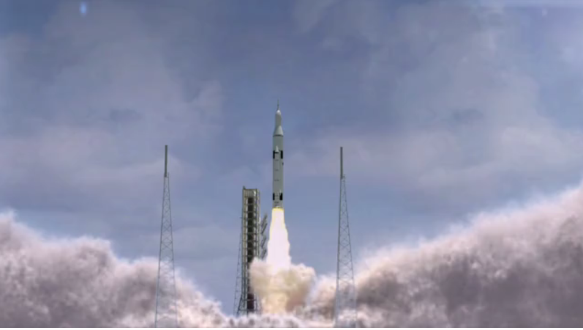
Most amazing rocket video ever created.
You must see this.

