Slide 1


Empowering Commitment, Unleashing Focus
FocusGaurd
Amplify Your Focus, Elevate Your Dedication

Slide 2
Introduction
In today's fast-paced world, we must focus and be dedicated. In a world filled with digital distractions, our productivity and potential can be easily hindered.
Digital distractions can easily derail our productivity and limit our potential.
Explore "FocusGaurd." an interesting new endeavor in this session.
This pioneering venture provides a game-changing experience for people who fully engage in their profession or studies for the full time to overcome the common distraction problem.
FocusGaurd was intended to combat traditional approaches' issues. Its main purpose is to eliminate distractions to promote focus and determination.
This initiative uses cutting-edge technology and a relentless focus on attention to change how we work and study.

Slide 3


Problem Statement
Proliferation of digital distractions hampers productivity and commitment.
Constant disruptions, such as phone calls, text messages, and social media, pose challenges to concentration.
Existing solutions often fall short in effectively addressing interruptions.
These interruptions impact the productivity and mental well-being of students and professionals.
The pressing need for technology to detect and prevent distractions while rewarding persistence is paramount.

Slide 4
Features
FocusGaurd establishes an environment that is conducive to distraction-free learning through the implementation of measures that restrict access to websites and applications that may cause distraction.
Distraction Prevention:During study sessions, the software proactively mitigates distractions by disabling notifications and preventing incoming calls.
Proctorial Mode: A feature of FocusGaurd, the proctorial mode ensures academic integrity during exams and assessments by monitoring the user's activity.
Activity Monitoring: Monitor and assess your productivity and study practices.
Commitment-Based Token System: Earn tokens by staying focused and committed to your tasks.
Reward Redemption: Obtain enticing incentives and rewards by redeeming your earned tokens.

Slide 5
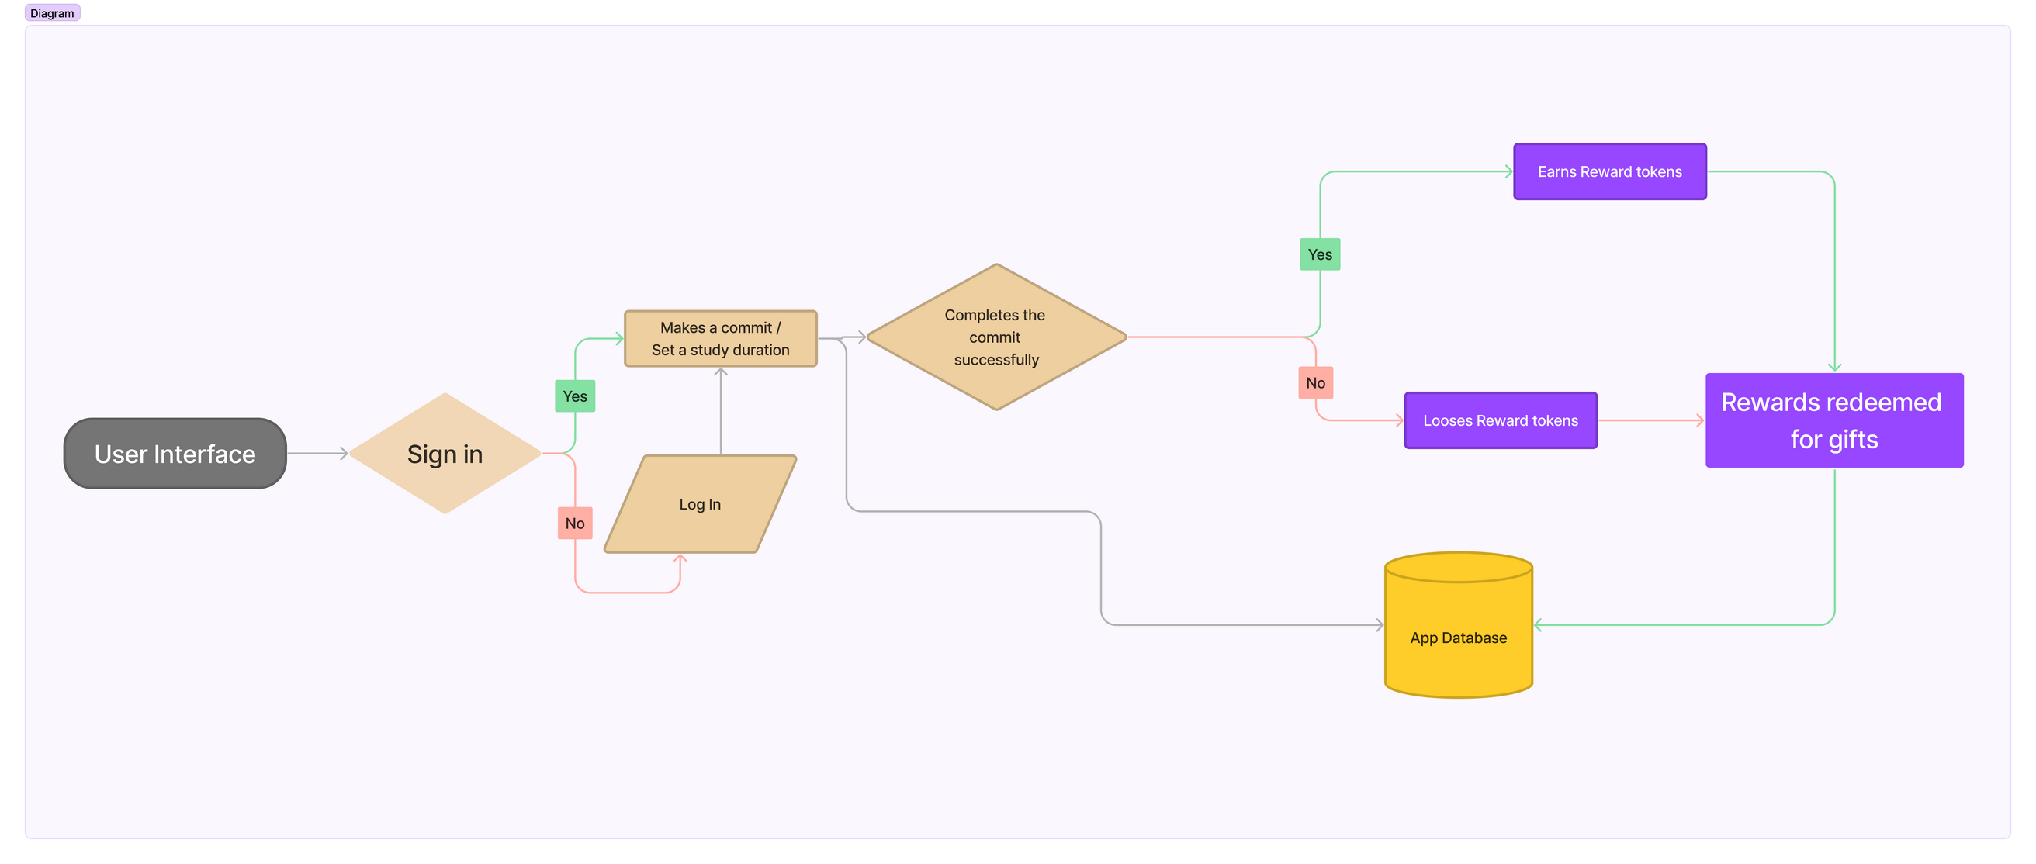
Workflow

Slide 6
TechStacks
We use YOLOv5, a state-of-the-art computer vision framework, to enable smooth, distraction-free environments through real-time object identification.
FocusGuard's cutting-edge features are powered by clever models developed and trained using the popular deep learning framework PyTorch.
Kotlin and the MERN stack (MongoDB, Express.js, React, and Node.js) are used in the deployment process to create an Android mobile app and a web application, respectively.
Our choice for model integration is Flask, which allows for efficient and trouble-free enforcement of distraction-free zones.
We use LabelMe to generate high-quality datasets, which improves the precision and dependability of our solution. FocusGuard is built on a solid foundation of technologies that together provide strong commitment and improved attention.

Slide 7
Business Prospects
Freemium Model: Offer essential features for free and reserve advanced features for paying users. Implementations are straightforward and aligned with user expectations.
Token-Based System: Implement a gamified system where users earn tokens for staying focused. This encourages user engagement and monetization through in-app token purchases.
Institutional Licensing: Target educational institutions and organizations with tailored versions of FocusGuard. While it requires relationship-building, it has potential for higher revenue per user.
Data Analytics and Insights: Offer data analytics on user behavior. It requires strong data security practices and may need significant development resources.
Sponsorships and Partnerships: Collaborate with institutions and experts. Requires marketing and sales efforts to secure partnerships and offers diversified revenue sources.
Affiliate Marketing: Promote affiliate products within FocusGuard. It's straightforward to implement but has limited revenue potential compared to other methods.
One-time Purchase Option: Offer a one-time purchase option for premium access. It's easy to implement but may result in lower recurring revenue.
Recommendation: Combine the Freemium Model and Token-Based System for the most straightforward and engaging revenue approach.

Slide 8
Target Audience
Meet our primary audience, the aspirants of JEE, NEET, and UPSC exams, some of the most prestigious and competitive tests in India.
This market is not only substantial but continuously expanding as more students aspire to excel in engineering, medicine, and civil services .
Compiling a tally of these candidates:
In 2022, an astounding ten million or more candidates sat for the JEE Mains examination.
A remarkable eighteen million or more candidates registered to take the NEET examination in 2022.
More than ten million candidates took the UPSC Civil Services Preliminary Examination in 2022.
JEE, NEET, and UPSC candidates are more than just students; they represent a dynamic and expanding business.
Understanding their specific demands and motivations is the key to unlocking commercial potential.
Customizing products and services to meet their specific needs can result in mutually beneficial consequences.

Slide 9
T H A N K Y O U

