Slide 1


Which U.S. states offer the best combination of market size and consumer purchasing power for expanding a retail business?
A data-driven analysis of market size and purchasing power by Foday Fuard Kamara

Slide 2
Business Problem
A Minnesota business needs to expand to new U.S. markets but must avoid states with either too few potential customers or low purchasing power.
Goal: Identify states where large populations align with high median incomes to ensure profitable expansion.

Slide 3
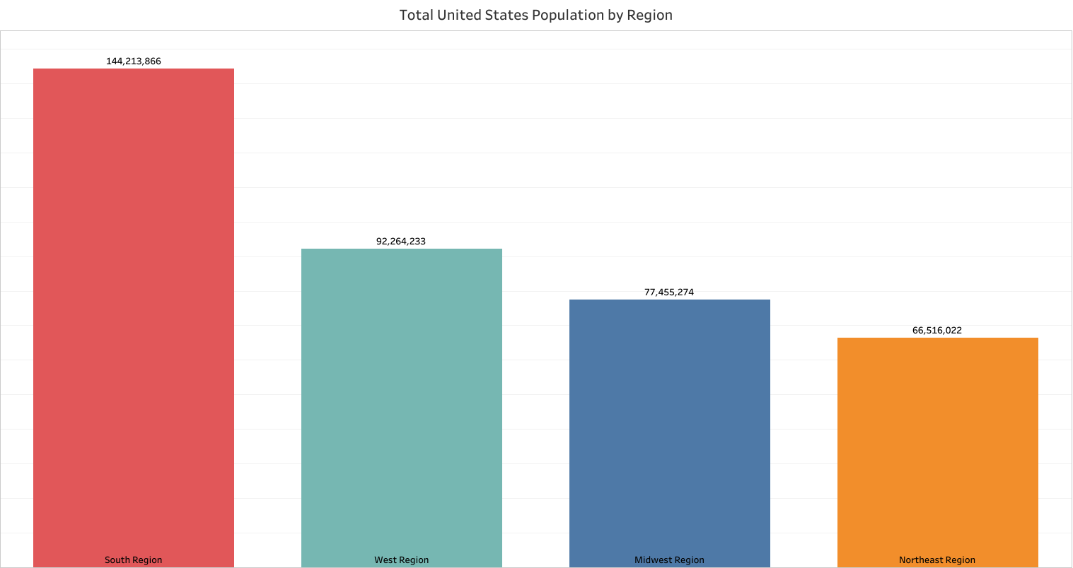
Population by Region
The South stands out with over 144 million people - the largest market opportunity among regions.

Slide 4
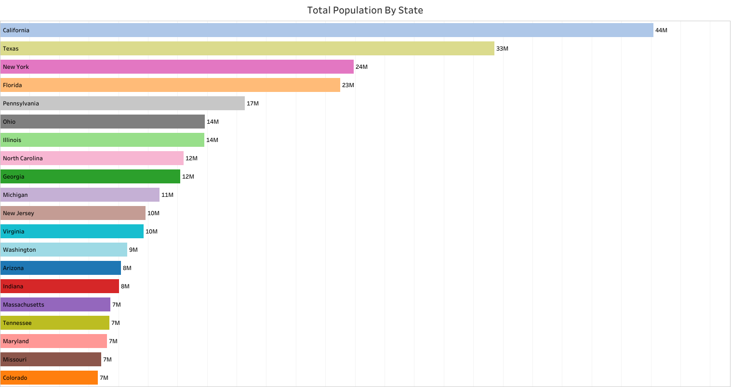
Top States by Population
California, Texas, Florida, and New York lead with the highest populations - critical indicators of market potential.

Slide 5
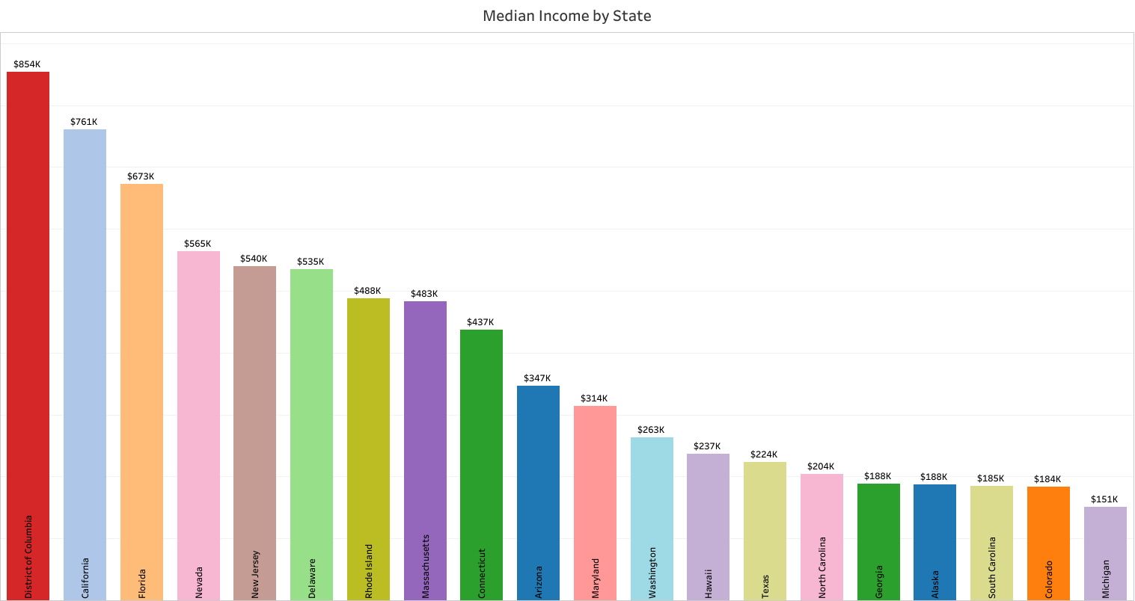
Top States by Median Income
District of Columbia, California, Florida, Nevada, and New Jersey show the strongest purchasing power, signaling greater potential for higher revenue per customer.

Slide 6
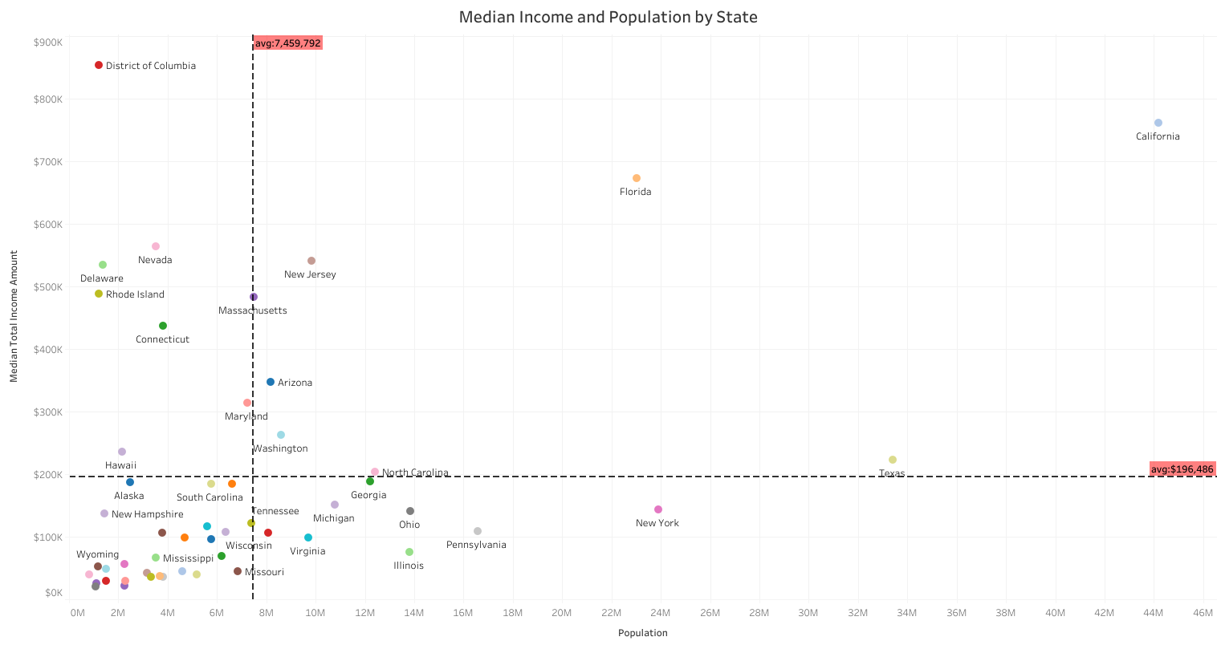
Median Income vs. Population
Upper-right quadrant: High income & high population ⇨ best states for immediate investment.
Upper-left: High income & low population ⇨ niche, premium opportunities.
Lower-right: High population & low income ⇨ large markets with affordability challenges.
Lower-left: Low income & low population ⇨ deprioritize.

Slide 7
Key Findings
California combines the largest population with one of the highest median incomes -- clear top priority.
☑ Florida shows both a large market and strong income levels -- a strong opportunity.
☑ Texas offers huge population but with lower median income than top peers -- requires tailored strategy.
☒ New York has a large population but lags in income -- approach with caution.

Slide 8
Recommendation
California high income + largest population
Florida balanced income + large population
Texas massive market, but adjust pricing for affordability
Focus on these states for initial rollout to maximize ROI and customer reach.

Slide 9
Next Steps
Conduct local market research in target states
Evaluate distribution and supply chain readiness
Develop pricing strategies tailored to each market
Plan phased rollout in selected metro areas

Slide 10
THANK YOU!!

