Slide 1
1.Why customers are happy or not?
Review_score:[1,2,3,4,5]
Happy~ review_score =5,unsatisfied~review_score=1
Groupby review_score get_group(5/1) to analyze review_comment_message
Sampling several times to get general ideas why they are happy or not

Slide 2
we can see from happy customers who give 5 score(why they are happy),
1. 'Eu só compro neste site tenho segurança ok': they feel secure when they purchase online
2. 'Muito bom! Compra tranquila, Entrega super rápida. Recomendo para todos!': quick delivery
3. 'Tecnologia japonesa': prefer japanses technology
3. 'Entregaram antes do prazo estipulado': delivered before expire date
4. 'Produto de ótima qualidade chegou bem antes do prazo':good quality item and arrived before expected date
6. 'muito bem foi entregue antes da data estão de parabens': get the item before his/her congratulation date
7. 'Rapida entrega, mesmo sem gqsolina nos postos, recomendo 100%, continuem assim pois estao de parabens': delivered in time even when the shipping cars with no gasoline(I guess?)
Almost all the sample customers think that the delivery service is good!

Slide 3
we can see from unsatisfied customers who give 1 score(why they are dissatisfied),
1. 'Não recebi o produto nem retorno do questionamento sobre o mesmo': don't get the item
2. 'Não recebi o produto nem retorno do questionamento sobre o mesmo':don't get what he/she wants, get sth else
3. 'Bem comprei esse quadro pela targaryen,e solicitei troca imediatamente,quadro parecido com o do anúncio no entanto apresenta impressão sem qualidade,sem foco imagem trêmula,o material da tela terr’: the item's quality is not good(I guess?)
4. 'Fiquei muito triste pq pedi um relógio, não tinha cancelei meu pedido e mesmo assim mandaram outro.Detalhe já tinha dito que não queria outro modelo,resumindo pedi extorno de cartão’: feel sad since he/she wants to cancel the order, but the item still been shipped
5. 'Produto não funciona aparentemente o produto não é original': can't work properly,not original
6. 'nao recebi minha compra':don't receive the item
7. 'Péssimo atendimento. Nao me deram nem explicações para este 1 MÊS de atraso. Nunca mais faço compras pela lannister':service is not good,since he/she get the item 1 month late and get no explanations.
8. 'Está mercadoria foi pedida duas vezes por engano. Pedi o cancelamento de um deles, porém não foi efetivado e não me deram resposta. Resultado estou com 6 peças idênticas do produto’: make wrong orders but cannot cancel them
9. 'O PRODUTO VEIO COM DEFEITO E NÃO ME DEVOLVEM O DINHEIRO. CANCELEI O PEDIDO, DEPOIS DO RECEIBIMENTO, DENTRO DOS 2 DIAS UTEIS E ATÉ AGORA NÃO FUI ATENDIDO’: defective item, make return request with no acception
10. 'produto ainda não chegou':don't receive the itme
To sum up, unsatisfied customer who give 1 score got situation like:don't receive item,can't cancel wrong orders,want to return item with no acception, bad quality.

Slide 4
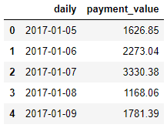
2.1. With purchase date information, predict the future sales information.
we need to merge order_payment with order to get a dataframe
I suppose sales only include payment_value when order_status == delievered
Relocate time range from 2017-2018(there’s time gap between 2016-2017)

Slide 5
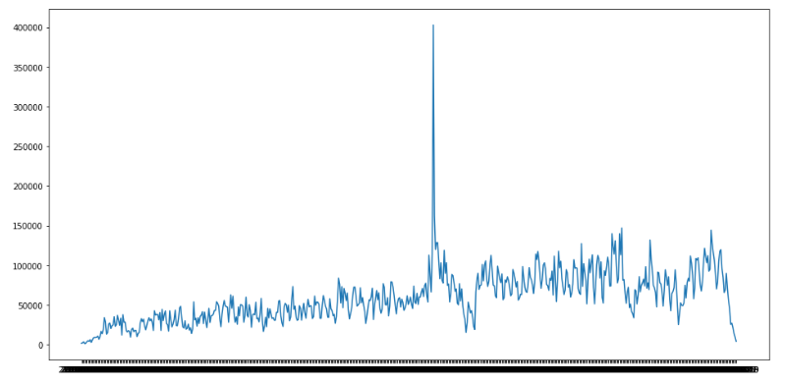

Slide 6
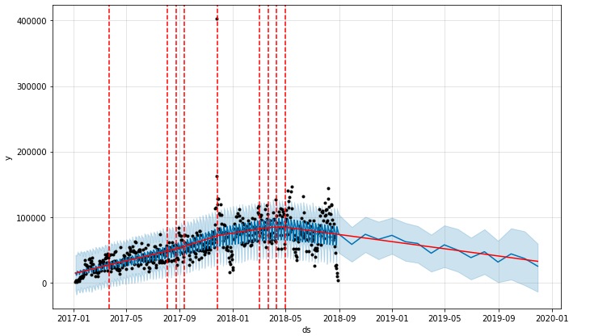
the sales of 2019 might be dropped a little bit compare to 2018

Slide 7
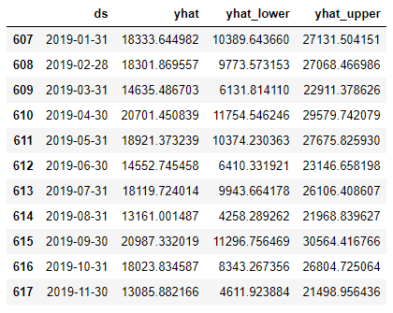
2.2. What is the expected Revenue for 2019?
Revenue = payment_value - price
so here we got the predicted 2019 revenue 188824.34 and with a range [93288.04,284456.92]

Slide 8
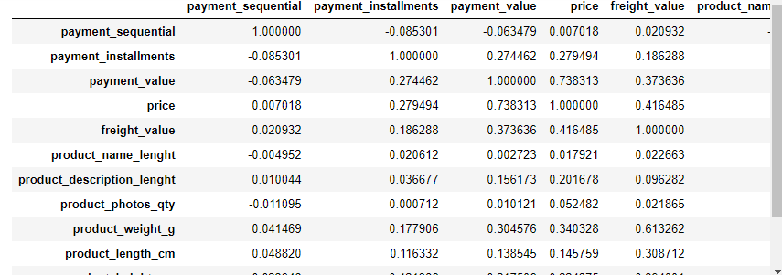
2.3. What are the factors that you might want to influence which may increase revenue in 2019?
From the correlation matrix, we can see that payment_value has a high positive correlation with
revenue which is obvious, and payment_value also got a high positive correlation with price,
so the direct way to increase revenue is too increase the price of the selling items

Slide 9
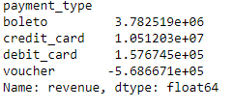
we can see that credit_card make the most contribution to the revenue,
then is the boleto,the voucher is negative.
So company should increase national credit_card payment support
and reduce voucher payment to increase revenue

Slide 10
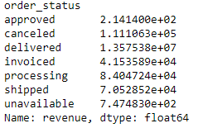
we can see delivered order's revenue is 1.357538e+07, canceled is 1.111063e+05,
so reduce canceled order can really make revenue increase.

Slide 11
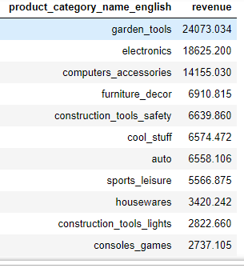
let's see what are those product categories have been canceled
we can see from the abouve table, the top 3 products categories been canceled are:1.garden_tool
2.Electronics 3.computers_accessories.
Company need to find the reason why these products categories been canceled so often.
Also we notice that fixed_telephony with a -3109.644 revenue at the bottom of the table which
can also be taken into consideration to increase the revenue

Slide 12
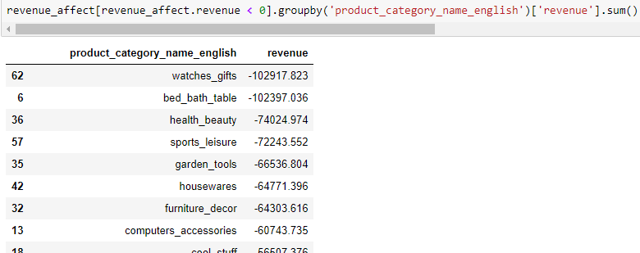
Let’s see categories that generate negative revenue
let's see the above table,we can see that our top 5 products categories that generate negative revenue are:
1. watches_gifts
2. bed_bath_table
3. health_beauty
4. sports_leisure
5. garden_tools
so maybe company need to take care the quality of the products in these 5 categories before they
put them online to sell which can alse reduce revenue lost.

Slide 13
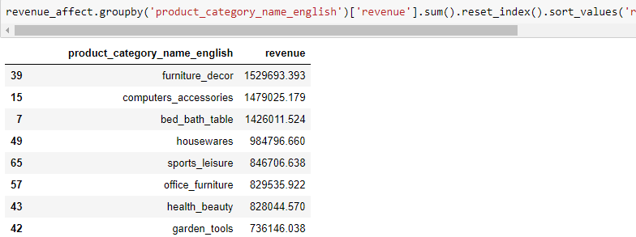
We can see the top 10 revenue product_category is: furniture_decor,computers_accessories, bed_bath_table ,
Housewares, sports_leisure, office_furniture, health_beauty, garden_tools, auto, watches_gifts
So company can increase revenue by putting effort on providing new products
in those product_categoryiesI mentioned above

Slide 14
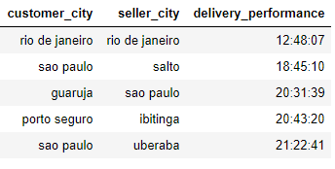
3.Identify delivery performance and find ways to optimize delivery times.
delivery_time = order_delivered_customer_date - order_purchase_timestamp
I generate delivery_performance.csv for you to check delivery_performance from
seller_city to customer_city

Slide 15
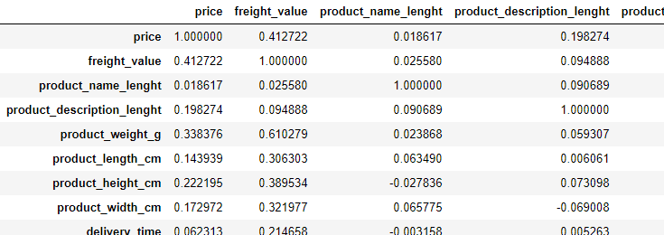
we can't get much information from the correlation matric,delivery_time has not so obvious
correlation with these other variables
Thus I come out an idea that we can improve the delivery_performance by doing shipping
between seller_city and customer_city if they are in the same state

Slide 16
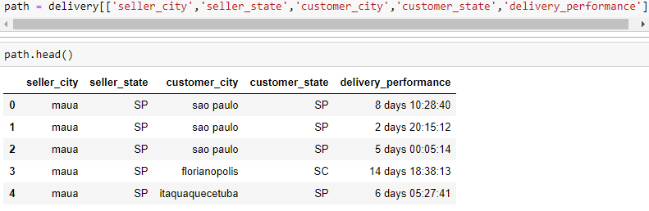
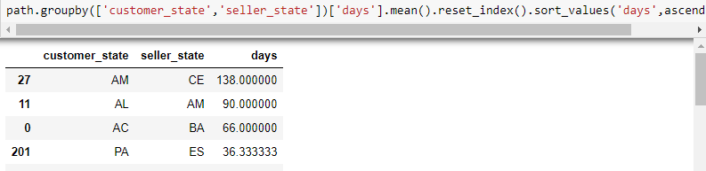
so if the retail company want to reduce delivery time , they can avoid trading between states like
AM->CE :cost 138 days
AL->AM :cost 90 days
AC->BA :cost 66 days
Actually I don't think this is a proper way to answer this question, I think we can use graph methods
to do some short path finding.But due to time limit,I'm just gonna stop here

Slide 17
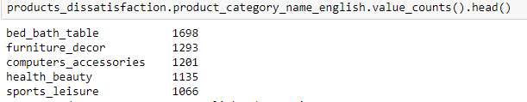
4.Discover the product categories that are more prone to customer dissatisfaction.
here I treat review_score == 1 as dissatisfaction
from the table above, we can see that the top 5 categories customer prone to be unsatisfied with is :
1. bed_bath_table
2. furniture_decor
3. computers_accessories
4. health_beauty
5. sports_leisure

Slide 18
5.There are 71 product categories. However, the ecommerce platform wants to optimize their number of product categories and want to reduce by 75%. How will they do that and which all will be the categories that they should concentrate?
I think they should deduct product_categories which generate the [least/negative] revenue
Actually I've done some analysis in question 2

Slide 19
positive_revenue = reduce[reduce.order_status == 'delivered'].groupby('product_category_name_english')['revenue'].sum()
negative_revenue = reduce[reduce.order_status == 'canceled'].groupby('product_category_name_english')['revenue'].sum()
net_revenue['net_revenue'] = net_revenue.positive_revenue - net_revenue.negative_revenue

Slide 20
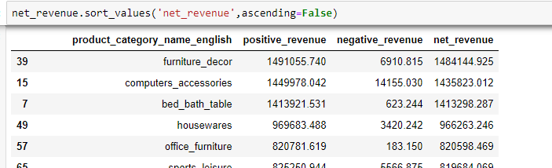
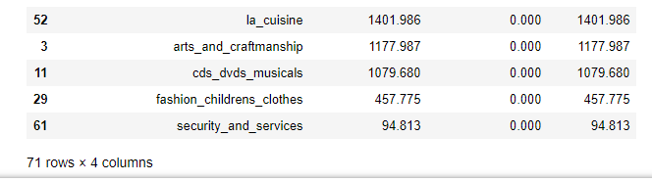
From table above , I suggest the retail organization:
1. deduct those categories at the bottom.
2. concentrate on those categories at the top.

Slide 21
Thanks!

