Slide 1
ICT3113 Assignment 1 – Performance Requirements & Testing
Group P2-10:
Loh Wen Xuan (2401561)
Jolie Ngai Ning Li (2403175)
Koh Tong Wei (2402162)
Toh Si Pei (2401835)
Yeo Kai Yuan (2403201)
Repository: https://github.com/Fokku/ICT3113-PTO

Slide 2
Service Architecture
Separate machine
System under test
The three endpoints
Apache JMeter
open-loop traffic and accuracy driver
Triage service
FastAPI, one uvicorn worker
Ollama
CPU only, one pinned model
POST /tickets
Classifies one narrative with Ollama, stores it, returns the category.
1
2
GET /search
Returns stored tickets whose narrative contains the query text.
3
4
team_rows.csv
1,000 rows
SQLite
named volume
JSONL request log
one line per request
GET /stats
Returns the count of stored tickets in each category.
1 one ticket per POST 2 service calls Ollama and waits
3 category stored 4 log line written Hosts: Slide 7
The service starts empty. Tickets arrive only through POST /tickets, never by CSV import.

Slide 3
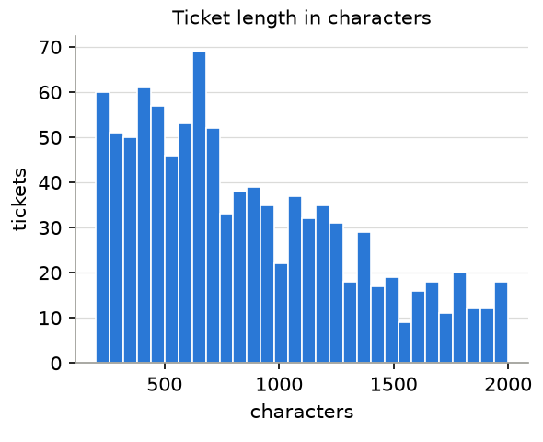
Workload Model
5,984,100
CFPB complaints, 2025 (published) [3]
× 0.025%
1 of 4,000
1,496
tickets a year (estimate)
÷ 260 days
÷ 8 hours
0.72
tickets an hour on average (estimate)
× 2
peak factor
1.4
tickets an hour at peak, 0.024 a minute (estimate)
Searches: 0.167 a minute (estimate). 2 agents × 5 an hour, the top of the 4 to 5 calls an hour per officer in CNA 2024 [4]. Assumed, not published.
Peak: 2× the average, in daytime (estimate). Whitt 2007 [5] shows time-of-day swings, but the factor of 2 is our assumption.
Limit: equal share is a generous load. About 77% of 2025 complaints [3] were credit reporting, so a typical firm likely sees fewer.
Ticket length (measured): median 744 characters, p95 1,799, longest 1,999 across the 1,000 team rows. None at risk of truncation.
Measured, 1,000 team rows. Source: workload/output/length_distribution.csv
Sources: [3] CFPB 2025 Consumer Response Annual Report (5,984,100 complaints; 4,000+ companies; about 77% credit reporting). [4] CNA 2024. [5] Whitt 2007. Workings: workload/workload_model.md.

Slide 4
Performance and Accuracy Requirements
ID | Requirement: number, percentile, load condition | Why it is set there
R1 | POST /tickets p95 ≤ 10 s at 1 request a minute, 600 s runs, 3 runs, every model | An agent waiting should get a routing answer in 10 s. 1 a minute is the lowest runnable rate, about 42× the modelled peak.
R2 | ≥ 95% classified without error, each run finished within 660 s, at 12 requests a minute (720 tickets an hour) | Capacity test at about 500× modelled peak. Fails if a queue builds; random arrivals make a fixed hourly cut-off unfair.
R3 | Overall accuracy ≥ 90% on the golden set, one serial pass per model; UNPARSEABLE counts as wrong | At about 1,496 tickets a year, 90% leaves at most about 150 misrouted tickets a year.
R4 | Every category ≥ 80% on the golden set, same serial pass, all seven categories | Stops a strong overall score hiding a failing category. Categories hold 19 to 41 tickets (source: golden/golden_set.csv), so each figure is coarse.
R5 | GET /search p95 ≤ 2 s under mixed load: 1 ticket and 1 search a minute, 600 s runs, 3 runs | Search should stay responsive while the model is busy. Modelled search rate is 0.167 a minute; 1 a minute is the lowest runnable.
R1, R2, R5 are judged on the worst of three runs.

Slide 5
Candidate Models
Size class | Ollama tag | Params | Quant. | Size | Licence | Digest (sha256)
Floor, 1B | llama3.2:1b-instruct-q4_K_M | 1.24B | Q4_K_M | 808 MB | Llama 3.2 Community | 22bc6b92eb0160c4629782fca05a9032c59d306ab2058b7dacc8a4644fbafa02
Middle, 3B | llama3.2:3b | 3.21B | Q4_K_M | 2.0 GB | Llama 3.2 Community | a80c4f17acd55265feec403c7aef86be0c25983ab279d83f3bcd3abbcb5b8b72
Middle, 3-4B | granite4:3b | 3.4B | Q4_K_M | 2.1 GB | Apache 2.0 | 89962fcc75239ac434cdebceb6b7e0669397f92eaef9c487774b718bc36a3e5f
Ceiling, 7B | qwen2.5:7b | 7.62B | Q4_K_M | 4.7 GB | Apache 2.0 | 845dbda0ea48ed749caafd9e6037047aa19acfcfd82e704d7ca97d631a0b697e
Spread. 1B is the fast end, 7B the slow end and the largest model honestly servable on CPU. No reasoning model and nothing above 8B.
Controlled pair. llama3.2 1B and 3B share family, tokeniser and chat template, so the gap between them is mostly size.
Licence cost. granite4:3b is Apache 2.0 in the same size class as llama3.2:3b, so what the Llama licence costs the client is measurable.
Quantisation. All four are Q4_K_M: we pinned the 4-bit 1B build, so the 1B vs 3B gap varies parameter count only.

Slide 6
Golden Test Set
200
tickets, sampled with fixed seed 3113
κ = 0.599
Cohen's kappa: moderate agreement
132 / 200
labels matched before discussion
68
disagreements, each resolved and recorded
Protocol and its revisions
Two resolved disagreements example:
Rev | What changed | Rows
R0 | Full protocol text, written after labelling | all
R1 | Mortgage servicing and escrow: Mortgage | 6
R2 | Collector conduct: Debt collection | 7
R3 | Credit-file-only fixes: Credit reporting | 16
R4 | Prepaid and gift cards: Credit card | 6
R5 | Student-loan relief: Consumer loan | 4
R6 | Freezes and closures: Bank account | 3
Row 10666: Debt collection vs Credit card
Agreed: Debt collection. A collector was chasing a card debt the consumer had already settled, so the complaint is the collector's conduct (rule R2).
Row 10454: Mortgage vs Bank account or service
Agreed: Mortgage. The servicer mishandled the consumer's escrow account, a servicing issue. Both labellers were highly confident (rule R1).

Slide 7
Test Environment
Role | Host | CPU | Memory | OS | Software
Service | omarchy | Ryzen 9 5900X, 12 cores / 24 threads | 31.3 GiB | Arch Linux, kernel 7.2.3-arch1-3 | Docker Engine 29.7.2
Ollama | omarchy | Ryzen 9 5900X, 12 cores / 24 threads | 31.3 GiB | Arch Linux, kernel 7.2.3-arch1-3 | Ollama 0.34.3, CPU only
Load generator | kais-macbook-pro | Apple M3 Pro, 11 cores | 18.0 GiB | macOS 15.1.1 | JMeter 5.6.3
Separate machine. Load generator on kais-macbook-pro; service and Ollama on omarchy. Evidence: service_url in metadata.json is http://192.168.50.130:8000, not a loopback address.
Network. Link type Gigabit Ethernet, load generator on 5 GHz Wi-Fi (802.11ac). Idle round trip 3.515 ms (measured).
Limitations. 1. Background desktop activity can increase variance and tail latency.
2. Warm models; cold starts excluded, making latency optimistic for infrequent requests.
Scaling. Assuming the same models, settings and workload, capacity can scale with independent hosts; adding hosts does not reduce single-request latency. Re-test latency and capacity on the client’s CPU servers

Slide 8
Playbook (Testing Procedure)
1 Freeze gate
freeze_gate.py exits 0
2 Health check
model tag and digest
3 Warm up
one request, logged apart
4 Run JMeter
open-loop, 600 s
5 Slice the log
service.jsonl, run window
6 Reconcile
reconcile.py passes
Steps 1 to 3 once per model; steps 4 to 6 for every arrival rate, three runs each, then summarise_load.py.
Open-loop schedule (Open Model Thread Group)
Tests run
rate(${__P(rate_per_min,60)}/min)
random_arrivals(${__P(duration_s,300)} sec)
Test and plan | Offered load
Load, R1 and R2 load_post_tickets | 1, 4 and 12 a minute, 600 s each, 3 runs each
Mixed, R5 mixed_load | 1 ticket and 1 search a minute, 600 s, 3 runs
Stress stress_ramp | 1 to 21 a minute in six steps of 120 s, then 120 s drain
Accuracy, R3 and R4 run_accuracy.py | 200 golden tickets, one at a time, per model
Poisson arrivals at a fixed rate: the service is offered that rate even as it slows, so queues can form. A closed loop would hide them.
Void if: gate failed, reconcile exits non-zero, wrong model digest, database not empty at start, or JMeter on the service host.
Notes:
Slide to be updated after the rehearsal

Slide 9
Load and Stress Test Results
Model | /min | p50 | p95 | p99 | Thru | Err %
llama3.2:1b | 1 | 0.501 | 0.765 | 0.802 | 91.07 | 0
llama3.2:1b | 4 | 0.561 | 1.025 | 1.239 | 253.45 | 0
llama3.2:1b | 12 | 0.520 | 1.042 | 1.272 | 729.40 | 0
llama3.2:3b | 1 | 1.222 | 2.085 | 2.315 | 82.52 | 0
llama3.2:3b | 4 | 1.015 | 2.430 | 2.910 | 250.52 | 0
llama3.2:3b | 12 | 1.211 | 2.800 | 3.244 | 739.13 | 0
granite4:3b | 1 | 1.094 | 1.824 | 1.973 | 74.09 | 0
granite4:3b | 4 | 1.259 | 2.818 | 3.207 | 256.29 | 0
granite4:3b | 12 | 1.537 | 3.240 | 4.569 | 726.59 | 0
qwen2.5:7b | 1 | 2.264 | 4.034 | 4.232 | 64.08 | 0
qwen2.5:7b | 4 | 2.152 | 7.017 | 8.532 | 252.86 | 0
qwen2.5:7b | 12 | 2.685 | 6.858 | 8.591 | 725.41 | 0
Stress limit. Last step meeting the limits for the recommended model, qwen2.5:7b: 17 requests a minute (p95 ≤ 10 s, errors ≤ 5%). At 21 a minute its p95 is 26 s.
Bottleneck. Ollama (queueing and inference) under load. For qwen2.5:7b, ollama_other_ms, Ollama's time outside loading, prompt processing and generation, is 66.3% of mean request latency.
Performance requirements. All four models meet R1, R2 and R5. The accuracy requirements R3 and R4 are missed (slides 10–11).
Latency (p50/p95/p99) in seconds; Thru in tickets an hour; Err in %. Mean of 3 runs.

Slide 10
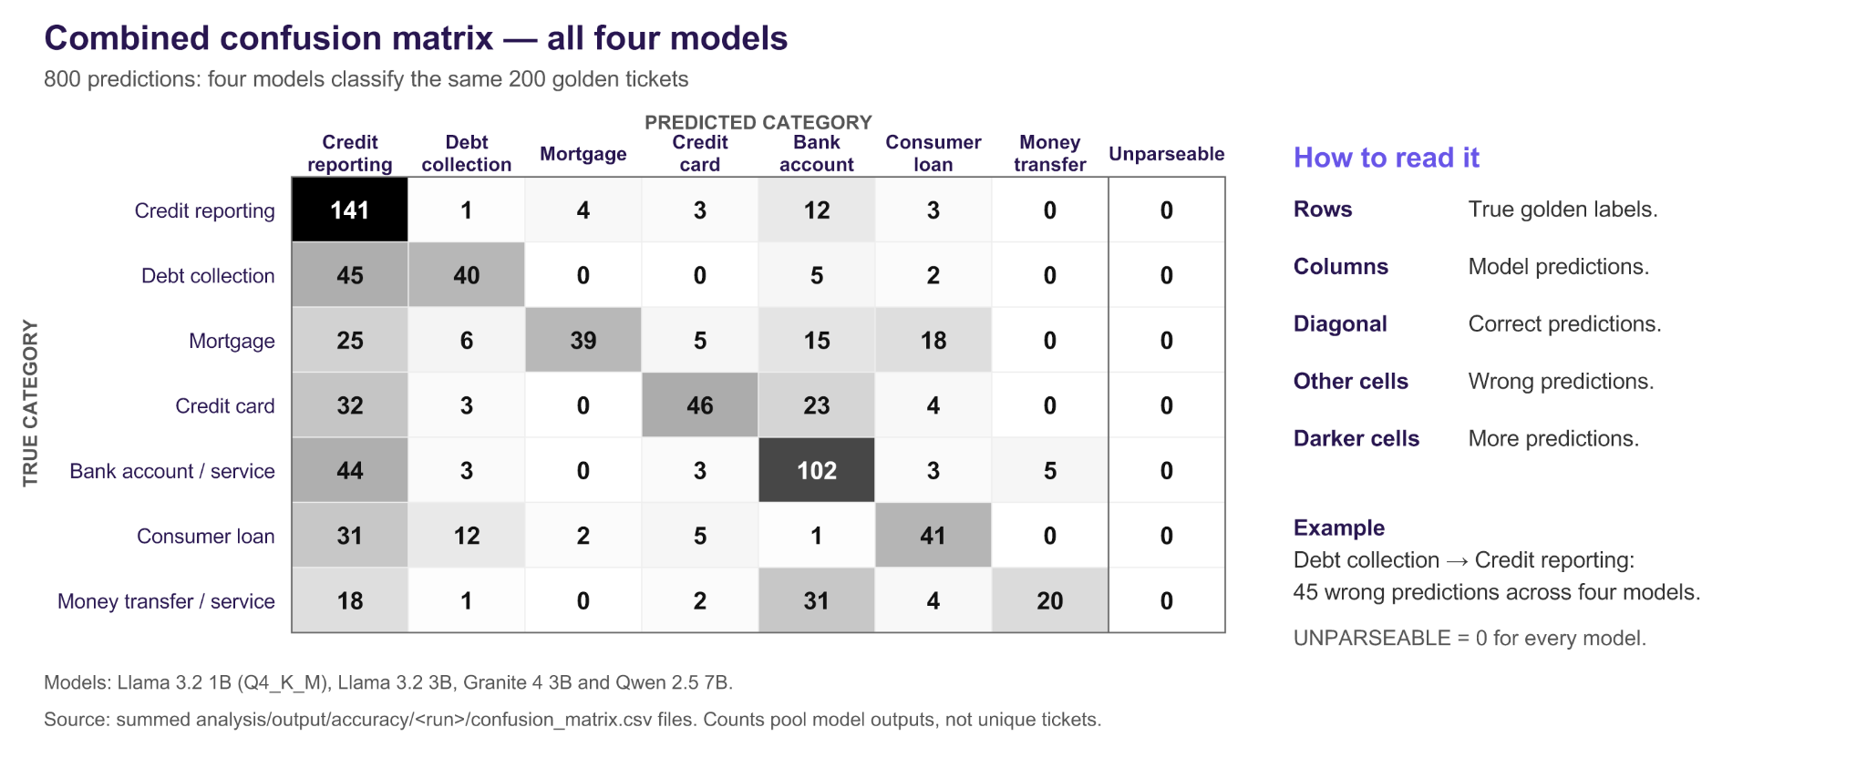
Accuracy Results
Model | Overall | Credit reporting | Debt coll. | Mortgage | Credit card | Bank account | Consumer loan | Money transfer | Unparsed
llama3.2:1b | 26.0% | 100% | 4.3% | 0.0% | 7.4% | 0.0% | 34.8% | 0.0% | 0
llama3.2:3b | 48.5% | 65.9% | 56.5% | 11.1% | 22.2% | 90.0% | 52.2% | 0.0% | 0
granite4:3b | 66.0% | 90.2% | 39.1% | 63.0% | 77.8% | 82.5% | 34.8% | 36.8% | 0
qwen2.5:7b | 74.0% | 87.8% | 73.9% | 70.4% | 63.0% | 82.5% | 56.5% | 68.4% | 0
Floor | ≥ 90% | ≥ 80% | ≥ 80% | ≥ 80% | ≥ 80% | ≥ 80% | ≥ 80% | ≥ 80% | n/a
Where each model goes wrong
llama3.2:1b: true Bank account predicted as Credit reporting
llama3.2:3b: true Money transfer or service predicted as Bank account or service
granite4:3b: true Debt collection predicted as Credit reporting
qwen2.5:7b: true Money transfer predicted as Bank account or service
Unparsed = replies mapping to none of the seven categories (UNPARSEABLE), counted as wrong.

Slide 11
Predictions, Recommendation and Defence
Prediction | Predicted | Measured | Why we were off
Bottleneck | Ollama’s single request slot; waiting increases under load | Waiting inside Ollama grows with load; Qwen ollama_other_ms: 10 → 488 → 858 ms at 1, 4 and 12/min | Correct location; overestimated waiting because inference was faster than expected
Accuracy, per model | 38%, 55%, 60%, 70% | 26%, 48.5%, 66%, 74% | Both Llama models over-used broad categories; Granite and Qwen fell within predicted bands
p50 latency, per model | 0.85, 2.00, 2.20, 4.60 s | 0.50, 1.22, 1.09, 2.26 s | Prefill ran 3–6× faster than assumed
Hardest categories | 1B: Debt collection / Money transfer; 3B: Money transfer; Granite / Qwen: Credit card | 1B: Mortgage / Bank account / Money transfer (0%); 3B: Money transfer (0%); Granite / Qwen: Consumer loan (35% / 57%) | Missed category boundaries defined by our labelling protocol but absent from the prompt
p95 at modelled peak | 1.80, 4.30, 4.60, 10.50 s | 0.96, 2.32, 2.40, 5.52 s | Faster prefill reduced latency; all four meet R1
Recommended model. qwen2.5:7b. Against R1 met, R2 met, R3 missed, R4 missed, R5 met.
No candidate meets R3 or R4. The best overall accuracy is 74.0% (qwen2.5:7b), below R3’s 90%, and every model has at least one category below R4’s 80% floor.

Slide 12
References and Acknowledgements
[1] US Consumer Financial Protection Bureau, "Consumer Complaint Database." [Online]. Available: https://www.consumerfinance.gov/data-research/consumer-complaints/.
[2] ICT3113 teaching team, "ICT3113 Assignment 1 ticket extract (ict3113_tickets.csv)," extract from [1], xSiTe, Week 1.
[3] US CFPB, "Consumer Response Annual Report: January 1 – December 31, 2025," Mar. 2026. [Online]. Available: https://www.consumerfinance.gov/data-research/research-reports/2025-consumer-response-annual-report/.
[4] CNA, "IN FOCUS: What happens when you contact a bank or telco customer care centre?," 2024. [Online]. Available: https://www.channelnewsasia.com/singapore/in-focus-what-happens-when-you-contact-bank-or-telco-customer-care-centre-4735346.
[5] W. Whitt, "What You Should Know About Queueing Models To Set Staffing Requirements in Service Systems," Columbia Univ., 2007. [Online]. Available: https://www.columbia.edu/~ww2040/shorter041907.pdf.
[6] Apache Software Foundation, "Apache JMeter," v5.6.3, and "User manual: component reference" (Open Model Thread Group). [Online]. Available: https://jmeter.apache.org/usermanual/component_reference.html#Open_Model_Thread_Group.
[7] Ollama, "Ollama," v0.34.3, and "Ollama model library" (model tags, sizes, quantisation). [Online]. Available: https://ollama.com/library.
[8] Ollama, "LICENSE" (MIT License). [Online]. Available: https://github.com/ollama/ollama/blob/main/LICENSE.
[9] Meta Platforms, Inc., "Llama 3.2 Community License Agreement," 25 Sep. 2024 (llama3.2:1b, llama3.2:3b). [Online]. Available: https://github.com/meta-llama/llama-models/blob/main/models/llama3_2/LICENSE.
[10] IBM Granite Team, "granite-4.0-micro" (granite4:3b; Apache-2.0). [Online]. Available: https://huggingface.co/ibm-granite/granite-4.0-micro.
[11] Qwen Team, Alibaba Cloud, "Qwen2.5-7B-Instruct" (qwen2.5:7b; Apache-2.0). [Online]. Available: https://huggingface.co/Qwen/Qwen2.5-7B-Instruct.
[12] Apache Software Foundation, "Apache License, Version 2.0," Jan. 2004. [Online]. Available: https://www.apache.org/licenses/LICENSE-2.0.
[13] Service stack (versions captured in docs/environment/ and requirements.txt): Docker Engine 29.7.2, Docker Compose 5.5.1, Python 3.11.17, FastAPI 0.142.4, Uvicorn 0.54.0, SQLite 3.46.1.

