Slide 1

SonnarSage
Multimodal Assistance
Team
Abdellah Nait Hadid
Project Manger
Oumaima Halim Product Manager
Anass Raid
Data Analyst
Nabiha Elboudali
UX Researcher
Issam Najim
UX/UI Designer
Walid Fikri
UX/UI Designer

Slide 2

Problem
“Deaf and hard-of-hearing students face significant barriers in online education due to a lack of accessibility features like captions, sign language interpretation and visual aids. “
GCGO
Why
Quality Education aims to ensure inclusive and equitable quality education and promote lifelong learning opportunities for all, including marginalized groups like the deaf and hard-of-hearing community.
This problem matters because it limits educational opportunities for deaf and hard-of-hearing students, hindering their academic success, career prospects, and overall inclusion in society.

Slide 3

Affected person/group
One group impacted by this problem is deaf and hard-of-hearing students, who struggle to fully engage with course materials and participate in online learning environments due to the lack of accessible features.

Slide 4
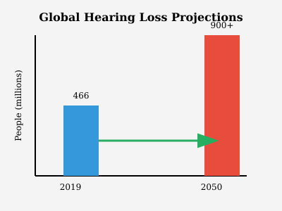
Hearing Loss in Education
15% of the global population experiences some form of hearing loss, making education inaccessible to millions without proper accommodations.
According to a 2019 study by the World Health Organization (WHO), approximately 466 million people globally suffer from hearing loss, with this number projected to rise to over 900 million by 2050.

Slide 5
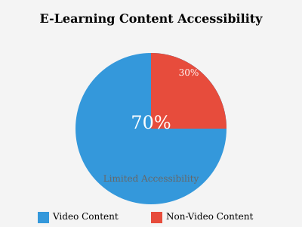
E-Learning Growth
The global e-learning market was valued at $315 billion in 2021 and is expected to exceed $1 trillion by 2030, highlighting a massive opportunity to include accessibility features.
70% of e-learning content is video-based, and a significant portion lacks captions, making it inaccessible to hearing-impaired individuals.

Slide 6
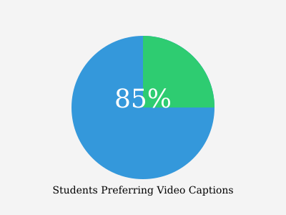
Accessibility Adoption in Education
Research shows that 85% of students prefer to have captions in video content for better comprehension and retention, including students with hearing loss.
A 2019 study by the National Center for Learning Disabilities found that accessibility features like captions increase overall engagement and academic performance in students with disabilities.

Slide 7



A multi-modal Chrome extension designed to support deaf and hard-of-hearing students by providing seamless access to learning platforms. It offers innovative tools to enhance the learning experience.
Solution
Integrate Real-Time Captioning
Why?
With the rise of technology in education, many platforms overlook the needs of deaf and hard-of-hearing students. This solution bridges that gap, ensuring equal access and full participation for all learners.
Sign Language Interpretation
Is it working?
The solution integrates essential accessibility features like captions and sign language support, directly enhancing engagement and inclusion for deaf and hard-of-hearing students, making it an effective tool for equalizing educational opportunities.
Visual Communication Features

Slide 8
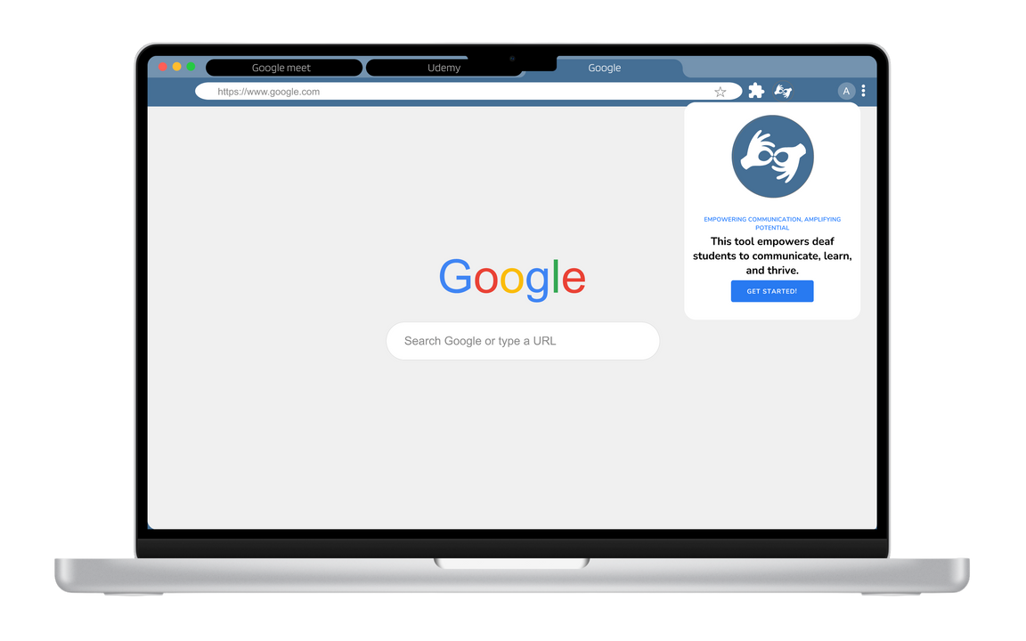
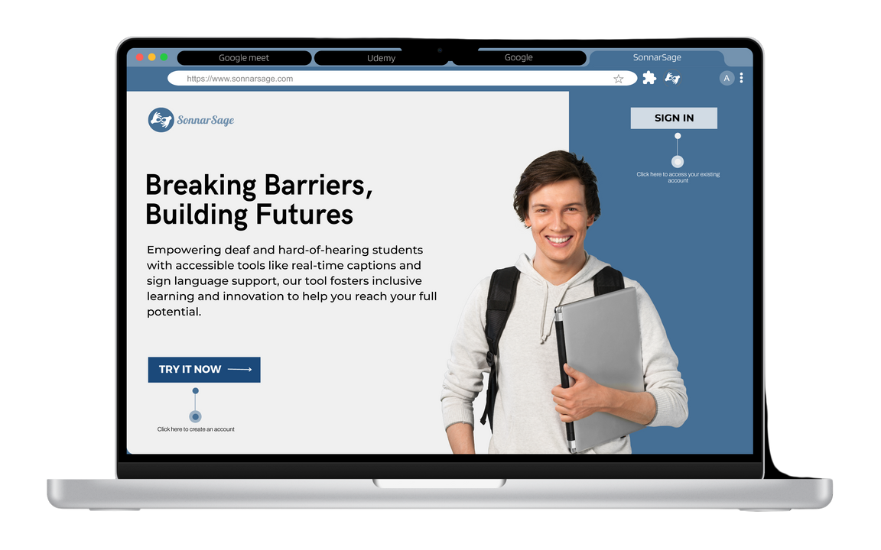
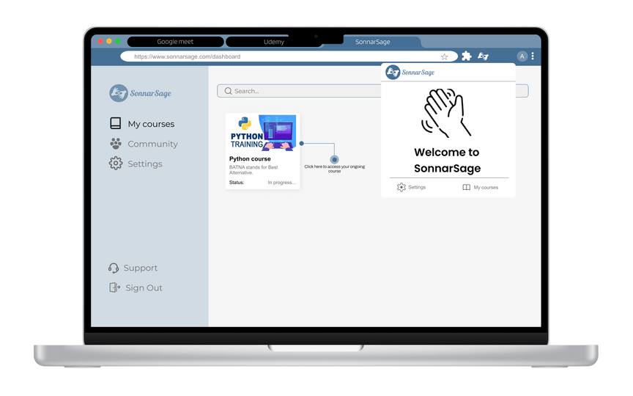
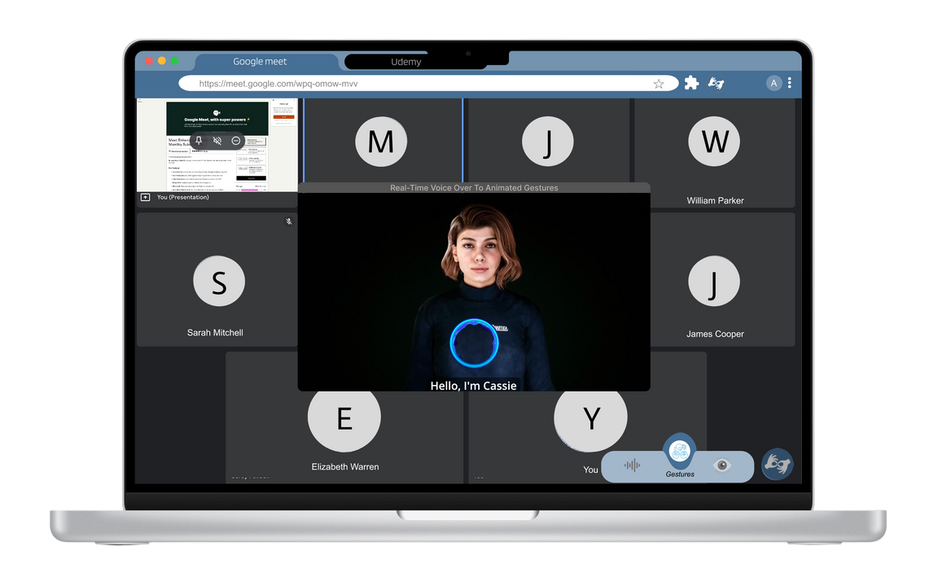
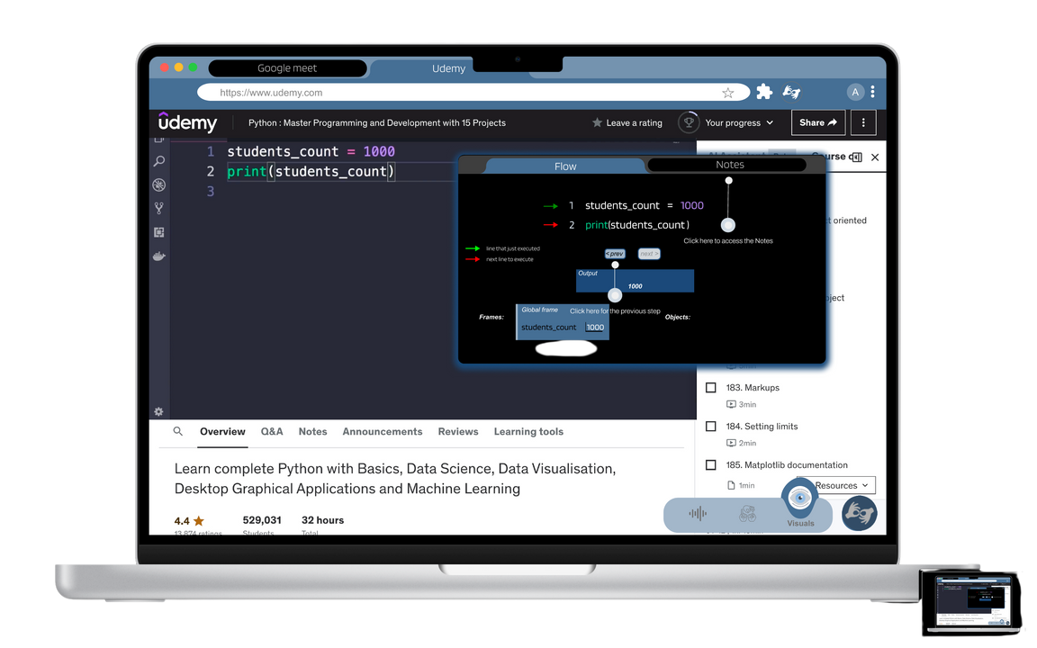
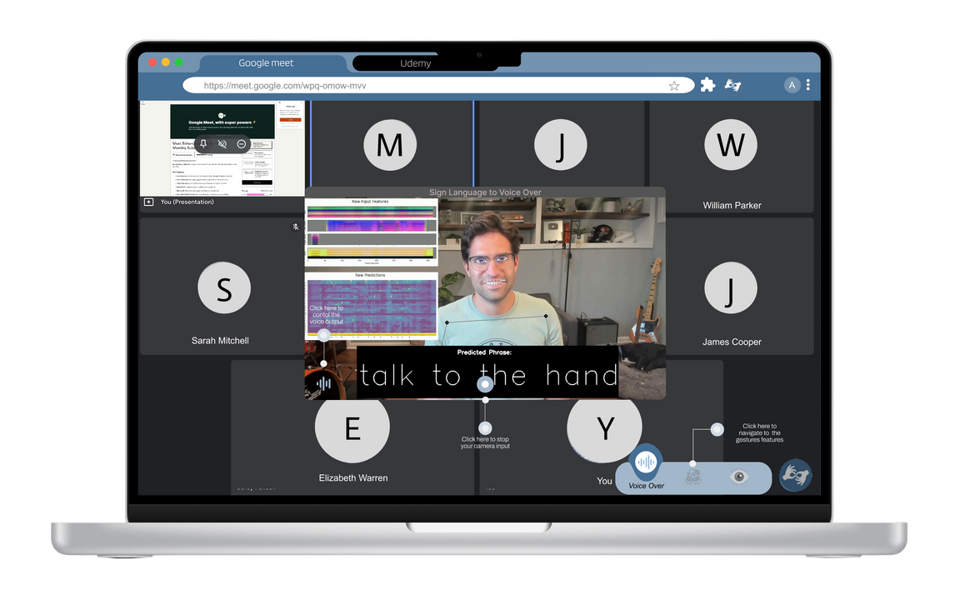
The product
Install
Log in
Learn
Listen
Talk

Slide 9

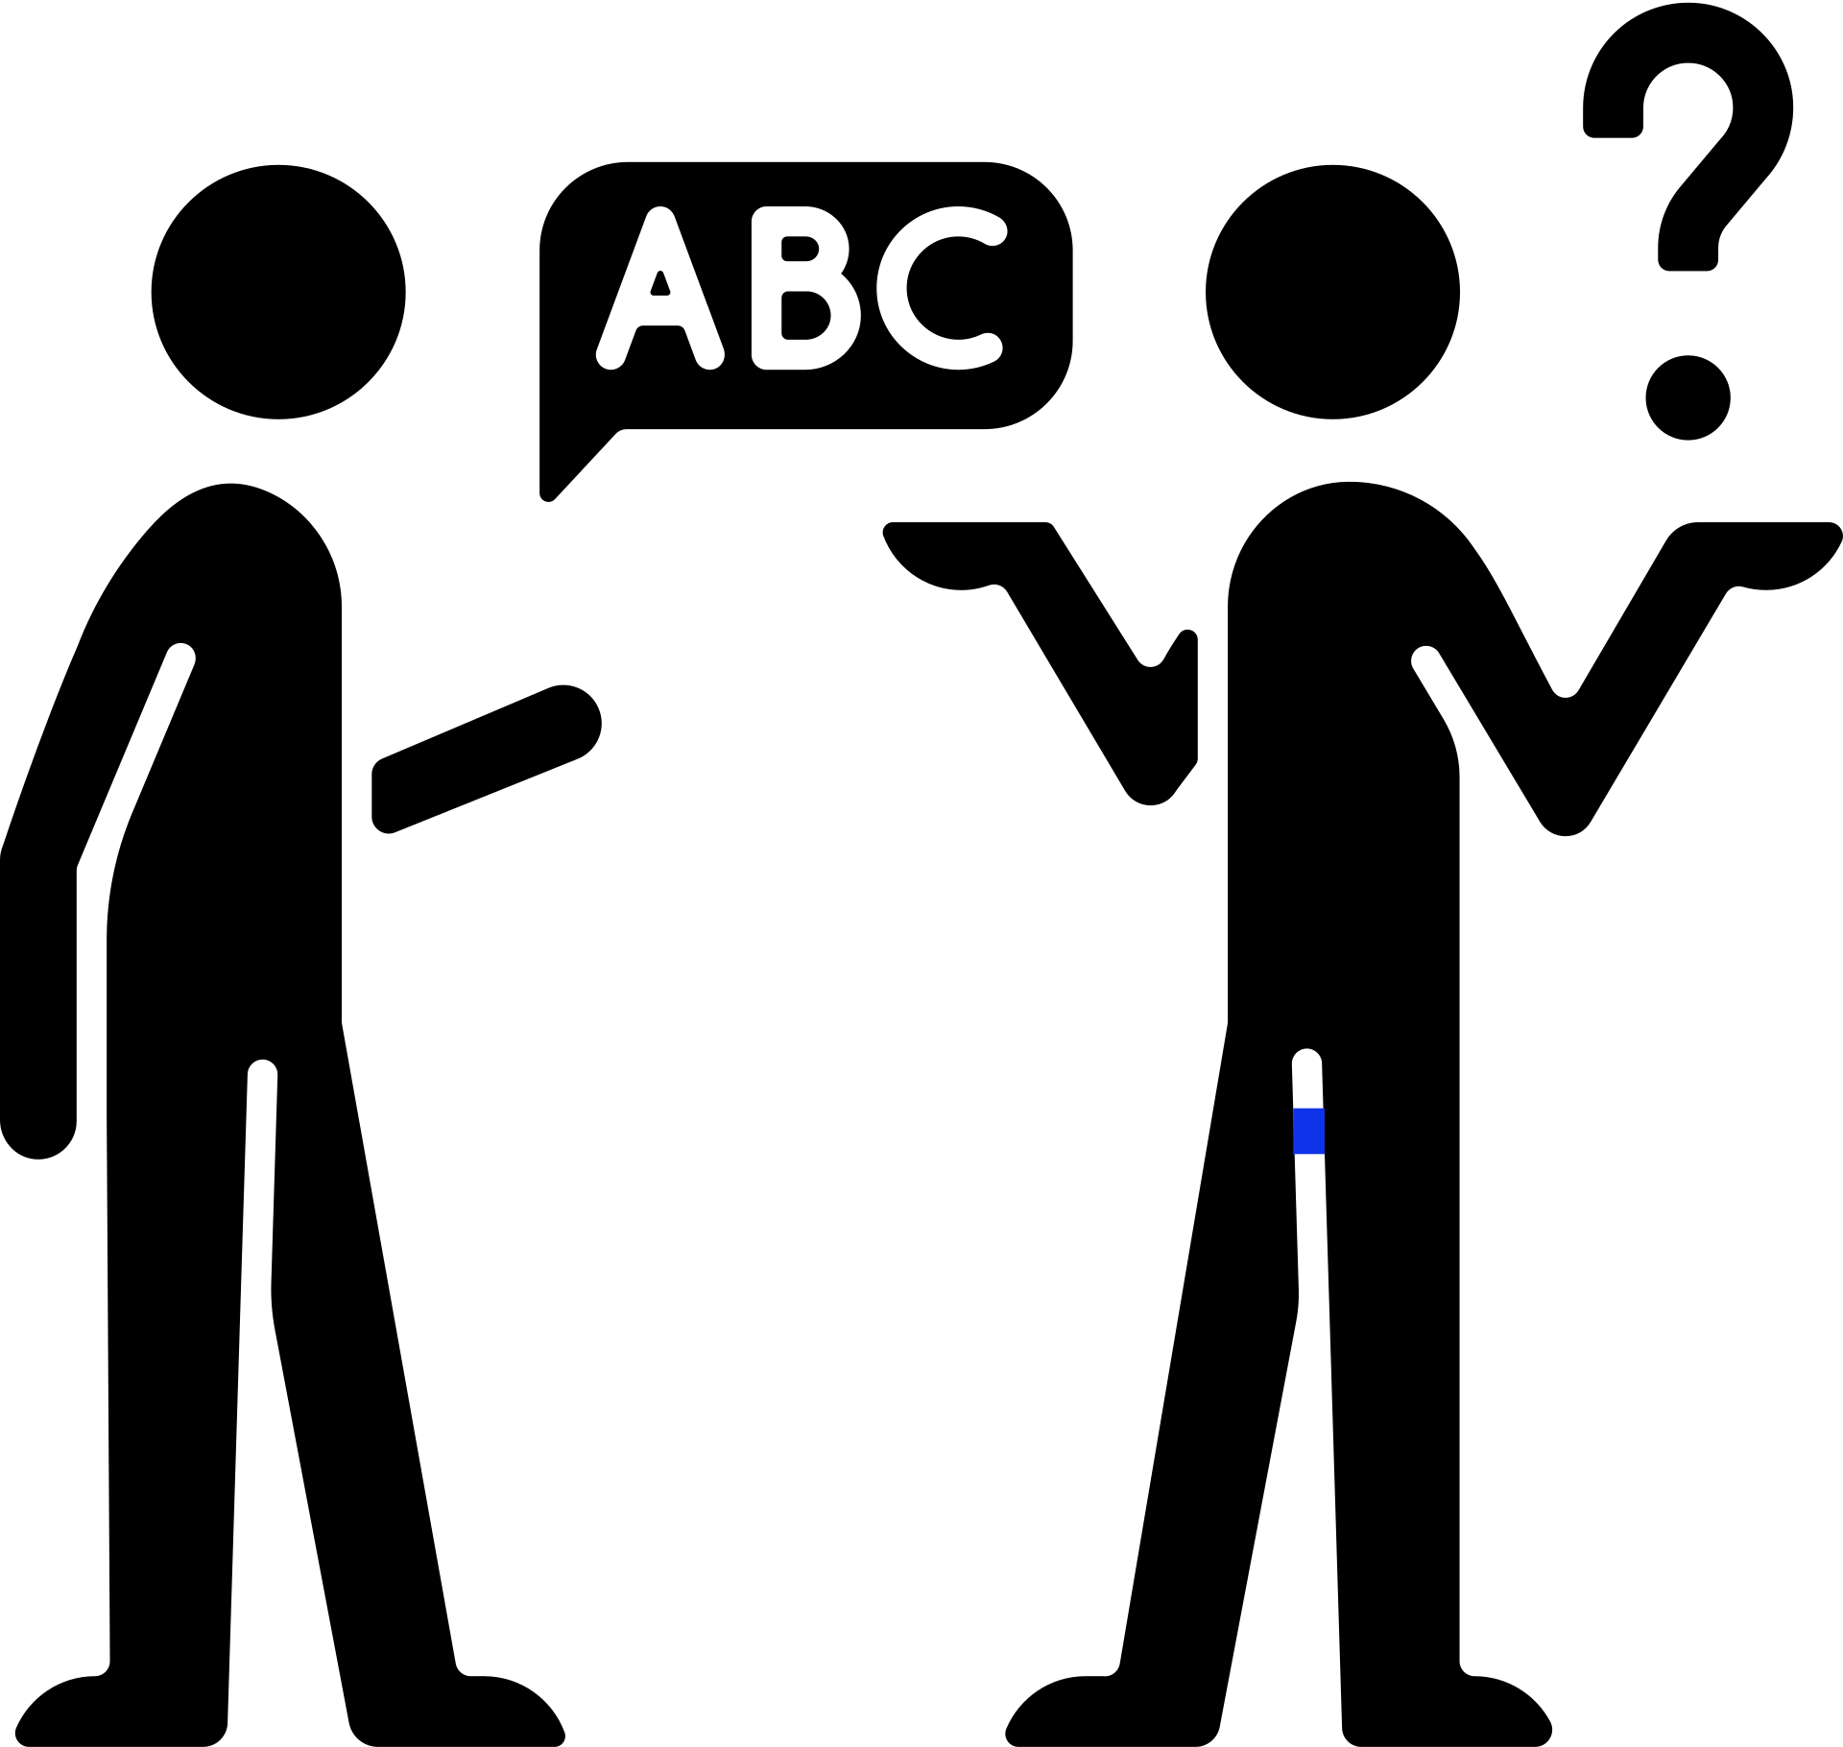
Pain Points
Lack of accessibility features in educational platforms – this is addressed by integrating captions and sign language support.
Barriers to comprehension and engagement for deaf and hard-of-hearing students – the solution enhances engagement and comprehension.

Slide 10

Recommendations / changes
Add a home page containing all the content the learner should check.
Add a profile page where the learner can enter personal information (such as previous education and work experience, LinkedIn profile, etc.).
Add the refresh button and also the back and forward button to make it easy for the user.

Slide 11

01
Development & Enhancement:
Expand and optimize the extension’s features, supporting additional learning platforms and languages.
Improve real-time captioning accuracy and integrate AI-powered sign language interpretation.
02
User Testing & Feedback
Conduct extensive testing with deaf and hard-of-hearing students to refine the user experience.
Collect feedback from educational institutions and platforms to ensure the extension meets their needs.
03
Partnerships & Outreach
What's next?
Build partnerships with universities and educational tech companies to integrate the tool into their platforms.
Launch awareness campaigns to promote the solution to students, educators, and institutions.
04
Scalability & Impact:
Develop a long-term plan for scaling the solution globally to serve a larger student base.

Slide 12

WHY
"This solution has the potential to make a significant difference by removing barriers for deaf and hard-of-hearing students, enabling them to fully engage with educational content. By providing seamless access to learning platforms through real-time captions and sign language support, we can foster inclusivity, improve comprehension, and ultimately enhance academic success for an often-overlooked group, creating equal educational opportunities for all."

