Slide 1
HHC DS Exercise: Summerlin Analysis
Connor Foley
1/24/2017

Slide 2
Objective
The purpose of this exercise was to investigate a dataset based on a shopping district’s visitors. Data engineering, analysis, and visualization was utilized to uncover insights into the population and to identify opportunities for the underlying business.

Slide 3
Contents
Environment Setup
Data ETL Process
Data Analysis
Insights &Visuals
Next Steps & Final Thoughts

Slide 4

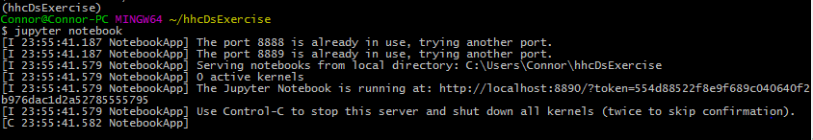
Environment Setup
A virtual environment was spun up with the latest version of python 2
Jupyter notebooks were configured and a variety of standard python packages were installed on the system

Slide 5
Data Extraction Transformation and Load
The raw source files were unzipped, processed by python and then loaded into a local installation of Postgres, a relational database system
Data ETL Process

Slide 6
Data Analysis
With the data loaded to RDS analysis focused on four different segments
General Summary
Store Type Usage
Location Distribution
Gender Study
Data Analysis Process

Slide 7
Insights & Visuals – General Summary
General Summary Top Ten Stores
Alphabetically
Given the variety of stores and the relatively small dataset these main metrics were exceedingly close to one another
The Average Visits per Person over this small date window was also surprisingly high

Slide 8
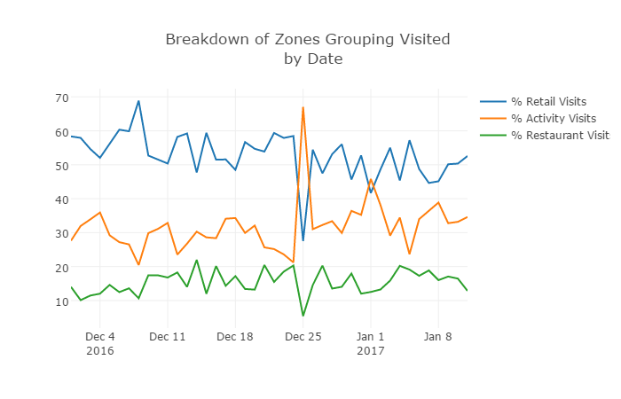
Insights & Visuals – Zone Groups
Breakdown of Zone Groups Visited
by Date
Prior to the holidays, majority of visitors spend their time on last minute shopping, however after Christmas there is a substantial rise in Activities and a slight rise in restaurants.

Slide 9
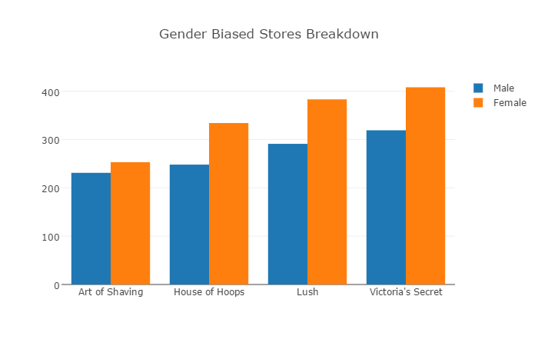
Insights & Visuals – Gender Effect
Although these four stores should be the most polarizing stores of those provided, we do not see any data to support this assumption, rather Female shoppers account for the majority of the unique visitors to these stores regardless of target audience

Slide 10
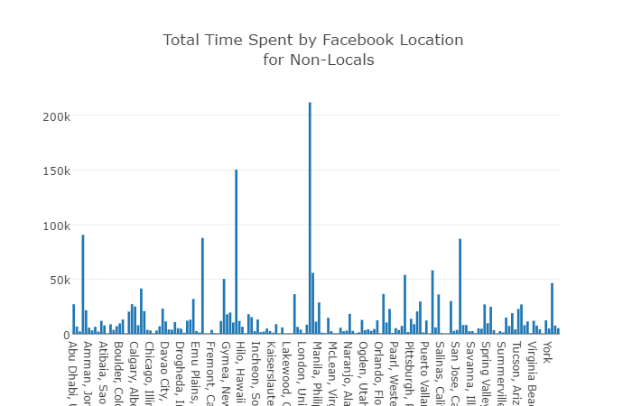
Insights & Visuals – Location Distribution
Once the immediate locals have been removed from the distribution, the majority of visitors to the Summerlin shopping center is split between those in surrounding states and those from foreign countries.

Slide 11
Next Steps and Final Thoughts
Time spent while at activities (Regal, Rink, D&B) should’ve been substantially larger than retail stores, but we don’t see this occurring. I would stand behind this business assumption and suspect a data related problem.
Although 23 stores were provided, the Summerlin shopping center contains many more. Depending on how the other stores were filtered out and the data collected, this could result in significant incorrect values.
The gender effect relies on the assumption that visitors with SSI data is an un-biased population, I don’t believe this to be a valid assumption
Going forward I think it would be interesting to investigate the relationship between purchases and amount spent with that of visits and duration
One other next step would be to perform a path analysis of visitors to see the relationship between stores and identify opportunities for cross promotions and store expansions

