Slide 1
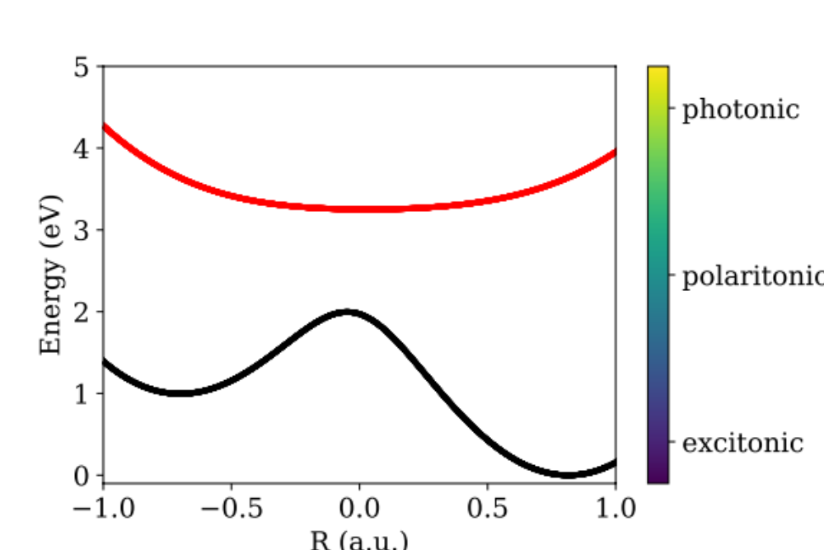
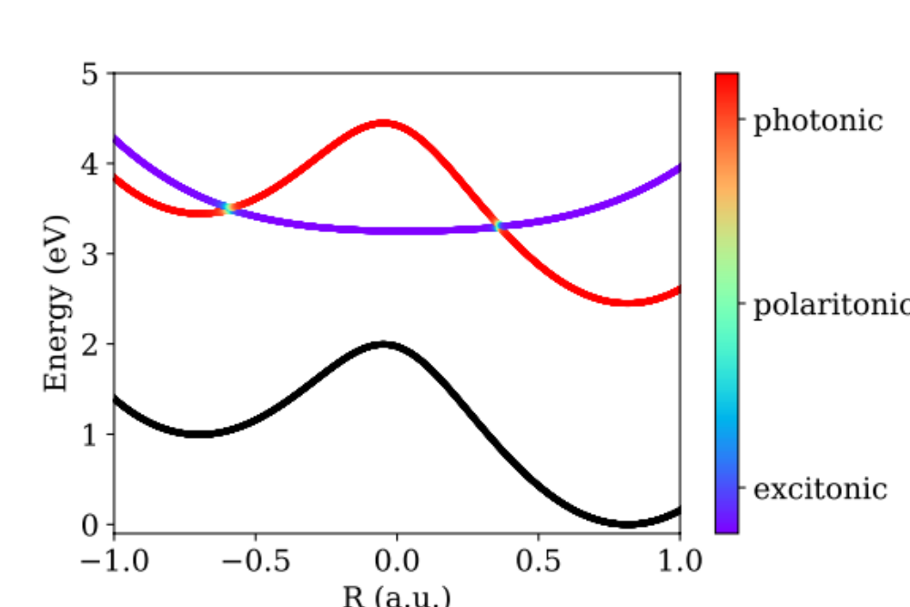





$$|e⟩$$
$$|UP⟩$$
$$|LP⟩$$
$$|g⟩$$
$$|g,0⟩$$

Slide 2
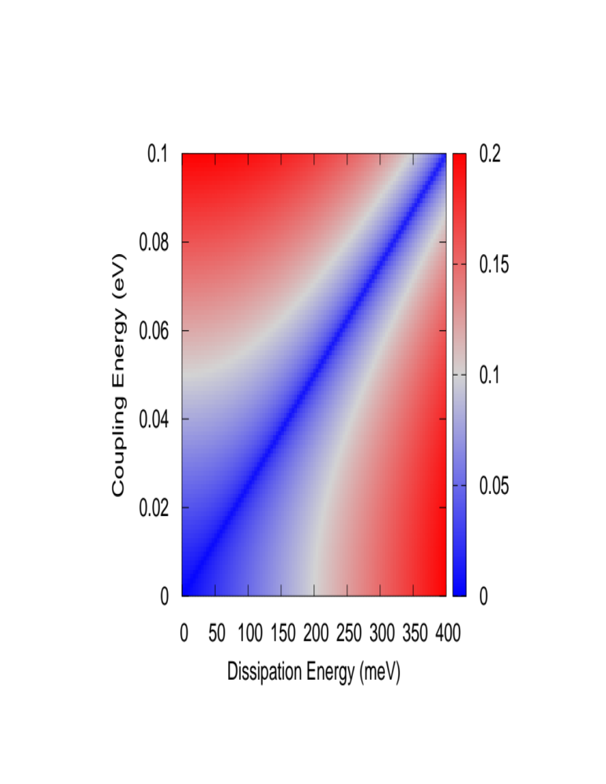
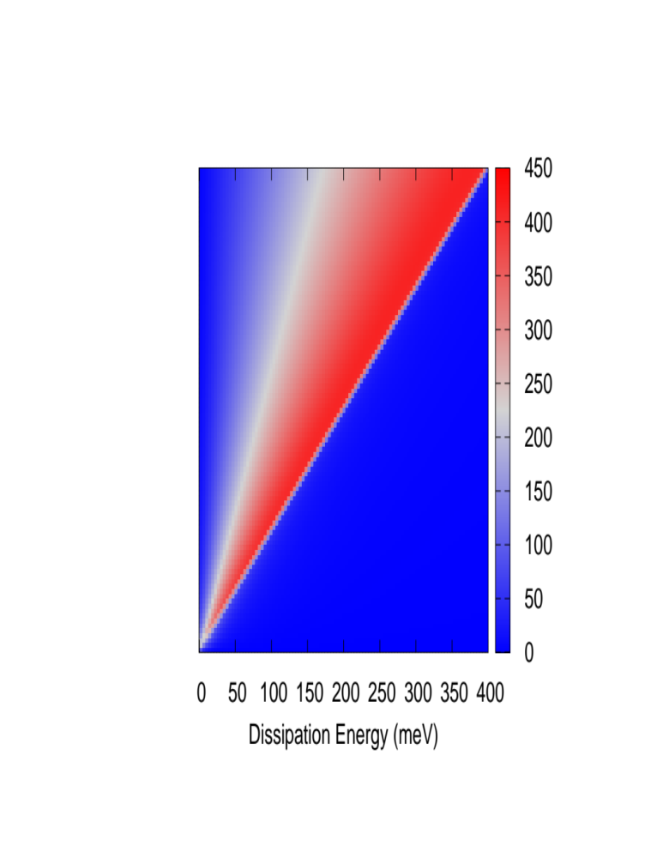
a
b
Real Splitting
This work
Imaginary Splitting
This work

Slide 3
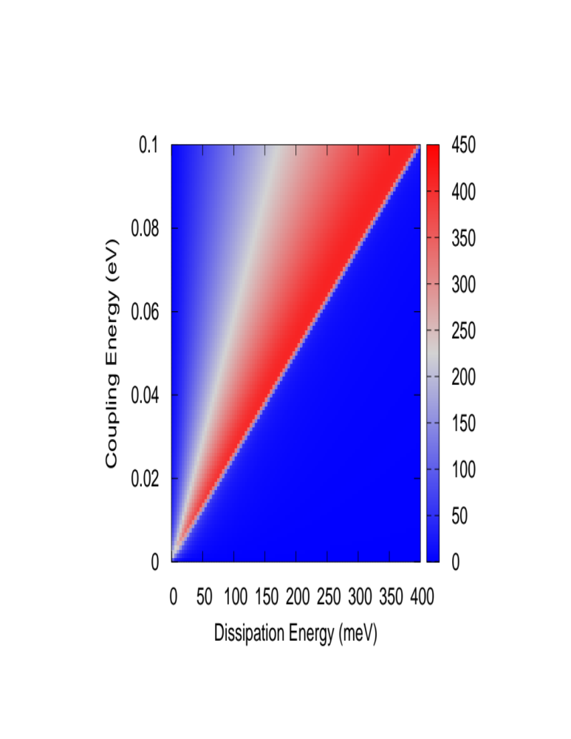
a
Real Splitting
This work
Imaginary Splitting
b
This work

Slide 4
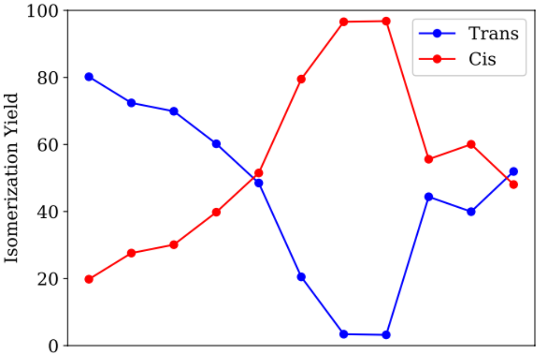













$$τ (ps)$$
$2⋅{10}^{1}$
$2⋅{10}^{0}$
$2⋅{10}^{−1}$
$2⋅{10}^{−2}$
$2⋅{10}^{−3}$
${10}^{−2}$
${10}^{−1}$
${10}^{0}$
${10}^{1}$
${10}^{2}$
${10}^{3}$
$$ℏγ (meV)$$

Slide 5
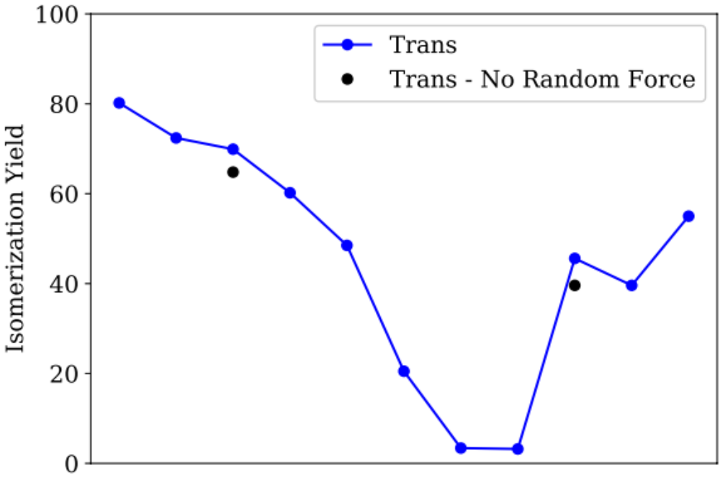
$$τ (ps)$$
$2⋅{10}^{1}$
$2⋅{10}^{0}$
$2⋅{10}^{−1}$
$2⋅{10}^{−2}$
$2⋅{10}^{−3}$
${10}^{−2}$
${10}^{−1}$
${10}^{0}$
${10}^{1}$
${10}^{2}$
${10}^{3}$
$$ℏγ (meV)$$

Slide 6

$$|e⟩$$
$$|UP⟩$$
$$|LP⟩$$
$$|g⟩$$
$$|g,0⟩$$

Slide 7
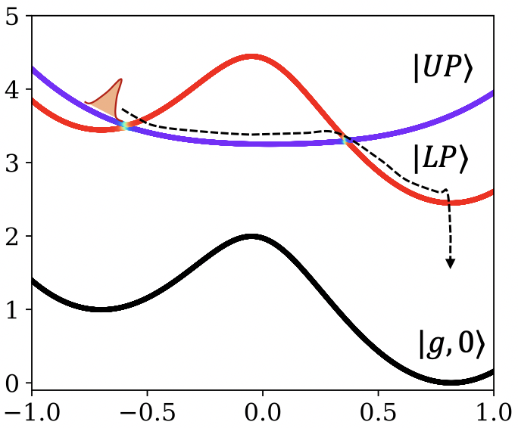
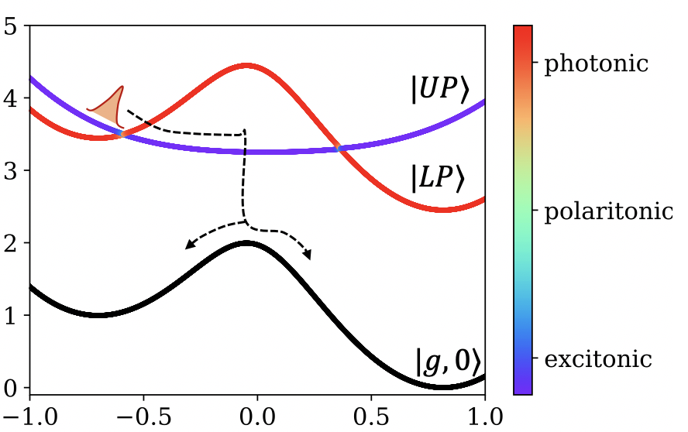






Strong Coupling, Low-Loss
Strong Coupling, Moderate-Loss
Strong Coupling, High-Loss
$$|UP⟩$$
$$|LP⟩$$
$$R$$
$$|g,0⟩$$

Slide 8
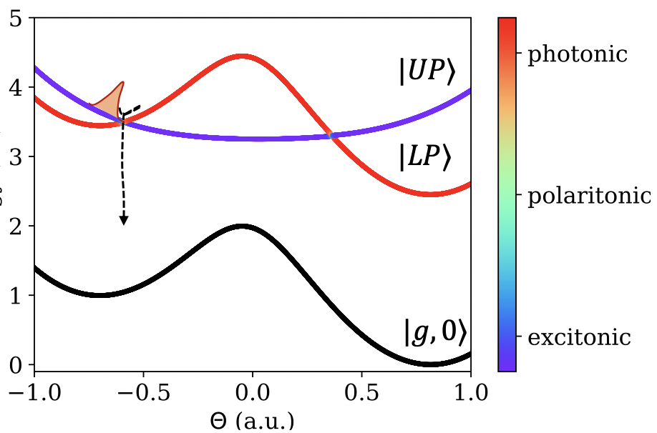

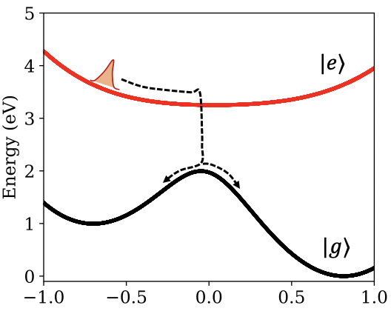

No Coupling
Strong Coupling, Low-Loss
Strong Coupling, High-Loss
$$θ$$

Slide 9


(a) Strong Coupling, Low-Loss
(b) Strong Coupling, High-Loss
Energy (eV)
$$R$$
$$R$$
R (a.u.)
R (a.u.)

Slide 10
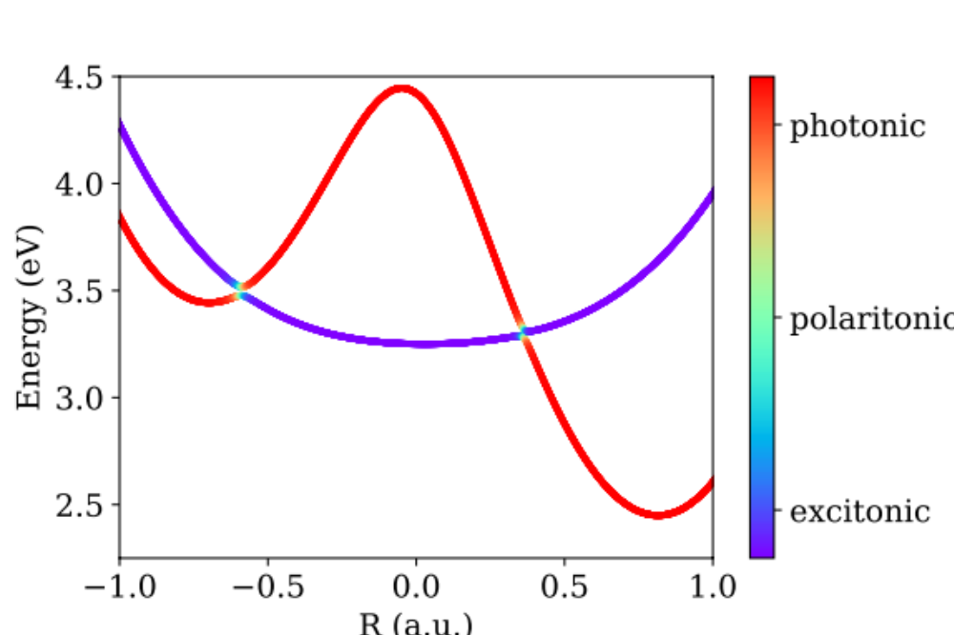
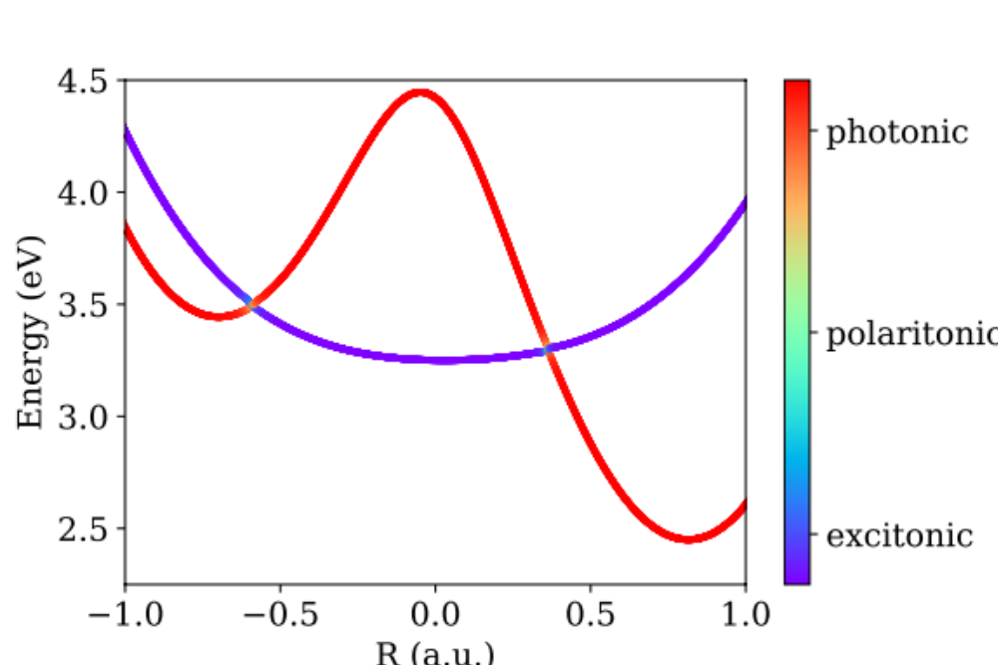
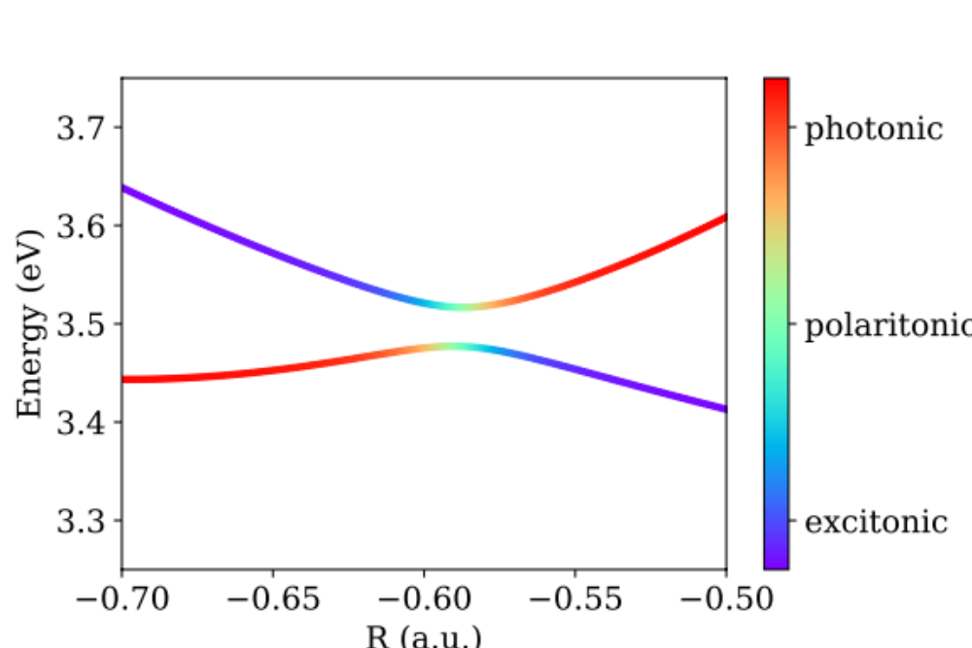
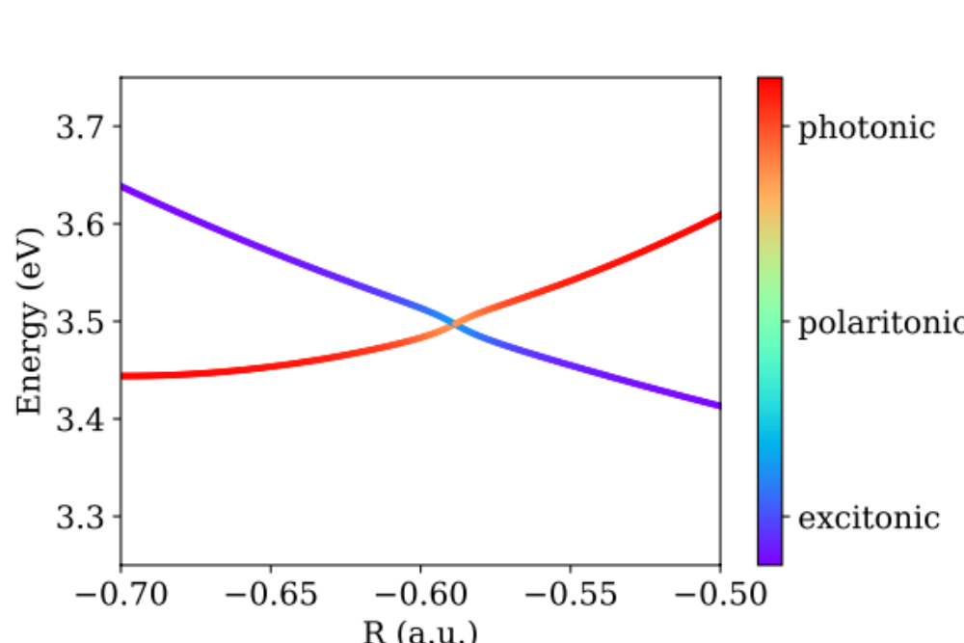


$$ℏγ=10 meV$$
$$ℏγ=100 meV$$
(a)
(b)
(c)
(d)

Slide 11
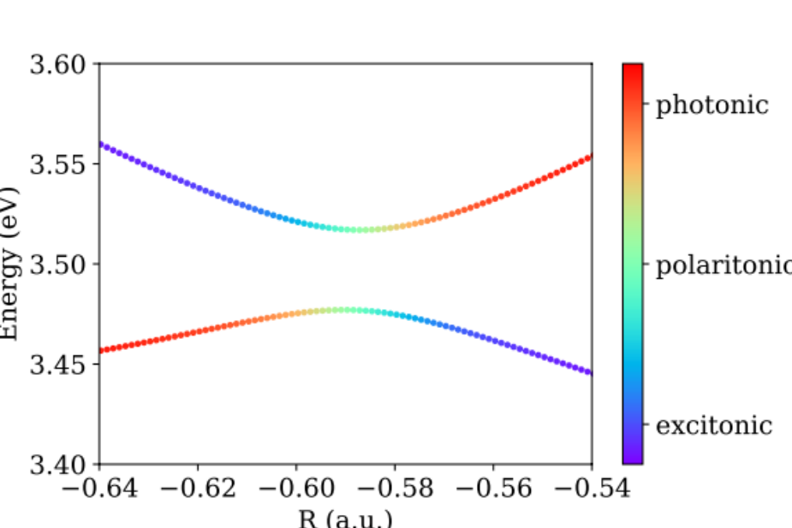

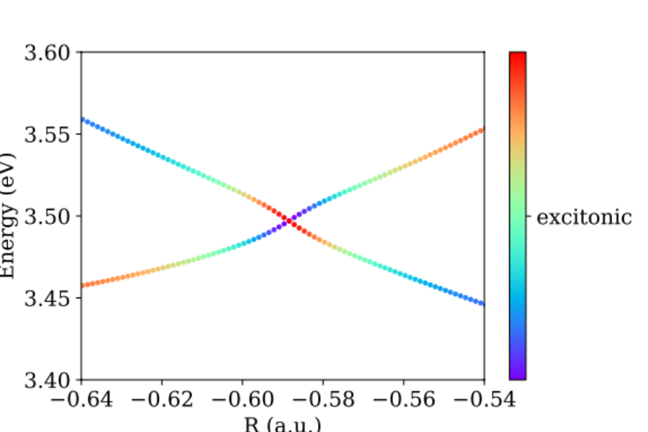
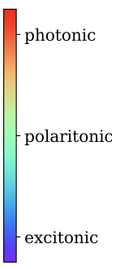
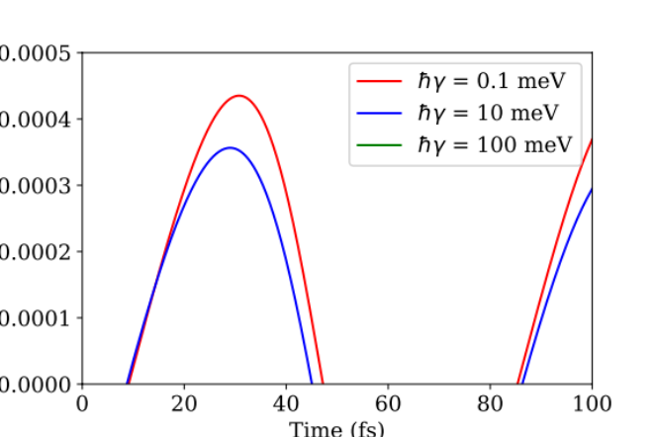
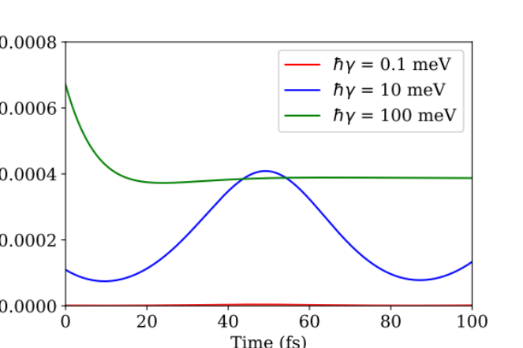
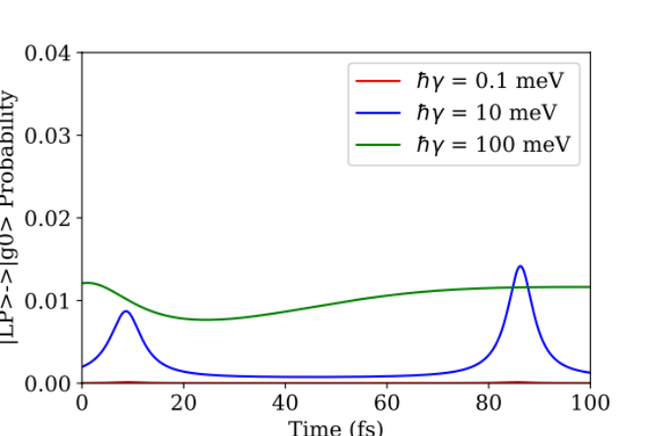



Energy (eV)
$$\left|UP\right\rangle →|LP⟩$$
$$\left|UP\right\rangle →|g,0⟩$$
$$\left|LP\right\rangle →|g,0⟩$$
Time (fs)
Time (fs)
Time (fs)

Slide 12
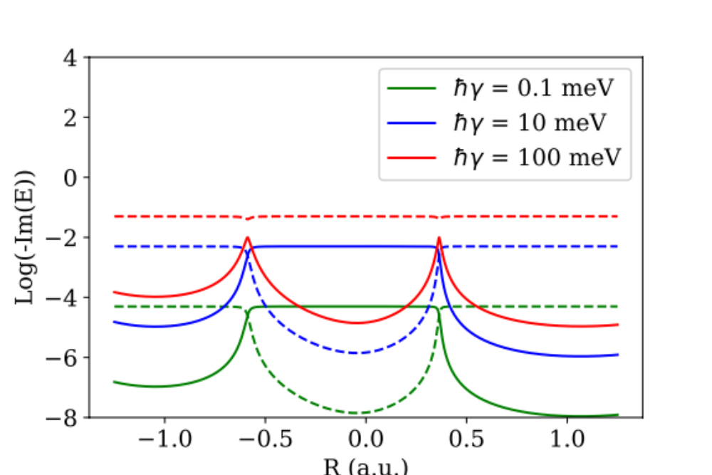
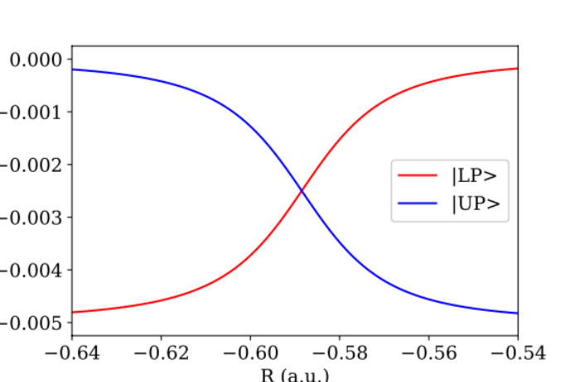
Energy (eV)

