Slide 1

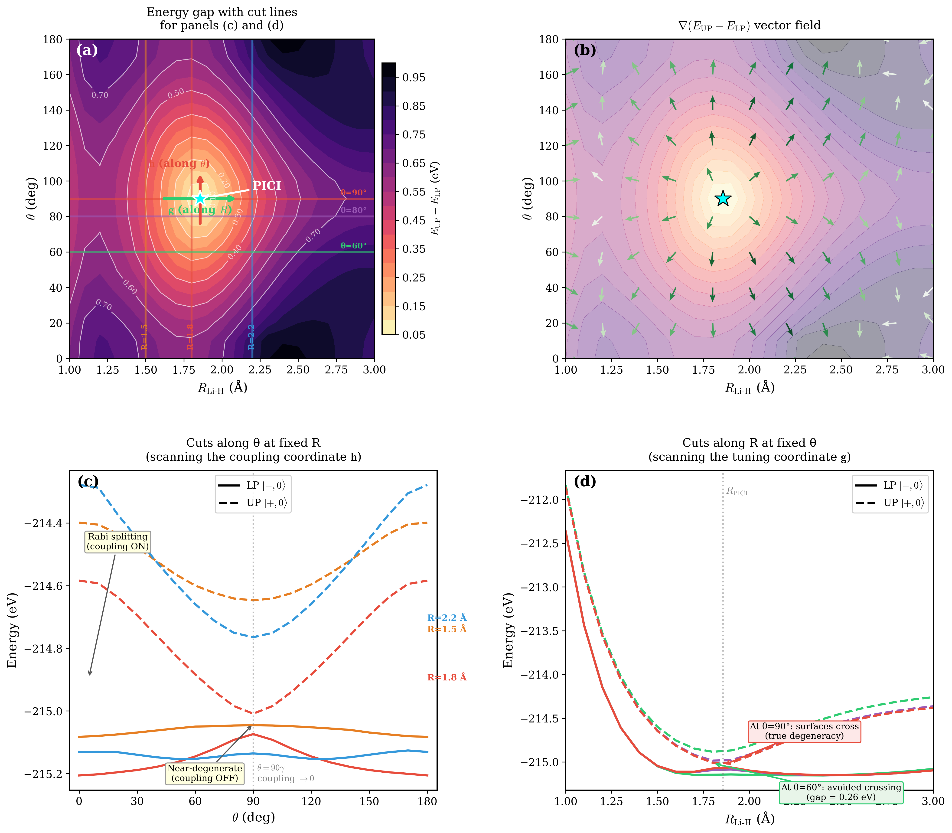
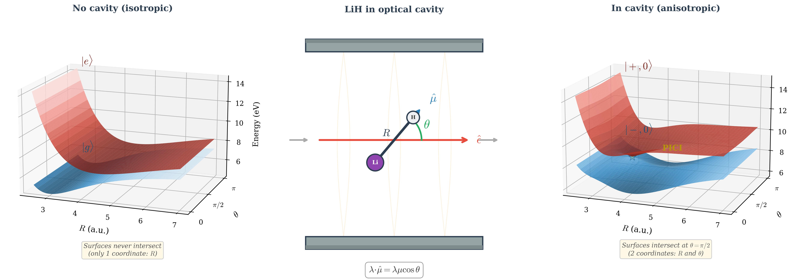
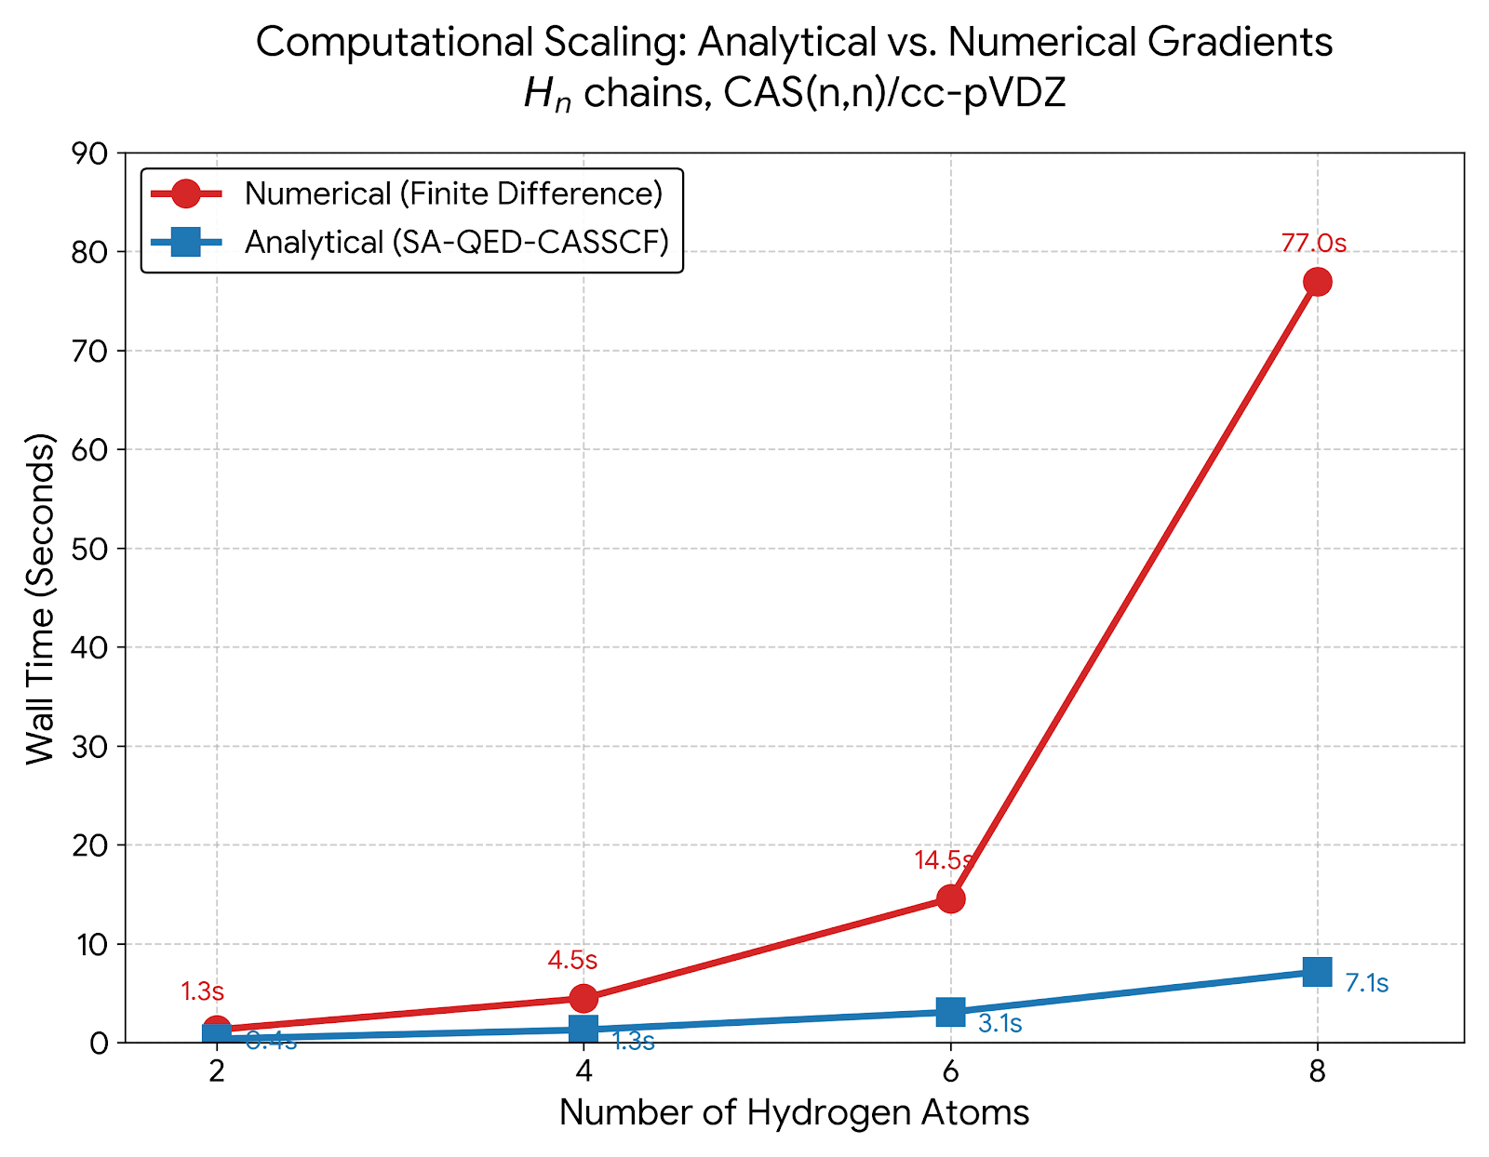



Analytical Gradient for State-Averaged Quantum Electrodynamics Complete Active Space Self-Consistent Field (SA-QED-CASSCF) Method
Nam Vu, Jay Foley,
Department of Chemistry and Nanoscale Science, UNC Charlotte
Introduction
Light-Matter Coupling: Optical cavities create hybrid polaritonic states, introducing an anisotropic environment based on molecular orientation (θ).
Isolated diatomic molecules have only one internal coordinate (R). The cavity adds θ, providing the 2D branching space necessary for a Conical Intersection (CI).
We implement exact analytical forces (gradients and derivative couplings) in SA-QED-CASSCF to systematically locate these Polariton-Induced CIs (PICIs).
Results
Polariton induce conical intersection:
Locating the precise crossing requires navigating the local branching space using two orthogonal forces:
Tuning Vector (g, Red): Adjusts bond length (R) to close the energy gap.
Coupling Vector (h, Blue): Rotates orientation (θ) to eliminate electronic mixing.
At the crossing, g and h are perfectly orthogonal, proving the PICI topology (converged energy gap: 0.0008 eV).
2. Computational efficiency of analytical gradient
Conclusions
The cavity promotes the orientation angle from a free rotation to an energy-active coordinate, enabling a polariton-induced conical intersection (PICI) in a diatomic molecule.
Using the MECP algorithm, the PICI in LiH was located at R = 1.857 A and theta = 90 degrees, where the branching vectors g and h align with the stretch (R) and rotational (theta) coordinates, respectively.
Future work will extend this approach to polyatomic molecules, where the PICI can interact with intrinsic molecular conical intersections to create new photochemical pathways.
4
Strong light-matter interaction can be described by the Pauli-Fierz Hamiltonian:
The interaction is maximized when the dipole vector aligns with the field vector (cos(λ,μ)=1).
To get the gradient vector and non-adiabatic coupling vector, we solve the linear equations resulting from stationary conditions of the Lagrangian:
The gradient difference g and non-adiabatic coupling vector h between state m and n are used to define two forces to drive molecule to conical intersection seam:
Theories
References
Farag, Mandal, Huo, Phys. Chem. Chem. Phys., 2021, 23, 16868.
Mandal, Huo, J. Phys. Chem. Lett., 2019, 10, 5519.
Flick, Ruggenthaler, Appel, Rubio, PNAS, 2017, 114, 3026.
Schafer, Ruggenthaler, Rokaj, Rubio, ACS Photonics, 2020, 7, 975.
Acknowledgement
Notes:
Instaed

