Slide 1
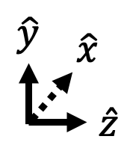
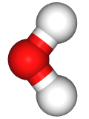

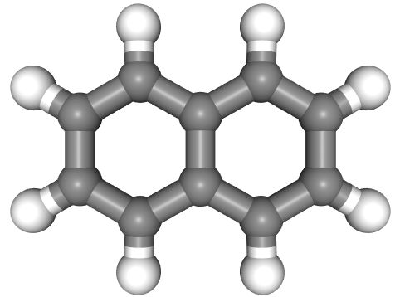
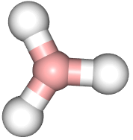



$$\hat{y}$$
$$\hat{x}$$
$$\hat{z}$$

Slide 2


$$ℏω=10 eV, λ=\left(0, 0, 0.01\right)a.u.$$
Molecular displacement coordinate
$$\hat{e}$$

Slide 3
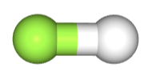

$$ℏω=3.7 eV, λ=\left(0, 0, 0.01\right) a.u.$$
Molecular displacement coordinate
$$\hat{e}$$

Slide 4
$$ℏω=3.7 eV, λ=\left(0, 0, 0.01\right) a.u.$$
$$\hat{e}$$

Slide 5

$$ℏω=3.28 eV, λ=\left(0, 0, 0.05\right)a.u.$$
$$\hat{e}$$

Slide 6


$$ℏω=26 eV, λ=\left(0, 0, λ_{z}\right)a.u.$$
$$\hat{e}$$

Slide 7


$$\hat{e}$$
$$ℏω=13 eV, λ=\left(0, λ_{y}, 0\right) a.u.$$

Slide 8



$$\hat{e}$$
$$\hat{y}$$
$$\hat{x}$$
$$\hat{z}$$
$$ℏω=5.92 eV, λ=\left(0, λ_{y}, 0\right) a.u.$$

Slide 9
Molecular displacement coordinate
$$\hat{e}$$

Slide 10


Molecular displacement coordinate
$$\hat{e}$$

