Slide 1
SUTD 2022 50.041 Final Checkpoint
Team SandDB
Start now!

Slide 2
01.
Problem Scope
Problem Scope and Definition
Implementation Plan
Validation Plan

Slide 3
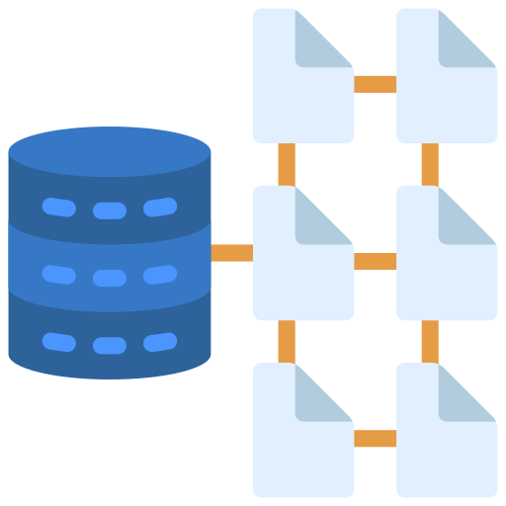
Historia
Problem Scope and Definition
Implementation Plan
Validation Plan
Data Management
Data is the lifeblood of every business — which is why we need a database at the center of it all.
Distributed databases allows improved performance, enables massive scalability and delivers round-the-clock reliability for all clients around the world.
Notes:
Data is the lifeblood of every business — which is why we need a database at the center of it all. we need distributed databases to meet the growing data needs of today’s businesses. Database management in one machine is practically a trivial problem in computer science in today’s age. In comparison, distributed databases are much harder to design and implement, simply because of their distributed nature, where consistency across database nodes is not guaranteed. However, we need distributed databases to meet the growing data needs of today’s businesses. By utilizing distributed databases as the core data infrastructure of an organization, we can gain improved performance, enable massive scalability, as well as deliver round-the-clock reliability for all clients around the world.

Slide 4


Historia
Problem Scope and Definition
Implementation Plan
Validation Plan
Large Scale Systems
Large-scale systems such as social media and e-commerce platforms span globally with thousands of nodes.
A distributed storage system can manage very large amounts of structured data spread out across many commodity servers while providing highly available service with no single point of failure.

Slide 5
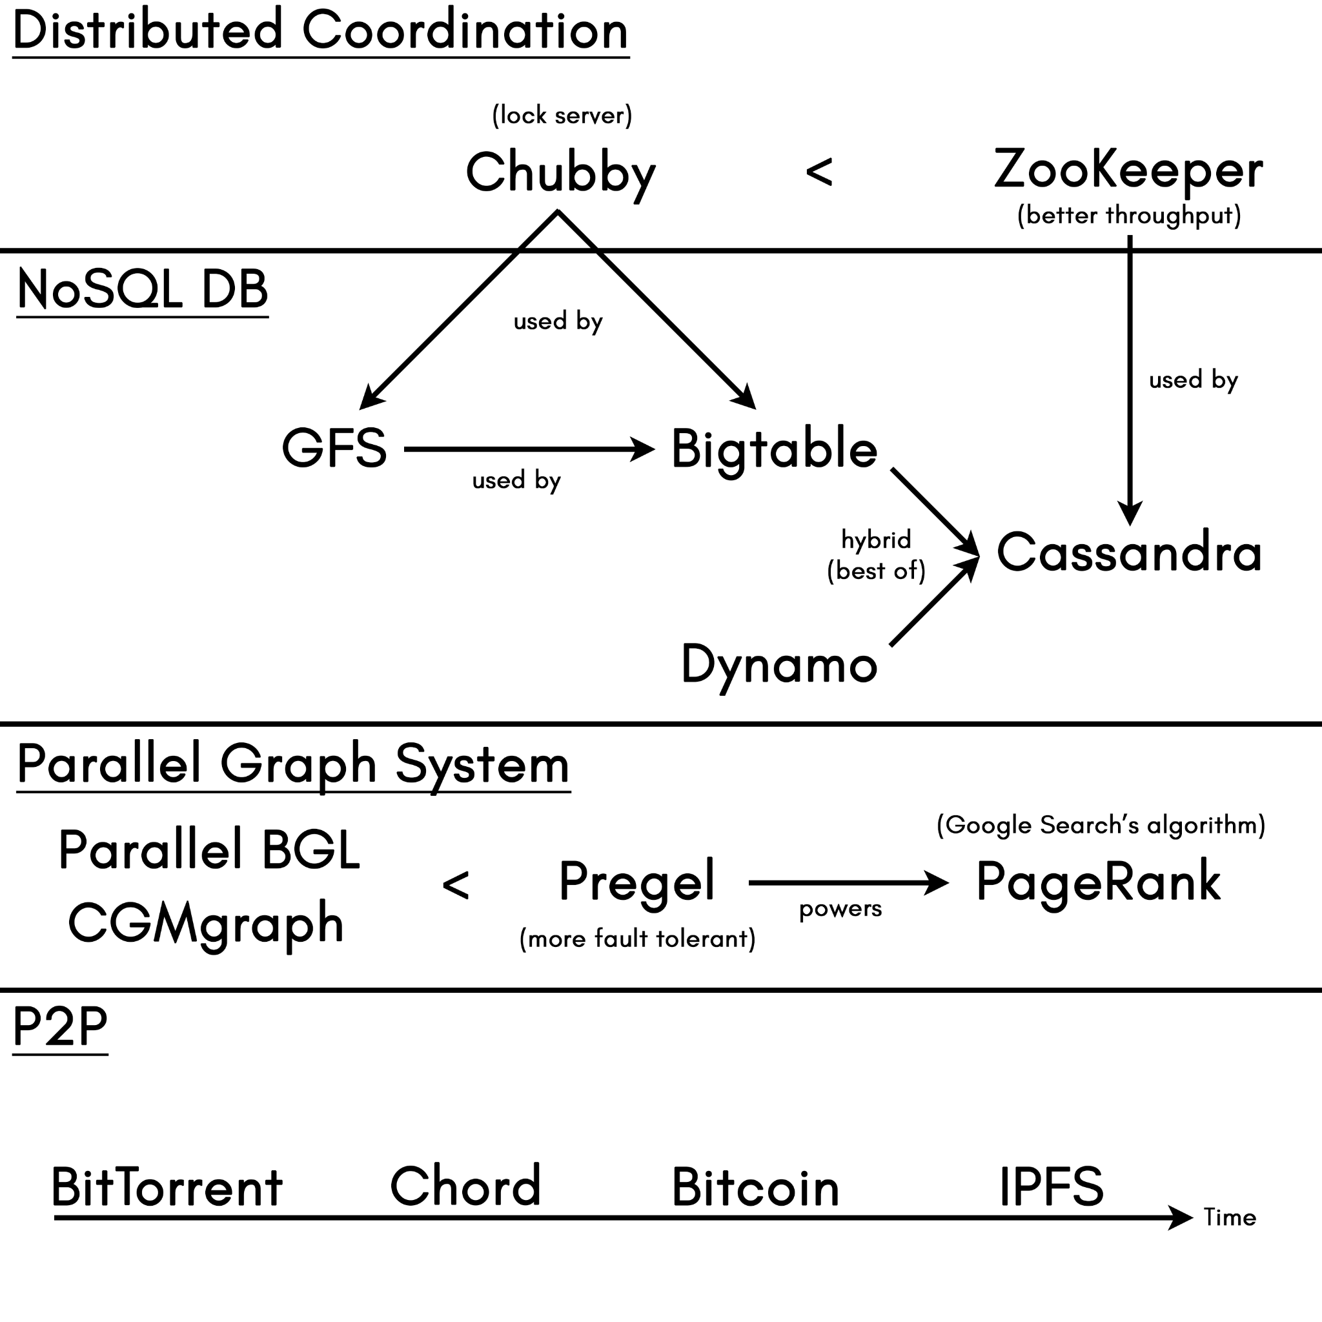



Our Inspiration
Problem Scope and Definition
Implementation Plan
Validation Plan
Cassandra
Designed by Facebook
Best in-class combination of Google’s Bigtable’s data and storage engine model and Amazon’s Dynamo’s distributed storage and replication techniques
Focuses on performance, scalability and reliability, but can only provide eventual consistency

Slide 6
02.
Implementation
Problem Scope and Definition
Implementation Plan
Validation Plan

Slide 7
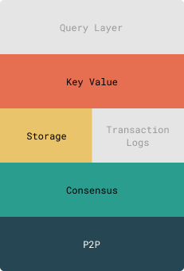
Historia
Problem Scope and Definition
Implementation Plan
Validation Plan
Our Architecture
For the purpose of this project, we will not be implementing the following:
Query Layer
Transaction Logs
Notes:
N: For the purpose of this project, we will forego transaction logs and the query layer. Transaction logs is added in Cassandra v2.0 and Query Layer is added in v3.0. Given that we’re only implementing v1.0, we will be simplifying these layers. What we will be implementing though are the following:
P2P - communication of nodes will be implemented through different go-routines
Consensus - to make sure nodes come to a consensus, we will be using Zookeeper, Paxos or Raft libraries. We are yet to look into which of the 3 libraries we will be using.
Storage - a simple json file will do to store our data
Key Value - the data we are retrieving via our API

Slide 8

Implemented Features
Problem Scope and Definition
Implementation Plan
Validation Plan
Limited Local Persistence
JSON Files
Notes:
For our project, we would only implement a limited version of the local storage persistence implemented by Cassandra. Managing the CommitLog in the hard disk and the Memtable cache in RAM would be quite tedious and they are not the focus of the course anyway. Hence, we would just directly write a JSON representation of the SSTables in the hard disk. That said, without full local persistence, we acknowledge that our database would be severely limited when facing system crashes that would wipe out the RAM, and thus, our version of Cassandra can only rely on its other features such as fault tolerance and eventual consistency to somehow enact error correction and hopefully ensure as much correctness as possible.

Slide 9
Historia
Monday
Tuesday
Wednesday
Thursday
Friday
Homework
Storage System
JSON instead of SSTable
No commit logs, persisted directly to the hard drive

Slide 10

Stretch Goals (Not Implemented)
Problem Scope and Definition
Implementation Plan
Validation Plan
Fault Detection
Gossip-Based Membership Communication Protocol
Notes:
When one server goes down, we need to inform the other servers. We deem this as a stretch goal, since we have quite a lot of features already on our plate. If we possess enough time after implementing the previous features, then we can consider to add this feature as well for the sake of completeness.

Slide 11

Stretch Goals (Not Implemented)
Problem Scope and Definition
Implementation Plan
Validation Plan
Byzantine Fault Tolerance
TLS, Byzantine Quorum, ECDSA PKI,
Full-Sym MAC Tags, Proxy ACK Verification,
Local Data Encryption
Notes:
We also need to handle the data stored in the database properly, in the case of potential malicious actors. This would certainly trade off performance for the sake of security. We consider this feature as out of the scope of our project unless we have too much extra time, since it is not even discussed in the original Cassandra paper in 2009, and methods to harden Cassandra were only found from a Master’s paper from Israel Institute of Technology in 2016, which was not completely verified/battle-tested, even though the authors graciously included a reference implementation in Java on GitHub.

Slide 12
03.
Scalability
Problem Scope and Definition
Implementation Plan
Validation Plan

Slide 13

Implemented Features
Problem Scope and Definition
Implementation Plan
Validation Plan
Scalability
Partitioning via Consistent Hashing
(Ring-Based Topology)
Notes:
We want our system to be able to scale horizontally as the number of transactions increase. Consistent hashing will allow us to avoid having to rehash all the keys when scaling the system, thus ensuring smooth load balancing. This feature would also have a configurable replication factor.

Slide 14

Implemented Features
Problem Scope and Definition
Implementation Plan
Validation Plan
High Write Availability
Leaderless Replication & Last-Write-Wins
Notes:
Clients should be able to GET/INSERT even amidst server failures. Ability to write to any one server at any point of time. Can compromise some consistency to reduce lag.

Slide 15
04.
Correctness & Fault Tolerance
Problem Scope and Definition
Implementation Plan
Validation Plan

Slide 16

Implemented Features
Problem Scope and Definition
Implementation Plan
Validation Plan
Eventual Consistency
Strict Quorum & Hinted Handoffs
Notes:
We want the client to reflect the right values of data in the event that writes to replicas are not completed on time. While Cassandra’s consistency level is tunable, depending on the needs of the application developer, for our project we would just select one particular consistency level “convenient” for us. This consistency level would be “QUORUM”.

Slide 17
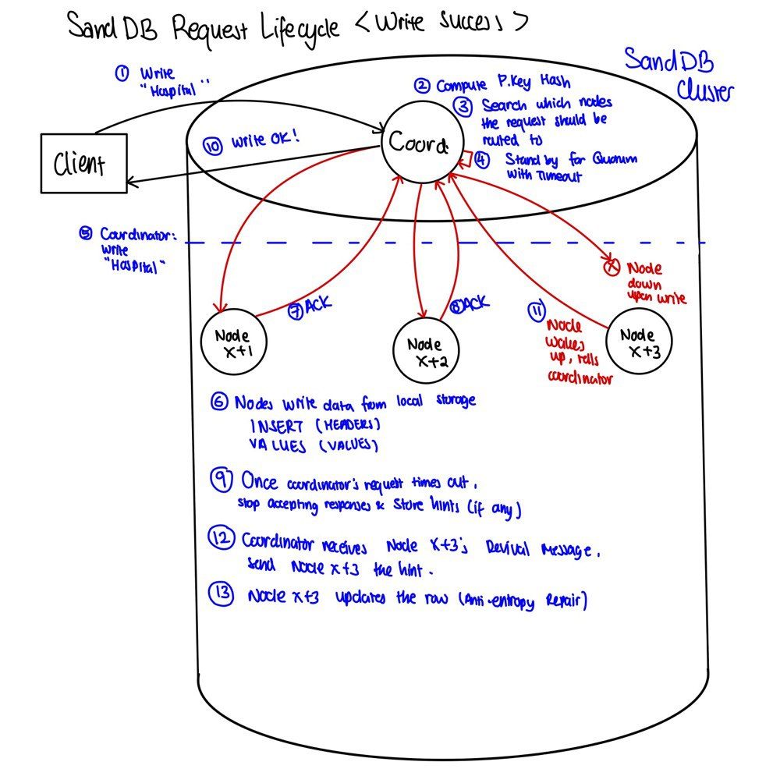
Historia
Monday
Tuesday
Wednesday
Thursday
Friday
Homework
Write Path
Strict Quorum
Hinted Handoff

Slide 18
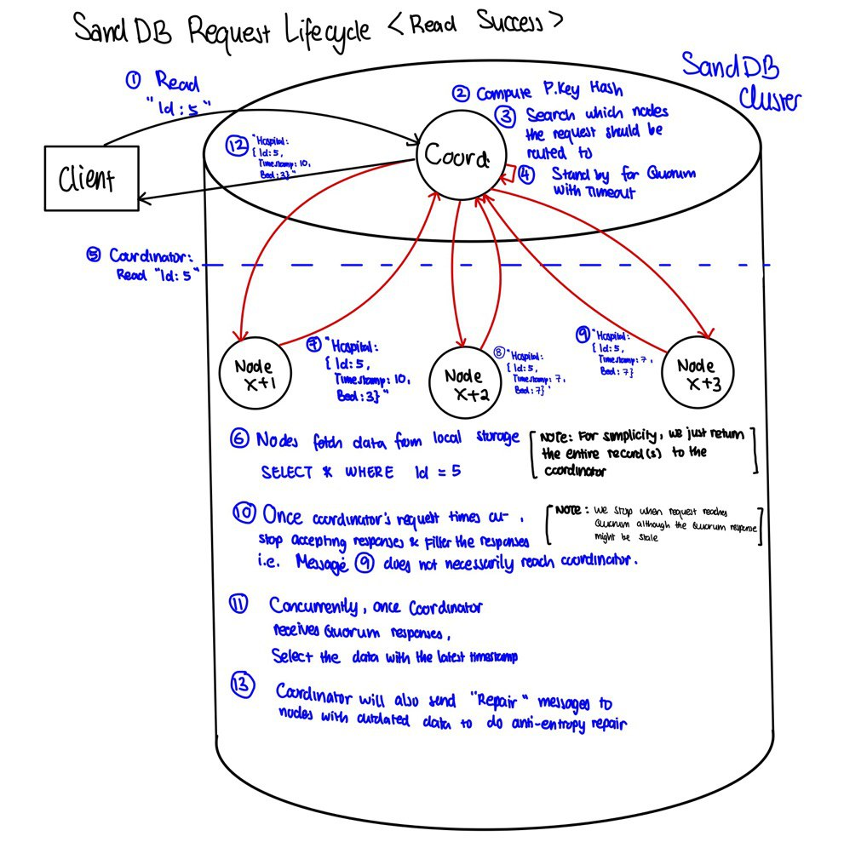
Historia
Monday
Tuesday
Wednesday
Thursday
Friday
Homework
Read Path
Strict Quorum
Read Repair

Slide 19

Implemented Features
Problem Scope and Definition
Implementation Plan
Validation Plan
Fault Tolerance
Anti-Entropy Repair Mechanism
Notes:
If a server is down temporarily, all read and write operations will be sent to another replica which will hold metadata regarding the intended server recipient. When the failed server recovers, all data will be transferred from the replica back to the original server. Hence, at any point of time, the number of replicas remains the same. This ensures the desired availability and durability guarantees.
Additionally, as part of the anti-entropy measures, hinted handoffs are used for write-time changes, read repair is used for read-time changes, and Merkle trees are used for periodic repair and maintenance.

Slide 20
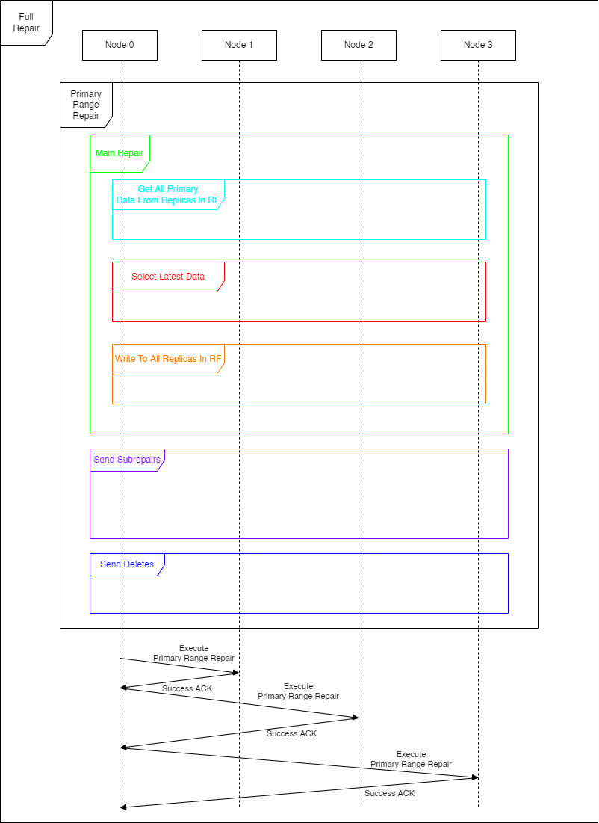
Historia
Monday
Tuesday
Wednesday
Thursday
Friday
Homework
Anti-Entropy Repair
Original implementation of Cassandra only accounts for intermittent faults
Anti-Entropy Repairs handle those

Slide 21
06.
Demo!
Problem Scope and Definition
Implementation Plan
Validation Plan

