Slide 1

Pokemawn: gotta organize them all
A system by
David chaney, steven cheney, and james spencer

Slide 2
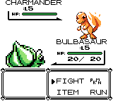
Pokemawndex and battle system
UML class diagram
Work breakdown
Design modifications
Class and flow details
Demonstration

Slide 3
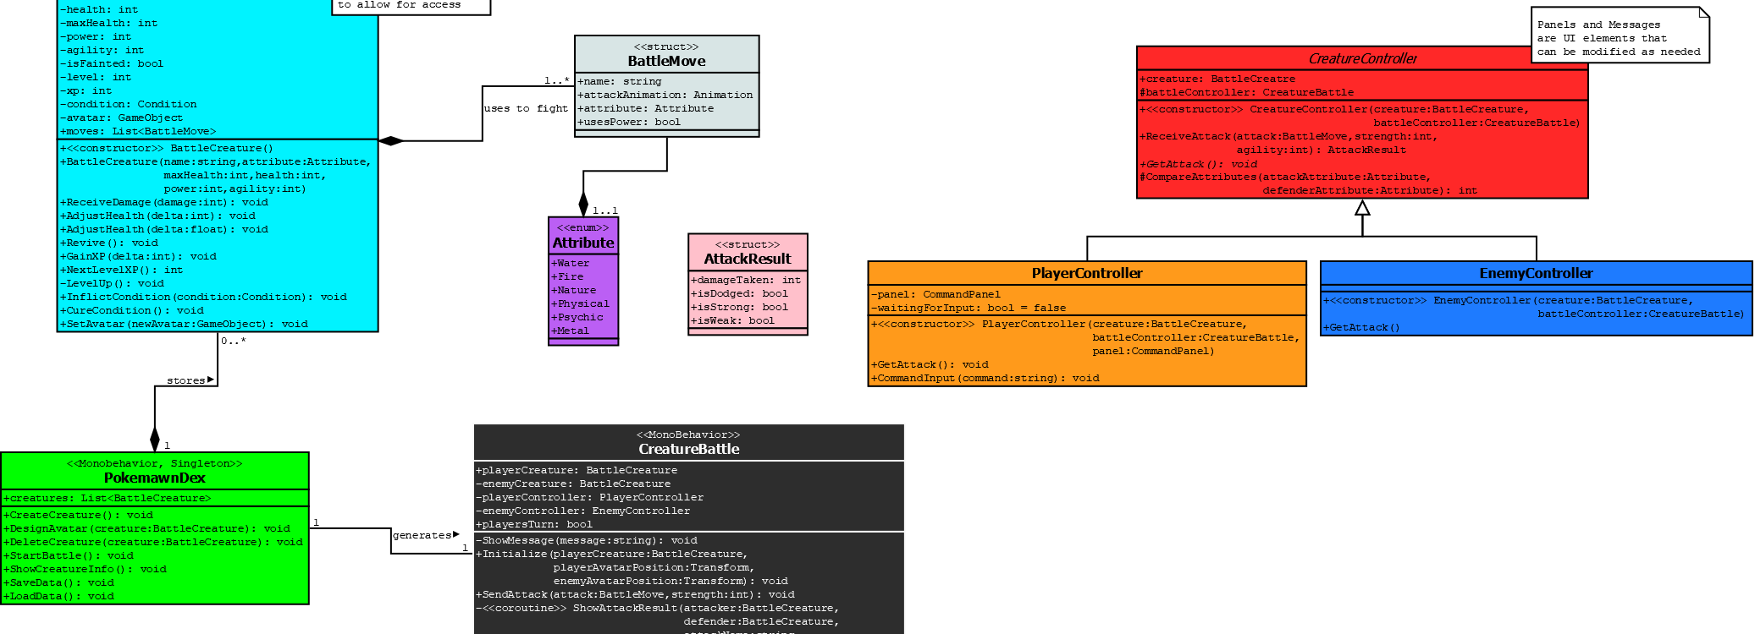
Uml Class Diagram
Fundamentals of system remain
Primary additions are the controllers
DataController handles loading the Dex to the program

