Slide 1
Pokemawn: gotta organize them all
A system by
David chaney, steven cheney, and james spencer

Slide 2
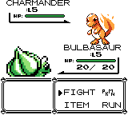
Pokemawndex and battle system
UML class diagram
Work breakdown
Design modifications
Demonstration

