Slide 1

Pokemawn: gotta organize them all
A system by
David chaney, steven cheney, and james spencer

Slide 2
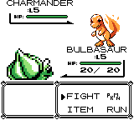
Pokemawndex and battle system
UML class diagram
Work breakdown
Design modifications
Class and flow details
Demonstration

Slide 3





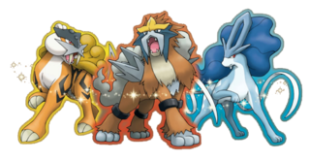
System overview
Three Primary Components
Creature class
The primary actors in the system
Battle Class
Determines how they interact
Dex class
Determines how they are organized

Slide 4
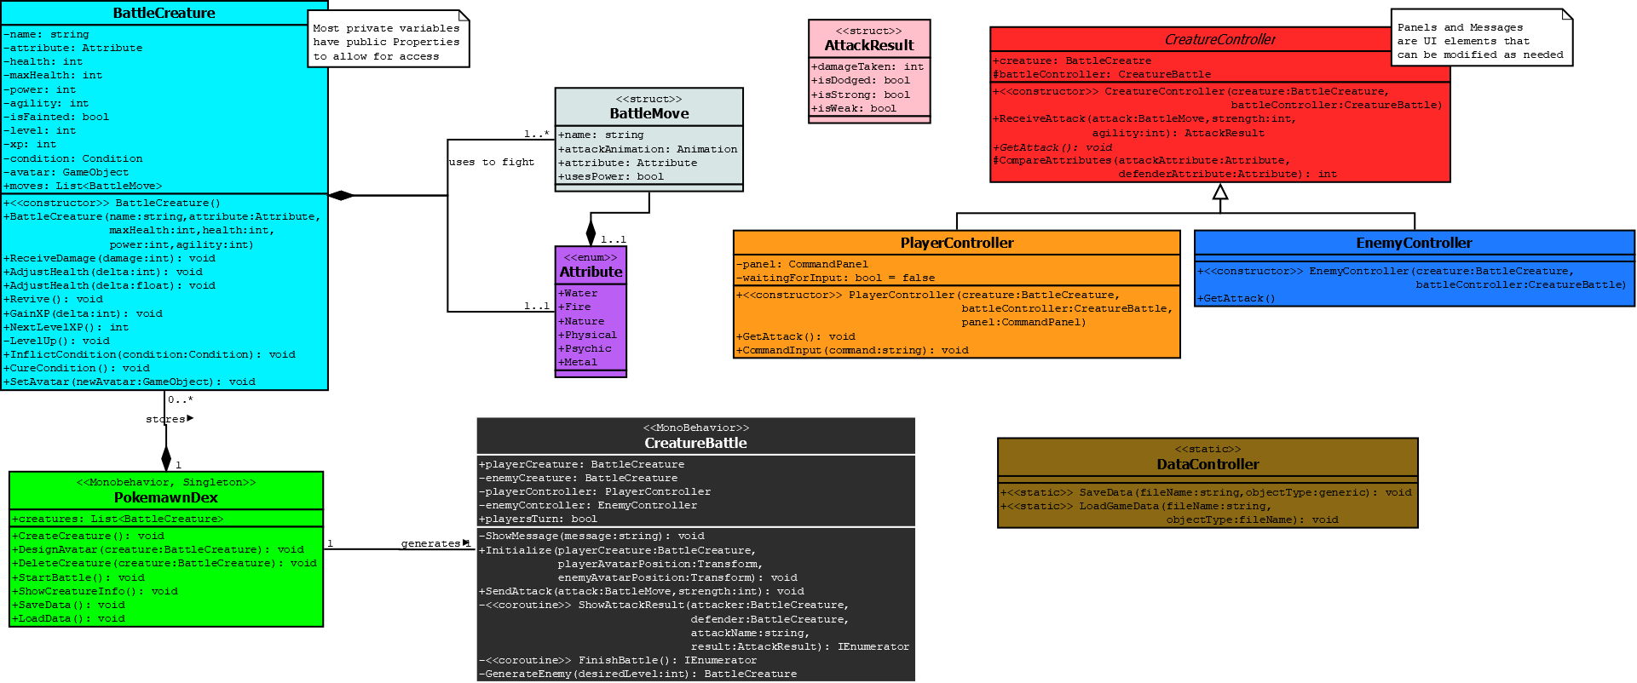
Uml Class Diagram and design modifications
Fundamentals of system remain
Primary additions are the controllers
DataController handles loading the Dex to the program

Slide 5

Work breakdown
Member
Responsibility
James
David
Steven
BattleCreature class, enums, structs
Pokemawndex, index UI
CreatureBattle class, overall implementation and graphical UI

Slide 6
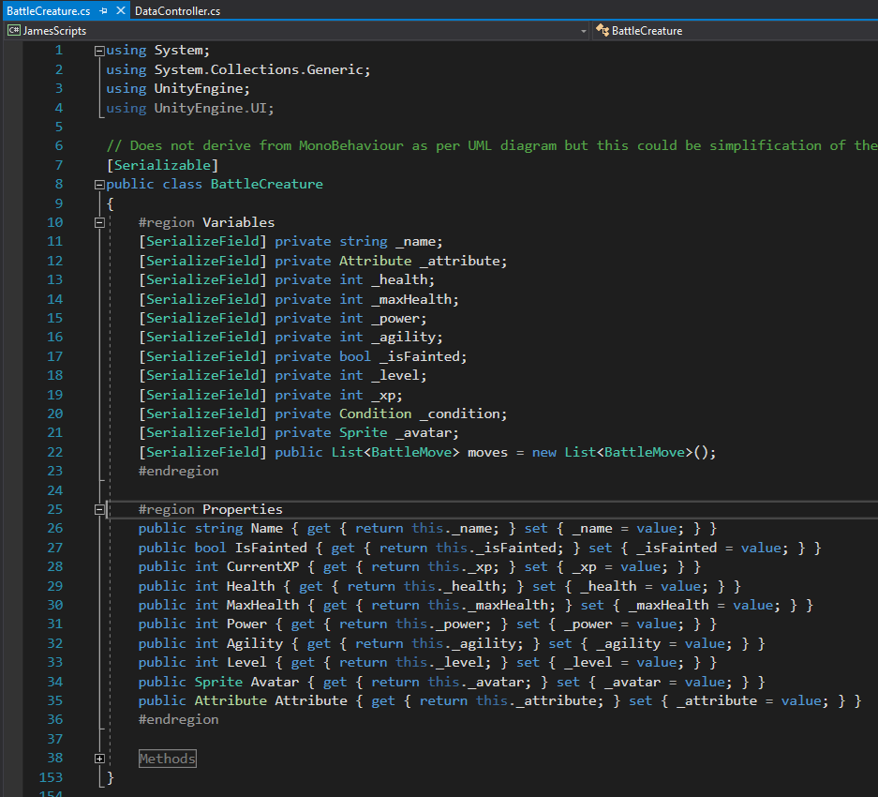
BattleCreature
Carries variables expected for a “living” creature
Methods are used to determine how information passed in manipulates those variables

Slide 7
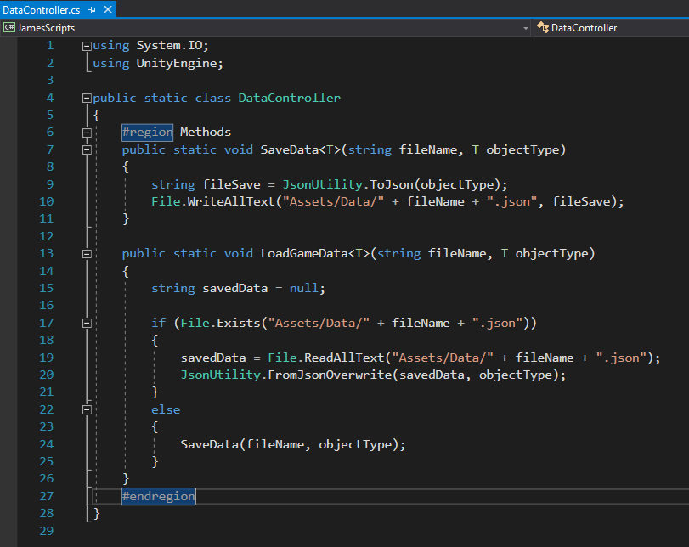
datacontroller
Class to serialize data
Utilized as a means to load and save Pokemawn data and the Dex
Generic form allows for many object types to be saved

Slide 8
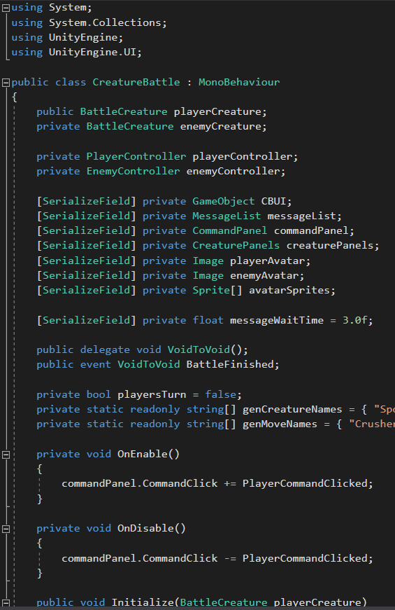
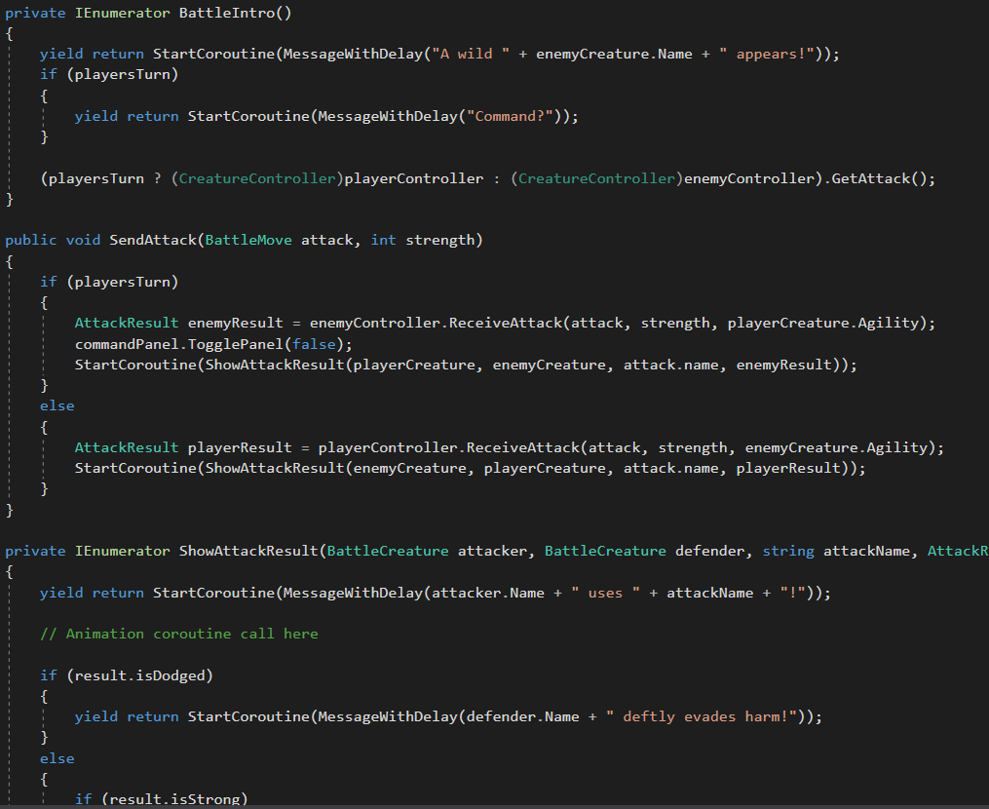
CreatureBattle
Runs the battle
Determines battle order
Provides results of attacks

Slide 9
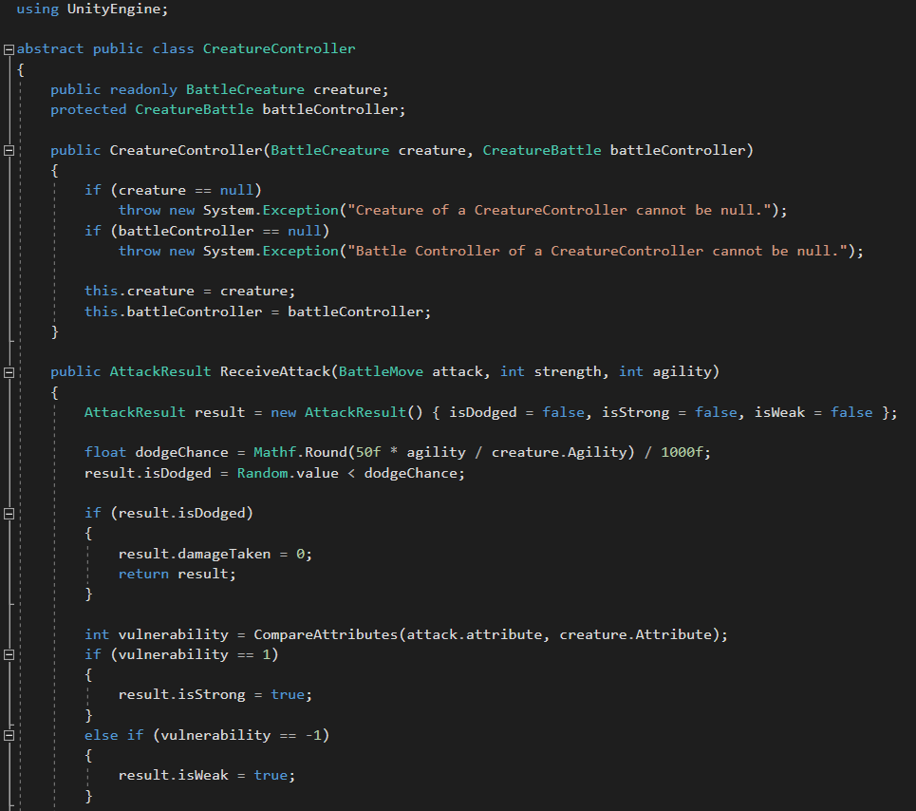
Creature controller
Abstract class that all controllers derive from
Cannot be instantiated
Sets up the basic framework for which all children have commonalities
Vehicle example
We can create a car and we can create a bus. These are types of vehicles but we cannot create a “vehicle”.

Slide 10
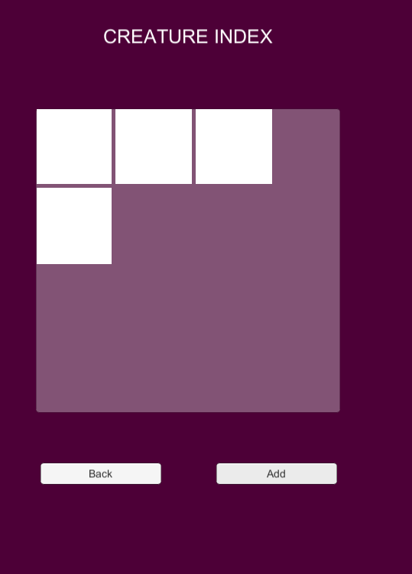
buttonmanager
Controls Pokemawndex UI
Facilitates the DataController to create, save, and load new Pokemawn
Stores the created creatures in an index UI

Slide 11
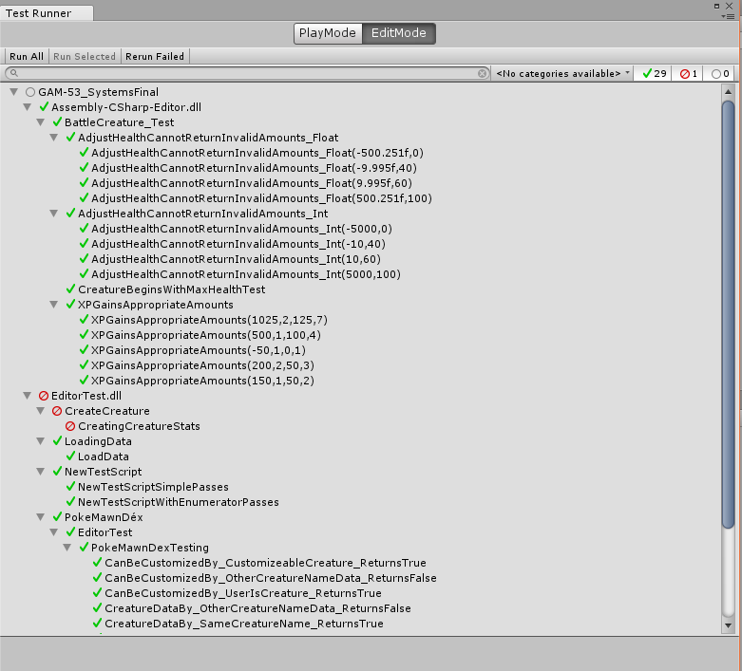
Unit testing
Unity Test Runner allows a framework for isolating class functions and calling them with a wide variety of cases
Gives an obvious visual cue to what is working and what isn’t
If a test does not pass, gives an indication of why it is not passing

Slide 12

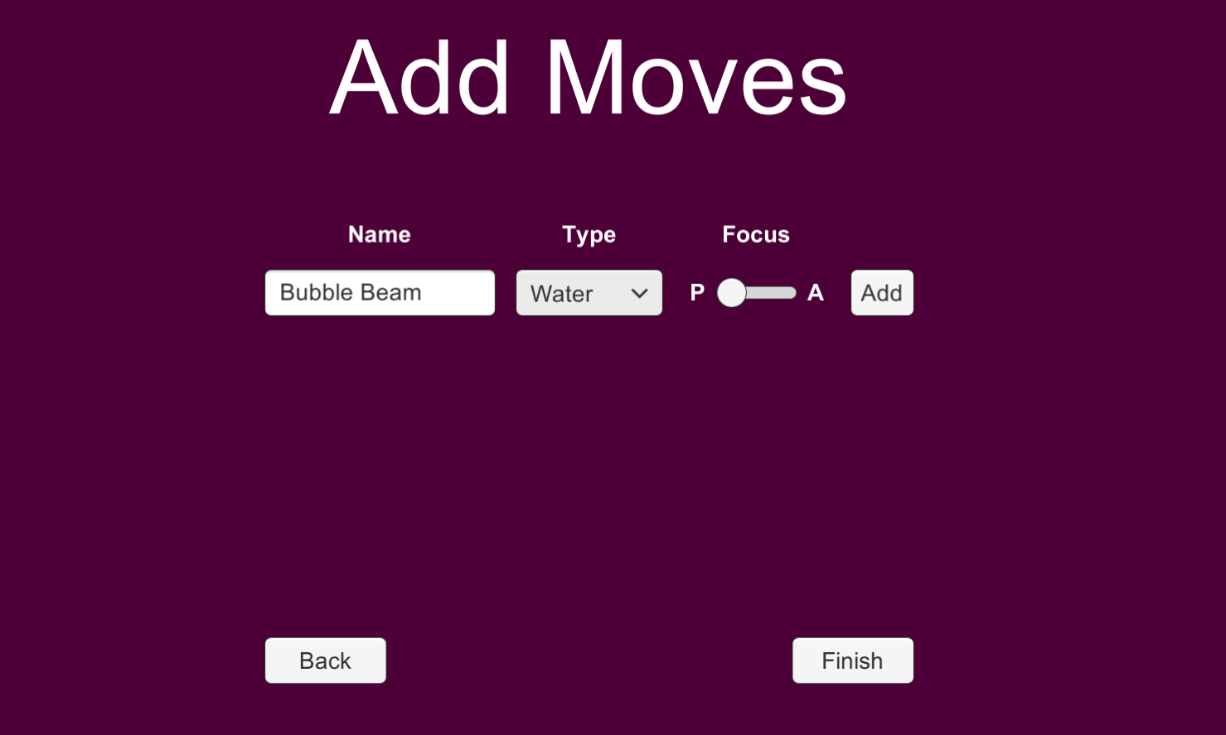
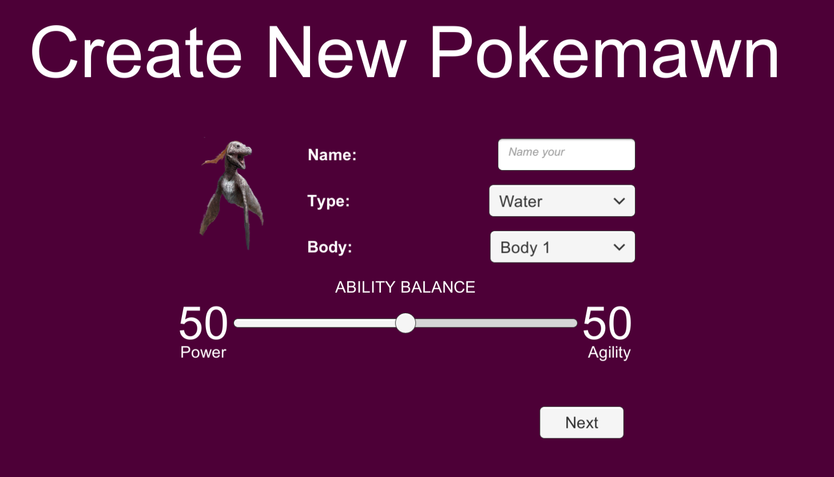
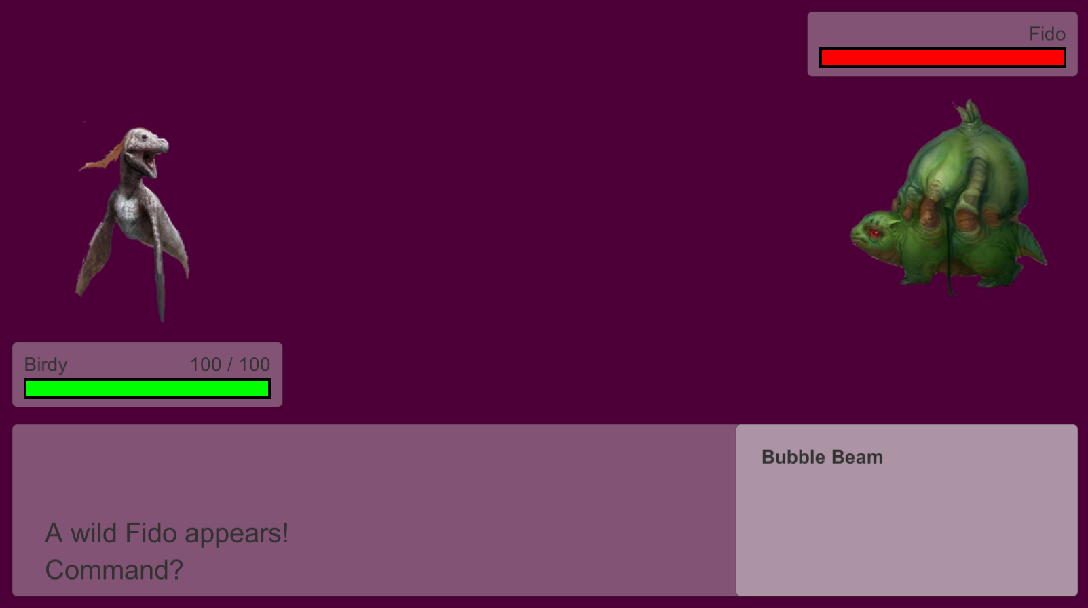
Supplemental UI classes
Allow for visualization and feedback of the system and its flow

Slide 13

