Slide 1

Pokemawn: gotta organize them all
A system by
David chaney, steven cheney, and james spencer

Slide 2
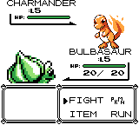
Pokemawndex and battle system
UML class diagram
Work breakdown
Design modifications
Class and flow details
Demonstration

Slide 3
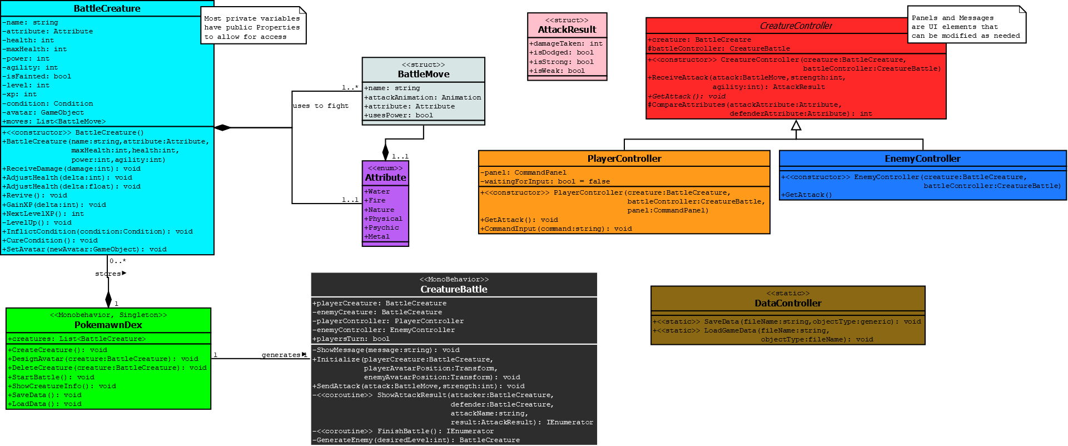
Uml Class Diagram and design modifications
Fundamentals of system remain
Primary additions are the controllers
DataController handles loading the Dex to the program

Slide 4

Work breakdown
Member
Responsibility
James
David
Steven
BattleCreature class, enums, structs
Pokemawndex
CreatureBattle class, overall implementation and graphical UI

Slide 5


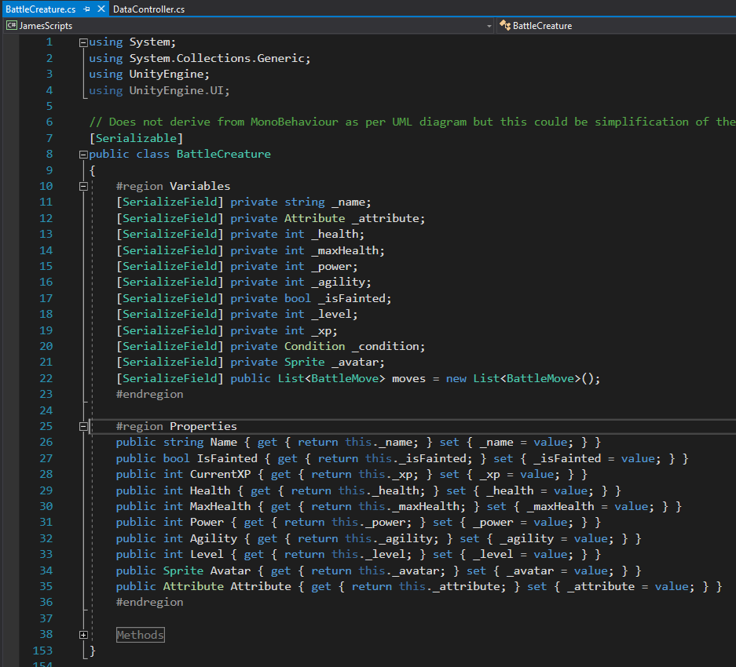
BattleCreature
Carries variables expected for a “living” creature
Methods are used to determine how information passed in manipulates those variables

Slide 6
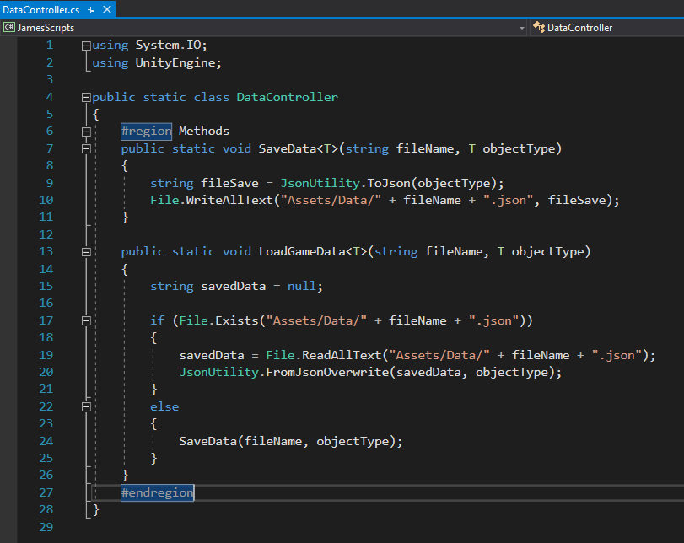
datacontroller
Class to serialize data
Utilized as a means to load and save Pokemawn data and the Dex
Generic form allows for many object types to be saved

Slide 7
Creaturebattle

Slide 8
david

Slide 9
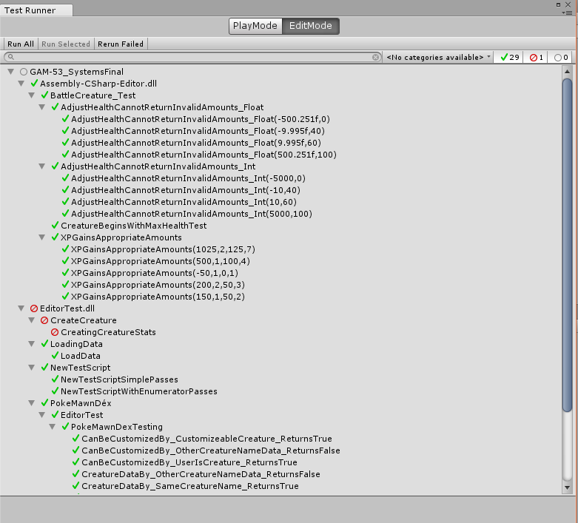
Unit testing
Unity Test Runner allows a framework for isolating class functions and calling them with a wide variety of cases
Gives an obvious visual cue to what is working and what isn’t
If a test does not pass, gives an indication of why it is not passing

Slide 10

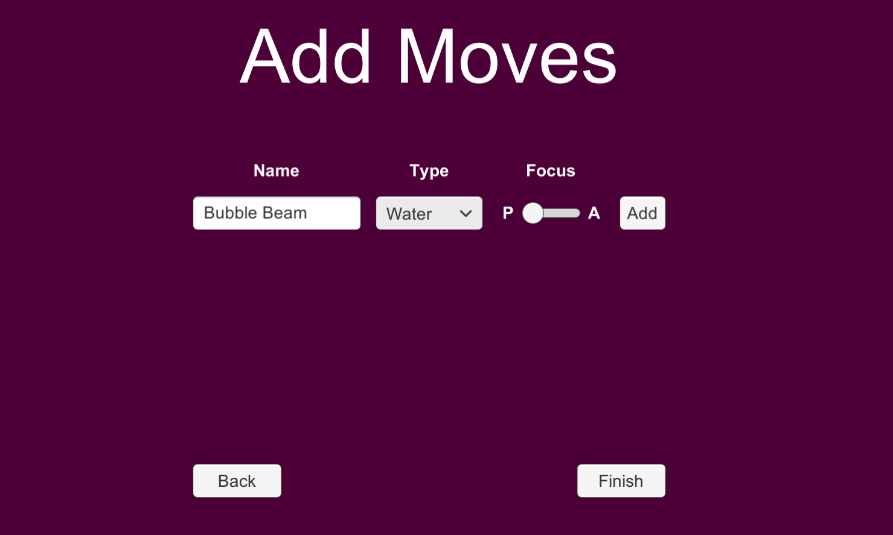
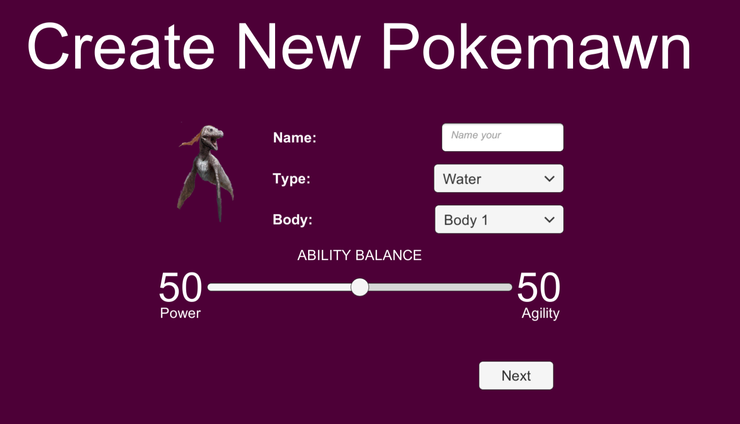
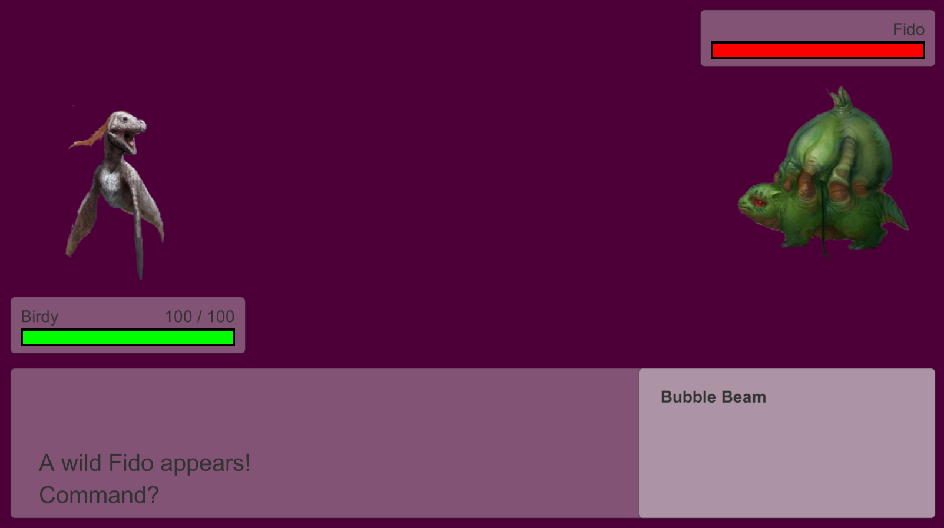
Supplemental UI classes
Allow for visualization and feedback of the system and its flow

Slide 11

