Slide 1


Beverly Unegbu, Edgar Pineda, Foluke Arogundade, Wahaj Siddiqui Frank Anderson
Group 5

Slide 2
Lottery Project
ITIL
Continuous Improvement
Java 16.0.1
Validation
SQLite V3.35
Primary Key
Random Numbers Generator
Read and write to external Files
Normalization
Database Management
JUNIT5

Slide 3
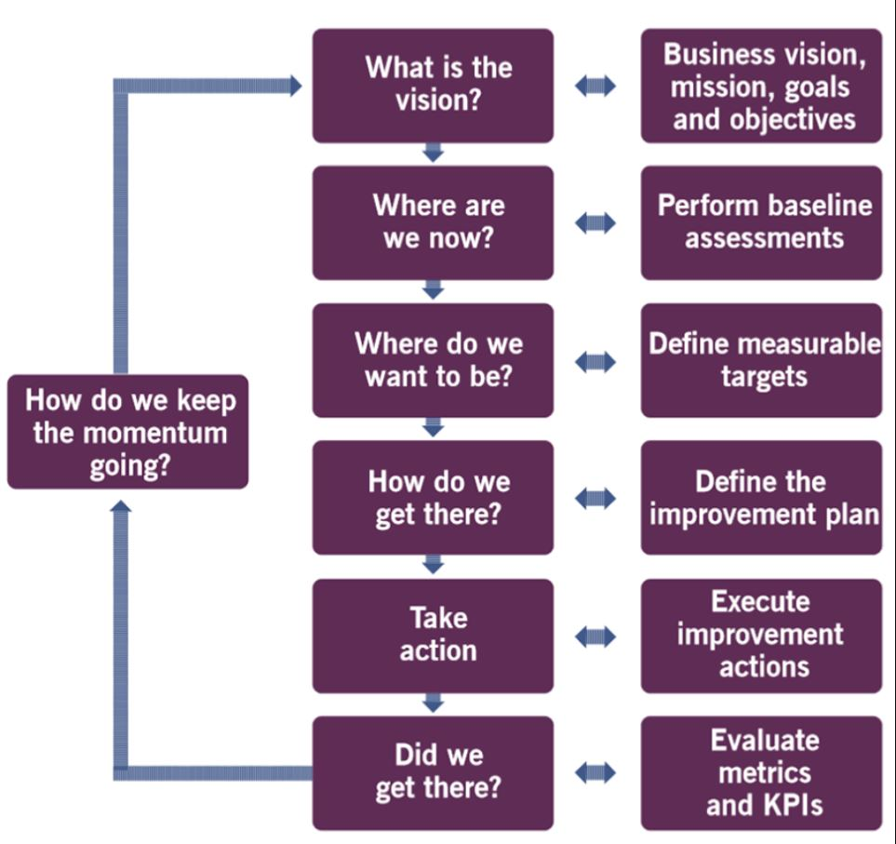
ITIL -4 Continuous Improvement
Customer names and their comments are collected in a Database. The Java program will Import the names from the SQL Database and Randomly select a winner. This winner will receive the predetermined prize.
Continuous Improvement model has seven steps. Applying the Continual Improvement Model can optimize services and maximize success.
(Where are we now) and possible (how do we get there) could be answered using the lottery as an incentive for collecting customer feedback on products and or services offered.

Slide 4
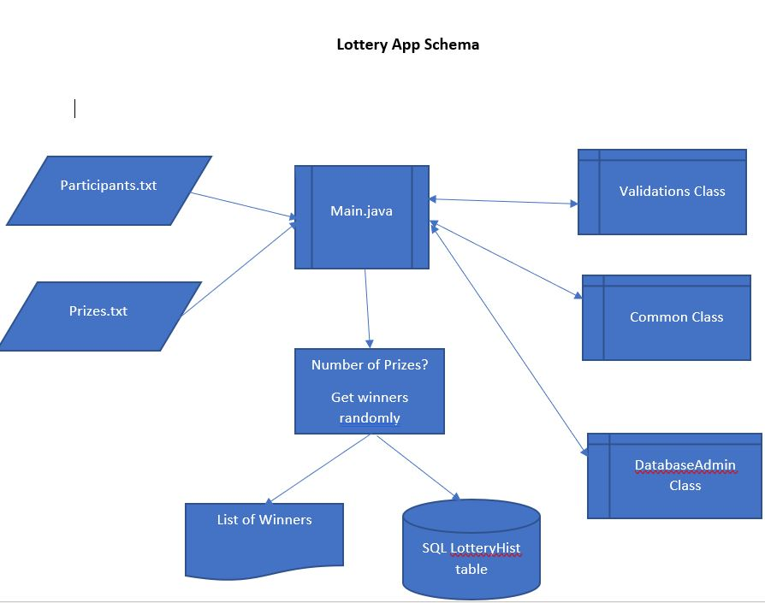
Java (16.0.1)
The Java code has 5 classes and one package together.
The text files contain the Participates names and the Prize files which have the list of what prizes are to be given away.
Main class asked administrator for number of prizes to be awarded and verifies database existence. This class also prints out the winners.
Validation class is utilized to verify if, True or False Boolean; that the number of prizes which are to given away are less than or equal to the amount elected to be given away
Common class pulls in files to java then reads the txt files (both participant list and prize name types. The program then generates a random number using get Random method and assigns a winning number to a participant.
DatabaseAdmin class takes winning names, awarded prize and date of contest and store them in a SQLite database.
GetHistoryJava class confirms database exist and prints out if error occurred.
Package class a mechanism for encapsulation of the 4 classes preventing naming conflict

