Slide 1



Hackathon Results
Folu Akintola, I-Han Cheng, Alessandro Rizzi and Francisca Valenzuela-Mella

Slide 2
#1Task

Slide 3
Task 1
Medical Context
Over 2 million knee replacement surgeries performed globally per year
Recovery trajectories are highly heterogeneous: over 3 months to 2+ years
Data from wearable devices could help predicting trajectories
Aim
Create a synthetic knee replacement (TKA) recovery dataset that realistically simulates wearable device
Missing values
Noise
Patient heterogeneity
French JMR, BMC Med, 2025

Slide 4
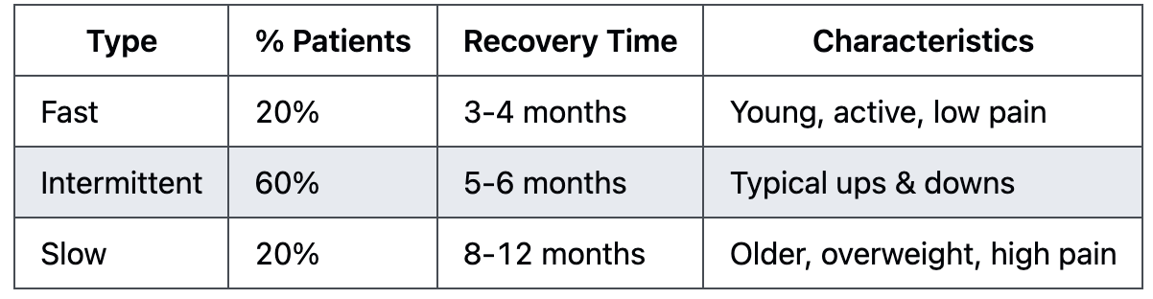
Simulator Development - Baseline Parameters
Anthropometric Parameters
Age (int)
Gender (categorical)
Height (cm) (float)
Body weight (kg) (float)
BMI (float)
Disease Specific Parameters
Pre-operation Activity Level (int)
Pre-operation Pain Level (int)
Number daily steps before op (float)
Surgery Date
Surgery Season
Concomitant Disease
Cardiovascular disease (binomial, 74.6%)
Diabetes (binomial, 42.3%)
Hypertension (binomial, 79.9%)
Osteoporosis (binomial, 7.8%)
Musculoskeletal disease (binomial, 22.9%)
Device Features
Device brand (float)
Device Battery Life (float)
Recovery Phenotypes definition
Rodriguez-Merchan EC, HSS J. , 2014 Nham FH, Arthroplasty. 2023
Daher M, Arthroplasty. 2024

Slide 5
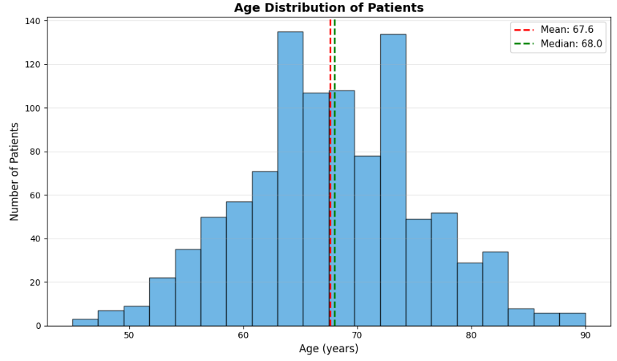
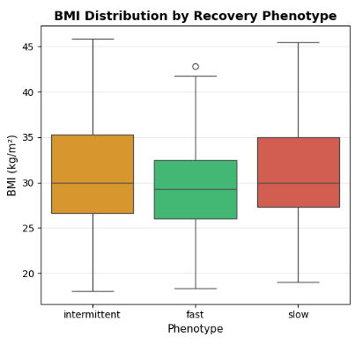
Simulator Development - Results

Slide 6
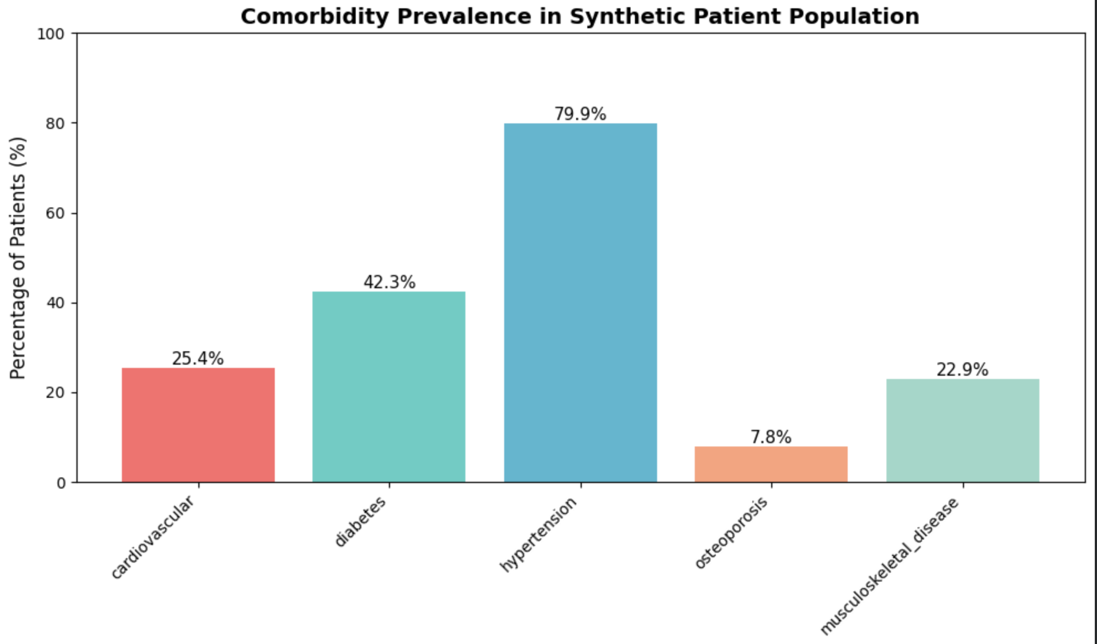
Simulator Development - Results

Slide 7
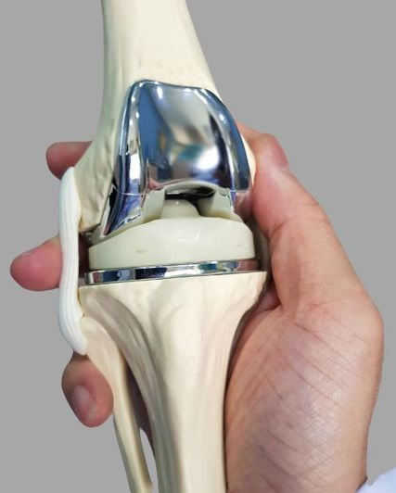
Model building
Markov chains: simulate progression between recovery states over time, where future outcomes depends on
Current condition
Baseline state
Other (eg. Mental Health)
Missingness mechanisms: introduce incomplete observations to mimic challenges commonly found in these scenarios
Application: designed for dashboard integration.
Ahli Hospital. (2025, March 18). Knee replacement surgery: Procedure, recovery, and more! https://blog.ahlihospital.com/en/a/دليلك-الشامل-لعملية-استبدال-مفصل-الركبة
Notes:
Recovery phenotypes: represent different patient recovery pathways (e.g., faster, delayed, or unstable recovery) to reflect real-world variability.
Markov chains: simulate progression between recovery states over time, where future outcomes depend on the current state.
Future states depend on the patient’s current condition, allowing realistic simulation of dynamic rehabilitation pathways while maintaining computational efficiency.
Missingness mechanisms: introduce incomplete observations to mimic challenges commonly found in healthcare and wearable datasets.
Application: designed for dashboard integration, scenario testing, and analysis of recovery trajectories under different conditions.

Slide 8
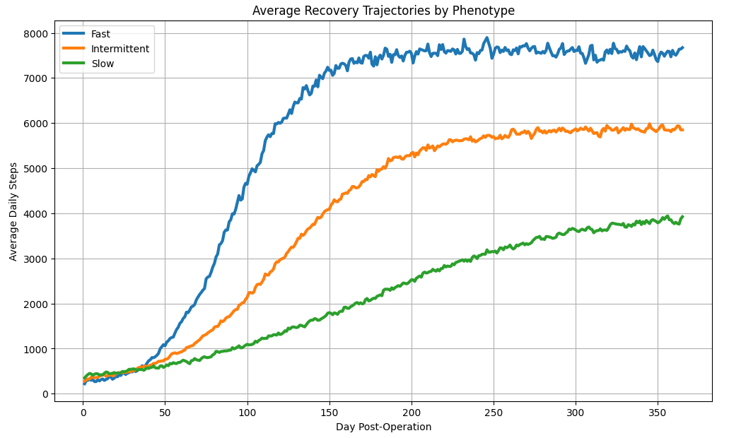
Simulator Development - Results

Slide 9
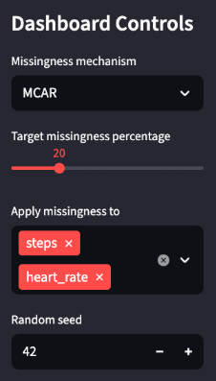
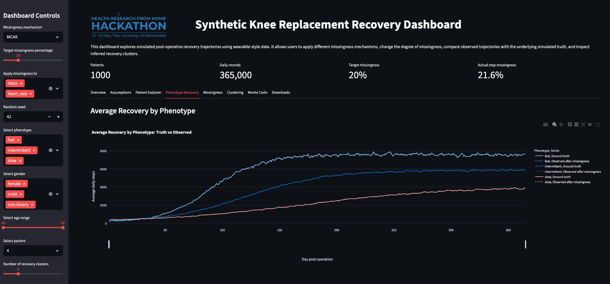

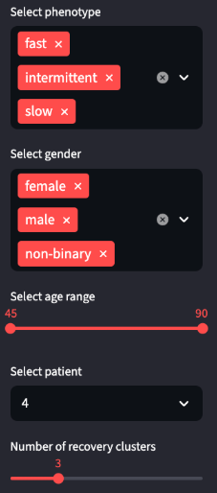
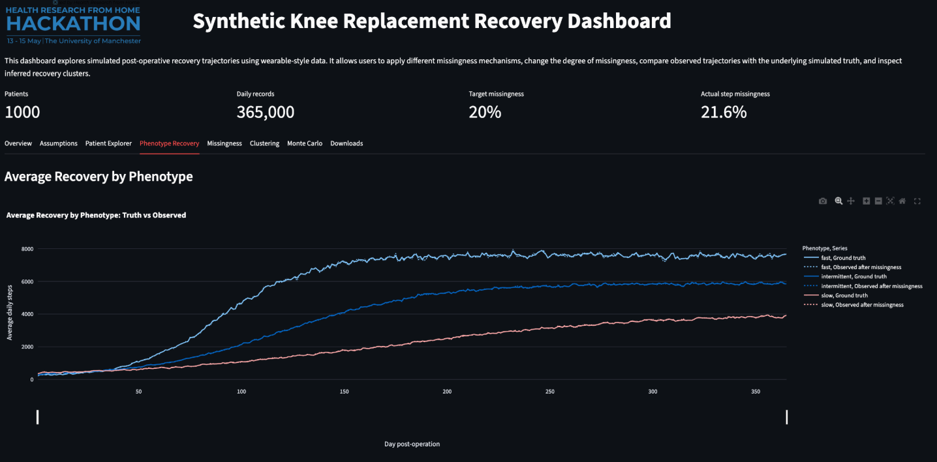

Slide 10
#2 TASK
Notes:
Good afternoon everyone. We are Fantastic 4 — Group 4 — and we're going to walk you through our work on Task 2: identifying recovery trajectory groups under different missingness scenarios.
we'll share how we approached the problem, what we found, what surprised us, and what we'd recommend for real-world use

Slide 11
Task 2
Aim
Identify post-treatment recovery trajectory groups
Assess how trajectory identification changes under different missingness settings.
4 Questions
How well can the recovery groups be identified when there is no missingness or very little missingness?
How does performance change as the amount of missingness increases?
Does performance differ when missingness occurs in different ways (MCAR, MAR, MNAR)?
What level or type of missingness appears to make recovery group identification unreliable?
Notes:
The task was to take daily step count data from post-treatment patients
like knee replacement recovery and identify which patients fall into 'fast', 'moderate', or 'slow' recovery groups.
The catch is that we have to do this under different missingness scenarios, because real wearable data is never complete.
We use the shiny app to generate 365-day step trajectories. And output the data.
Starting from here, we try to identify how well can we identify groups with no missing data, how does performance change as missingness increases, does the mechanism matter, and at what level does identification become unreliable.
We will address all four questions and give clear, practical answers for each.

Slide 12


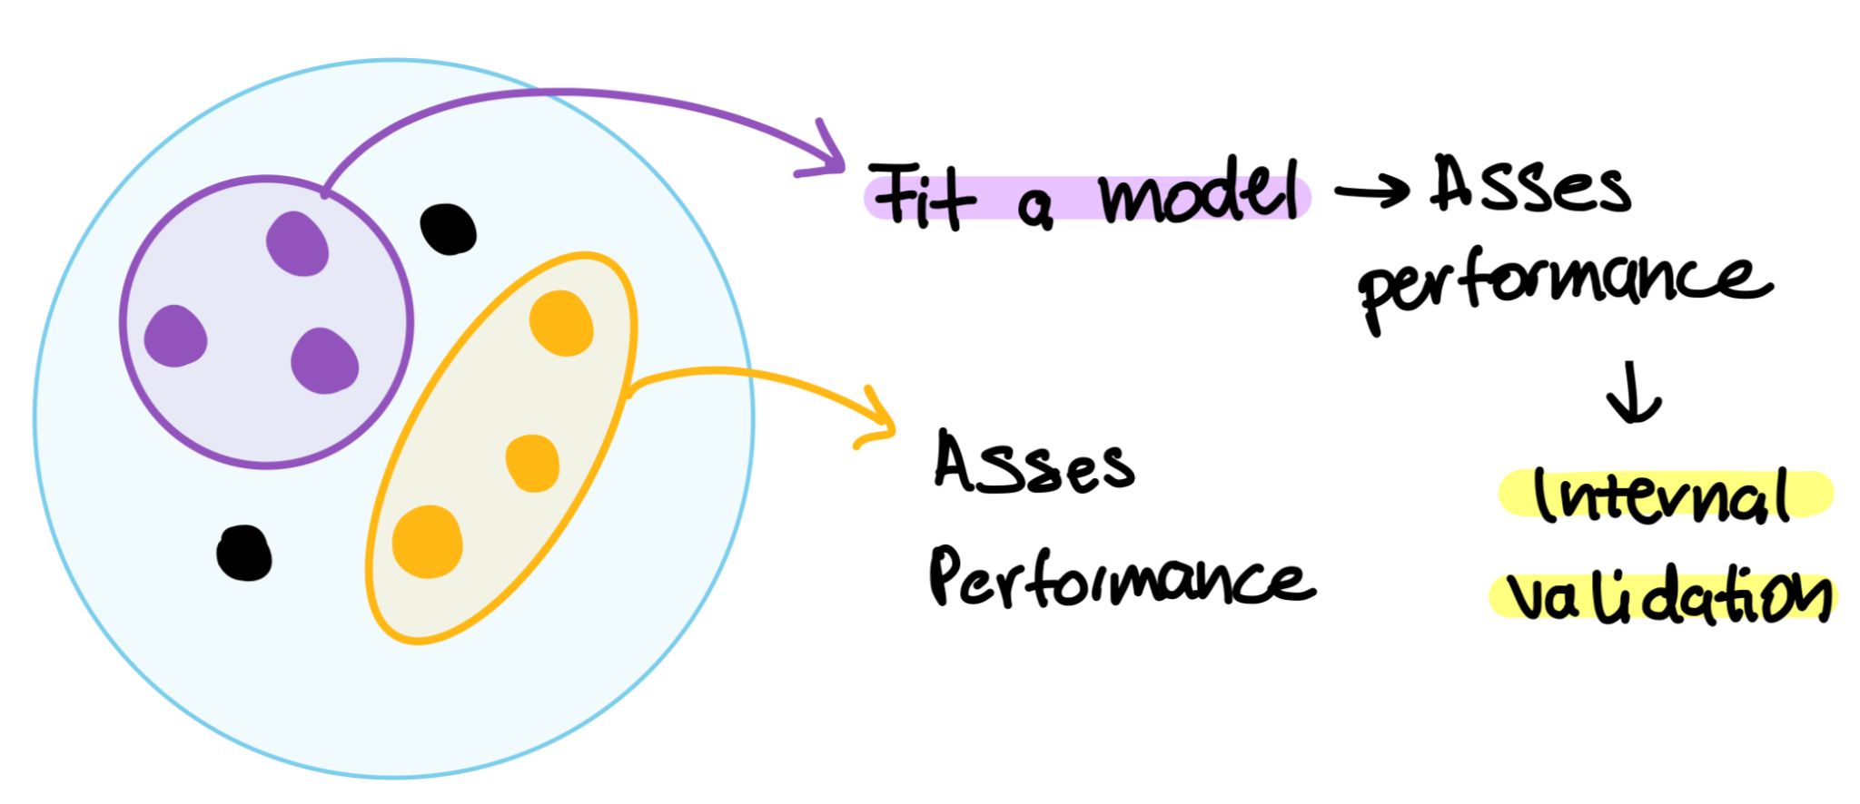
Three-Phase Validation, 23 Datasets
┌──────────────────────────────────────────────────────────┐
│ Phase 1: TRAIN │
│ Cohort C (seed=50) → K-means → LOCK MODEL │
│ ↓ │
│ Phase 2: EXTERNAL VALIDATION │
│ Cohort B (seed=42) complete data │
│ ↓ │
│ Phase 3: MISSINGNESS SENSITIVITY │
│ Cohort B + 21 missingness configurations │
│ (7 levels: 10/25/50/75/90/95/99% × 3 mechanisms) │
└──────────────────────────────────────────────────────────┘
Notes:
Our approach uses a three-phase validation design across 23 datasets.
Phase 1 is training. We use one complete cohort , generated with random seed of 50 to train K-means and lock the model.
Phase 2 is external validation. We test on a different complete cohort seed of 42.
I am mentioning this because this is one key thing ive learned l: training and testing data come from different cohorts, so we are measuring true generalisation, not memorisation.
Phase 3 is the missingness sensitivity analysis. We use 21 datasets derived from the Cohort B patients, with 7 missingness levels — 10, 25, 50, 75, 90, 95, and 99 percent — crossed with 3 mechanisms: MCAR, MAR, and MNAR.
We deliberately chose 7 levels rather than just a few, so we can see exactly where the model starts to break down. And we held every other simulator parameter constant ( age, BMI, number of patients, seed ) so any change in accuracy is attributable to missingness alone.

Slide 13
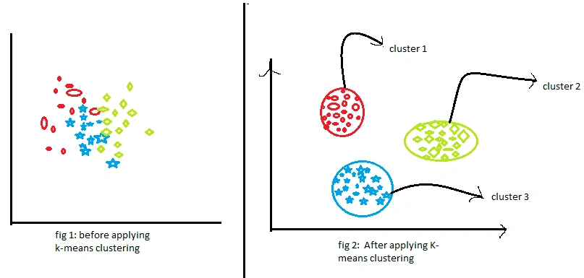
Why K-means? Why Lock the Model?
Why K-means:
Interpretable: centroids = "typical" patients
Reproducible (random_state=42)
Standard, accepted by clinical reviewers
Cross-cohort design:
Training (Cohort C) ≠ Testing (Cohort B)
joblib.dump() → lock after training
All test uses transform() + predict() only (never fit)
Notes:
The task was to take daily step count data from post-treatment patients
like knee replacement recovery and identify which patients fall into 'fast', 'moderate', or 'slow' recovery groups.
The catch is that we have to do this under different missingness scenarios, because real wearable data is never complete.
We use the shiny app to generate 365-day step trajectories. And output the data.
Starting from here, we try to identify how well can we identify groups with no missing data, how does performance change as missingness increases, does the mechanism matter, and at what level does identification become unreliable.
We will address all four questions and give clear, practical answers for each.

Slide 14
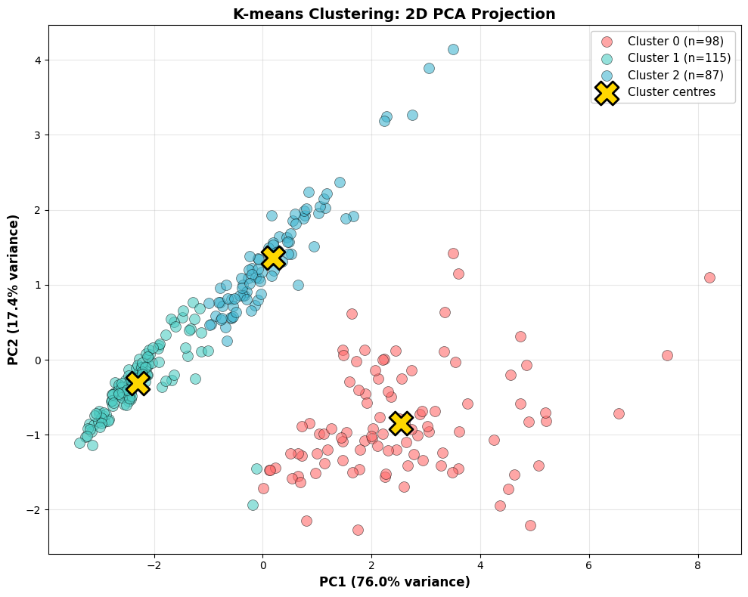
Phase A Performance (Complete Data)
Baseline Performance Looks Strong
Metric | Value
Training accuracy (Cohort C) | 94%
External validation (Cohort B) | 95%
ARI (training) | 0.83
ARI (external) | 0.85
Training ≈ External validation ⇒ Model generalises well
Notes:
On complete data, our model performs strongly.
Training accuracy on Cohort C is 94 percent.
External validation on Cohort B — a completely different cohort — is 95 percent.
Adjusted Rand Index, which is the standard metric for clustering accuracy, is 0.83 on training and 0.85 on validation.
The fact that external validation slightly exceeds training tells us the model generalises well. It's not overfitting to Cohort C; it's learning a real underlying pattern.
Now this is the easy case. The interesting question is: what happens when data goes missing?
ARI (Adjusted Rand Index) 是什麼
簡單版： 衡量「兩個分群結果有多像」的指標。

Slide 15
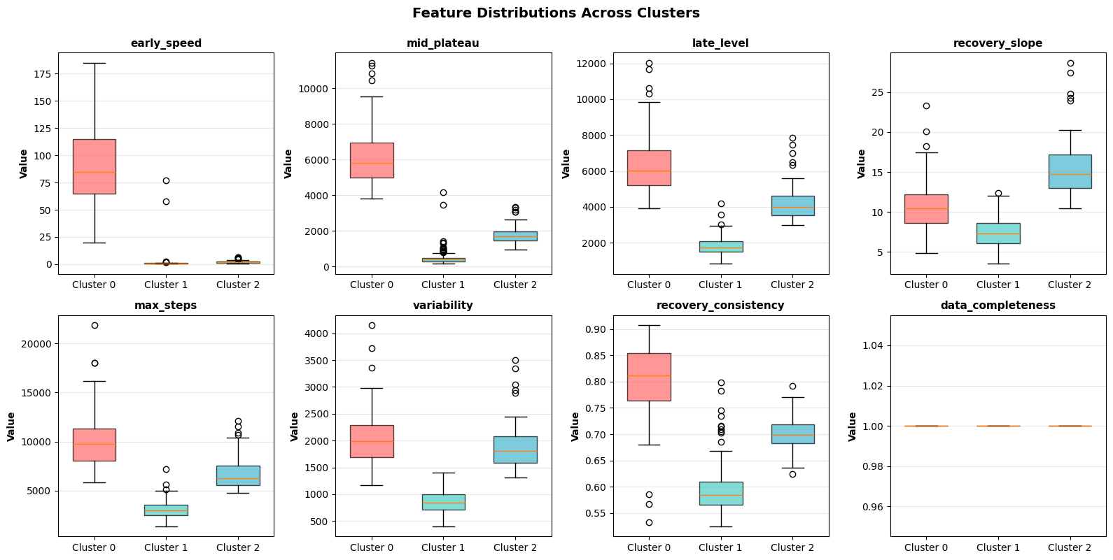
Feature Engineering
Compressing 365 Days into 6 Clinical Features
early_speed_log | 「patients still in pain, recently discharged, find it harder to wear the device consistently」
mid_plateau | 「patients settle into a new routine, trajectory more predictable」
late_level | 「represents their 'new normal' after a full year of recovery」
max_steps | 「represents their best day — better indicator of true capacity than average」
variability | 「smooth = stable healing; erratic = pain flares, comorbidities, setbacks」
recovery_consistency | 「deviation from textbook pattern may flag atypical recovery worth a closer look」
Notes:
Before we can cluster, we need to compress each patient's 365 daily step counts into a manageable feature vector. We chose 6 features, organised around three clinical questions that a physiotherapist or rehabilitation clinician would naturally ask when assessing a recovering patient.
The first question is when — at what point are they recovering? We capture this with three time-window features.
early_speed_log measures how steeply step counts rise in the first 60 days, because this is the most volatile period — patients are still in pain, may have been recently discharged, and often find it harder to wear the device consistently. The slope captures whether they are climbing out of that phase quickly or slowly.
mid_plateau captures where activity stabilises between days 61 and 180, because this is when patients settle into a new routine and the trajectory should look more predictable. It tells us their typical post-acute activity level.
late_level records the final activity level from day 181 onwards, because this represents their 'new normal' after a full year of recovery — essentially what their life looks like long-term.
Together, these three describe the shape of recovery over time.
The second question is how much — what is this patient capable of? We use max_steps, the single highest daily step count. This represents their best day — the ceiling of what they could achieve when conditions allowed, which is often a better indicator of true capacity than the average.
The third question is how steadily — is recovery smooth or erratic? Two features capture this.
variability quantifies day-to-day fluctuation. Smooth recoveries suggest stable healing; erratic patterns may flag pain flares, comorbidities, or other setbacks a clinician would want to investigate.
recovery_consistency measures how closely the trajectory matches an idealised sigmoid recovery curve, the textbook pattern clinicians are taught to expect. A patient whose trajectory deviates strongly from this shape may have an atypical recovery worth a closer look.
On the left you can see example trajectories for each of the three true groups. Notice that fast, moderate, and slow patterns have visibly different starting slopes, plateau heights, and final ceilings. These are precisely the differences our six features are designed to capture.
====
We deliberately avoided dimensionality-reduction features like PCA components, because we want clinicians to be able to read this analysis without learning the mathematics first. Every feature on this slide can be plotted, interpreted, and discussed with a patient directly.

Slide 16
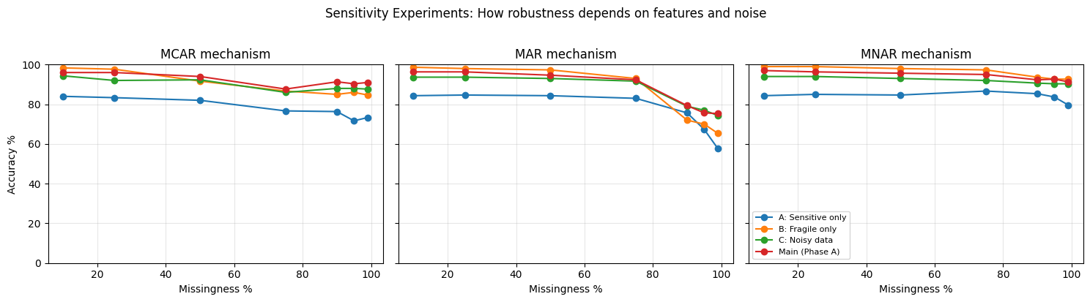
Sensitivity Analysis
│ 📅 Patient drops out at → Accuracy: 65%
│ day 60 (early only)
│
│ 📊 Sporadic logging → Baseline -10-15% Steeper degradation
│ (broken anchors)
│
│ ⌚ Consumer wearable → Baseline 95% → 85%
│ (noisy data)
Notes:
We ran three sensitivity experiments to mimic real clinical situations.
First, what if a patient drops out after 60 days and we only have early data? Accuracy crashes to about 65 percent.
Second, what if a patient only logs sporadically — wearing the device intensely some days and not at all on others — so our long-window summary features become unreliable? Baseline drops 10 to 15 percent and degradation under missingness becomes much steeper.
Third, what if the device is a consumer wearable rather than a research-grade actigraph? Adding realistic sensor noise drops baseline from 95 to about 85 percent.
Together these tell us our 95 percent accuracy depends on a full year of continuous tracking from a high-quality device. In real clinical deployment, we should expect closer to 85 percent — still useful, but more honest than the headline number.

Slide 17
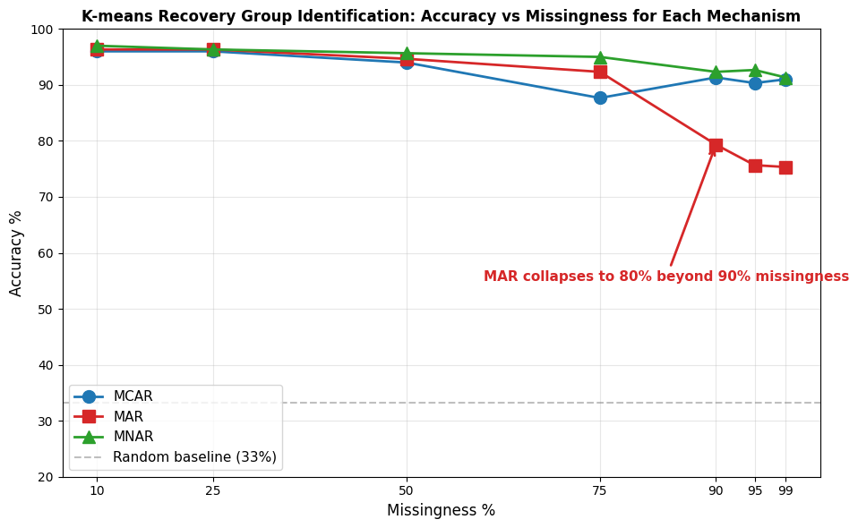
Missing Data Sensitivity
Robust Up to 75% Missingness — MAR is the Critical Mechanism
Key observations:
MCAR & MNAR remain >87% even at 99% missing
MAR collapses at 90%+ (drops to ~75%)
Clean degradation curve at 75–90% MAR boundary
Notes:
This is our headline result.
The chart shows accuracy on the y-axis against missingness percentage on the x-axis, with three lines one for each mechanism: MCAR, MAR, and MNAR.
Two important observations:
First, up to 75 percent missingness, all three mechanisms remain above 87 percent accuracy. The model is remarkably robust to missing data, regardless of mechanism, in this range.
Second, beyond 75 percent, the lines diverge dramatically. MCAR and MNAR stay above 90 percent even at 99 percent missing. But MAR collapses — dropping from 92 percent at 75 percent missing down to 75 percent at 90-plus percent missing.
So the answer to the brief's fourth question — at what level does identification become unreliable — is mechanism-dependent.
For MCAR and MNAR, the model handles up to 99 percent missing. For MAR, the warning starts at 90 percent.
So why does MAR break the model and the others don't? That's the next slid

Slide 18

Thank you!
Questions?

Slide 19
Why MAR Causes Collapse
MAR Removes the Most Diagnostic Information
MAR mechanism:
Concentrates missing days in early recovery (post-op compliance is realistically poor)
Models post-op patients forgetting/avoiding device in first weeks
Why this hurts:
early_speed_log (most diagnostic feature) needs day 1–60 data
90% MAR removes 90% of those days → feature degenerates to noise
Fast vs moderate distinction collapses
Why MCAR/MNAR don't hurt:
MCAR keeps contiguous data via gap_length=50
MNAR keeps high-activity days → max_steps preserved
Notes:
MAR in our simulator concentrates missing days in the early recovery phase — the first 60 days post-treatment.
This is a clinically realistic pattern. Post-op patients have worse device compliance in the first weeks. They might be in hospital, in too much pain, or simply overwhelmed by recovery to wear a device every day.
The problem is, our most diagnostic feature — early_speed_log — is calculated from days 1 to 60. When 90 percent of those days are missing, this feature degenerates to noise. The 'fast vs moderate' distinction collapses because both groups now look like they 'started slowly'.
MCAR removes data uniformly across time, so early_speed_log still has some valid days. And MNAR removes low-activity days, which paradoxically preserves the high-activity peaks needed for max_steps and mid_plateau.
So the lesson: the harm of a missingness mechanism depends on which features it damages. MAR happens to damage our most diagnostic feature.

Slide 20
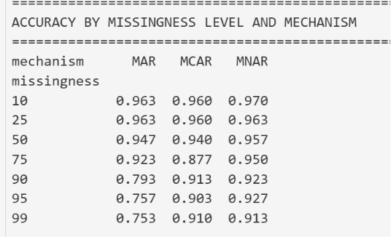
Blooper 1 — Distribution Shift Hidden in Baseline
Baseline Accuracy Can Be Misleading
The problem:
8-feature model: training accuracy ~93% (looked fine!)
But under missing data, degradation was much steeper than Phase A
Three diagnostic checks revealed three feature problems:
Check | Found | Action
Post-scaling std | data_completeness std=0 | Drop it
Group monotonicity | recovery_slope non-monotonic | Drop it
Distribution skew | early_speed 55x range | Log-transform
Notes:
We want to be transparent about our development process, because the journey to this model included two important failures.
Blooper one. Our first attempt used 8 features instead of 6. The training accuracy on the new cohort looked acceptable — about 93 percent. We initially thought we were done.
But under missing data, the 8-feature model degraded much faster than our final 6-feature model. At 75 percent missing, MAR accuracy was 79 percent for the 8-feature version, versus 92 percent for our final version. A 13-percentage-point gap.
Three diagnostic checks revealed why.
First, post-standardisation standard deviation. The feature data_completeness had a standard deviation of zero in training, because all training data was complete. Useless in training, harmful under missing data when its distribution shifted.
Second, feature monotonicity. The feature recovery_slope was non-monotonic — moderate patients had a higher slope than fast patients, which is biologically implausible. This was caused by computing np.polyfit over filled-with-zero missing days.
Third, distribution skewness. The feature early_speed had a 55-fold range between fast and moderate, which dominated standardisation.
The lesson: baseline accuracy is necessary but not sufficient. You have to test for distribution shift. Removing 2 features and log-transforming a third made the model both more accurate and more robust — counter-intuitive but real.

Slide 21
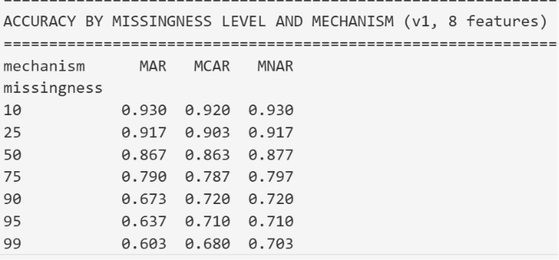
Blooper 2 — Data Leakage Test
Cross-Cohort Design Is Justified (Empirically)
Test: Train on Cohort B, test on Cohort B's missing data variants (data leakage scenario)
Result:
Leakage advantage: +0.1% on average (range -0.7% to +1.3%)
Statistically negligible
Interpretation:
K-means with summary features does not memorise patients
Missing data destroys patient-level fingerprints
Confirms our cross-cohort design is methodologically defensible
Notes:
Blooper two. We wanted to verify that our cross-cohort design was actually necessary, so we deliberately did it wrong: trained on Cohort B and tested on Cohort B's missing-data variants — same patients, just with data removed.
Surprisingly, the leakage advantage was negligible: plus 0.1 percent on average, with a range of minus 0.7 to plus 1.3 percent.
This tells us something important: K-means with summary features does not memorise individual patients. It learns group-level cluster boundaries that reproduce across cohorts.
So our cross-cohort design is justified — but not because leakage would have inflated our results dramatically. It's because cross-cohort is methodologically defensible without overpaying for it

Slide 22
Where to Be Cautious
Practical Recommendations for Clinical Use
Scenario | Reliability
0–50% missing (any mechanism) | Excellent (>94%) | Use confidently
75% missing | Good (88–95%) | Use with reported uncertainty
90%+ MAR | Unreliable (~80%) | Flag for manual review
99% MAR | Near-random | Do not use
Noisy real-world data | 🤔 80–88% baseline | Budget realistic expectations
Clinical translation:
Early-day compliance (day 1–60) is more critical than total compliance.
Notes:
Now to the practical question: when should clinicians trust this model, and when should they be cautious?
From our results, here's our recommendation:
At zero to 50 percent missing across any mechanism, the model is excellent — above 94 percent. Use confidently.
At 75 percent missing, accuracy is 88 to 95 percent. Use the model but report the uncertainty alongside the prediction.
At 90-plus percent MAR specifically, accuracy drops to around 80 percent. We recommend flagging these cases for manual clinical review rather than relying on the algorithm alone.
At 99 percent MAR, the model approaches random. Do not use it.
For real-world deployment with noisy sensors, expect a baseline closer to 80 to 88 percent rather than 95.
The single most important clinical recommendation: early-day compliance matters more than total compliance. A patient with consistent late-period data but sporadic early-period data is harder to phenotype than a patient with random gaps throughout.

Slide 23
PPIE Considerations (Patient-Centered)
Listening to the Patient Voice
Why might patients have missing data? (from PPIE input)
Post-op recovery is hard — pain, fatigue, hospital admission
Device burden — uncomfortable, forgetting to charge
Trust/privacy — concerns about monitoring
Life events — illness, travel, family emergencies
Our findings respect this reality:
MAR (early-recovery dropout) is the realistic and most-damaging pattern
Don't blame patients for missing early data
Models should tolerate missing data, not punish patients with poorer care
Notes:
We want to centre patient voices in how we interpret these findings. Here's where PPIE shaped our thinking.
Why might patients miss data in the early recovery period?
They might be in hospital. They might be in significant pain. The device might be uncomfortable on a fresh surgical site. They might simply forget to charge it, or to put it back on after a shower, in the disorientation of post-op recovery. They might have anxieties about being monitored.
These are not patient failures — they are realistic and reasonable behaviours.
Our MAR finding maps directly onto this reality. The most damaging missingness pattern in our model is precisely the pattern we'd expect to see in real clinical practice.
So our recommendations are patient-centered:
First, do not blame patients for missing early data. The data gap reflects life circumstances, not engagement.
Second, when models perform poorly on partial data, we should communicate that uncertainty to patients and clinicians — not silently produce a confident-looking but unreliable result.
Third, design clinical pathways that tolerate missing data rather than punishing patients with poorer care or excluded analyses.
Thanks to Lynn Laidlaw and the PPIE contributors whose insights informed this framing

Slide 24
Limitations & Take-Home
Limitations and Key Messages
Limitations:
Simulator data is cleaner than real clinical data
Tested only K-means (other algorithms may differ)
100% missingness not testable (theoretical floor: 33%)
Two cohorts from same generative process — true external validation needs different source
Take-home:
K-means + 6 summary features achieves 95% on complete data
Robust up to 99% missingness for MCAR/MNAR
MAR is the critical mechanism — clinical alert at 90%+
Diagnostic methodology generalisable to any clustering task
Reported accuracy is an optimistic upper bound (real-world ~80–88%)
Notes:
Briefly, our limitations.
Our data is from a simulator, not real patients. Group separation may be cleaner than reality. We tested only K-means — other algorithms may behave differently. And we couldn't test 100 percent missingness because there's nothing to extract features from.
Our take-home messages:
One, K-means with 6 well-chosen features achieves 95 percent on complete data.
Two, it's robust up to 99 percent missingness for MCAR and MNAR.
Three, MAR is the critical mechanism — clinical alert beyond 90 percent.
Four, our diagnostic methodology — checking standardisation std, group monotonicity, and skewness — is generalisable to any clustering task and is itself a contribution.
Five, reported accuracy is an optimistic upper bound. Real-world performance is likely 80 to 88 percent

Slide 25
Thank you!
Questions?
──────────────────────────────────────
GitHub: Task 1: https://github.com/Foluwa/HRfH-2026-Team-4-Task-2
GitHub: Task 2: https://github.com/Foluwa/HRfH-2026-Team-4
Team: Fantastic 4 (Group 4)
Acknowledgements:
- HRfH 2026 organisers
- PPIE contributors: Lynn Laidlaw,
Matt Barker, Colette Kelly, Lissie Fahey
- Faculty: Prof. Will Dixon, Dr. Mia Tackney,
Dr. Alexander Pate

