Slide 1
Autorennspiel “Drift”
Leistungskurs Informatik
Zai Shi

Slide 2
Einleitung
Unity
Autorennspiel mit Drift und Vogelperspektive
Ähnliche Spiele: Smash Cops Heat, Drift Runner 2

Slide 3
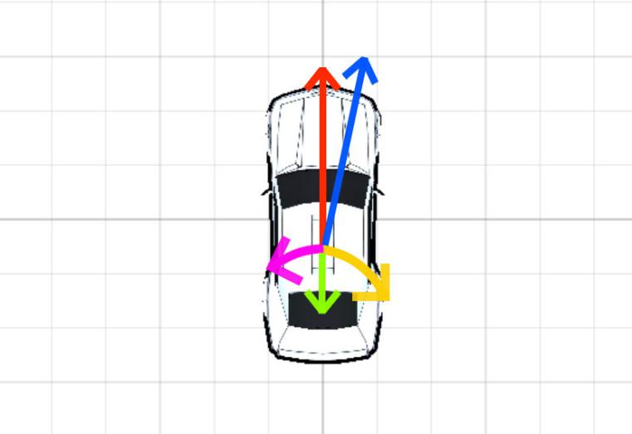
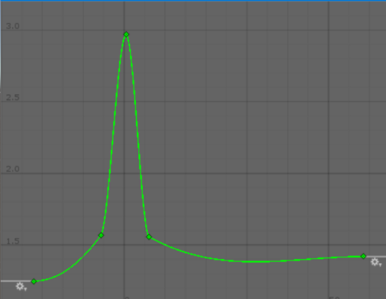
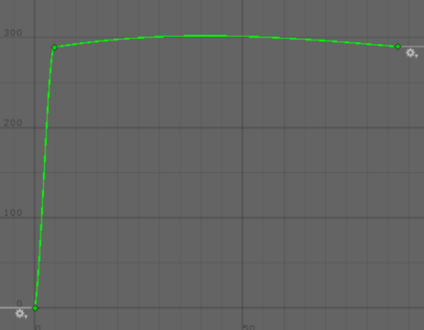
Physik und Bewegung
accelerationDrag
torqueDrag
Rot: anfangs velocity, Grün: accelerationDrag, Gelb: torque, Lila: torqueDrag, Blau: neue velocity

Slide 4
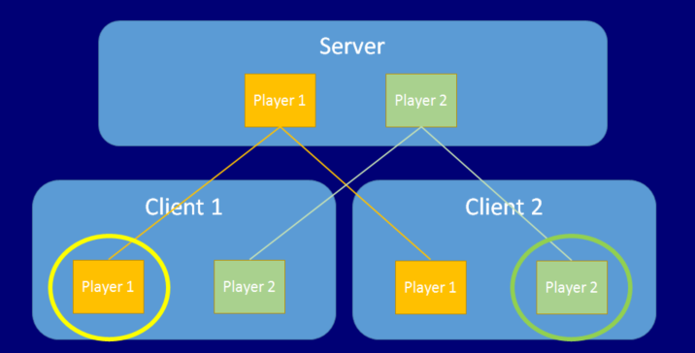
Netzwerk und Syncronisierung

Slide 5
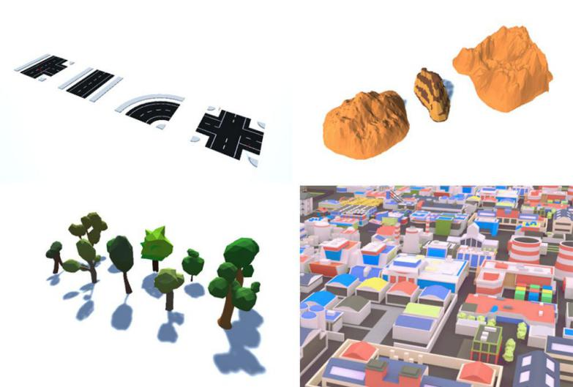
Graphik und Modelle

Slide 6
UI und Interaktion
Hauptmenü
Schwerkraft-Sensor auf Handy
Zwei Perspektiven

Slide 7
Quellen
[1]https://unity3d.com
[2]https://docs.unity3d.com/ScriptReference/Vector3.html
[3]https://docs.unity3d.com/ScriptReference/AnimationCurve.html
[4]https://docs.unity3d.com/Manual/UNet.html
[5]https://docs.unity3d.com/ScriptReference/Networking.NetworkManager.html
[6]https://docs.unity3d.com/uploads/Main/NetworkLocalPlayers.png
[7]https://docs.unity3d.com/ScriptReference/Networking.NetworkDiscovery.html
[8]https://docs.unity3d.com/ScriptReference/Networking.NetworkBehaviour.html
[9]https://docs.unity3d.com/ScriptReference/Networking.ClientRpcAttribute.html
[10]https://docs.unity3d.com/ScriptReference/Networking.CommandAttribute.html
[11]https://docs.unity3d.com/ScriptReference/Vector3.Lerp.html https://docs.unity3d.com/ScriptReference/Quaternion.Lerp.html
[12]https://assetstore.unity.com/
[13]https://assetstore.unity.com/packages/3d/vehicles/land/modern-sports-car-8-2209
https://assetstore.unity.com/packages/3d/vehicles/land/modern-sports-car-5-2203
https://assetstore.unity.com/packages/3d/vehicles/land/modern-sports-car-10-5368 https://assetstore.unity.com/packages/3d/vehicles/land/modern-sports-car-2196
[14]https://assetstore.unity.com/packages/3d/environments/urban/lowpoly-modern-city-decorations-set-66070
[15]https://assetstore.unity.com/packages/3d/environments/landscapes/lowpoly-environment-pack-99479
[16]https://assetstore.unity.com/packages/3d/vegetation/lowpoly-vegetation-season-pack-lite-96083
[17]https://assetstore.unity.com/packages/3d/environments/urban/lowpoly-modern-city-buildings-set-64427
[18]https://docs.unity3d.com/ScriptReference/Input-gyro.html
[19]https://docs.unity3d.com/Manual/GIIntro.html
[20]https://www.kongregate.com/games/LongAnimals/drift-runners-2
[21]http://www.hutchgames.com/smash-cops-heat/

