Slide 1
SoftHier Progress Update
Chi Zhang chizhang@iis.ee.ethz.ch
Thomas Benz tbenz@iis.ee.ethz.ch
Luca Colagrande colluca@iis.ee.ethz.ch

Slide 2
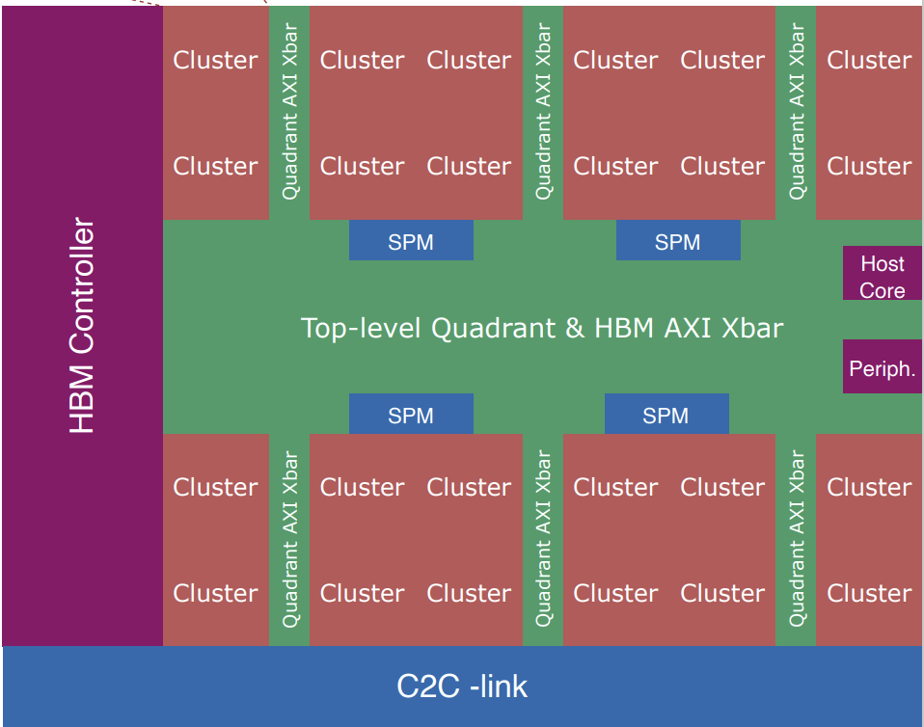
System Scale-out Schemes
Plan1: Hierarchical Scale-out with Xbar
Example here (Occamy):
Quadrant: Group 4 clusters, 512b wide Xbar
Top-level: Xbar interconnect (6 Quadrants, Host Core, SPM(L2),HBM channels, C2C-links, Peripherals )
Discussion for SoftHier:
Adding hierarchy-levels to scale-out more
Organization of SPM (L2 memories): Only place at top-level? Or adding some SPM also into quadrants?
Optimize LLM’s workload mapping & access dataflow: leverage more BW of intra-cluster & intra-quadrant communication

Slide 3
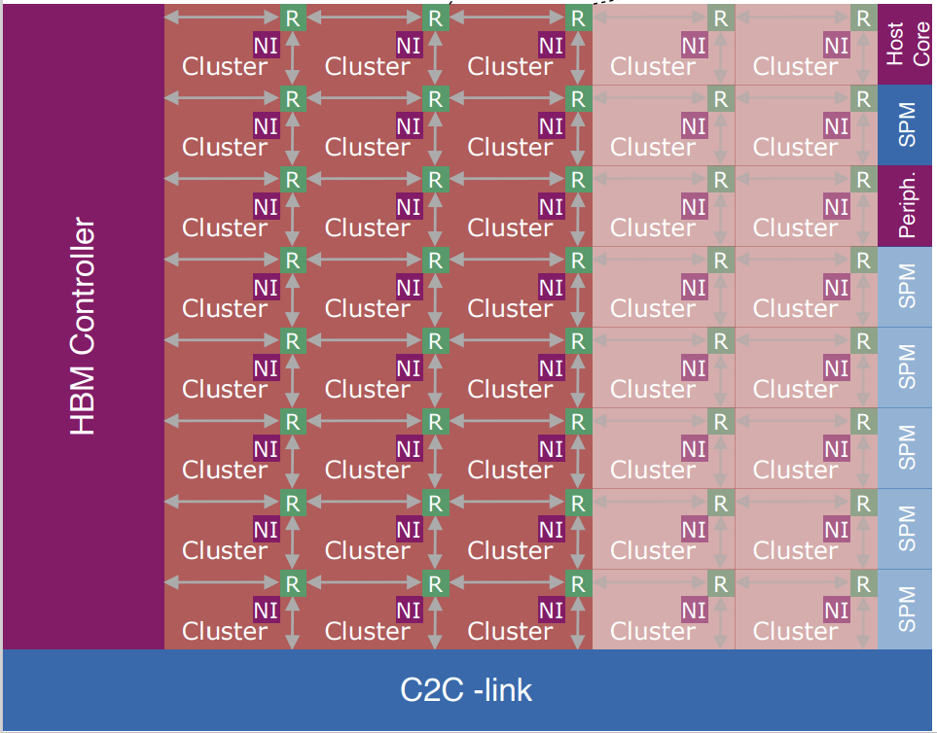
System Scale-out Schemes
Plan2: Flatten Scale-out with Mesh NoC
Example here:
Flatten every component (clusters, Host Core, SPM(L2),HBM channels, C2C-links, Peripherals)
Connect every components by mesh NoC
Discussion for SoftHier:
Placement of SPM (L2 memories): How to keep short distance to Clusters & to HBM channels?
Optimize LLM’s workload mapping & access dataflow: Minimize NoC traffic

Slide 4
Current Statues
Modeling Hierarchical Scale-out System in GVSoC
We are first modeling Occamy, because:
We have RTL & tape-out chips, so that can calibrate GVSoC models
Occamy model in GVSoC:
Snitch cluster (iDMA equipped) – done
Extending Snitch cluster with RedMule – done
Quadrant modeling – done
Top-level modeling – on going
Functional testing – on going
iDMA testing – on going

Slide 5
iDMA
DATE24
Easter
Busy with a publication and tapeout

Slide 6
Snitch cluster
Efforts reported as ongoing in the last meeting have been merged:
PRs #90, #102, #104
Along with others:
PRs #103, #111, #96, #119, #120, #112, #117, #113
In summary, these:
Add new kernels and benchmarks (e.g. atax, correlation, covariance)
Optimize existing kernels (e.g. Layernorm)
Introduce minor improvements and bug fixes to build system and verification infrastructure
Add proper FP8 verification, develop pyflexfloat library
We aligned the Occamy repo with all the changes which have been merged to Snitch in the last months (PR #22)

