Slide 1
SoftHier Bi-Weekly Meeting
Chi Zhang chizhang@iis.ee.ethz.ch
Thomas Benz tbenz@iis.ee.ethz.ch
Luca Colagrande colluca@iis.ee.ethz.ch

Slide 2
SoftHier Progress General Updates
Flatten-Attention Paper
Heavily review and rewrite
Current paper is well structured
We already submit one, still some optimization undergoing
SoftHier Simulator Improvement
Uploaded Spatz Model Integration
Tutorials Updating
DeepSeek-V3 on SoftHier
Progress on expert route of MoE

Slide 3
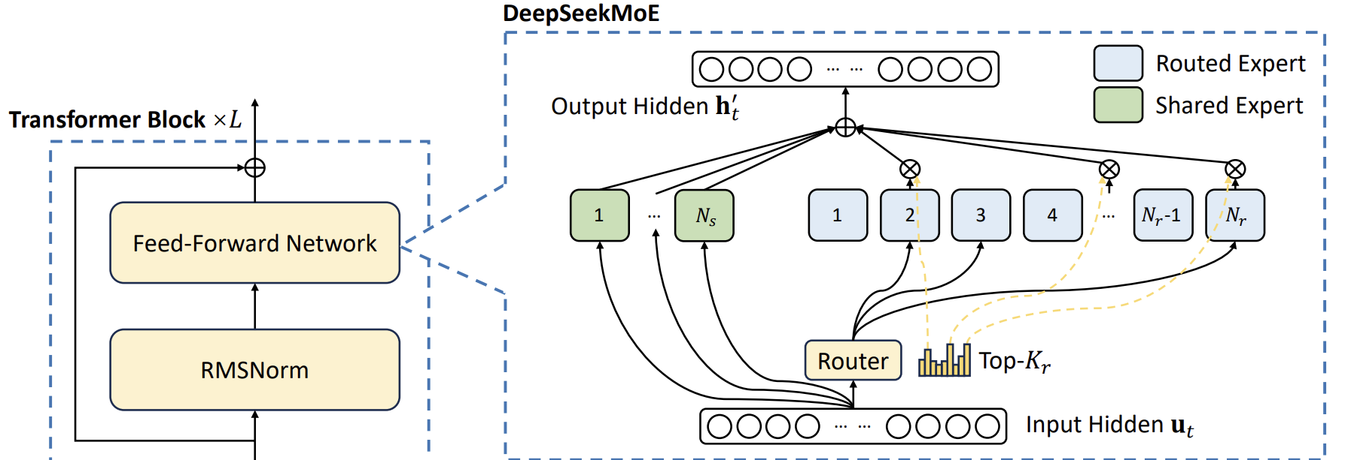
DeepSeekMoE
Expert Computing
Expert Routing

Slide 4
DeepSeekMoE – Expert Routing
Build a python golden model with Numpy
Finished a template code
Support both decode and prefill
Evaluated on SoftHier
Passed numerical check
Golden
Model
Golden Model:
Token vector
1
2
[1,3] Expert idx
Numerical
Check
SoftHier:
HBM Preload
SoftHier
Simulation
HBM
Dump
Expert
Weight
sigmoid
normalize
Expert Routing :
Token vector
x
=
score
1
2
1
2
Top-k
compress
[1,3] Expert idx

Slide 5
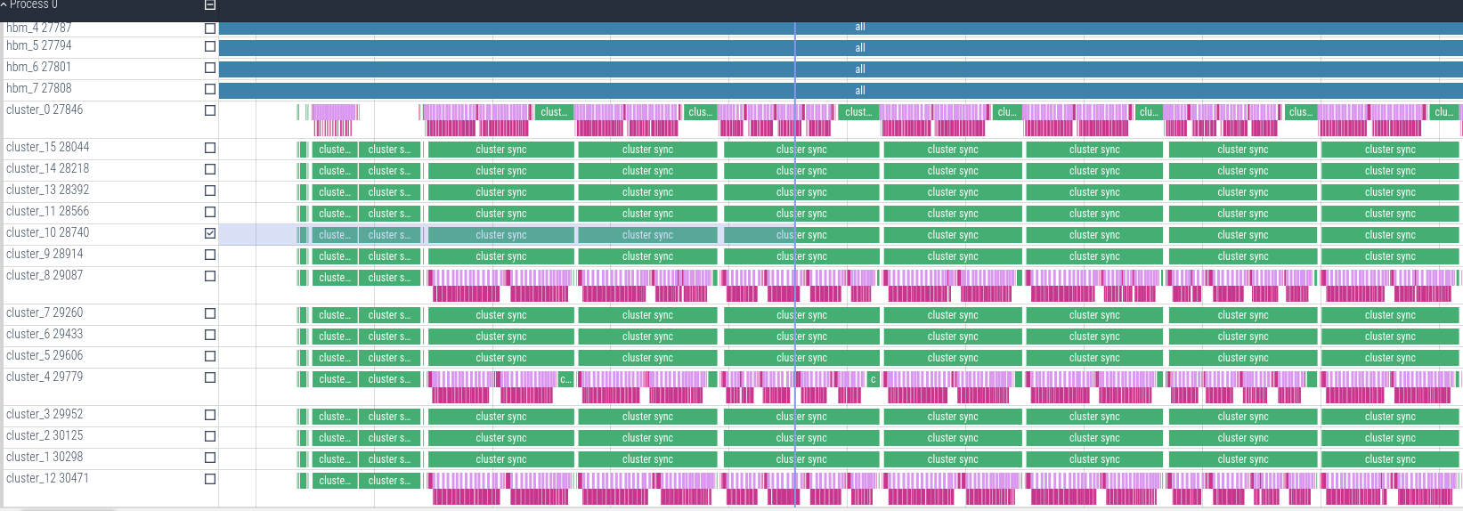
DeepSeekMoE – Expert Routing
Premilitary results
Expert routing in decode stage
Weight in on HBM channel
Only enable edge clusters for computation
Memory-bounded:
75.97% Bw Uti of HBM channel 0
1.0% Compute Uti
Cluster
Cluster
Cluster
Cluster
A
B
C
D
A
HBM ch
CTRL
R
R
R
R
Cluster
Cluster
Cluster
Cluster
B
HBM ch
CTRL
R
R
R
R
Cluster
Cluster
Cluster
Cluster
C
HBM ch
CTRL
R
R
R
R
Cluster
Cluster
Cluster
Cluster
D
HBM ch
CTRL
R
R
R
R

Slide 6
Next Steps
Optimize data layout
Interleave to ever available HBM channle
Goal is to reach>70% all available HBM BW for decode expert routing
Try with prefill stage execution
Code for expert compute
PS. Now we have a complete template paramterizable code for MoE for both decode and prefill,

