Slide 1
SoftHier Bi-Weekly Meeting
Chi Zhang chizhang@iis.ee.ethz.ch
Thomas Benz tbenz@iis.ee.ethz.ch
Luca Colagrande colluca@iis.ee.ethz.ch

Slide 2
SoftHier Progress General Updates
FlatAttention presentation slide
We take some time preparing the slides for presenting the FlatAttention work to the architects in HQ
Thanks for your comments on this slide
Now we are ready for the meeting
FlatAttention open-source
Prof. Luca is pretty OK with open-sourcing the code
We are cleaning up the code and write general README for usage
Planed release day: this week Thursday / Friday
DeepSeek-V3 + SoftHier
We had nice progress in MoE dataflow on SoftHier (Decode Stage)
In this slide we will demonstrate in detail

Slide 3
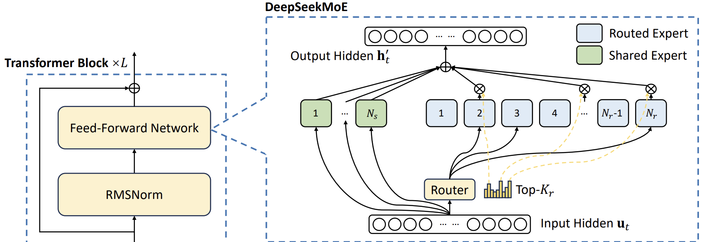
DeepSeekMoE
Expert Computing
Expert Routing

Slide 4
DeepSeekMoE – Decode Stage
Expert
Weight
sigmoid
normalize
Expert Routing :
Token vector
x
=
score
1
2
1
2
Top-k
compress
[1,3] Expert idx
Expert Computing :
Expert Computing
Token vector
W1
x
=
Shared
Expert
Shared
Expert
Route
Expert1
Route
Expert3
Token vector
silu
W2
*
x
output
1
2
W3
Token vector
x
=
+
output

Slide 5
Mapping for Expert Routing
Assign one Cluster
For Expert routing in decode stage
The total runtime of expert routing is a very small portion vs. MoE computing
Use RedMule for GEMV
We use quick sort on snitch core for Top-K operation
Expert
Weight
sigmoid
normalize
Token vector
x
=
score
1
2
1
2
Top-k
compress
[1,3] Expert idx
Expert
Weight
Cluster
Cluster
Cluster
Cluster
Token vector
HBM ch
CTRL
R
R
R
R
Cluster
Cluster
Cluster
Cluster
HBM ch
CTRL
R
R
R
R
Cluster
Cluster
Cluster
Cluster
HBM ch
CTRL
R
R
R
R
Cluster
Cluster
Cluster
Cluster
HBM ch
CTRL
R
R
R
R
CTRL
CTRL
CTRL
CTRL
HBM ch
HBM ch
HBM ch
HBM ch

Slide 6
Dataflow for Expert Computing
Process Experts Sequentially
Partition workloads to every cluster
Shared
Expert
Shared
Expert
Route
Expert1
Route
Expert3
Time
Cluster
Cluster
Cluster
Cluster
HBM ch
CTRL
R
R
R
R
Cluster
Cluster
Cluster
Cluster
HBM ch
CTRL
R
R
R
R
Cluster
Cluster
Cluster
Cluster
HBM ch
CTRL
R
R
R
R
Cluster
Cluster
Cluster
Cluster
HBM ch
CTRL
R
R
R
R
CTRL
CTRL
CTRL
CTRL
HBM ch
HBM ch
HBM ch
HBM ch

Slide 7
Workload Partition Example - GEMV
Expert Computing
W1
Token vector
x
=
silu
W2
*
x
output
W3
Token vector
x
=
dim
2048
Token vector
x
dim

Slide 8
Workload Partition Example - GEMV
Expert Computing
W1
Token vector
x
=
silu
W2
*
x
output
W3
Token vector
x
=
dim
128
Token vector
x
dim

Slide 9
Workload Partition Example - GEMV
Cluster
Cluster
Cluster
Cluster
HBM ch
CTRL
R
R
R
R
Cluster
Cluster
Cluster
Cluster
HBM ch
CTRL
R
R
R
R
Cluster
Cluster
Cluster
Cluster
HBM ch
CTRL
R
R
R
R
Cluster
Cluster
Cluster
Cluster
HBM ch
CTRL
R
R
R
R
CTRL
CTRL
CTRL
CTRL
HBM ch
HBM ch
HBM ch
HBM ch
dim
128
Token vector
x
dim

Slide 10
Workload Partition Example - GEMV
Cluster
Cluster
Cluster
Cluster
HBM ch
CTRL
R
R
R
R
Cluster
Cluster
Cluster
Cluster
HBM ch
CTRL
R
R
R
R
Cluster
Cluster
Cluster
Cluster
HBM ch
CTRL
R
R
R
R
Cluster
Cluster
Cluster
Cluster
HBM ch
CTRL
R
R
R
R
CTRL
CTRL
CTRL
CTRL
HBM ch
HBM ch
HBM ch
HBM ch
dim
128
Token vector
x
dim

Slide 11
Workload Partition Example - GEMV
Cluster
Cluster
Cluster
Cluster
Token
R
R
R
R
Token
Token
Token
Token
Token
Token
Token
Token
Token
Token
Token
Token
Token
Token
Token
HBM ch
CTRL
Cluster
Cluster
Cluster
Cluster
HBM ch
CTRL
R
R
R
R
Cluster
Cluster
Cluster
Cluster
HBM ch
CTRL
R
R
R
R
Cluster
Cluster
Cluster
Cluster
HBM ch
CTRL
R
R
R
R
CTRL
CTRL
CTRL
CTRL
HBM ch
HBM ch
HBM ch
HBM ch

Slide 12
Workload Partition Example - GEMV
Cluster
Cluster
Cluster
Cluster
Token
Token
Token
Token
Token
Token
Token
Token
Token
Token
Token
Token
Token
Token
Token
Token
HBM ch
CTRL
R
R
R
R
Cluster
Cluster
Cluster
Cluster
HBM ch
CTRL
R
R
R
R
Cluster
Cluster
Cluster
Cluster
HBM ch
CTRL
R
R
R
R
Cluster
Cluster
Cluster
Cluster
HBM ch
CTRL
R
R
R
R
CTRL
CTRL
CTRL
CTRL
HBM ch
HBM ch
HBM ch
HBM ch

Slide 13
Workload Partition Example - GEMV
Cluster
Cluster
Cluster
Cluster
Token
Token
Token
Token
HBM ch
CTRL
R
R
R
R
Cluster
Cluster
Cluster
Cluster
Token
Token
Token
Token
HBM ch
CTRL
R
R
R
R
Cluster
Cluster
Cluster
Cluster
Token
Token
Token
Token
HBM ch
CTRL
R
R
R
R
Cluster
Cluster
Cluster
Cluster
Token
Token
Token
Token
HBM ch
CTRL
R
R
R
R
CTRL
CTRL
CTRL
CTRL
HBM ch
HBM ch
HBM ch
HBM ch

Slide 14
Workload Partition Example - GEMV
Cluster
Cluster
Cluster
Cluster
Token
Token
Token
Token
HBM ch
CTRL
R
R
R
R
Cluster
Cluster
Cluster
Cluster
Token
Token
Token
Token
HBM ch
CTRL
R
R
R
R
Cluster
Cluster
Cluster
Cluster
Token
Token
Token
Token
HBM ch
CTRL
R
R
R
R
Cluster
Cluster
Cluster
Cluster
Token
Token
Token
Token
HBM ch
CTRL
R
R
R
R
CTRL
CTRL
CTRL
CTRL
HBM ch
HBM ch
HBM ch
HBM ch

Slide 15
Workload Partition Example - GEMV
Cluster
Cluster
Cluster
Cluster
Token
Token
Token
Token
HBM ch
CTRL
R
R
R
R
Cluster
Cluster
Cluster
Cluster
Token
Token
Token
Token
HBM ch
CTRL
R
R
R
R
Cluster
Cluster
Cluster
Cluster
Token
Token
Token
Token
HBM ch
CTRL
R
R
R
R
Cluster
Cluster
Cluster
Cluster
Token
Token
Token
Token
HBM ch
CTRL
R
R
R
R
CTRL
CTRL
CTRL
CTRL
HBM ch
HBM ch
HBM ch
HBM ch

Slide 16
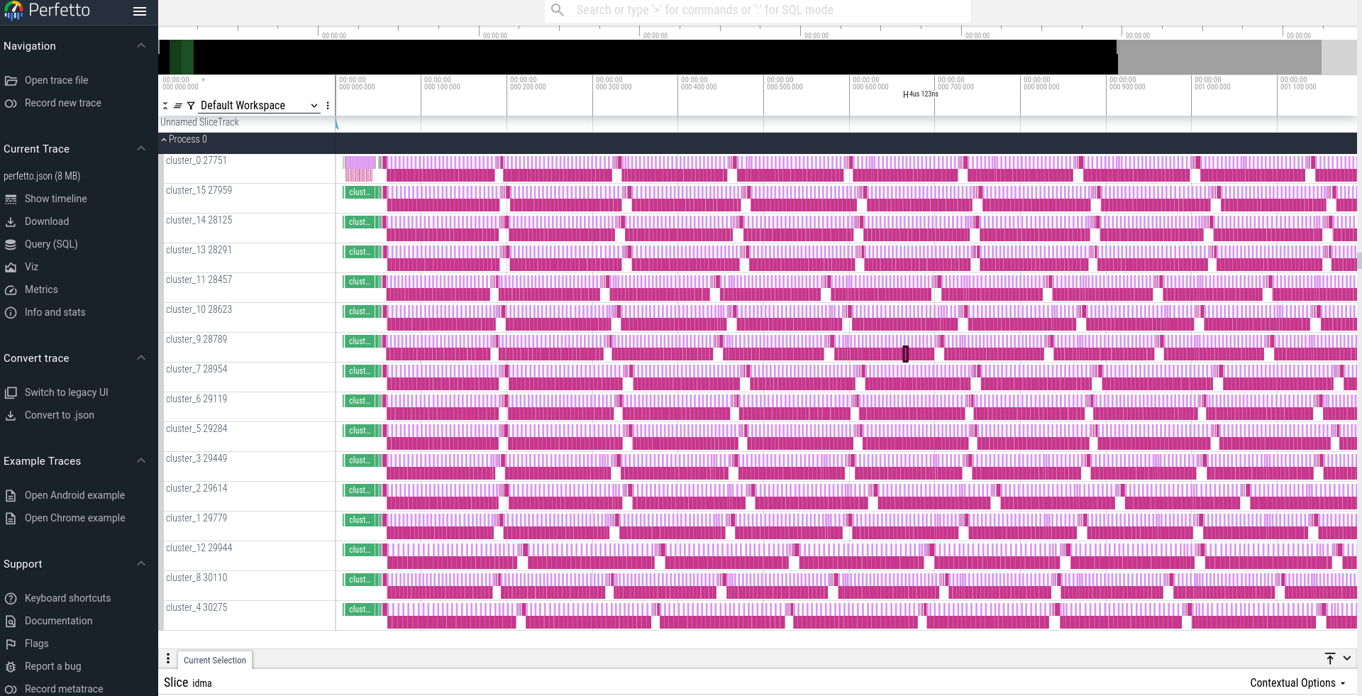
Current Results
Expert Routing
Expert Computing
DeepSeek MoE Decode
16B configuration
64 routed expert
2 shared expert
6 activate expert
W/o dedicate workload partition – 10% HBM uti
W/ dedicate workload partition – 64% HBM uti
W/ reducing redundant synchronization – 73% HBM uti

