Slide 1
SoftHier Progress Update
Chi Zhang chizhang@iis.ee.ethz.ch

Slide 2

Progress Updates
Cleaned up the SoftHier simulator Git repository
Developed a new build process for non-Eth machines
Prepared a simple tutorial
Get started with SoftHier Simulation
Architecture and configuration files
Example of SW for SoftHier
Use DMA to transfer data: HBM <-> cluster; cluster <-> cluster
Use RedMule to accelerate GEMM in cluster L1
Inter-/intra-cluster synchronization
Still need to provide toolchains to build SW
https://github.com/gvsoc/gvsoc/tree/soft_hier_flex_cluster

Slide 3
General MatMul Kernel for SoftHier
MatMul Kernel SW
Program Cluster to behave like Systolic array
Tiling policy:
best usage of Cluster L1 capacity
Mapping policy:
enable clusters according to tiles on M and K dimensions
K
W₀₀
W₀₁
W₁₀
W₁₁
N
W₂₀
W₂₁
N
W₃₀
W₃₁
I₀₀
I₀₁
I₀₂
I₀₃
C
C
C
C
M
I₁₀
I₁₁
I₁₂
I₁₃
C
C
C
C
I₂₀
I₂₁
I₂₂
I₂₃
C
C
C
C
C
C
C
C

Slide 4
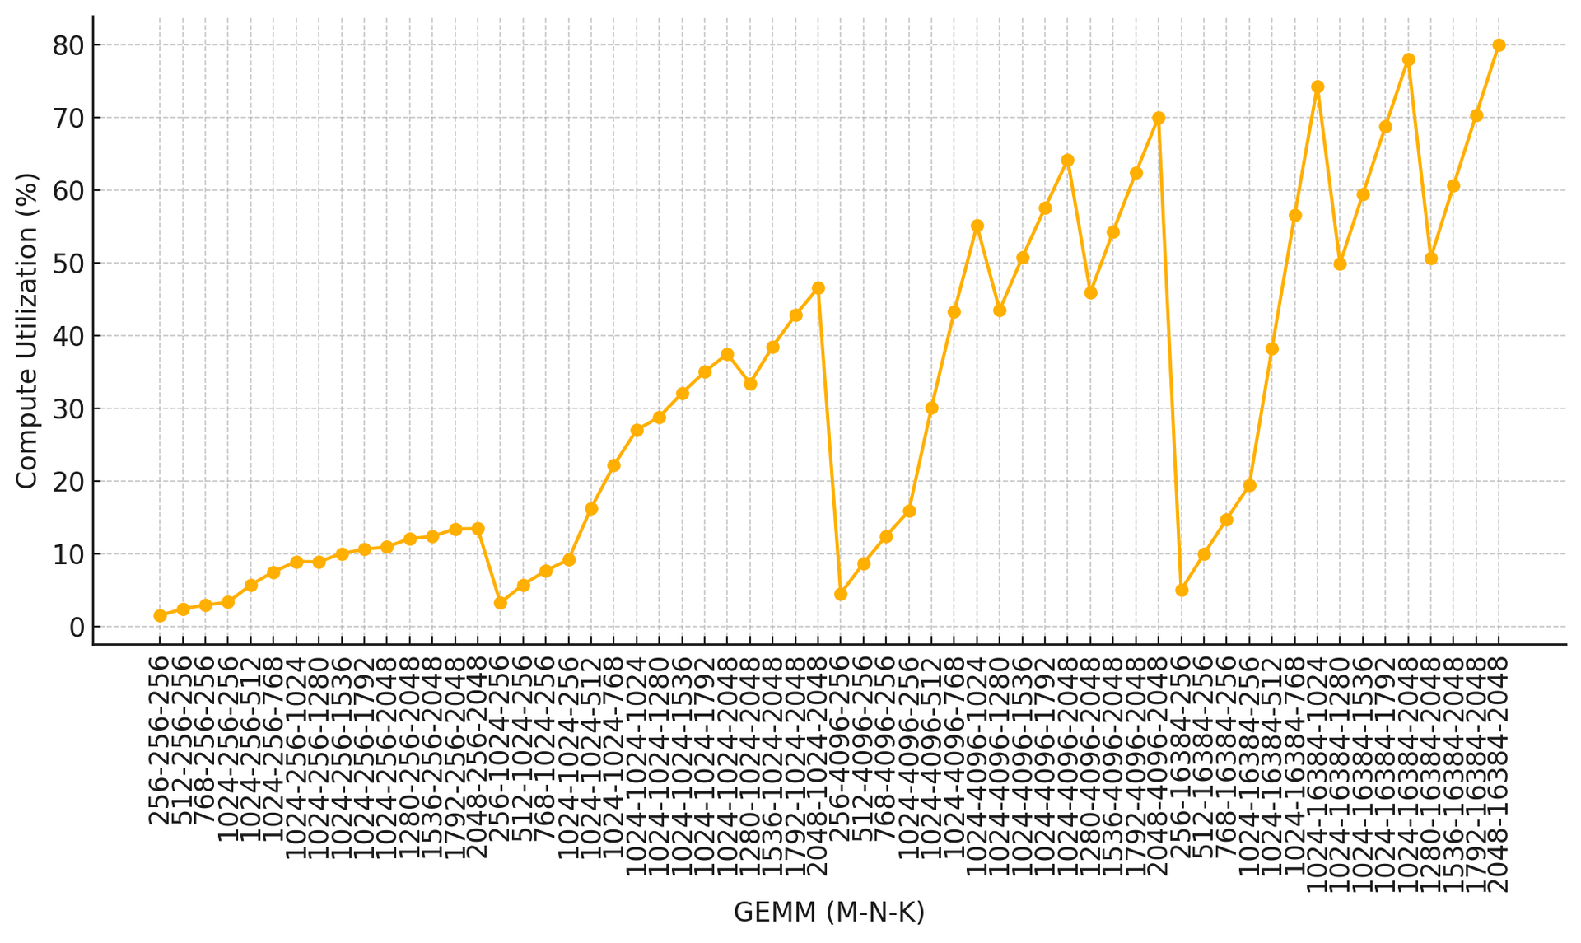
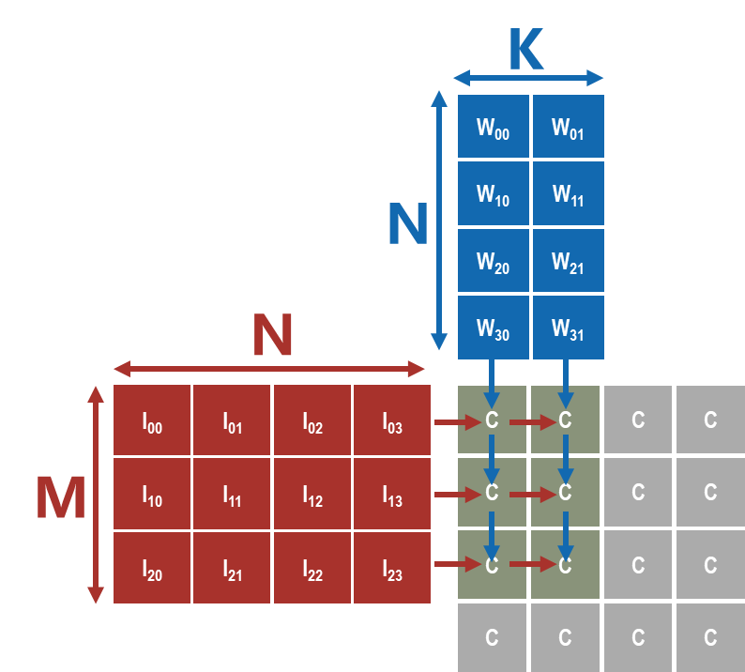
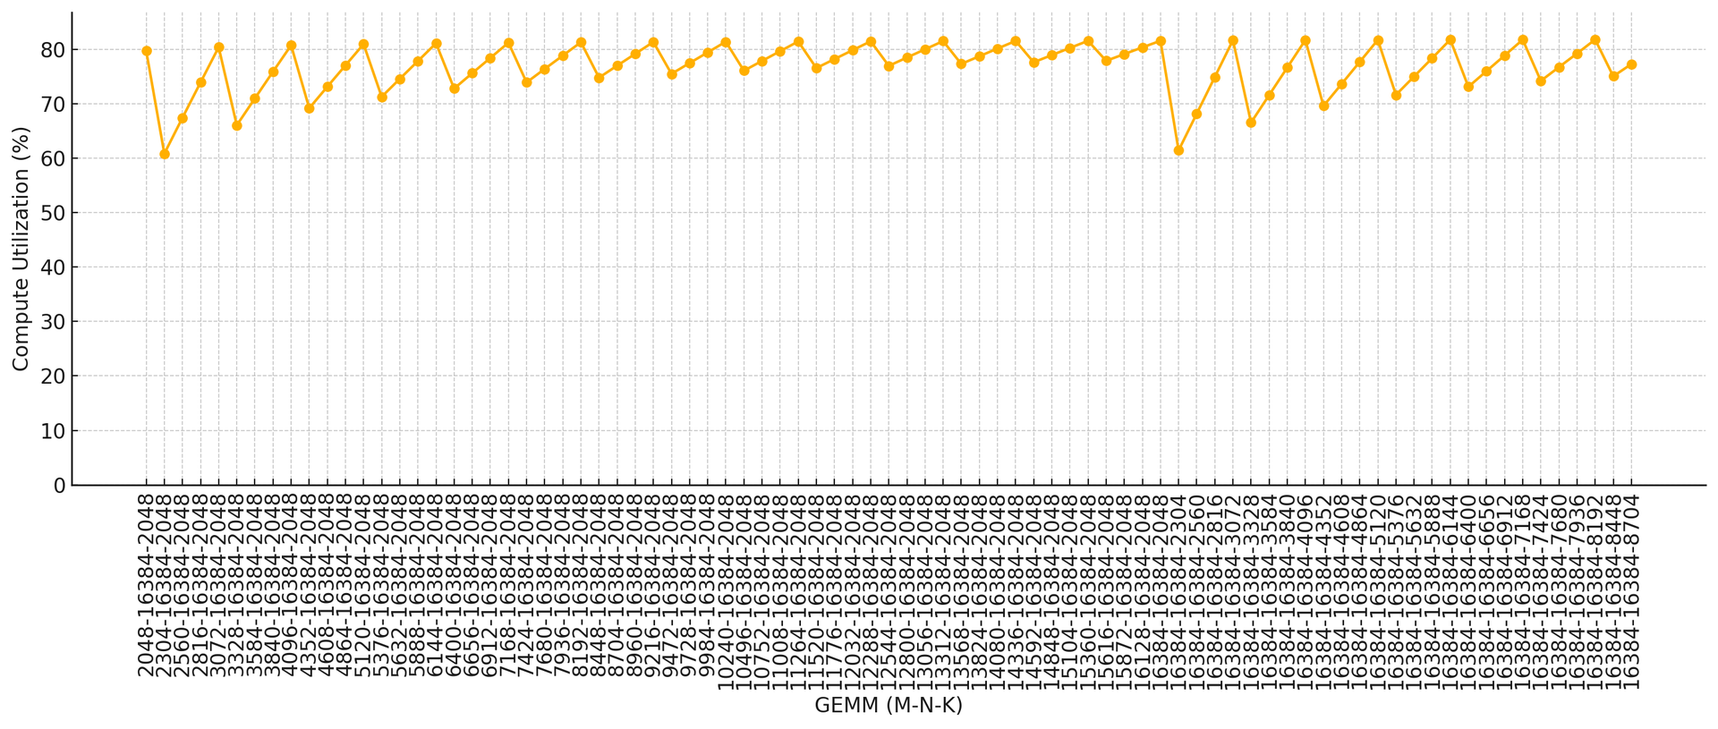
N=256
N=1024
N=4096
N=16384
Performance
SoftHier config
4x4 Cluster(128x32 RedMule)
NoC Link BW: 512bit
HBM: 8 channel, 512 GB/s
Peak Perf: 128TFLOPS
Evaluation:
Different M-N-K of MatMul
Tile size = 256
Result:
M,K determines how many clusters are enabled
Large N helps to reach high compute utilization
Jagged curve due to leftover tiles on M & K dimension
M=K=256, only one cluster is enabled for computation
N=16384, M & K increase from 2048

Slide 5
Collaboration Plan
Master Thesis: Automative GEMM Kernel deployment framework for SoftHier architecture
Basic goal:
Complete the SoftHier Backend in DaCe: SDFG -> executable SoftHier code
Evaluate GEMM performance on SoftHier with baseline DaCe SDFG transformation (GPU Frontend, local shared memory + DMA, no inter-cluster data communication/hard-coded schedule)
Compare to hand-written optimized GEMM kernel performance
Stretch goals:
Extend DaCe frontend to support inter-cluster data communication
Discussion on tiling, mapping and scheduling schemes in SDFG transformation.

Slide 6
Next Steps
Baseline end-to-end LLM on SoftHier
Code for rest kernels in LLM: softmax, normalization.
Support Matrix Transposition in RedMule: required by attention head
Evaluate end-to-end performance of LLM inference: prefill & decode

Slide 7
SoftHier Progress Update
Thomas Benz tbenz@iis.ee.ethz.ch

Slide 8
Status
Thomas was away for 4.5 weeks due to military service and just resumed work last Thursday.

Slide 9
SoftHier Progress Update
Luca Colagrande colluca@iis.ee.ethz.ch

Slide 10
Snitch cluster updates
Primarily busy on multicast paper (submitted to AICAS)
Extended Snitch cluster, iDMA and Occamy interconnect with multicast support
Evaluated the benefit of multicast for ML workloads, benchmarking GEMM kernel improvements
Potentially useful insights for SoftHier project
Merged PRs
#192: significant improvements to Docker container and CI execution time
#175: update tool dependencies
#184: improve error messages on illegal instruction and misaligned load/stores

