Slide 1
SoftHier Bi-Weekly Meeting
Chi Zhang chizhang@iis.ee.ethz.ch
Thomas Benz tbenz@iis.ee.ethz.ch
Luca Colagrande colluca@iis.ee.ethz.ch

Slide 2
SoftHier Progress General Updates
FlatAttention presentation to HQ
FlatAttention open-source
Already open-sourced under this link
https://github.com/gvsoc/gvsoc/tree/soft_hier_doc/examples/Implementation/FlatAttention
DeepSeek-V3 + SoftHier
Previously we had a good progress in mapping DeepSeekMoE in decode stage on SoftHier
73% HBM BW uti
Our student are heavily working on DeepSeekMoE in Prefill stage
We also started to analyze the DeepSeekMLA part
We plan to use our FlatAttention for MLA

Slide 3
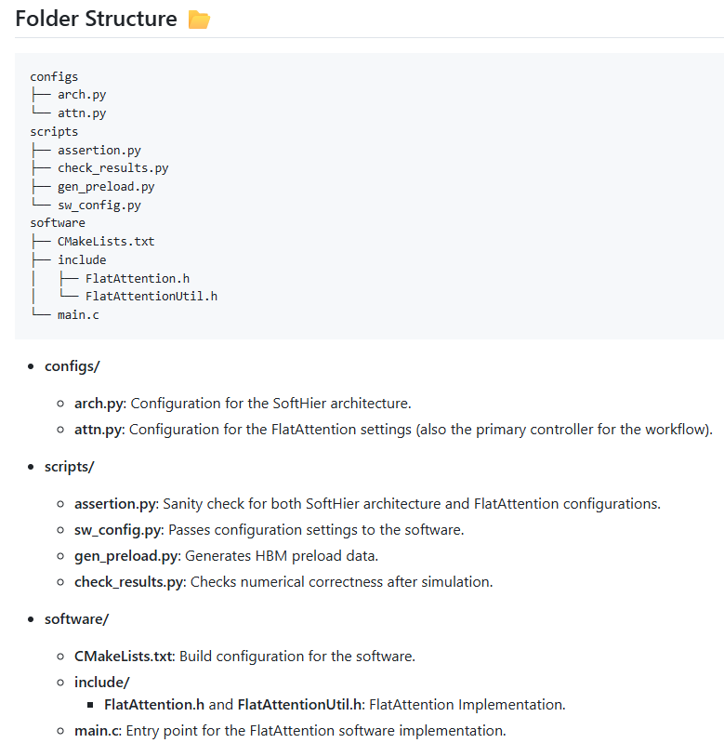
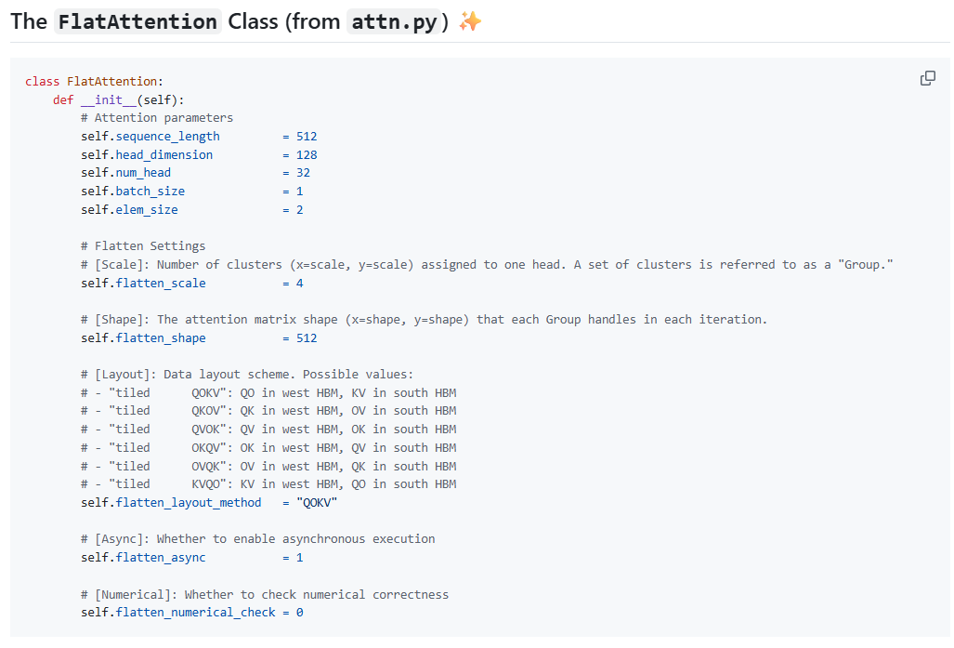

FlatAttention Open-Source
https://github.com/gvsoc/gvsoc/tree/soft_hier_doc/examples/Implementation/FlatAttention

Slide 4
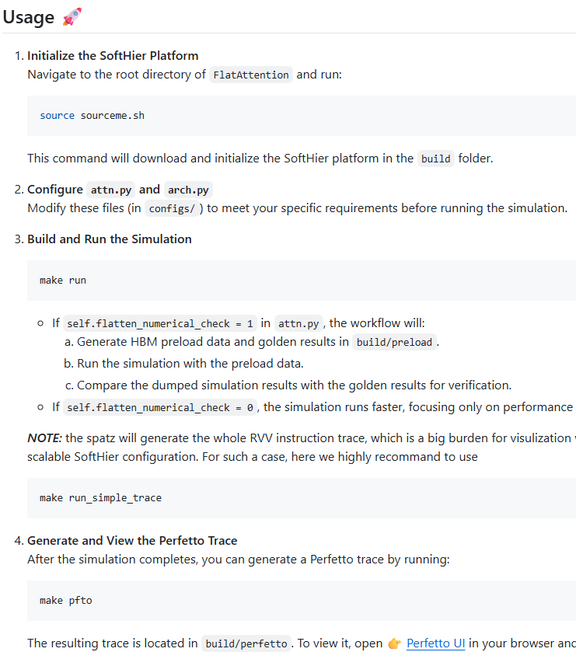
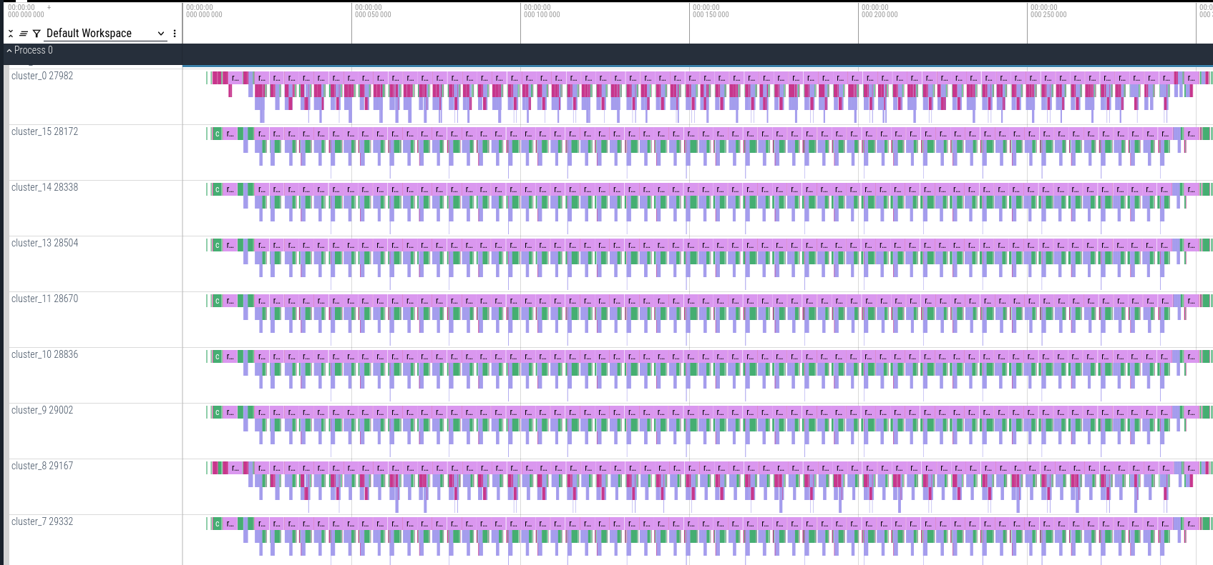
FlatAttention Open-Source
In Perfetto to view the trace

Slide 5
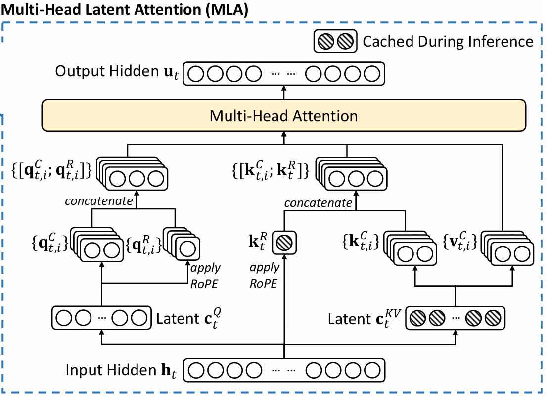
DeepSeekMLA
Standard MHA
-> FlatAttention
Decompression + RoPE information appending
-> Forming Q,K,V
Low-Rank Compression
-> Latent matrices

Slide 6



DeepSeekMLA
Low-Rank Compression
-> Latent matrices

Slide 7
Low-Rank Compression -> Latent matrices
Input h
Cluster
Cluster
Cluster
Cluster
Token 0
HBM ch
CTRL
R
R
R
R
Token 1
Cluster
Cluster
Cluster
Cluster
Token 2
R
R
R
R
HBM ch
CTRL
Token 3
Cluster
Cluster
Cluster
Cluster
Token 4
Token 5
HBM ch
CTRL
R
R
R
R
Token 6
Cluster
Cluster
Cluster
Cluster
Token 7
R
R
R
R
HBM ch
CTRL
CTRL
CTRL
CTRL
CTRL
HBM ch
HBM ch
HBM ch
HBM ch
W^{DQ}
W^{DKV}
W^{KR}

Slide 8
Low-Rank Compression -> Latent matrices
Input h
Cluster
Cluster
Cluster
RoPE -> element-wise
Cluster
C^{Q}
C^{KV}
K^{R}
Token 0
HBM ch
CTRL
R
R
R
R
Token 1
Cluster
Cluster
Cluster
Cluster
Token 2
R
R
R
R
HBM ch
CTRL
Token 3
Cluster
Cluster
Cluster
Cluster
Token 4
Token 5
HBM ch
CTRL
R
R
R
R
Token 6
Cluster
Cluster
Cluster
Cluster
Token 7
R
R
R
R
HBM ch
CTRL
CTRL
CTRL
CTRL
CTRL
HBM ch
HBM ch
HBM ch
HBM ch
W^{DQ}
W^{DKV}
W^{KR}

Slide 9
Low-Rank Compression -> Latent matrices
Cluster
Cluster
Cluster
Cluster
C^{Q}
C^{KV}
K^{R}
HBM ch
CTRL
R
R
R
R
Cluster
Cluster
Cluster
Cluster
HBM ch
CTRL
R
R
R
R
Cluster
Cluster
Cluster
Cluster
HBM ch
CTRL
R
R
R
R
Cluster
Cluster
Cluster
Cluster
HBM ch
CTRL
R
R
R
R
CTRL
CTRL
CTRL
CTRL
HBM ch
HBM ch
HBM ch
HBM ch
W^{DQ}
W^{DKV}
W^{KR}

Slide 10
DeepSeekMLA
Decompression + RoPE information appending
-> Forming Q

Slide 11


DeepSeekMLA
Decompression + RoPE information appending
-> Forming Q

Slide 12
Decompression + RoPE -> Forming Q
Cluster
Cluster
Cluster
Cluster
C^{Q}
C^{KV}
K^{R}
HBM ch
CTRL
R
R
R
R
Cluster
Cluster
Cluster
Cluster
HBM ch
CTRL
R
R
R
R
Cluster
Cluster
Cluster
Cluster
HBM ch
CTRL
R
R
R
R
Cluster
Cluster
Cluster
Cluster
HBM ch
CTRL
R
R
R
R
CTRL
CTRL
CTRL
CTRL
HBM ch
HBM ch
HBM ch
HBM ch
W₀^{UQ}
W₀^{QR}
W₁^{UQ}
W₁^{QR}

Slide 13
Decompression + RoPE -> Forming Q
Cluster
RoPE
RoPE
Cluster
Cluster
Cluster
C^{Q}
C^{KV}
K^{R}
Q₀^{C}
Q₀^{R}
Q₁^{C}
Q₁^{R}
HBM ch
CTRL
R
R
R
R
Cluster
Cluster
Cluster
Cluster
HBM ch
CTRL
R
R
R
R
Cluster
Cluster
Cluster
Cluster
HBM ch
CTRL
R
R
R
R
Cluster
Cluster
Cluster
Cluster
HBM ch
CTRL
R
R
R
R
CTRL
CTRL
CTRL
CTRL
HBM ch
HBM ch
HBM ch
HBM ch
W₀^{UQ}
W₀^{QR}
W₁^{UQ}
W₁^{QR}

Slide 14
Decompression + RoPE -> Forming Q
Cluster
Cluster
Cluster
Cluster
Q₀^{C}
Q₀^{R}
Q₁^{C}
Q₁^{R}
C^{KV}
K^{R}
HBM ch
CTRL
R
R
R
R
Cluster
Cluster
Cluster
Cluster
HBM ch
CTRL
R
R
R
R
Cluster
Cluster
Cluster
Cluster
HBM ch
CTRL
R
R
R
R
Cluster
Cluster
Cluster
Cluster
HBM ch
CTRL
R
R
R
R
CTRL
CTRL
CTRL
CTRL
HBM ch
HBM ch
HBM ch
HBM ch
W₀^{UQ}
W₀^{QR}
W₁^{UQ}
W₁^{QR}

Slide 15
DeepSeekMLA
Decompression + RoPE information appending
-> Forming V

Slide 16

DeepSeekMLA
Decompression + RoPE information appending
-> Forming V

Slide 17
Decompression + RoPE -> Forming V
Cluster
Cluster
Cluster
Cluster
C^{KV}
K^{R}
HBM ch
CTRL
R
R
R
R
Cluster
Cluster
Cluster
Cluster
HBM ch
CTRL
R
R
R
R
Cluster
Cluster
Cluster
Cluster
HBM ch
CTRL
R
R
R
R
Cluster
Cluster
Cluster
Cluster
HBM ch
CTRL
R
R
R
R
CTRL
CTRL
CTRL
CTRL
HBM ch
HBM ch
HBM ch
HBM ch
W₀^{UV}
W₁^{UV}
W₂^{UV}
W₃^{UV}

Slide 18
Decompression + RoPE -> Forming V
Cluster
Cluster
Cluster
Cluster
C^{KV}
K^{R}
V₀^{C}
V₁^{C}
V₂^{C}
V₃^{C}
HBM ch
CTRL
R
R
R
R
Cluster
Cluster
Cluster
Cluster
HBM ch
CTRL
R
R
R
R
Cluster
Cluster
Cluster
Cluster
HBM ch
CTRL
R
R
R
R
Cluster
Cluster
Cluster
Cluster
HBM ch
CTRL
R
R
R
R
CTRL
CTRL
CTRL
CTRL
HBM ch
HBM ch
HBM ch
HBM ch
W₀^{UV}
W₁^{UV}
W₂^{UV}
W₃^{UV}

Slide 19
Decompression + RoPE -> Forming V
Cluster
Cluster
Cluster
Cluster
C^{KV}
K^{R}
HBM ch
CTRL
R
R
R
R
Cluster
Cluster
Cluster
Cluster
HBM ch
CTRL
R
R
R
R
Cluster
Cluster
Cluster
Cluster
HBM ch
CTRL
R
R
R
R
Cluster
Cluster
Cluster
Cluster
HBM ch
CTRL
R
R
R
R
CTRL
CTRL
CTRL
CTRL
HBM ch
HBM ch
HBM ch
HBM ch
V₀^{C}
V₁^{C}
V₂^{C}
V₃^{C}

Slide 20
DeepSeekMLA
Decompression + RoPE information appending
-> Forming K

Slide 21

DeepSeekMLA
Decompression + RoPE information appending
-> Forming K

Slide 22
Decompression + RoPE -> Forming K
Cluster
Cluster
Cluster
Cluster
C^{KV}
K^{R}
HBM ch
CTRL
R
R
R
R
Cluster
Cluster
Cluster
Cluster
HBM ch
CTRL
R
R
R
R
Cluster
Cluster
Cluster
Cluster
HBM ch
CTRL
R
R
R
R
Cluster
Cluster
Cluster
Cluster
HBM ch
CTRL
R
R
R
R
CTRL
CTRL
CTRL
CTRL
HBM ch
HBM ch
HBM ch
HBM ch
W₀^{UV}
W₁^{UV}
W₂^{UV}
W₃^{UV}

Slide 23
Decompression + RoPE -> Forming K
Cluster
Cluster
Cluster
Cluster
C^{KV}
K^{R}
K^{R}
K^{R}
K^{R}
K^{R}
K^{R}
K₀^{C}
K₁^{C}
K₂^{C}
K₃^{C}
HBM ch
CTRL
R
R
R
R
Cluster
Cluster
Cluster
Cluster
HBM ch
CTRL
R
R
R
R
Cluster
Cluster
Cluster
Cluster
HBM ch
CTRL
R
R
R
R
Cluster
Cluster
Cluster
Cluster
HBM ch
CTRL
R
R
R
R
CTRL
CTRL
CTRL
CTRL
HBM ch
HBM ch
HBM ch
HBM ch
W₀^{UV}
W₁^{UV}
W₂^{UV}
W₃^{UV}

Slide 24
Decompression + RoPE -> Forming K
Cluster
Cluster
Cluster
Cluster
K^{R}
K^{R}
K₀^{C}
K^{R}
K₁^{C}
K^{R}
K₂^{C}
K^{R}
K₃^{C}
K^{R}
HBM ch
CTRL
R
R
R
R
Cluster
Cluster
Cluster
Cluster
HBM ch
CTRL
R
R
R
R
Cluster
Cluster
Cluster
Cluster
HBM ch
CTRL
R
R
R
R
Cluster
Cluster
Cluster
Cluster
HBM ch
CTRL
R
R
R
R
CTRL
CTRL
CTRL
CTRL
HBM ch
HBM ch
HBM ch
HBM ch

Slide 25
Decompression + RoPE -> Forming K^{T}
Cluster
Cluster
Cluster
Cluster
HBM ch
CTRL
R
R
R
R
Cluster
Cluster
Cluster
Cluster
HBM ch
CTRL
R
R
R
R
Cluster
Cluster
Cluster
Cluster
HBM ch
CTRL
R
R
R
R
Cluster
Cluster
Cluster
Cluster
HBM ch
CTRL
R
R
R
R
CTRL
CTRL
CTRL
CTRL
HBM ch
HBM ch
HBM ch
HBM ch

Slide 26
Decompression + RoPE -> Forming K^{T}
Cluster
Cluster
Cluster
Cluster
HBM ch
CTRL
R
R
R
R
Cluster
Cluster
Cluster
Cluster
HBM ch
CTRL
R
R
R
R
Cluster
Cluster
Cluster
Cluster
HBM ch
CTRL
R
R
R
R
Cluster
Cluster
Cluster
Cluster
HBM ch
CTRL
R
R
R
R
CTRL
CTRL
CTRL
CTRL
HBM ch
HBM ch
HBM ch
HBM ch

Slide 27
Decompression + RoPE -> Forming K^{T}
Cluster
Cluster
Cluster
Cluster
HBM ch
CTRL
R
R
R
R
Cluster
Cluster
Cluster
Cluster
HBM ch
CTRL
R
R
R
R
Cluster
Cluster
Cluster
Cluster
HBM ch
CTRL
R
R
R
R
Cluster
Cluster
Cluster
Cluster
HBM ch
CTRL
R
R
R
R
CTRL
CTRL
CTRL
CTRL
HBM ch
HBM ch
HBM ch
HBM ch

Slide 28
Decompression + RoPE -> Forming K^{T}
Cluster
Cluster
Cluster
Cluster
HBM ch
CTRL
R
R
R
R
Cluster
Cluster
Cluster
Cluster
HBM ch
CTRL
R
R
R
R
Cluster
Cluster
Cluster
Cluster
HBM ch
CTRL
R
R
R
R
Cluster
Cluster
Cluster
Cluster
HBM ch
CTRL
R
R
R
R
CTRL
CTRL
CTRL
CTRL
HBM ch
HBM ch
HBM ch
HBM ch

Slide 29
DeepSeekMLA
Standard MHA
-> FlatAttention

Slide 30
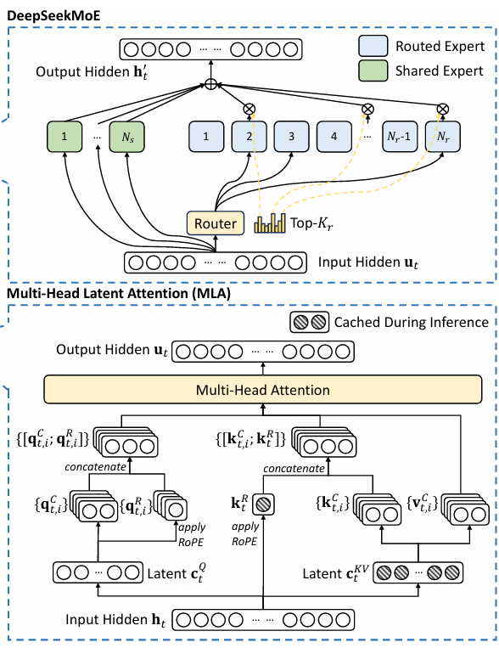
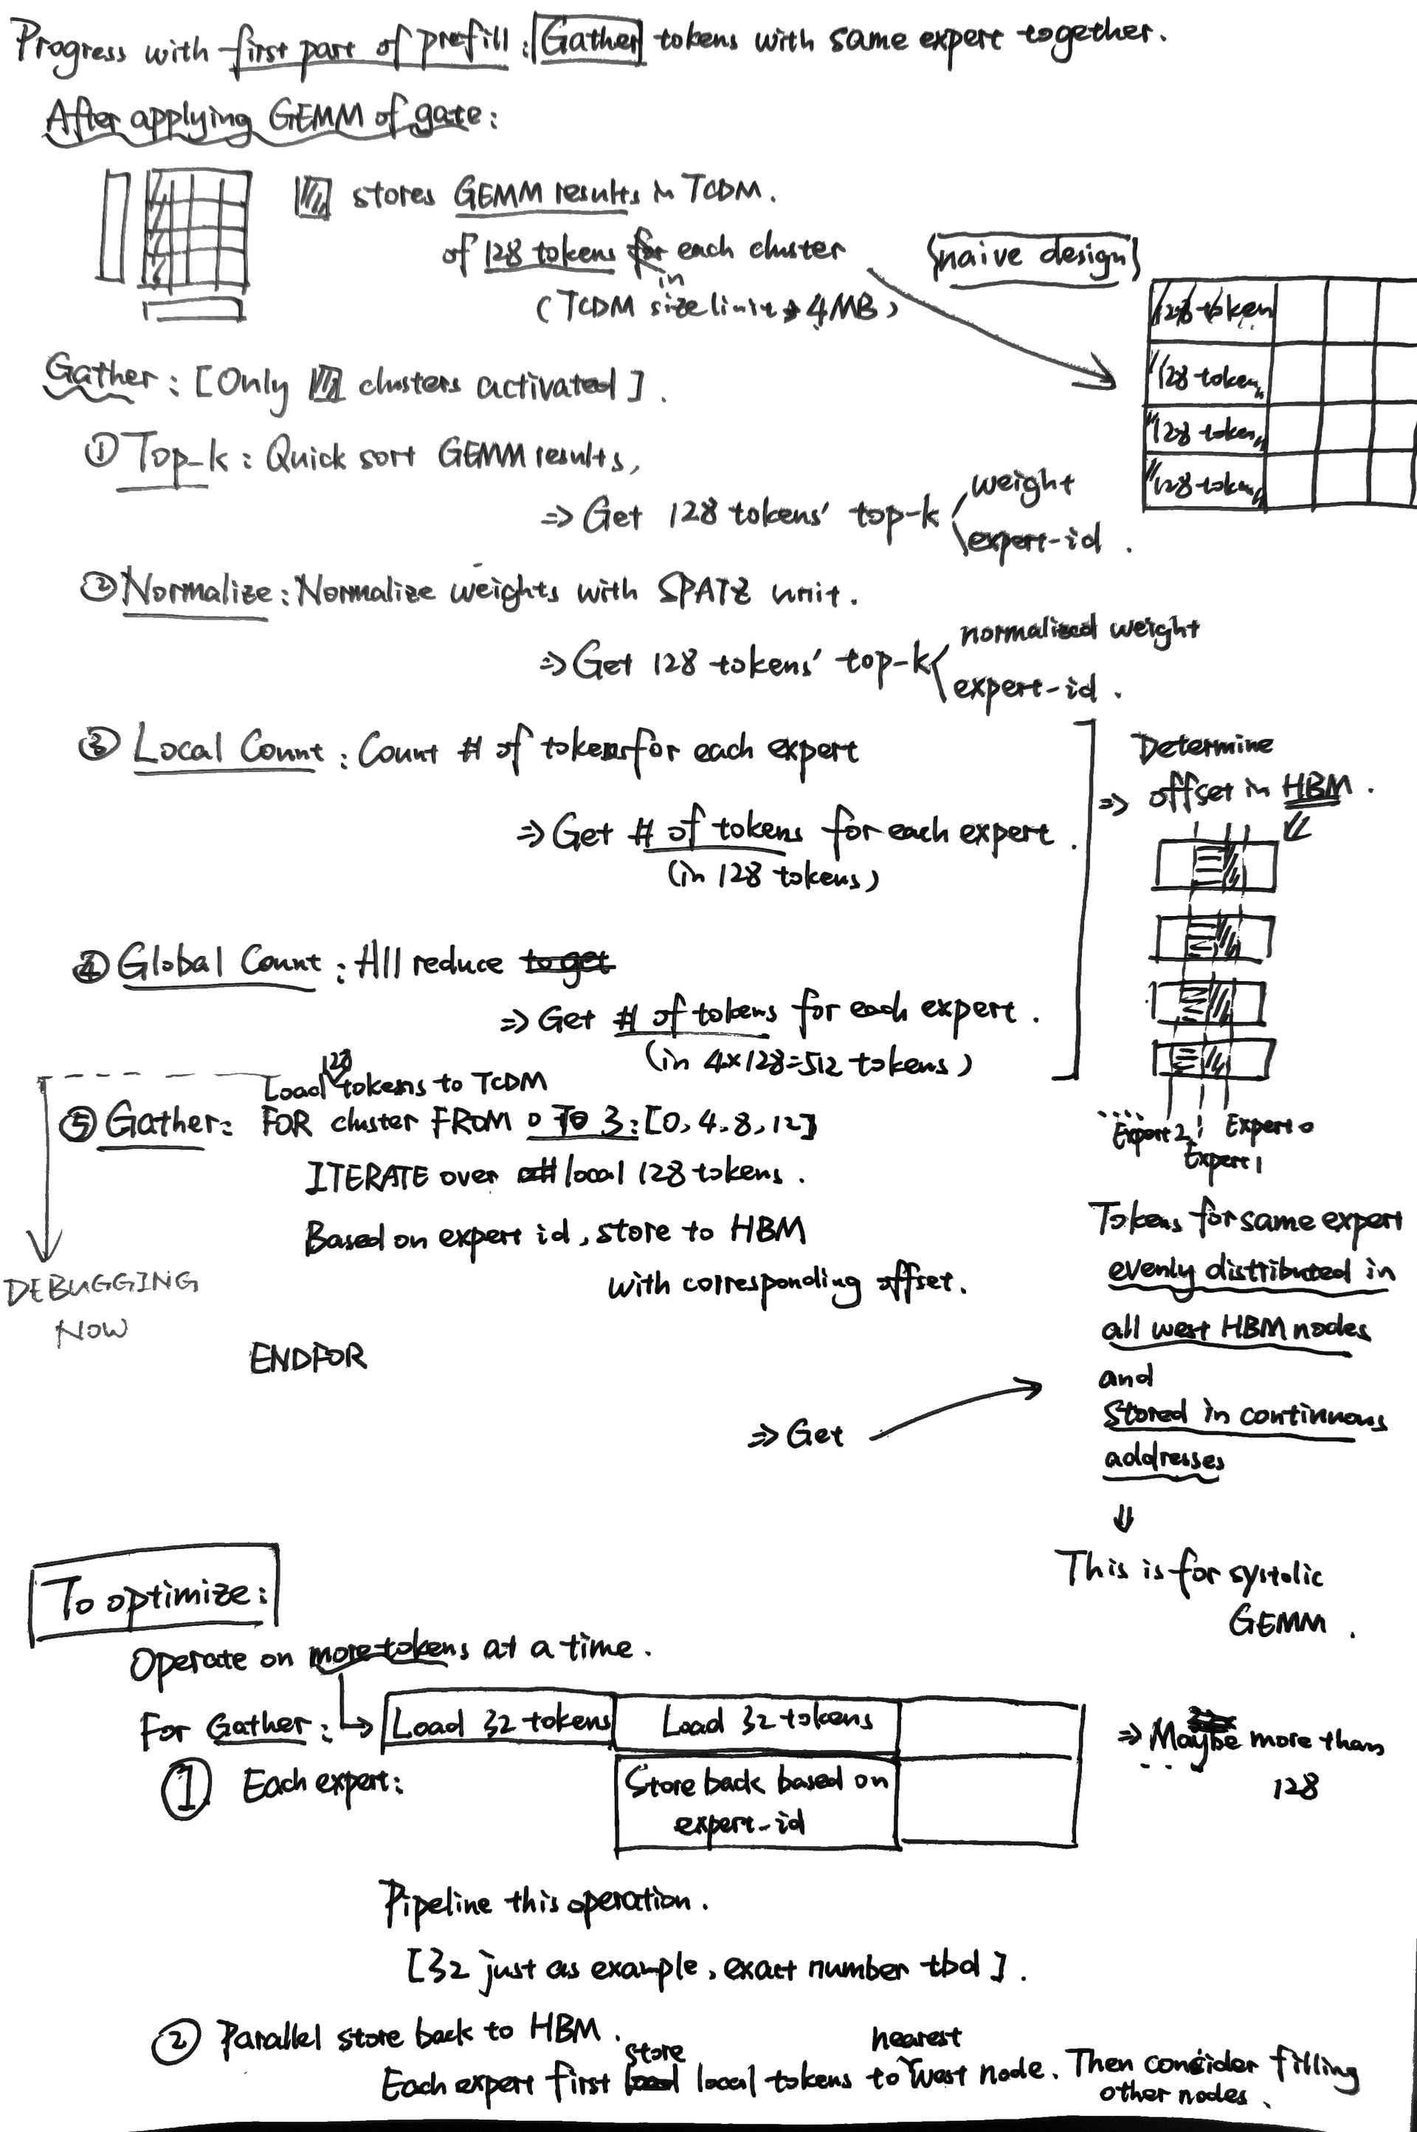
Next Plan
DeepSeekMoE Prefill Dataflow Plan
DeepSeek MLA Prefill
Write a template code on SoftHier
DeepSeek MoE Prefill
Our students are keeping working on this
FlooNoC Collective Primitives
We only have RTL implementation done with multicast supported
The Multicast speedup is aligned with SoftHier modeling
Start to estimate the area cost

