Slide 1
SoftHier Bi-Weekly Meeting
Chi Zhang chizhang@iis.ee.ethz.ch
Thomas Benz tbenz@iis.ee.ethz.ch
Luca Colagrande colluca@iis.ee.ethz.ch

Slide 2
SoftHier Progress General Updates
FlatAttention Paper
We finally submitted this paper to ISVLSI
Now are cleaning up code and preparing for open sourcing FlatAttention
NoC RTL model with Collectives
We are now focusing on extending FlooNoC RTL with Collectives
The goal is to evaluate the area and power
SoftHier + DaCe update
We had some quite good progress and here show some results

Slide 3

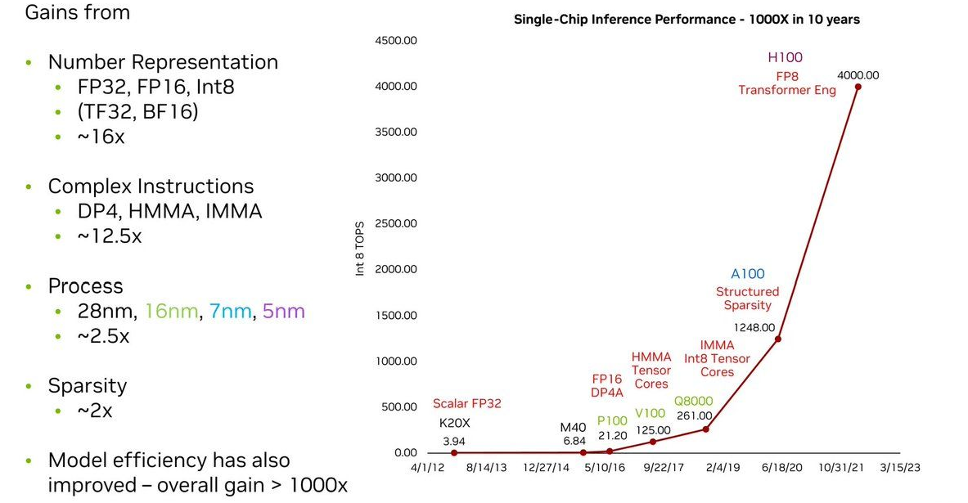

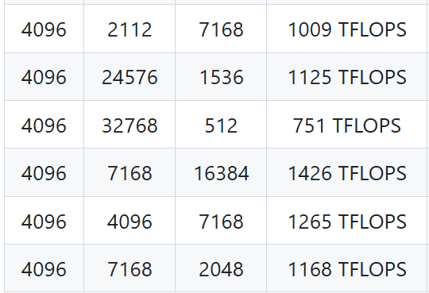
Yes Chip with PetaFLOPS, But The Utilization …
GEMM FP8 on H100
Peak Perf = 2000TFLOPS
(w/o sparsity)

Slide 4
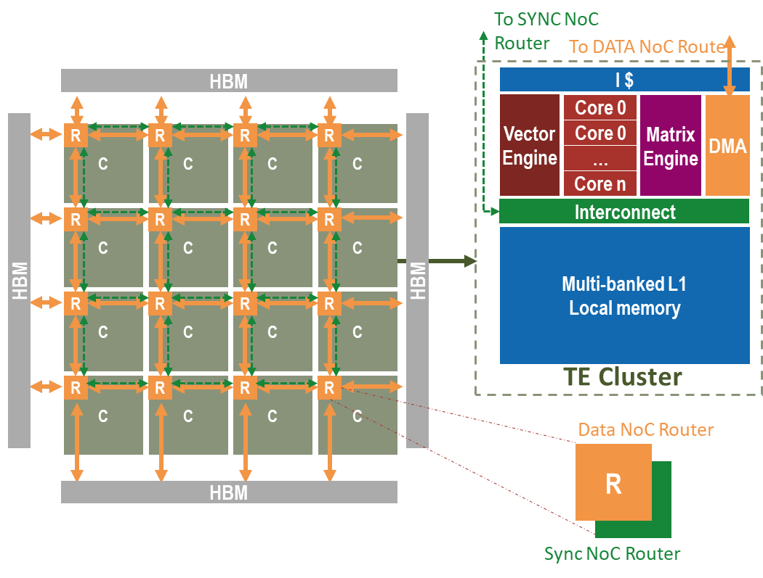
New HW-SW Solution for Better PetaFLOPS Chip Utilization
SoftHier
for HW exploration
Dace Code Generation
for SW exploration
Tiling
Parameter
Data
Layout
Design Space
Co-exploration
Dataflow
Workload
Maping

Slide 5
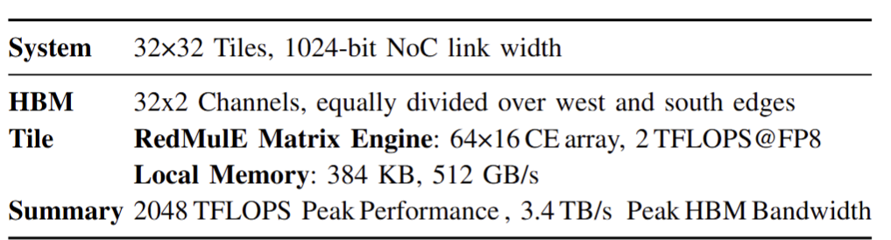
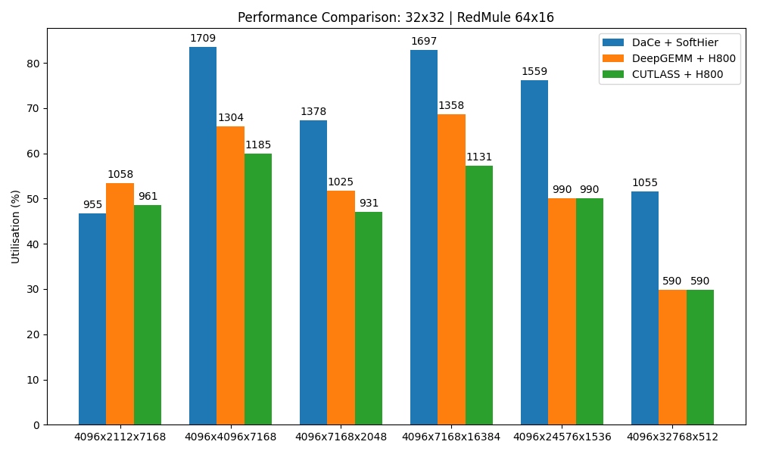
We Are Bridging The Gap
Some GEMMs already achieve 80% utilization, while DeepSeek’s solution on H800 only ~60%.
In some cases, we achieve 2× speedup over DeepGEMM.
We are still plugin more dataflow schemes into DaCe Framework, seeking for more improvements

Slide 6
Further Focuses
End-to-End Deployment of SoA Models
Emphasis on full-stack implementation (e.g., DeepSeek)
Support for low-compute operators essential for complete End-to-End flows
RTL Design & PPA Analysis
Focus on performance, power, and area (PPA) cost of collective operations in NoCs
Emerging Workloads: Non-Prefill Inference
Shift toward autoregressive and reasoning-heavy strategies
Includes methods like beam search becoming increasingly relevant

