Slide 1
QuantSparse 3D Biweekly 2025-04-08
Integrated Systems Laboratory (ETH Zürich)
Bowen Wang bowwang@iis.ee.ethz.ch Paul Scheffler paulsc@iis.ee.ethz.ch
Luca Benini lbenini@iis.ee.ethz.ch

Slide 2
Agenda
Progress Update
Spatz: GVSoC Modeling and RTL
NoC packing: GVSoC Modeling
3D stacking: Literature Review and Initial Plan
Timeline
Discussion

Slide 3
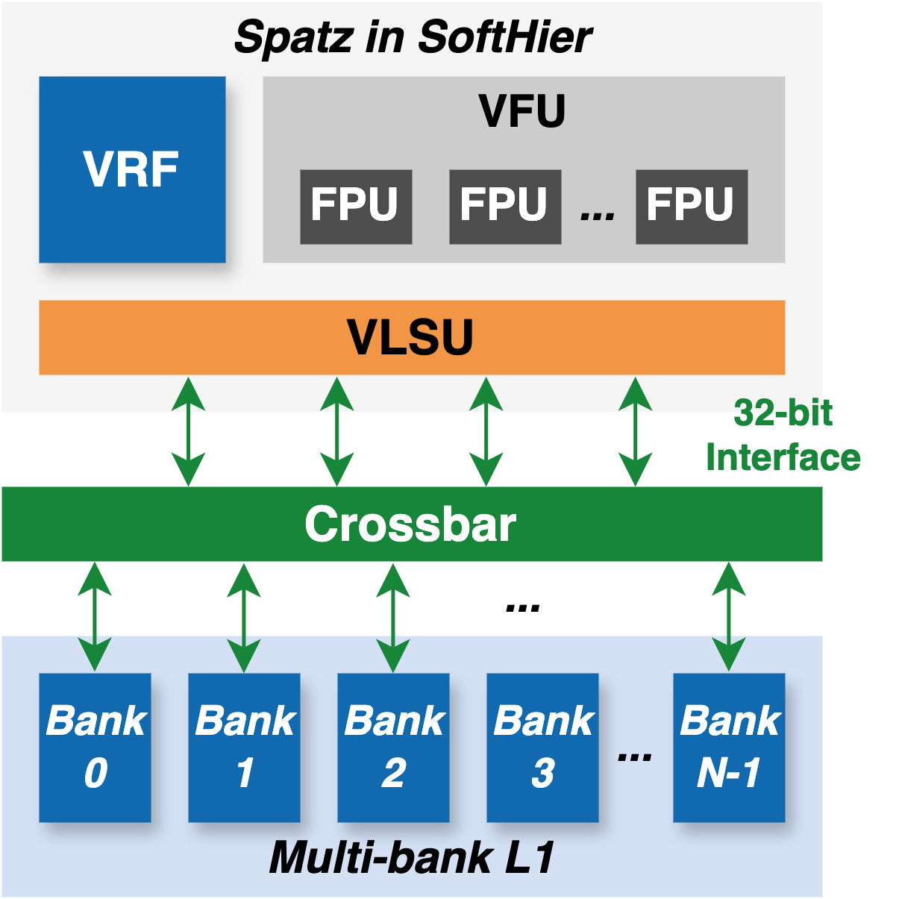
Spatz GVSoC Model Update
Original Spatz model in SoftHier
Configurable number of VLSU ports
Configurable L1 bank data width
Fixed VLSU bus-width

Slide 4
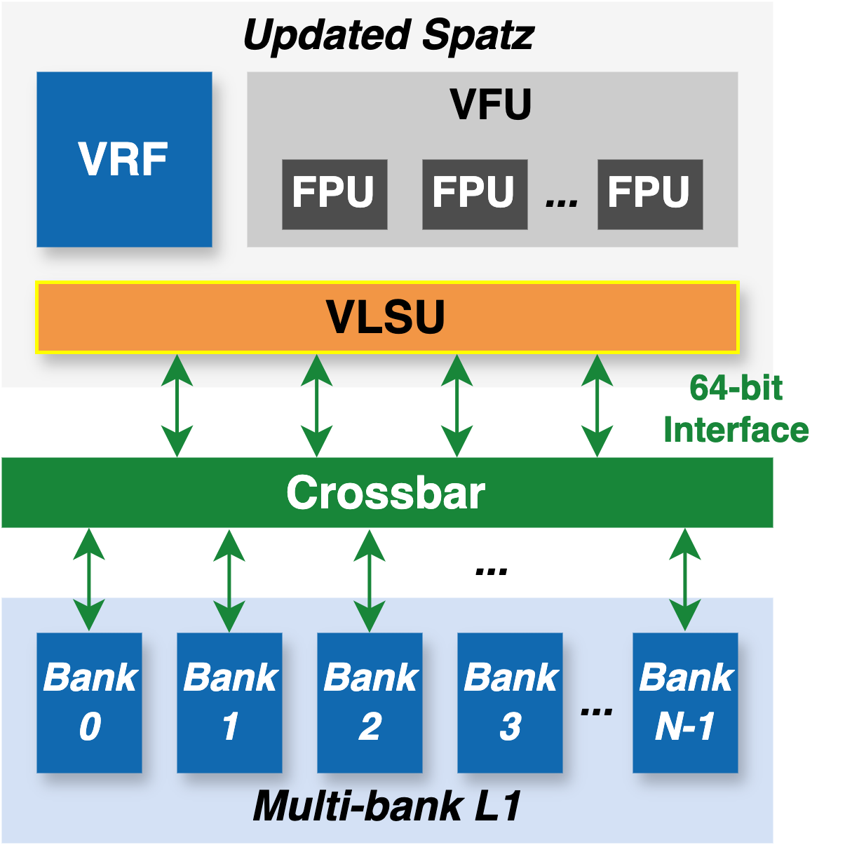

Spatz GVSoC Model Update
Original Spatz model in SoftHier
Configurable number of VLSU ports
Configurable L1 bank data width
Fixed VLSU bus-width
Updated Spatz model
Configurable VLSU bus-width
Updated vector instruction libraries
Vector load: vleX.v (X=8, 16, 32, 64)
Vector store: vseX.v (X=8, 16, 32, 64)
Additional instruction support
Minor fix on vid.v
https://github.com/gvsoc/gvsoc/tree/soft_hier_release(#94, #99)

Slide 5
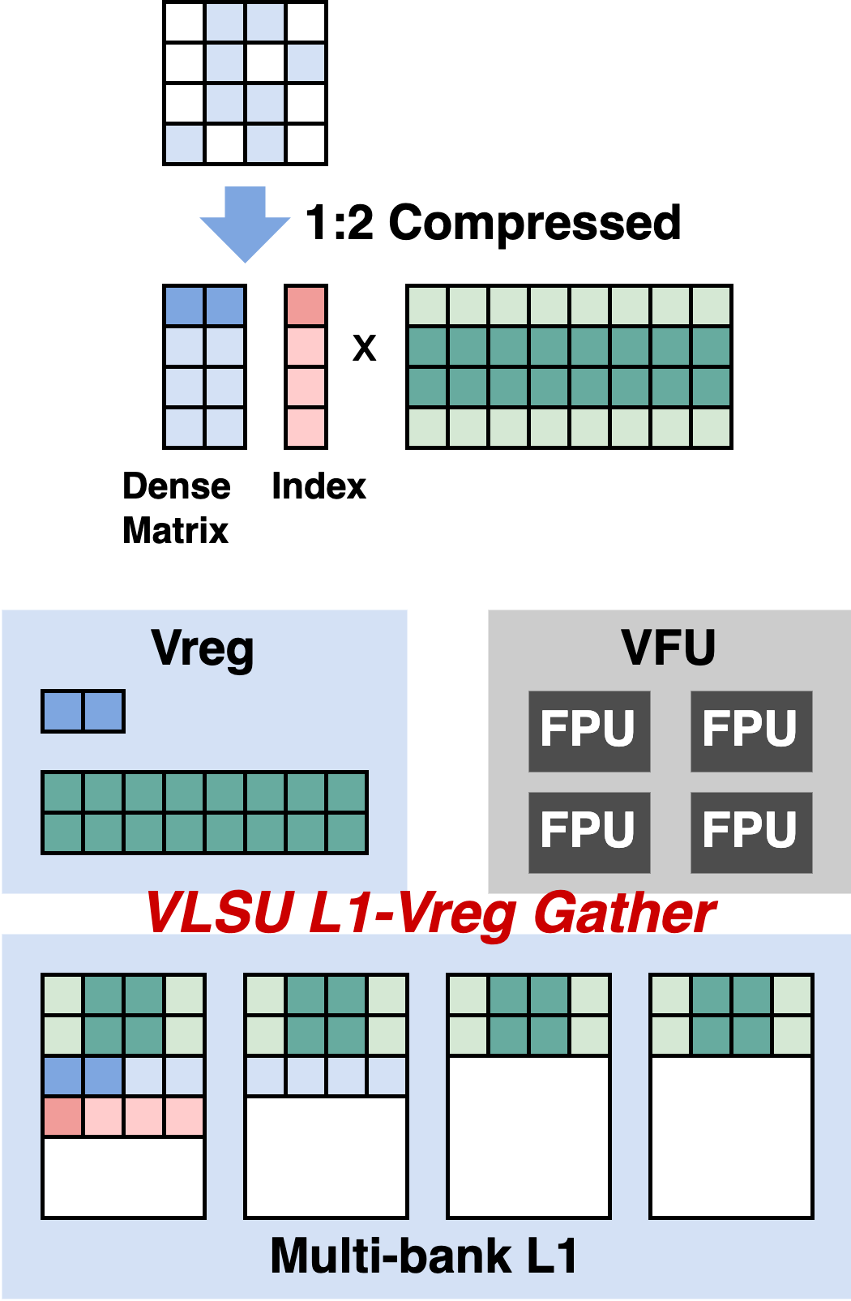
Spatz N:M Structure Sparsity RTL Update
Spatz has a limited stride/index load support
64-bit stride load/store operations are supported
Lower precision stride load/store operations are missing
Index load/store operations are missing
Current progress
The student project started working on low-precision stride load/store RTL implementation
https://github.com/gvsoc/gvsoc/tree/soft_hier_release(#94, #99)

Slide 6
NoC Packing Scheme: Cluster (TX) side
Started work on cluster-side (TX) architecture design
Wide bus (e.g. 256b) split into narrow request lanes (e.g. 64b)
Parallel address generators generate strided or indirect sequences
Determine target NoC endpoint
Indices fetched from L1
Per-lane reorder buffers store reqs, vote to decide next target endpoint
Goal: maximum BW utilization
Request sequences are segmented, limiting latency and preventing starvation
Req. Gen
Segment: (ID, R/W,
#reqs)
TX Packer
DMA xfers (strided/indir)
flit hdr.
segment control
segment control
endp. vote
Index fetch (to TCDM)
ctrl
ctrl
narrow requests
endps
narrow addrgen
L0 ROB
BM
CAM
narrow addrgen
L1 ROB
BM
CAM
flit data
narrow addrgen
CAM
L2 ROB
BM
narrow addrgen
L3 ROB
BM
CAM

Slide 7
NoC Packing Scheme: GVSoC Implementation
Worked on implementation of TX model in GVSoC
Common requirement: FIFO buffers with backpressure support
Existing GVSoC queues enqueue callback times on push → complex handling required in case of stalls
Alternative: Recurring callback on head whenever nonempty → No downstream stall handling!
Worked on reusable dataflow FIFO for simpler backpressure
Store data, enqueue event
at t + fill
Store data, enable recurring event if off
Data3
evt @ t+3
Data3
Recurring FIFO evt. (data is at head)
Data2
evt @ t+2
Data2
GVSoC Queue
Dataflow FIFO
Data1
evt @ t+1
Data1
Data0
evt @ t
Data0
On stall: must reschedule
pending events!
No reschedule on stall; just disable evt. when empty

Slide 8
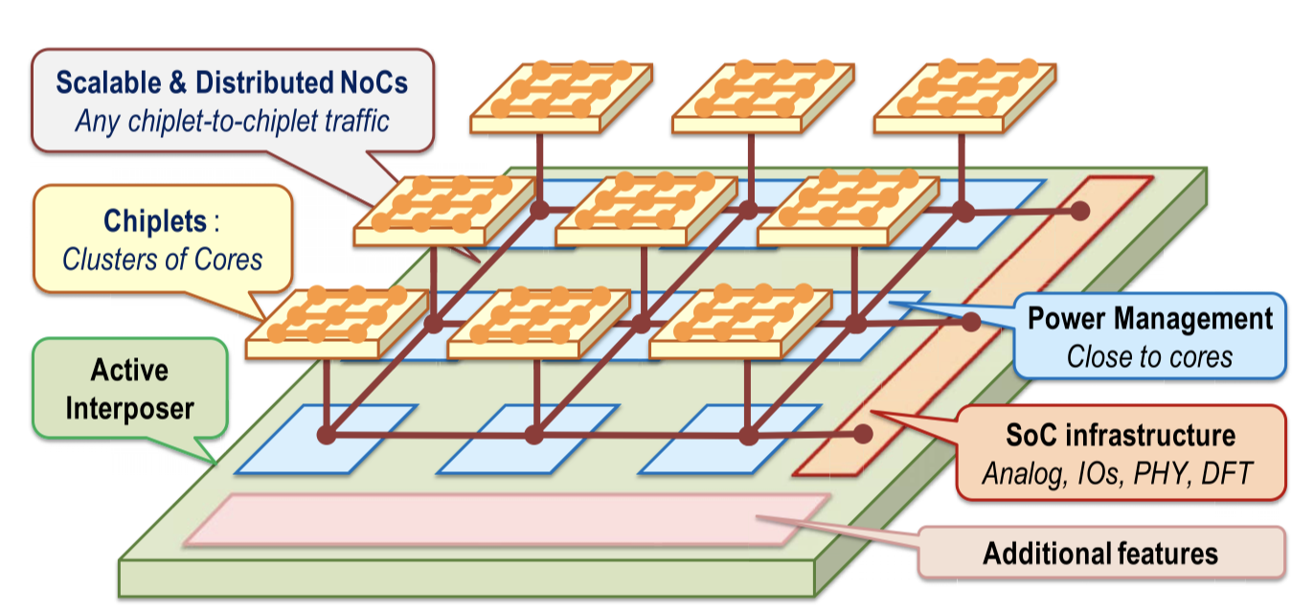
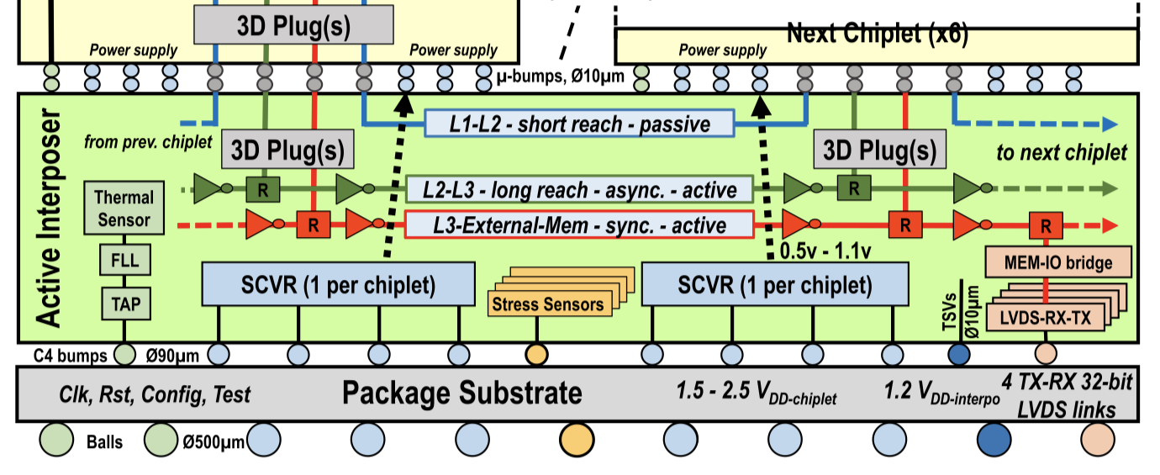
3D-Chiplet Integration: Literature Review
IntAct^{[1]}: Architecture overview
Six 16-core chiplets in 28nm FDSOI technology
3D-stacked onto a 65nm CMOS active interposer
Active interposer is not just wiring:
Integrated power management
Distributed NoC for chiplet-to-chiplet communication
System I/O PHYs
Face-to-face 3D stacking
20 µm-pitch micro-bumps→3 Tbit/s/mm² bandwidth density
Distributed Interconnects via Active Interposer → Hierarchical NoC: 2D NoCs inside chiplets + 2D NoC in the interposer

Slide 9
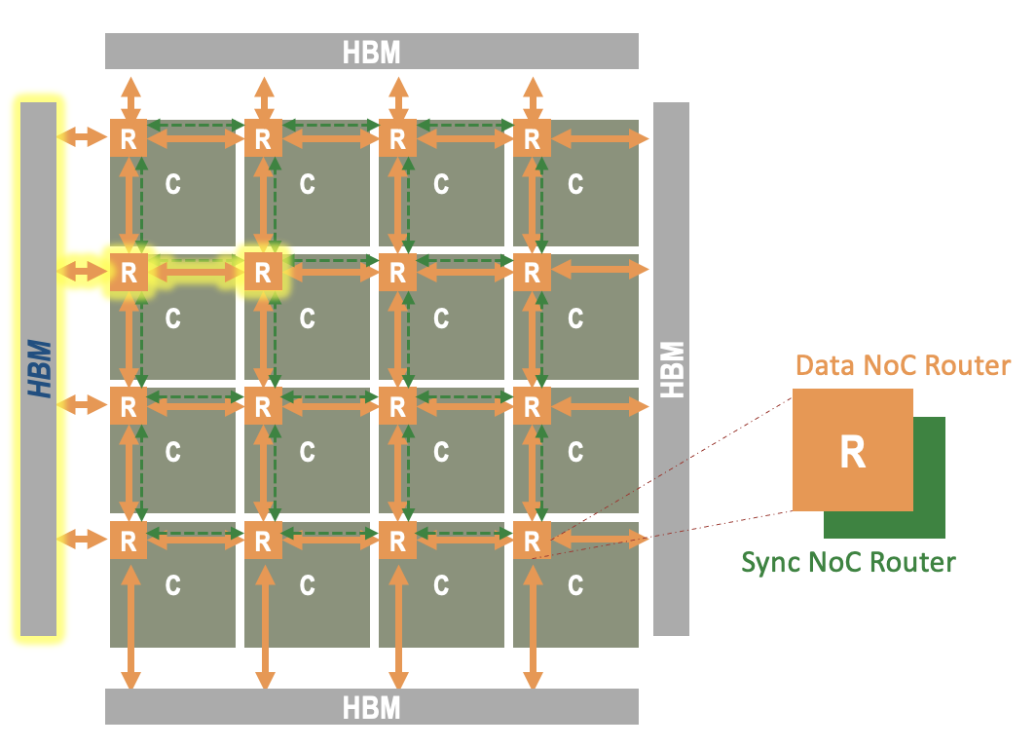
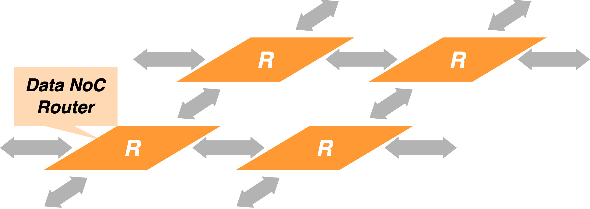
3D-Chiplet Integration: Initial Plan
Current SoftHier Clusters
PEs clustered in 2D NoC mesh, HBM as main memory
NoC enables:
Cluster L1 ←→ HBM, Cluster L1 ←→ Cluster L1
Wide link data NoC, iDMA for buck data transfer
Narrow link sync NoC, snitch core remote access for global synchronization purposes

Slide 10
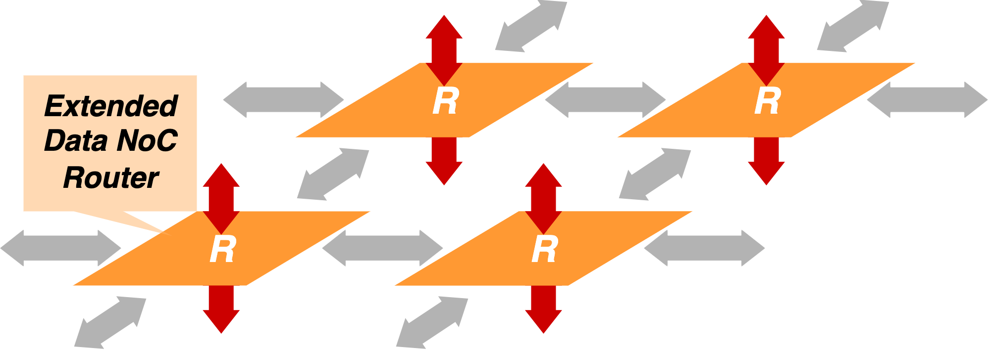
3D-Chiplet Integration: Initial Plan
Current SoftHier Clusters
PEs clustered in 2D NoC mesh, HBM as main memory
NoC enables:
Cluster L1 ←→ HBM, Cluster L1 ←→ Cluster L1
Wide link data NoC, iDMA for buck data transfer
Narrow link sync NoC, snitch core remote access for global synchronization purposes
Initial plan:
Extend the GVSoC data router model with two additional degrees of freedom
Literature review on physical feasibility, design specifications, and advancements in chiplet-based 3D integration technologies

Slide 11
Timeline
Multi-granularity sparsity handling
Spatz GVSoC model VLSU port extension
Start GVSoC modeling of NoC packing scheme
Initial discussion on 3D chiplet integration
Year 1
Year 2
2025-02
2025-04
2026-02
2027-02
Project
Start
Literature
Review
Proposed Spatz-based multi-cluster architecture
Literature review on quantization handling
Literature review on sparsity and quantization format supported on SoA platforms

Slide 12
Timeline
Multi-granularity sparsity handling
Spatz GVSoC model VLSU port extension
Start GVSoC modeling of NoC packing scheme
Initial discussion on 3D chiplet integration
Year 1
Year 2
2025-02
2025-04
2026-02
2027-02
Project
Start
Literature
Review
Next step:
Proposed Spatz-based multi-cluster architecture
Literature review on quantization handling
Customized data format for MX-like quantization and N:M structured sparsity
Customized ISA support in Spatz GVSoC model
Literature review on 3D chiplet integration and discussion on GVSoC modeling
Literature review on sparsity and quantization format supported on SoA platforms

Slide 13
References
[1] Vivet, Pascal, et al. "IntAct: A 96-core processor with six chiplets 3D-stacked on an active interposer with distributed interconnects and integrated power management." IEEE Journal of Solid-State Circuits 56.1 (2020): 79-97.

