Slide 1
FlatAttention: Dataflow and Fabric Collectives Co-Optimization for Efficient Multi-Head Attention on Tile-Based Many-PE Accelerators
Chi Zhang chizhang@iis.ee.ethz.ch
Luca Colagrande, Renzo Andri, Thomas Benz, Gamze Islamoglu, Alessandro Nadalini, Francesco Conti, Yawei Li and Luca Benini

Slide 2



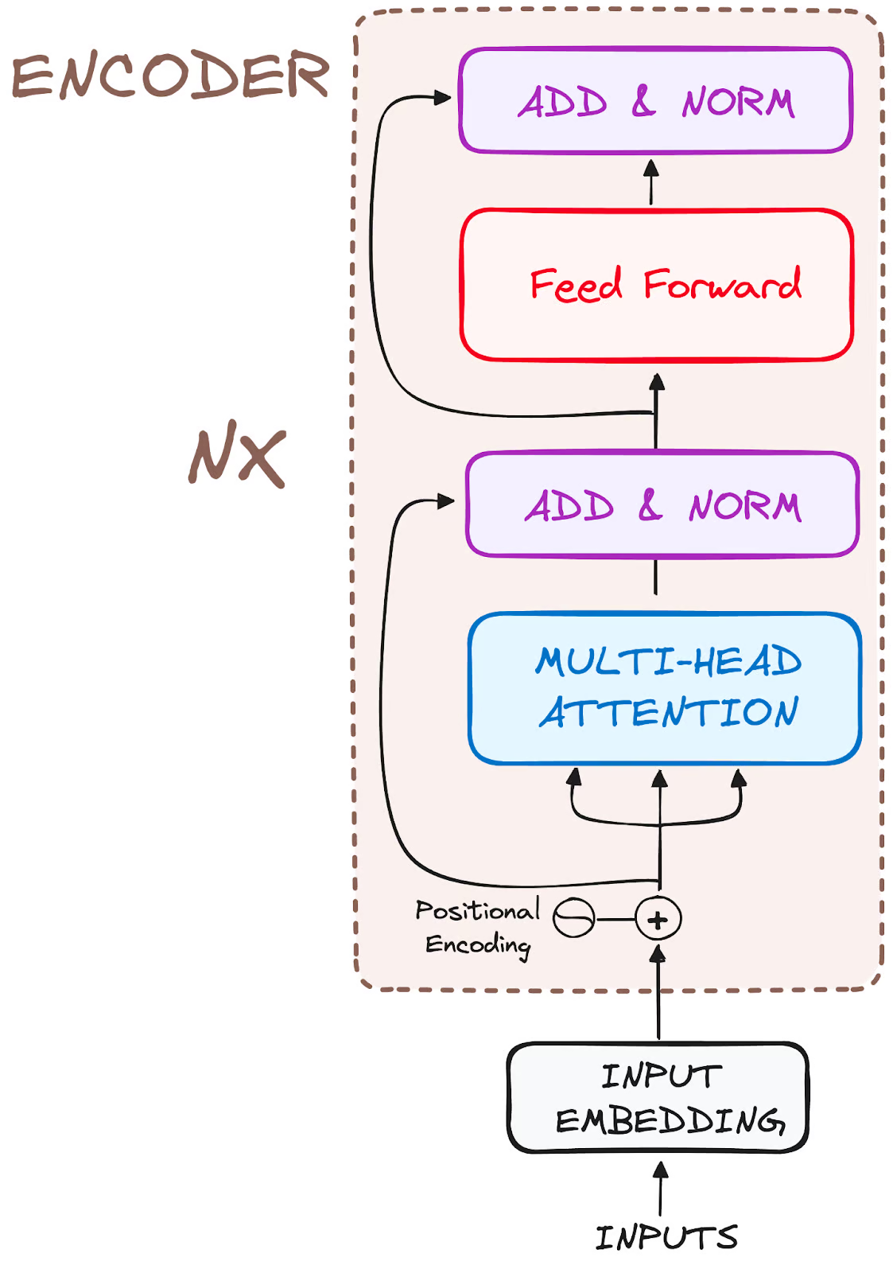



The Attention Bottleneck in Transformer-Based LLMs
LLM workloads have become increasingly impactful
DeepSeek-V3, ChatGPT, Llama
Dominating LLM are Transformer-based
The attention bottleneck
Multi-Head Attention (MHA) exhibits quadratic complexity over sequence length. O(S²)
Most operations in MHA are bottlenecked by memory accesses^{[1]}
Performance bottleneck for
LLM inference
Especially during long context prefill
LLM training
D
K^{T}
S
Q
Attention Score
(1).$\frac{Q∗K^{T}}{\sqrt{D}}$
S
(2).$SoftMax$
O
SoftMax(Att.Score)
V
S
(3).$S∗V$
Multi Heads

Slide 3
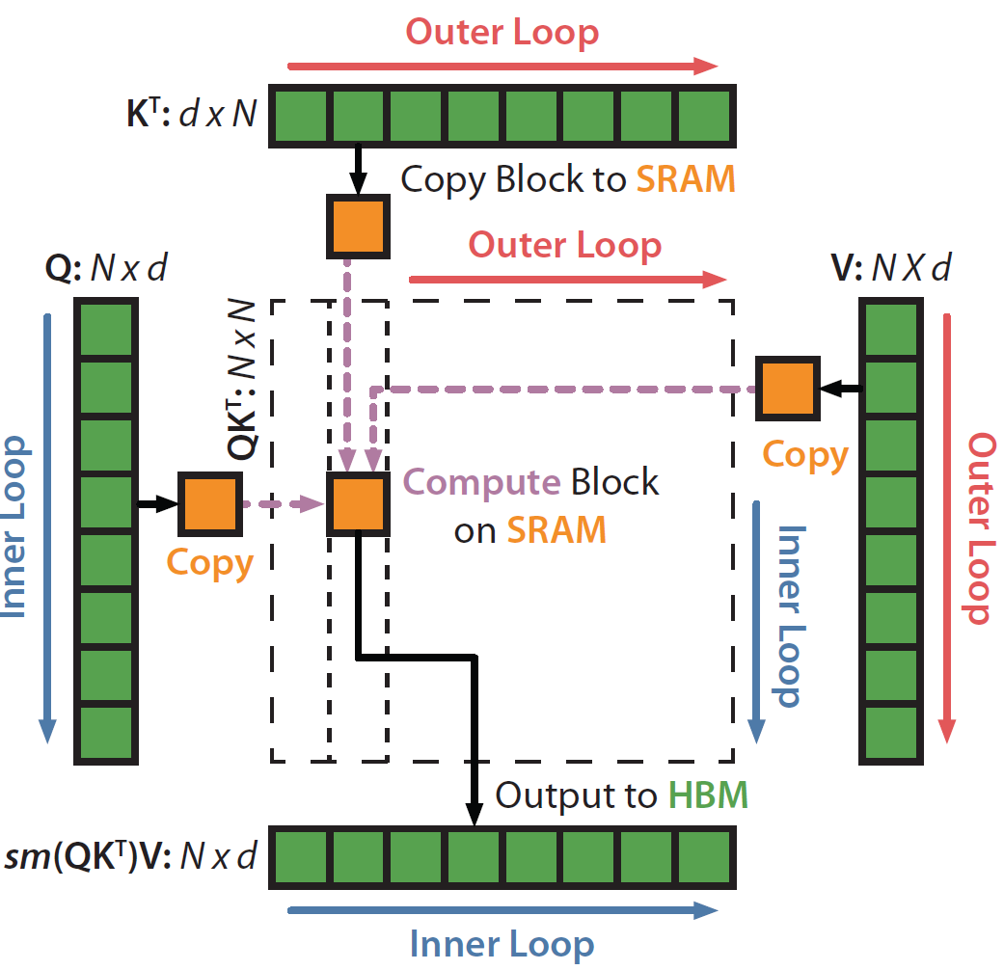
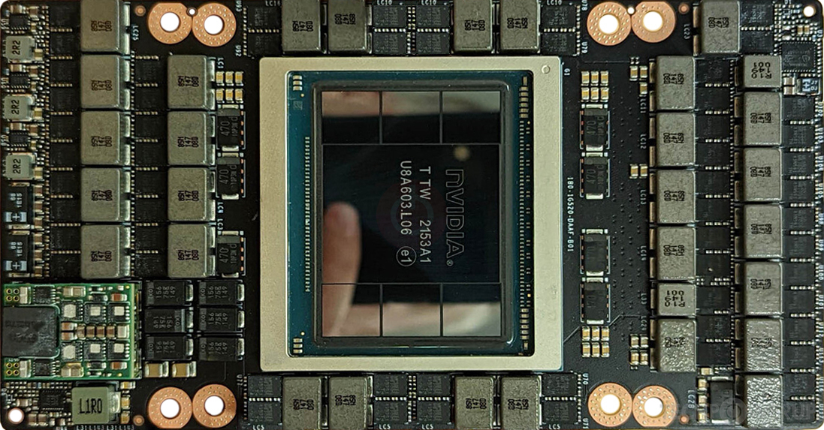
SoA Solution: FlashAttention-3 on Nvidia H100 GPU
The attention bottleneck has driven optimizing MHA dataflows on the dominant AI hardware platform – Nvidia GPU
FlashAttention^{[2]} – most widely adopted solution
Efficiently fuses MHA microkernels
FlashAttention-2^{[8]}: algorithmic optimizations
FlashAttention-3^{[9]}: leverages asynchronous execution
Drawback of SoA solution: FlashAttention-3 on H100
Suboptimal performance
No more than 75% utilization on H100
High cost of hardware platform
814 mm² die on TSMC’s 5nm process node
6 HBM3 stacks – up to 50% total cost
700W Thermal Design Power(TDP)
HBM
HBM
HBM
Die
HBM
HBM
HBM

Slide 4
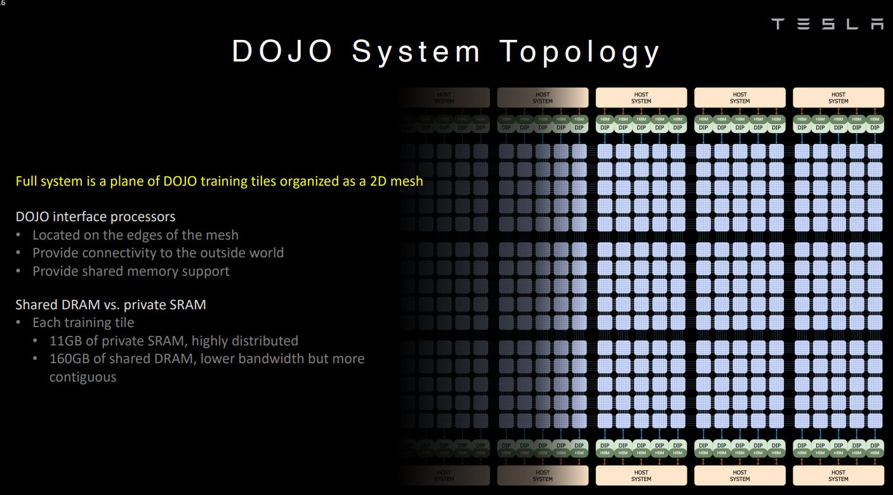
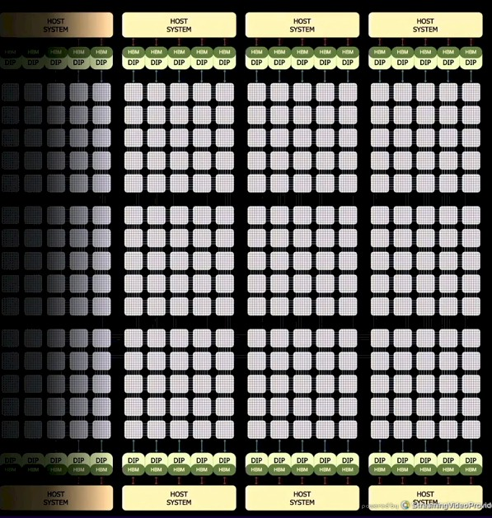
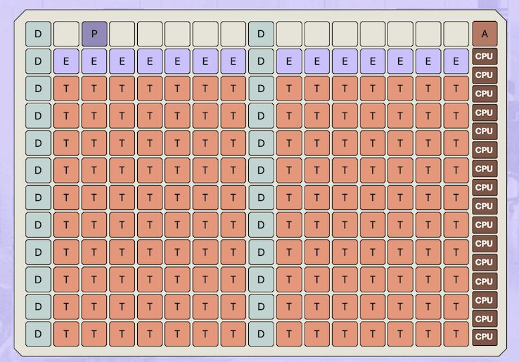

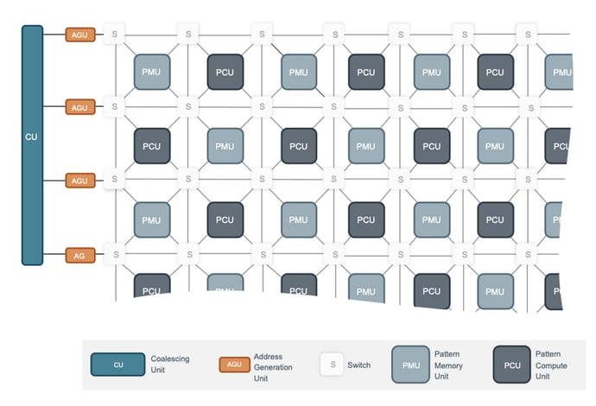
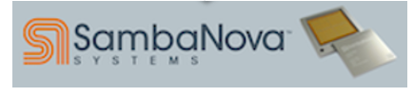
Emerging AI Accelerator: Tile-Based Many-PE Architecture
Tile-based many-PE accelerators
Structured as meshes of compute tiles
Matrix, vector and scalar engines
Local explicitly managed memories
Interconnect with scalable NoC topology
Main memory positioned at die boundaries
Favors silicon efficiency and scalability
A dense compute tile placement
Software-controlled partitioned memory hierarchy
Eliminates L2 on-chip cache for area efficiency
Examples
Tesla’s Dojo, Tenstorrent’s Blackhole, SambaNova
Matrix engine
L1 local memory
Vector engine
I$
interconnect
Scalar core
DMA
To Router
CH0
CH1
…
CHn
HBM CTRL
Tile
Tile
Tile
Tile
R
R
R
R
Tile
Tile
Tile
Tile
R
R
R
R
CH0
CH1
…
CHn
HBM CTRL
HBM CTRL
Tile
Tile
Tile
Tile
CH0
CH1
…
CHn
R
R
R
R
Tile
Tile
Tile
Tile
R
R
R
R
HBM CTRL
CH0
CH1
…
CHn
Tile-Based Many-PE
vs Nvidia GPU Arch
HBM CTRL
HBM CTRL
HBM CTRL
SM
SM
L2 Cache
SM
SM
L1
L1
L1
L1
SM
SM
SM
SM
L1
L1
L1
L1
SM
SM
SM
SM
L1
L1
L1
L1
SM
SM
SM
SM
L1
L1
L1
L1
HBM CTRL
HBM CTRL
HBM CTRL

Slide 5
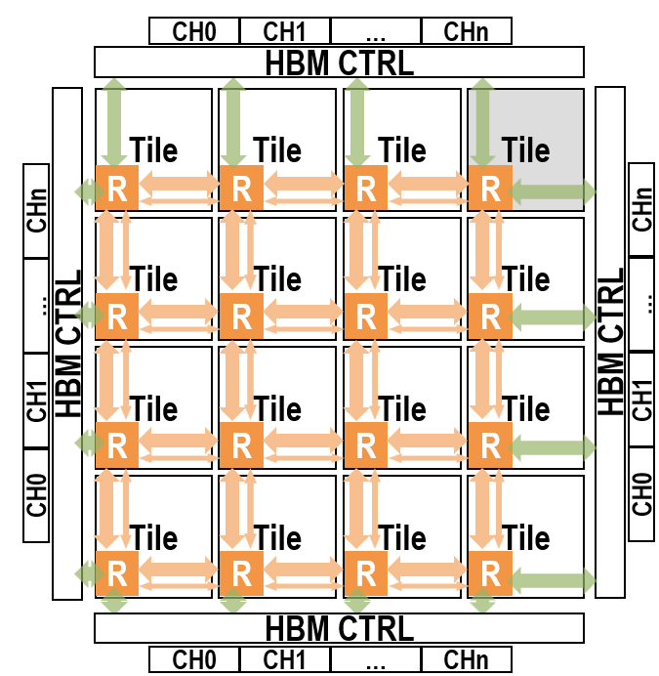
Challenge: MHA Dataflow on Tile-Based Many-PE Architecture
The goal is to
Achieve high utilization of the tiles’ matrix engines
Minimize energy-hungry off-chip accesses
Current solutions
have not reached > 80% utilization on PetaFLOPS chips.
Architecture and dataflow need to be co-explored
Dataflow leverages HW feature, e.g., collective primitives on NoC fabric
Accelerate inter-tile collective communications
Determine optimal architecture design parameters alongside dataflow exploration
SW-Based Multicast
(1)
(2)
(3)
HW-Supported Multicast
Packet Duplicate & Forward

Slide 6
Our Contributions
Modeling and simulation framework for tile-based architecture template (SoftHier)
Estimating the performance of a large set of tile-based accelerators
Enabling the co-design of network collective primitives
FlatAttention MHA dataflow
Leverages collective primitives on the NoC fabric and minimizes off-chip HBM traffic
Co-exploration of accelerator architecture and FlatAttention parameters
Key Results
FlatAttention vs. FlashAttention-3 on tile-based accelerator
Up to 89.3% utilization, 4.1× performance speedup, 16× HBM traffic reduction
Algorithm-architecture co-exploration -> find optimal configuration of tile-based accelerator (BestArch)
Peak FP16 Perf(1024 TFLOPS) matches H100 (989 TFLOPS)
40% less available HBM BW, 1.8× die size reduction (estimated at TSMC 5nm)
Up to 1.3× utilization speedup (FlatAttention on BestArch vs. FlashAttention-3 on H100)

Slide 7
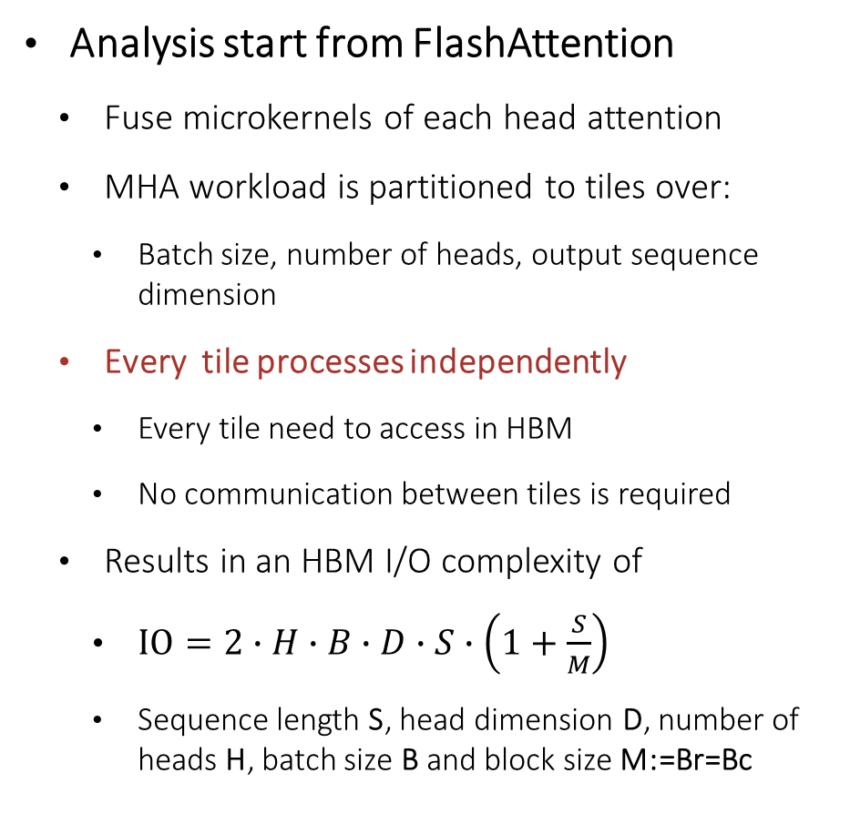
Inner Loop
FlatAttention Motivation
K^{T}: d x S
Copy Block to SRAM
Analysis start from FlashAttention
Fuse microkernels of each head attention
MHA workload is partitioned to tiles over:
Batch size, number of heads, output sequence dimension
Every tile processes independently
Every tile need to access in HBM
No communication between tiles is required
Results in an HBM I/O complexity of
$IO=2∙H∙B∙D∙S∙\left(1+\frac{S}{M}\right)$
Sequence length S, head dimension D, number of heads H, batch size B and block size M:=Br=Bc
d x B_{c}
Q: S x d
V: S x d
Copy
B_{r} x d
B_{c} x d
Outer Loop
B_{r} x B_{c}
Copy
Inner Loop
Output to HBM
sm(QK^{T})V: S x d
Outer Loop
Tile
Tile
Tile
Tile
Tile
Tile
Tile
Tile
Tile
Tile
Tile
Tile
Tile
Tile
Tile
Tile

Slide 8
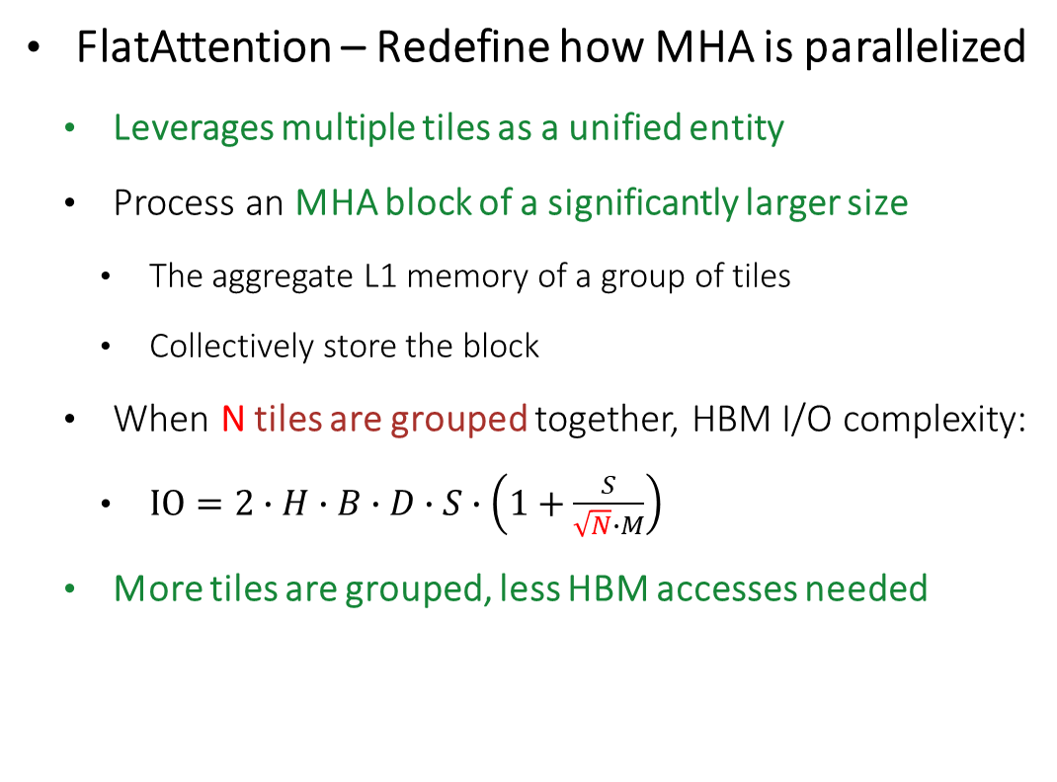
Inner Loop
FlatAttention Motivation
K^{T}: d x S
Copy Block to SRAM
FlatAttention – Redefine how MHA is parallelized
Leverages multiple tiles as a unified entity
Process an MHA block of a significantly larger size
The aggregate L1 memory of a group of tiles
Collectively store the block
When N tiles are grouped together, HBM I/O complexity:
$IO=2∙H∙B∙D∙S∙\left(1+\frac{S}{\sqrt{N}∙M}\right)$
More tiles are grouped, less HBM accesses needed
d x B_{c}
Copy
Q: S x d
V: S x d
B_{r} x d
B_{c} x d
Outer Loop
B_{r} x B_{c}
Copy
Inner Loop
Output to HBM
sm(QK^{T})V: S x d
Outer Loop
Tile
Tile
Tile
Tile
Tile
Tile
Tile
Tile
Tile
Tile
Tile
Tile
Tile
Tile
Tile
Tile

Slide 9
Detailed FlatAttention Dataflow
Distinct data movement patterns within the tile group
Edge tiles collect data from HBM once and inter-tile data exchange via collective communications
Tile
Tile
Tile
Tile
1
V
V
2
V
V
3
V
V
4
V
V
O
Q
O
Q
O
Q
O
Q
O
Q
O
Q
O
Q
O
Q
K^{T}
K^{T}
K^{T}
K^{T}
K^{T}
K^{T}
K^{T}
K^{T}
Att
Att
Att
Att
S
S
S
S
Tile
Tile
Tile
Tile
m l e l₋₁ m₋₁
m l e l₋₁ m₋₁
m l e l₋₁ m₋₁
m l e l₋₁ m₋₁
m l e l₋₁ m₋₁
m l e l₋₁ m₋₁
m l e l₋₁ m₋₁
m l e l₋₁ m₋₁
m l e l₋₁ m₋₁
O
Q
V
O
Q
V
O
Q
V
O
Q
V
O
Q
V
O
Q
V
O
Q
V
O
Q
V
Tile
Tile
Tile
Tile
K^{T}
K^{T}
K^{T}
K^{T}
K^{T}
K^{T}
K^{T}
K^{T}
Att
Att
Att
Att
S
S
S
S
G_{y}
m l e l₋₁ m₋₁
m l e l₋₁ m₋₁
m l e l₋₁ m₋₁
m l e l₋₁ m₋₁
m l e l₋₁ m₋₁
m l e l₋₁ m₋₁
m l e l₋₁ m₋₁
m l e l₋₁ m₋₁
m l e l₋₁ m₋₁
Tile
Tile
Tile
Tile
Load Q and row-wise multicast
Load K^{T} V and col-wise multicast
Calculate att.score, scaling, and local rowmax m
Row-wise red.max m and multicast
5
V
V
6
V
V
7
V
V
8
V
V
G_{x}
O
Q
O
Q
O
Q
O
Q
O
Q
O
Q
O
Q
O
Q
B_{c}
K^{T}
K^{T}
K^{T}
K^{T}
K^{T}
K^{T}
K^{T}
K^{T}
P
P
P
P
P
P
P
P
B_{c}/G_{x}
K^{T}
B_{c}/G_{x}
m l e l₋₁ m₋₁
m l e l₋₁ m₋₁
m l e l₋₁ m₋₁
m l e l₋₁ m₋₁
m l e l₋₁ m₋₁
m l e l₋₁ m₋₁
m l e l₋₁ m₋₁
m l e l₋₁ m₋₁
m l e l₋₁ m₋₁
B_{r}
O
Q
Attention Score
V
B_{c}
O
Q
V
O
Q
V
O
Q
V
O
Q
V
O
Q
V
O
Q
V
O
Q
V
O
Q
V
K^{T}
K^{T}
K^{T}
K^{T}
K^{T}
K^{T}
K^{T}
K^{T}
B_{r}/G_{y}
P
P
P
P
P
P
P
P
m l e l₋₁ m₋₁
m l e l₋₁ m₋₁
m l e l₋₁ m₋₁
m l e l₋₁ m₋₁
m l e l₋₁ m₋₁
m l e l₋₁ m₋₁
m l e l₋₁ m₋₁
m l e l₋₁ m₋₁
m l e l₋₁ m₋₁
Calculate softmax numerator P and demoninator l
Row-wise red.sum l and multicast
Calculate and update local O & tracking statistics l₋₁ , m₋₁
Finalize O with demoninator , row-wise red.sum and store back to HBM

Slide 10
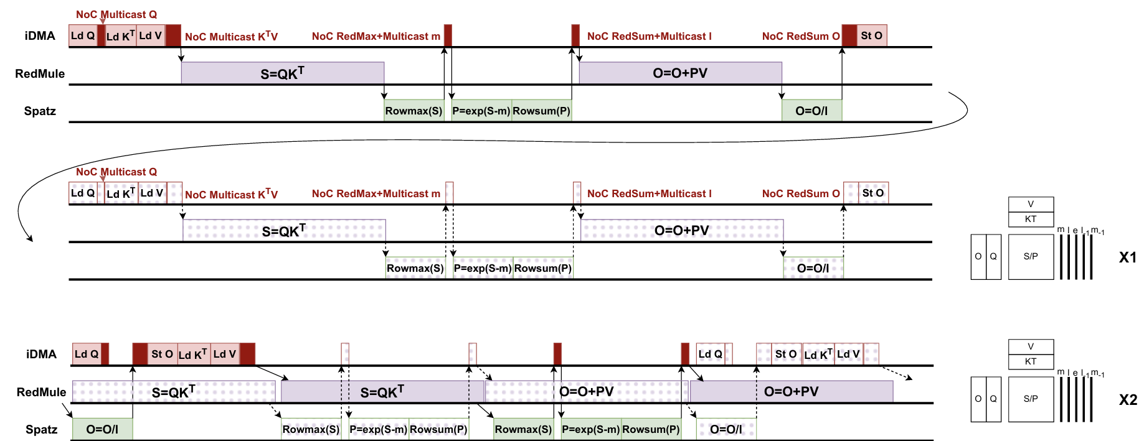
Asynchronous FlatAttention
To further improve utilization
Using asynchronization nature of {DMA, Matrix, Vector} engines invoking
One tile group dealing with 2 heads concurrently
Overlap the runtime of {DMA, Matrix, Vector} engines
DMA
Matrix
^{Engine}
Vector
^{Engine}
_{Naïve FlatAttention}
O
Q
V
K^{T}
_{x1}
Att
m l e l₋₁ m₋₁
DMA
_{Asynchronous FlatAttention}
O
Q
V
Matrix
^{Engine}
K^{T}
_{x2}
Vector
^{Engine}
Att
m l e l₋₁ m₋₁

Slide 11

High-Level Simulation Model – SoftHier System
Fully Parameterizable through Configuration File
System configuration
#Tiles (#row, #column)
NoC link data width
#HBM channels and placement on 4 edges
Cluster configuration
L1 memory capacity and bandwidth
Matrix engine systolic array (shape, CE pipeline stage)
DMA burst length, #outstanding burst
Based on GVSoC^{[10]} Platform
Event-based simulator, fast simulation speed up to 25 MIPS
Calibrated with RTL Models
To SYNC NoC Router
To DATA NoC Router
HBM
I $
Vector
Engine
Core 0
Matrix
Engine
DMA
R
R
R
R
Core 0
T
T
T
T
…
Core n
T
T
T
T
Interconnect
R
R
R
R
L1 local memory
HBM
HBM
T
T
T
T
R
R
R
R
TE Cluster
T
T
T
T
R
R
R
R
Data NoC Router
R
R
HBM
Sync NoC Router
https://github.com/gvsoc/gvsoc/tree/soft_hier_release

Slide 12
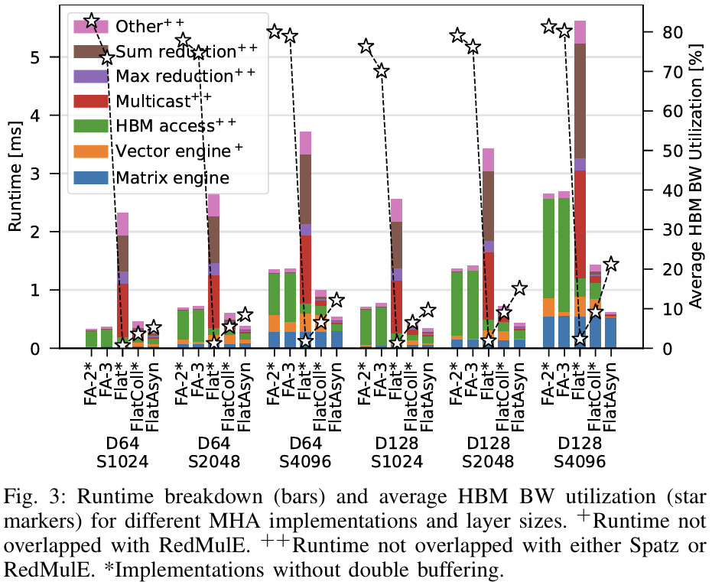
FlashAttention vs. FlatAttention
Compare different MHA implementations
FlashAttention-2(FA-2) and FlashAttention-3 (FA-3)
Naïve FlatAttention without (Flat) and with (FlatColl) Collective primitves on NoC fabric.
Asynchronous FlatAttention (FlatAsyn) with NoC collective primitives
With FlatAttention group includes all tiles
Results
FlashAttention is highly memory-bound
FlatAttention significantly reduces HBM access
NoC supported collective primitives are essential to accelerate inter-tile data exchange
With NoC collective primitives + Asynchronous:
Up to 89.3% uti, 4.1× perf speedup, 16× less HBM traffic

Slide 13
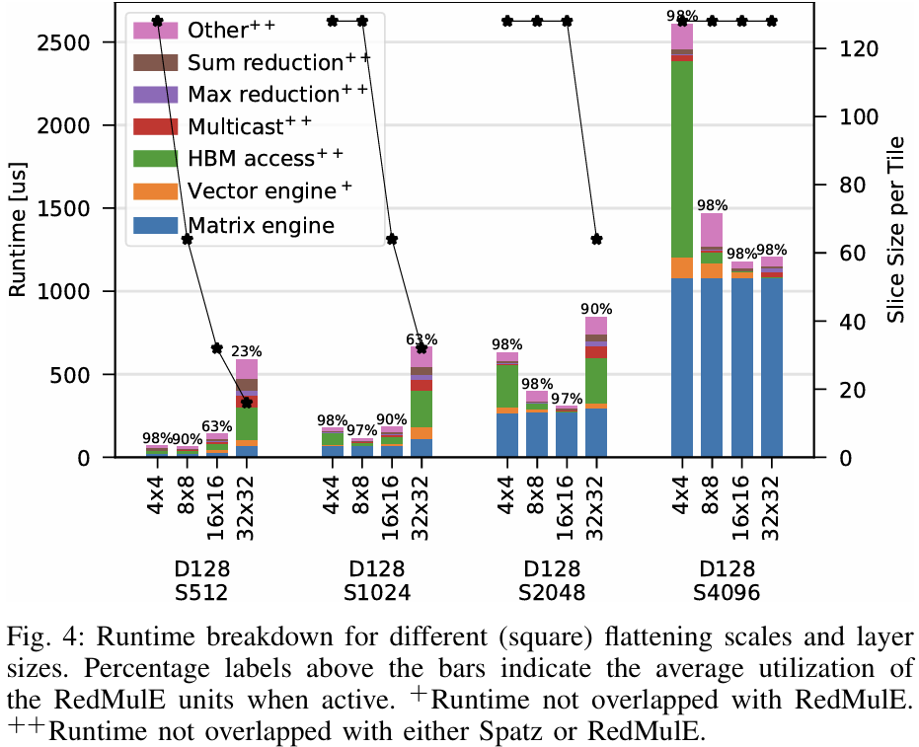
Tile Group ScaleTrade-offs for FlatAttention
Tile
Tile
The group scale is a sensitive parameter to utilization of different MHA layers
MHA with long sequences benefit from large tile group
Reduced overall HBM traffic
MHA with shorter sequence length would suffer from “over-flatten effect”.
Reduced slice size per tile
Reduced matrix engine utilization
Increased synchronization overhead
For every sequence length there exists an optimal group scale balancing the two effects
O
Q
V
slice size per tile
K^{T}
Tile
Tile
Att
m l e l₋₁ m₋₁

Slide 14
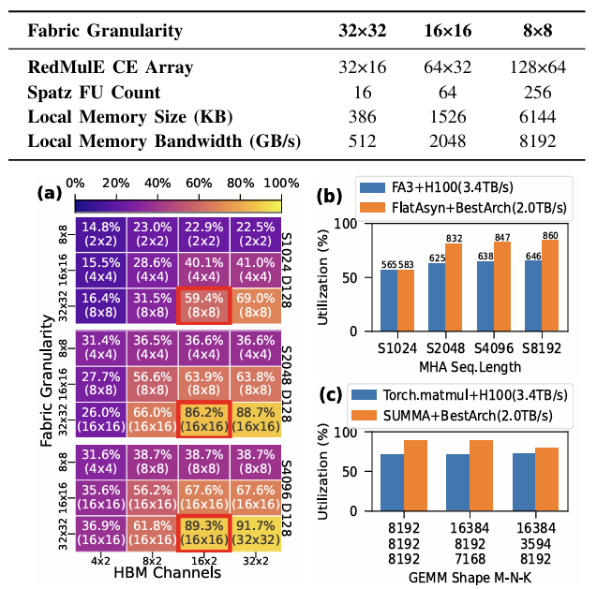
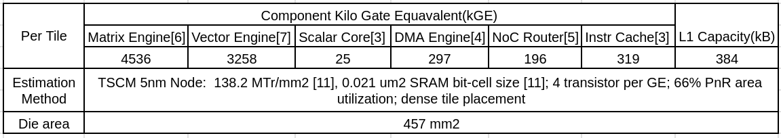
Co-exploration of Architecture and Algorithm Parameters
Our goal
Design a tile-based accelerator with comparable peak performance to Nvidia’s H100
While improve utilization and reducing overall HBM bandwidth requirements on MHA workloads
Searching for both architecture and MHA dataflow parameter design space
Select BestArch for performance over cost
Up to 1.3× utilization speedup in MHA (FlatAttention on BestArch vs. FlashAttention-3 on H100)
Up to 1.2× utilization speedup in GEMM (SUMMA on BestArch vs. Torch.Matmul on H100)
Require 40% less available HBM BW to H100
Estimate die area cost from reference RTLs
1.8x die size reduction to H100 (TSMC 5nm)

Slide 15
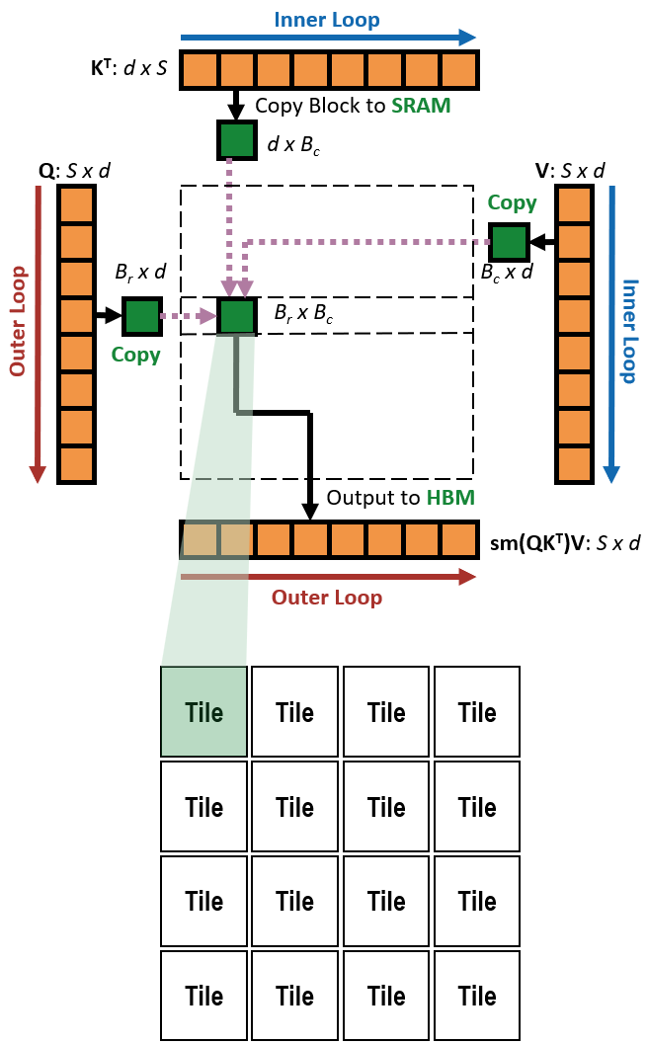
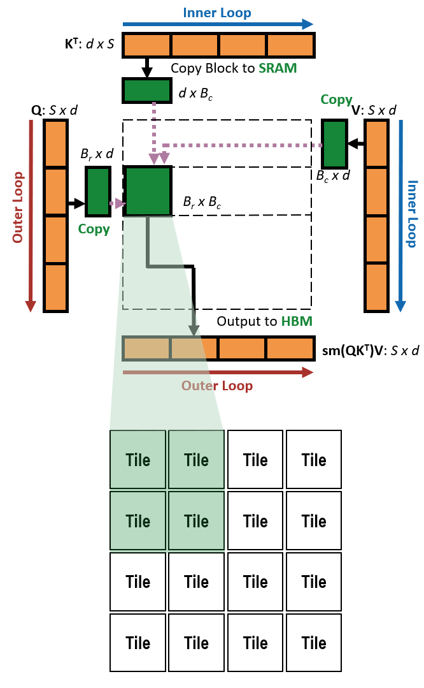
Conclusion For FlatAttention
We propose FlatAttention
An optimized dataflow for MHA on tile-based many-PE accelerators
Co-designed with NoC collective primitives
FlatAttention vs. FlashAttention-3 on tile-based accelerator
Up to 89.3% utilization, 4.1× performance speedup, 16x HBM traffic reduction
The key idea of FlatAttention is general for other MHA variants
Tile groups collectively handle larger MHA Blocks: also applies to FlashMLA in DeepSeek
Through algorithm architecture co-exploration
Find optimal configuration of tile-based accelerator (BestArch)
Peak FP16 Perf(1024 TFLOPS) Match H100 (989 TFLOPS)
Requires 40% less HBM BW, 1.8× die size reduction (estimated at TSMC 5nm)
Up to 1.3× utilization speedup in MHA (FlatAttention on BestArch vs. FlashAttention-3 on H100)
Up to 1.2× utilization speedup in GEMM (SUMMA on BestArch vs. Torch.Matmul on H100)
Flatten
NoC Collectives
& Async

Slide 16
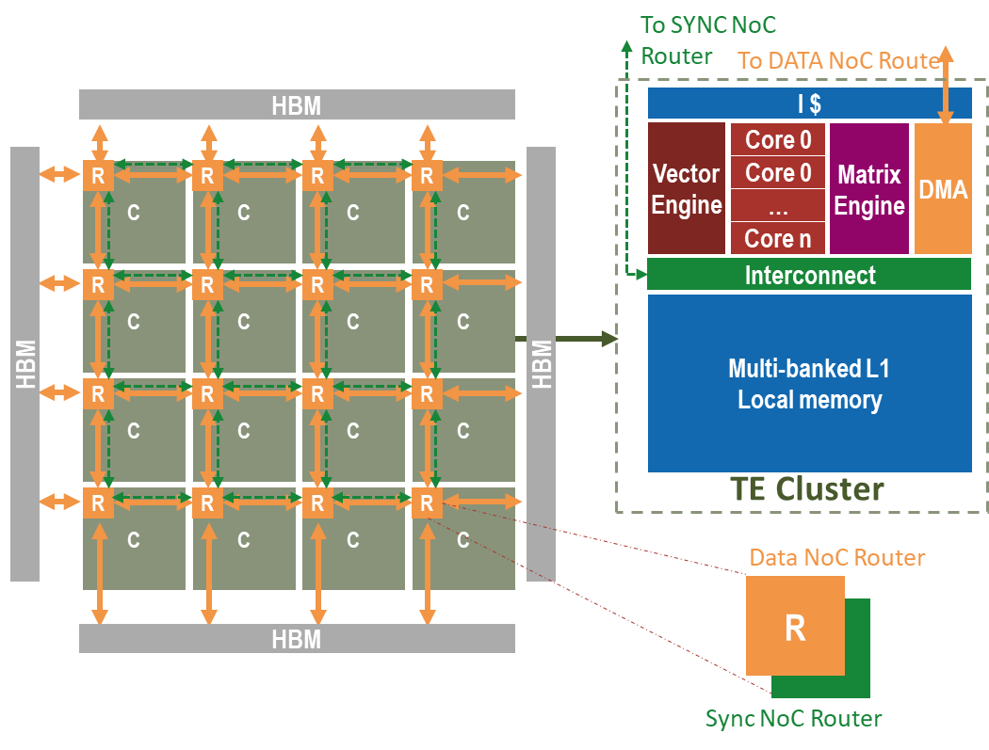

Beyond FlatAttention: Work in Progress
End-to-End Deployment of SoA Models
Emphasis on full-stack implementation (e.g., DeepSeek)
Support for low-compute operators essential for complete End-to-End flows
Focus on workloads in non-prefill inference
Toward autoregressive and reasoning-heavy strategies
Methods like beam search becoming increasingly relevant
Automatic code generation for optimal dataflow
SoftHier backed in DaCe^{[12]} (Data-Centric Optimization) framework for automated code generation, in collaboration with Prof. Torsten Hoefler’s group.
Automating design space exploration for both architecture and dataflow
E.g., for GEMM, this tool flow helps us find better HW-SW solutions that outperform DeepGEMM on H100
SoftHier Framework
Design Space
Co-exploration
Tiling
Parameter
Data
Layout
Dataflow
Workload
Mapping

Slide 17
References
[1] A. Ivanov et al., “Data movement is all you need: A case study on optimizing transformers,” in MLSys, 2021.
[2] T. Dao et al., “FlashAttention: Fast and memory-efficient exact attention with IO-awareness,” in NeurIPS, 2022.
[3] F. Zaruba et al., “Snitch: A tiny pseudo dual-issue processor for area and energy efficient execution of floating-point intensive workloads,” IEEE TCOMP, 2020.
[4] T. Benz et al., “A high-performance, energy-efficient modular DMA engine architecture,” IEEE TCOMP, 2023.
[5] T. Fischer et al., “FlooNoC: A 645-Gb/s/link 0.15-pJ/B/hop open-source NoC with wide physical links and end-to-end AXI4 parallel multistream support,” IEEE TVLSI, 2025.
[6] Y. Tortorella et al., “RedMule: A mixed-precision matrix–matrix operation engine for flexible and energy-efficient on-chip linear algebra and TinyML training acceleration," FGCS, 2023.
[7] M. Perotti et al., “Spatz: Clustering compact RISC-V-based vector units to maximize computing efficiency,” IEEE TCAD, 2025.
[8] T. Dao, “FlashAttention-2: Faster attention with better parallelism and work partitioning,” in ICLR, 2024.
[9] J. Shah et al., “FlashAttention-3: Fast and accurate attention with asynchrony and low-precision,” in NeurIPS, 2024.
[10] N. Bruschi et al., “GVSoC: a highly configurable, fast and accurate full-platform simulator for RISC-V based IoT processors,” in ICCD, 2021.
[11] D. Schor, “TSMC N3, and challenges ahead,” 2023. [Online]. Available: https://fuse.wikichip.org/news/7375/tsmc-n3-and-challenges-ahead/
[12] Rausch, Oliver, et al. "A data-centric optimization framework for machine learning." in SC, 2022.

