Slide 1
SoftHier Bi-Weekly Meeting
Chi Zhang chizhang@iis.ee.ethz.ch
Thomas Benz tbenz@iis.ee.ethz.ch
Luca Colagrande colluca@iis.ee.ethz.ch

Slide 2
SoftHier Progress General Updates
Chi comes back from holiday recently
Some work did before holiday
We started to prepare the final report for SoftHier project
We also plan to extend the FlatAttention work to journal extension
Including the exploration we did: DeepSeek on SoftHier, the FlatMLA implementation
We received the MoE distribution dataset from your side and started model dedicated Network-on-Interposer
Detailed modeling of D2DLink
Extend Router model with other topologies: HexaMesh, OctaMesh, FoldedTorus, etc

Slide 3
DeepSeekv3 FP8 Decoding on SoftHier
Expert 0
SoftHier
Chip 0
Expert 1
SoftHier Chip Configuration
Each cluster with one 32x32 CE array RedMule (2TFLOPs/cluster)
32x32 cluster with total 2048 TFLOPs @FP8
32 HBM2.ch on both west and south die boundary (4TB/s)
Expert-Parallelism
Each chip handles a subset of experts in parallel
Requires heavy inter-chip communication (dispatch & combine)
Overlaps communication with kernel execution
Configure with EP-64
Expert 2
Expert 3
Expert 4
SoftHier
Chip 1
Expert 5
Expert 6
Expert 7
C2C Interconnect
Expert 8
SoftHier
Chip 2
Expert 9
Expert 10
Expert 11
……
Expert 252
SoftHier
Chip 63
Expert 253
Expert 254
Expert 255
Kernel Compute
MLA + Shared Expert + Gate
MLA + Shared Expert + Gate
Routed Expert
Routed Expert
MLA + Shared Expert + Gate
C2C Communication
Dispatch
Dispatch
Combine
Combine
Time

Slide 4
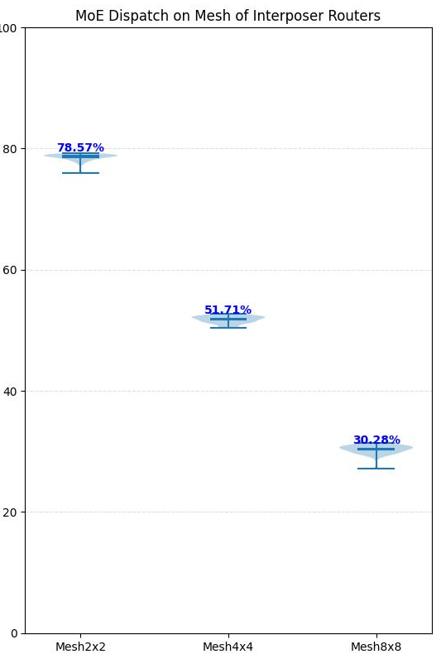
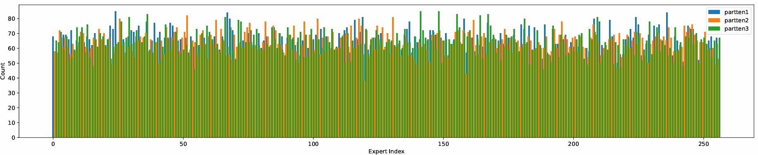
Previous Analyse Network-on-Interposer with GVSoC NoC Model
Motivation
C2C communication need to overlap with kernel computation
Supposing we connect chips with on-chip routers on active interposer, with a 2D Mesh
Analyse the link BW required
Drawback
Not using the real DeepSeek MoE distribution
D2DLink has different characteristics than link in a NoC
Very long latency, >200ns
Normally use credit-based flow control
Need to discuss with more topologies rather than 2D Mesh
SoftHier
Chip 0
SoftHier
Chip 1
SoftHier
Chip 2
R
R
R
SoftHier
Chip 3
SoftHier
Chip 4
SoftHier
Chip 5
R
R
Ideal BW Uti%
R
SoftHier
Chip 6
SoftHier
Chip 7
SoftHier
Chip 8
R
R
R
Active Interposer
Generate Expert Activation Distribution Examples

Slide 5
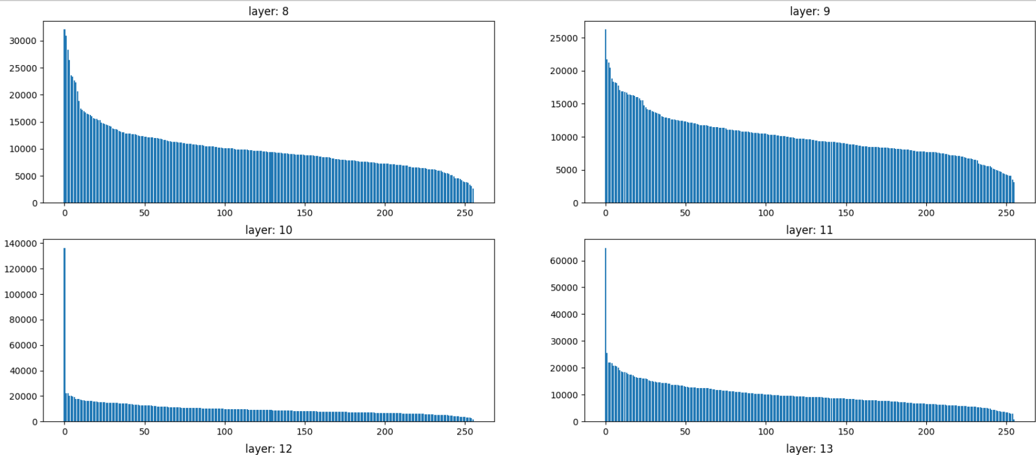
DeepSeek MoE – Expert Activation Distribution
Pretty thanks for your help!
We manage to open and analyse the DeepSeek’s MoE experts' activation distribution for each layer
Questions:
We got the bincounts data for expert activation, are experts sorted according to their counts?

Slide 6
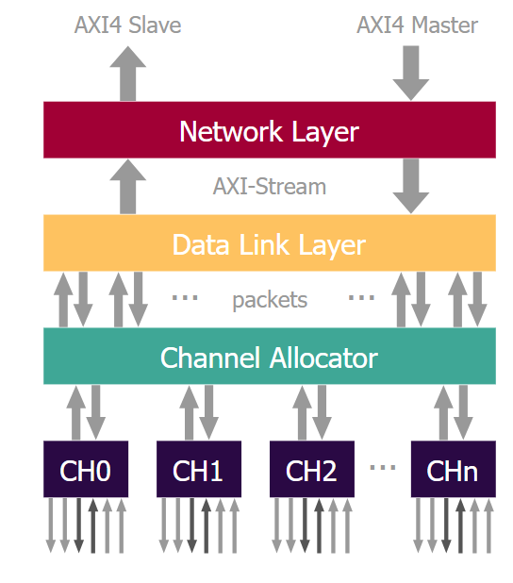
We Model the D2DLink in GVSoC
D2DLink Model
Higher abstraction for serial link IP we developed
Credit-based flow control
Long latency configurable
Abstraction
latency
RX
TX
TX
RX
latency

Slide 7
We Model the D2DLink in GVSoC
D2DLink Model
Higher abstraction for serial link IP we developed
Credit-based flow control
Long latency configurable
latency
RX
TX
TX
RX
latency
RX
8
8
TX
TX
8
8
RX

Slide 8
D2DLink GVSoC Model Characteristics
D2DLink Model
We have the D2DLink GVSoC model ready
Benchmark the characteristics:
Packet Size = 256Byte
Credit Buffer Size = 512 packets
latency
RX
TX
TX
RX
latency

Slide 9
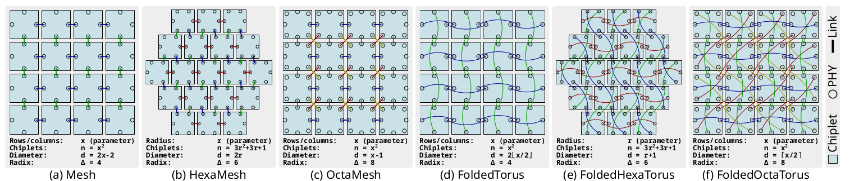
Router Supporting for more Flexible Topologies
Topologies
Mesh
HexaMesh
OctaMesh
FoldedTorus
…
Routing Algorithm
Dimension-order routing
Example for OctaMesh
Current Status:
We have the router implemented in GVSoC
Now we are setting up experiments for the MoE dispatch & combine test
3
2
1
Start
0

Slide 10
Plan For Next
Mainly working on the final report and FlatAttention Journal Extensions
Collecting the results for DeepSeek MoE dispatch and combine on a more dedicated Network-on-Interposer GVSoC model

