Slide 1
SoftHier Bi-Weekly Meeting
Chi Zhang chizhang@iis.ee.ethz.ch
Thomas Benz tbenz@iis.ee.ethz.ch
Luca Colagrande colluca@iis.ee.ethz.ch

Slide 2
SoftHier Progress General Updates
Current Progress
Working on the Flatten-Attention Paper (Chi, Luca C, Thomas etc.)
We had initial meeting to discuss the selling point
let us know if you want to participate to the writing and to the technical work (if so, we can have a dedicated meeting to discuss the work split)
We have planned experiments and results to collect
The nearest target would be ISVLSI (DDL 10th Feb)
More features supported on SoftHier simulator
We had initial SoftHier simulator technical overview meeting with Renzo and Giuseppe
Pretty productive progress on DaCe backend for SoftHier (Aofeng)

Slide 3
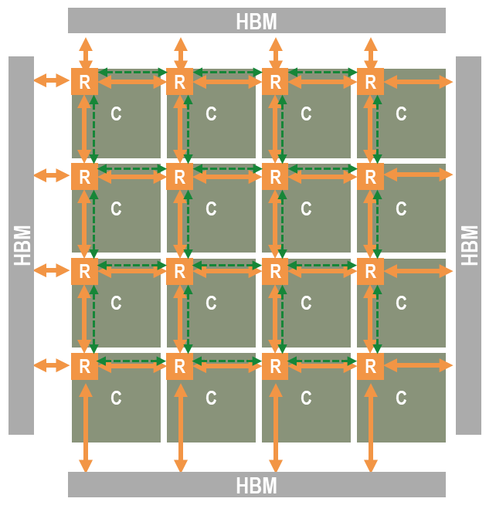
Flatten-Attention Paper Key Selling Points
Background
A pattern for scalable inference accelerators for attention-based network is emerging
Mesh of PE tiles + off-chip memory at the boundary
Two-level memory hierarchy: on-chip PE-local + off-chip global
Key Challenge for achieving top energy efficiency and utilization is:
how to maximally epxloit the on-chip bandwidth, minimizing access to energy-hungry HBM
Paper Contributions
We propose a workload allocation and scheduling strategy called Flatten-Attention to maximize the use of internal bandwidth and improve upon the current SoA Flash Attention
leverages collective primitives on the on-chip network fabric to achieve high performance
We develop a modeling and simulation framework that enables us to assess performance on a large class of tile based accelerator and enables us to refine the codesign of network primitives

Slide 4
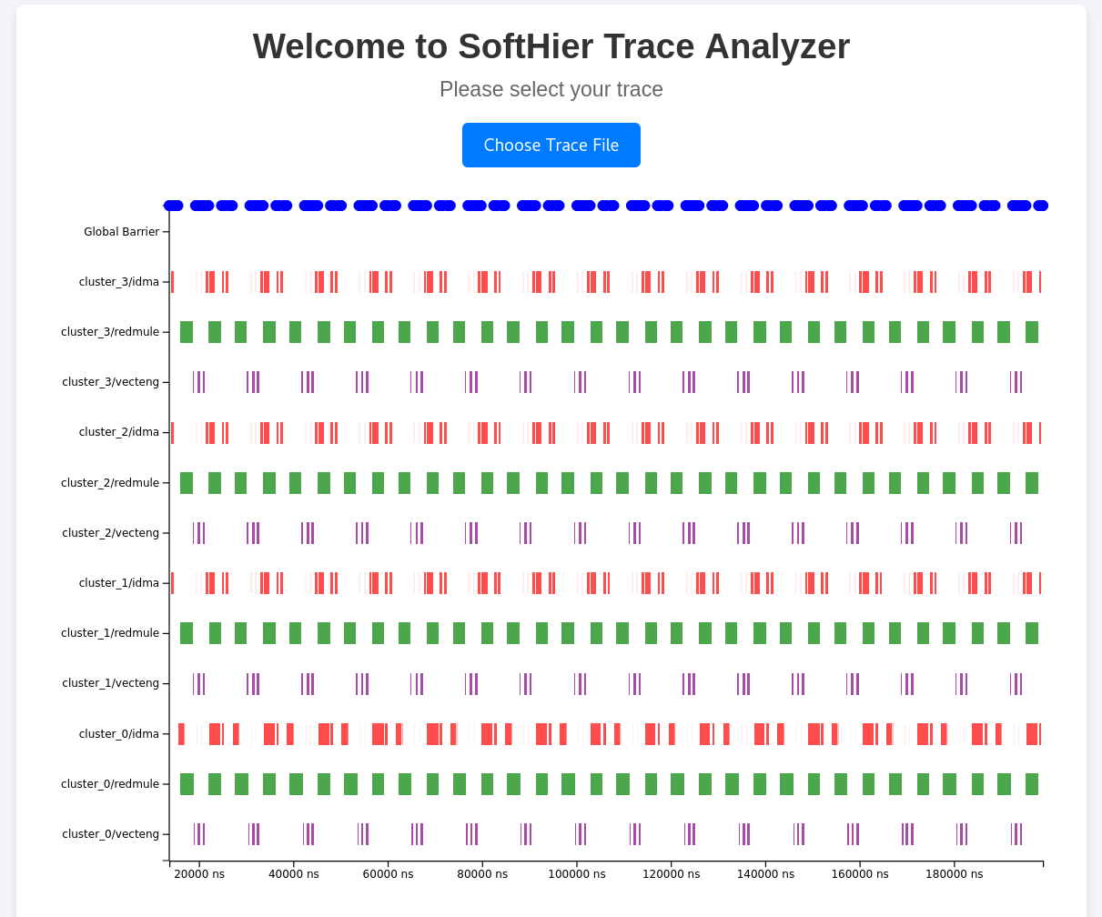
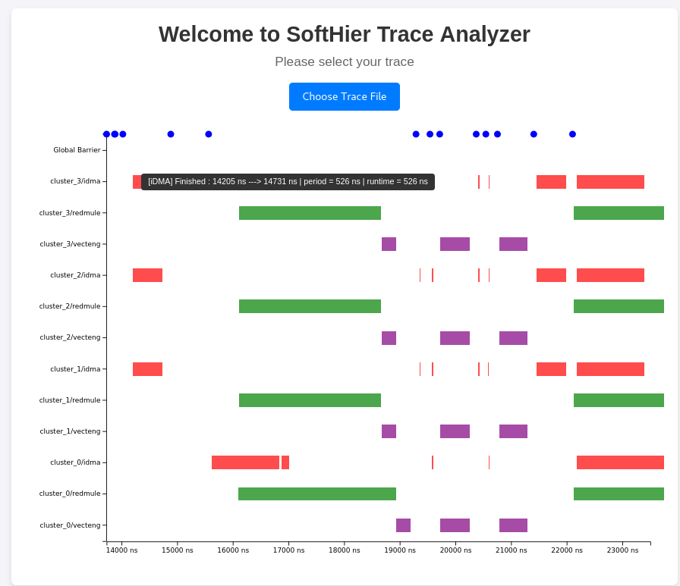
More features supported on SoftHier simulator
2D DMA transfer API support for iDMA
Enabled HBM preloading before SoftHier simulation starts
Python library to convert numpy arrays to HBM preloading files
Develop SoftHier trace analyzer for visualization and debugging

Slide 5
SoftHier Collaborations
DaCe + SoftHier
Aofeng started his Msc Thesis on DaCe + SoftHier
Developed the first version of SoftHier backend code generation in DaCe
Completed code generation for 2D memory copy using iDMA
Implemented code generation for configuring and triggering the RedMule Engine.
Tested with a simple GEMM SDFG to automatically generate code for SoftHier
The generated code runs successfully on SoftHier and the passed numerical checking
There are still some bugs when using other configuration of SDFG, we will keep debugging and updating
Technical Support
SoftHier simulator usage overview meeting with Renzo and Giuseppe

Slide 6
Next Steps
Focus on Flatten-Attention Paper
Target ISVLSI, DDL 10th Feb 2025. Primary timeline:
9th Dec – 16th Dec: Discuss and figure out paper story and contributions
16th Dec – 6th Jan: Experiments and collect initial results for the basic story (cross Xmas)
6th Jan – Paper DDL: Discuss and split work for: writing, creating figures, extra experiments if needed, paper polishing
Prepare API documentation for SoftHier
Provide more example kernels
E.g. 3 types of GEMM dataflow on SoftHier
Wishing you a Merry Christmas!

