Slide 1
SoftHier Progress Update
Chi Zhang chizhang@iis.ee.ethz.ch
Thomas Benz tbenz@iis.ee.ethz.ch

Slide 2
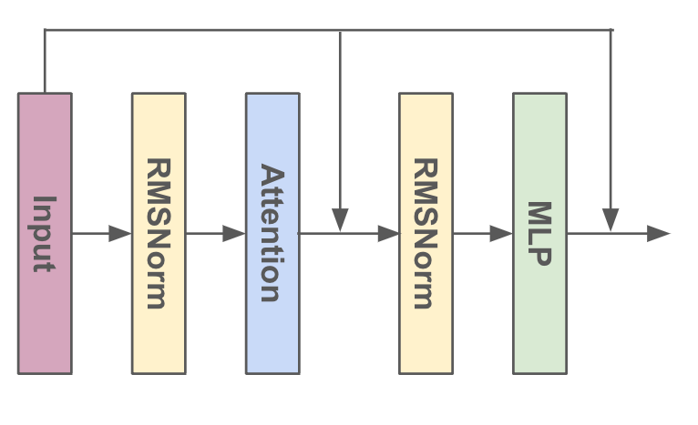
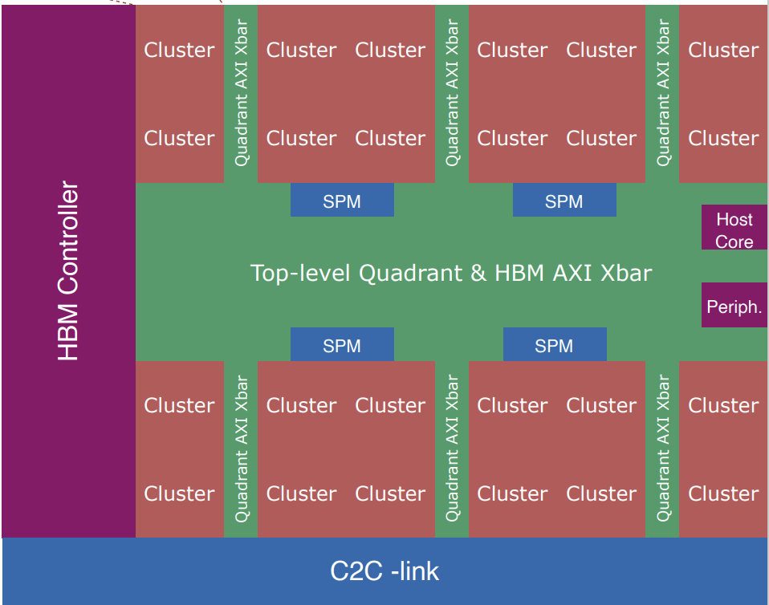
Benchmark LLama2 MLP block
Problem Size
Sequence length x 5120 x 13824
Let the sequence length = 768
Implementation
Clusters take care of different output tiles (384x384).
At each round:
iDMA transfers input matrix tile + weight matrix tile from HBM
RedMule GEMM 384x256x384.
Variables
RedMule Configuration:
48x16 arrays -- 768 MACs/Cycle
96x32 arrays -- 3072 MACs/Cycle
Data format: FP8, FP16
5120
13824
13824
Input
Weight
Output
384
256
384
Sequence length
384
384
256
Sequence length
5120
iDMA
iDMA
x6
iDMA
TCDM
#Banks = 32
Bank Width = 32b
Total Memory = 1MB
64GB/s
Max 384GB/s
128
GB/s
RedMule
Xbar
HBM2E: Max 410GB/s
HBM Channel
x8
HBM Channel

Slide 3
Results
End-to-End System Performance
Occamy + 48x16 RedMule, 410 GB/s HBM
FP8: 34.6 TOP/s
FP16: 34.3 TOP/s
Occamy + 96x32 RedMule, 410 GB/s HBM
FP8: 120.9 TOP/s
FP16: 72.3 TOP/s
BW-Bound When:
RedMule 96x32
FP16 GEMM
But in Roofline Model
MLP AI = 637 OP/B
> Roofline Limit 359 OP/B
Improvement:
Inter-Cluster Data Reuses

Slide 4
Leverage Inter-Cluster Data Reuses
Modeling
Previous model only contain Cluster-to-HBM Interconnect
Modeling Cluster-to-Cluster Interconnect
Also triggered by iDMA in each Cluster
Modeling Finished
Current Progress:
New Code for LLama2 MLP Layer
Take Inter-Cluster Transfer into account
We first do intra-quadrant communication only

Slide 5
MLP Layer Dataflow: initial stage
5120
13824
13824
I₀₀
I₀₁
Weight
I₀₀W₀₀ + I₀₁W₁₀ = O_{00_part}
I₀₀W₀₁ + I₀₁W₁₁ = O_{01_part}
I₁₀W₀₀ + I₁₁W₁₀ = O_{10_part}
I₁₀W₀₁ + I₁₁W₁₁ = O_{11_part}
Input
O₀₀
O₀₁
384
W₀₀
W₀₁
256
Output
384
Sequence length
I₁₀
I₁₁
W₁₀
W₁₁
Sequence length
O₁₀
O₁₁
5120
256
384
384
Example in one quadrant
0. Initial stage
HBM
I₁₁
I₁₁
W₁₀
I₁₀
W₁₀
I₁₀
W₀₀
I₀₀
W₀₀
I₀₀
W₀₁
I₀₁
W₀₁
I₀₁
W₁₁
W₁₁

Slide 6
MLP Layer Dataflow: initial stage
5120
13824
13824
I₀₀
I₀₁
Weight
I₀₀W₀₀ + I₀₁W₁₀ = O_{00_part}
I₀₀W₀₁ + I₀₁W₁₁ = O_{01_part}
I₁₀W₀₀ + I₁₁W₁₀ = O_{10_part}
I₁₀W₀₁ + I₁₁W₁₁ = O_{11_part}
Input
O₀₀
O₀₁
384
W₀₀
W₀₁
256
Output
384
Sequence length
I₁₀
I₁₁
W₁₀
W₁₁
Sequence length
O₁₀
O₁₁
5120
256
384
384
Example in one quadrant
0. Initial stage
Load tiles from HBM
Equally distribute to clusters
I₀₀
I₀₁
I₀₀
W₀₀
I₀₁
W₁₁
W₀₀
W₁₁
I₁₁
I₁₀
I₁₁
W₁₀
I₁₀
W₀₁
W₁₀
W₀₁
HBM

Slide 7
MLP Layer Dataflow: routines stage
5120
13824
13824
I₀₀
I₀₁
Weight
I₀₀W₀₀ + I₀₁W₁₀ = O_{00_part}
I₀₀W₀₁ + I₀₁W₁₁ = O_{01_part}
I₁₀W₀₀ + I₁₁W₁₀ = O_{10_part}
I₁₀W₀₁ + I₁₁W₁₁ = O_{11_part}
Input
O₀₀
O₀₁
384
W₀₀
W₀₁
256
Output
384
Sequence length
I₁₀
I₁₁
W₁₀
W₁₁
Sequence length
O₁₀
O₁₁
5120
256
384
384
Example in one quadrant
0. Initial stage
Load tiles from HBM
Equally distribute to clusters
1. Routines stage
iDMA copy tiles to other clusters
I₀₀
W₀₀
I₀₁
W₁₁
I₀₁
W₁₀
I₀₀
W₀₁
I₁₁
W₁₀
I₁₀
W₀₁
I₁₀
W₀₀
I₁₁
W₁₁
HBM

Slide 8
MLP Layer Dataflow: routines stage
5120
13824
13824
I₀₀
I₀₁
Weight
I₀₀W₀₀ + I₀₁W₁₀ = O_{00_part}
I₀₀W₀₁ + I₀₁W₁₁ = O_{01_part}
I₁₀W₀₀ + I₁₁W₁₀ = O_{10_part}
I₁₀W₀₁ + I₁₁W₁₁ = O_{11_part}
Input
O₀₀
O₀₁
384
W₀₀
W₀₁
256
Output
384
Sequence length
I₁₀
I₁₁
W₁₀
W₁₁
Sequence length
O₁₀
O₁₁
5120
256
384
384
Example in one quadrant
0. Initial stage
Load tiles from HBM
Equally distribute to clusters
1. Routines stage
iDMA copy tiles to other clusters
RedMule computation
I₀₀
W₀₀
O₀₀
O₀₁
I₀₁
W₁₁
I₀₁
W₁₀
I₀₀
W₀₁
I₁₁
W₁₀
O₁₀
O₁₁
I₁₀
W₀₁
I₁₀
W₀₀
I₁₁
W₁₁
HBM

Slide 9
MLP Layer Dataflow: routines stage
5120
13824
13824
I₀₀
I₀₁
Weight
I₀₀W₀₀ + I₀₁W₁₀ = O_{00_part}
I₀₀W₀₁ + I₀₁W₁₁ = O_{01_part}
I₁₀W₀₀ + I₁₁W₁₀ = O_{10_part}
I₁₀W₀₁ + I₁₁W₁₁ = O_{11_part}
Input
O₀₀
O₀₁
384
W₀₀
W₀₁
256
Output
384
Sequence length
I₁₀
I₁₁
W₁₀
W₁₁
Sequence length
O₁₀
O₁₁
5120
256
384
384
Example in one quadrant
0. Initial stage
Load tiles from HBM
Equally distribute to clusters
1. Routines stage
iDMA copy tiles to other clusters
RedMule computation
2. Routines stage
Load next tiles from HBM
RedMule computation
O₀₀
O₀₁
I₀₂
W₂₀
I₀₃
W₃₁
I₀₁
W₁₀
I₀₀
W₀₁
O₁₀
O₁₁
I₁₃
W₃₀
I₁₂
W₂₁
I₁₀
W₀₀
I₁₁
W₁₁
HBM

Slide 10
Leverage Inter-Cluster Data Reuses: Results
Results
Increase RedMule execution uti from 63% to 74%
Speedup 1.17x …
Inter-Cluster communication within quadrant is efficient and make kernel compute-bound
We need more inter-cluster communication phases …
Hierarchical organization is not good for exploring more inter-cluster comm.
Intra-quadrant BW is sufficient, but inter-quadrant BW is still limited …
We need another cluster connection topology
x6
Max 384GB/s
HBM2E: Max 410GB/s
HBM Channel
x8
HBM Channel

Slide 11
If we move to Mesh NoC topology, how we map MLP
256
384
Cluster₀₀
I₀₀
I₀₁
I₀₂
I₀₃
256
W₀₀
W₀₁
W₀₂
W₀₃
R
R
Cluster₀₁
R
Cluster₀₂
R
Cluster₀₃
384
I₁₀
I₁₁
I₁₂
I₁₃
x
W₁₀
W₁₁
W₁₂
W₁₃
I₂₀
I₂₁
I₂₂
I₂₃
W₂₀
W₂₁
W₂₂
W₂₃
R
R
R
R
Cluster₁₀
Cluster₁₁
Cluster₁₂
Cluster₁₃
W₃₀
W₃₁
W₃₂
W₃₃
I₃₀
I₃₁
I₃₂
I₃₃
HBM
R
R
R
R
Cluster₂₀
Cluster₂₁
Cluster₂₂
Cluster₂₃
384
384
O₀₀
O₀₁
O₀₂
O₀₃
O₁₀
O₁₁
O₁₂
O₁₃
R
R
R
R
Cluster₃₀
Cluster₃₁
Cluster₃₂
Cluster₃₃
O₂₀
O₂₁
O₂₂
O₂₃
O₃₀
O₃₁
O₃₂
O₃₃

Slide 12
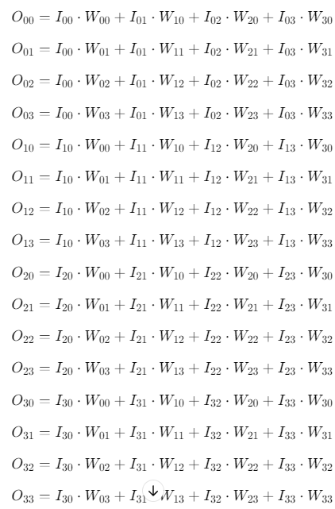
Distribute Tiles to Clusters
Load All (16 Input tiles, 16 weight tiles) from HBM
Cluster contain different tiles from each other
I₀₀
I₀₁
I₀₂
I₀₃
Cluster₀₀
Cluster₀₁
Cluster₀₂
Cluster₀₃
W₀₀
W₁₁
W₂₂
W₃₃
I₁₀
I₁₁
I₁₂
I₁₃
Cluster₁₀
Cluster₁₁
Cluster₁₂
Cluster₁₃
HBM
W₃₀
W₀₁
W₁₂
W₂₃
I₂₂
I₂₀
I₂₁
I₂₃
Cluster₂₀
Cluster₂₁
Cluster₂₂
Cluster₂₃
W₃₁
W₀₂
W₁₃
W₂₀
I₃₁
I₃₂
Cluster₃₀
Cluster₃₁
Cluster₃₂
Cluster₃₃
I₃₀
I₃₃
W₁₀
W₂₁
W₀₃
W₃₂

Slide 13
Distribute Tiles to Clusters
Load All (16 Input tiles, 16 weight tiles) from HBM
Cluster contain different tiles from each other
Cluster₀₀
I₀₀
I₀₁
Cluster₀₁
Cluster₀₂
I₀₂
I₀₃
Cluster₀₃
W₀₀
W₁₁
W₂₂
W₃₃
Cluster₁₀
I₁₃
I₁₀
Cluster₁₁
Cluster₁₂
I₁₁
Cluster₁₃
I₁₂
HBM
W₃₀
W₀₁
W₁₂
W₂₃
I₂₂
Cluster₂₀
I₂₃
Cluster₂₁
Cluster₂₂
I₂₀
Cluster₂₃
I₂₁
W₂₀
W₃₁
W₀₂
W₁₃
I₃₁
Cluster₃₀
Cluster₃₁
I₃₂
Cluster₃₂
Cluster₃₃
I₃₃
I₃₀
W₁₀
W₂₁
W₃₂
W₀₃

Slide 14
Inter-Cluster Tile Exchanging
I₀₃
Cluster₀₀
Cluster₀₁
I₀₀
Cluster₀₂
I₀₁
Cluster₀₃
I₀₂
W₃₀
W₀₁
W₁₂
W₂₃
I₁₂
I₁₀
I₁₁
Cluster₁₀
I₁₃
Cluster₁₁
Cluster₁₂
Cluster₁₃
HBM
W₁₃
W₂₀
W₃₁
W₀₂
Cluster₂₀
I₂₂
Cluster₂₁
I₂₃
Cluster₂₂
Cluster₂₃
I₂₁
I₂₀
W₁₀
W₂₁
W₃₂
W₀₃
I₃₀
I₃₁
Cluster₃₀
Cluster₃₁
Cluster₃₂
I₃₂
Cluster₃₃
I₃₃
W₀₀
W₁₁
W₂₂
W₃₃

Slide 15
Inter-Cluster Tile Exchanging
Cluster₀₀
I₀₂
Cluster₀₁
I₀₃
Cluster₀₂
I₀₀
Cluster₀₃
I₀₁
W₂₀
W₃₁
W₀₂
W₁₃
I₁₁
I₁₂
I₁₀
Cluster₁₀
Cluster₁₁
Cluster₁₂
I₁₃
Cluster₁₃
HBM
W₁₀
W₂₁
W₃₂
W₀₃
Cluster₂₀
I₂₂
I₂₀
Cluster₂₁
Cluster₂₂
Cluster₂₃
I₂₁
I₂₃
W₀₀
W₁₁
W₂₂
W₃₃
Cluster₃₀
I₃₀
I₃₁
Cluster₃₁
Cluster₃₂
Cluster₃₃
I₃₃
I₃₂
W₃₀
W₀₁
W₁₂
W₂₃

Slide 16
Inter-Cluster Tile Exchanging
Cluster₀₀
I₀₁
Cluster₀₁
I₀₂
Cluster₀₂
I₀₃
Cluster₀₃
I₀₀
W₁₀
W₂₁
W₃₂
W₀₃
I₁₀
I₁₁
I₁₂
Cluster₁₀
Cluster₁₁
Cluster₁₂
I₁₃
Cluster₁₃
HBM
W₀₀
W₁₁
W₂₂
W₃₃
Cluster₂₀
I₂₂
I₂₃
Cluster₂₁
I₂₀
Cluster₂₂
Cluster₂₃
I₂₁
W₃₀
W₀₁
W₁₂
W₂₃
Cluster₃₀
I₃₀
I₃₁
I₃₂
Cluster₃₁
Cluster₃₂
Cluster₃₃
I₃₃
W₂₀
W₃₁
W₀₂
W₁₃

Slide 17
On-going work
Modeling FlooNoC in GVSoC
FlooNoC: A Fast, Low-Overhead On-chip Network. RTL open-sourced: https://github.com/pulp-platform/FlooNoC
Model in GVSoC + Calibrate timing with RTL simulation
Modeling Mesh-NoC Connected Clusters
Enabling collective operations and extra computation operations in FlooNoC
Multi-head Attention need: broadcasting
When exploring Tensor Parallel, we need:
In-network reduction
In-network softmax, normalization …
Chi will be on holiday from 5th June to 17th June

Slide 18
iDMA
Thomas Benz tbenz@iis.ee.ethz.ch

Slide 19
iDMA GVSoC
Evaluating transposition extensions in Snitch
End-to-end ML workloads
Work still ongoing, results expected first meeting in June
Multichannel support
Very important in NUMA memory systems
RTL in Snitch completed
GVSoC adaptations started

Slide 20
Snitch Runtime -- Luca Colagrande is on Holiday till June 4th
Luca Colagrande colluca@iis.ee.ethz.ch

