Slide 1
SoftHier Bi-Weekly Meeting
Chi Zhang chizhang@iis.ee.ethz.ch
Thomas Benz tbenz@iis.ee.ethz.ch
Luca Colagrande colluca@iis.ee.ethz.ch

Slide 2
SoftHier Progress General Updates
SoftHier Programming Model Update
DeepSeek-V3 + SoftHier
DeepSeekMLA decode

Slide 3
Programing Model Update
The original
Distributed Main Memory Model
Granularity: number of tiles on the edge
Previous programming need:
Manually split matrix
Taking care of how tiles are distributed in different channels
Careful programming to avoid channel conflicts
Inefficiency of programbility, portability and extenbility
Tile
Tile
Tile
Tile
0x00000000 – 0x0FFFFFFF
R
R
R
R
Tile
Tile
Tile
Tile
0x10000000 – 0x1FFFFFFF
R
R
R
R
Tile
Tile
Tile
Tile
0x20000000 – 0x2FFFFFFF
R
R
R
R
Tile
Tile
Tile
Tile
0x30000000 – 0x03FFFFFF
R
R
R
R

Slide 4
Programing Model Update
Updated – unified shared memory for each edge
Enabling by new entry in configure file
Backward compatible
Granularity: number of tiles on the edge
Previous programming need:
Manually split matrix
Taking care of how tiles are distributed in different HBM channels
Careful programming to avoid channel conflicts
Inefficiency of programbility, portability and extenbility
Tile
Tile
Tile
Tile
0x00000000 – 0x0FFFFFFF
R
R
R
R
Tile
Tile
Tile
Tile
R
R
R
R
Tile
Tile
Tile
Tile
R
R
R
R
Tile
Tile
Tile
Tile
R
R
R
R

Slide 5
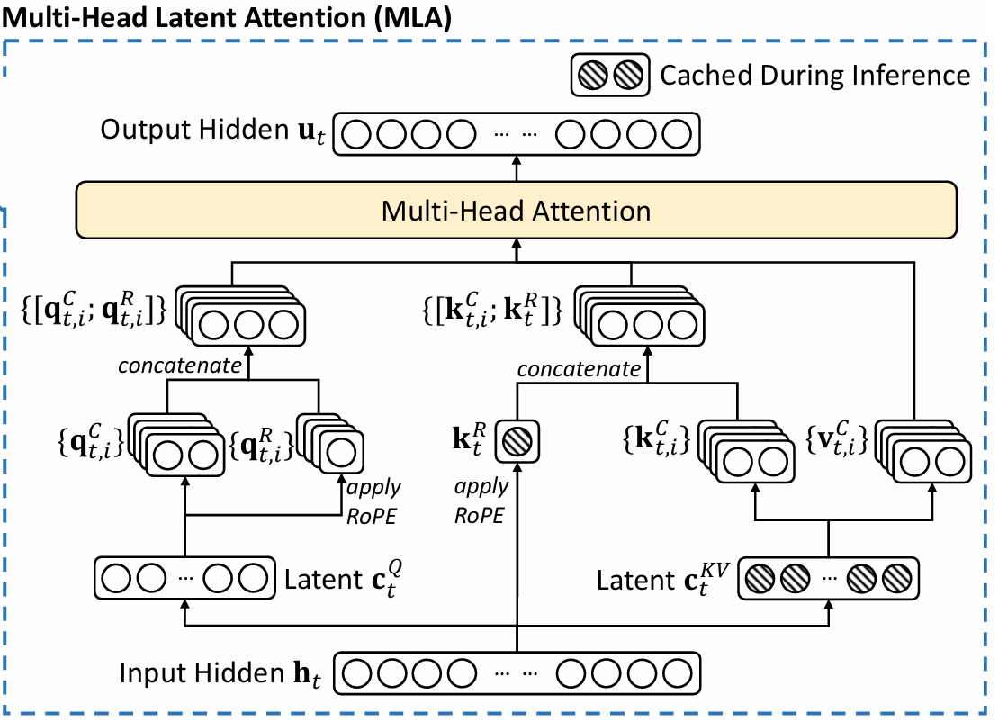
DeepSeekMLA Decode -- Recap
Standard MHA
Decompression + RoPE information appending
-> Forming Q,K,V
Low-Rank Compression
-> Latent matrices

Slide 6
MLA Decode Can Be Compute-Bound (Learned from FlashMLA)
K₀
V₀
The MHA part:
All GEMV Operations
-- Memory-bound
Head 0
×
₍
₎^{T}
SoftMax
×
K₁
V₁
Head 1
×
₍
₎^{T}
SoftMax
×
…
×
……
W^{O}
K_{h}
V_{h}
Head h
×
₍
₎^{T}
SoftMax
×

Slide 7
MLA Decode Can Be Compute-Bound
C^{KV}
C^{KV}
W₀^{UQ}
W₀^{UK}
SoftMax
W₀^{UV}
Merge Decompress to MHA part
Head 0
₍
×
₎
×
₍
×
₎^{T}
×
₍
×
₎
C^{KV}
C^{KV}
W₁^{UQ}
W₁^{UK}
SoftMax
W₁^{UV}
Head 1
₍
×
₎
×
₍
×
₎^{T}
×
₍
×
₎
…
×
……
W^{O}
C^{KV}
C^{KV}
W_{h}^{UQ}
W_{h}^{UK}
SoftMax
W_{h}^{UV}
Head h
₍
×
₎
×
₍
×
₎^{T}
×
₍
×
₎

Slide 8
MLA Decode Can Be Compute-Bound
C^{KV}
C^{KV}
W₀^{UQ}
W₀^{UK}
SoftMax
W₀^{UV}
Formular transformation
Head 0
×
×
×
×
×
C^{KV}
C^{KV}
W₁^{UQ}
W₁^{UK}
SoftMax
W₁^{UV}
Head 1
×
×
×
×
×
…
×
……
W^{O}
C^{KV}
C^{KV}
W_{h}^{UQ}
W_{h}^{UK}
SoftMax
W_{h}^{UV}
Head h
×
×
×
×
×

Slide 9
MLA Decode Can Be Compute-Bound
C^{KV}
C^{KV}
W₀^{UQ}
W₀^{UK}
SoftMax
W₀^{UV}
Weight absorption
Head 0
×
×
×
×
×
Weight absorption
C^{KV}
C^{KV}
W₁^{UQ}
W₁^{UK}
SoftMax
W₁^{UV}
Head 1
×
×
×
×
×
…
Weight absorption
×
……
W^{O}
C^{KV}
C^{KV}
W_{h}^{UQ}
W_{h}^{UK}
SoftMax
W_{h}^{UV}
Head h
×
×
×
×
×
Weight absorption
Weight absorption

Slide 10
MLA Decode Can Be Compute-Bound
C^{KV}
C^{KV}
W₀^{UQK}
SoftMax
Head 0
×
×
×
C^{KV}
C^{KV}
W₁^{UQK}
SoftMax
Head 1
×
×
×
…
×
……
W^{VO}
C^{KV}
C^{KV}
Head h
W_{h}^{UQK}
SoftMax
×
×
×

Slide 11
MLA Decode Can Be Compute-Bound
C^{KV}
C^{KV}
W₀^{UQK}
SoftMax
Inter head merging
Head 0
×
×
×
C^{KV}
C^{KV}
W₁^{UQK}
SoftMax
Head 1
×
×
×
…
×
……
W^{VO}
C^{KV}
C^{KV}
Head h
W_{h}^{UQK}
SoftMax
×
×
×
Merge
Merge

Slide 12
MLA Decode Can Be Compute-Bound
W₀^{UQK}
W₁^{UQK}
W_{h}^{UQK}
…
×
C^{KV}
C^{KV}
Nb_head
…
×
SoftMax
…
×
…
W^{VO}
…
×

Slide 13
MLA Decode Can Be Compute-Bound
W₀^{UQK}
W₁^{UQK}
W_{h}^{UQK}
…
×
Fold
C^{KV}
C^{KV}
Nb_head
…
×
SoftMax
…
×
…
Flat
W^{VO}
…
×

Slide 14
MLA Decode Can Be Compute-Bound
Memory-bound for weight-related operation
W₀^{UQK}
W₁^{UQK}
W_{h}^{UQK}
…
×
Compute-bound for the key MHA
Fold
C^{KV}
C^{KV}
Nb_head
…
×
SoftMax
…
×
…
Flat
W^{VO}
…
×

Slide 15
MLA Decode Can Be Compute-Bound
Batching various user’s token:
Weight related operation -> Compute-bound
W₀^{UQK}
W₁^{UQK}
W_{h}^{UQK}
…
×
Nb_user
Fold
C^{KV} of Usr0
C^{KV} of user0
×
SoftMax
W^{VO}
Nb_head
Of user0
…
×
…
Flat
…
×
C^{KV}
of User1
C^{KV} of user1
×
SoftMax
Nb_head
Of user1
…
×
…
Batching does not help for the Key MHA part
(User has their own context, ie. KV cache)
……

Slide 16
FlatMLA Decode Results
FlatMLA implementation
Key idea of FlatAttention + FlashMLA
SoftHier
32x32 tiles, 1024 TFLOPS @FP16, 4TB/s HBM BW
MLA decode
Batch size = 1024
Assume every user has the same KV cache length

Slide 17
On-Going Progress
DeepSeekMoE
End-to-end DeepSeek Decode will be evaluated soon
Hopefully to present the end-to-end performance in the next meeting

