Slide 1
SoftHier Bi-Weekly Meeting
Chi Zhang chizhang@iis.ee.ethz.ch
Thomas Benz tbenz@iis.ee.ethz.ch
Luca Colagrande colluca@iis.ee.ethz.ch

Slide 2
SoftHier Progress General Updates
FlatAttention presentation on Mini-workshop
DeepSeek-V3 + SoftHier
Preliminary DeepSeekMLA runtime breakdown
FlooNoC router RTL with multicast support
Physical implementation to analyze the area overhead

Slide 3
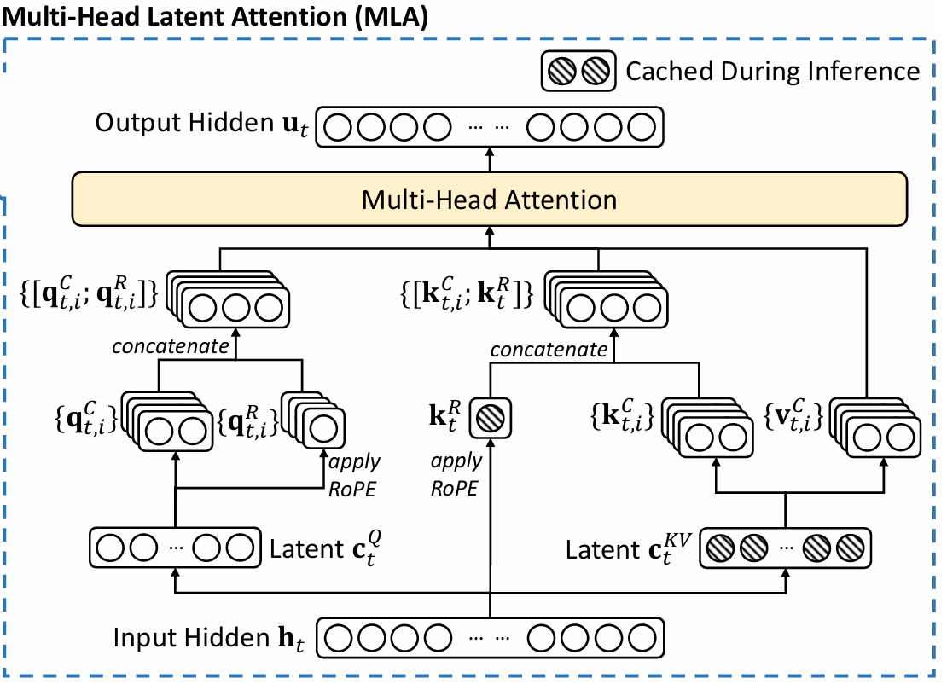
DeepSeekMLA -- Recap
Standard MHA
-> FlatAttention
Decompression + RoPE information appending
-> Forming Q,K,V
Low-Rank Compression
-> Latent matrices

Slide 4
Low-Rank Compression -> Latent matrices
Input h
Cluster
Cluster
Cluster
Cluster
Token 0
HBM ch
CTRL
R
R
R
R
Token 1
Cluster
Cluster
Cluster
Cluster
Token 2
R
R
R
R
HBM ch
CTRL
Token 3
Cluster
Cluster
Cluster
Cluster
Token 4
Token 5
HBM ch
CTRL
R
R
R
R
Token 6
Cluster
Cluster
Cluster
Cluster
Token 7
R
R
R
R
HBM ch
CTRL
CTRL
CTRL
CTRL
CTRL
HBM ch
HBM ch
HBM ch
HBM ch
W^{DQ}
W^{DKV}
W^{KR}

Slide 5
Low-Rank Compression -> Latent matrices
Input h
Cluster
Cluster
Cluster
RoPE -> element-wise
Cluster
C^{Q}
C^{KV}
K^{R}
Token 0
HBM ch
CTRL
R
R
R
R
Token 1
Cluster
Cluster
Cluster
Cluster
Token 2
R
R
R
R
HBM ch
CTRL
Token 3
Cluster
Cluster
Cluster
Cluster
Token 4
Token 5
HBM ch
CTRL
R
R
R
R
Token 6
Cluster
Cluster
Cluster
Cluster
Token 7
R
R
R
R
HBM ch
CTRL
CTRL
CTRL
CTRL
CTRL
HBM ch
HBM ch
HBM ch
HBM ch
W^{DQ}
W^{DKV}
W^{KR}

Slide 6
Low-Rank Compression -> Latent matrices
Cluster
Cluster
Cluster
Cluster
C^{Q}
C^{KV}
K^{R}
HBM ch
CTRL
R
R
R
R
Cluster
Cluster
Cluster
Cluster
HBM ch
CTRL
R
R
R
R
Cluster
Cluster
Cluster
Cluster
HBM ch
CTRL
R
R
R
R
Cluster
Cluster
Cluster
Cluster
HBM ch
CTRL
R
R
R
R
CTRL
CTRL
CTRL
CTRL
HBM ch
HBM ch
HBM ch
HBM ch
W^{DQ}
W^{DKV}
W^{KR}

Slide 7
Decompression + RoPE -> Forming Q
Cluster
Cluster
Cluster
Cluster
C^{Q}
C^{KV}
K^{R}
HBM ch
CTRL
R
R
R
R
Cluster
Cluster
Cluster
Cluster
HBM ch
CTRL
R
R
R
R
Cluster
Cluster
Cluster
Cluster
HBM ch
CTRL
R
R
R
R
Cluster
Cluster
Cluster
Cluster
HBM ch
CTRL
R
R
R
R
CTRL
CTRL
CTRL
CTRL
HBM ch
HBM ch
HBM ch
HBM ch
W₀^{UQ}
W₀^{QR}
W₁^{UQ}
W₁^{QR}

Slide 8
Decompression + RoPE -> Forming Q
Cluster
RoPE
RoPE
Cluster
Cluster
Cluster
C^{Q}
C^{KV}
K^{R}
Q₀^{C}
Q₀^{R}
Q₁^{C}
Q₁^{R}
HBM ch
CTRL
R
R
R
R
Cluster
Cluster
Cluster
Cluster
HBM ch
CTRL
R
R
R
R
Cluster
Cluster
Cluster
Cluster
HBM ch
CTRL
R
R
R
R
Cluster
Cluster
Cluster
Cluster
HBM ch
CTRL
R
R
R
R
CTRL
CTRL
CTRL
CTRL
HBM ch
HBM ch
HBM ch
HBM ch
W₀^{UQ}
W₀^{QR}
W₁^{UQ}
W₁^{QR}

Slide 9
Decompression + RoPE -> Forming Q
Cluster
Cluster
Cluster
Cluster
Q₀^{C}
Q₀^{R}
Q₁^{C}
Q₁^{R}
C^{KV}
K^{R}
HBM ch
CTRL
R
R
R
R
Cluster
Cluster
Cluster
Cluster
HBM ch
CTRL
R
R
R
R
Cluster
Cluster
Cluster
Cluster
HBM ch
CTRL
R
R
R
R
Cluster
Cluster
Cluster
Cluster
HBM ch
CTRL
R
R
R
R
CTRL
CTRL
CTRL
CTRL
HBM ch
HBM ch
HBM ch
HBM ch
W₀^{UQ}
W₀^{QR}
W₁^{UQ}
W₁^{QR}

Slide 10
Decompression + RoPE -> Forming V
Cluster
Cluster
Cluster
Cluster
C^{KV}
K^{R}
HBM ch
CTRL
R
R
R
R
Cluster
Cluster
Cluster
Cluster
HBM ch
CTRL
R
R
R
R
Cluster
Cluster
Cluster
Cluster
HBM ch
CTRL
R
R
R
R
Cluster
Cluster
Cluster
Cluster
HBM ch
CTRL
R
R
R
R
CTRL
CTRL
CTRL
CTRL
HBM ch
HBM ch
HBM ch
HBM ch
W₀^{UV}
W₁^{UV}
W₂^{UV}
W₃^{UV}

Slide 11
Decompression + RoPE -> Forming V
Cluster
Cluster
Cluster
Cluster
C^{KV}
K^{R}
V₀^{C}
V₁^{C}
V₂^{C}
V₃^{C}
HBM ch
CTRL
R
R
R
R
Cluster
Cluster
Cluster
Cluster
HBM ch
CTRL
R
R
R
R
Cluster
Cluster
Cluster
Cluster
HBM ch
CTRL
R
R
R
R
Cluster
Cluster
Cluster
Cluster
HBM ch
CTRL
R
R
R
R
CTRL
CTRL
CTRL
CTRL
HBM ch
HBM ch
HBM ch
HBM ch
W₀^{UV}
W₁^{UV}
W₂^{UV}
W₃^{UV}

Slide 12
Decompression + RoPE -> Forming V
Cluster
Cluster
Cluster
Cluster
HBM ch
CTRL
R
R
R
R
Cluster
Cluster
Cluster
Cluster
HBM ch
CTRL
R
R
R
R
Cluster
Cluster
Cluster
Cluster
HBM ch
CTRL
R
R
R
R
Cluster
Cluster
Cluster
Cluster
HBM ch
CTRL
R
R
R
R
CTRL
CTRL
CTRL
CTRL
HBM ch
HBM ch
HBM ch
HBM ch

Slide 13
Decompression + RoPE -> Forming V
Cluster
Cluster
Cluster
Cluster
HBM ch
CTRL
R
R
R
R
Cluster
Cluster
Cluster
Cluster
HBM ch
CTRL
R
R
R
R
Cluster
Cluster
Cluster
Cluster
HBM ch
CTRL
R
R
R
R
Cluster
Cluster
Cluster
Cluster
HBM ch
CTRL
R
R
R
R
CTRL
CTRL
CTRL
CTRL
HBM ch
HBM ch
HBM ch
HBM ch

Slide 14
Decompression + RoPE -> Forming V
Cluster
Cluster
Cluster
Cluster
HBM ch
CTRL
R
R
R
R
Cluster
Cluster
Cluster
Cluster
HBM ch
CTRL
R
R
R
R
Cluster
Cluster
Cluster
Cluster
HBM ch
CTRL
R
R
R
R
Cluster
Cluster
Cluster
Cluster
HBM ch
CTRL
R
R
R
R
CTRL
CTRL
CTRL
CTRL
HBM ch
HBM ch
HBM ch
HBM ch

Slide 15
Decompression + RoPE -> Forming V
Cluster
Cluster
Cluster
Cluster
C^{KV}
K^{R}
HBM ch
CTRL
R
R
R
R
Cluster
Cluster
Cluster
Cluster
HBM ch
CTRL
R
R
R
R
Cluster
Cluster
Cluster
Cluster
HBM ch
CTRL
R
R
R
R
Cluster
Cluster
Cluster
Cluster
HBM ch
CTRL
R
R
R
R
CTRL
CTRL
CTRL
CTRL
HBM ch
HBM ch
HBM ch
HBM ch
V₀^{C}
V₁^{C}
V₂^{C}
V₃^{C}

Slide 16
Decompression + RoPE -> Forming K
Cluster
Cluster
Cluster
Cluster
C^{KV}
K^{R}
HBM ch
CTRL
R
R
R
R
Cluster
Cluster
Cluster
Cluster
HBM ch
CTRL
R
R
R
R
Cluster
Cluster
Cluster
Cluster
HBM ch
CTRL
R
R
R
R
Cluster
Cluster
Cluster
Cluster
HBM ch
CTRL
R
R
R
R
CTRL
CTRL
CTRL
CTRL
HBM ch
HBM ch
HBM ch
HBM ch
W₀^{UV}
W₁^{UV}
W₂^{UV}
W₃^{UV}

Slide 17
Decompression + RoPE -> Forming K
Cluster
Cluster
Cluster
Cluster
C^{KV}
K^{R}
K^{R}
K^{R}
K^{R}
K^{R}
K^{R}
K₀^{C}
K₁^{C}
K₂^{C}
K₃^{C}
HBM ch
CTRL
R
R
R
R
Cluster
Cluster
Cluster
Cluster
HBM ch
CTRL
R
R
R
R
Cluster
Cluster
Cluster
Cluster
HBM ch
CTRL
R
R
R
R
Cluster
Cluster
Cluster
Cluster
HBM ch
CTRL
R
R
R
R
CTRL
CTRL
CTRL
CTRL
HBM ch
HBM ch
HBM ch
HBM ch
W₀^{UV}
W₁^{UV}
W₂^{UV}
W₃^{UV}

Slide 18
Decompression + RoPE -> Forming K
Cluster
Cluster
Cluster
Cluster
K^{R}
K^{R}
K₀^{C}
K^{R}
K₁^{C}
K^{R}
K₂^{C}
K^{R}
K₃^{C}
K^{R}
HBM ch
CTRL
R
R
R
R
Cluster
Cluster
Cluster
Cluster
HBM ch
CTRL
R
R
R
R
Cluster
Cluster
Cluster
Cluster
HBM ch
CTRL
R
R
R
R
Cluster
Cluster
Cluster
Cluster
HBM ch
CTRL
R
R
R
R
CTRL
CTRL
CTRL
CTRL
HBM ch
HBM ch
HBM ch
HBM ch

Slide 19
Decompression + RoPE -> Forming K^{T}
Cluster
Cluster
Cluster
Cluster
HBM ch
CTRL
R
R
R
R
Cluster
Cluster
Cluster
Cluster
HBM ch
CTRL
R
R
R
R
Cluster
Cluster
Cluster
Cluster
HBM ch
CTRL
R
R
R
R
Cluster
Cluster
Cluster
Cluster
HBM ch
CTRL
R
R
R
R
CTRL
CTRL
CTRL
CTRL
HBM ch
HBM ch
HBM ch
HBM ch

Slide 20
Decompression + RoPE -> Forming K^{T}
Cluster
Cluster
Cluster
Cluster
HBM ch
CTRL
R
R
R
R
Cluster
Cluster
Cluster
Cluster
HBM ch
CTRL
R
R
R
R
Cluster
Cluster
Cluster
Cluster
HBM ch
CTRL
R
R
R
R
Cluster
Cluster
Cluster
Cluster
HBM ch
CTRL
R
R
R
R
CTRL
CTRL
CTRL
CTRL
HBM ch
HBM ch
HBM ch
HBM ch

Slide 21
Decompression + RoPE -> Forming K^{T}
Cluster
Cluster
Cluster
Cluster
HBM ch
CTRL
R
R
R
R
Cluster
Cluster
Cluster
Cluster
HBM ch
CTRL
R
R
R
R
Cluster
Cluster
Cluster
Cluster
HBM ch
CTRL
R
R
R
R
Cluster
Cluster
Cluster
Cluster
HBM ch
CTRL
R
R
R
R
CTRL
CTRL
CTRL
CTRL
HBM ch
HBM ch
HBM ch
HBM ch

Slide 22
Decompression + RoPE -> Forming K^{T}
Cluster
Cluster
Cluster
Cluster
HBM ch
CTRL
R
R
R
R
Cluster
Cluster
Cluster
Cluster
HBM ch
CTRL
R
R
R
R
Cluster
Cluster
Cluster
Cluster
HBM ch
CTRL
R
R
R
R
Cluster
Cluster
Cluster
Cluster
HBM ch
CTRL
R
R
R
R
CTRL
CTRL
CTRL
CTRL
HBM ch
HBM ch
HBM ch
HBM ch

Slide 23
Preliminary DeepSeekMLA Runtime Breakdown -- Setup
DeepSeekMLA
Hyper-parameters using 671B configuration
128 heads, 128 head.dim
Sequence length = 4k
We only estimation runtime of one layer’s MLA
For a preliminary analysis, we ignore the ROPE part and the SW hard coded
SoftHier
32x32 cluster, each 1TFLOPs @FP16, total 1024TFLOPs @FP16
32 HBM2.ch on both west and south die boundary (4TB/s)

Slide 24
Preliminary DeepSeekMLA Runtime Breakdown

Slide 25
Preliminary DeepSeekMLA Runtime Breakdown
Further Optimization not Needed

Slide 26
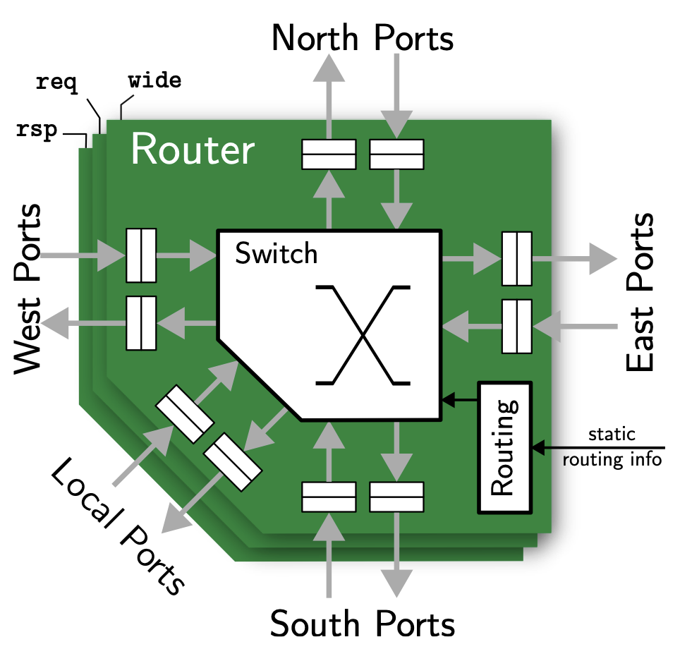
Physical Implementation of Router with Multicast
Place and route for
A multi-channel 5x5 router module (req & rsp & wide)
A compute tile
Setup:
Technology: GlobalFoundries’ 12nm FinFet technology
Tool: Synopsys Fusion Compiler 2023.12
router
NI
Snitch Cluster

Slide 27
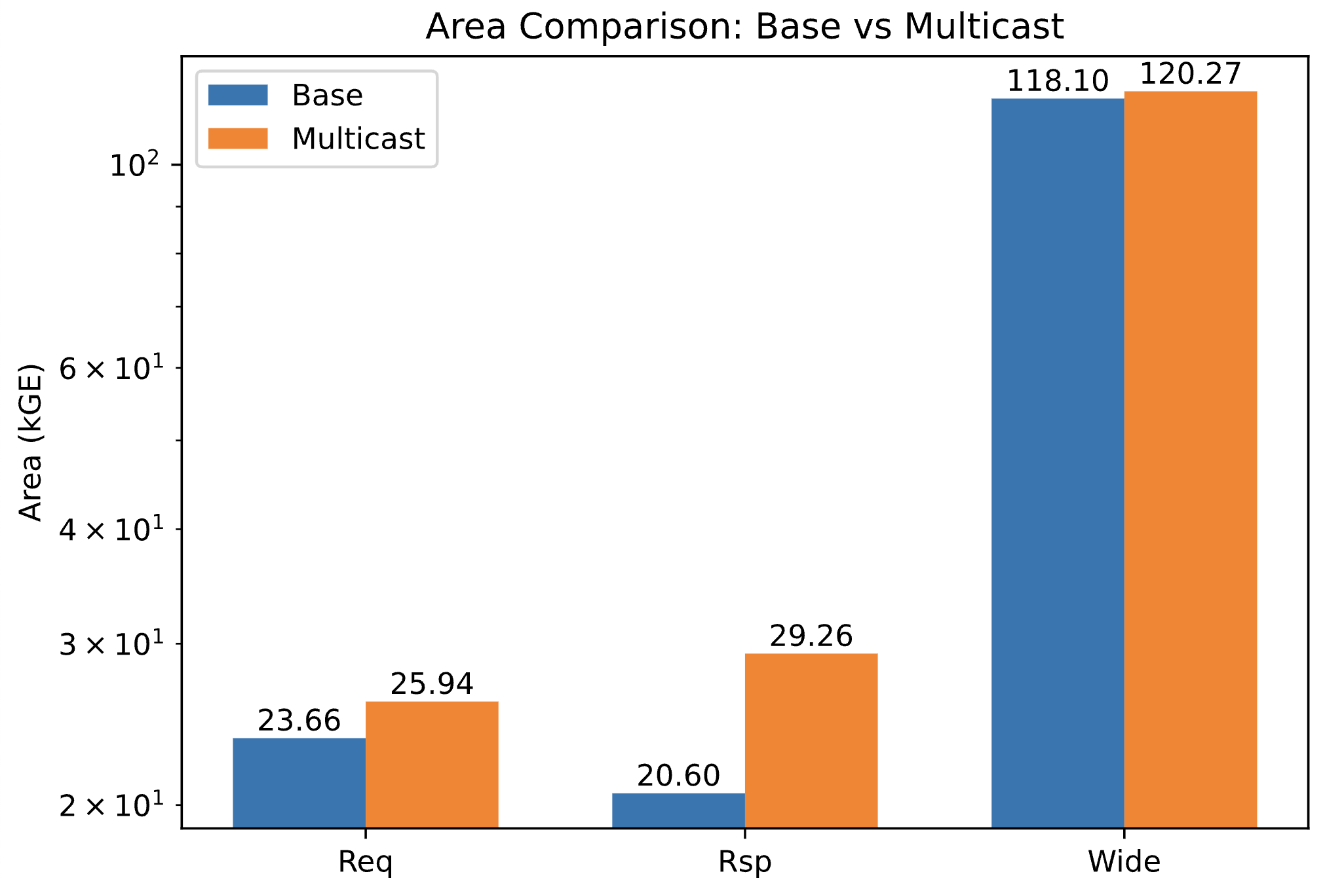
Physical Implementation
Area: Router
164.2kGE -> 178.8kGE ~8.9% overhead
Reducing flits needs more area than multicast flits.
SOA area overhead:
ESP platform^{[1]}(2024): 1.7~25%
MMNNN^{[2]}(2021): 32.9%
[4] Zuckerman, Joseph, et al. "Towards Generalized On-Chip Communication for Programmable Accelerators in Heterogeneous Architectures." arXiv preprint arXiv:2407.04182 (2024). [5] Ouyang, Yiming, et al. "Mmnnn: A tree-based multicast mechanism for noc-based deep neural network accelerators." Microprocessors and Microsystems 85 (2021)

Slide 28
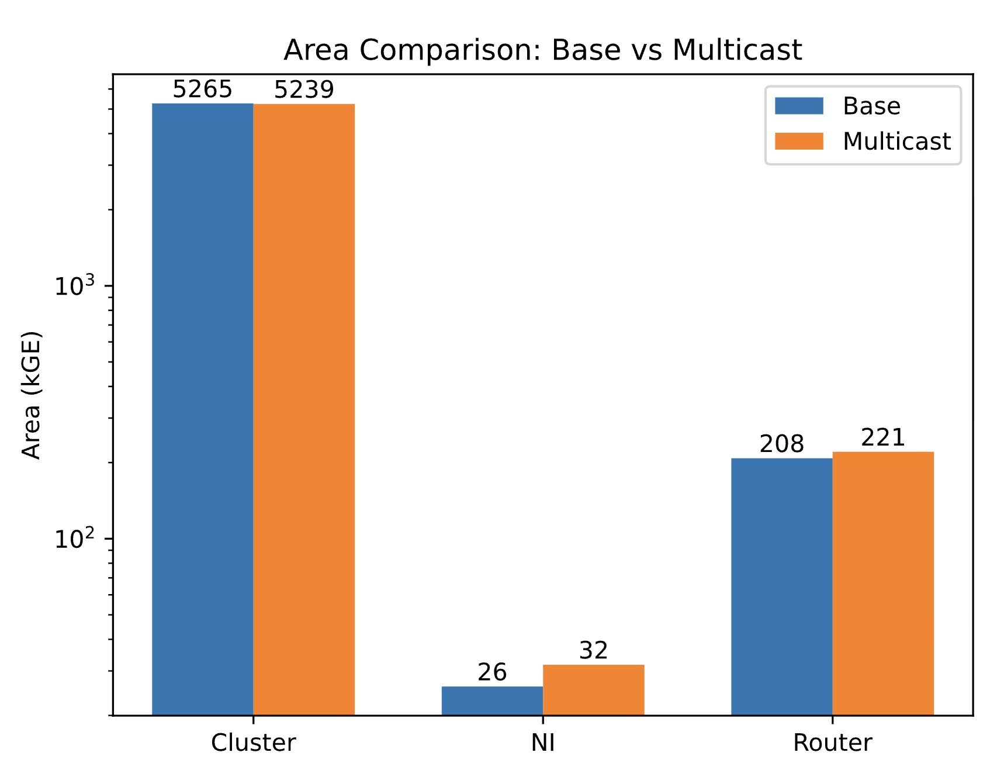
Physical Implementation
Area: Tile
NI↑ Router↑
NoC increased by 20kGE
Compared to the ~5200kGE cluster, such overhead is less than 0.4%.
Timing:
Critical path is still inside the snitch cluster
The timing closes at 1.27 GHz in typical conditions (TT, 0.8 V, 25 °C)
Notes:
integer on plot

Slide 29
Journal Plan
Scalable accelerator design
The key challenge is how to design the memory system for massive compute tiles
Goal is to:
achieve high utilization of kernel and end-to-end LLM workload (decode/prefill)
Save die area
Save power
Candidate architecture
Hierarchical cache
Mesh NoC
Mesh NoC + Fabric Collectives
Hierarchical Xbar (Optional)
Hierarchical Xbar + Fabric Collectives (Optional)
We want to argue that Mesh NoC + Fabric Collectives could enable us …

Slide 30
Journal Plan
CH0
CH1
…
CHn
HBM CTRL
Matrix engine
L1 local memory
L3$
Vector engine
I$
interconnect
Scalar core
DMA
Tile
L2$
Tile
L2$
Tile
L2$
Tile
L2$
To Router
Tile
Tile
Tile
Tile
Tile
Tile
Tile
Tile
R
R
R
R
Tile
Tile
Tile
Tile
Tile
Tile
Tile
Tile
R
R
R
R
CH0
CH1
…
CHn
HBM CTRL
Tile
Tile
Tile
Tile
Tile
Tile
Tile
Tile
R
R
R
R
Tile
Tile
Tile
Tile
L3$
R
R
R
R
HBM CTRL
HBM CTRL
CH0
CH1
…
CHn
CH0
CH1
…
CHn

Slide 31
Journal Plan
 | Tile with Hierarchical cache | Tile with Mesh NoC + SW collective | Tile with Mesh NoC + HW Collective
MHA - Decode
MHA - Prefill
MLA - Decode
MLA - Prefill
GQA - Decode
GQA - Prefill

Slide 32
Journal Plan
 | Tile with Hierarchical cache | Tile with Mesh NoC + SW collective | Tile with Mesh NoC + HW Collective
MLP - Decode
MLP - Prefill
MoE - Decode
MoE - Prefill

Slide 33
Journal Plan
Performance Model to develop
Cache modeling and Hierarchical Connection
Dataflow developing
Attention part
MHA (FlashAttetnion, FlatAttention) – Qwen model
MLA (FlashMLA, FlatMLA) – DeepSeek model
GQA – Llama3 model
FNN part
MoE – DeepSeek Model
Basic MLP – Qwen and Llama3

Slide 34
Journal Plan
Performance Model to develop
Nonblocking Cache modeling and Hierarchical Connection
Dataflow developing
Attention part
MHA (FlashAttetnion, FlatAttention) – Qwen model
MLA (FlashMLA, FlatMLA) – DeepSeek model
GQA – Llama3 model
FNN part
MoE – DeepSeek Model
Basic MLP – Qwen and Llama3

Slide 35
Journal Plan
Area model
Xbar area model (N_master, N_slave, Bus_width -> mm2)
NoC router area model (link width , multicast enable, reduction enable -> mm2)
Nonblocking cache area model (data_width, capacity -> mm2)
Tile area model (mm2)
Power model
Tile Power model
Energy per TCDM access
Energy for Redmule

Slide 36
DeepSeekMLA -- Recap
Standard MHA
Decompression + RoPE information appending
-> Forming Q,K,V
Low-Rank Compression
-> Latent matrices

Slide 37
MLA Decode Can Be Compute-Bound
K₀
V₀
The MHA part:
All GEMV Operations
-- Memory-bound
Head 0
×
₍
₎^{T}
SoftMax
×
K₁
V₁
Head 1
×
₍
₎^{T}
SoftMax
×
…
×
……
W^{O}
K_{h}
V_{h}
Head h
×
₍
₎^{T}
SoftMax
×

Slide 38
MLA Decode Can Be Compute-Bound
C^{KV}
C^{KV}
W₀^{UQ}
W₀^{UK}
SoftMax
W₀^{UV}
Merge Decompress to MHA part
Head 0
₍
×
₎
×
₍
×
₎^{T}
×
₍
×
₎
C^{KV}
C^{KV}
W₁^{UQ}
W₁^{UK}
SoftMax
W₁^{UV}
Head 1
₍
×
₎
×
₍
×
₎^{T}
×
₍
×
₎
…
×
……
W^{O}
C^{KV}
C^{KV}
W_{h}^{UQ}
W_{h}^{UK}
SoftMax
W_{h}^{UV}
Head h
₍
×
₎
×
₍
×
₎^{T}
×
₍
×
₎

Slide 39
MLA Decode Can Be Compute-Bound
C^{KV}
C^{KV}
W₀^{UQ}
W₀^{UK}
SoftMax
W₀^{UV}
Formular transformation
Head 0
×
×
×
×
×
C^{KV}
C^{KV}
W₁^{UQ}
W₁^{UK}
SoftMax
W₁^{UV}
Head 1
×
×
×
×
×
…
×
……
W^{O}
C^{KV}
C^{KV}
W_{h}^{UQ}
W_{h}^{UK}
SoftMax
W_{h}^{UV}
Head h
×
×
×
×
×

Slide 40
MLA Decode Can Be Compute-Bound
C^{KV}
C^{KV}
W₀^{UQ}
W₀^{UK}
SoftMax
W₀^{UV}
Weight absorption
Head 0
×
×
×
×
×
Weight absorption
C^{KV}
C^{KV}
W₁^{UQ}
W₁^{UK}
SoftMax
W₁^{UV}
Head 1
×
×
×
×
×
…
Weight absorption
×
……
W^{O}
C^{KV}
C^{KV}
W_{h}^{UQ}
W_{h}^{UK}
SoftMax
W_{h}^{UV}
Head h
×
×
×
×
×
Weight absorption
Weight absorption

Slide 41
MLA Decode Can Be Compute-Bound
C^{KV}
C^{KV}
W₀^{UQK}
SoftMax
Head 0
×
×
×
C^{KV}
C^{KV}
W₁^{UQK}
SoftMax
Head 1
×
×
×
…
×
……
W^{VO}
C^{KV}
C^{KV}
Head h
W_{h}^{UQK}
SoftMax
×
×
×

Slide 42
MLA Decode Can Be Compute-Bound
C^{KV}
C^{KV}
W₀^{UQK}
SoftMax
Inter head merging
Head 0
×
×
×
C^{KV}
C^{KV}
W₁^{UQK}
SoftMax
Head 1
×
×
×
…
×
……
W^{VO}
C^{KV}
C^{KV}
Head h
W_{h}^{UQK}
SoftMax
×
×
×
Merge
Merge

Slide 43
MLA Decode Can Be Compute-Bound
W₀^{UQK}
W₁^{UQK}
W_{h}^{UQK}
…
×
C^{KV}
C^{KV}
Nb_head
…
×
SoftMax
…
×
…
W^{VO}
…
×

Slide 44
MLA Decode Can Be Compute-Bound
W₀^{UQK}
W₁^{UQK}
W_{h}^{UQK}
…
×
Fold
C^{KV}
C^{KV}
Nb_head
…
×
SoftMax
…
×
…
Flat
W^{VO}
…
×

Slide 45
MLA Decode Can Be Compute-Bound
Memory-bound for weight-related operation
W₀^{UQK}
W₁^{UQK}
W_{h}^{UQK}
…
×
Compute-bound for the key MHA
Fold
C^{KV}
C^{KV}
Nb_head
…
×
SoftMax
…
×
…
Flat
W^{VO}
…
×

Slide 46
MLA Decode Can Be Compute-Bound
Batching various user’s token:
Weight related operation -> Compute-bound
W₀^{UQK}
W₁^{UQK}
W_{h}^{UQK}
…
×
Nb_user
Fold
C^{KV} of Usr0
C^{KV} of user0
×
SoftMax
W^{VO}
Nb_head
Of user0
…
×
…
Flat
…
×
C^{KV}
of User1
C^{KV} of user1
×
SoftMax
Nb_head
Of user1
…
×
…
Batching does not help for the Key MHA part
(User has their own context, ie. KV cache)
……

