Slide 1
SoftHier Progress Update
Chi Zhang chizhang@iis.ee.ethz.ch
Luca Colagrande colluca@iis.ee.ethz.ch
Viviane Potocnik vivianep@iis.ee.ethz.ch

Slide 2
Current Progress
Just back from holiday
A scalable interconnect model is under developing in GVSoC
Connect multiple clusters (redmule inside), host core, L2 memory, main memory (HBM)

Slide 3
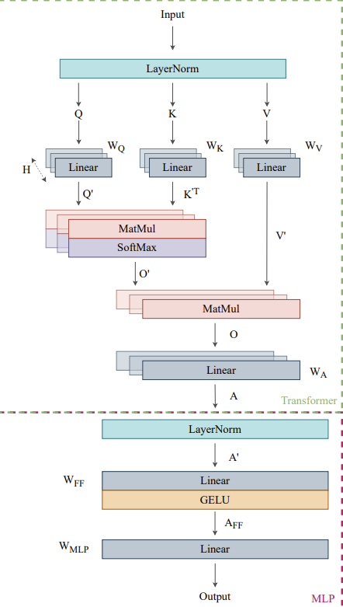
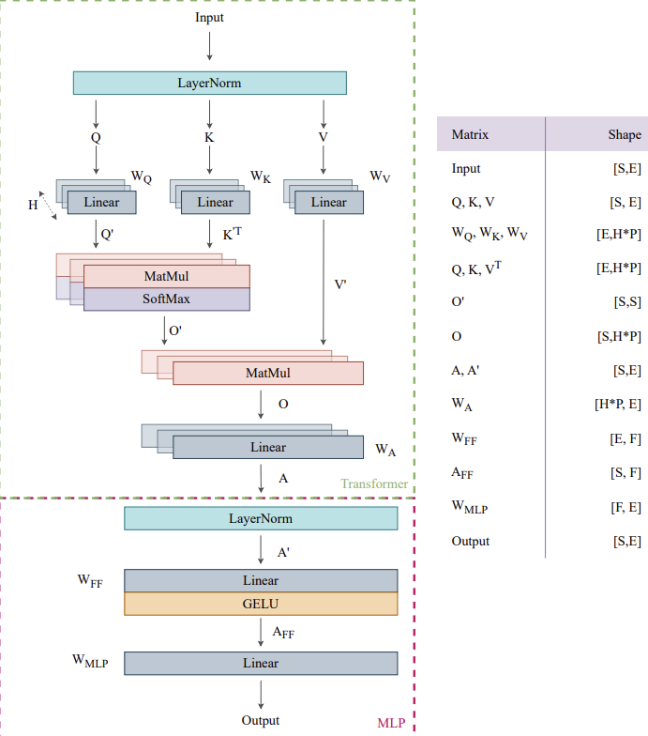
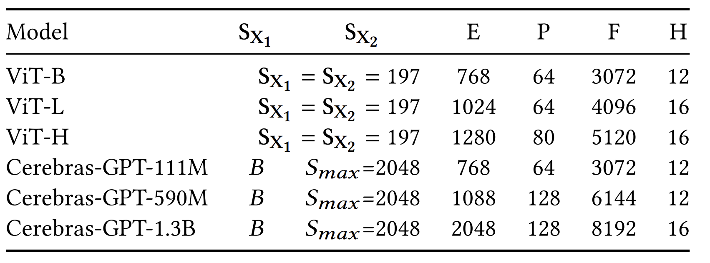
GEMM sizes in transformer
Most GEMMs in transformer models are big
Smallest sizes are found in vision transformers 197 * 197 * 768
Smallest sizes of GEMM to reach 97% uti on big Redmule (768MACs/Cycle)
192 * 256 * 192

Slide 4
SoftHier Progress Update
Thomas Benz tbenz@iis.ee.ethz.ch

Slide 5
Current Progress
Working on expandable GVSoC iDMA model
Simple implementation is working (Occamy can boot)
No timing, just a memcpy-wrapper
Model iDMA architecture ongoing, ETA 2-3 weeks
iDMA feature integration in Snitch is progressing
Cleanup and maintenance operation
In-system verification of basic operation
Started work on a new iDMA verification environment

Slide 7
GVSoC RedMule Scaling-Out Experiment -- Recall
Scale-out RedMule CE array
48 MACs/cycle RedMule(12x4) + 16 TCDM banks (16 element/cycle)
192 MACs/cycle RedMule(24x8) + 16 TCDM banks (16 element/cycle)
768 MACs/cycle RedMule(48x16) + 16 TCDM banks (16 element/cycle)
768 MACs/cycle RedMule(48x16) + 32 TCDM banks (32 element/cycle)
Findings
Larger RedMule
Need much bigger input matrix to reach utilization close to 100%
Need Bandwidth increase to avoid memory bound
Unfriendly for small matrices

